Slide 1
Memory Sweeper for UAF

Slide 2
Things to Note
Relatively new technique, inspired by garbage collection
They make changes to workflow memory management; overriding memory management
Other current sample's sweeper doesn't sweep for references inside the object. This is a change we need for sure.

Slide 3
MarkUs, Minesweeper, Swiftsweeper
Pretty much the only ones referenced. Might be one or two more with similar ideas.
Core differences:
MarkUs (2020)
Graph-like "sweep" instead of linear sweeper. Go from a root set (registers, data segments, stack, ...) and recursively traverse to identify reachable memory.
Minesweeper (2022)
A linear sweeper of memory, unlike in MarkUs.
Swiftsweeper (2025)
Implementation uses ebpf to perform kernel actions, achieved high performance by bypassing context switches, and unnecessary bottlenecks and memory copying with existing solutions

Slide 4
Mutator Write
An open question in garbage collection (how to do this efficiently without stop the world?)
When a write happens onto memory that's already been marked.
Addressed by None of the Papers? (unless with stop the world)
In Minesweeper, it justifies that when "free" happens, any references should already be present in memory (no new references should be born). (section 4.3)

Slide 5
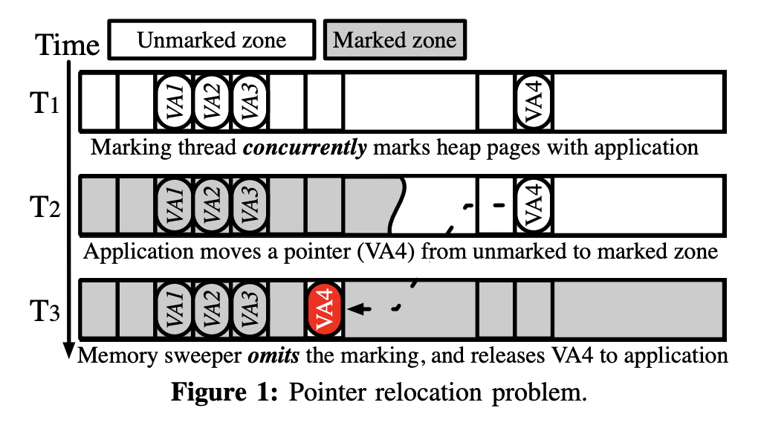
Pointer Relocation
A problem arising from concurrent marking and application threads
When a pointer is relocation from an unmarked region to a marked region
Addressed by Swiftsweeper but not Minesweeper or MarkUs
The solution involves a new ebpf program type that allows them to deal with page faults efficiently.

Slide 6
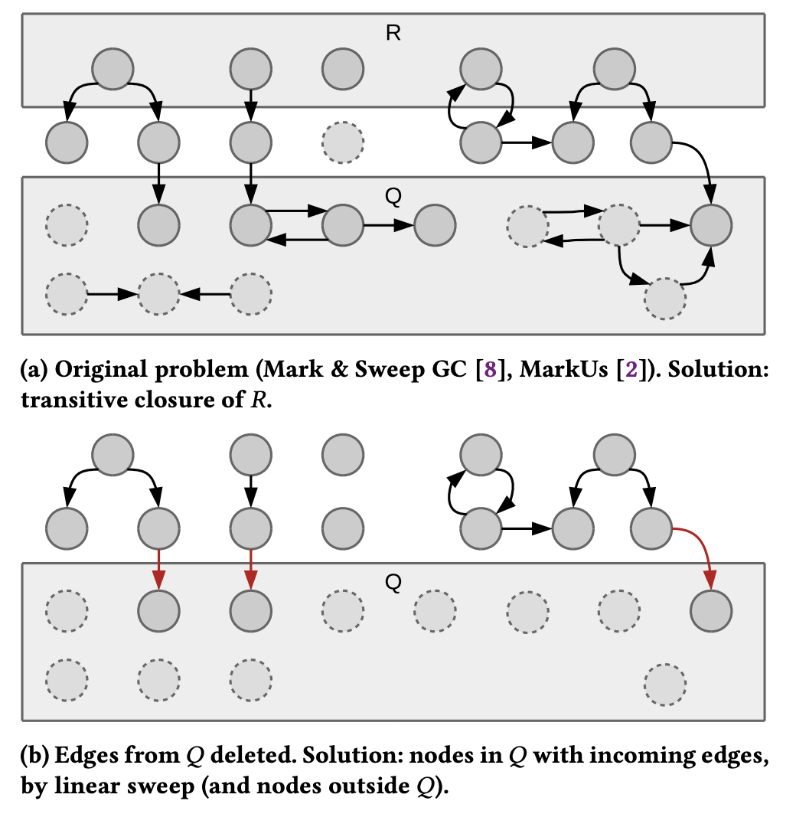
MarkUs and Minesweeper
On free, quarantine.
Minesweeper zeros the freed object to prevent quarantined objects pointing at other quarantined objects, which would make them permanantely unfreeable
By some metric (ex, if quarantined list is too big), trigger sweep 1 concurrently as applications
In Minesweeper, an optional sweep 2 with stop-the-world that sweepers only dirty pages (page table has dirty bit)
Actually free any objects that are unmarked

Slide 7
Swiftsweeper
In userspace, a memory allocator. Allocator bitmap, mark bitmap.
Collects a page pool, with additional metadata whose location is randomized for their on-demand marking and delta marking techniques.
Uses shared kernel and user space pages
In kernel space, a new ebpf program type, XMP. Extends onto userfaultfd. (I'm also not sure how ebpf program types are defined, resource suggestions would be cool)
Iterates pages mapped by page table. For each page, lock page and mark.
On page fault, perform on-demand marking
Keeps a "fragmentation index". Sweep when over a threshold.
On sweep, perform delta marking (I'm very confused by this)

