Slide 1


Error Detection in the Linux Kernel with EBPF
Marcus Lai, Soo Yee, Thomas Pasquier

Slide 2
Bugs in Linux and Sanitizers
The Linux kernel has millions of lines of code → error prone
Syzkaller Fuzzer
Runs with Kernel Sanitizers
Instruments every read, write (large overhead, unsuitable for production use)
Snapshots kernel configuration for error reproduction
Constantly finding new errors
Takes time to patch
manual effort to diagnose the cause + fix
66 days to fix errors on avg*, even more time to distribute patch
Fig. Syzkaller Entries for KASAN: use-after-free Read in hugetlb_fault
*S. M. S. Talebi, Z. Yao, A. A. Sani, Z. Qian, and D. Austin, “Undo Workarounds for Kernel Bugs,” in 30th USENIX Security Symposium, SEC 2021, August 11-13, 2021.

Slide 3
Temporary error prevention – Related Work
Ebpf is a lib that allows execution of verified userspace code in kernel space
Can inject code at (almost) any instruction by using kprobes
static checker for program verification (no non-terminating loops, unauthorized writes…)
 | PET (2023) | Vulshield (2025)
Approach | eBPF | Kernel Modules (insecure)
Kernel | Only 5.15 | General Kernel
Automation | Partially | Automated; pipeline implementation unavail
Coverage | Limited (12/25 types) | Better, not all (14/25 types)
Goal: We extend PET’s work to create a detection approach that is secure, dynamically applicable, generalizable (to different kernels and errors) and automated
Integrates with Syzkaller
Big portion of project – exploration of exisiting techniques
Before automation we must first manually produce ebpf programs
Notes:
Using kernel modules do have their merits. Vulshield uses kernel modules to enable dynamic error patching in very legacy kernels with limited ebpf support.
Also, the goal after detection is also to enable recovery, and undo changes that might have been made on the path to the error. For example, if we are writing to a file and encounter a kernel error, we would hope to reset to the point before writing to the file.

Slide 4
Bugs in the Linux Kernel - Use after free (UAF)
Ex: Use after free error
When an object is allocated then freed, a reference on the object that persist is a dangling pointer
if this reference is accessed (read/write), we have use after free
allocation
Reference Propagated (#2)
deallocation
Reference #2 accessed
Reference (#1)
Reference #1 deleted
Ebpf 3: check quarantine
Ebpf 1: record addr
Ebpf 2: if addr recorded, skip free + quarantine

Slide 5
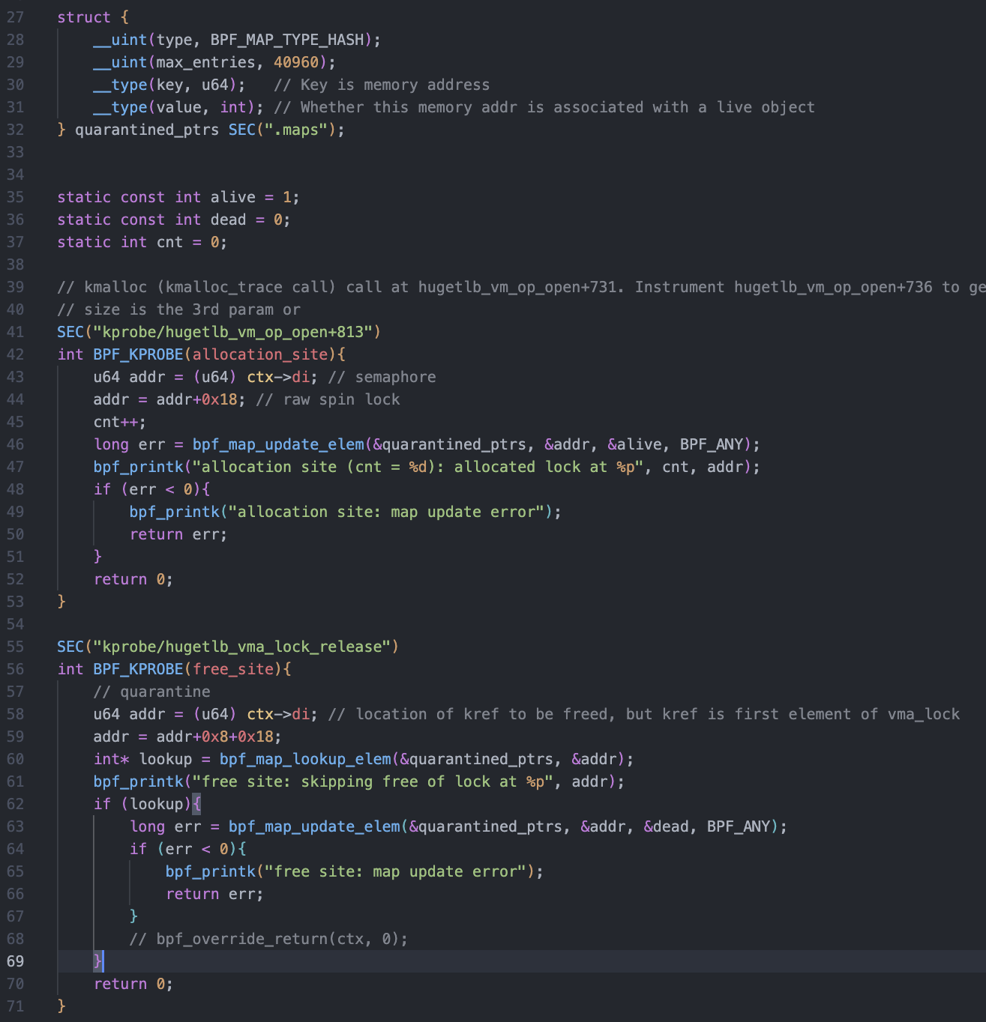
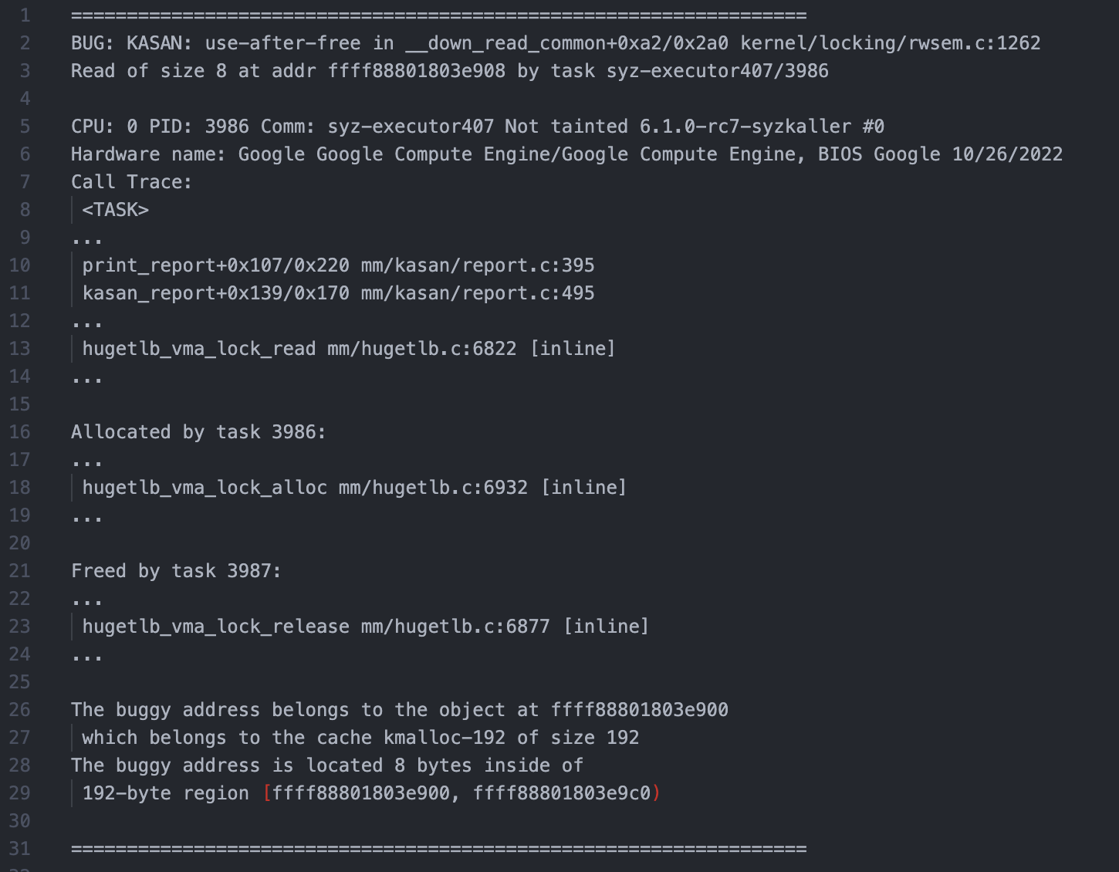
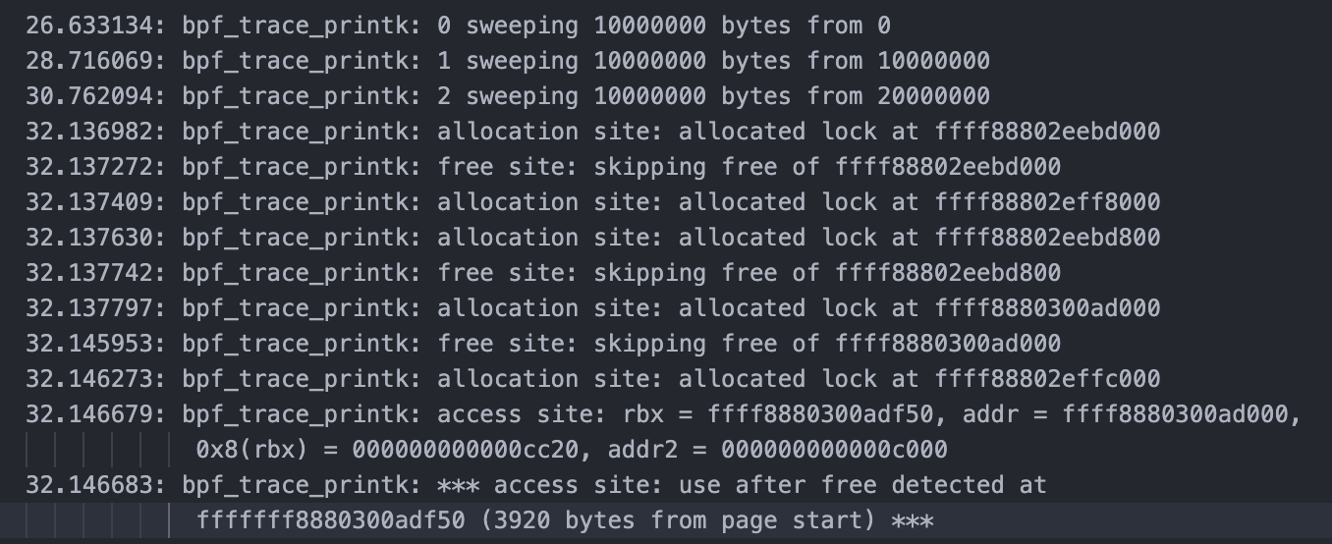
Sanitizer report and UAF template
hugetlb_vma_lock_alloc
record allocated object addr in ebpf map
hugetlb_vma_lock_release
if obj exists in map, quarantine (track in a map & skip free)
__down_read_common,
if obj is in quarantine → **uaf detection**
Asynchronous sweeper that scans kernel memory and free quarantined objs
Complete around 15/25 error class templates in ebpf. Multiple samples, different kernel versions.
Problematic read
Fig. Ebpf Program Log (UAF)
Call Trace of Read
Allocation function of read obj
Free site of read obj
Slab Information

Slide 6
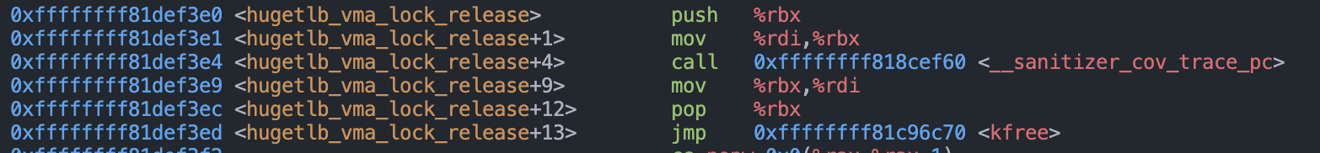
Our Error Detection Pipeline
Automated
Manual
1. Collection of error configuration from syzkaller
2. Building the kernel + ebpf helpers
3. Run error reproducer script on local kernel, obtain error report
4. Identify and verify installation sites in assembly
5. Write eBPF programs for detection
6. Rebuild without sanitizer, re-identify installation sites
7. Verify error detection
Fig. Ebpf Program Log (UAF)
Fig. Assembly at Free Site
Notes:
We focus on these two classes of errors.

Slide 7
Challenges
A search for improved Use-after-free detection
Why skip free? Why Quarantine?
A reduced problem
One-time allocation, ID tagging in LAM (w/o recycling!)
Free and access race (potential)
Use after free is sometimes caused by a race condition between freeing an object and accessing that object
eBPF free site and access site can race too. Causing a missed detection
Solution: in the ebpf map, persist time stamps. If the time stamps are too close (< some_threshold), **warn use-after-free**
Notes:
My work so far has largely been an exploration of existing work, demonstrating where they work and thinking of ways to overcome their limitations. But I’ve found that applying the same techniques of multiple error samples helped me gain insight on some undiscovered mini challenges and limitations which I’ve had to think about. I think coming up with ways to handle these mini challenges have been one of the highlights of my internship.

Slide 8
Towards Automation and Future Work
Produce templates for even more error classes
Proceed to ebpf program automation
Using DWARF debugging information to find where variables are stored in runtime to fill in ebpf template
Continue to improve the overall pipeline

Slide 9


Takeaways
Ebpf programs, Sanitizers, Linux kernel memory management
Bringing the right problem to the right people, and abstracting the problem to their domain of expertise
I’d like to thank Thomas and Soo for the opportunity to learn more about systems and their time and mentorship.
Notes:
In terms of more hard skills I was able to write my own bpf programs and adding my own ebpf helpers. I learned more about how Linux sanitizers work and how memory is managed in the Linux kernel. In terms of soft skills, I gained even more practice with communication which is something I’ve always struggled with. Specifically, it was always important to remind myself that everyone’s time is limited, and no one will remember entirely that’s going on with your research, so I needed to think about how to abstract out the parts they don’t need to know, frame my problem in their domain of expertise, and communicating my problem in the time I’ve given.

