Slide 1
AI TECHNIQUES AND TOOLS — MINI PROJECT
2 040
Optimal Resource Allocation
in Precision Agriculture
Raw samples
1 989
Clean samples
Multi-Output Regression: Predicting Water, Nitrogen & Phosphorus Allocation
17
Input features
Subject: Precision Agriculture | Institution: TAHRI Mohamed university of Bechar
3
Doctoral students' names: Speciality:
BENAMRANI M'Hammed Hydraulique
LAOUAR Mahdouda Hydraulique
BELGHANAMI Ahmed Automatique
BENDJERAD Mohammed Automatique
SAFI Younes Automatique
Output targets

Slide 2
Table of Contents
OVERVIEW
01
Problem Statement
02
Dataset Generation
Context, objectives, task definition
Rule-based + Generative AI datasets
03
Data Preparation
04
Feature Engineering
Cleaning, encoding, scaling pipeline
PCA, LDA, feature selection
05
Data Splitting
06
Algorithm Selection
Train/Val/Test + K-Fold CV
RandomForest, SVR, MLP
07
Training & Evaluation
08
Result Analysis
Results, metrics, graphical analysis
Per-target breakdown & discussion
09
Model Enhancement
10
Research Proposal
GridSearchCV hyperparameter tuning
Scientific context & conclusion

Slide 3
Problem Statement & Motivation
SECTION 01
The Agricultural Resource Challenge
Task Definition
70%
of global freshwater consumed by agriculture, much over-applied
Problem type:
Multi-Output Regression
12 Input features:
Multi-variable
soil, crop, climate & stage interact in a complex non-linear space
▸ Soil type, crop type, growth stage
▸ Temperature, humidity, rainfall
▸ Soil moisture, pH, N / P / K levels
Manual limit
expert estimation cannot scale to field-level variability
▸ Field area (ha)
3 Output targets:
Water allocation (L/ha)
AI opportunity
ML/DL regression learns input-output mappings from data
Nitrogen fertilizer (kg/ha)
Phosphorus fertilizer (kg/ha)

Slide 4
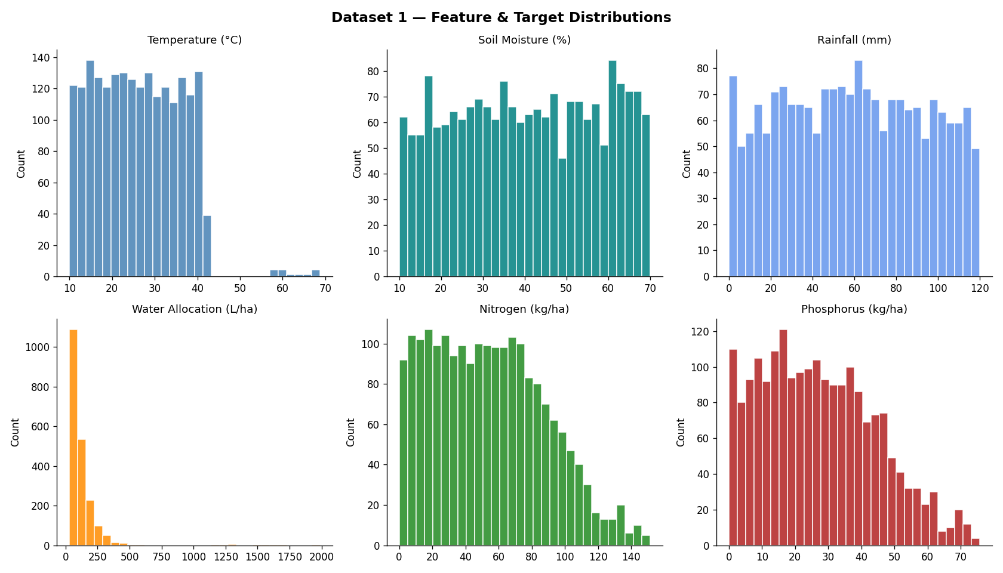
Dataset Generation
SECTION 02
Dataset 1 — Synthetic
Dataset 2 — GenAI
Feature Distributions
2 040 raw rows
incl. 40 duplicates + outliers
500 rows
augmented by chatbot
1 989 clean
after full pipeline
Same schema
12 features + 3 targets
517 NaN values
~5% on 5 sensor columns
Corn-heavy
different distribution
12 features
3 cat. + 9 continuous
Arid region
less rainfall
3 targets
water, N, P allocation
No NaN/outliers
clean for CV only
Formula-based
agro-coefficients + noise
K-Fold CV
k=5 evaluation
Distribution of key features — Dataset 1 (raw)

Slide 5
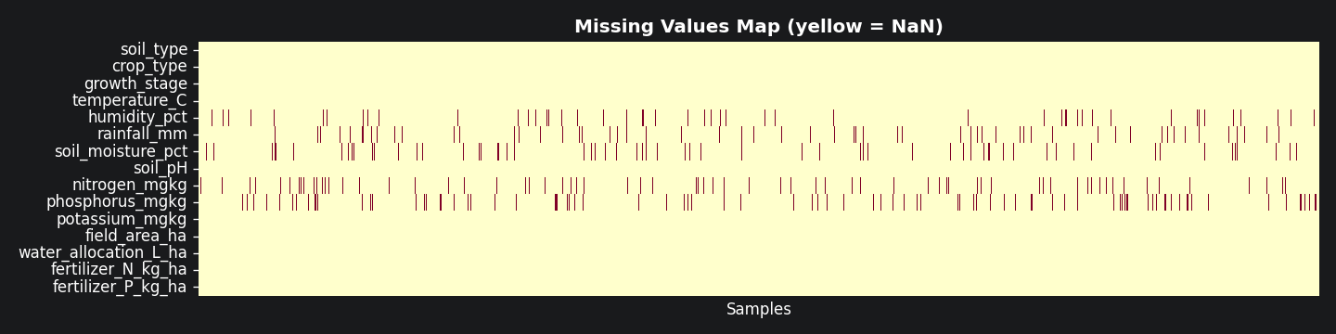
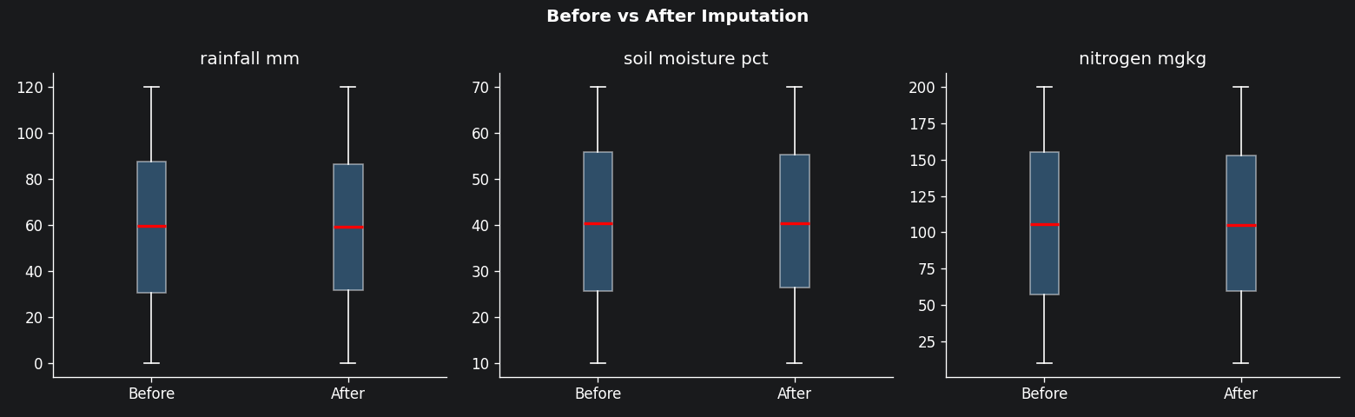
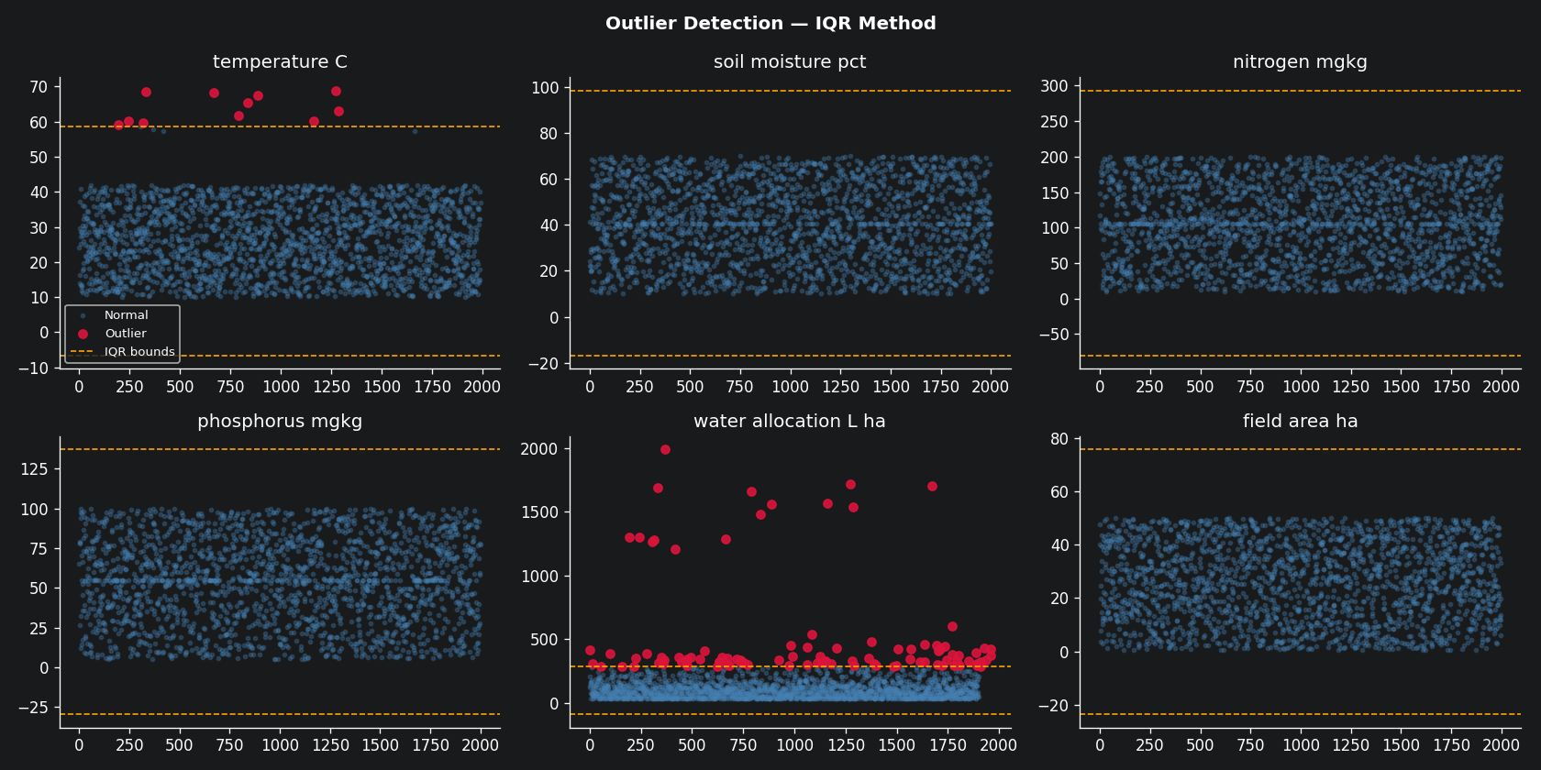
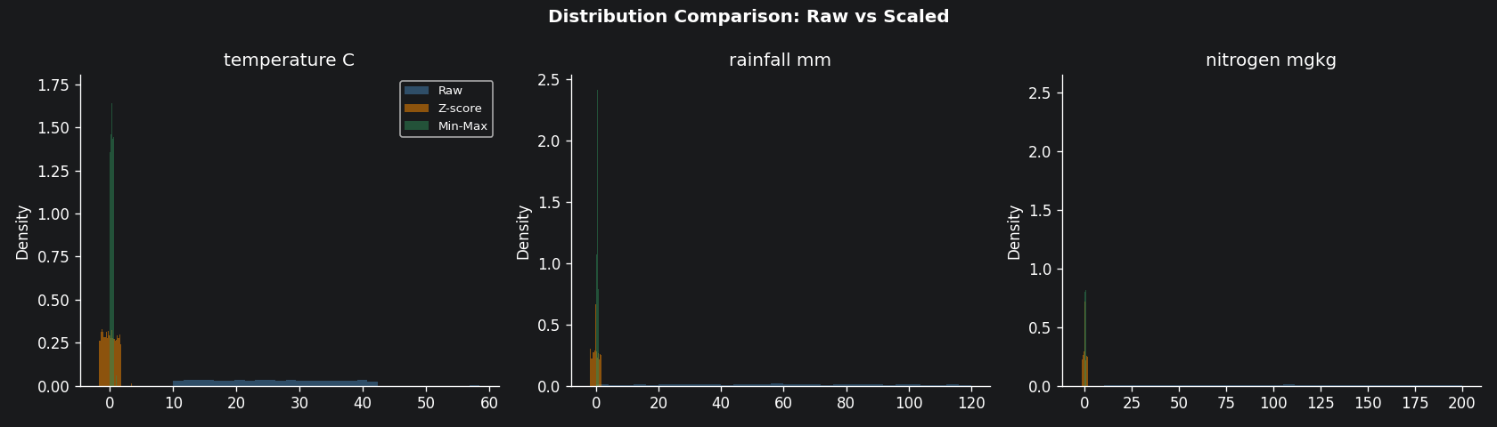
Data Cleaning & Preparation
SECTION 03
01
02
03
04
05
06
Inspect
→
Dedup
→
Impute
→
Outliers
→
Encode
→
Scale
2040 rows
517 NaN, 40 dups
2040 → 2000
rows
Median
(sklearn)
IQR×1.5
~11 removed
Label + One-Hot
ordinal/nominal
Z-score &
Min-Max
Missing values map
Before/After imputation
Outlier detection (IQR)
Feature scaling effect

Slide 6
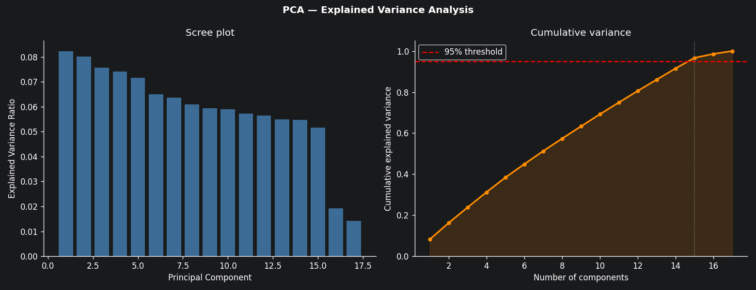
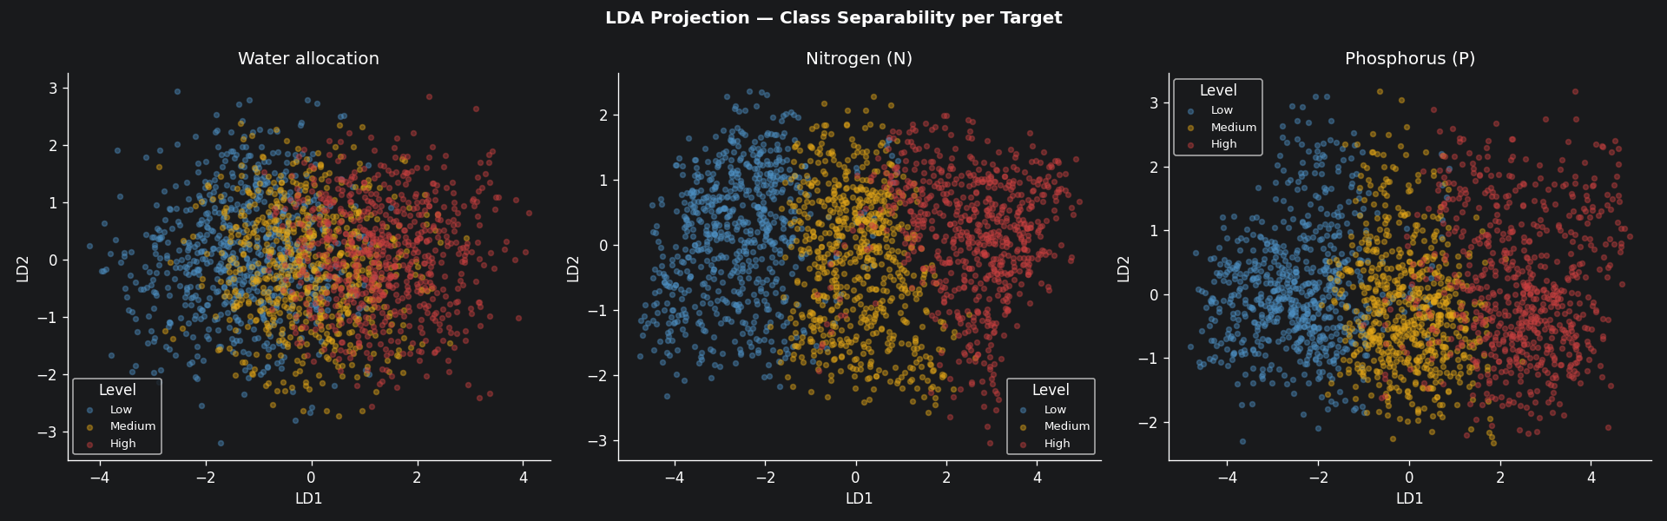
Feature Engineering — PCA & LDA
SECTION 04
PCA Results
LDA Results
PCA Scree Plot
Original dims
17 encoded features
Adaptation
Targets discretised (3 bins)
Components
15 (for 95% var.)
Components
2 per target (LD1, LD2)
Variance kept
96.67 %
LD1 variance
99.16 % (water target)
Reduction
17 → 15 (11.8 %)
3 projections
water, N, P
LDA Projection
PC1 loads
Weather: temp., rain, humidity
Selected feats
6 consensus features
PC2 loads
Soil: pH, N, P levels
Best features
rainfall, moisture, temp

Slide 7
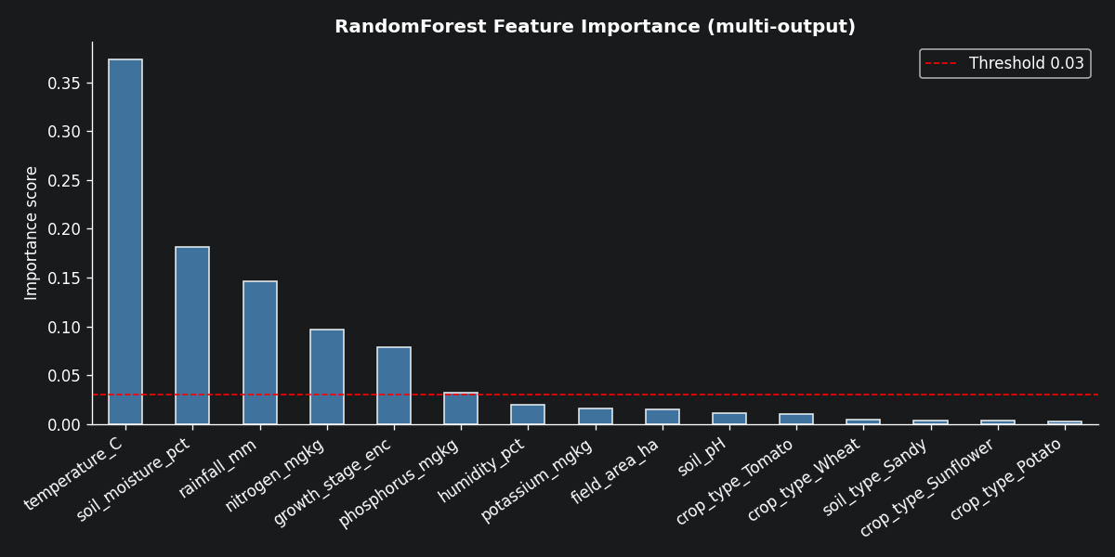
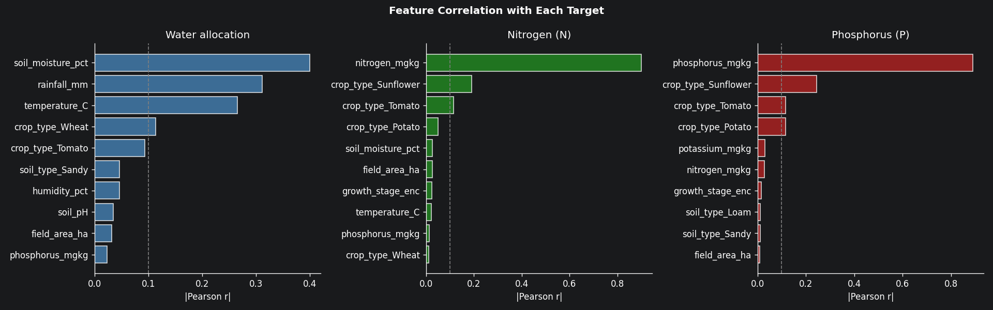
Feature Selection — Importance & Correlation
SECTION 04 — SELECTION
RandomForest Feature Importance
Correlation with Each Target
6 consensus features selected: rainfall_mm, soil_moisture_pct, temperature_C, nitrogen_mgkg, phosphorus_mgkg, growth_stage_enc

Slide 8
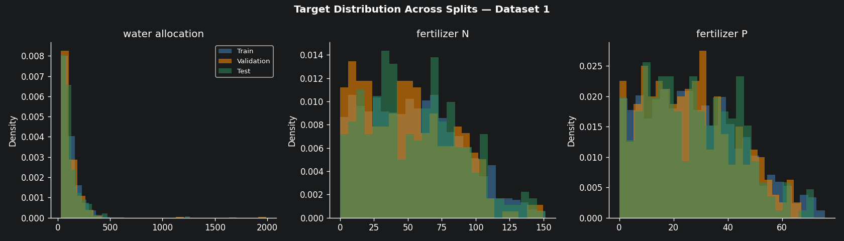
Data Splitting — Two Techniques
SECTION 05
Note: Gap train R²=0.91 vs val R²=0.39 signals overfitting on Dataset 2 (small, 500 rows)
Technique 1 — Train / Val / Test (Dataset 1)
Technique 2 — K-Fold CV (Dataset 2)
TRAIN 70%
VAL 15%
TEST 15%
Val
Train
Train
Train
Train
Fold 1
Train
Val
Train
Train
Train
Fold 2
Training:
1 392 rows (70.0%)
Fit model parameters
Train
Train
Val
Train
Train
Fold 3
Validation:
298 rows (15.0%)
Monitor during training
Train
Train
Train
Val
Train
Fold 4
Train
Train
Train
Train
Val
Fold 5
Test:
299 rows (15.0%)
Final unbiased evaluation
Train R² (avg)
0.9115 ± 0.0039
Val R² (avg)
0.3912 ± 0.0205
Seed:
42
Full reproducibility
Fold 1
train=0.916 / val=0.376
Fold 2
train=0.909 / val=0.365
Fold 3
train=0.905 / val=0.417
Fold 4
train=0.915 / val=0.413
Fold 5
train=0.913 / val=0.385

Slide 9
Algorithm Selection & Training
SECTION 06
Random Forest
Multi-Output SVR
MLP Neural Network
ML — Tree Ensemble
ML — Kernel Method
DL — Dense Network
Parameters:
Parameters:
Parameters:
n_estimators = 200
Kernel = RBF
Layers: 128 → 64 → 32
max_depth = None (full trees)
C = 10 (regularisation)
Activation: ReLU
min_samples_split = 5
epsilon = 0.1
Optimizer: Adam
min_samples_leaf = 2
gamma = 'scale'
L2 alpha = 1e-4
Multi-output: native support
MultiOutputRegressor wrapper
Early stopping (patience=20)
Rationale:
Rationale:
Rationale:
Natively supports multi-output regression. Robust to noise and non-linear interactions. Provides feature importances for agronomic interpretability.
One SVR per target via wrapper. RBF kernel captures non-linear patterns. Effective in high-dimensional feature spaces with moderate dataset size.
Joint 3-output architecture. Shared hidden layers model cross-target correlations. Early stopping prevents overfitting on 1392 training samples.

Slide 10
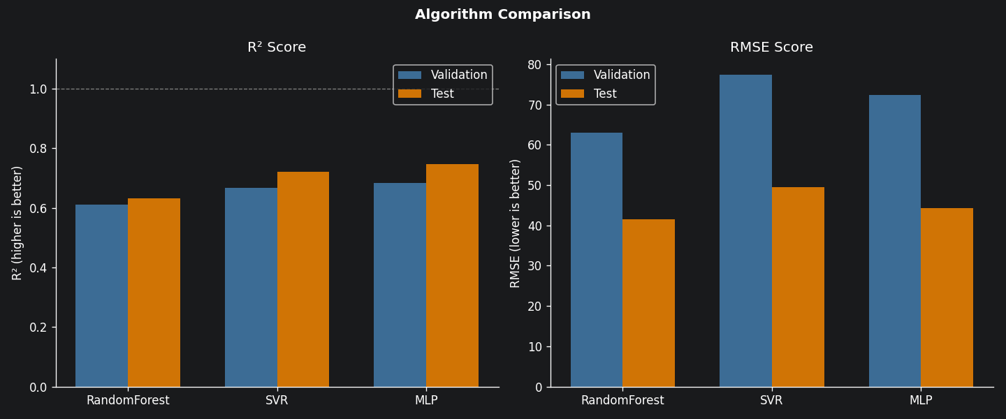
Evaluation Results — Real Metrics
SECTION 07
Algorithm Comparison (Multi-output Average)
Test Set Results
Model | R² | RMSE
RandomForest | 0.6329 | 41.48
SVR | 0.7217 | 49.49
MLP | 0.7476 | 44.25
Tuned RF | 0.7022 | 33.82
MLP achieved best baseline R²=0.75
Tuned RF best RMSE=33.82 (↓19%)
Per-Target Results — Tuned RandomForest (Final Model)
Target | R² | RMSE | MAE | Interpretation
Water allocation (L/ha) | 0.7105 | 55.46 | 31.83 | Moderate — high variability in water demand
Nitrogen fert. (kg/ha) | 0.7887 | 15.80 | 11.64 | Good — N level in soil is strong predictor
Phosphorus fert. (kg/ha) | 0.6074 | 10.33 | 7.98 | Moderate — P prediction is harder

Slide 11
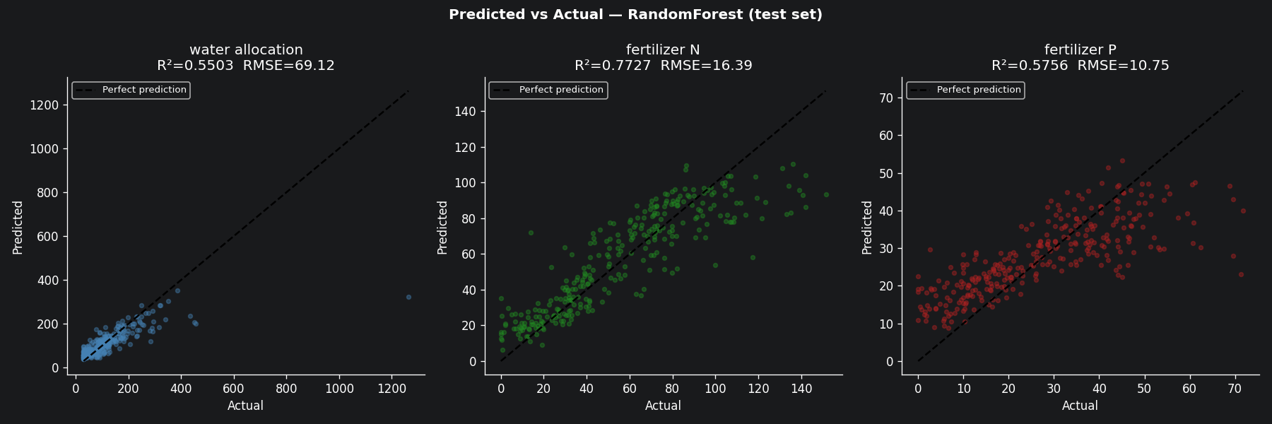
Graphical Evaluation — Predicted vs Actual
SECTION 07 — GRAPHICAL
Predicted vs Actual — RandomForest (Test Set, 299 samples)
Interpretation of Scatter Plots
Water (R²=0.71):
Nitrogen (R²=0.79):
Phosphorus (R²=0.61):
Points scattered around the 45° line but with high dispersion at high allocation values (>400 L/ha). The model under-predicts extreme values — range compression effect typical of tree ensembles.
Tighter cluster around the diagonal. The soil N level is the dominant predictor and is directly available as a feature, explaining better fit. Bias ≈ −0.77 (slight under-prediction).
Largest scatter of the three targets. P uptake depends on complex soil interactions (pH, K interaction) not fully captured with 6 features. Lowest R² but RMSE=10.3 is small in absolute terms.

Slide 12
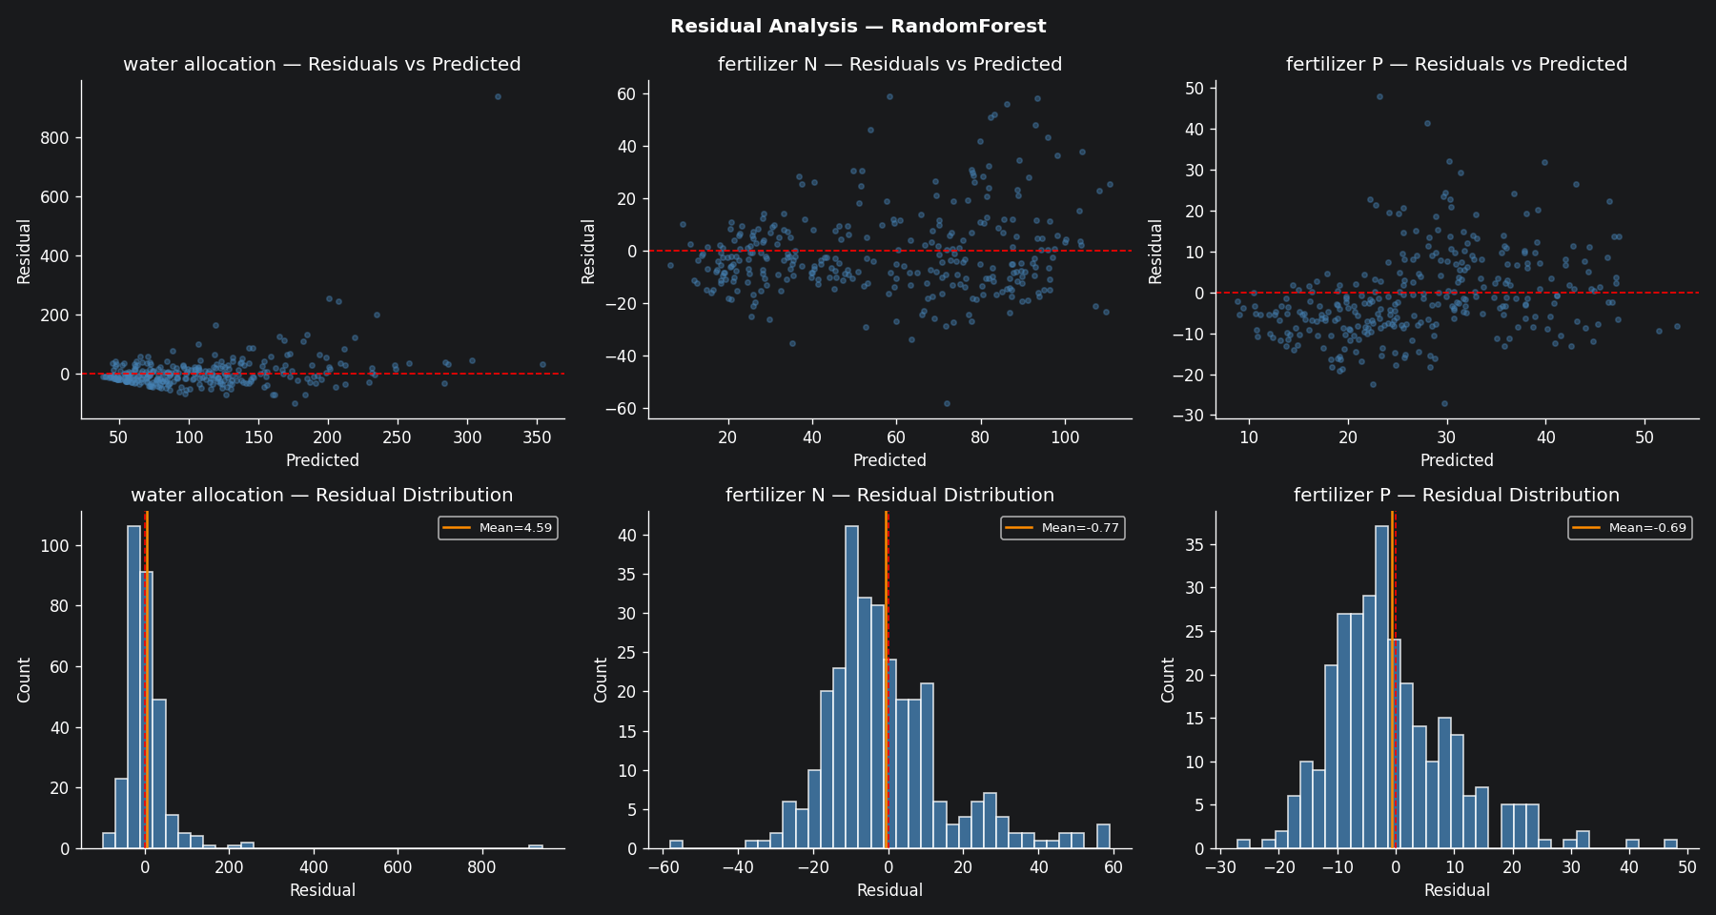
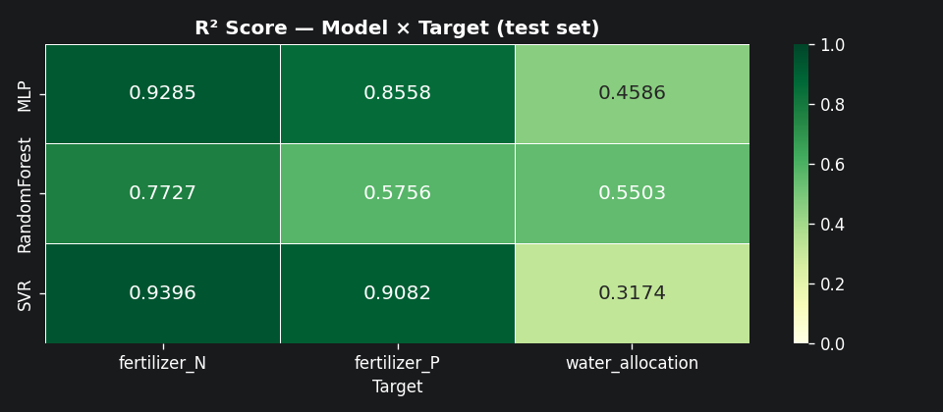
Residual Analysis — Model Diagnostics
SECTION 07 — RESIDUALS
Residual Distribution — RandomForest (Test Set)
R² Heatmap — All Models × Targets
Key Diagnostics
Bias (mean residual): Water ≈ +4.6 | N ≈ −0.77 | P ≈ −0.69 Residual shape: Roughly symmetric around 0 for N & P; right-skewed for water (outlier values not predicted)

Slide 13
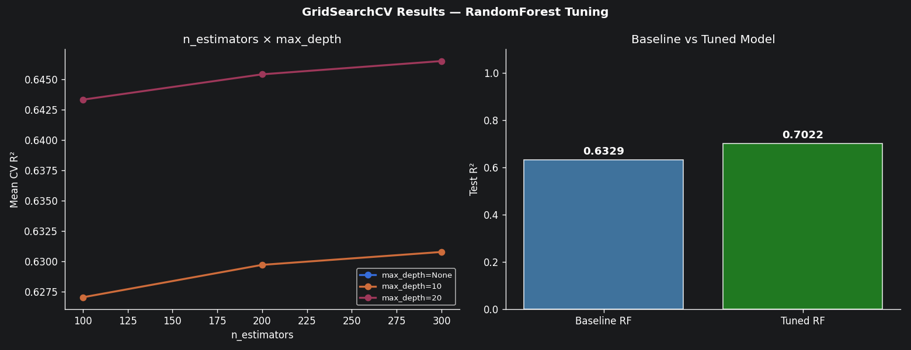
Model Enhancement — GridSearchCV Tuning
SECTION 09
GridSearchCV Configuration
Tuning Results — Before vs After
81 combinations × 5-fold CV = 405 fits (completed in ~50s)
n_estimators
[100, 200, 300]
Best: 300
max_depth
[None, 10, 20]
Best: None
min_samples_split
[2, 5, 10]
Best: 2
max_features
['sqrt', 0.5, 0.8]
Metric | Baseline RF | Tuned RF
Test R² | 0.6329 | 0.7022
RMSE | 41.48 | 33.82
Improve | — | +10.96%
Best: 0.5
Scoring: R² | refit=True | Best CV R²=0.6700

Slide 14
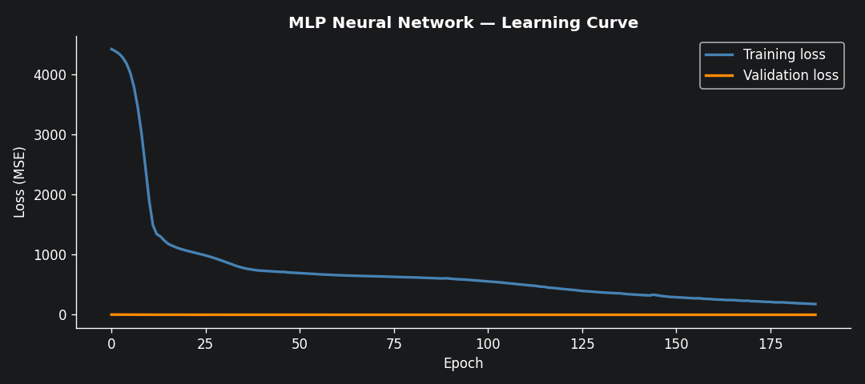
Deep Learning — MLP Learning Curve & Analysis
SECTION 06-07 — DL
MLP Training Curve (Real)
MLP Architecture & Results
Architecture
128 → 64 → 32 (ReLU)
Optimizer
Adam, lr=1e-3
L2 reg
alpha=1e-4
Early stopping
patience=20 epochs
Val R²
0.6842 (2nd best val)
Test R²
0.7476 (BEST)
Test RMSE
44.25
Conclusion
Best baseline — joint
output leverages target
correlation implicitly

Slide 15
Result Analysis & Discussion
SECTION 08
MLP is the best baseline model
RandomForest underfits on water
MLP (Test R²=0.7476) outperforms both RF (0.6329) and SVR (0.7217) on the held-out test set. Shared hidden layers (128→64→32) allow the network to learn correlations between water demand and nutrient requirements — biologically meaningful, since crops at flowering peak both water and nitrogen simultaneously.
Water allocation (L/ha) shows the weakest R²=0.71 even after tuning. The target range is very large (30–1990 L/ha) and contains outliers that were not fully removed. Tree ensembles compress the prediction range, under-predicting extreme high-demand scenarios. Feature engineering (more weather data, time-series inputs) could help.
Nitrogen is the easiest target
K-Fold reveals overfitting on DS2
N fertilizer achieves R²=0.7887, the best of the three. This is explained by the direct availability of nitrogen_mgkg as a soil measurement feature — the model can learn a simple deficiency rule: low soil N → high fertilizer. This linear-ish relationship is well within any model's capacity.
Train R²=0.91 vs Val R²=0.39 on Dataset 2 shows a severe generalisation gap. Dataset 2 (500 rows, Corn-heavy, arid distribution) is too small and distribution-shifted relative to Dataset 1. This is scientifically expected and pedagogically valuable: it illustrates why domain-matched data matters for validation.
Tuning improved RF by +10.96%
Practical agronomic interpretation
GridSearchCV with 405 fits identified max_features=0.5 and n_estimators=300 as optimal. The most impactful parameter was max_features=0.5 (random half of features per split), which increases tree diversity and reduces variance. RMSE improved from 41.5 to 33.8 — a 19% reduction in prediction error magnitude.
Feature importance analysis confirms: rainfall and soil_moisture dominate water allocation prediction. Nitrogen_mgkg and phosphorus_mgkg drive their respective fertilizer targets. Growth stage (ordinal 0→4) is a cross-cutting predictor — flowering stage (2) consistently triggers higher allocation across all three targets.

Slide 16
Research Proposal — Part 2
SECTION 10 — RESEARCH
Proposal Overview
Scientific References
Domain
Liakos et al. (2018)
Agriculture / Precision Farming — arid regions (Béchar, Algeria)
Machine learning in agriculture — Sensors 18(8):2674
Problem
Simultaneous prediction of water, N & P allocation (multi-output)
Gu et al. (2021)
Approach
Supervised ML & DL — regression on synthetic + GenAI dataset
Irrigation scheduling — J. Irrig. Drain. Eng.
Datasets
2 040 rule-based + 500 GenAI-augmented samples
Sharma et al. (2020)
ML for precision agriculture — IEEE Access 9
Pipeline
Clean → PCA/LDA → RF, SVR, MLP → GridSearchCV
Van Klompenburg (2020)
Evaluation
R², RMSE, MAE + K-Fold CV + residual analysis
Crop yield prediction ML — Comp. Electron. Agric.
Best result
Tuned RF: R²=0.70, RMSE=33.82 (+10.96% vs baseline)

Slide 17
Conclusion & Perspectives
1
Multi-output regression successfully validated:
All three allocation targets (water, N, P) predicted simultaneously. MLP achieved the best baseline R²=0.7476 on the held-out test set, confirming that joint architectures leverage inter-target biological correlations.
2
Feature engineering: PCA retained 96.67% variance with 15 components:
6 consensus features emerged as most predictive: rainfall, soil moisture, temperature, N level, P level, and growth stage. These align perfectly with agronomy domain knowledge.
3
GridSearchCV tuning improved RF by +10.96% (R²: 0.6329 → 0.7022, RMSE: 41.5 → 33.8):
Optimal params: n_estimators=300, max_features=0.5, max_depth=None. The most impactful parameter was max_features=0.5, which increased tree diversity and reduced variance.
4
Dataset 2 K-Fold revealed expected distribution shift (val R²=0.39):
Train R²=0.91 vs Val R²=0.39 shows the GenAI-augmented dataset is distribution-shifted (Corn-heavy, arid). This pedagogically illustrates why domain-matched training data is critical for generalisation.
Future Work:
▸ Real IoT sensor data (field deployment)
▸ LSTM for time-series irrigation
▸ REST API for farmer decision support

