Slide 1
ECE 4150/6250_Lab1 Environment Set Up
TA: You Zhou
E-mail: yzhou57@gwu.edu
GitHub: https://github.com/YouZhou57/ECE6250_Lab

Slide 2
Quick question
Have you taken course ECE6213 ?
Or ECE4140/6240?

Slide 3
Lab Goal
You will learn some useful tools for synthesizing RTL code.
You will learn place & Route tool to generate IC Layout (You did it manually in ECE6240 ).
You will make a CPU for the final project by the end of this semester.
The Linux system was updated but the tool, library, and scripts were not updated accordingly so that only 80% of the lab can be finished.

Slide 4
Environment set up for Cadence & Synopsys
Remote access to the Linux in Tompkins 411 with this link:
https://shell.seas.gwu.edu:3443/auth/ssh
2. If you have not taken ECE6213, please follow the ECE213_env_setup_22 V1 and ECE6213_synopsys_dc_v18 instructions to set up the environment.
(GitHub: https://github.com/YouZhou57/ECE6250_Lab)

Slide 5
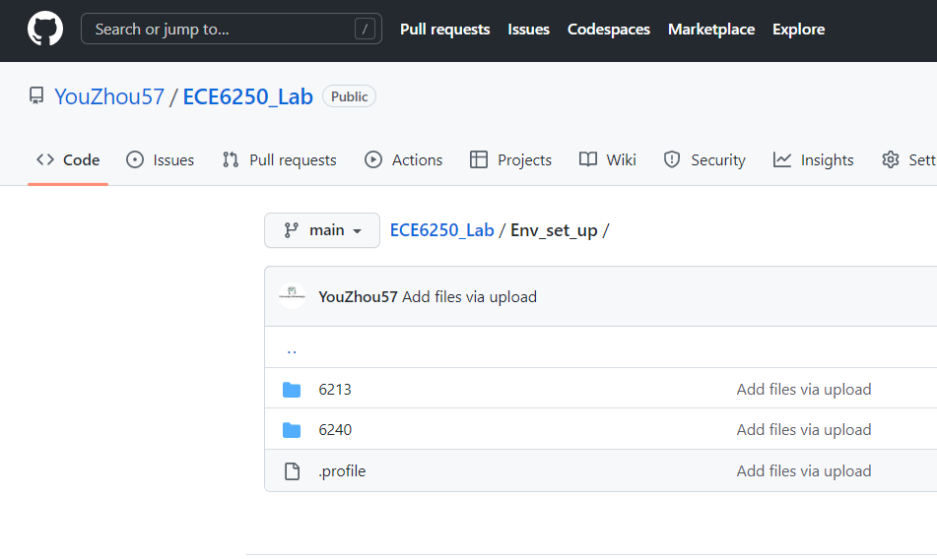
Check your .profile
Make sure you have the correct .profile after you set up the environment
Or you can replace your .profile with mine
The .profile and video are uploaded
to the GitHub:
Completely Log out and log in !

Slide 6
Lab 1
https://blogs.gwu.edu/ece4150/labs/
Password: 41506250RFF

Slide 7
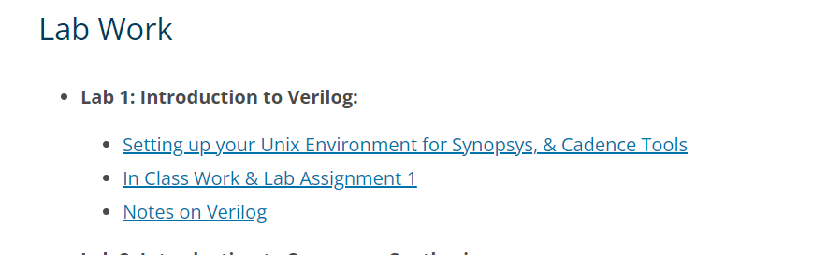
Lab 1 Skip the first task

Slide 8
Make groups
2-3 students can make a group to submit lab homework and final project
Let me know your group members before next Monday
Email: yzhou57@gwu.edu

