Slide 2
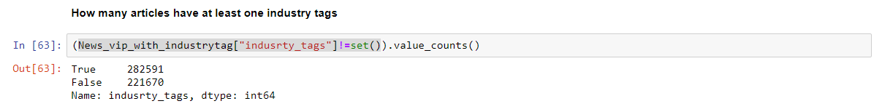
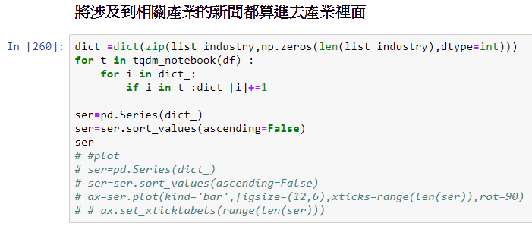
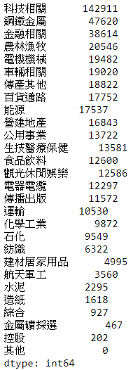
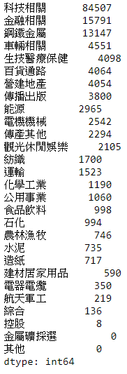
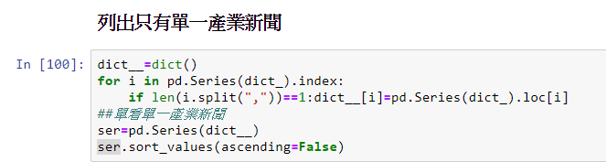
485,842則
154,884則

Slide 3
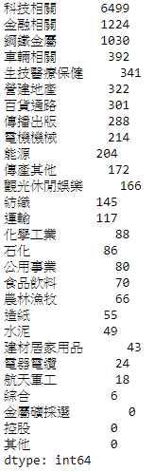
隨機一萬篇

Slide 4
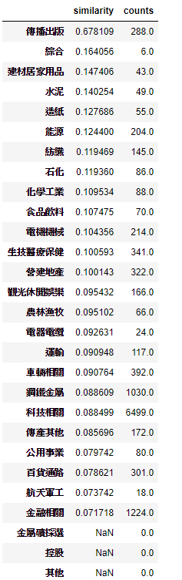
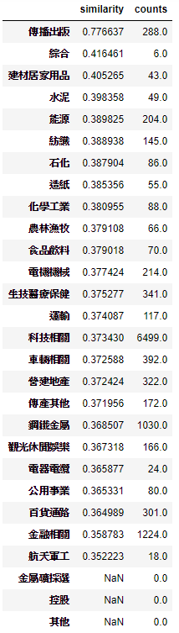
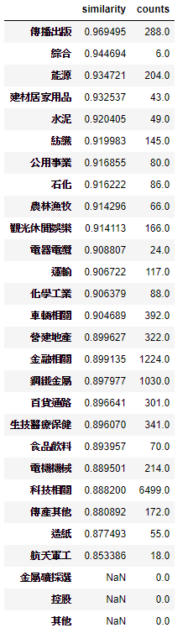
Similarity within industry-Bow,unAE,AE

Slide 5
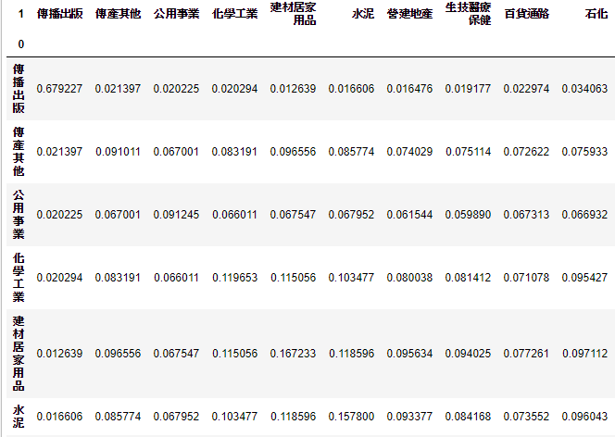
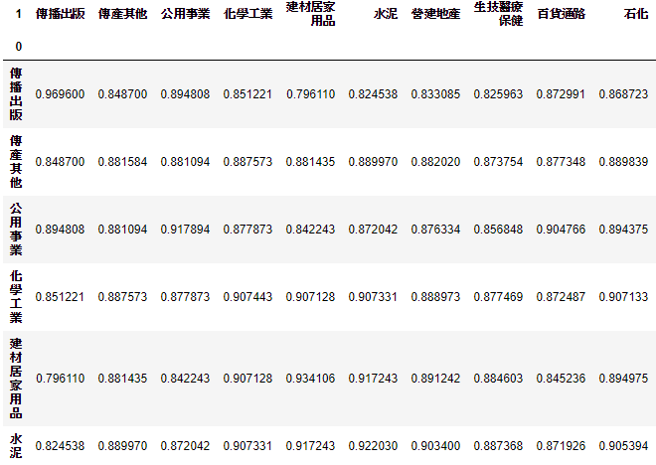
Similarity between 2 industry-Bow,unAE,AE
Bow
AutoEncoder

Slide 6
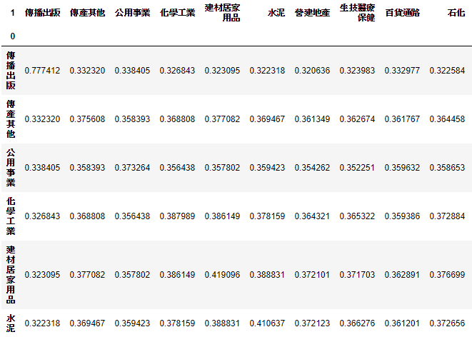
Similarity between 2 industry-unAE

Slide 7
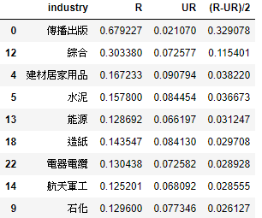
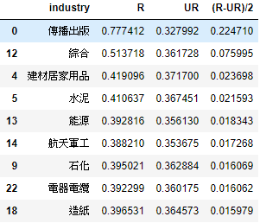
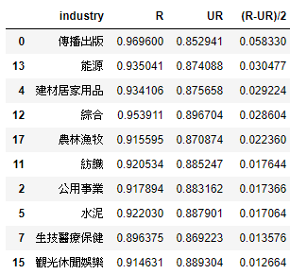
Similarity in R,UR,(R-UR)/2
BOW
UAE
AE
-1<(R-UR)/2<1

Slide 8
Supervised Denoising AE
Dataset(from 10000 random)
Train set (80%)
Test set(20%)

Slide 9
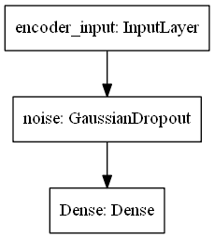
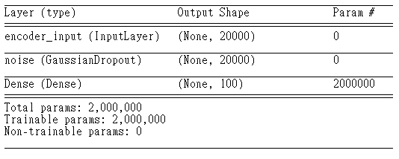
Encoder

Slide 10
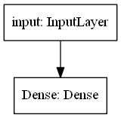
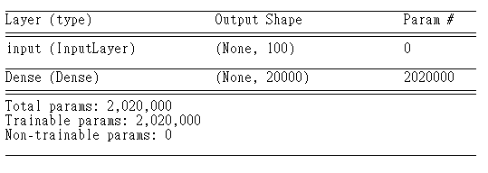
Decoder

Slide 11
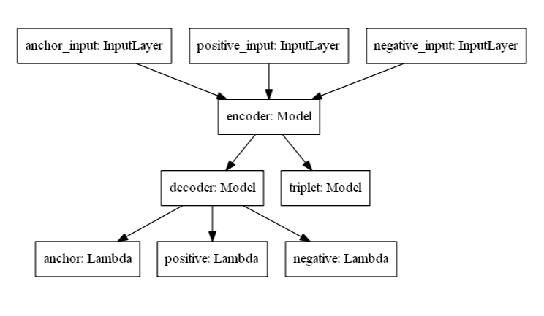
Tri-AutoEnocoder

Slide 12
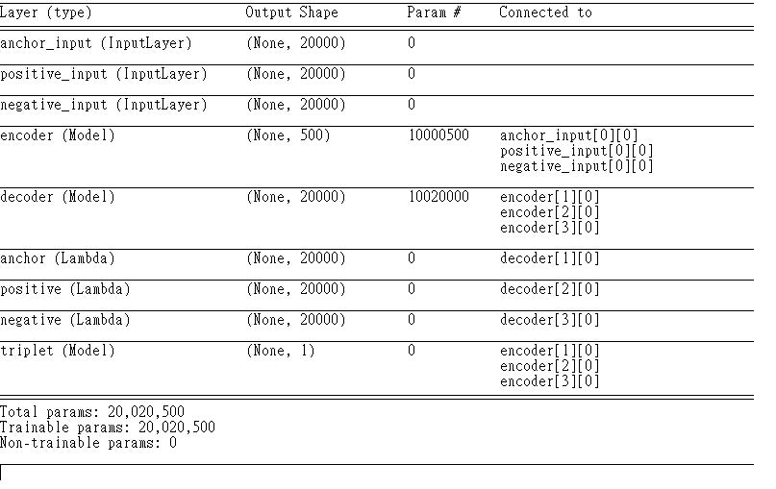

Slide 13
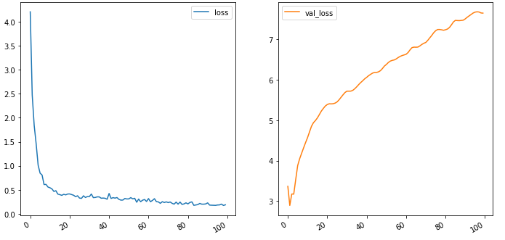
loss

Slide 14
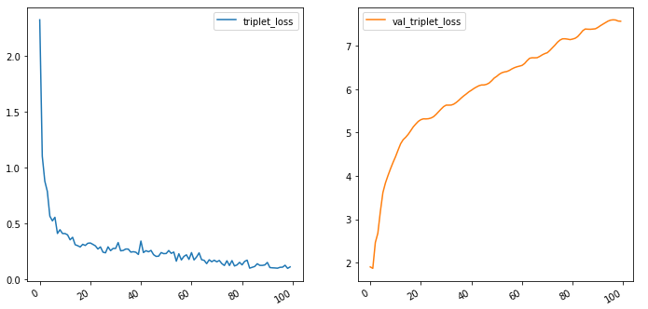
Triplet loss

Slide 15
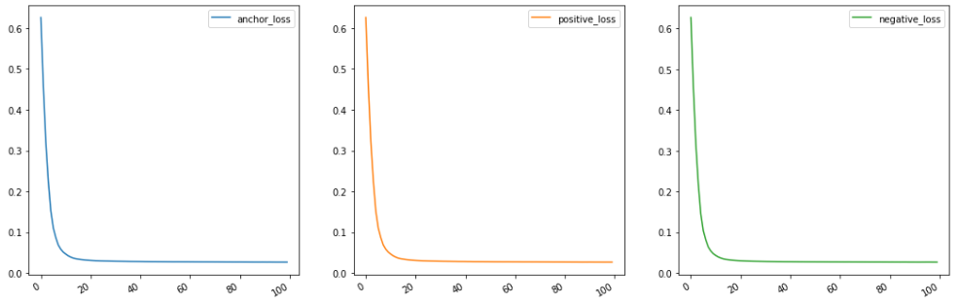
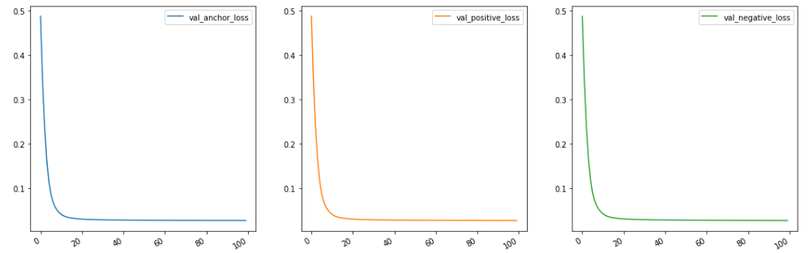
Reconstruction loss

Slide 16
Sampling
A1,A2,A3,A4
B1,B2,B3,B4
C1,C2,C3,C4
D1,D2,D3,D4
(A1,A2,B1),(A2,A3,C1),(A3,A4,D1)
(B1,B2,C1)

Slide 17
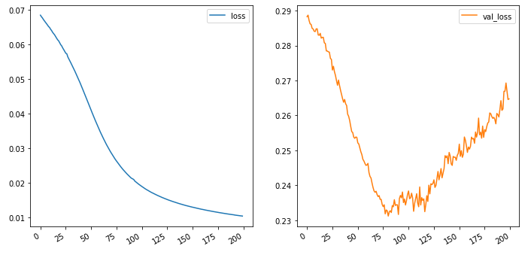
loss

Slide 18
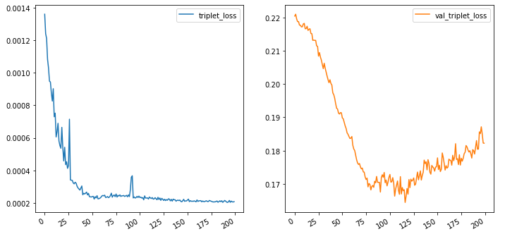
Triplet loss

Slide 19
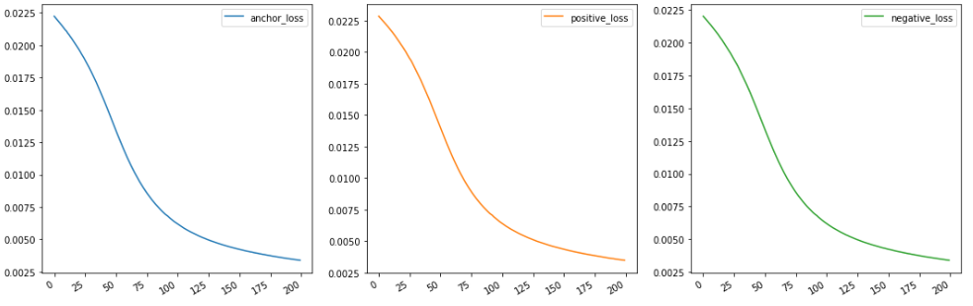
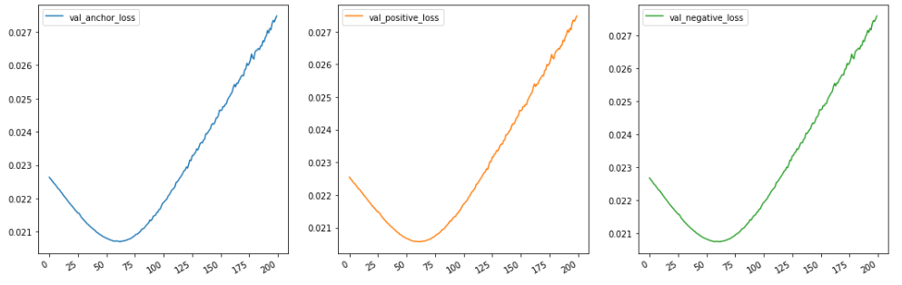
Reconstruction loss

Slide 20
Sampling
A1,A2,A3,A4
B1,B2,B3,B4
C1,C2,C3,C4
D1,D2,D3,D4
Hyper parameter : P=2,K=2
Random : P=(A,B) K=(A1,A2),(B1,B2)
Sample=
(A1,A2,B1), (A1,A2,B1),(A2,A1,B1), (A2,A1,B2)
(B1,B2,A1), (B1,B2,A1),(B2,B1,A1), (B2,B1,A2)
Size of Batch:PK(K-1)(PK-K)

Slide 21

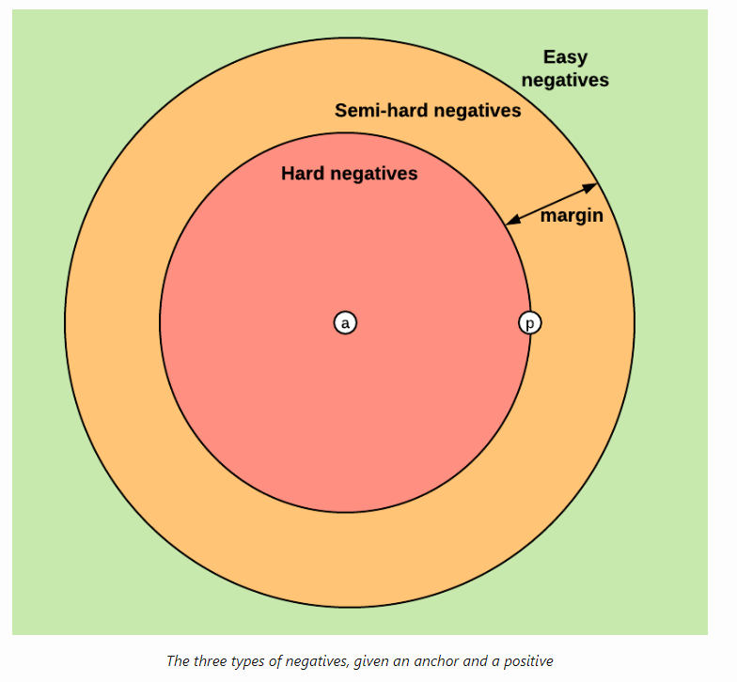

Slide 22
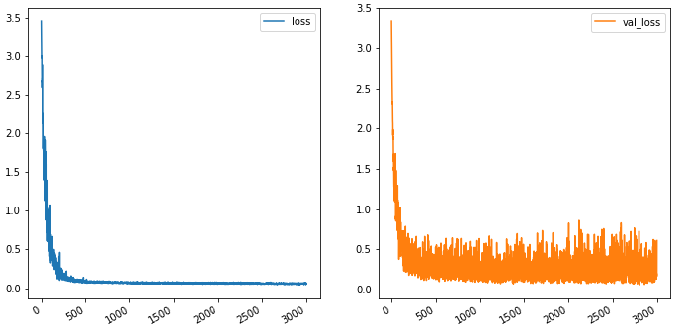
loss

Slide 23
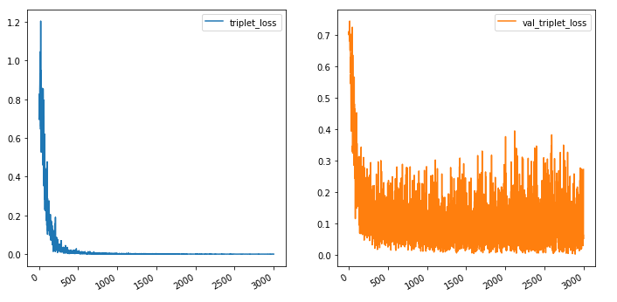
Triplet loss

Slide 24
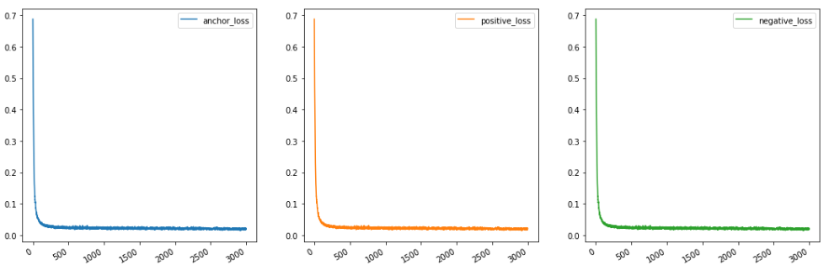
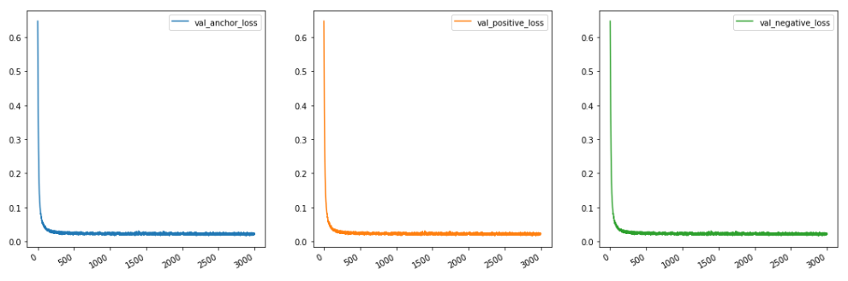
Reconstruction loss

Slide 25
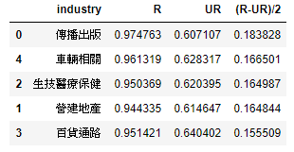
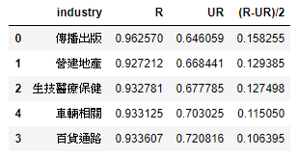
Similarity in R,UR,(R-UR)/2 on TrainSet
BOW
AE in Trainset
Supervised Denosising AE
Test set
Test set

Slide 26
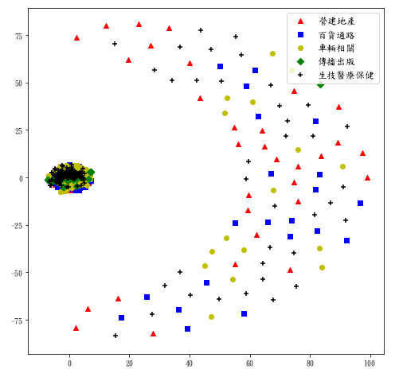
Tsne on original data

Slide 27
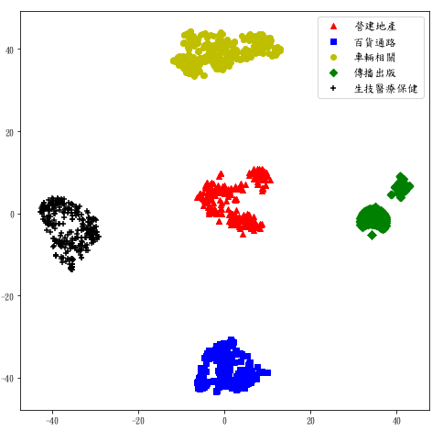
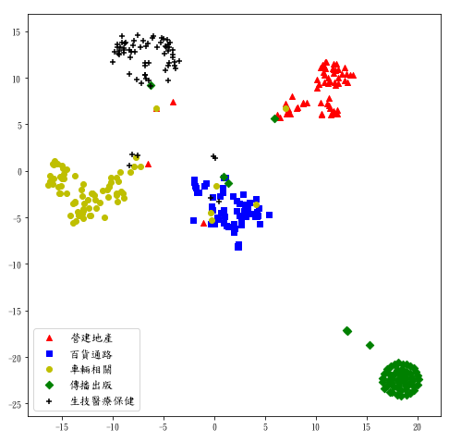
Tsne on embedding data
Train set
Test set

