Slide 1
VIP 新聞

Slide 2
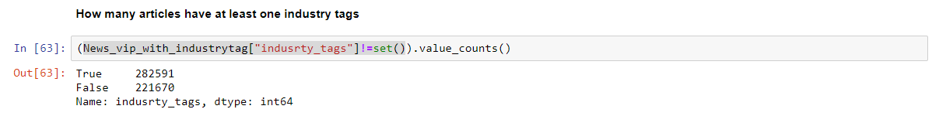
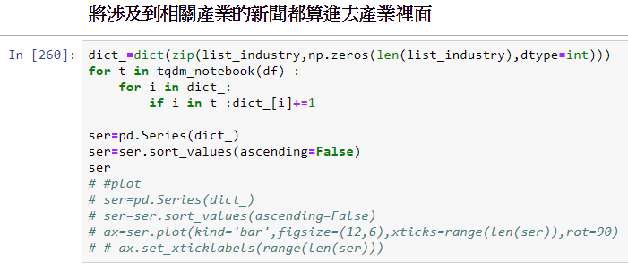
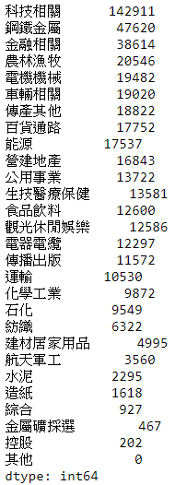
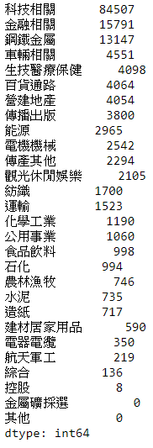
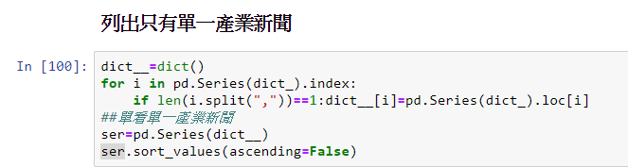
485,842則
154,884則

Slide 3
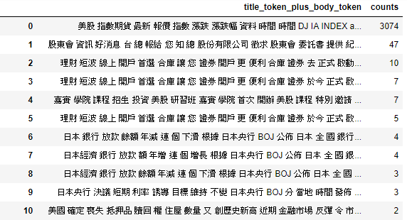
VIP with only one industry

Slide 4
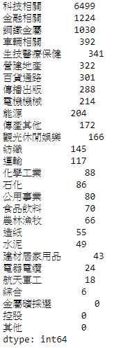
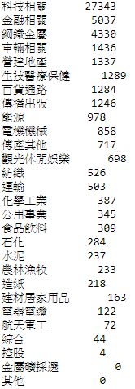
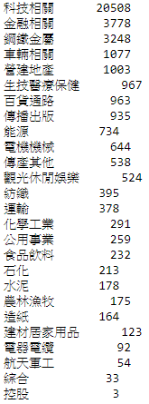
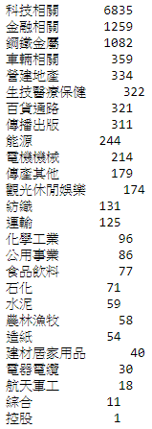
隨機一萬篇
隨機五萬篇
Trainset(3/4)
Testset(1/4)

Slide 5
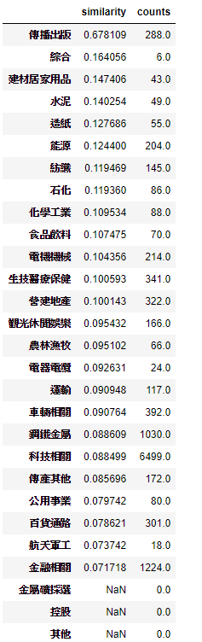
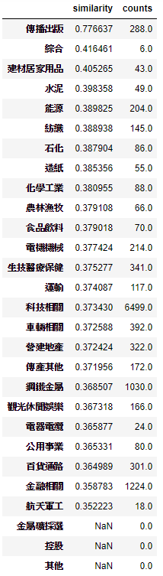
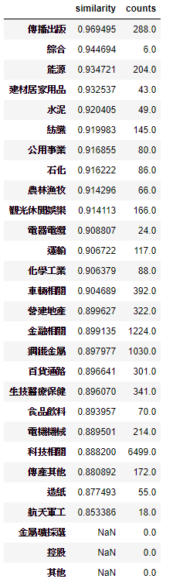
Similarity within industry-Bow,unAE,AE

Slide 6
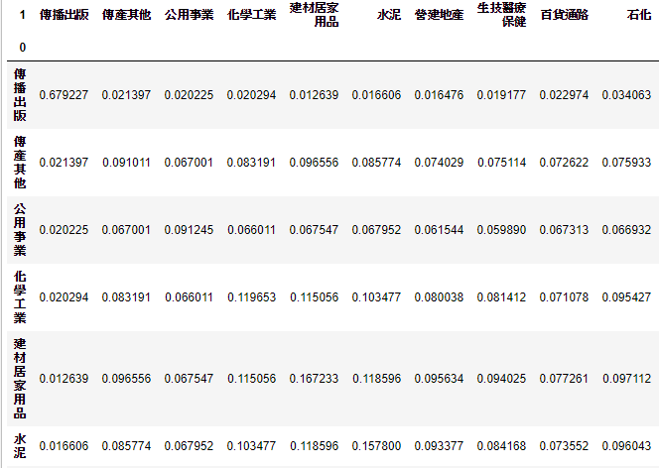
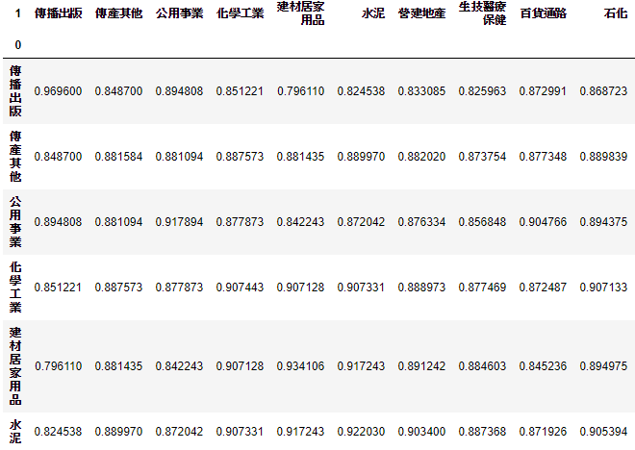
Similarity between 2 industry-Bow,unAE,AE
Bow
AutoEncoder

Slide 7
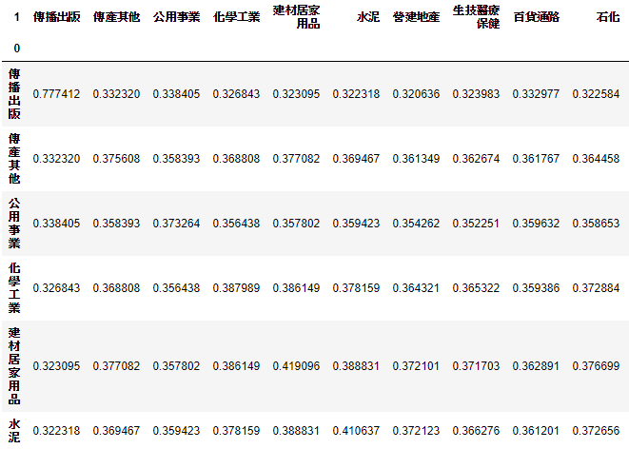
Similarity between 2 industry-unAE

Slide 8
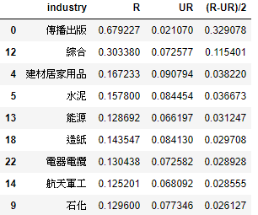
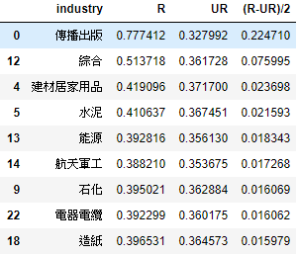
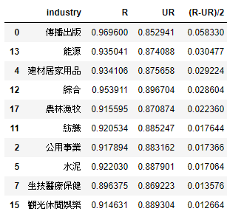
Similarity in R,UR,(R-UR)/2
BOW
UAE
AE
-1<(R-UR)/2<1

Slide 9
Supervised Denoising AE
Dataset(from 10000 random)
Train set (80%)
Test set(20%)

Slide 10
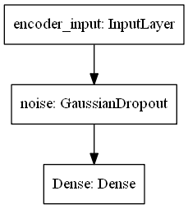
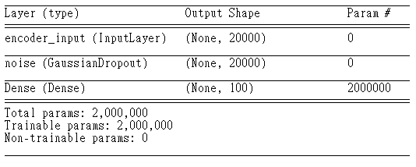
Encoder

Slide 11
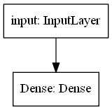
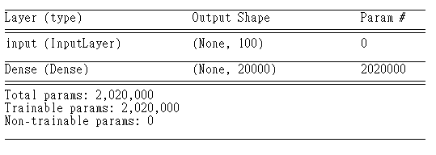
Decoder

Slide 12
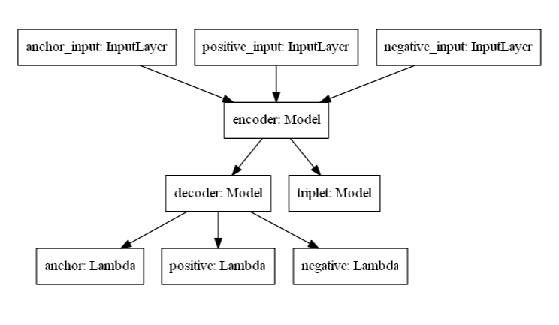
Tri-AutoEnocoder

Slide 13
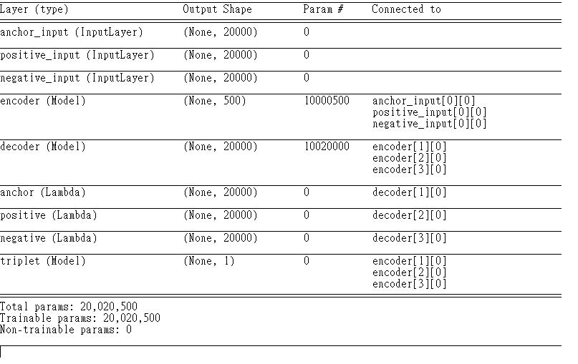

Slide 14
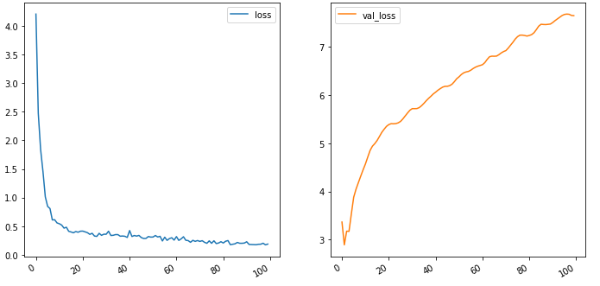
loss

Slide 15
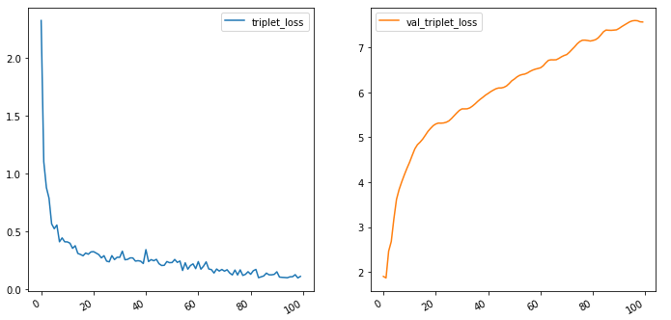
Triplet loss

Slide 16
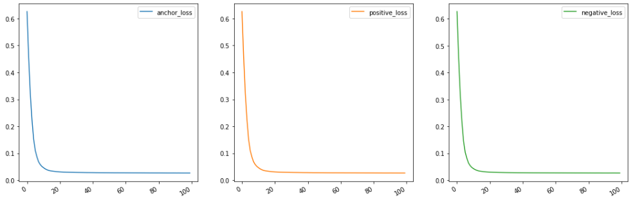
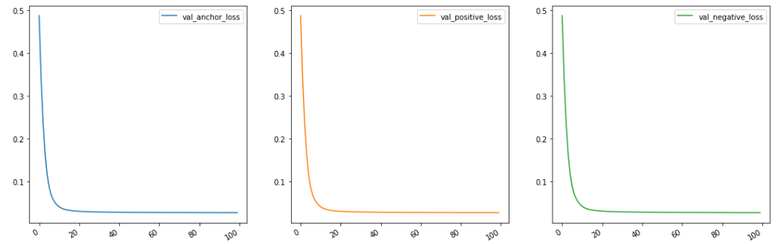
Reconstruction loss

Slide 17
Sampling
A1,A2,A3,A4
B1,B2,B3,B4
C1,C2,C3,C4
D1,D2,D3,D4
(A1,A2,B1),(A2,A3,C1),(A3,A4,D1)
(B1,B2,C1)

Slide 18
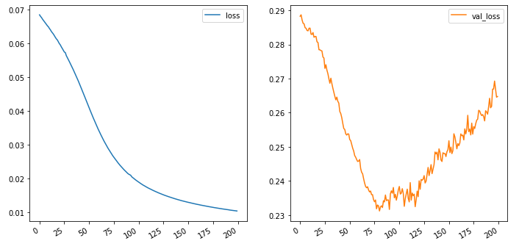
loss

Slide 19
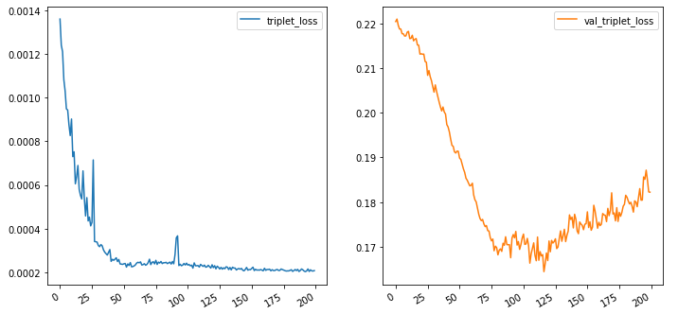
Triplet loss

Slide 20
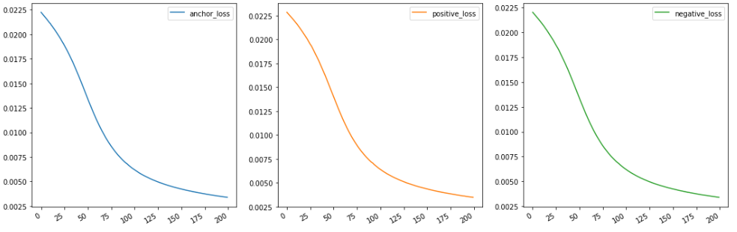
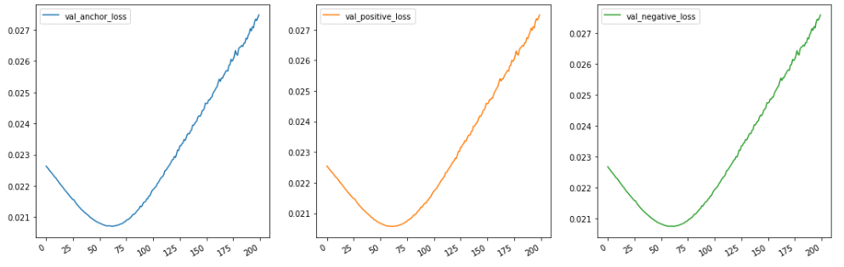
Reconstruction loss

Slide 21
Sampling
A1,A2,A3,A4
B1,B2,B3,B4
C1,C2,C3,C4
D1,D2,D3,D4
Hyper parameter : P=2,K=2
Random : P=(A,B) K=(A1,A2),(B1,B2)
Sample=
(A1,A2,B1), (A1,A2,B1),(A2,A1,B1), (A2,A1,B2)
(B1,B2,A1), (B1,B2,A1),(B2,B1,A1), (B2,B1,A2)
Size of Batch:PK(K-1)(PK-K)

Slide 22

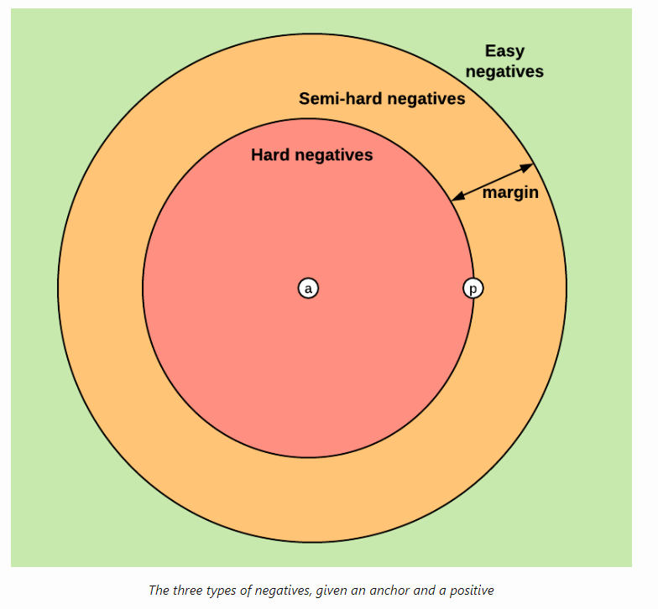

Slide 23
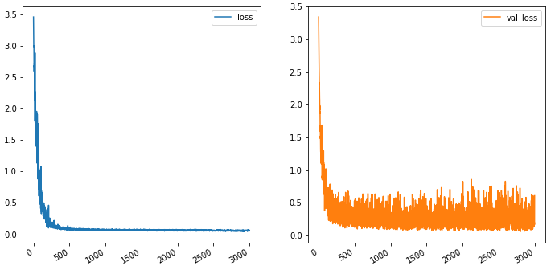
loss

Slide 24
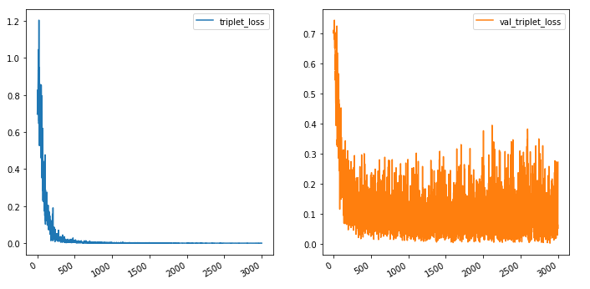
Triplet loss

Slide 25
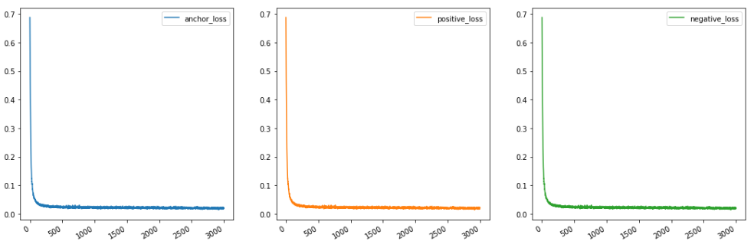
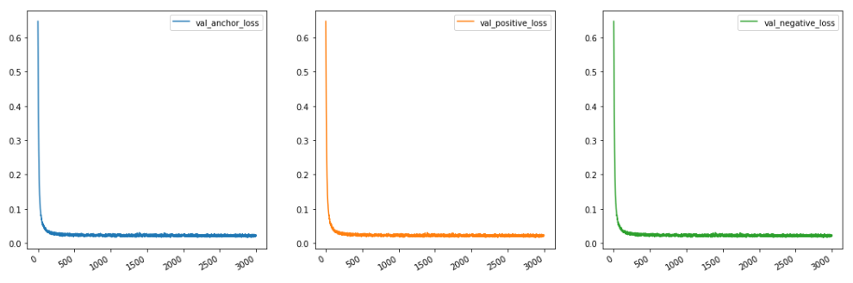
Reconstruction loss

Slide 26
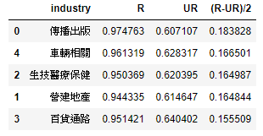
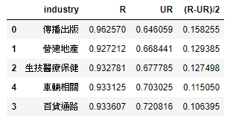
Similarity in R,UR,(R-UR)/2 on TrainSet
BOW
AE in Trainset
Supervised Denosising AE
Test set
Test set

Slide 27
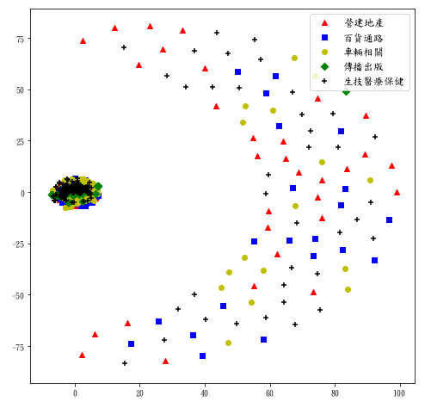
Tsne on original data

Slide 28
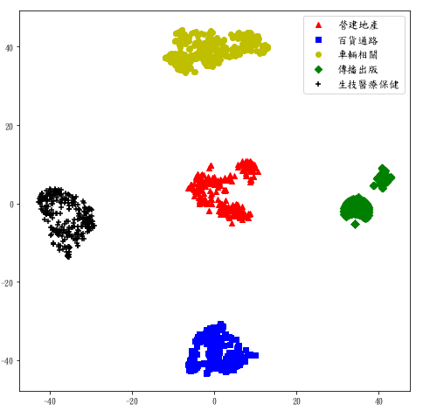
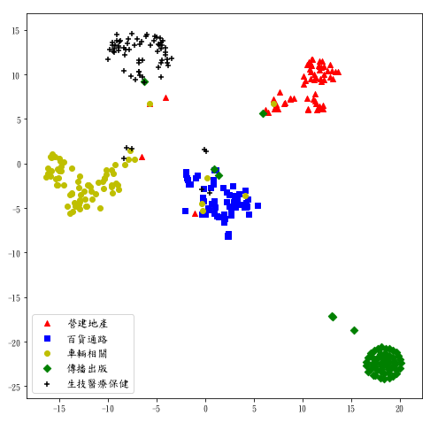
Tsne on embedding data
Train set
Test set

