Slide 1
VIP 新聞

Slide 2
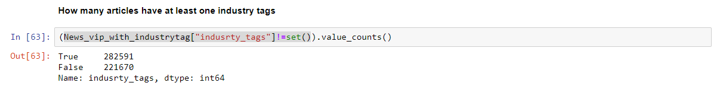
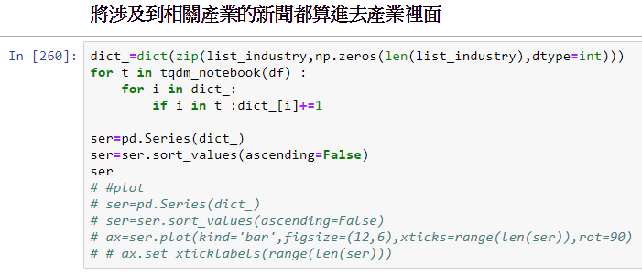
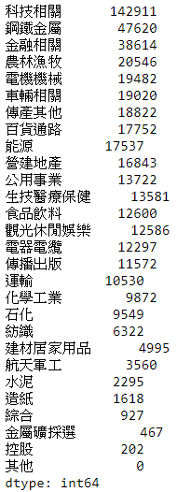
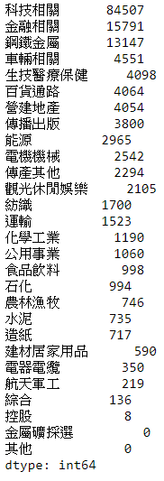
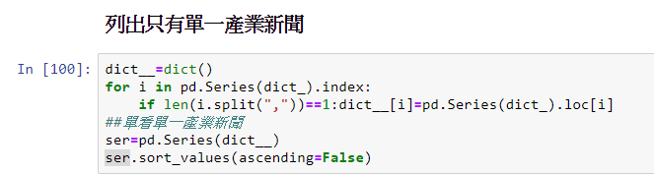
485,842則
154,884則

Slide 3
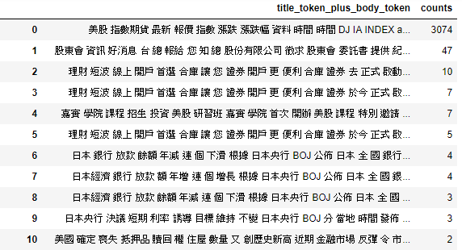
VIP with only one industry

Slide 4
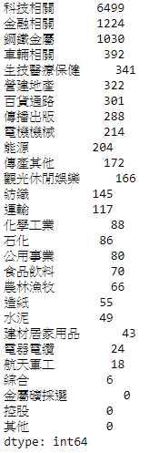
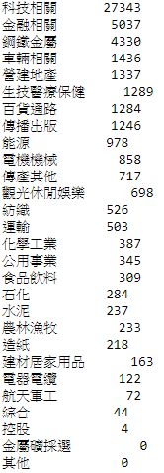
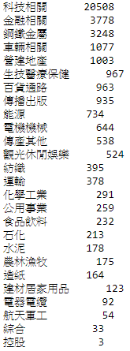
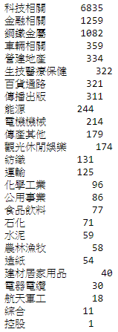
隨機一萬篇
隨機五萬篇
Trainset(3/4)
Testset(1/4)

Slide 5
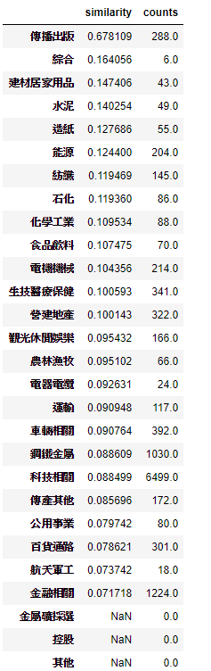
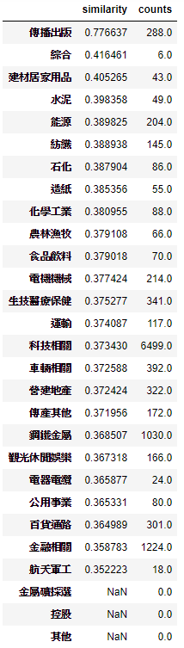
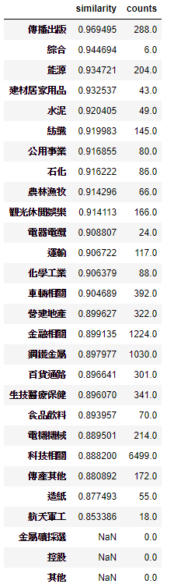
Similarity within industry-Bow,unAE,AE

Slide 6
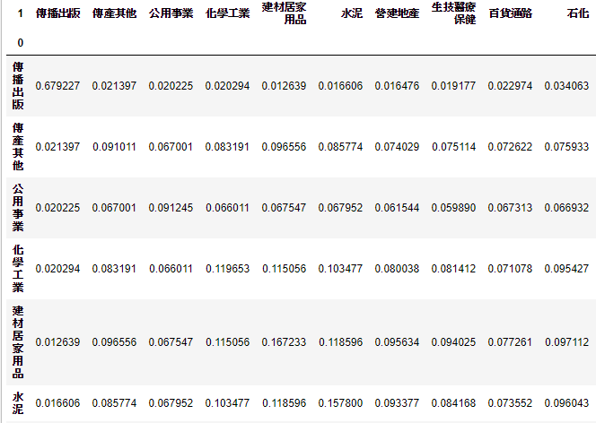
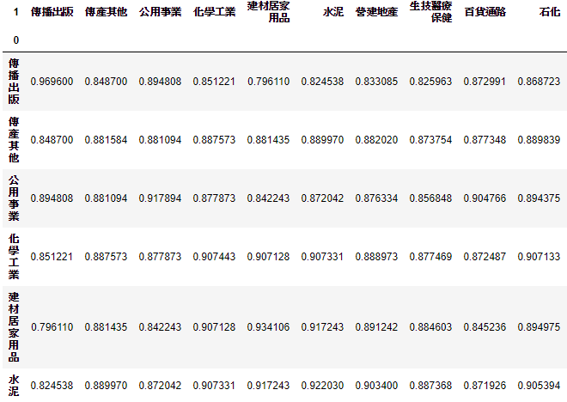
Similarity between 2 industry-Bow,unAE,AE
Bow
AutoEncoder

Slide 7
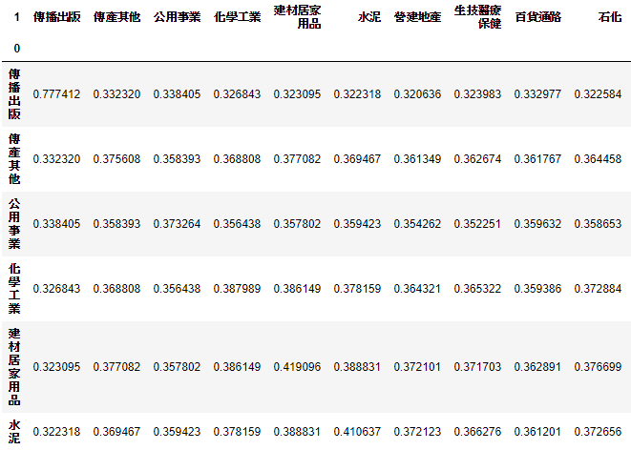
Similarity between 2 industry-unAE

Slide 8
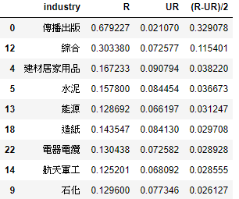
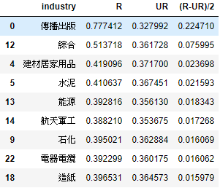
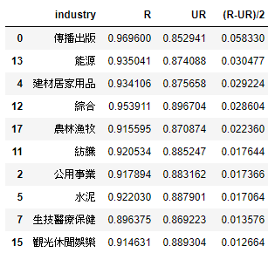
Similarity in R,UR,(R-UR)/2
BOW
UAE
AE
-1<(R-UR)/2<1

Slide 9
Supervised Denoising AE
Dataset(from 10000 random)
Train set (80%)
Test set(20%)

Slide 10
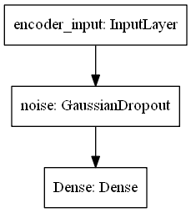
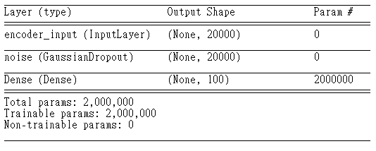
Encoder

Slide 11
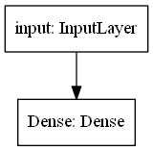
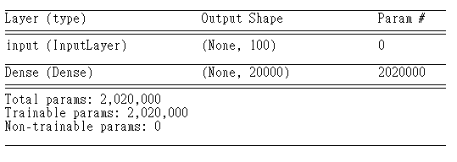
Decoder

Slide 12
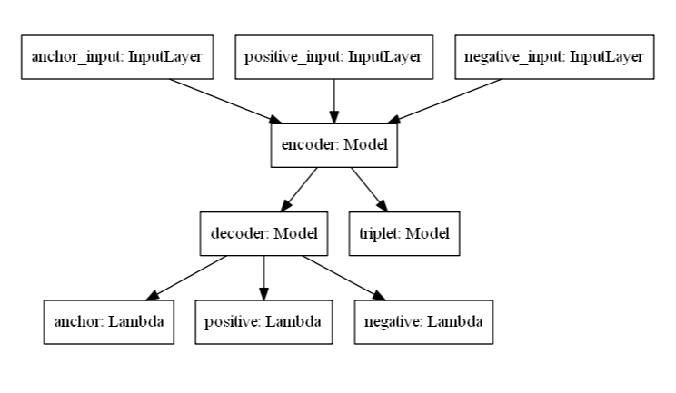
Tri-AutoEnocoder

Slide 13
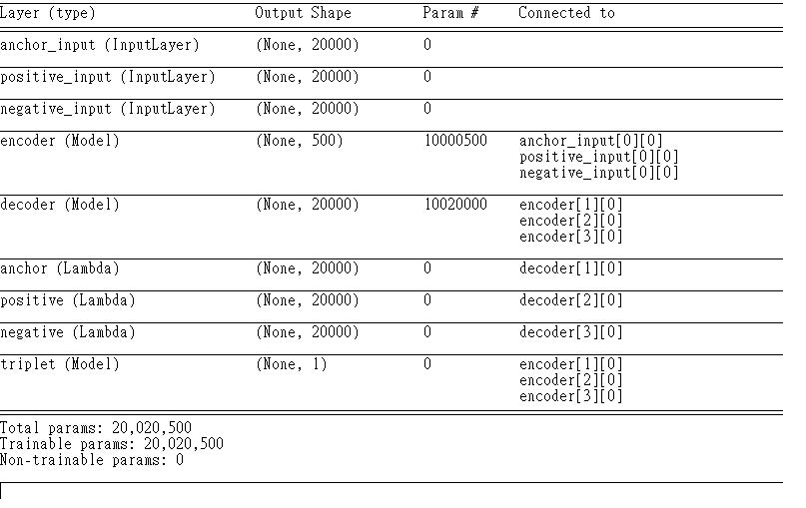

Slide 14
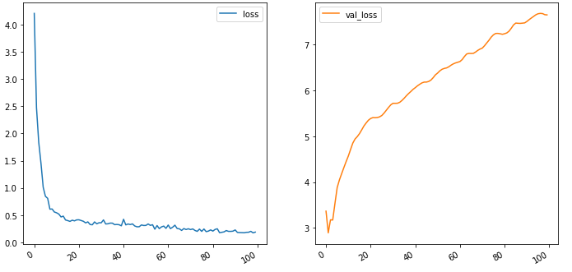
loss

Slide 15
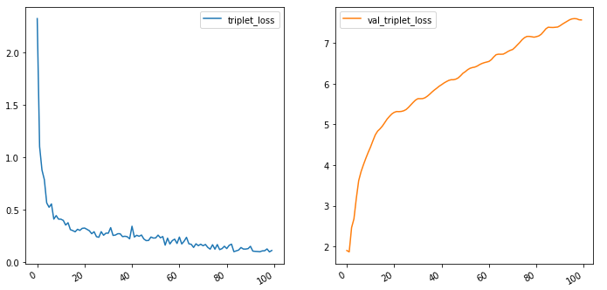
Triplet loss

Slide 16
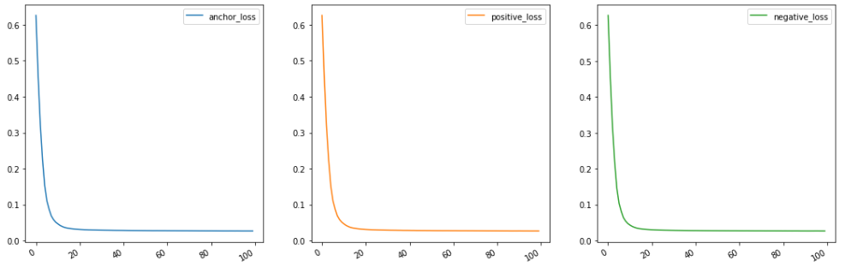
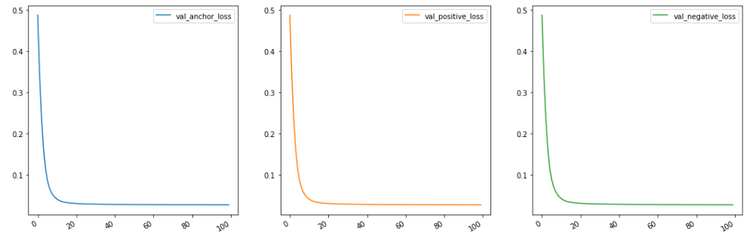
Reconstruction loss

Slide 17
Sampling
A1,A2,A3,A4
B1,B2,B3,B4
C1,C2,C3,C4
D1,D2,D3,D4
(A1,A2,B1),(A2,A3,C1),(A3,A4,D1)
(B1,B2,C1)

Slide 18
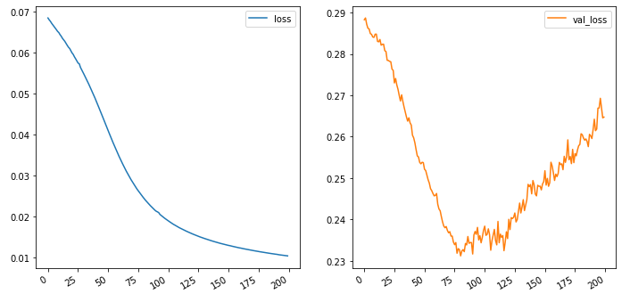
loss

Slide 19
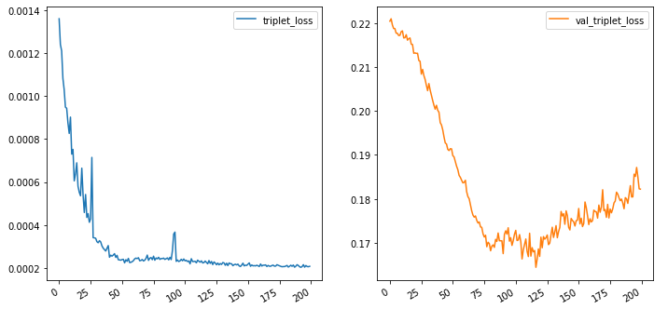
Triplet loss

Slide 20
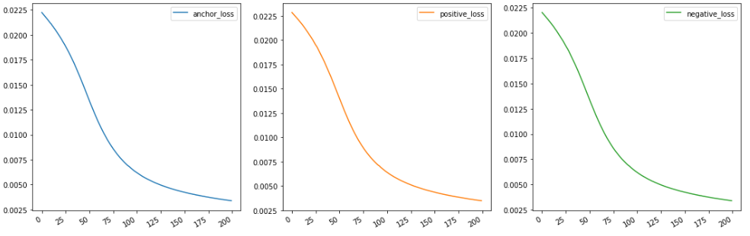
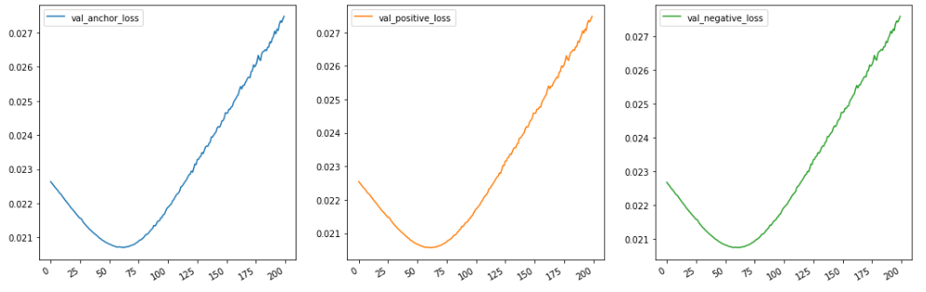
Reconstruction loss

Slide 21
Sampling
A1,A2,A3,A4
B1,B2,B3,B4
C1,C2,C3,C4
D1,D2,D3,D4
Hyper parameter : P=2,K=2
Random : P=(A,B) K=(A1,A2),(B1,B2)
Sample=
(A1,A2,B1), (A1,A2,B1),(A2,A1,B1), (A2,A1,B2)
(B1,B2,A1), (B1,B2,A1),(B2,B1,A1), (B2,B1,A2)
Size of Batch:PK(K-1)(PK-K)

Slide 22

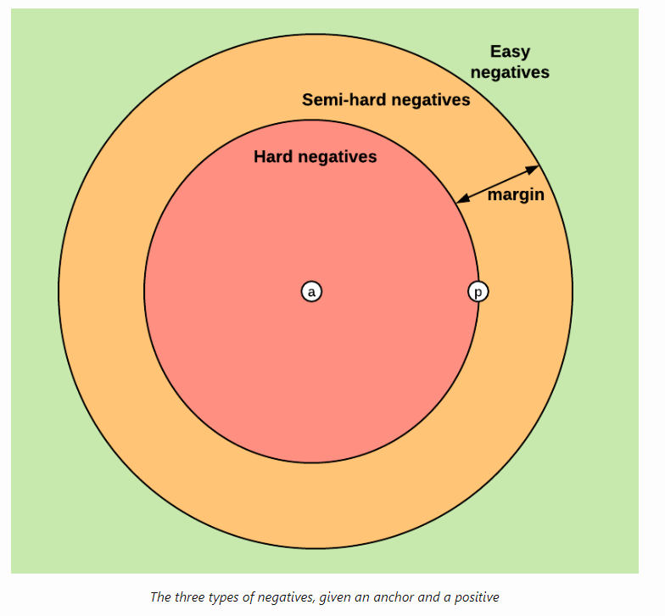

Slide 23
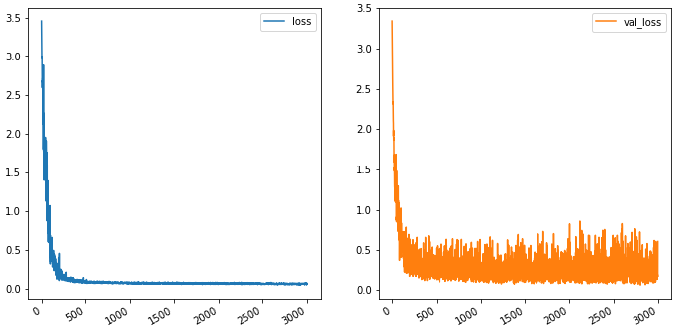
loss

Slide 24
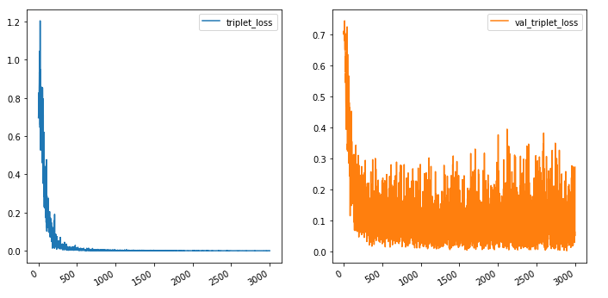
Triplet loss

Slide 25
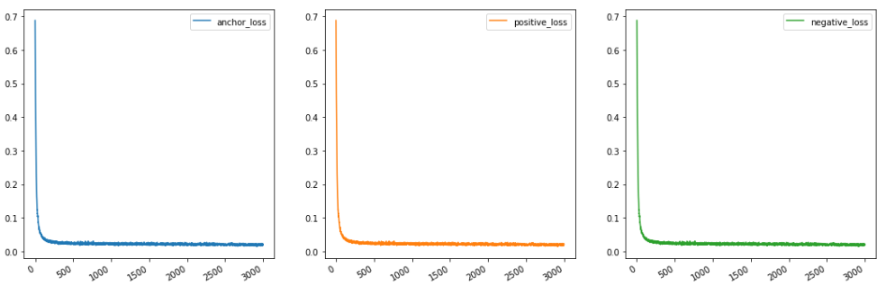
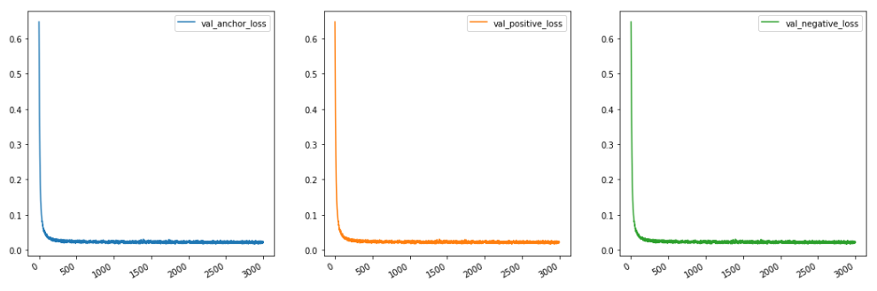
Reconstruction loss

Slide 26
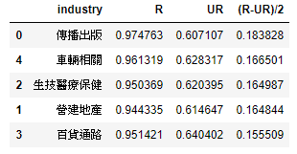
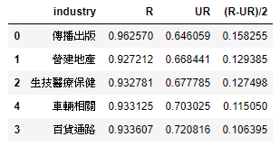
Similarity in R,UR,(R-UR)/2
BOW
AE in Trainset
Supervised Denosising AE
Test set
Test set

Slide 27
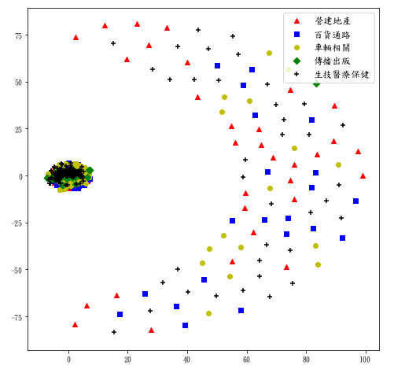
Tsne on original data

Slide 28
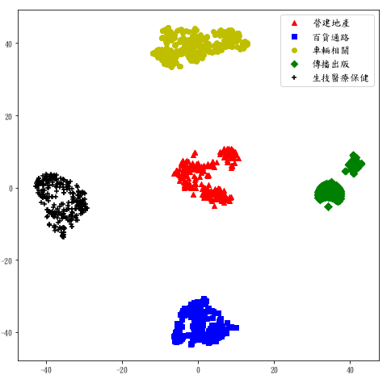
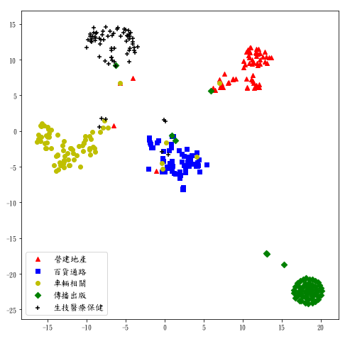
Tsne on embedding data
Train set
Test set

Slide 29
50,000 news in all industry
隨機五萬篇
Trainset(3/4)
(37509)
Testset(1/4)
(12491)
隨機一萬篇

Slide 30
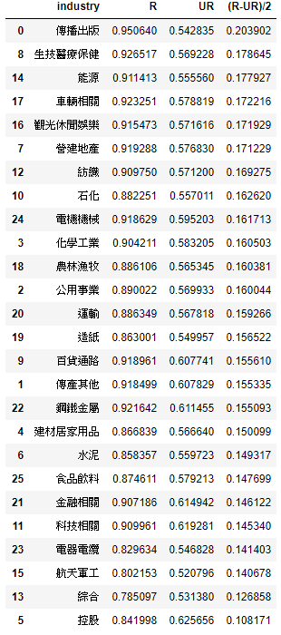
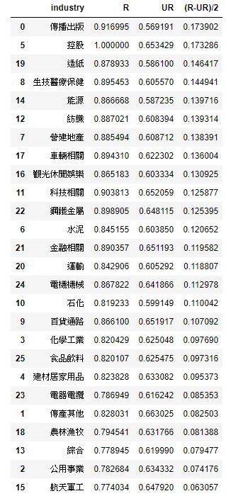

Slide 31
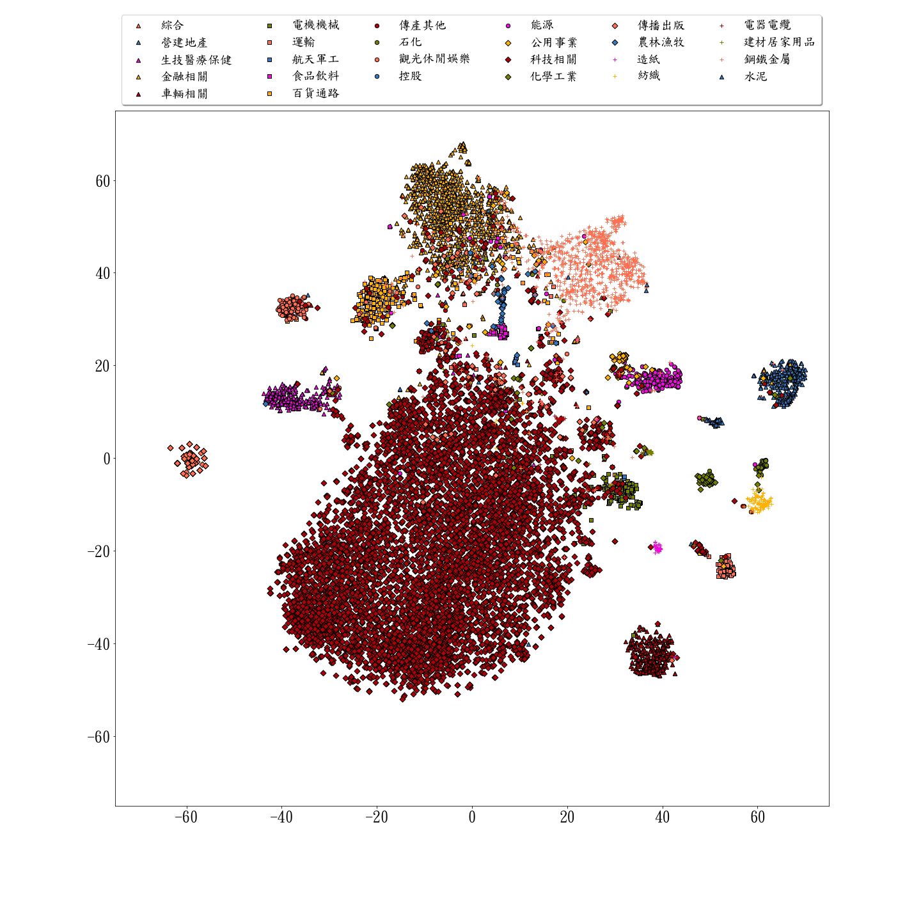
Testset(12491)
金融相關
鋼鐵金屬
觀光休閒
百貨通路
綜合
農林漁牧
食品飲料
公用事業
生技醫療
傳產其他
航天軍工
能源
營建地產
傳播出版
電器電纜
水泥
建材居家
化學工業
石化
電機機械
紡織
造紙
運輸
車輛相關
科技相關

Slide 32
