Slide 1

sQueue
com.MobiSeeker.sQueue
youssefmyh@gmail.com & meyouhana@gmail.com
Youssef Hana & Youhana Hana

Slide 2
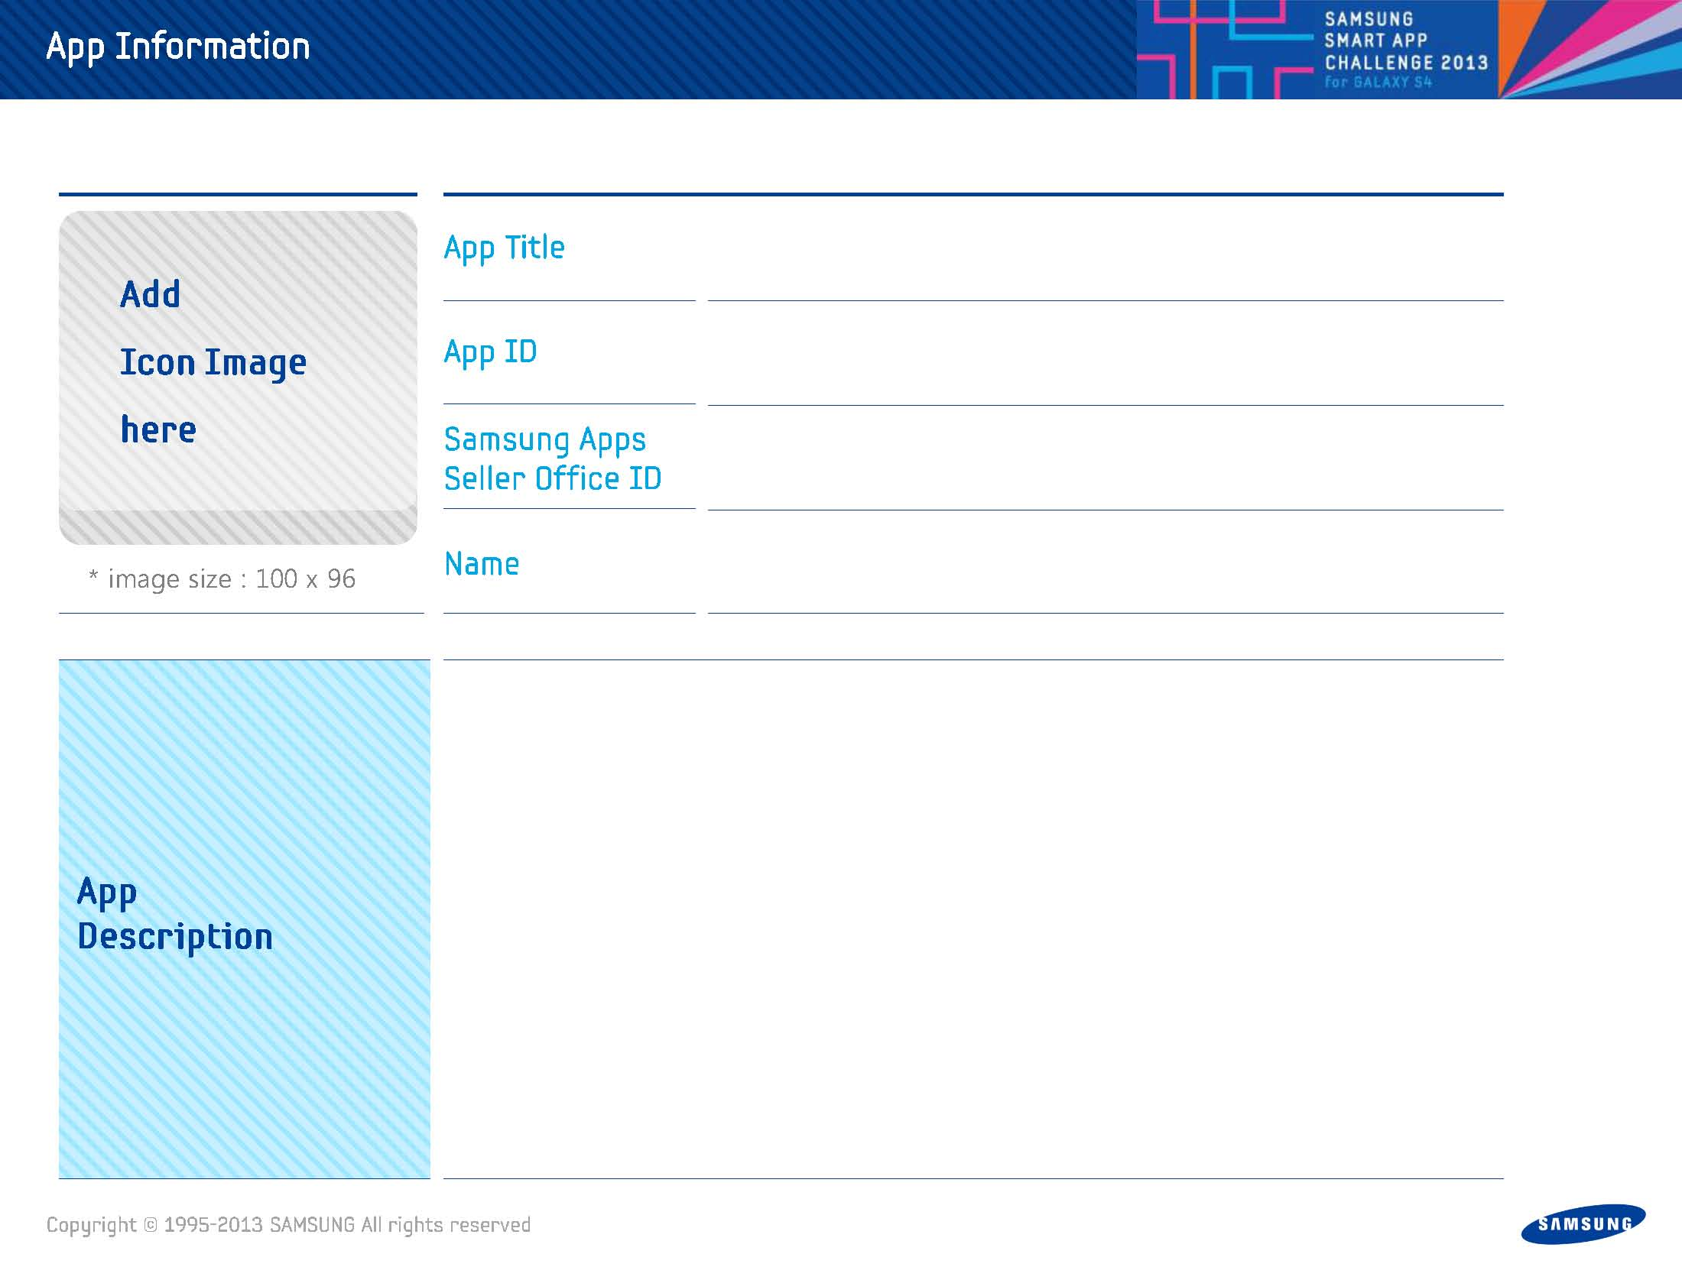

sQueue
com.MobiSeeker.sQueue
youssefmyh@gmail.com & meyouhana@gmail.com
Youssef Hana & Youhana Hana
sQueue offers the ability to chat, send and receive images and video files between anonymous users they just on the same queue.
It's easy to know what's up when you are in the queue like traffic for accident or road work ! Here's how it works:
Users in the queue like car traffic, bus and tax stations are bored from waiting and they have a curiosity for what's going on, then using
sQueue they can chat with people in from of the Queue to know what's really going on, besides asking for picture and video from them.
Features:
- Send messages to all users in the queue
- Ask for photo or videos
- Map view for the Queue
- Add profile name and picture
- Global conversation for all users in the Queue
- Private conversations for users you select
- Vibrate when message received

Slide 3
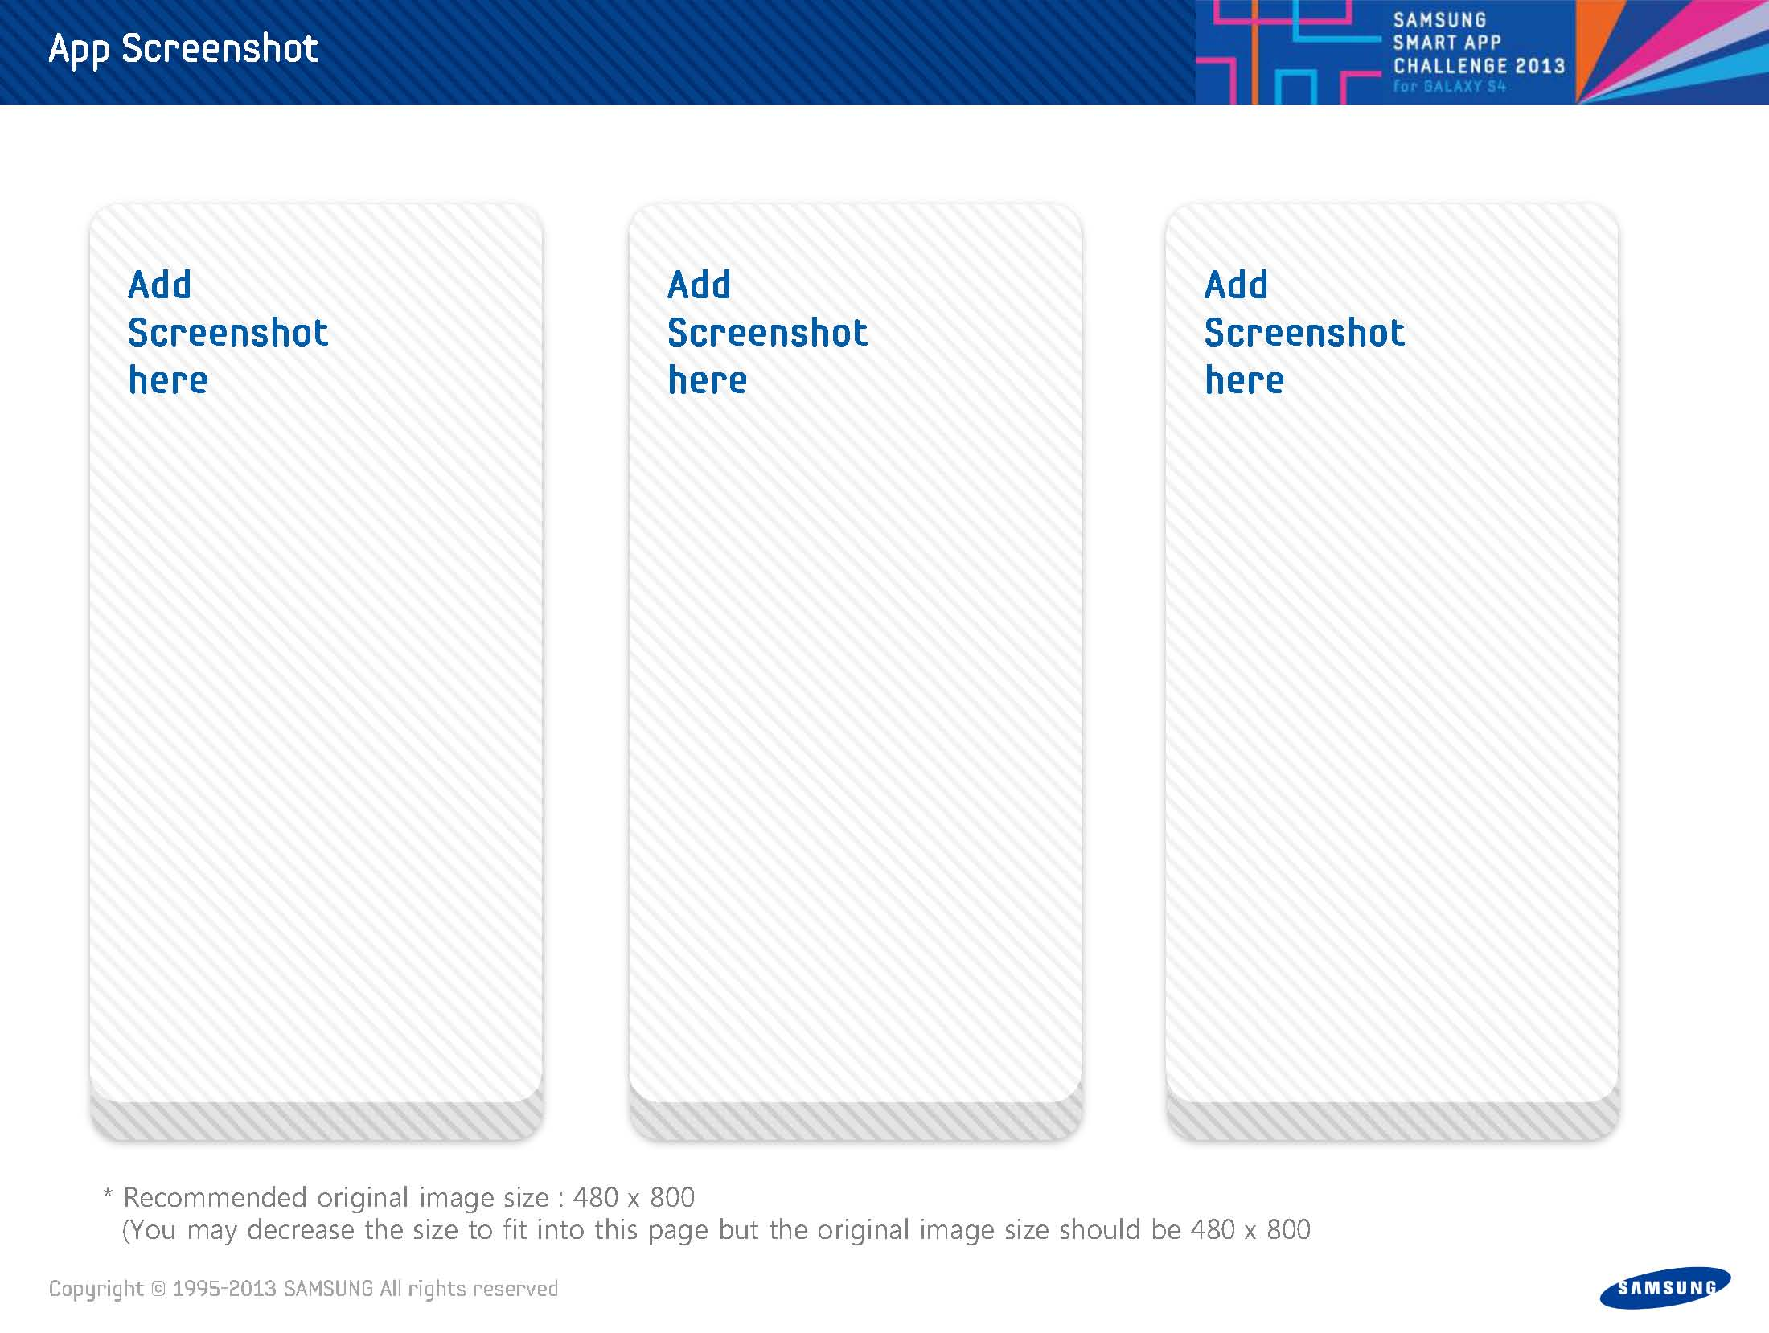

Slide 4
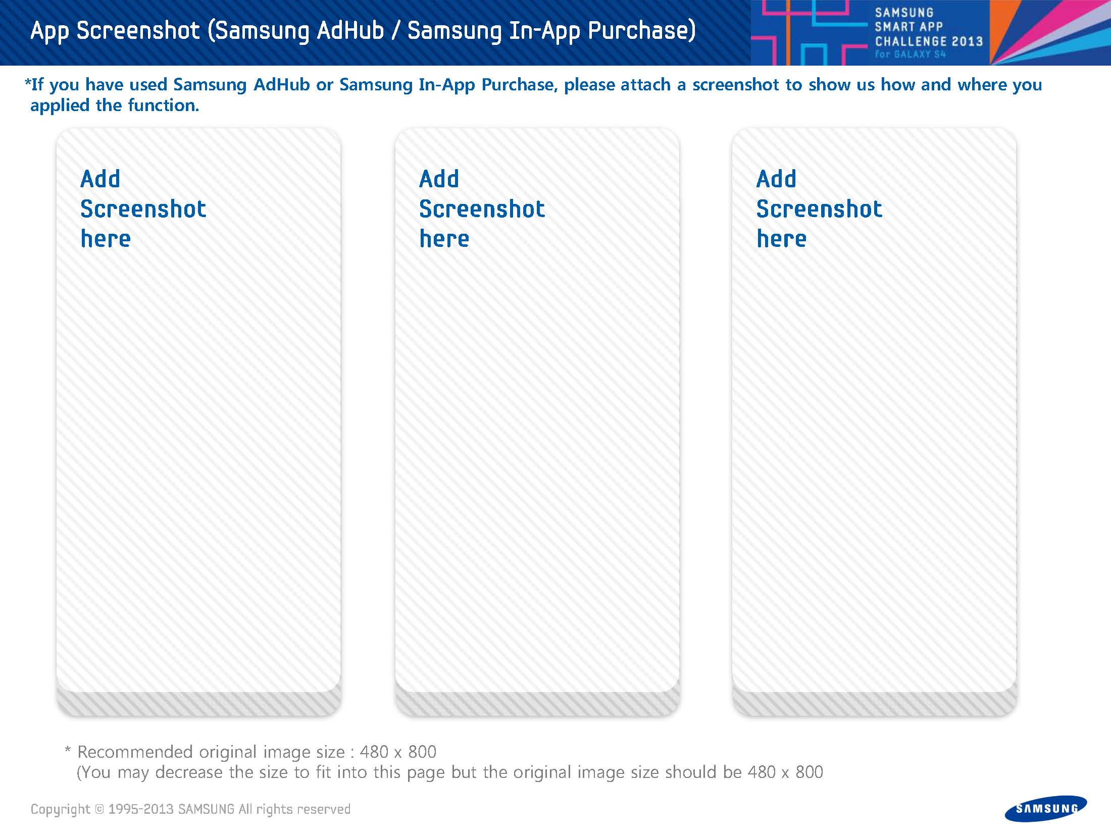

Slide 5

sQueue use Samsung chord SDK to listen to any node that join the application channel and list it as contact in the queue
sQueue uses chord APIs to send messages, picture and video files between devices.
sQueue will be strongly used in:
1- High traffic roads,
2- Bus stations,
3- Taxi stations
4- Train stations
7- Restaurants and night clubs
8- shopping centres
9- places which frequently have queues

Slide 6

The main differentiator is that sQueue will allows anonymous in the same queue to having a chat together and sharing photos and videos.
Users don't need to know each other. they are stuck on the same queue
Users at the end of the queue will ask users at the front of the queue to send them pictures and videos of what's going on.
There are no registration of any type (facebook, twitter, google) required, just launch sQueue and kill your curiosity
That application developed to help people stuck in the queue like traffic queue to make sue of their time and updated of what's happing at the front of the queue.
I usually stuck on queue and unable to know what's going on. There is no one of may Facebook fiends near me and really need to know what's going on.
sQueue is targeting users that usually involved in queue like traffic, bus or train queue. They usually bored and spending their tie check social networks or twitter searching for any information about their queue, this why sQueue developed to give users the ability to get more friends and be aware of why the queue is slow.

Slide 7

sQueue brings values to users usually stuck on queue,
1- Chat between anonymous users
2- Send queue information as text, image and video files to all people in the queue
3- Map view for the Queue
4- No registration required , no need for Facebook account, gmail or twitter
5- Provide user profile (login name and image)
6- private and global conversations
Chord SDK to support large files transfer
Chord SDK tu support get location feature

Slide 8


