Slide 1
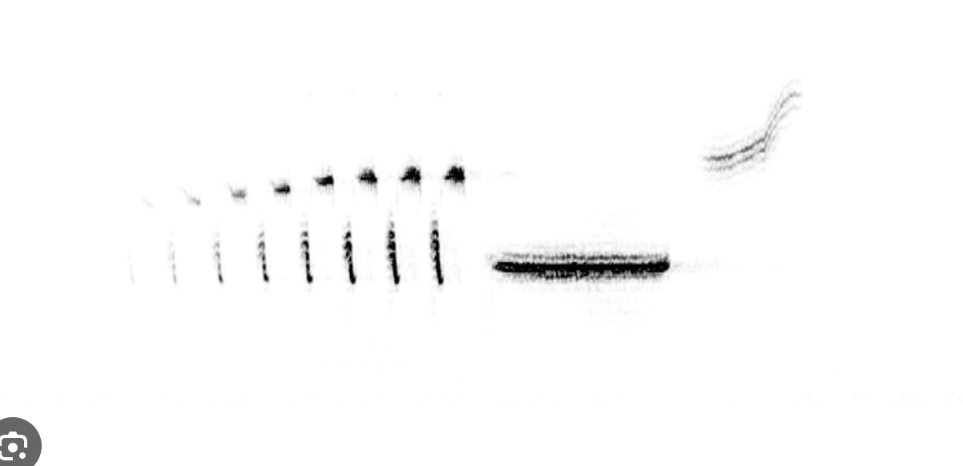
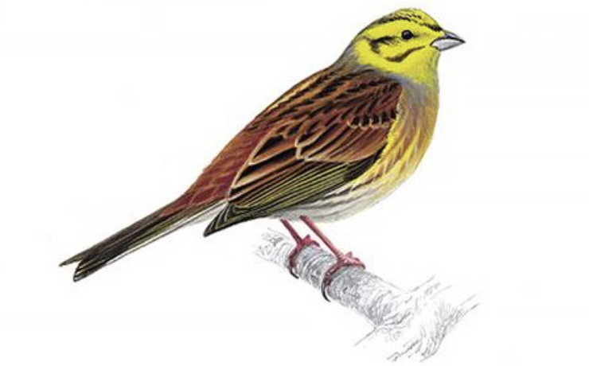
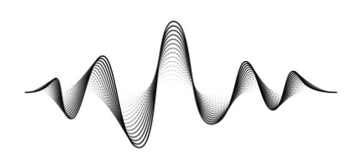
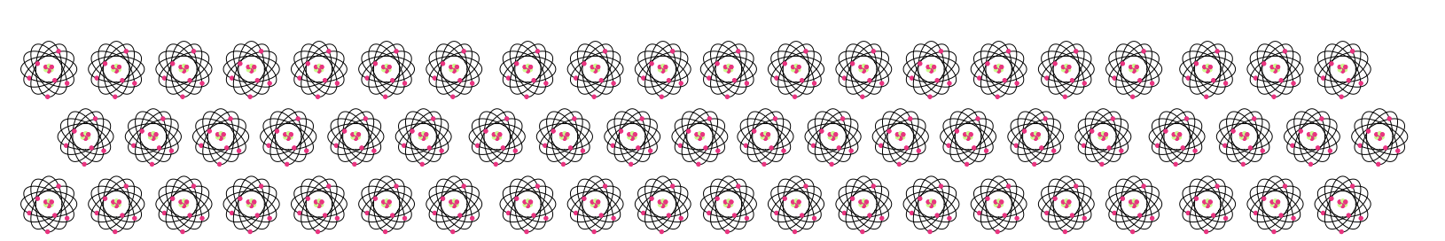
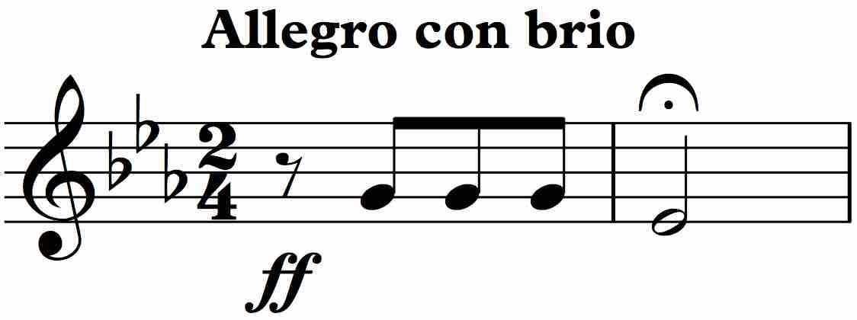
Transformation
Pattern
representation
T₁
Data
spectrogram
T₂
011010011100101001001001001010010
computer (bits)
T₃
quantum computer (q-bits)
T₄
motif

Slide 2
Transformation
T₁
Pattern Encoding
T₂
011010011100101001001001001010010
computer (bits)
T₃
quantum computer (q-bits)
T₄

Slide 3
Data
Representation
T
frequency (Hz)
time (s)

Slide 4
Data
Spectrogram
T
frequency (Hz)
time (s)

