Slide 1
What I have learned from EAST experiments
胡友俊
2016-04-01

Slide 2
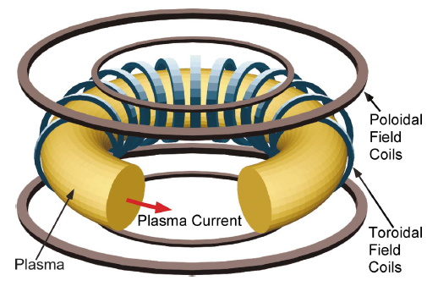
Main Coils on Tokamak
A. Boozer, 2004, Rev. Mod. Phys.
<number> /14

Slide 3




Toroidal Field (TF) coils of EAST
TF coils=16coil*130turn/coil
Two scenarios for EAST:
  =10000A➔ = 2.447T at R=1.7m
  = 8000A ➔ = 1.957T at R=1.7m

Slide 4
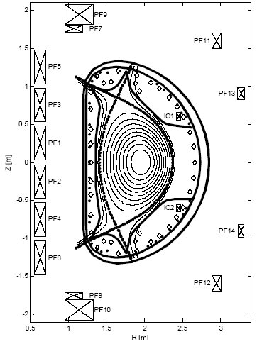
Poloidal Field (PF) Coils of EAST
12 superconductive PF coils
➔(6 central solenoid coils+6 shaping coils)
PF1 to PF6➔120 turns/coil
PF7+PF9 connected in series➔248 turns
PF8+PF10 connected in series➔248 turns
PF11➔64 turns
PF12➔64 turns
PF13➔32 turns
Pf14➔32 turns
Maximal current per turn=14.5kA
2 in-vessel Copper coils (2 turns/coil) connected in anti-series➔ to control VDE

Slide 5
Plasma Control System (PCS) on EAST
Adapted from DIII-D PCS
Acuators: 12 PF coils + 2 fast coils
Two typical control scenarios:
  “RZIP control”➔ (R,Z) of the center of the plasma current, and the total current IP are feedback controlled by PF coils.
  “iso-flux control” ➔shape of LCFS, in additon to the RZIP, is feedback controlled by PF coils.➔X point, gap between plasma and wall

Slide 6
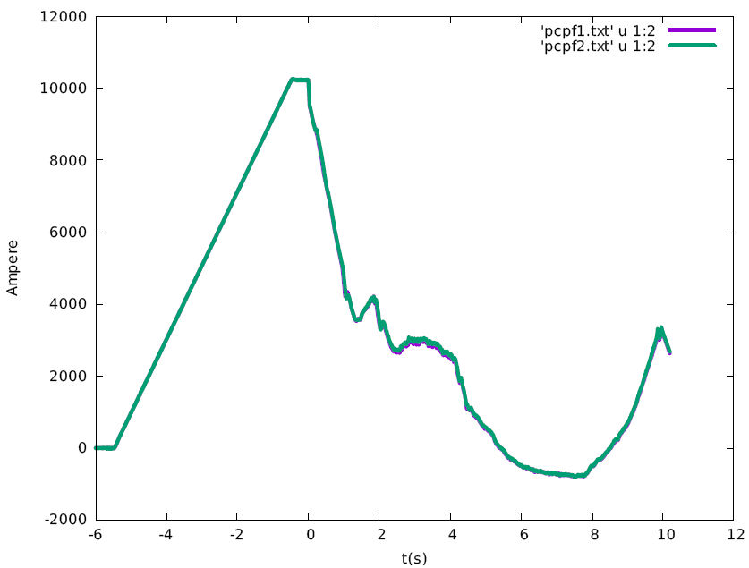
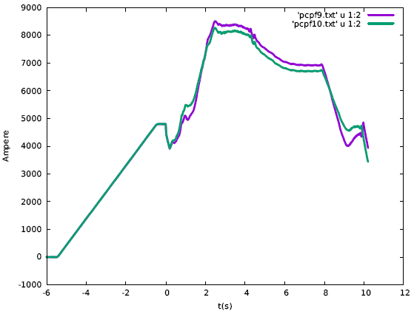
Typical wave-forms of current in PF coils
Charge to maximal current before plasma discharge
to provide maximal Voltage*Second
Central solenoid coils
Charge to median current before plasma discharge
to provide flexibility of shaping plasma
Plasma Discharge beginning
Shaping coils

Slide 7
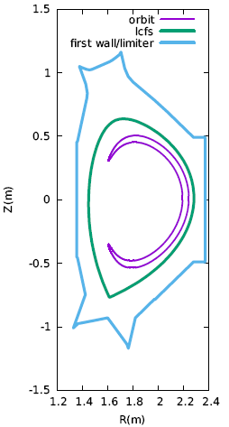
Components and material of first wall of EAST
divertor plate (W)
High-field-side wall (Mo+Carbon)
Ports for
diagnostic and
heating (antenna, NBI)
Inner divertor plate (C)
Passive plates (Mo)
Outer divertor plate (Carbon)
Dome (Carbon)

Slide 8
Time evolution of space-averaged quantities
Complete signal names on MDSplus server ➔can be found on EAST wiki page
View data online: webscope
Download data for analysis:
via webscope
directly access MDSplus server using matlab or Fortran code

Slide 9
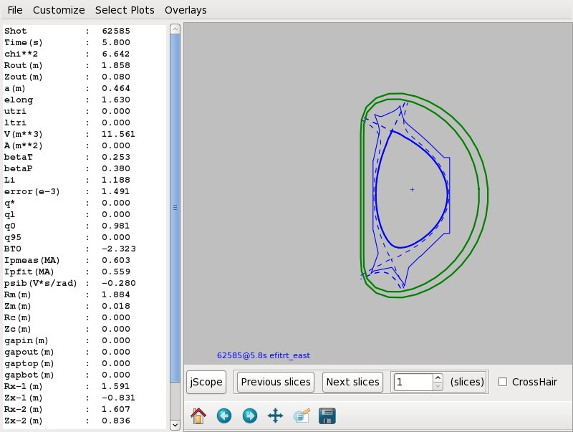
View Plasma configuration:
“eastviewer” on cs1.ipp.ac.cn

Slide 10
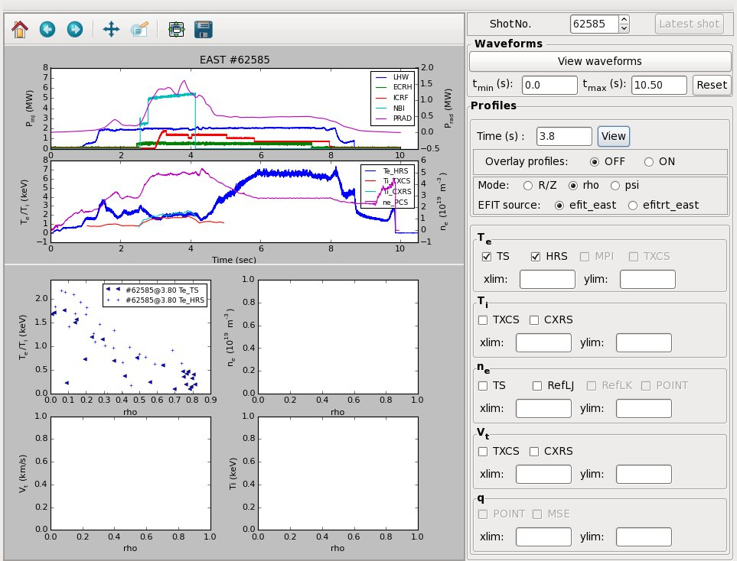
View profile:
EASTprofiles on cs1.ipp.ac.cn

Slide 11
谢谢!

Slide 12
Gass puff,
LHW asistent breakdown and start-up

