Slide 1
Comparison of Edge and Internal
Transport Barriers in Drift Wave Predictive Simulations
J. Weiland¹, K. Crombe², P. Mantica³, T. Tala⁴, V. Naulin⁵ and the JET-EFDA Contributors*
  1. Chalmers University of Technology and EURATOM-VR Association, Gothenburg, Sweden
  2. Association EURATOM-Belgian State Department of Applied Physics, Ghent University , Belgium
  3. Istituto di Fisica del Plasma-P Caldirola, Association EURATOM-ENEA-CNR, Milano, Italy
  4. Association EURATOM-Tekes VTT P.O. Box 1000 FIN-02044 VTT Finland
  5. Association EURATOM-Risö DTU DK 4000 Risö Denmark
IFP-CNR – Chalmers Workshop on Nonlinear Phenomena in Fusion Plasmas Varenna June 8 – 10 2011

Slide 2
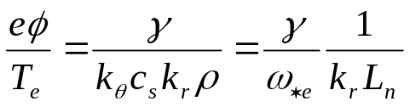

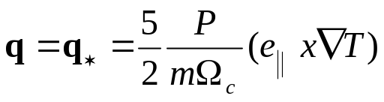
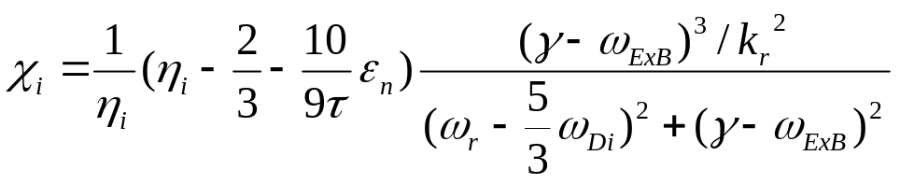
Transport model
The main features of our transport model are:
Saturation level:
Reactive fluid closure
Simple ITG mode transport

Slide 3
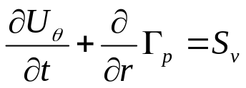
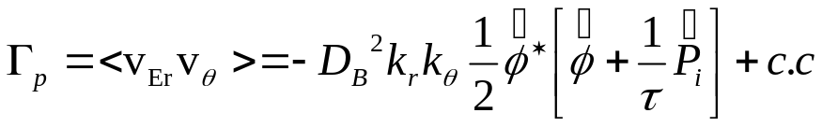
Poloidal spinup due to Reynolds stress
The radial flux of poloidal momentum
(1a)
(1b)
We have obtained a spinup of poloidal momentum both at an internal and at an edge transport barrier. In both cases the bifurcation seems to be closely related to this spinup
Electromagnetic toroidal (parallel) momentum equation including curvature effects from the stress tensor (caused by the Coriolis pinch in gyrokinetics)
(2)

Slide 4
Saturation level
For reference we show our ion thermal conductivity for the simple pure ITG mode
(3)
We have here used a Non-Markovian mixing length rule [J.Weiland and H. Nordman Theory of Fusion Plasmas, Chexbres 1988, A. Zagorodny and J. Weiland Phys. Plasmas 6, 2359 (1999)] and the Waltz rule [R.E. Waltz et. al. Phys. Plasmas 1, 2229 (1994) (numerical) and A. Zagorodny and J. Weiland, Phys. Fluids 16, 052308 (2009) (analytical)]

Slide 5
General features of model
The model includes the following features:
Our usual electromagnetic fluid model for ITG and TE modes
with transport of energy and momenta (includes pressure gradient drive)
Current gradient (kink) drive
Collisions on both trapped and free electrons
This gives the following modes:
ITG (both toroidal and slab), TE modes, collisionless (driven by electron or density gradients) and collision dominated
MHD and kinetic Ballooning modes
Peeling modes
Resistive ballooning modes

Slide 6
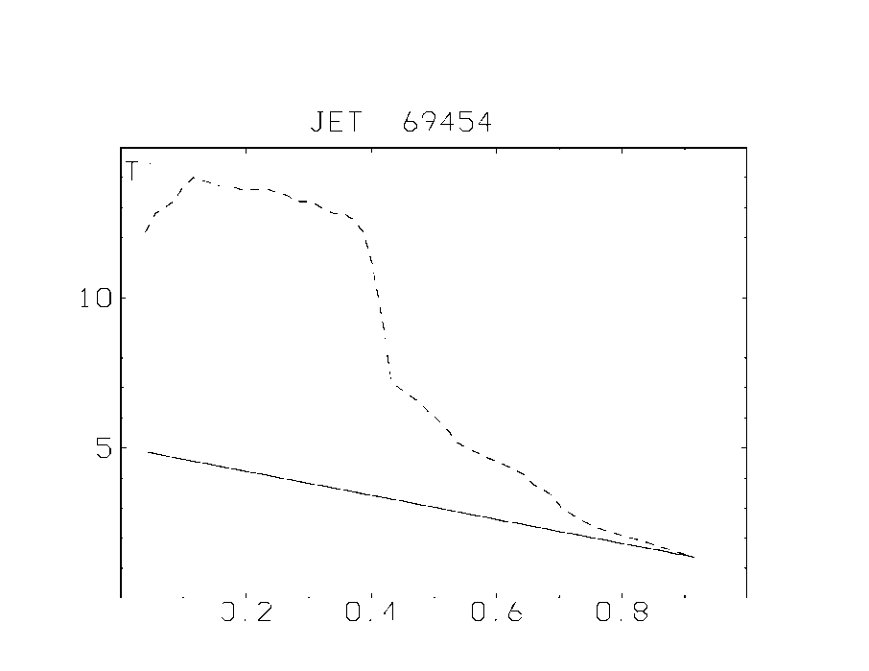
Internal transport barrier
Fig 1
Internal transport barrier in T _{i} (dotted) in JET69454 as simulated in the code selfconsistently including also T_{e,} V_{pol} and V_{tor} . The location and approximate magnitude are in agreement with the experiment.
As seen in the initial profiles there was no initial trace of a barrier. The density was kept fixed and did not show any sign of barrier.

Slide 7
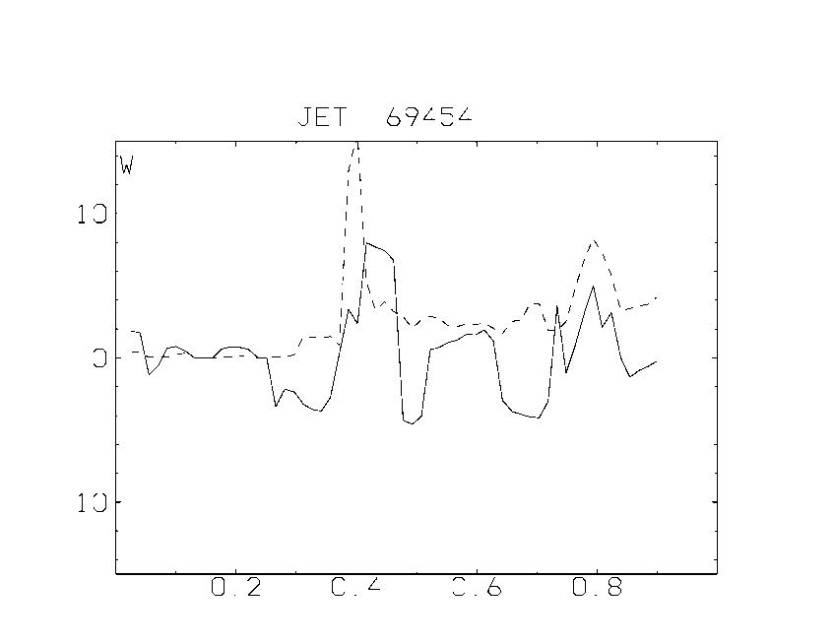
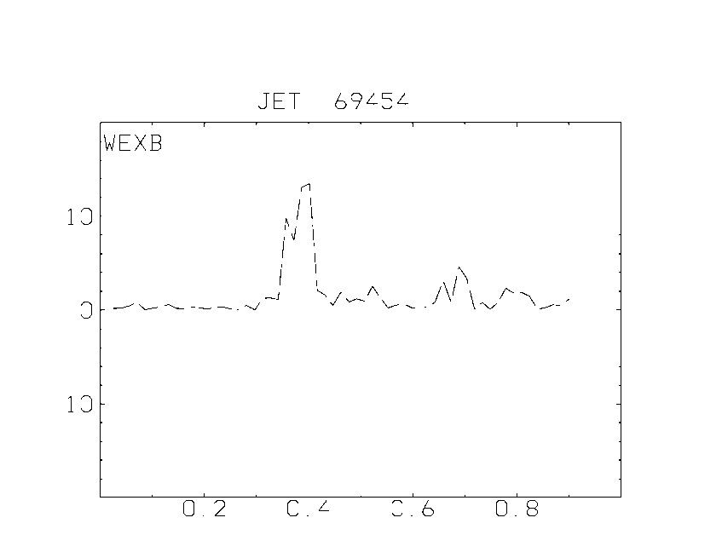
A TE mode is still unstable at the centre of the internal barrier
________ Real eigenfrequency
………… Growthrate
The fastest growing
mode is an electron
mode in the barrier. (top figure)
The shearing rate is not
sufficient for
stabilization at the
centre of the barrier.
(note that the scales are the same!)

Slide 8
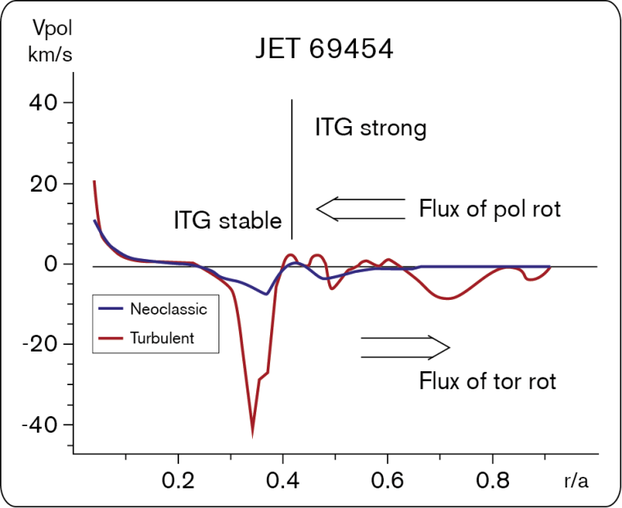
Simulation of JET69454 -Poloidal spinup
The ITG mode was stable in the barrier but provided a flux of poloidal rotation towards the barrier
Fig 2
The TE mode was marginal at the barrier. The location and magnitude of the poloidal spinup was in agreement with the experiment

Slide 9
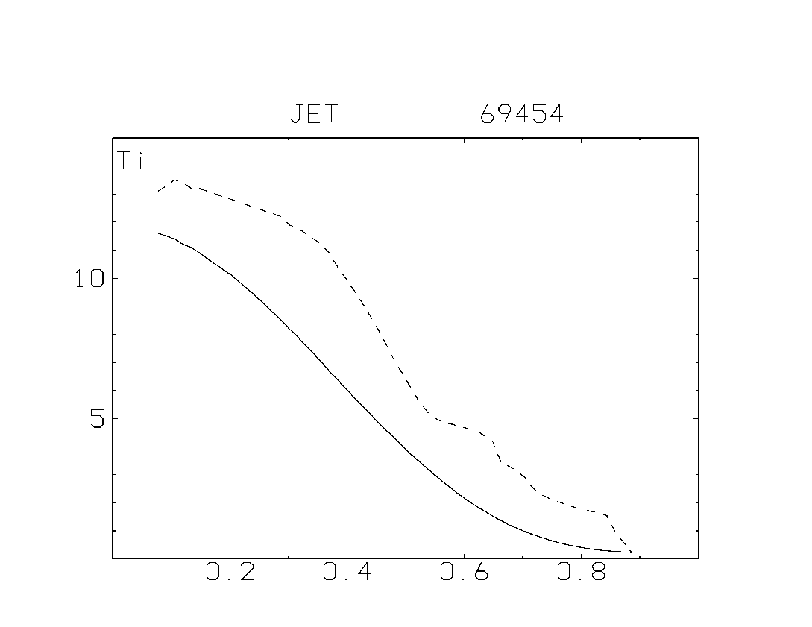
Edge barrier with basic data from JET69454
Fig 3
____________ Start profile
……………… Simulation
Experimental T_{i} at r/a = 0.9 was around 1.5 KeV. B_{p} =0.2T

Slide 10
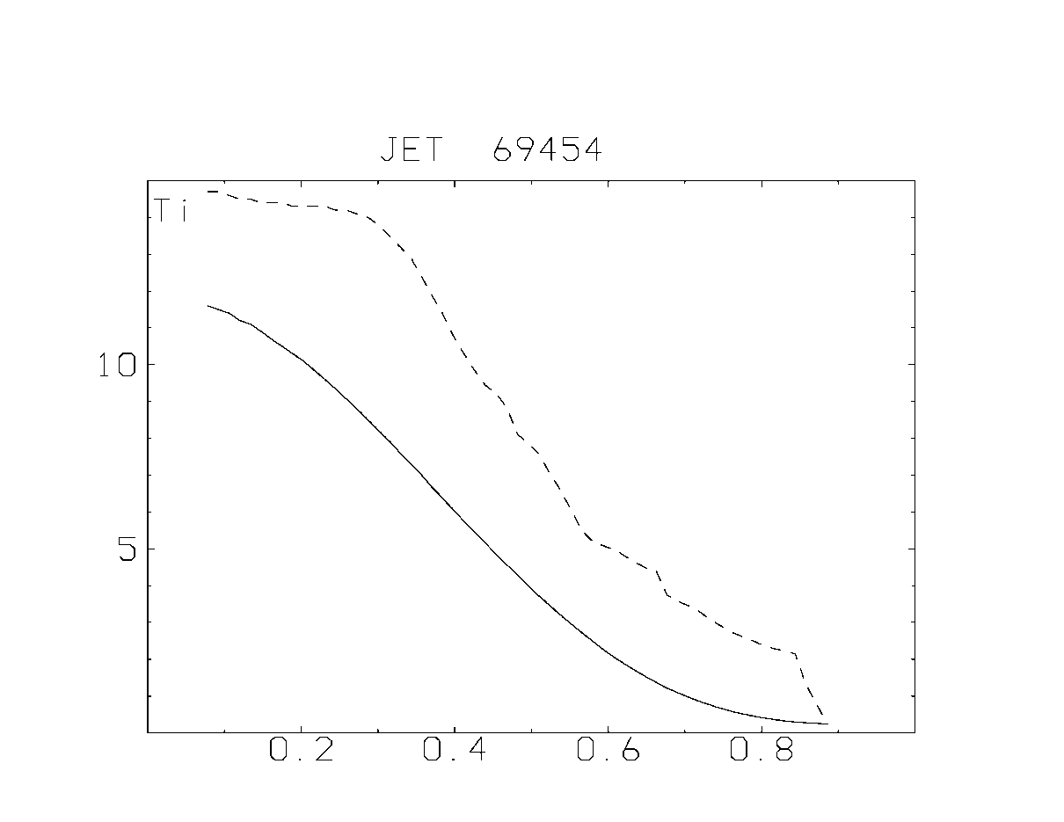
Increased B_{p}
Fig 4
Same case as in Fig 3 but with B_{p} increased by 50%. The height of the pedestal has increased but no further increase is seen for higher B_{p} .

Slide 11
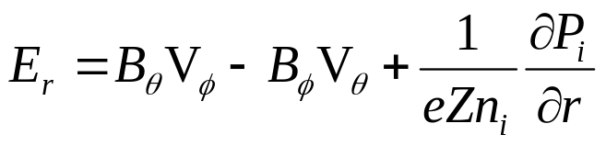
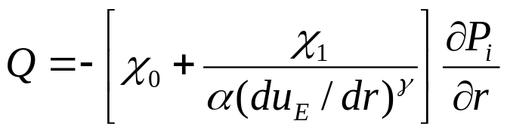
Bifurcation due to flows
A nice picture of the bifurcation of transport due to flows was given by Hinton and Staebler (Phys. Fluids B5, 1282 (1993)) :
Radial electric field
(4)
Energy flow:
(5)
Here a large part of the flow can be reduced by flowshear. In the neoclassical case considered by Hinton and Staebler, the pressure gradient dominates in (1a) but in our case it is the poloidal rotastion which also incleases with the pressure gradient as seen in (1b)

Slide 12
Bifurcation cont
This will lead to the same type of bifurcation as found by Hinton and Staebler both for the edge and internal barriers.
Of course the present model applies to quasistationary situations where a broad spectrum is involved. In our simulations the excitation of zonal flows has been essential both for ETB’s and ITB’s. Several authors have studied this analytically with low dimensional systems (Chen, Lin and White, Phys. Plasmas 7, 3129 (2000), Guzdar, Kleva, Das and Kaw, PRL 87, 015001 (2001), Singh, Tangri, Kaw and Guzdar, Physics of Plasmas 12, 092307 (2005)). While such systems will eventually develop into turbulent systems, they may well describe an initial onset of a transition. For phase mixed situations we may use the inverse modenumber of the fastest growing mode as correlation length (Weiland, Nordman Proc Varenna-Lausanne Joint Workshop, Chexbres 1988 p 451, Nordman, Weiland Nuclear Fusion 29, 251 (1989)).

Slide 13
What determines the slope of the Edge barrier?
In the edge pedestal electromagnetic effects become important. In this case we need a somewhat longer correlation length. This is actually accomplished by our parameter dependent correlation length according to Weiland and Holod (Phys Plasmas 12, 012505 (2005)) leading to k_{θ} ρ ~0.1 (rather than 0.3 in the core). The main destabilizing mechanism in the model for strong pressure gradients is the kinetic ballooning mode. However for large poloidal B also the peeling (kink) mode is important.
The height of the barrier increases with B_{p}. However, this is due to increased slope. Thus β_{p} is almost unchanged! It appears that a stronger B allows a steeper temperature gradient as expected from a β limit. However the width of the barrier is unchanged.

Slide 14
The poloidal spinup is due to nonlocal effects (pileup) both for the internal and edge barriers
For stabilization of the relevant instabilities it is the temperature length scale that is important for bifurcation.
At the edge the outer temperature is kept low by the boundary condition and increased heating diectly leads to a reduced temperature lengthscale
In the core the temperature and temperature gradient can increase together keeping the same length scale. Thus we need something more, like small magnetic shear to cause the initial local reduction of transport.

Slide 15
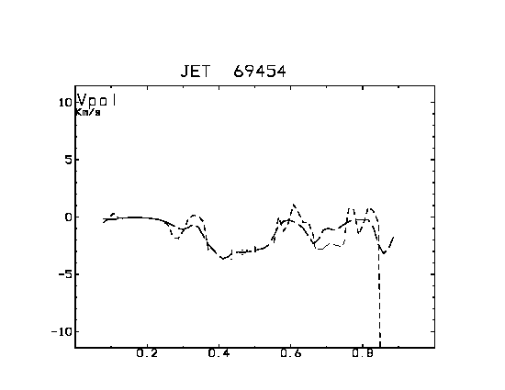
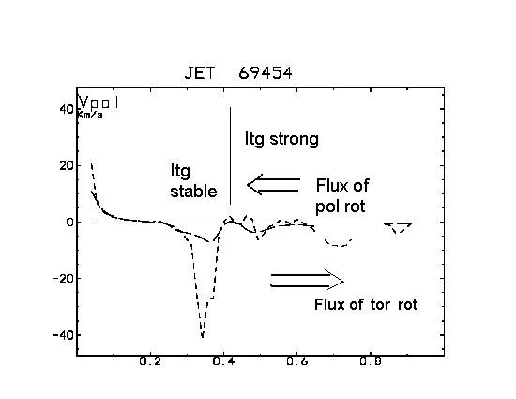
Similarities between Transport barriers in Core and Edge
Electromagnetic – Nonlocal simulations
Fig 6
ITB ETB
Fig 5
J. Weiland et. al EPS Dublin 2010 J. Weiland TTG Cordoba 2010 Strong poloidal spinup both in internal barrier (ITB) and in edge barrier (ETB). Both electromagnetic and nonlocal effects needed for the internal barrier. For the edge barrier we also need nonlocal effects but electromagnetic effects reduce the barrier.

Slide 16
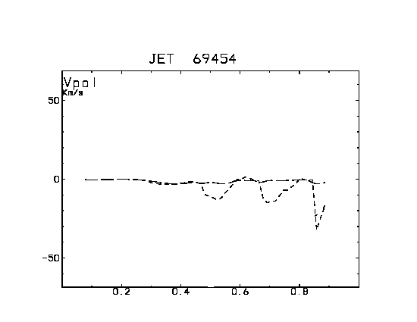
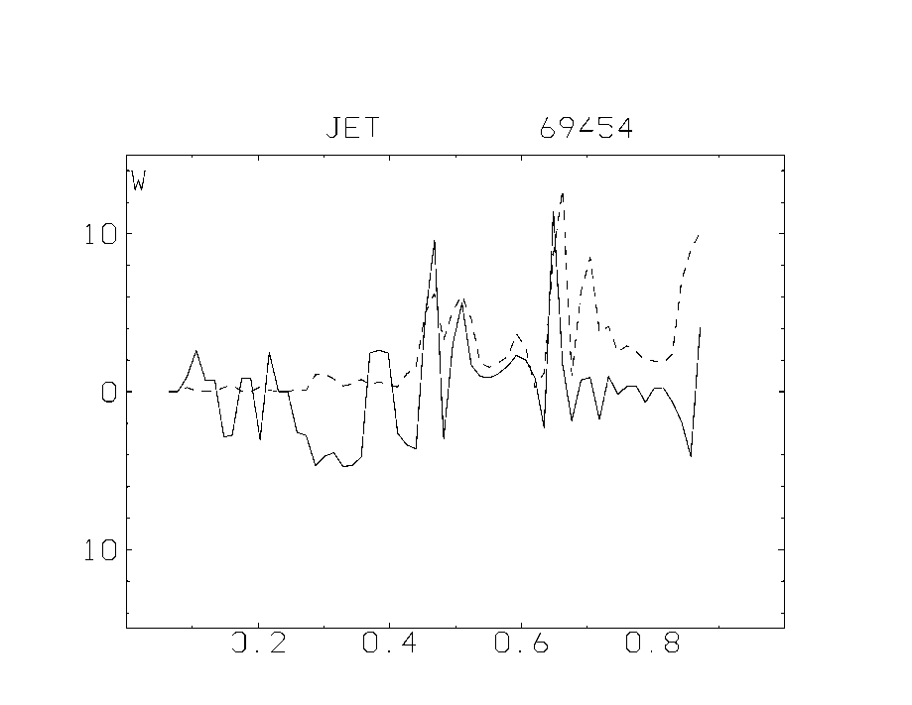
Mechanism of poloidal spinup
Fig 7
Poloidal rotation
Fig 8
Eigenvalue most unstable mode

Slide 17
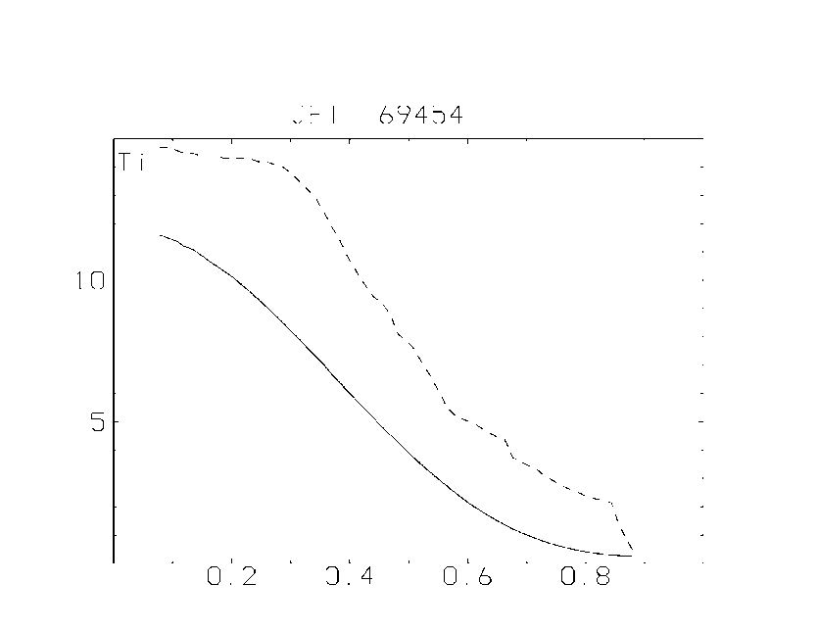
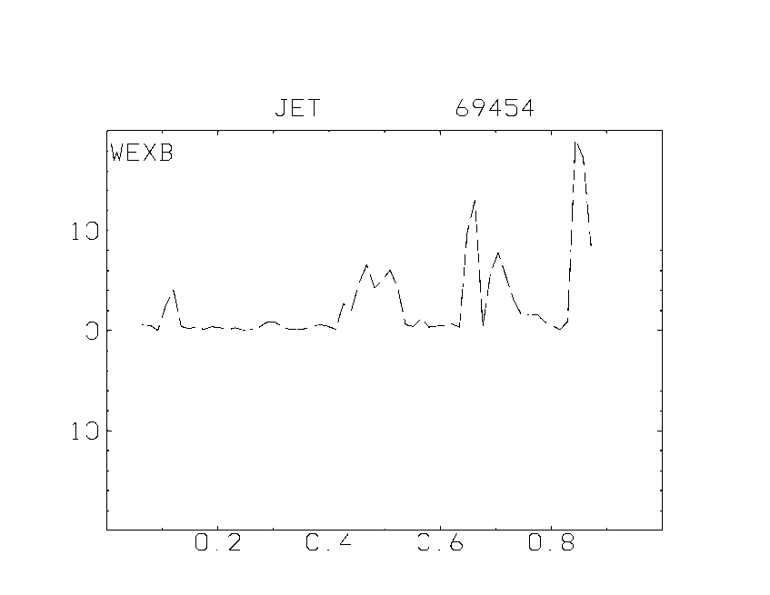
Flowshear
Fig 9a,b
Ion temperature and Flowshear profiles showing why we get stabilization at the edge. Note that this was obtained self-consistently in a global simulation The flowshear is driven primarily by the poloidal nonlinear spinup of rotation. Careful study of simulation data shows that a mode propagating in the electron drift direction is unstable at the edge point and at the first point inside the edge.

Slide 18
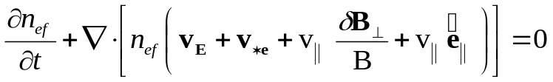

Peeling
Preliminary simulations have also been made with the inclusion of a kink term (peeling)
Fig 10. This case corresponds to Fig 4, i.e. 50% increase in B_{p} . As seen also without peeling, a mode rotating in the electron drift direction gets unstable at the outer end of the barrier. This trend gets stronger when peeling is included.

Slide 19
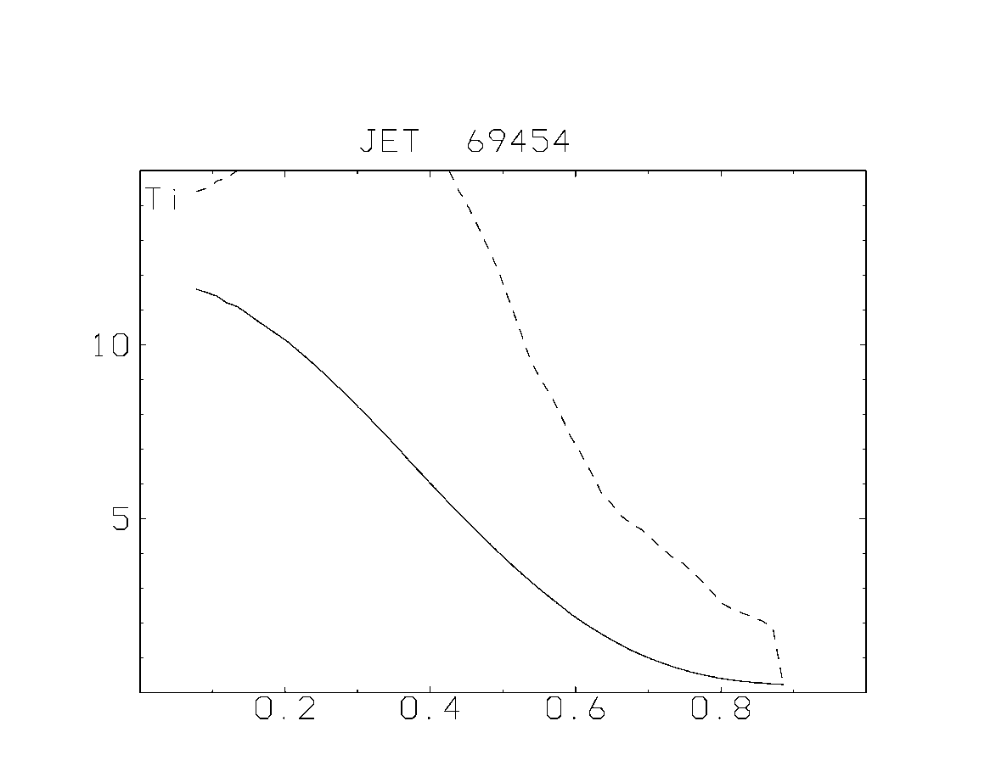
Reduced edge density
Fig 12. This case has 9% increase in B_{p} but edge density reduced to 0.28

Slide 20
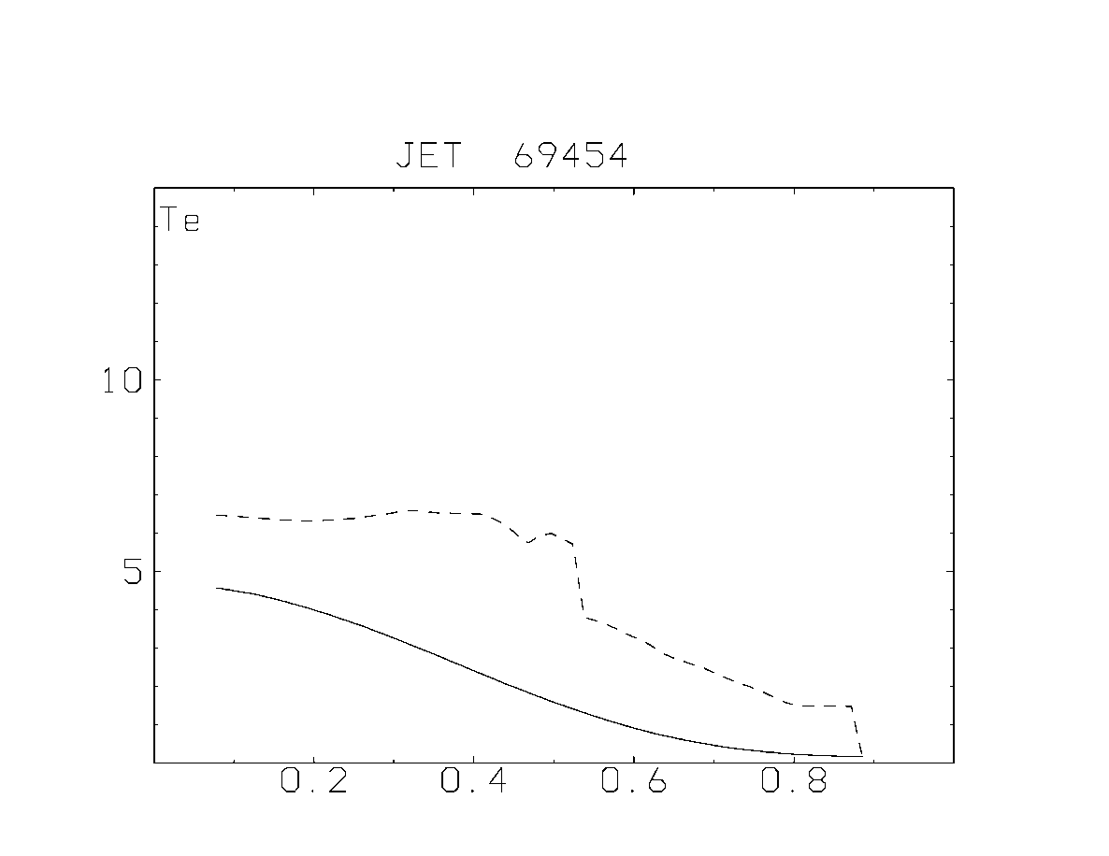
Electron temperature pedestal
Fig 13. This case has 9% increase in B_{p} but edge density reduced to 0.28

Slide 21
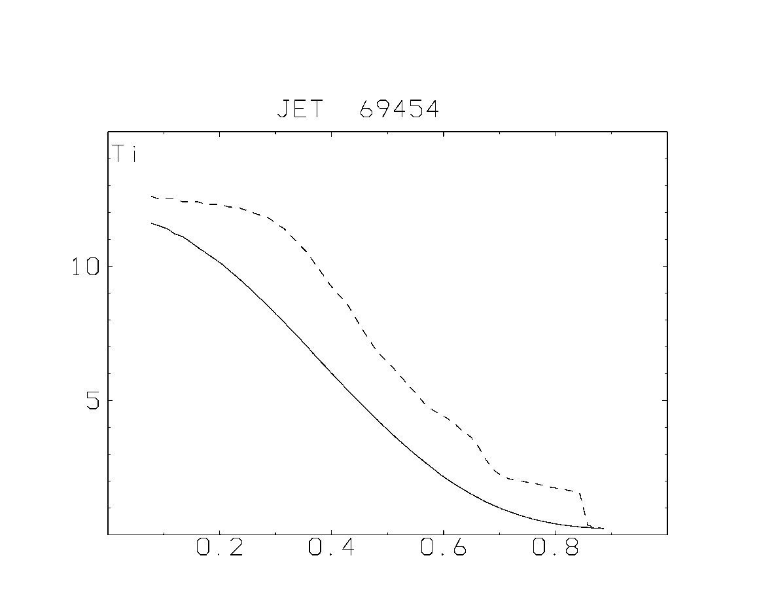
Peeling
Peeling tends to create a shelf with smaller slope at the outer edge of the barrier while the remaining barrier gets steeper
Fig 14. This case has 50% increase in B_{p} and experimental edge density

Slide 22
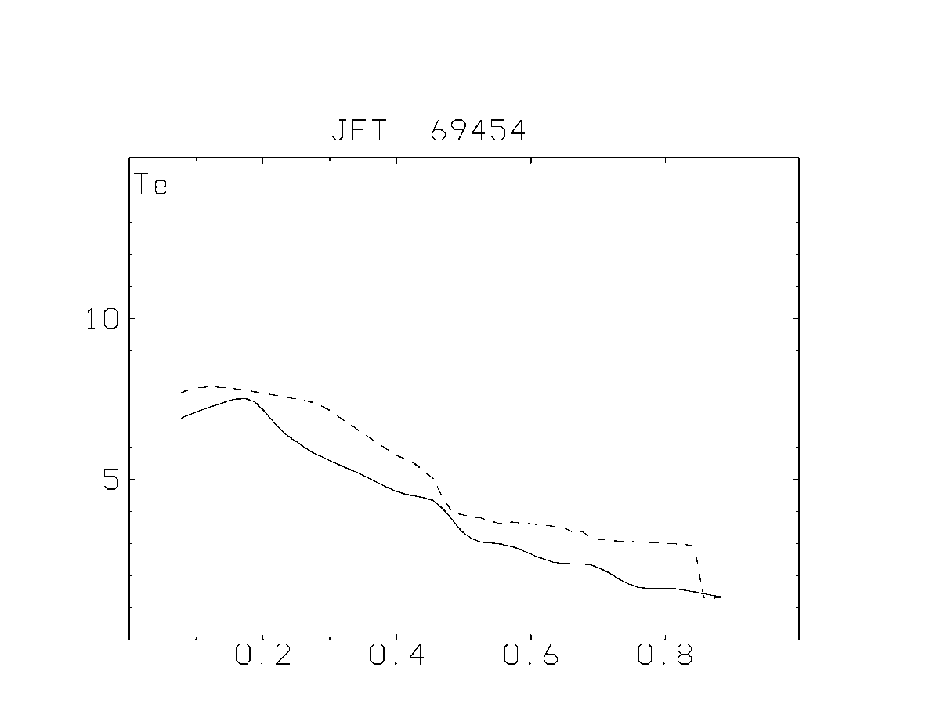
Peeling cont, Electron temp
Fig 15. The same case as in Fig 14 but for electron temperature. The electron edge temperature has been reduced as compared to experiment but we can see the similar interior structure. Again we have the peeling shelf

Slide 23
Discussion
We have here applied a transport code for both ITB’s and ETB’s. The principle justifying this is the same as for core transport, i.e. in a phase mixed situation we can use the correlation length corresponding to the inverse mode number of the fastest growing mode. This means that in a phase mixed situation with a broad spectrum, the sidebands studied in low dimensional nonlinear systems will be part of the broadband turbulence giving the correlation length as the inverse modenumber of the fastest growing mode. As it turns out, nonlocal and electromagnetic effects are important for both ITB and ETB just as in turbulence simulations.
In the broadband, phase mixed situation we can use the model of Hinton and Staebler (Phys. Fluids B5, 1281 (1993)) modified to dominating poloidal flow, to describe the bifurcation.

Slide 24
Summary
Previous results on the formation of an internal transport barrier have been extended to include also the edge barrier. Electromagnetic and nonlocal effects play dominant roles in both cases.
The turbulent spinup of poloidal rotation is instrumental for both transitions.
Our parameter dependent correlation length gives a realistic description of turbulence also in the edge barrier.
The peeling mechanism leads to further excitation of an electron mode close to the outer boundary.

Slide 25
Summary cont
We note the increase in the pedestal for reduced edge density
Peeling (Kink term) may generate a shelf with reduced slope in the outer part of the edge barrier. This seems to happen mainly for large poloidal B and high density .
We have here included collisions on both trapped and free electrons. Collisions on free electrons can trigger an L-H transition by reducing the growthrate but seem to make rather little difference in H- mode.

Slide 26
Planned work
• To continue the study of momentum transport using our transport code.
• To simulate the formation of internal and edge transport barriers in the same simulation.
• To simulate hybrid shots
• To continue to investigate the combined effects of magnetic shear and flowshear on the correlation length and stiffness.
• To continue the development of a fluid global 3d turbulence code and to compare results with gyrokinetic theory and our transport code.
• I am right now writing a new book for Springer. I plan to also include ITER simulations in that and I have already discussed this with Tom Casper in the ITER team. Thus this will probably be a joint effort with the ITER team. However, this may also trigger work in China.

