Slide 1
The reactive advanced fluid transport model (Weiland model), background, achievements, present state
Jan Weiland^{1,2}
1.Chalmers University of Technoloy and EURATOM_VR Association, S-41296 Göteborg, Sweden
2. Presently guest professor at ASIPP, Hefei, China
Seminar at ASIPP, March 16, 2012

Slide 2
Outline
The state of transport research towards the end of the 1980’s
The problem of treating plasmas with ω ≈ ω_{D} (magnetic drift, toroidal)
The drift wave problem of radially decreasing transport
coefficients
The problem of the need for a particle pinch (gas puffing at the edge
gave peaked density profiles)
The problem of describing H-modes with drift wave models
All these problems turned out to be direct consequences of the first!
These problems were addressed at the end of the 1980’s

Slide 3
Outline cont
The development of advanced fluid models for ω ≈ ω_{D}
Of course this problem requires a more accurate treatment of the closure problem for fluid models or a kinetic model. However, the kinetic model is required to be nonlinear and this leads to long computation times!
The main achievements were
Radially growing transport coefficients in L-mode
The inclusion of the flat density regime, Stability parameter R/L_{T} (includes H-mode)
Strong particle pinch but also possibility for heat pinch
The description of the Kinetic ballooning mode in fluid theory

Slide 4
Early transport research
Transport is so fundamental for fusion mashines that it has been studied intensively since the beginning of the fusion research i.e. beginning of 1950’s.
In the 1960’s Bohm diffusion in multipole mashines was so large that many were pessimistic about the achievement of nuclear fusion. However, the introduction of magnetic shear reduced transport by several orders of magnitude.
Still neoclassical transport in stellarators (Princeton) was so large that fusion research was still in trouble. Then, in the USSR the tokamak was considerably better than stellarators at that time. Fusion research was declassified in 1958 and then tokamaks slowly spread to the western world.
Originally there was only Ohmic heating. Then the ion heat transport was often approximated as neoclassical but sometimes with an enhancement factor up to 3. However electron transport was turbulent, often about a factor 100 above neoclassical.

Slide 5
The history of transport research
In 1979 there was a breakthrough on Neutral Beam Heating on PLT in Princeton where a temperature of about 6 Kev was reached. Ohmic heating gave only around 1 Kev. With temperatures of this magnitude it became clear that also ion energy transport was turbulent.
A strong candidate for this was from the beginning the Ion Temperature Gradient driven drift mode (ITG). It was discovered in its slab version already in 1961 by Rudakov and Sagdeev (Soviet Phys. Dokl. 6, 415 1961) . The toroidal branch actually follows from the general formulation for trapped particle modes by C.S. Liu (Phys fluids 12, 1489 1969). At this time electron transport , as the dominant energy transport, was usually described by the neo-Alcator scaling.
τ_{E} ≈ n a²
This scaling was approximated by the theory of collision dominated trapped electron modes where the growthrate is prop. to 1/ν_{ef} thus giving a growthrate decreasing with n due to the n dependence of ν_{ef} . Now this scaling was found to saturate at a certain density and the remaining turbulent transport was attributed to ion temperature gradient driven drift waves (Romanelli, Tang, White Nucl. Fusion 26,1515 1986)

Slide 6
The state of transport research towards the end of the 1980’s.
We now recall our initial outline. Towards the end of the 1980’s very serious problems remained in transport research
The problem of treating plasmas with ω ≈ ω_{D} (magnetic drift, toroidal)
The drift wave problem of radially decreasing transport coefficients
The problem of the need for a particle pinch (gas puffing at the edge
gave peaked density profiles) (see Wagner and Stroth PPCF 35, 1321 1993)
The problem of describing H-modes with drift wave models
All these problems turned out to be direct consequences of the first!
Since a proper discussion of these points goes back to the fluid closure for an understanding (computation can now often be done kinetically) we will first make brief discussions of the main points.

Slide 7
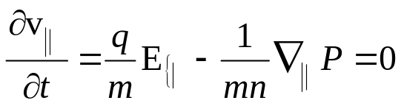
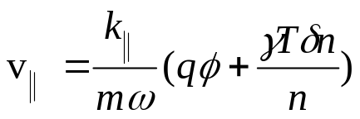
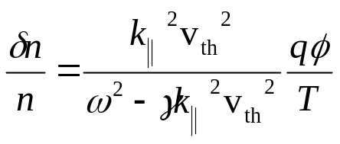
Problems at the end of the 1980’s, main points
Parallel and perpendicular resonances: You are probably most familiar with the unmagnetized or parallel fluid resonance
(1)
Harmonic variation in time and space and δp =γTδn electrostatically lead to
The continuity equation then gives
(2)
We notice that Eq (2) contains the fluid resonance. It gives the Boltzmann distribution in the low frequency, isothermal limit where γ =1 and the
thermal correction from the pressure term in the adiabatic, high frequency limit.

Slide 8
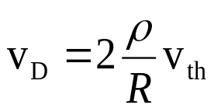

The perpendicular fluid resonance
For the perpendicular fluid motion the magnetic drift plays the same role as the thermal velocity in the unmagnetized case
(3)
Here the factor 2 is due to the summation of gradB and curvature drifts. The perpendicular fluid resonance has the form:
(4)
Where Г = 5/3. In the ion density response enters also a factor ω – ω_{Di} . Thus the
perpendicular ion fluid resonance is similar to the parallel. However, the parallel gives
a larger difference to linear kinetic theory.

Slide 9
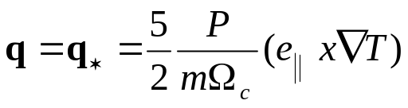
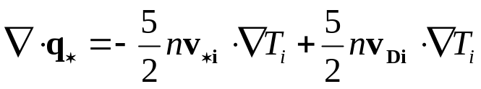
The advanced reactive fluid model
The first requirement in an attempt to include the perpendicular fluid resonance was to make the model nonadiabatic. In the end of the 1980’s this has hardly been done at all. (with advanced fluid model we mean a fluid model that attempts to include the fluid resonance accurately).
The perpendicular fluid resonance was included in our model by including the diamagnetic heatflow
(5)
Its divergence has both a convective diamagnetic part and a curvature part
(6)
The convective diamagnetic part cancels with other convective diamagnetic parts in the energy equation so we are left with the curvature part. This is what gives us the perpendicular fluid resonance.

Slide 10
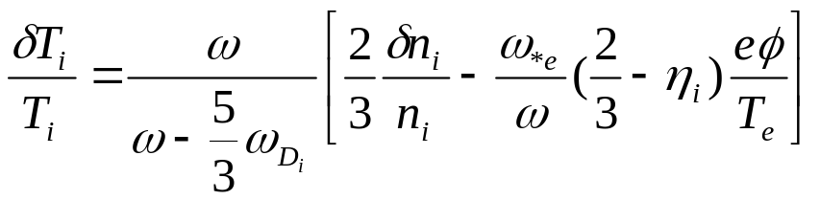
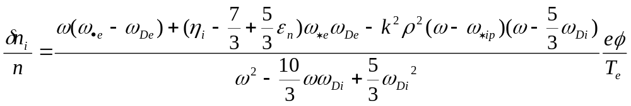
The advanced reactive fluid model
Including only reactive parts of the energy equation (no dissipation) We then obtain
(6)
Which includes the isothermal limit for large ω_{D} . The corresponding ion density response is:
(7)
which gives the Boltzmann response -eφ/T_{i} in the isothermal limit.

Slide 11
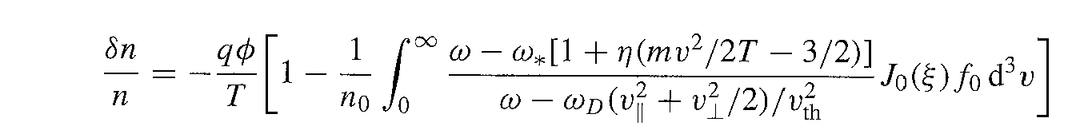
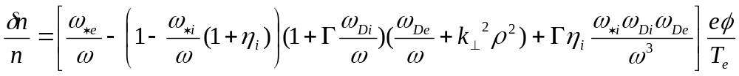
The reactive advanced fluid model
Although our primary aim has not been to describe linear kinetic theory some comparisons are interesting. We start by giving the 2d gyrokinetic response:
(8)
Here (7) includes FLR effects only up to k²ρ² so for comparison we expand the Besselfunction in(8) to the same order (this is sufficient for ITG). Expansions of (7) and (8) in ω_{D}/ω up to quadratic terms then both give:
(9)
Here Г=5/3 for (7) and 7/4 for (8). Thus the difference is 5%!

Slide 12
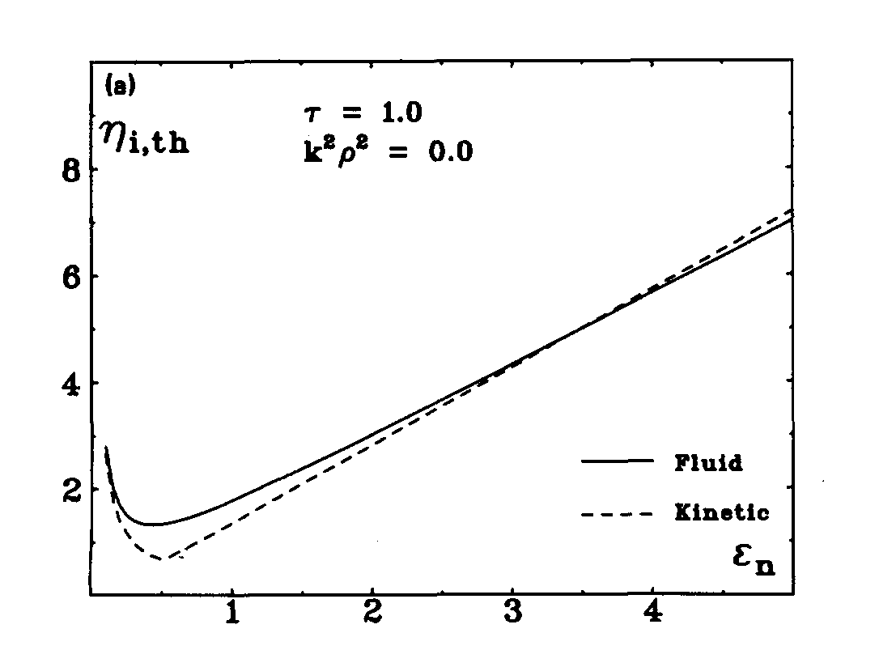
The reactive advanced fluid model
Here we made the expansion just in order to compare the linear kinetic and fluid responsed analytically. It also turns out that the last term is due to the diamagnetic heat flow and is at the same time the first term in this expansion that singles out the dependence of the temperature gradient from the pressure gradient. It also gives rise to the kinetic ballooning mode. For Boltzmann electrons, ITG stability with these descriptions was studied by Nilsson, Liljeström and Weiland, Phys. Fluids B2, 2568 (1990). The stability diagrams in η_{i} ε_{n} = 2/L_{n} /R are compared in Fig 1.
Fig 1, Stability diagram in η_{i,} ε_{n} for the kinetic (dotted) and our fluid model (full)

Slide 13
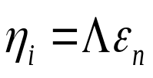
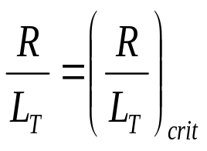
The reactive advanced fluid model
The asymptotic slopes for large ε_{n} differ by only 5%. The asymptotes correspond to the ”Flat density regime” where the terms quadratic in ε_{n} stabilize the mode. Since the driving term is linear in ε_{n} the condition then takes the form
Clearly L_{n} cancels out here and we obtain a threshold of the form
(10)
This type of condition is valid in the flat density regime. Here typically ω/ω_{D} ≈2
The flat density regime is particularly dominant in H-mode but usually includes most of L-modes as well. Models linear in ω_{D} are usually valid only in the outer 20% of tokamaks.

Slide 14


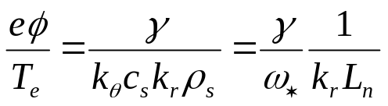
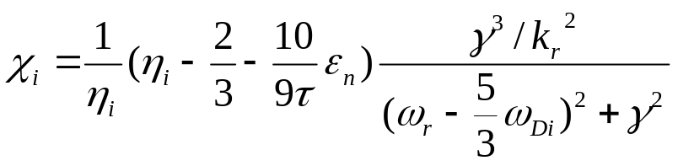
Transport
In order to calculate the transport we first need to estimate the saturation level. We do that by balancing the linear growthrate with ExB convection
(11)
Using Boltzmann electrons and the energy equation (6) we then obtain
(12)
This was first derived in J. Weiland and H. Nordman, Proc. Varenna Lausanne Workshop Chexbres 1988 page 451. Later a transition probability approach gave the same type
of frequency dependent (non Markovian) diagonal part (Zagorodny and Weiland Phys. Plasmas 6, 2359 (1999))

Slide 15
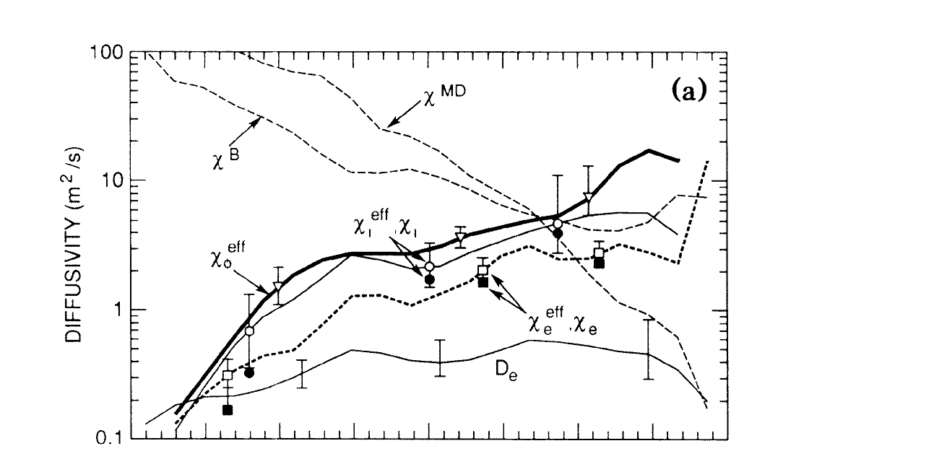
Radial variation of diffusivities
12a Experimentally determined particle diffusivity, effective momentum and diffusivities for a TFTR discharge. The solid symbols on the curves for χ_{i}^{eff} and χ_{e}^{eff} show the corresponding values of χ_{i} and χ_{e} (χ_{φ}^{eff} = χ_{φ} within ~10%). Also shown are the theoretical χ_{φ} (=χ_{i}) from Mattor and Diamond (Phys. Fluids 31, 1180 (1988)) (labeled χ^{MD} ) and the χ_{i} from the toroidal η_{i} analysis of Biglari, Diamond and Rosenbluth (Phys. Fluids B1, 109, (1989)) (labeled χ^{B}). (Reprinted figure from S.D. Scott et. al. Phys. Rev. Lett 64, 531 (1990), Fig 2, with the permission of the American Physical Society (copyright 2008) and S.D. Scott). http://prola.aps.org/abstract/PRL/v64/i5/p531_1 .
In (12) all magnetic curvature effects are due to the diamagnetic heatflow. Since ε_{n} is large towards the axis (L_{n} goes to infinity) we conclude that transport will be reduced towards the axis, i.e. a trend for the transport to grow towards the edge. This had been a problem to achieve for drift wave models for many years. One example is shown in Fig 2.
Fig 2 Experimentally determined particle diffusivity, effective momentum and diffusivities for a TFTR discharge. The solid symbols on the curves for χ_{i}^{eff} and χ_{e}^{eff} show the corresponding values of χ_{i} and χ_{e} (χ_{φ}^{eff} = χ_{φ} within ~10%). Also shown are the theoretical χ_{φ} (=χ_{i}) from Mattor and Diamond (Phys. Fluids 31, 1180 (1988)) (labeled χ^{MD} ) and the χ_{i} from the toroidal η_{i} analysis of Biglari, Diamond and Rosenbluth (Phys. Fluids B1, 109, (1989)) (labeled χ^{B}). (Reprinted figure from S.D. Scott et. al. Phys. Rev. Lett 64, 531 (1990), Fig 2)

Slide 16
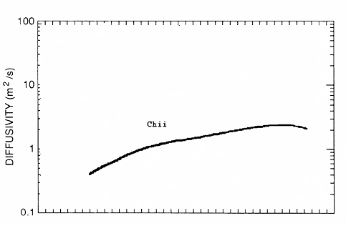
Radial variation of diffusivities
The result for χ_{i} for the same shot with our model, including also electron trapping is shown in Fig 3
Fig 3 Radial variation of χ_{i} for the case in Fig 3 with the model derived in
J. Weiland, A. Jarmén and H. Nordman in Nuclear Fusion 29, 1810 (1989).
This model is from 1989. The first US model with this property was the IFS-PPPL model from 1994

Slide 17
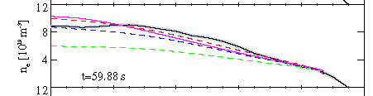


Particle pinch
The model from 1989 also gave a strong particle pinch. An example is shown in L. Garzotti et al. Nuclear Fusion 43, 1829 (2003).
Fig 5 Simulation of JET L-mode 49030 by Garzotti et.al. NF 43, 1829 (2003). Black line is experimental (Lidar)
Full pink line is Weiland
Dotted pink line is Mixed Bohm-Gyrobohm with part added
Dotted green line is Mixed Bohm-Gyrobohm with part added
The particle pinch also played an important role in the simulation of the heat pinch on DIII-D 1993 (Weiland, Nordman Phys Fluids B5 1669 (1993)). Experimental results on the levitated dipole at MIT also show a strong particle pinch (A.C. Boxer et al. Nature Physics 6, 207 (2010)) These results were interpreted in terms of our model (J. Weiland, Nature Physics 6, 168 (2010))

Slide 18
Confinement in H-mode
The main characteristic property of H-modes for drift wave modelling is the flat density pofile. As seen by Fig 1 our model is in good agreement with kinetic theory in the linear regime. We will return to the nonlinear regime in connection with the fluid closure. The presence of both L and H mode equilibria in the model was shown already in the first transport simulation (J. Weiland and H. Nordman, Nuclear Fusion 31, 390 (1991)). Recently simulations of the L-H transition have confirmed this
(J. Weiland et. al., AIP proceedings 1392, 85 (2011)).
As pointed out in the beginning all these features go back to the fluid closure, i.e. using an unexpanded fluid density response including both adiabatic and isothermal limits.

Slide 19
Fluid closure
We consider steady state in a tokamak where sources are needed to maintain all moments
We discuss Fluid closure on the confinement timescale in tokamaks and compare with the turbulence timescale
Our problem may thus be divided into two parts:
1 To show that high order moments will actually damp out in the absence of sources
2 To show that there will not be sources for higher moments

Slide 20
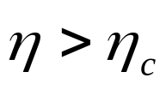
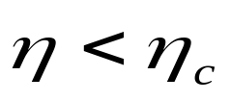
ITG and Trapped electron modes depend on competition between relaxation of density and temperature
As it turns out, competition between relaxation of density and temperature introduce pinch fluxes that are particularly sensitive to dissipative kinetic resonances like Landaudamping. This competition shows already in the simplest stability conditions:
Thermal type
Interchange type

Slide 21
Particle pinches
The strongest pinch observed in tokamaks is the Particle pinch. ( F. Wagner and U. Stroth, Plasma Phys. Controlled Fusion 35, 1321 (1993)).
The first theories of particle pinches were: In a slab plasma with main application to the edge: B. Coppi and C. Spight, Phys. Rev. Lett. 41, 551 (1978).
In a toroidal plasma with main application to the core: J. Weiland, A. Jarme’n and H. Nordman , Nuclear Fusion 29, 1810 (1989).
The particle pinch in the Levitated dipole at MIT was recently discussed in J. Weiland, Nature Physics 6, 167 (2010).

Slide 22
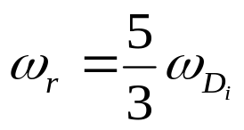

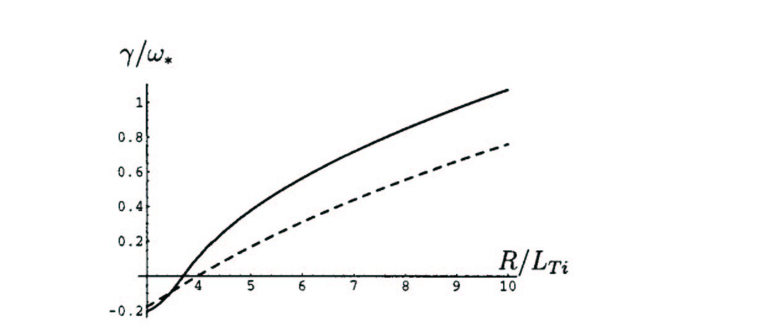
Fluid and kinetic resonances
As it turns out marginal stability of the simple toroidal ITG mode, including parallel ion motion, occurs exactly at the fluid resonance in a fluid picture
Nevertheless the fluid threshold is usually not too far from the kinetic
Fig 6
______ React. Fluid
------------- Fluid with Ld
Fig 6 growthrates the Cyclone basecase (Dimits et. Al. Phys. Plasmas 7, 969 (2000))

Slide 23
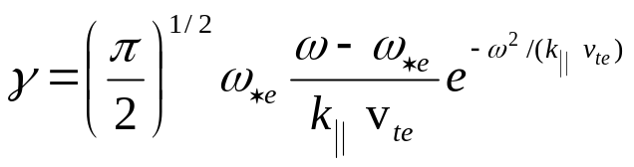
The Coherent limit, the Mattor Parker system
A very useful approach to the fluid closure was suggested by Mattor and Parker (Phys, Rev. Letters 793419 (1997)). They studied a system of two slab ITG modes and a driven zonal flow. However, from the dynamics point of view this was usual three wave interaction.
They derived fluid equations up to the third moment and closed the system with he remaining kinetic integral.
In the kinetic integral they introduced a nonlinear frequency shift.
The effect of this can easily be imagined by looking at the usual Universal instability due to invers Landaudamping
We notice that a nonlinear frequency shift can easily change the sign of the growthrate!

Slide 24
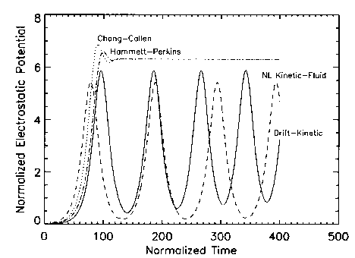
Mattor-Parker nonlinear closure
The same change of wave energy is possible for ITG modes (Mattor and Parker, PRL 79, 1997). Mattor and Parker studied a simple three-wave system of slab ITG modes corresponding to generation of zonal flows by self-interaction.
Nonlinear frequency shift in plasma dispersion function
Nonlinear closure Fig 7
Linear closure Gyro Landau fluid
Drift kinetic
Nonlinear closure
Interaction of three slab ITG modes
Note the significant improvement of the nonlinear closure (Mattor – Parker) over the linear closures (Hammett-Perkins and Chang-Callen)
The main argument against this work has been that it is coherent. However, we will show how to generalize this!

Slide 25
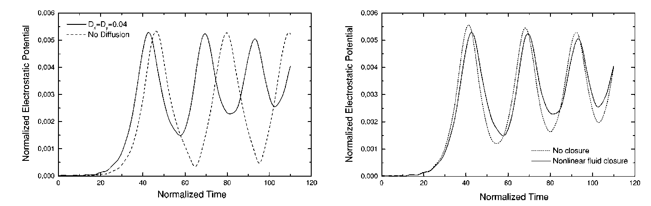
Generalized Mattor Parker system
The Mattor Parker system was later generalized by Holod, Weiland and Zagorodny ,(Phys. Plasmas 9, 1217 (2002)). Here the closure was made at the fifth moment and damping due to background turbulence was included. Thus we have a partially coherent situation
Fig 8
Fig 8This system shows interaction between two slab ITG modes and a Zonal flow where closure is provided by nonlinear frequency shifts inside the Z functio.

Slide 26
Wave particle interaction
The gross oscillations are here due to three wave interaction. However there are superimposed oscillations due to oscillating frequency shifts.
This is shown as the difference between the curves with closure and without closure in the right part.
The kinetic resonance is reducing the amplitude maxima and increasing the minima. Thus on the average it has a very small effect.
This can be seen as a result of the fact that linear kinetic resonances are always accompanied by nonlinear effects that tend to cancel them. We should also remember that the three wave system is a fundamental element in turbulence so we expect this feature to be general.

Slide 27
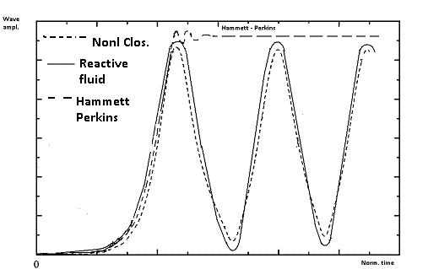
Nonlinear kinetic fluid equations
Fig 9 shows a combination of the Hammett Perkins results and those by Holod et al (partly qualitative but semi quantitative) The interaction is between two slab ITG modes and a zonal flow. We can see how much better the reactive fluid model is than the Hammett-Perkins model!
Fig 9 Development in time of three-wave interaction between two slab ITG modes and a zonal flow with different fluid descriptions including reactive fluid, fluid with nonlinear closure and the Hammett Perkins gyro-Landau fluid model.

Slide 28
Transition to turbulence
The question of the coherent state was actually addressed by Holod et.al. where a diffusion damping was introduced in order to represent the effect of the background turbulence. We also note that the Mattor Parker system includes both quadratic mode coupling terms and qubic nonlinear frequency shifts. This is the same situation as for the turbulent state and, due to self interactions, the turbulent state will also include nonlinear frequency shifts. The effect of diffusion damping was to make the system approach a stationary nonlinear state which appears to be close to the average of the oscillations in the Mattor Parker system. While the Mattor Parker work got good agreement with a fully kinetic system, the work by Holod et al compared with a reactive closure.
It is important to notice that the kinetic resonance is stabilizing at maxima and destabilizing at minima, thus the effect of the kinetic resonance tends to be averaged out. It is clear from the small effect of the closure term that the large scale oscillations, in both systems is due to three wave interaction. We also note, that just as in the fully turbulent case there are both quadratic and cubic nonlinearities present. The quadratic nonlinearities phase mix but the cubic do not.

Slide 29
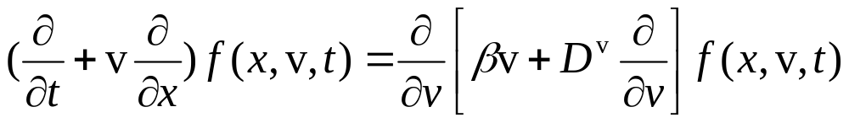
Many wave case, the Fokker Planck equation
In the stochastic limit we can derive a Fokker-Planck equation
Here D^{v} is the turbulent diffusivity in velocity space and β is the turbulent friction coefficient. These will both be due to wave intensities in a turbulent state with random phases. However β (and partly also D^{v} )
contributes a nonlinear frequecy shift which actually reenters correlations into the system.

Slide 30
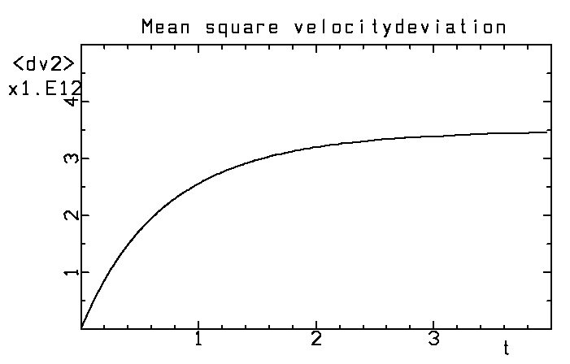
Solution of the Fokker Planck equation
In the case of constant coefficients the Fokker-Planck equation has an exact analytical solution. However numerical solutions in more general cases give qualitatively the same type of solution
The mean square deviation from the initial velocity (velocity dispersion) as a function of time. The initial phase is quasilinear while the saturated phase is due to strong nonlinearity. The transition is at t=1/β.

Slide 31
Transistion between coherent and turbulent states
The asymptotic result <Δv²> = const. means that there is no more an energy transfer between waves and resonant particles.
This result is also due to the Dupree-Weinstock renormalisation.
This state is reached on the order of a confinement time.
We had indications that this would happen also for multiple three-wave system but this is the ultimate proof that the average energy transfer will really vanish. The situation is the same as for trapping in a coherent wave.
We then conclude that a reactive closure will always be possible asymptotically. However, this does not tell us at which order in the fluid hierarchy this will happen. We also need sources to maintain density and temperature.

Slide 32
Sources
We note also that the variational method of Anile and Muscato (Phys Rev B51, 16728 (1995)) gives the same closure for solid state plasmas (collisions do not give a source for the irreducible fourth moment).
In our model we include just the moment with sources in the experiment
The condition to have a Maxwellian source is clearly that fuelling and heating produce such sources.
Heating usually produces non-Maxwellian tails at very high velocities but these very fast particles will have thermalized before getting resonant with the drift waves

Slide 33
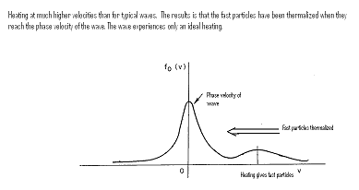
Dynamics of heating
Heating of tokamaks almost always takes place at velocities much higher than the phase velocity of drift waves
Since heating generally occurs at velocities ~10³ higher than the phase velocity of drift waves, it will have time to thermalize before reaching the phase velocity of drift waves

Slide 34
How close to the drift wave phase velocity are perturbations resonant?
One way of testing this is to investigate how sensitive impurity transport is to the fluid closure. The reason is that, as pointed out above, the ITG mode is resonant with the main ions.
Thus means the ITG mode will not be resonant with imputity ions!
Thus we will compare particle transport of main and impurity ions for reactive driftwaves and driftwaves subject to Landau damping.

Slide 35
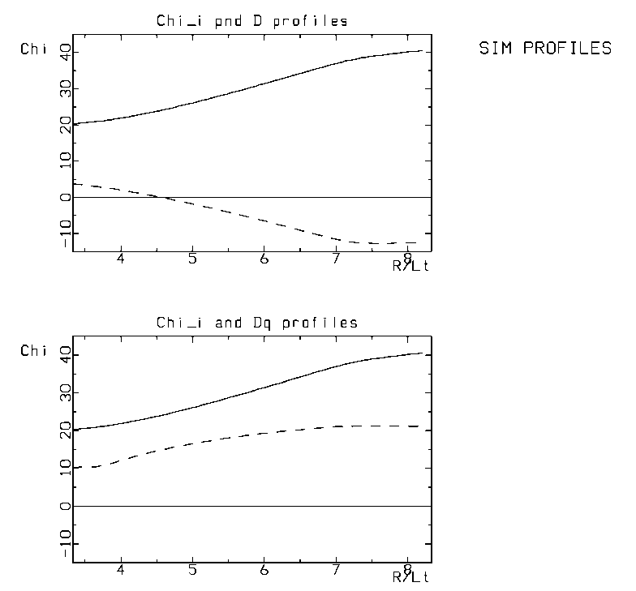
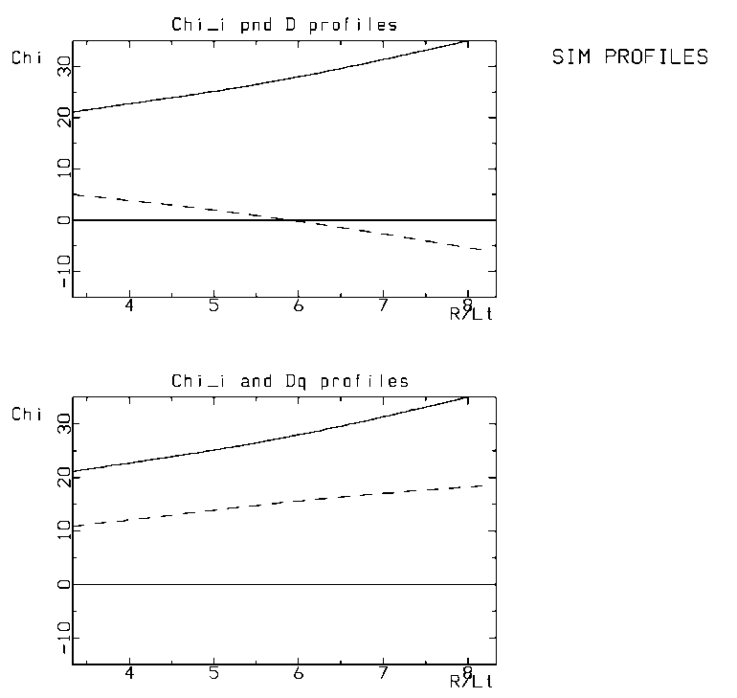


Dependence of pinches on fluid closure
Fig 5
Particle transport as a function of temperature gradient for a reactive fluid model (left) and a fluid model with Landaudamping (right)
The top graphs are for Hydrogen while the bottom graphs are for Coal.
We note that the particle pinch is stronger for the reactive model and that differences are considerably smaller for coal.

Slide 36
Effects of fluid closure on particle pinches
It is well known that dissipation plays a stronger role near marginal stability. This can actually also be seen in the last figure.
The reason is that the system is close to balance between stabilizing and destabilising effects so that smaller effects can play a role.
The same is true when we have a net pinch flux, i.e. we are near a balance between outward and inward fluxes.
It is actually the reactive model that has agreement with experiment (L. Garzotti et. al. Nuclear Fusion 43, 1829 (2003)). This gets even more obvious in a comparison with a quasilinear kinetic model.

Slide 37
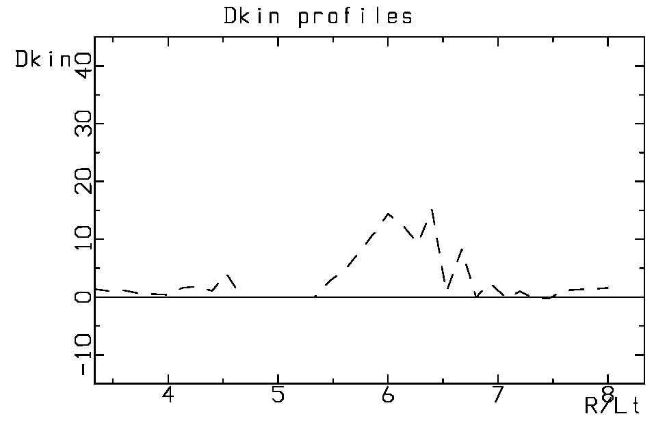
Quasilinear kinetic
Kinetic theory is much more sensitive to strongly nonlinear effects than fluid theory
Fig 6
Quasilinear kinetic calculation of particle diffusivity. Parameters are the same as in Fig 5. Compare also Romanelli and Briguglio, Phys. Fluids B2, 754 (1990). No particle pinch!

Slide 38
Conclusions
A reactive closure including only moments with sources in the experiment has proven very successful both in comparison with experiments and nonlinear (and linear) kinetic modela. We have here given mechanisms which detune wave particle resonances in both coherent and incoherent (turbulent) limits.
A strong indication of the validity of a fluid closure is that a suitable fluid model is vastly superior to quasilinear kinetic models in describing particle pinches
We can also use particle pinches of main ions and impurities to see how important the fluid resonance is (impurity ions are not resonant with the main driftwaves)
.

Slide 39
Conclusions cont.
With only ideal fuelling and heating higher order moments will not have sources and will decay at the latest on the confinement timescale.
This would require nonlinear kinetic codes to be run on the confinement timescale. However we have also given reasons why kinetic resonanses are detuned on a shorter timescale when the turbulence is still strong (coherent limit). However, these are not as rigoirous as those for the confinement timescale.

Slide 40
Conclusions, cont
Toroidal effects are very important for both pinch fluxes and fluid closure.
Pinch fluxes are reversible and are strongest when velocity space is treated in a self-consistent way.

