Slide 1
The heatpinch in DIII-D experiment and simulation
Jan Weiland^{1,2}
1.Chalmers University of Technology and EURATOM_VR Association, S-41296 Göteborg, Sweden
2. Presently guest professor at ASIPP, Hefei, China
Seminar at ASIPP, March 31, 2012

Slide 2
Outline
Experimental setup
Physics model
Reasons for applicability of the 4x4 model
Simulation
Relation between R/L_{ti} and R/L_{te}

Slide 3
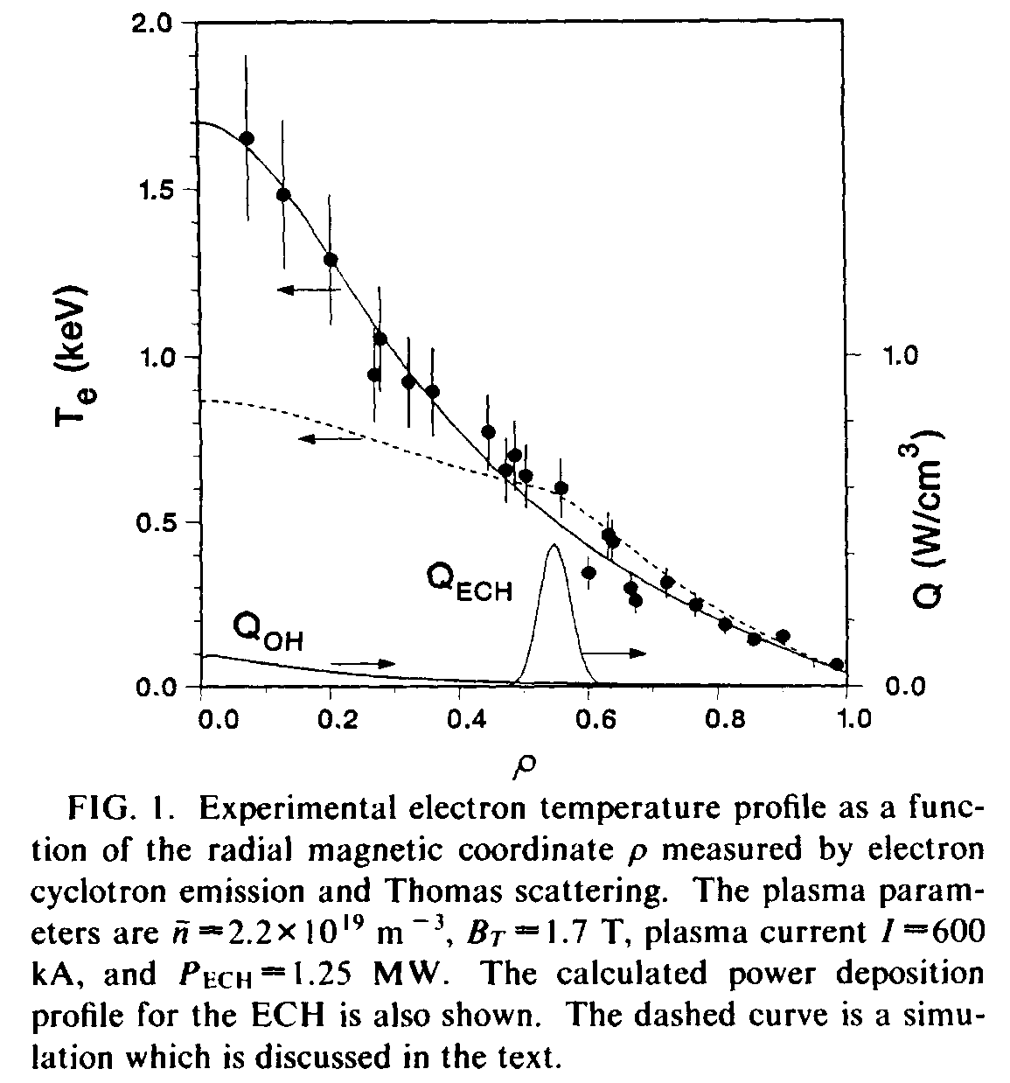
Experimental setup

Slide 4
Exp data
From the PRL and from exp data we recieved much later (sim in 2001) we find
β_{e} = 0.5%
q = 1.25
s = 0.65
in the pinch region
Only electrons were heated externally. This was with ECH heating at ρ=0.5 – 0.6. The power was 1.25 MW. Both ECH and Ohmic heating profiles were given in the PRL.
The only particle source was gas puffing at the edge.

Slide 5
The 4x4 model
The low β means that we can use an electrostatic model. Magnetic shear of order 1 means that the effect of parallel ion motion is small.
This is actually a question of the fluid closure. In Weiland and Hirose Nuclear Fusion 32, 151 (1992) good agreement between the 4x4 model with parallel ion motion and Landaudamping was found with linear kinetic theory for s of order 1. However, a substantially lower threshold was found without Landaudamping. The pure parallel ion motion in the fluid approximation made very little difference to the 4x4 system without Landaudamping.
Now, at this time people using gyro-Landau fluid models told us that parallel ion motion was very important. However, now the same people, running nonlinear gyrokinetic codes, tell us that parallel ion motion (for s of order 1) is not important.
From this we can only conclude that Landaudamping vanishes in the nonlinear regime!
This also motivates using the 4x4 system for the DIII-D heat pinch.
It was also later verified that rotation was small in this shot with only ECH heating

Slide 6
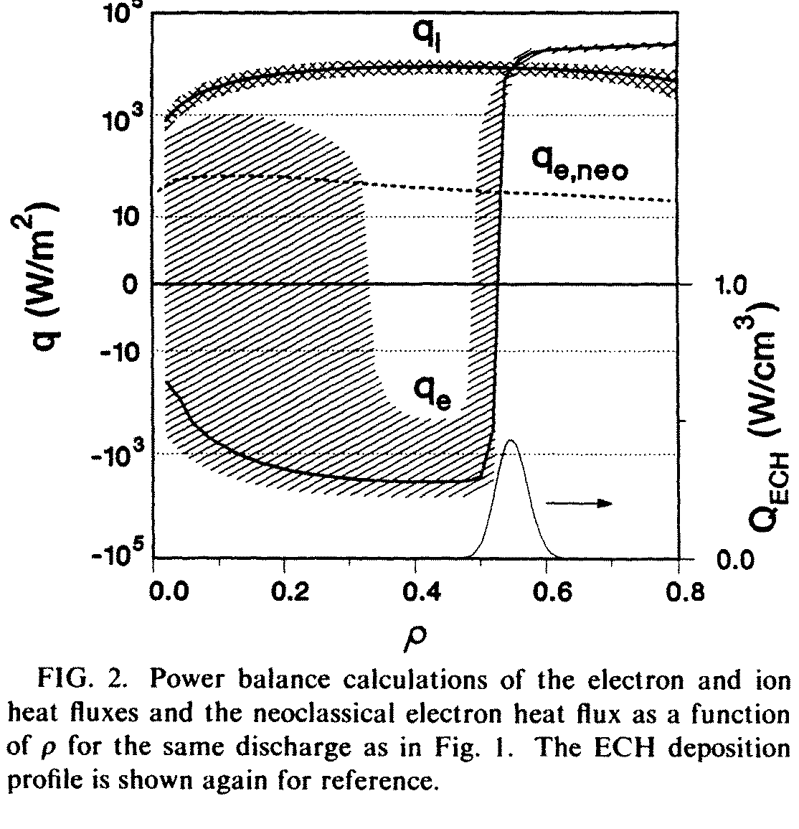
Experimental result
Although the ECH source was far off axis, the electron temperature profile was peaked towards the axis. Power balance required an electron heat pinch!

Slide 7
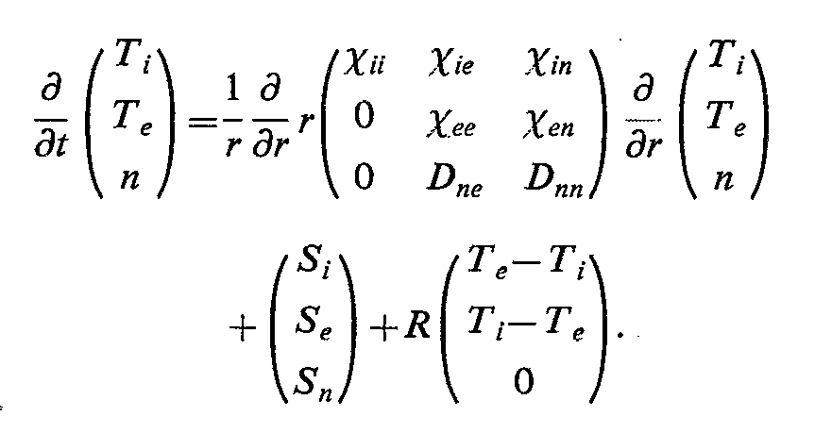

The 4 x 4 system
The transport in the 4x4 system can be written in matrix form as
(1)
The energy flux can be written:
(2)

Slide 8


Simulation of the DIII-D heat pinch
Since the only particle source is at the edge we must have
(3)
In a stationary state. This means that the diagonal and off diagonal parts of the transport balance. Thus the source does not influence the density gradient it is just used to obtain steady state . Then Eq (2) requirees
(4)
The outgoing ion heat flux is here driven by the resistive equilibration term in the energy equation . This acts as a sink for electron energy so an electron heat pinch is needed to maintain steady state. Both temperatures and density were simulated. The density profile was not known so a rather flat initial density was used. The particle source at the edge was used as a free parameter.

Slide 9
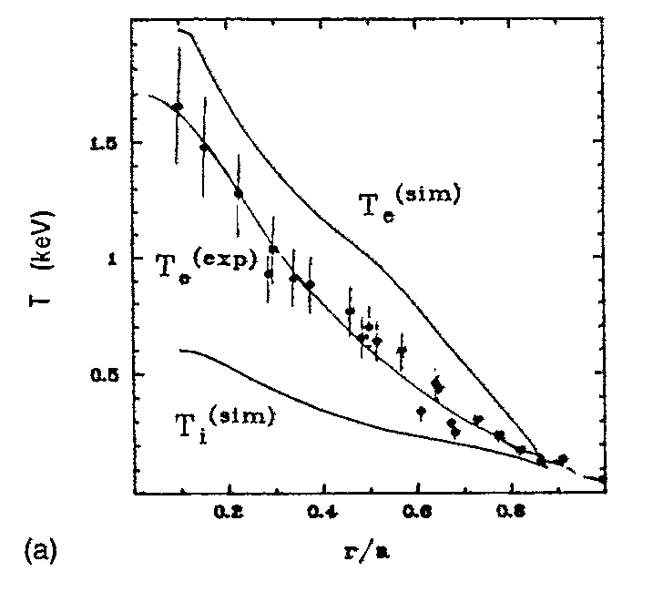
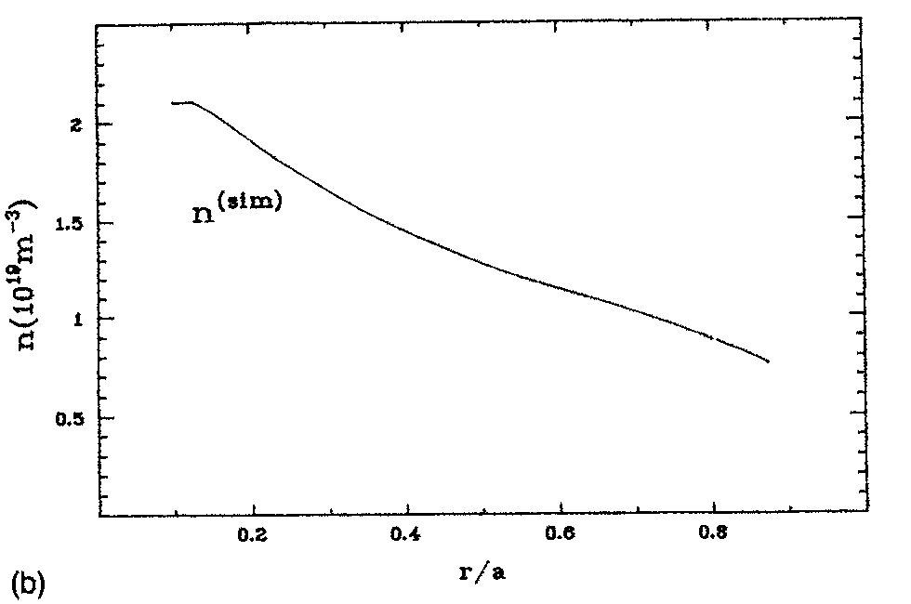
Simulation profiles
The profiles of temperatures , density and heatfluxes are shown in the figures
Fig 3 shows the temperature profiles (a) and density (b). In (a) also the experimental temperature profilke, with error bars, is shown. Thus the simulation slightly over predicts the electron temperature. We notice the slight wiggle on the electron temperature near the source at r/a = 0.55. This is what shows that this result has been obtained with a model using local transport coefficients. The particle source is gas puffing at the edge.

Slide 10
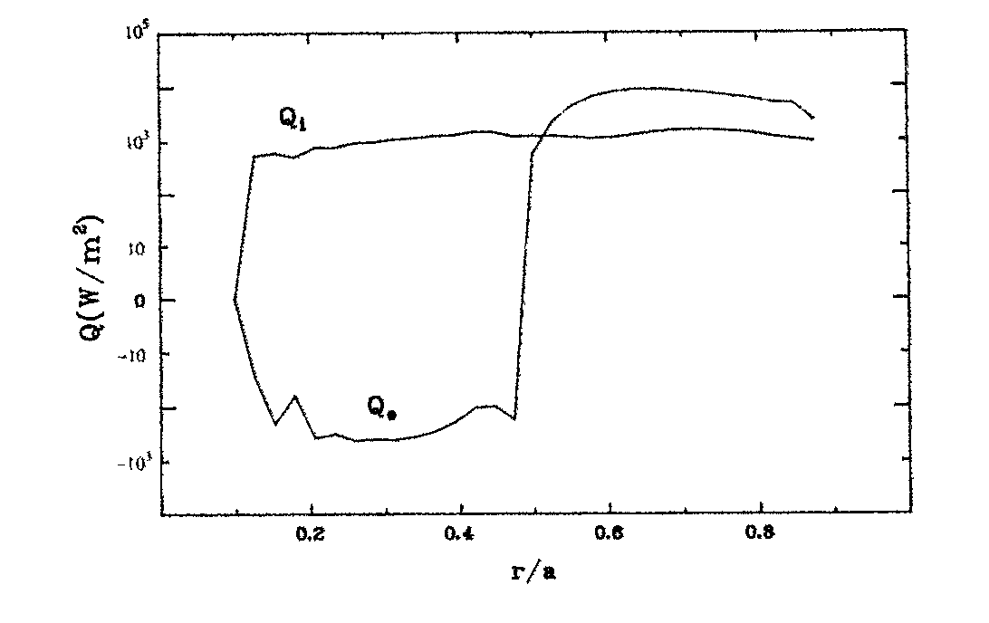
Simulated heatflux
The ion heatflux is outwards. Its only source is heat transfer from electrons. Outside the source both are outwards with higher electron heatflux but inside the source the energy fluxes cancel leaving only a very small total outward energy flux due to Ohmic heating of electrons.
Fig 4. Simulated heat fluxes of ions and electrons:

Slide 11
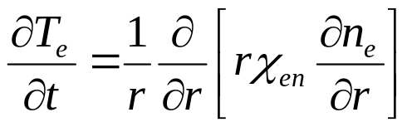
Discussion
The simulation of the DIII-D heat pinch can be divided into two phases.
First the density peakens due to the particle pinch. It reaches steady state when the diagonal and off diagonal transport fluxes balance. This is a built in proberty of the model and is independent of the unknown source due to gas puffing.
Second the electron heat pinch is driven by the density gradient
according to Eq (1). Thus we need a model with both heat and particle pinches

Slide 12
Discussion cont.
The present work was made with only the information in the PRL by the DIII-D group. In particular the density profile in the experiment was unknown until we met with the experimentalists at the APS meeting in Seattle in 1993. We then found out that the density profiles were quite close in the simulation and experiment with the same central density.
As can be seen from the electron temperature profile, there is a slight flattening just inside the source. This gives a rather small η_{e} which is required for the pinch. However the ion heat transport is outward. Thus η_{i} is larger. This is possible also for small T_{i} since it is the lengthscale L_{ti} = - T_{i} /d T_{i} /dr that is important.

Slide 13
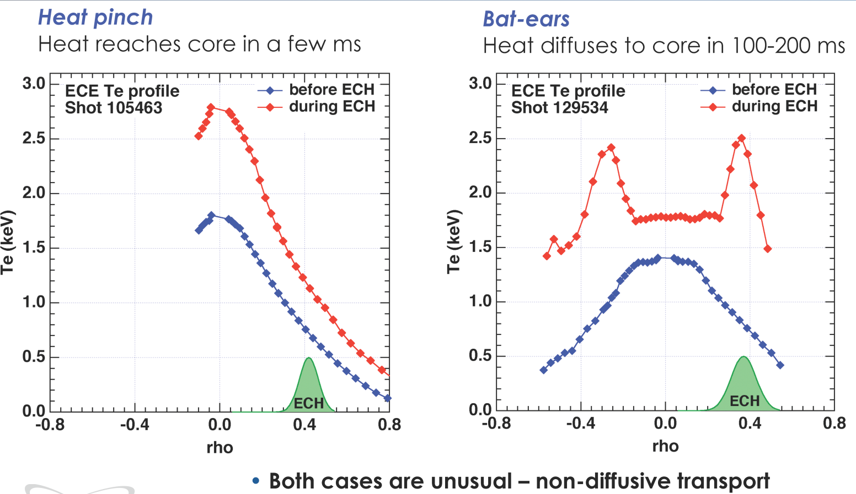
Pinch experiment in H-mode
In 2009 the DIII-D and Austin groups repeated the off axis ECH experiment in H-mode (Austin, Gentle, Petty, Rhodes, Schmitz and Wang, APS, Atlanta 2009).
Due to the flat density profile there was no heat pinch. Instead strong lokal peaking (bat ears) was obtained at the heating location

Slide 14
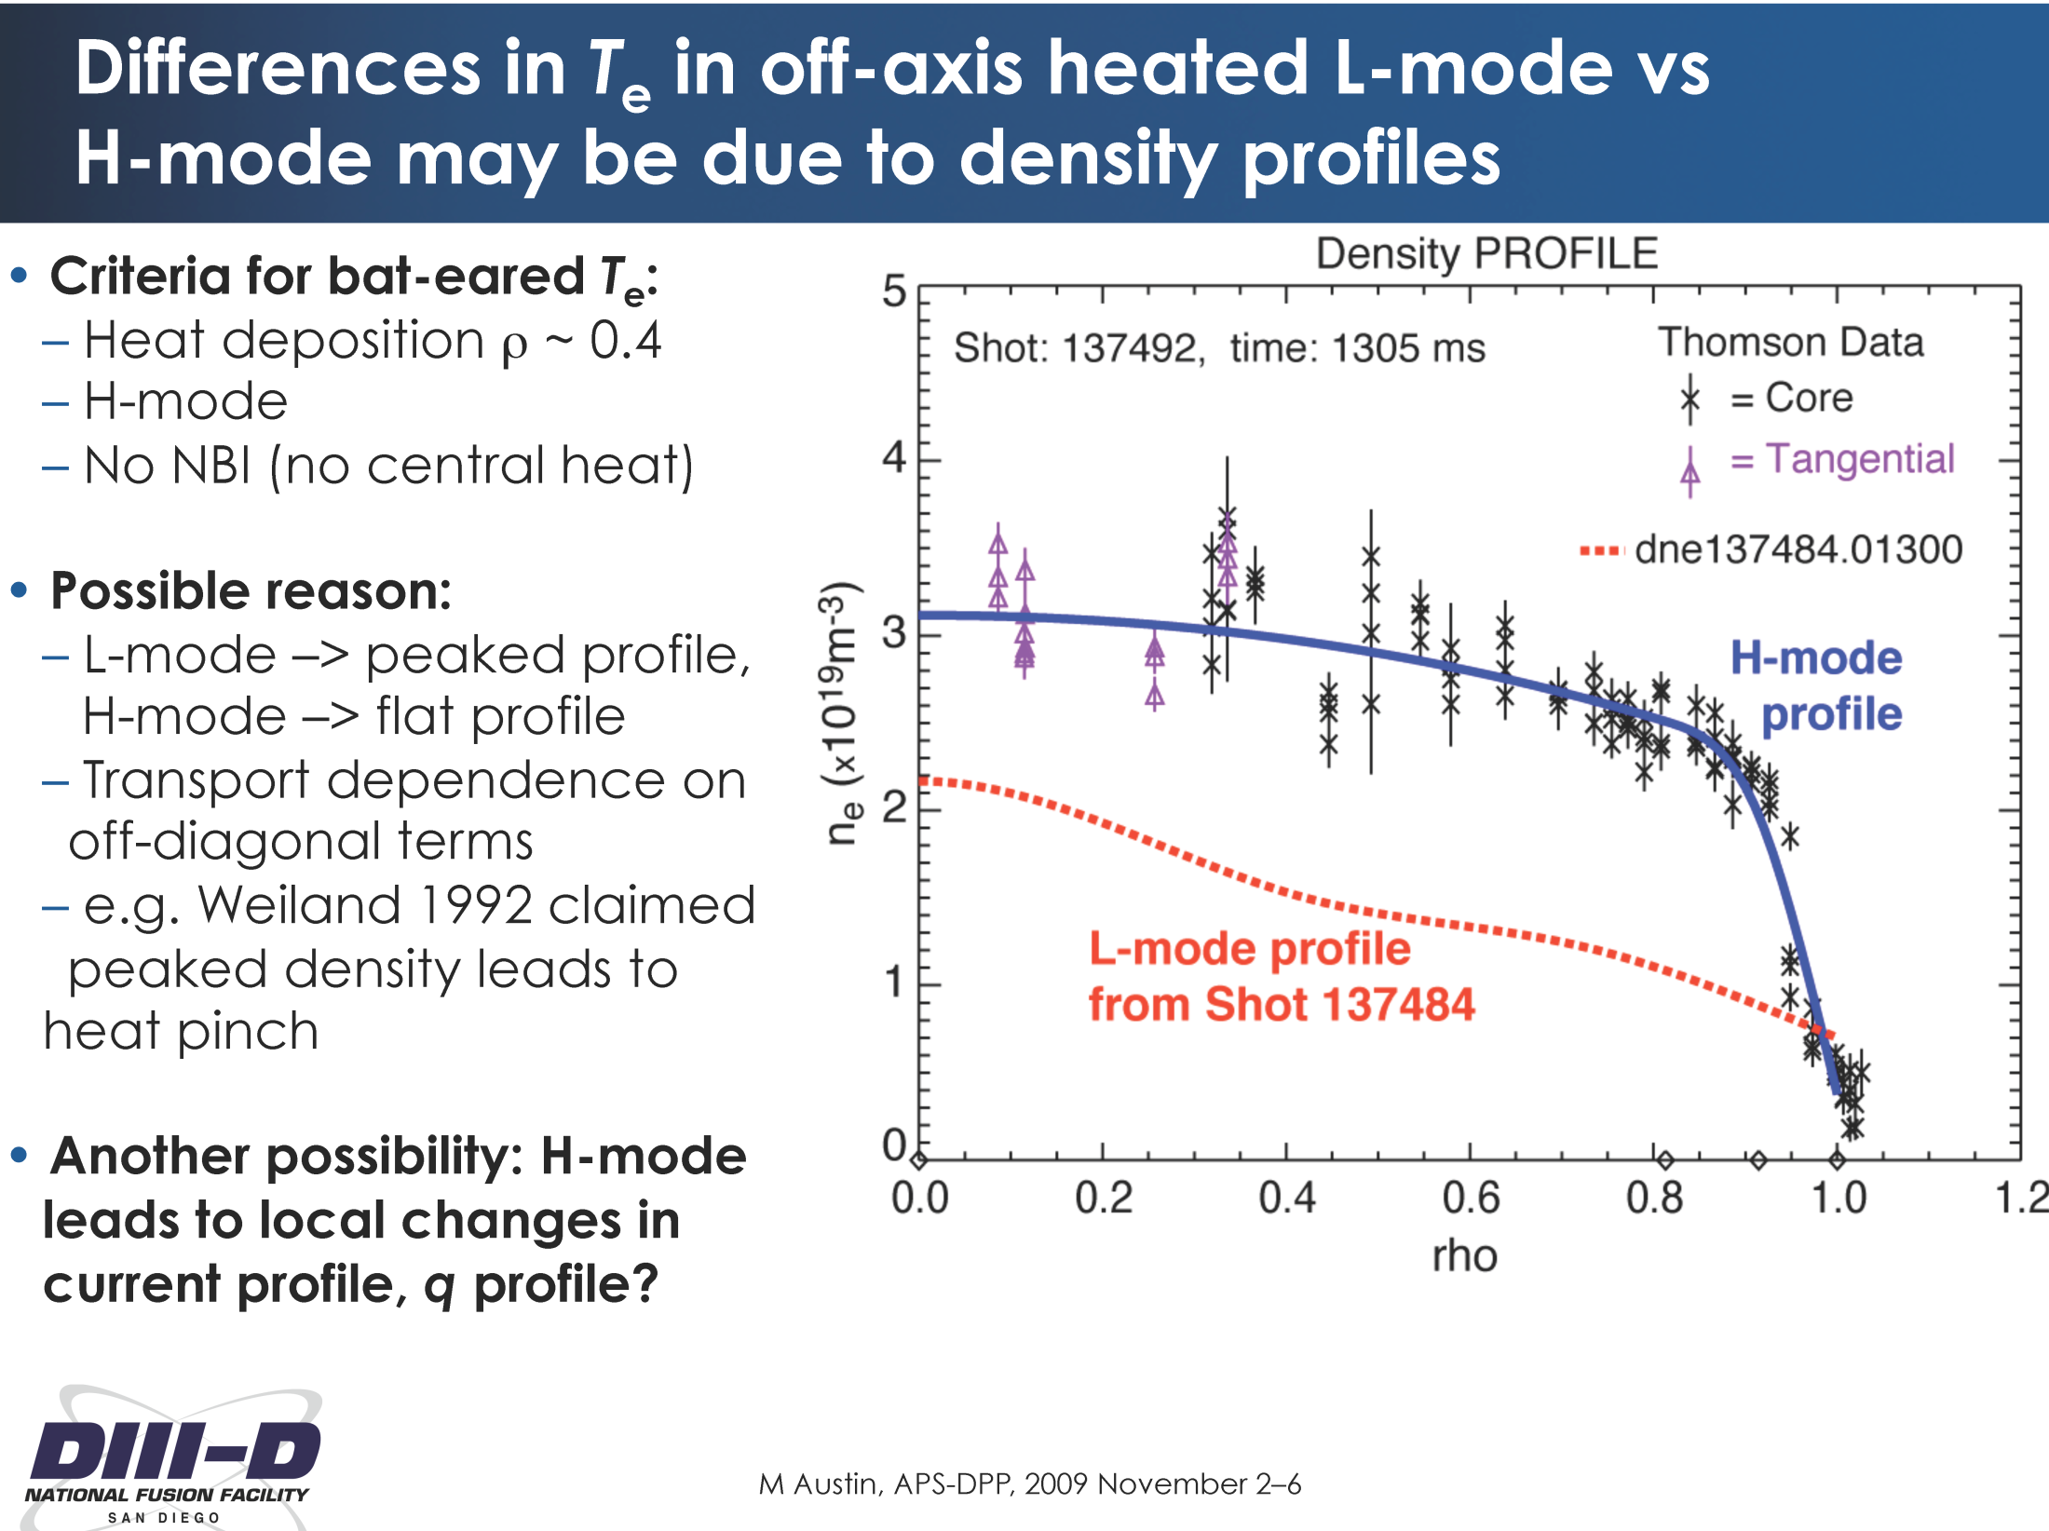

Slide 15
Conclusion
The new experiment in H-mode shows that this problem is still of interest and the result confirms our previous results.
Our simulation from 1993 is a nice test of the model since it is comparatively simple. It involves only the (2d) basic physics in the model including the fluid closure. This is important since gyro-fluid resonances have a strong influence on pinches, usually reducing them.
The fact that the local flattening of T_{e} just inside the source is hardly visible in the experimental data has led many to suggest a nonlocal mechanism for the DIII-D heat pinch. However, due to the sensitive balance of outgoing and ingoing flux components a very small local wiggle is sufficient to explain the pinch with local transport coefficients.

