Slide 1
Statistical aspects of transport
Jan Weiland^{1,2}
1.Chalmers University of Technoloy and EURATOM_VR Association, S-41296 Göteborg, Sweden
2. Presently guest professor at ASIPP, Hefei, China

Slide 2
Outline
Particle orbit theory
Integration along unperturbed orbits
Integration along diffusive orbits
Derivation of transport coefficients
The Mattor – Parker system
The Fokker-Plank equation for turbulent collisions
Unification of coherent and turbulent limits

Slide 3
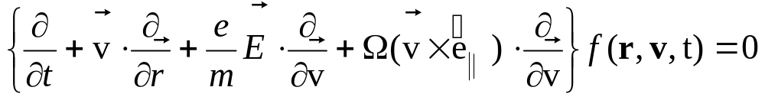
Integration along unperturbed orbits
We write the Vlasov equation in the form:
(1)
In ω, k space it may be written in the linear approximation
(2)
Here the left hand side is the derivative of f_{k} due to the unperturbed fields. This is the derivative along the unperturbed orbit

Slide 4
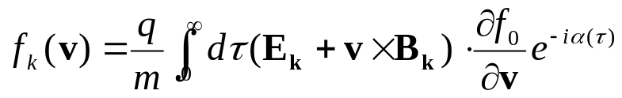
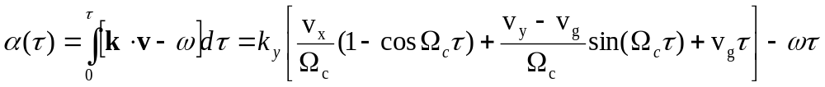

Integration along unperturbed orbits
This leads to the integral
(3a)
(3b)
After integrating along the orbit we integrate over velocity space and obtain the density perturbation. Then using quasineitrality we obtain a dispersion relation which we may write in the general form
(4)

Slide 5
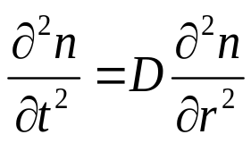
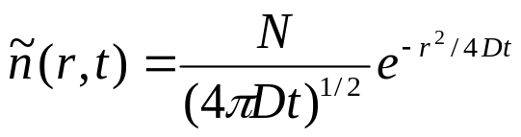
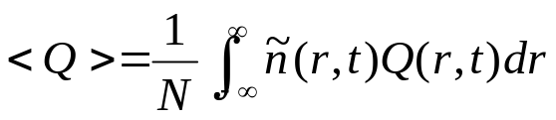
Diffusive orbit
The unperturbed orbit can be generalized to include the effect of diffusion. Diffusion will come out as the result of motion in many waves with random phases. We will start by looking at the simple diffusion equation.
(5)
It has the analytical solution
(6)
Since ñ(r,t) can be seen as the probability of finding a particle at the point r at time t, we can use this solution to define ensemble averages
(7)

Slide 6
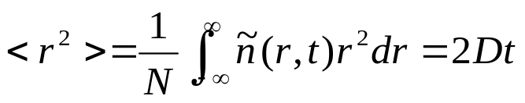


Nonlinear stochastic orbit
We can now use the ensemble average to derive well known properties of diffusion. The first simple example is the mean square displacement:
(8)
Which is often used as the definition of diffusion. Another quantity which arizes when we perform the time integration in the phase of the integration in 3b , i.e.
Using the definition (7) we find
(9)

Slide 7


Dupree’s renormalization of diffusion
Now the unperturbed orbit in Eq (3b) is linear. It can be generalized by adding the nonlinear orbit and that can be treated analytically in the stochastic limit as shown by (9). Thus we may include diffusion by the replacement
(10)
In the orbit (3b). However, for simplicity using Boltzmann electrons, this leads to the same replacement in the dispersion relation (4)
(11)
We have here treated D as a constant. This is possible even if it is due to turbulence since it will then depend only on slowly varying intensities. However D will increase slowly when an instability is active. Thus (11) is then a nonlinear, renormalized dispersion relation.

Slide 8


Turbulent diffusion
We may now use the fact that the dispersion relation (11) has the solution there the linear growthrate is known. Thus
(12)
At saturation we have γ(t) = 0 and thus
(13)
Thus the linear growthrate remains as an important quantity in the nonlinear state. We can interpret it as a source strength.
So far we worked only with diffusion in real space. In velocity space the diffudion equatiuon is replaced by the Fokker-Planck equation

Slide 9
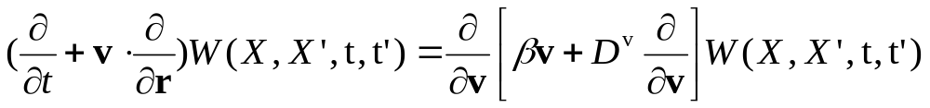


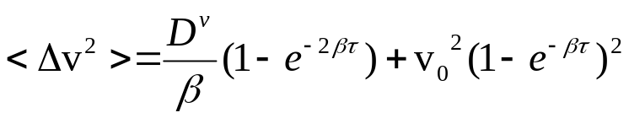
The Fokker-Planck equation
In the limit of fully developed turbulence one can derive a Fokker-Planck equation for turbulent collisions
(14)
Eq (14) has a solution of the type (6) but considerably more complicated. We can use it to calculate ensembble averages in the same way as (7). The most interesting is the mean square velocity deviation (corresponding to (8). It is
(15)
Where v₀ is a fixed initial condition which we may choose to be zero.
We then get the time development in Fig 1

Slide 10
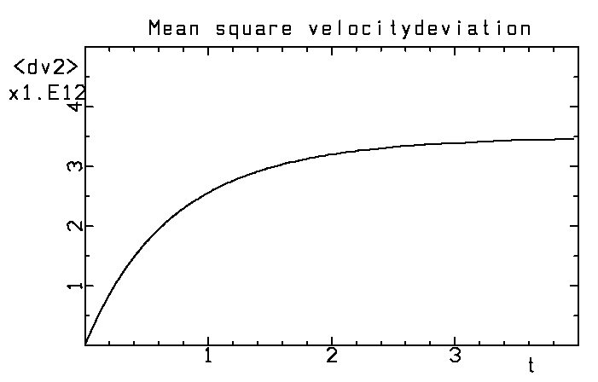
Mean square velocity displacement
The mean square velocity deviation starts off as linear growth which corresponds to quasilinear diffusion but this saturates at a time t = 1/β
And for large times the mean square velocity deviation is zero, i.e. there is no energy transfer between turbulence and resonant particles

Slide 11
Fluid closure
We consider steady state in a tokamak where sources are needed to maintain all moments
We discuss Fluid closure on the confinement timescale in tokamaks and compare with the turbulence timescale
Our problem may thus be divided into two parts:
1 To show that high order moments will actually damp out in the absence of sources
2 To show that there will not be sources for higher moments

Slide 12
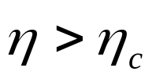
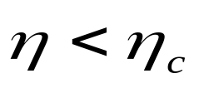
ITG and Trapped electron modes depend on competition between relaxation of density and temperature
As it turns out, competition between relaxation of density and temperature introduce pinch fluxes that are particularly sensitive to dissipative kinetic resonances like Landaudamping. This competition shows already in the simplest stability conditions:
Thermal type
Interchange type

Slide 13
Particle pinches
The strongest pinch observed in tokamaks is the Particle pinch. ( F. Wagner and U. Stroth, Plasma Phys. Controlled Fusion 35, 1321 (1993)).
The first theories of particle pinches were: In a slab plasma with main application to the edge: B. Coppi and C. Spight, Phys. Rev. Lett. 41, 551 (1978).
In a toroidal plasma with main application to the core: J. Weiland, A. Jarme’n and H. Nordman , Nuclear Fusion 29, 1810 (1989).
The particle pinch in the Levitated dipole at MIT was recently discussed in J. Weiland, Nature Physics 6, 167 (2010).

Slide 14
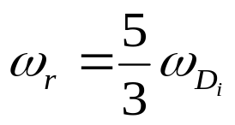

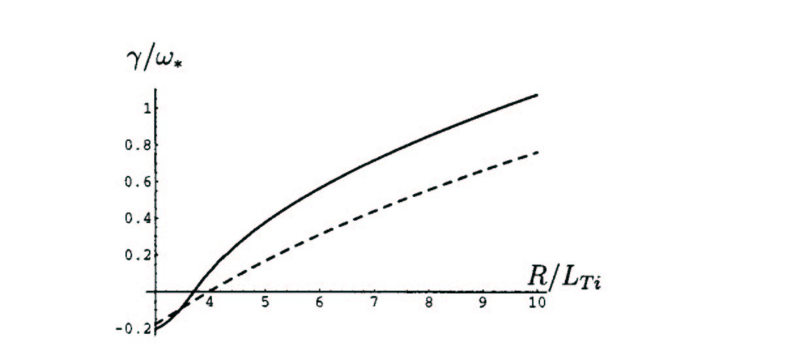
Fluid and kinetic resonances
As it turns out marginal stability of the simple toroidal ITG mode, including parallel ion motion, occurs exactly at the fluid resonance in a fluid picture
Nevertheless the fluid threshold is usually not too far from the kinetic
Fig 6
______ React. Fluid
------------- Fluid with Ld
Fig 6 growthrates the Cyclone basecase (Dimits et. Al. Phys. Plasmas 7, 969 (2000))

Slide 15
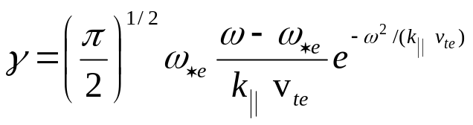
The Coherent limit, the Mattor Parker system
A very useful approach to the fluid closure was suggested by Mattor and Parker (Phys, Rev. Letters 793419 (1997)). They studied a system of two slab ITG modes and a driven zonal flow. However, from the dynamics point of view this was usual three wave interaction but with nonlinear frequency shifts (termed four wave interact.).
They derived fluid equations up to the third moment and closed the system with he remaining kinetic integral.
In the kinetic integral they introduced a nonlinear frequency shift.
The effect of this can easily be imagined by looking at the usual Universal instability due to inverse Landaudamping
We notice that a nonlinear frequency shift can easily change the sign of the growthrate!

Slide 16
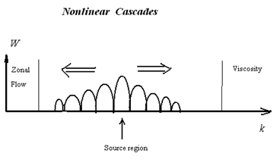
Three wave interaction
Fig 7 Turbulent cascades from the fastest growing mode in both directions
The system of three interacting waves is the most fundamental part of turbulence. In principle we could represent the turbulent cascade above with the fastest growing mode in the centre coupling to two sibands, one below and one above in modenumber and represent the continuing cascades in both directions by dampings.

Slide 17
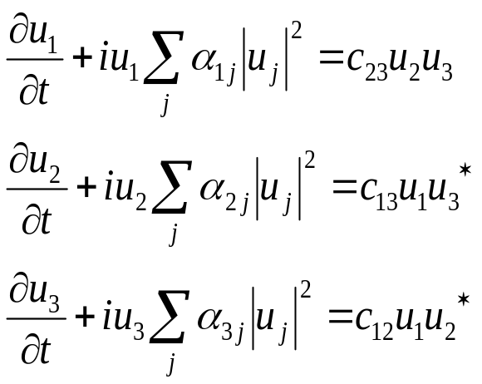
Three wave interaction cont.
The general form of a three-wave system (with four-wave nonlinearity)is given below:
This system corresponds to the resonance condition
k₁ =k₂ + k₃
The amplitudes are complex and thus a phase dependence enters in the quadratic terms. However, the qubic terms (nonlinear frequency shifts) Do not phase mix!

Slide 18
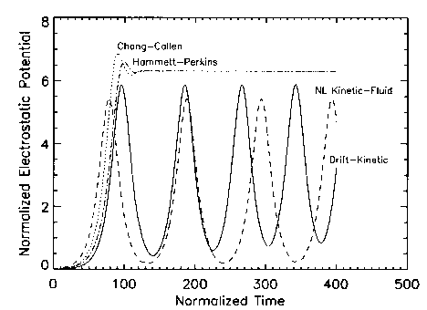
Mattor-Parker nonlinear closure
The same change of wave energy as in the universal instability is possible for ITG modes (Mattor and Parker, PRL 79, 1997). Mattor and Parker studied a simple three-wave system of slab ITG modes corresponding to generation of zonal flows by self-interaction.
Nonlinear frequency shift in plasma dispersion function
Fig 8 Nonlinear closure
Linear closure Gyro Landau fluid
Drift kinetic
Nonlinear closure
Interaction of three slab ITG modes
Note the significant improvement of the nonlinear closure (Mattor – Parker) over the linear closures (Hammett-Perkins and Chang-Callen)
The main argument against this work has been that it is coherent. However, we will show how to generalize this!

Slide 19
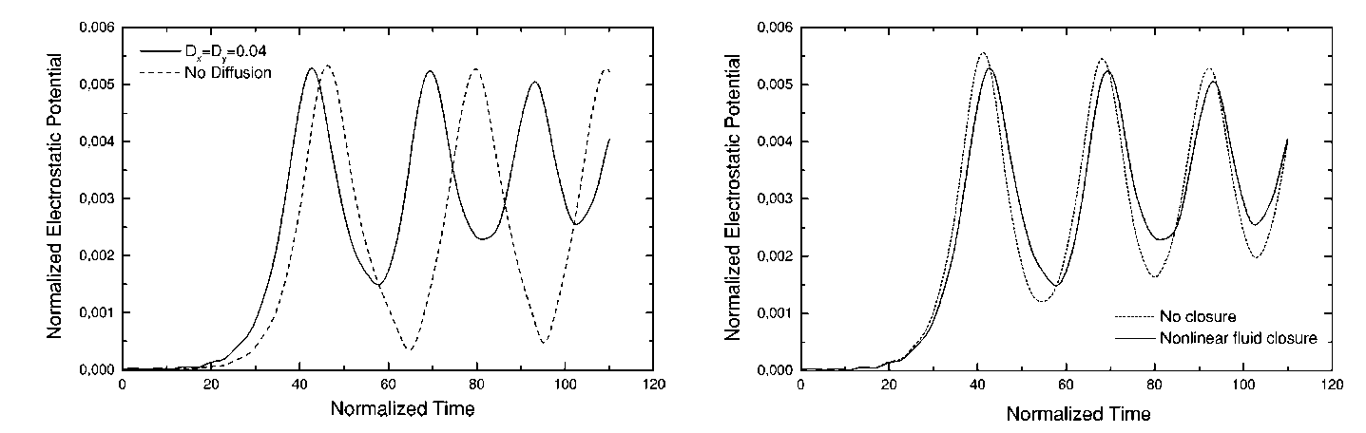
Generalized Mattor Parker system
The Mattor Parker system was later generalized by Holod, Weiland and Zagorodny ,(Phys. Plasmas 9, 1217 (2002)). Here the closure was made at the fifth moment and damping due to background turbulence was included. Thus we have a partially coherent situation
Fig 9
Fig 9 This system shows interaction between two slab ITG modes and a Zonal flow where closure is provided by nonlinear frequency shifts inside the Z function.

Slide 20
Wave particle interaction
The gross oscillations are here due to three wave interaction. However there are superimposed oscillations due to oscillating frequency shifts.
This is shown as the difference between the curves with closure and without closure in the right part.
The kinetic resonance is reducing the amplitude maxima and increasing the minima. Thus on the average it has a very small effect.
This can be seen as a result of the fact that linear kinetic resonances are always accompanied by nonlinear effects that tend to cancel them. We should also remember that the three wave system is a fundamental element in turbulence so we expect this feature to be general.

Slide 21
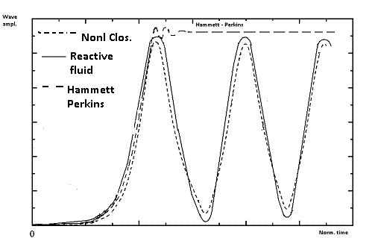
Nonlinear kinetic fluid equations
Fig 9 shows a combination of the Hammett Perkins results and those by Holod et al (partly qualitative but semi quantitative) The interaction is between two slab ITG modes and a zonal flow. We can see how much better the reactive fluid model is than the Hammett-Perkins model!
Fig 10 Development in time of three-wave interaction between two slab ITG modes and a zonal flow with different fluid descriptions including reactive fluid, fluid with nonlinear closure and the Hammett Perkins gyro-Landau fluid model.

Slide 22
Transition to turbulence
The question of the coherent state was actually addressed by Holod et.al. where a diffusion damping was introduced in order to represent the effect of the background turbulence. We also note that the Mattor Parker system includes both quadratic mode coupling terms and qubic nonlinear frequency shifts. This is the same situation as for the turbulent state and, due to self interactions, the turbulent state will also include nonlinear frequency shifts. The effect of diffusion damping was to make the system approach a stationary nonlinear state which appears to be close to the average of the oscillations in the Mattor Parker system. While the Mattor Parker work got good agreement with a fully kinetic system, the work by Holod et al compared with a reactive closure.
It is important to notice that the kinetic resonance is stabilizing at maxima and destabilizing at minima, thus the effect of the kinetic resonance tends to be averaged out. It is clear from the small effect of the closure term that the large scale oscillations, in both systems is due to three wave interaction. We also note, that just as in the fully turbulent case there are both quadratic and cubic nonlinearities present. The quadratic nonlinearities phase mix but the cubic do not.

Slide 23
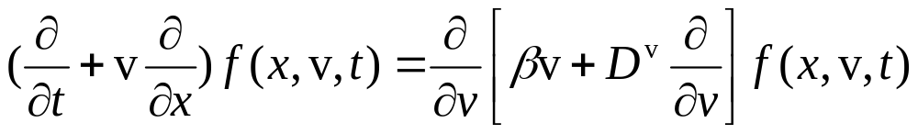
Many wave case, the Fokker Planck equation
In the stochastic limit we can derive a Fokker-Planck equation
Here D^{v} is the turbulent diffusivity in velocity space and β is the turbulent friction coefficient. These will both be due to wave intensities in a turbulent state with random phases. However β (and partly also D^{v} )
contributes a nonlinear frequecy shift which actually reenters correlations into the system.

Slide 24
Solution of the Fokker Planck equation
In the case of constant coefficients the Fokker-Planck equation has an exact analytical solution. However numerical solutions in more general cases give qualitatively the same type of solution
Fig 11
The mean square deviation from the initial velocity (velocity dispersion) as a function of time. The initial phase is quasilinear while the saturated phase is due to strong nonlinearity. The transition is at t=1/β.

Slide 25
Transistion between coherent and turbulent states
The asymptotic result <Δv²> = const. means that there is no more an energy transfer between waves and resonant particles.
This result is also due to the Dupree-Weinstock renormalisation.
This state is reached on the order of a confinement time.
We had indications that this would happen also for multiple three-wave system but this is the ultimate proof that the average energy transfer will really vanish. The situation is the same as for trapping in a coherent wave.
We then conclude that a reactive closure will always be possible asymptotically. However, this does not tell us at which order in the fluid hierarchy this will happen. We also need sources to maintain density and temperature.

Slide 26
Sources
We note also that the variational method of Anile and Muscato (Phys Rev B51, 16728 (1995)) gives the same closure for solid state plasmas (collisions do not give a source for the irreducible fourth moment).
In our model we include just the moment with sources in the experiment
The condition to have a Maxwellian source is clearly that fuelling and heating produce such sources.
Heating usually produces non-Maxwellian tails at very high velocities but these very fast particles will have thermalized before getting resonant with the drift waves

Slide 27
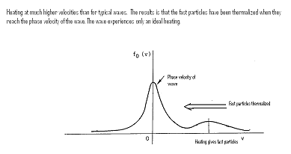
Dynamics of heating
Heating of tokamaks almost always takes place at velocities much higher than the phase velocity of drift waves
Fig 12
Since heating generally occurs at velocities ~10³ higher than the phase velocity of drift waves, it will have time to thermalize before reaching the phase velocity of drift waves

Slide 28
How close to the drift wave phase velocity are perturbations resonant?
One way of testing this is to investigate how sensitive impurity transport is to the fluid closure. The reason is that, as pointed out above, the ITG mode is resonant with the main ions.
Thus means the ITG mode will not be resonant with imputity ions!
Thus we will compare particle transport of main and impurity ions for reactive driftwaves and driftwaves subject to Landau damping.

Slide 29
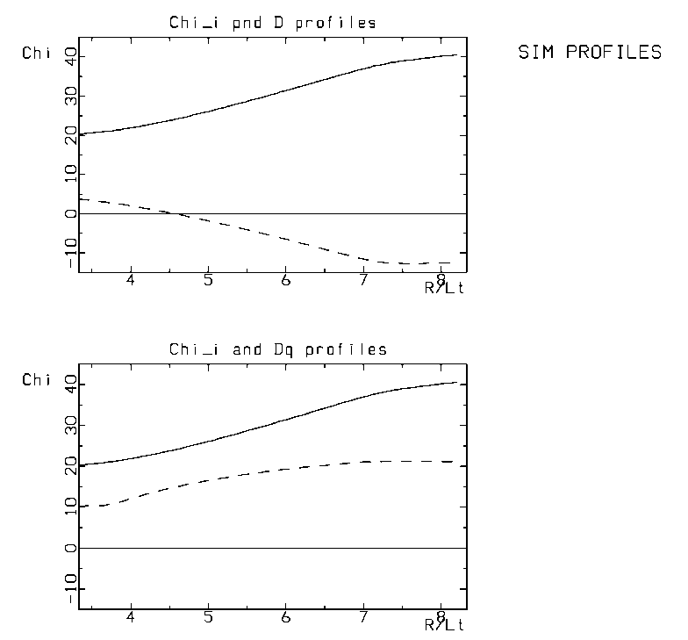
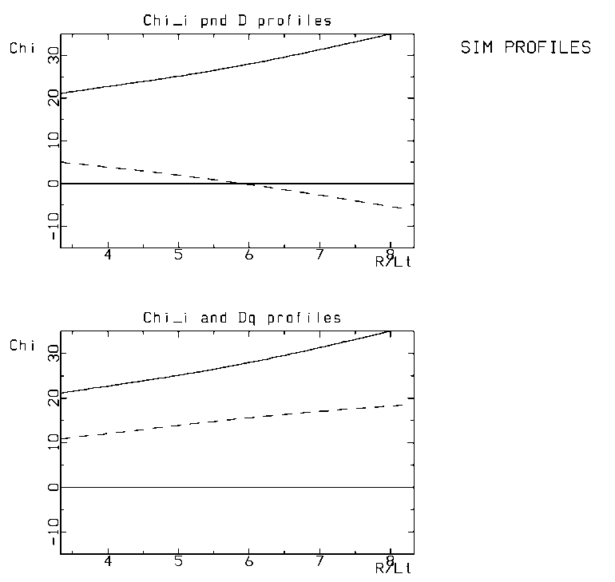


Dependence of pinches on fluid closure
Fig 13
Particle transport as a function of temperature gradient for a reactive fluid model (left) and a fluid model with Landaudamping (right)
The top graphs are for Hydrogen while the bottom graphs are for Coal.
We note that the particle pinch is stronger for the reactive model and that differences are considerably smaller for coal.

Slide 30
Effects of fluid closure on particle pinches
It is well known that dissipation plays a stronger role near marginal stability. This can actually also be seen in the last figure.
The reason is that the system is close to balance between stabilizing and destabilising effects so that smaller effects can play a role.
The same is true when we have a net pinch flux, i.e. we are near a balance between outward and inward fluxes.
It is actually the reactive model that has agreement with experiment (L. Garzotti et. al. Nuclear Fusion 43, 1829 (2003)). This gets even more obvious in a comparison with a quasilinear kinetic model.

Slide 31
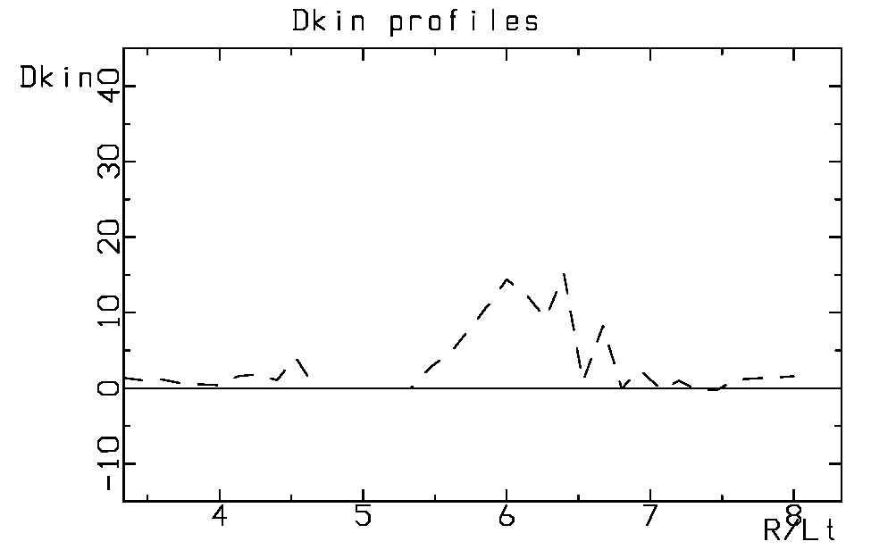
Quasilinear kinetic
Kinetic theory is much more sensitive to strongly nonlinear effects than fluid theory
Fig 14
Quasilinear kinetic calculation of particle diffusivity. Parameters are the same as in Fig 5. Compare also Romanelli and Briguglio, Phys. Fluids B2, 754 (1990). No particle pinch!

Slide 32
Conclusions
A reactive closure including only moments with sources in the experiment has proven very successful both in comparison with experiments and nonlinear (and linear) kinetic modela. We have here given mechanisms which detune wave particle resonances in both coherent and incoherent (turbulent) limits.
A strong indication of the validity of a fluid closure is that a suitable fluid model is vastly superior to quasilinear kinetic models in describing particle pinches
We can also use particle pinches of main ions and impurities to see how important the fluid resonance is (impurity ions are not resonant with the main driftwaves)
.

Slide 33
Conclusions cont.
With only ideal fuelling and heating higher order moments will not have sources and will decay at the latest on the confinement timescale.
This would require nonlinear kinetic codes to be run on the confinement timescale. However we have also given reasons why kinetic resonanses are detuned on a shorter timescale when the turbulence is still strong (coherent limit). However, these are not as rigoirous as those for the confinement timescale.

Slide 34
Conclusions, cont
Toroidal effects are very important for both pinch fluxes and fluid closure.
Pinch fluxes are reversible and are strongest when velocity space is treated in a self-consistent way.

