Slide 1
Deep Learning and its application in tokamak magnetic equilibrium reconstruction
Youjun Hu（胡友俊）
Institute of Plasma Physics, Chinese Academy of Sciences
2022-05-27, seminar@ASIPP

Slide 2
Outline
Artificial intelligence (AI) and Machine Learning (ML)
Deep Learning
Neural Network
Reconstruct EAST magnetic equilibrium using deep learning
How to use Tensorflow (deep learning library by google)
Notes:
ITER hybrid是13.54,BEST PSOL/R=16.9
<number>

Slide 3
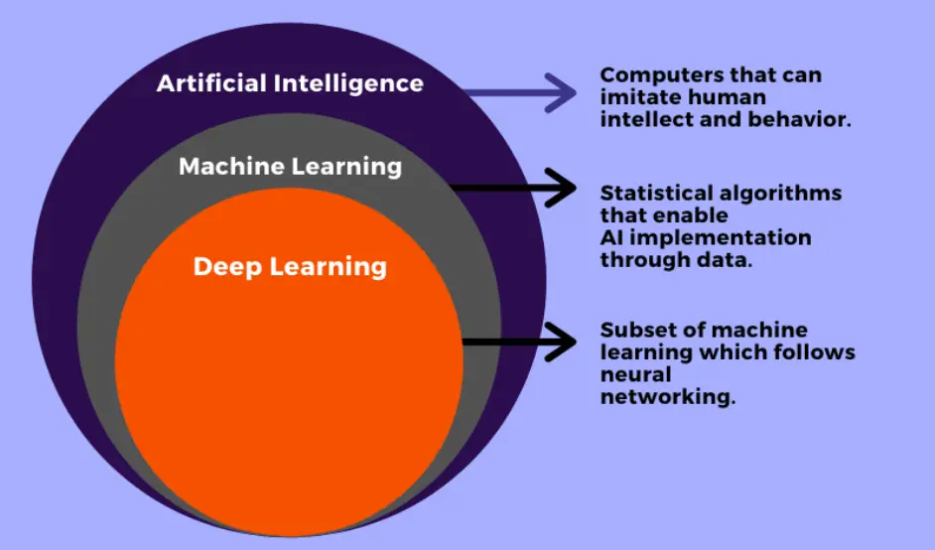
Artificial intelligence (AI) and Machine Learning (ML)
Notes:
ITER hybrid是13.54,BEST PSOL/R=16.9
<number>

Slide 4
A short history of AI
Founded as an academic discipline in 1956 (LISP vs. Fortran)
Waves of optimism, followed by disappointment => loss of funding (known as "AI winter"), followed by new approaches => success and renewed funding
AI research has tried and discarded many different approaches since its founding
Traditional AI: formal logic, explicit rule-based (If-then)
Modern AI: based on numerical optimization, statistical machine learning, using data to infer rules
Deep learning: due to discover of an efficient way of computing differential in multiple-layer neural network (backpropation algorithm)
Notes:
ITER hybrid是13.54,BEST PSOL/R=16.9
<number>

Slide 5
Informal definition of ML
“Machine learning is essentially a form of applied statistics with increased emphasis on the use of computers to statistically estimate complicated functions and a decreased emphasis on proving confidence intervals around these functions.”
--- Ian Goodfellow et al., Deep Learning, MIT Press, 2016

Slide 6
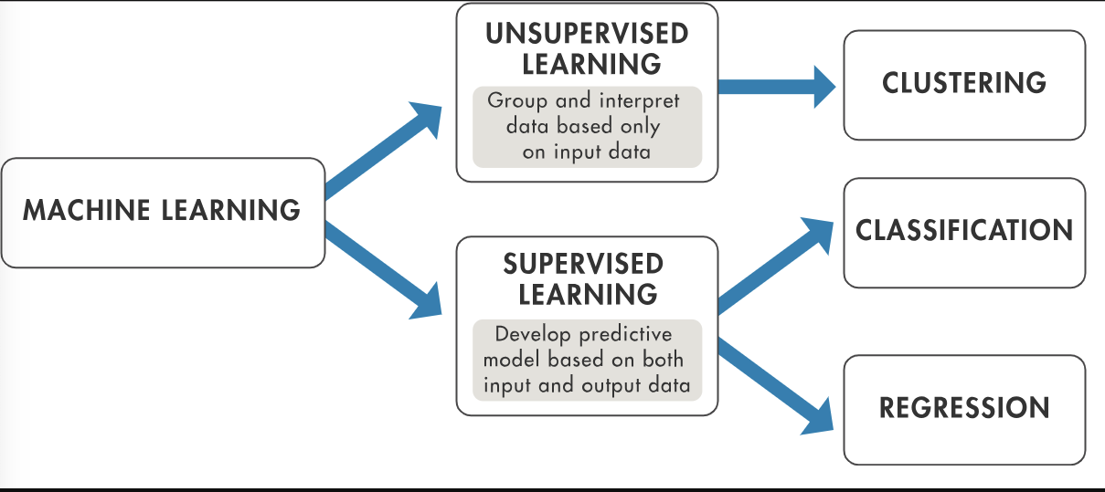
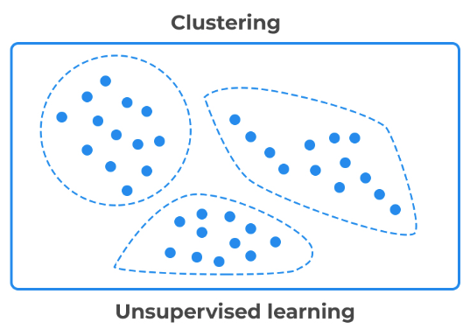
Supervised learning vs. Unsupervised learning
Supervised learning utilizes labeled datasets to make predictions.
The predication has two types:
Classification (predicting discrete values)
Regression (predicting continuous values).
Unsupervised learning: doesn't require labeled datasets,
it detects patterns in the data
Notes:
ITER hybrid是13.54,BEST PSOL/R=16.9
<number>

Slide 7
More abstract definition of (un-)supervised learning
Unsupervised learning involves observing several examples of a random vector x,
then attempting to learn the probability distribution p(x)
Supervised learning involves observing several examples of a random vector x and an associated value or vector y,
then learning to predict y from x, usually by estimating p(y | x).
In both unsupervised learning and supervised learning, the training dataset is fixed during the training process.
In the reinforcement learning, new training data are produced by the algorithm itself.
Deep learning can be applied to all the above algorithms.

Slide 8
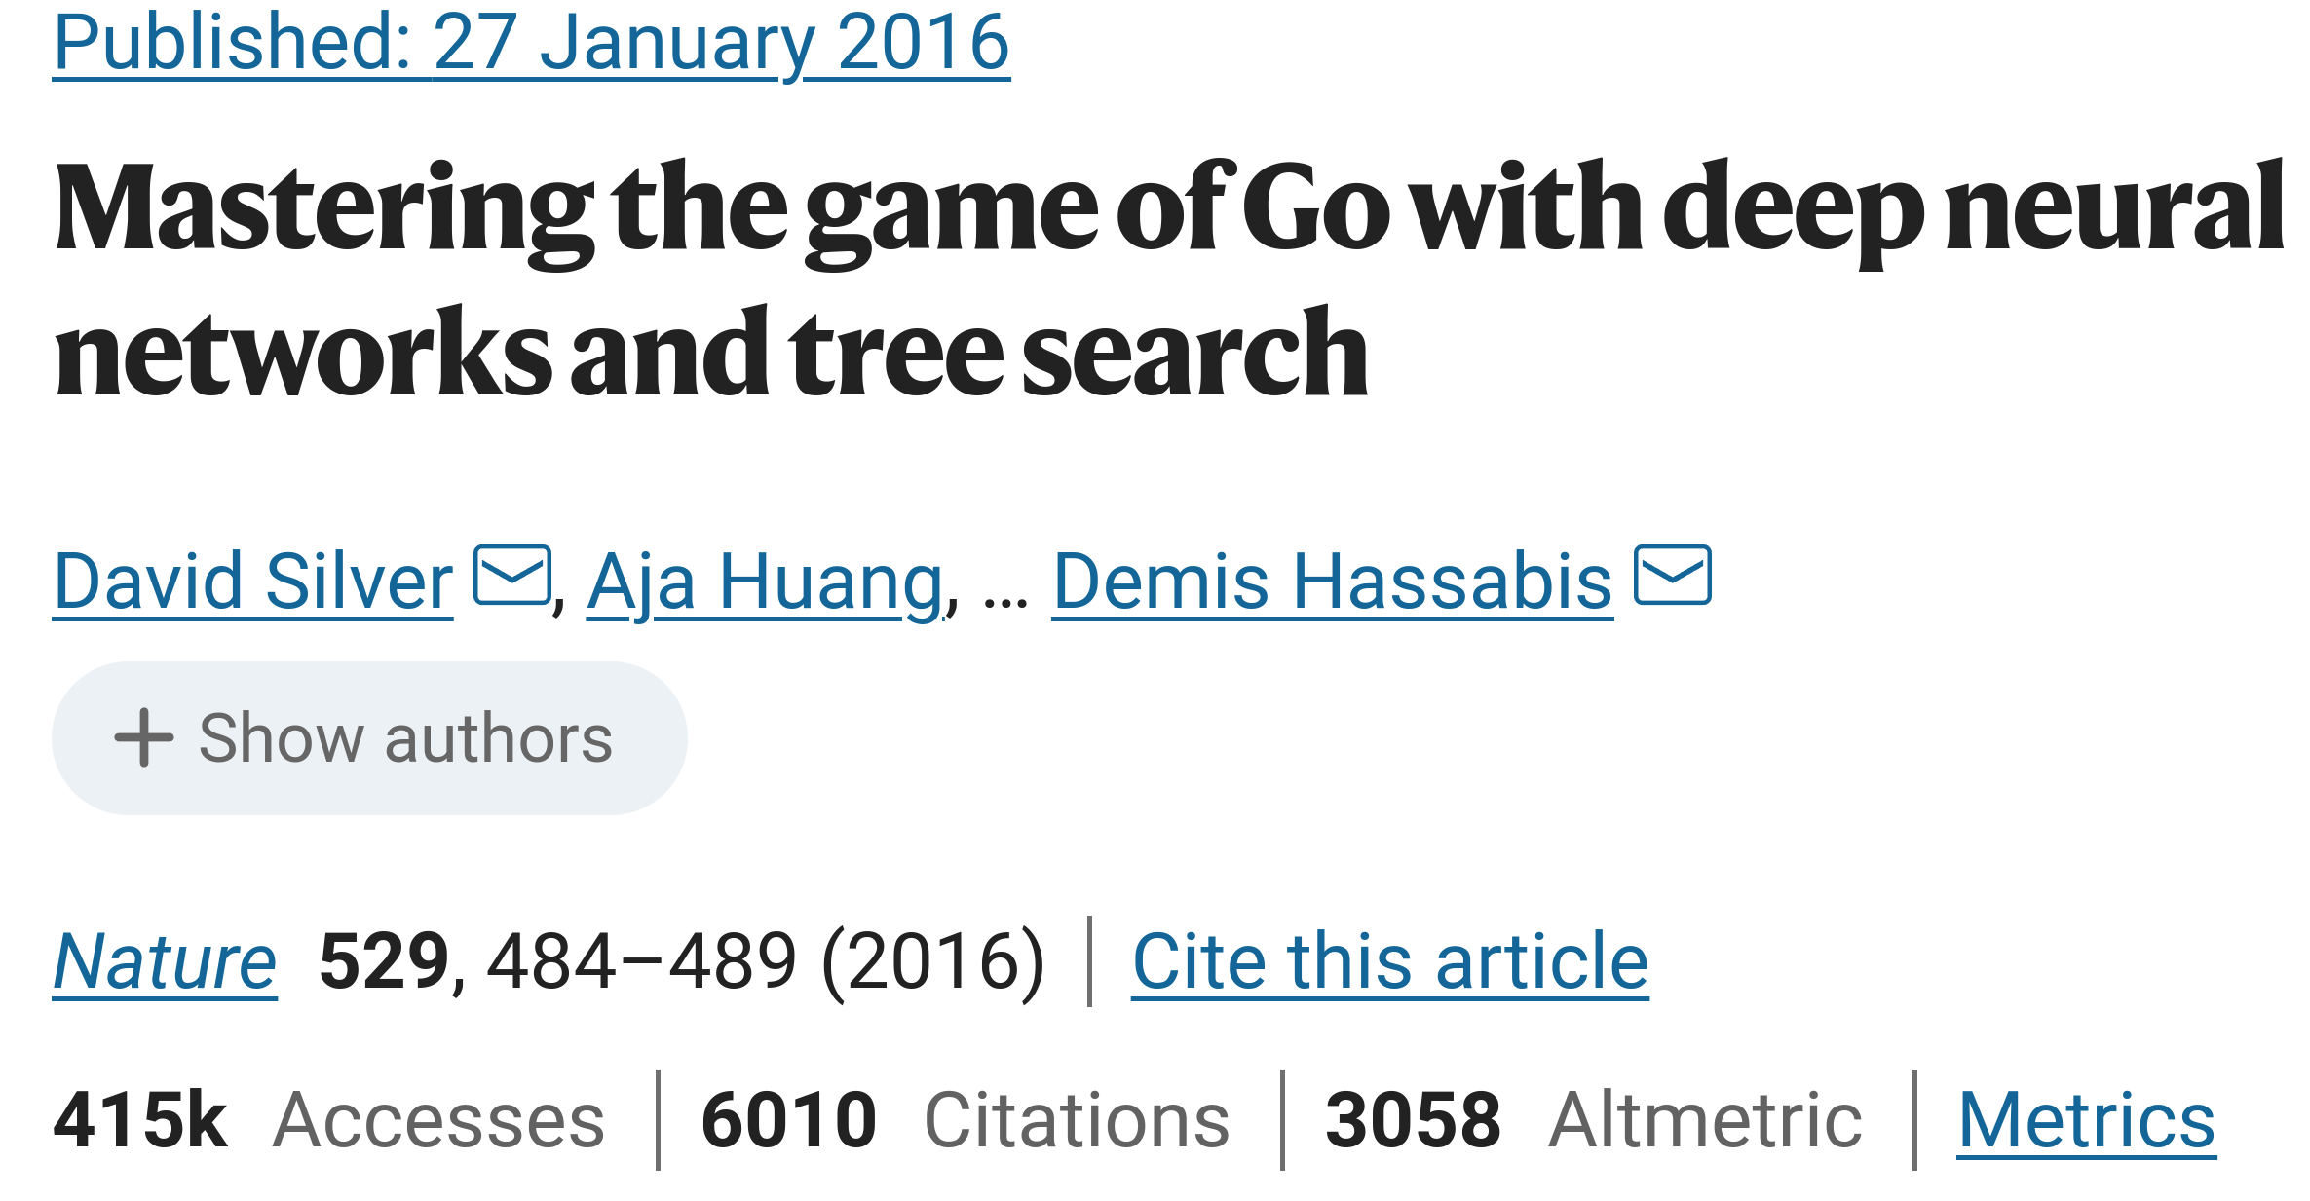
The deep neural networks are trained by a combination of supervised learning (from human expert games) and reinforcement learning (from games of self-play).

Slide 9

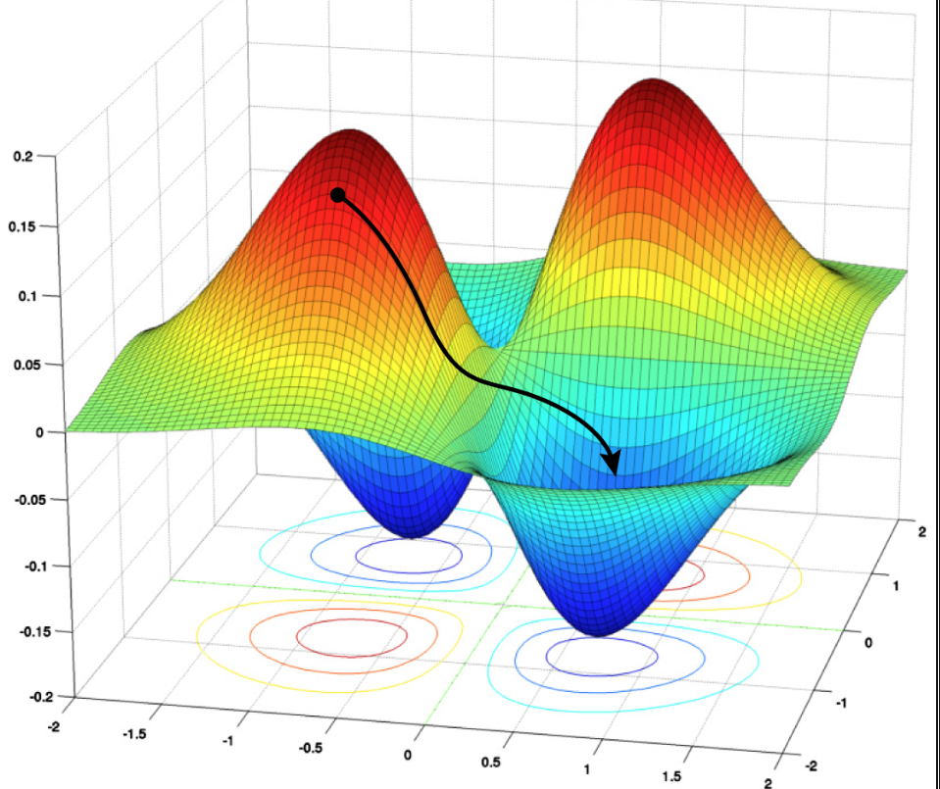


But what is “learning”?
Learning/Traning ==> a gradual process of improving
Supervised ML==> a gradual process of adjusting parameters to get better answers
Q: How to judge if an answer is better?
A: Define a loss/cost function
Q: How to adjust parameters?
A: Gradient descent
==>Reach Local minimal
and hopefully global minimal of the loss function
w2
w1
Notes:
ITER hybrid是13.54,BEST PSOL/R=16.9
<number>

Slide 10
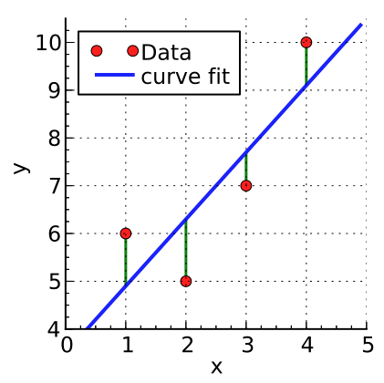
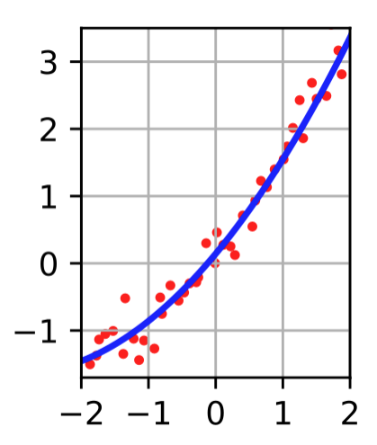


Linear least squares is a machine learning algorithm?
Yes, it is.
Q: Where is the training process?
A: There exist closed expressions for the fitting parameters.
We do not need to use iterative methods to learn the parameters.
Still linear model
(in terms of parameters)
Notes:
ITER hybrid是13.54,BEST PSOL/R=16.9
<number>

Slide 11
Deep learning models
Deep feedforward networks, also called multilayer perceptrons,
are the quintessential deep learning models.

Slide 12
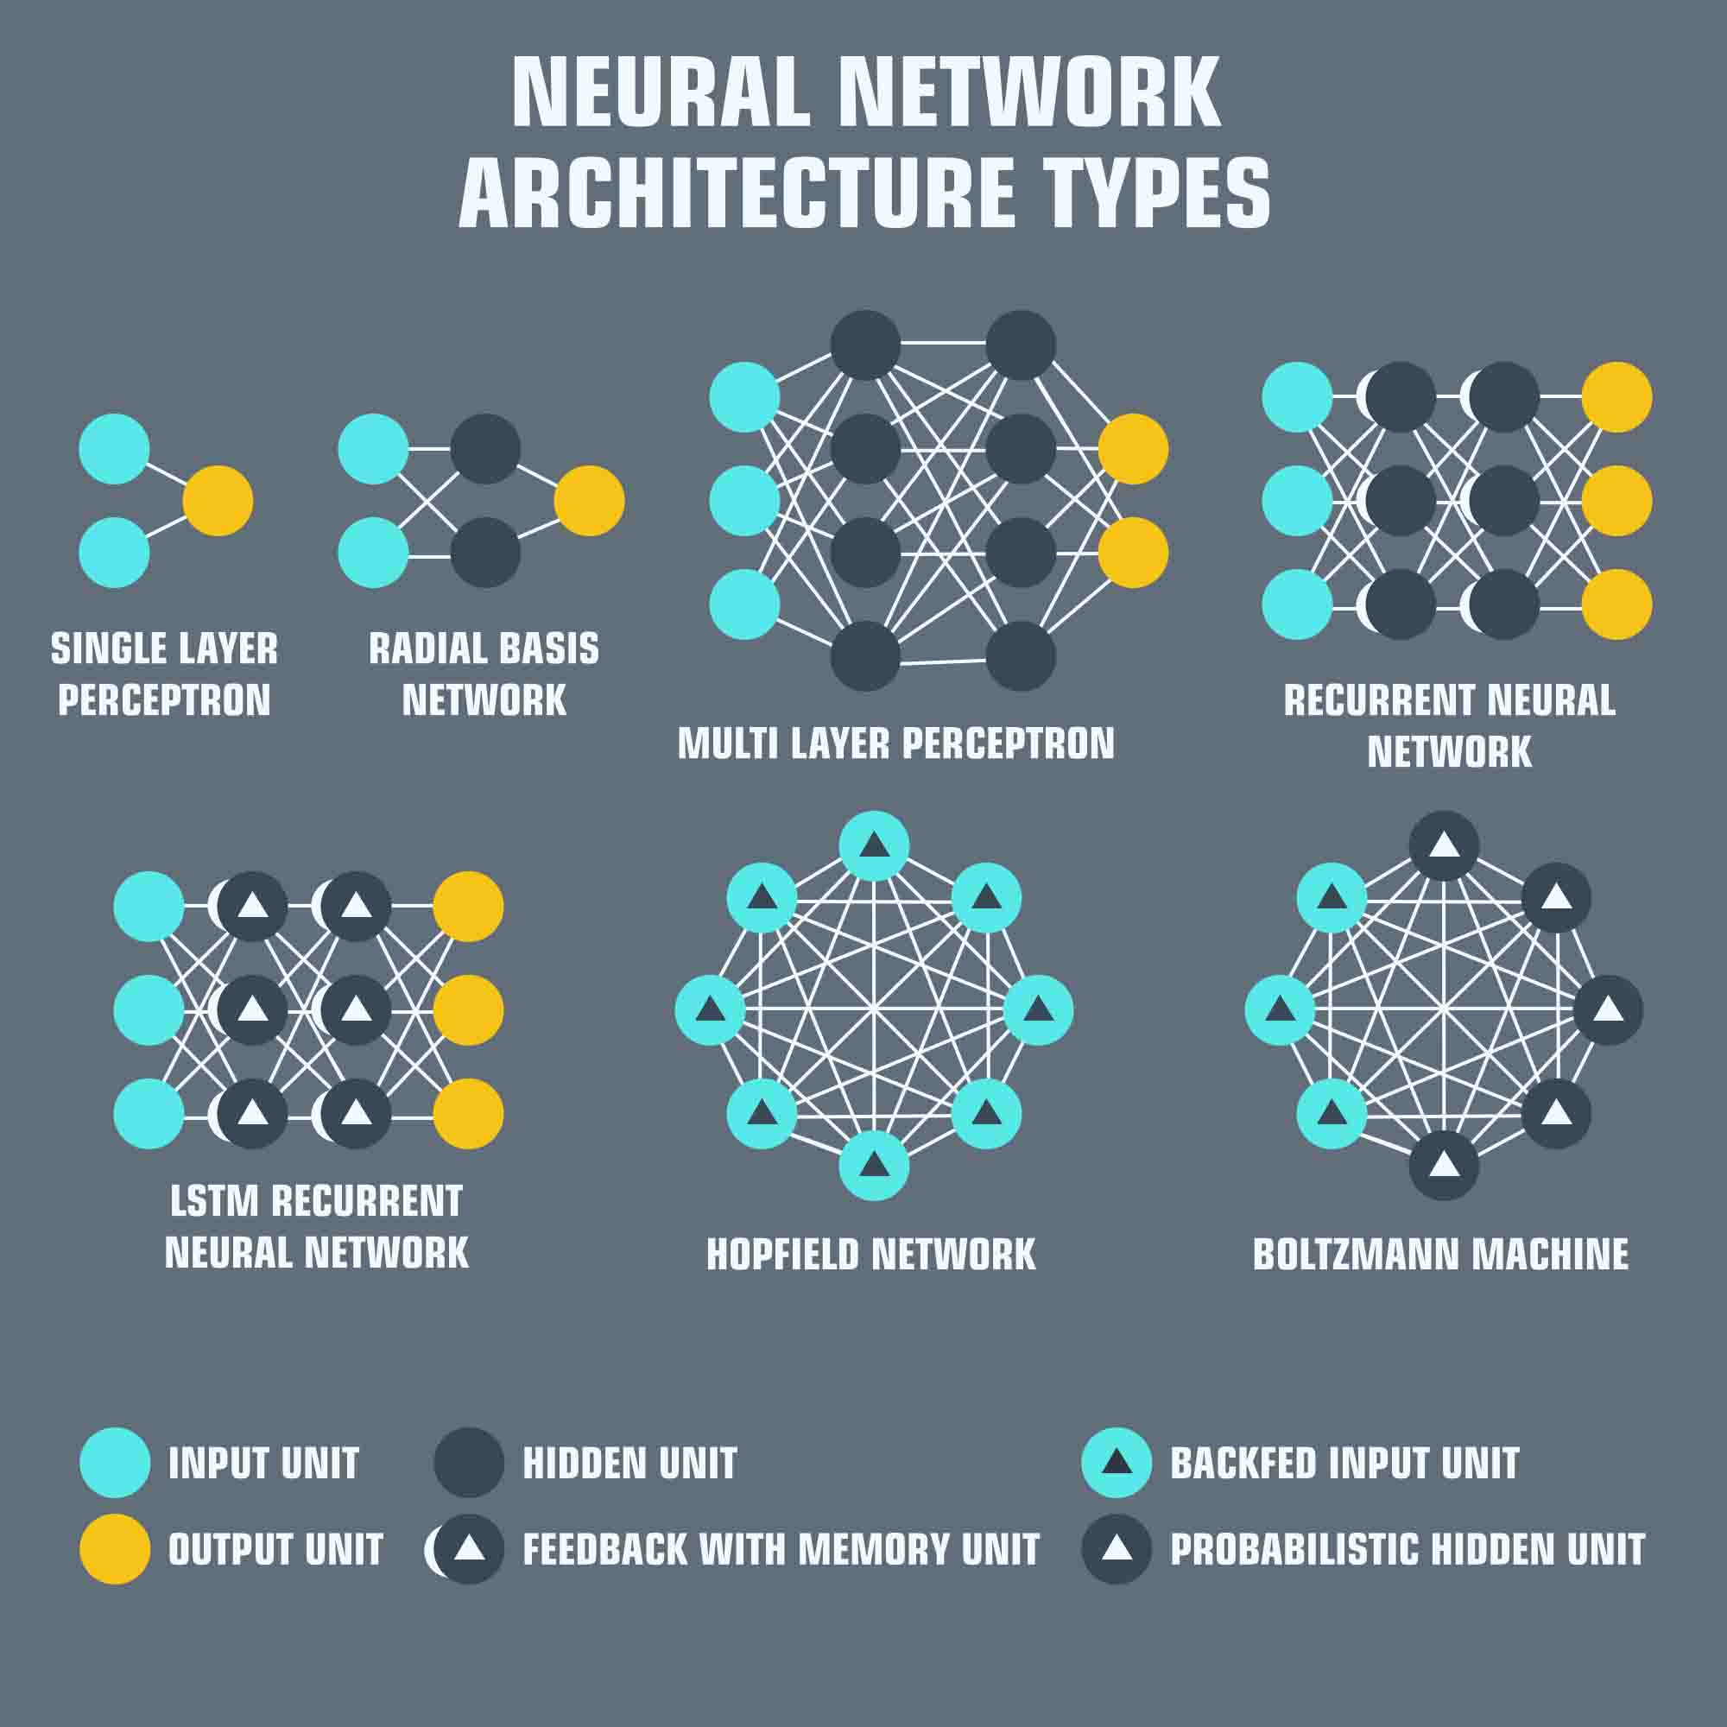
Many kinds of networks

Slide 13
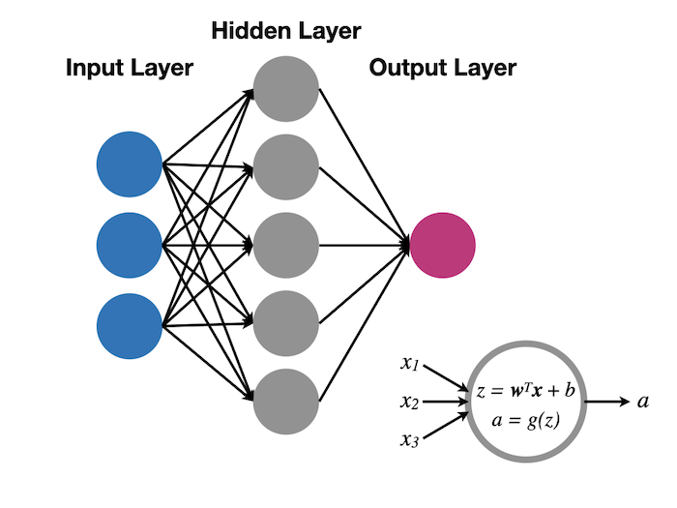

Feedforward neural networks
information moves in only one direction
no cycles or loops
No intra-layer connections
Fully connected
Information propagation correspond to function composition:

Slide 14
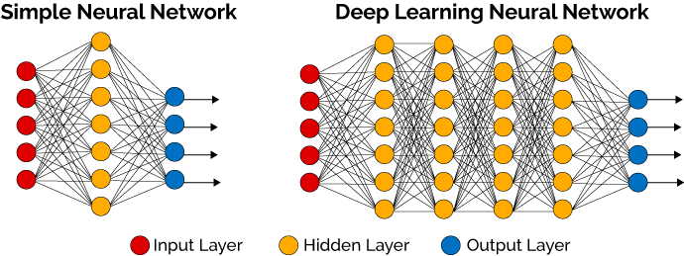
Q: “Deep” in deep learning?
A: The adjective "deep" in deep learning refers to the use of multiple layers in the neural network

Slide 15
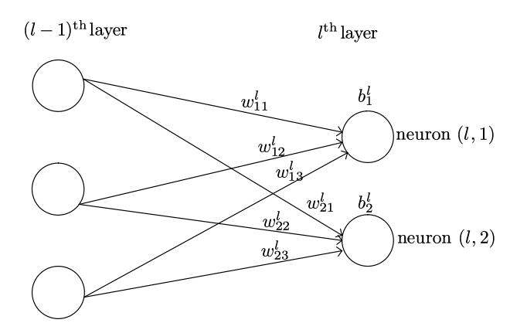




Node (Neuron), weight, bias, and activation
Trainable parameter: weights, bias
Millions of trainable parameters in a typical network
Multilayer network is a universal function approximator
In vector form:

Slide 16
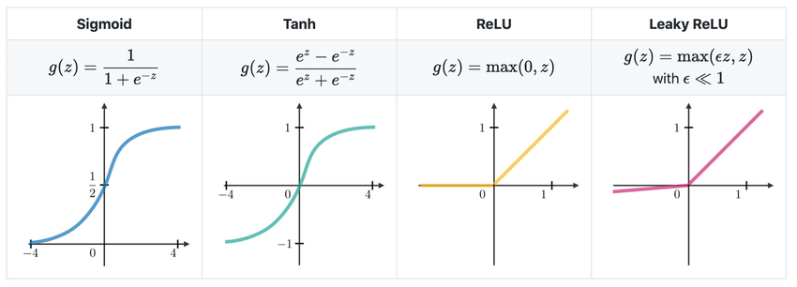
Many kinds of activation functions

Slide 17
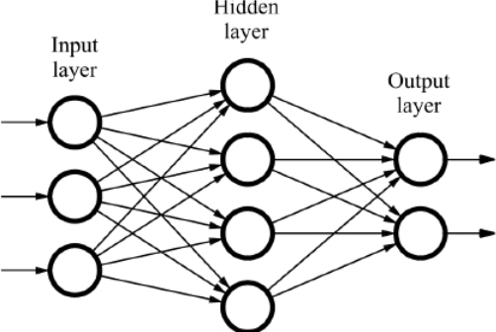
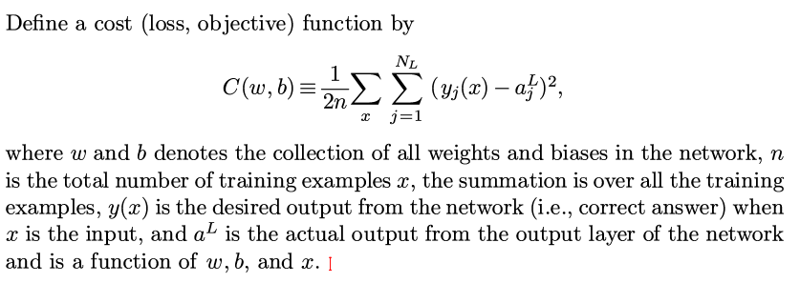
Before training the network, define cost function to judge answers given by the network
L layer

Slide 18
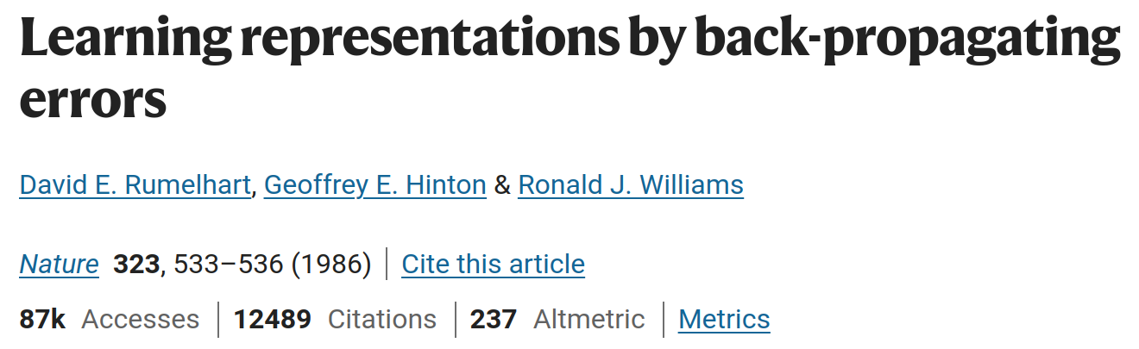
We need the gradient of the cost function when training the network using Gradient descent method
But how do you compute the partial derivatives of the cost function with respect to millions of variables (weights)?
==>computationally expensive
An efficient method: the backpropagation algorithm

Slide 19

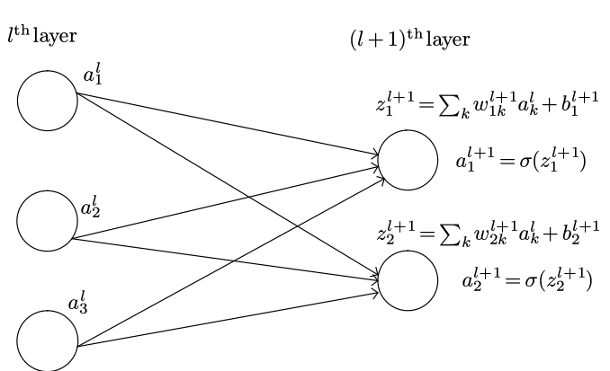




Backpropagation algorithm: core of Deep Learning libraries
Computing starts from the last layer and then moves backward
easy to be derived and implemented, using the chain rule
but it is not obvious why it is more efficient than other methods
This algorithm is in Tensorflow (google) and Pytorch (Facebook)

Slide 20
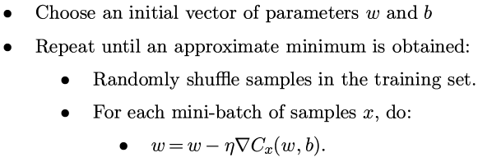
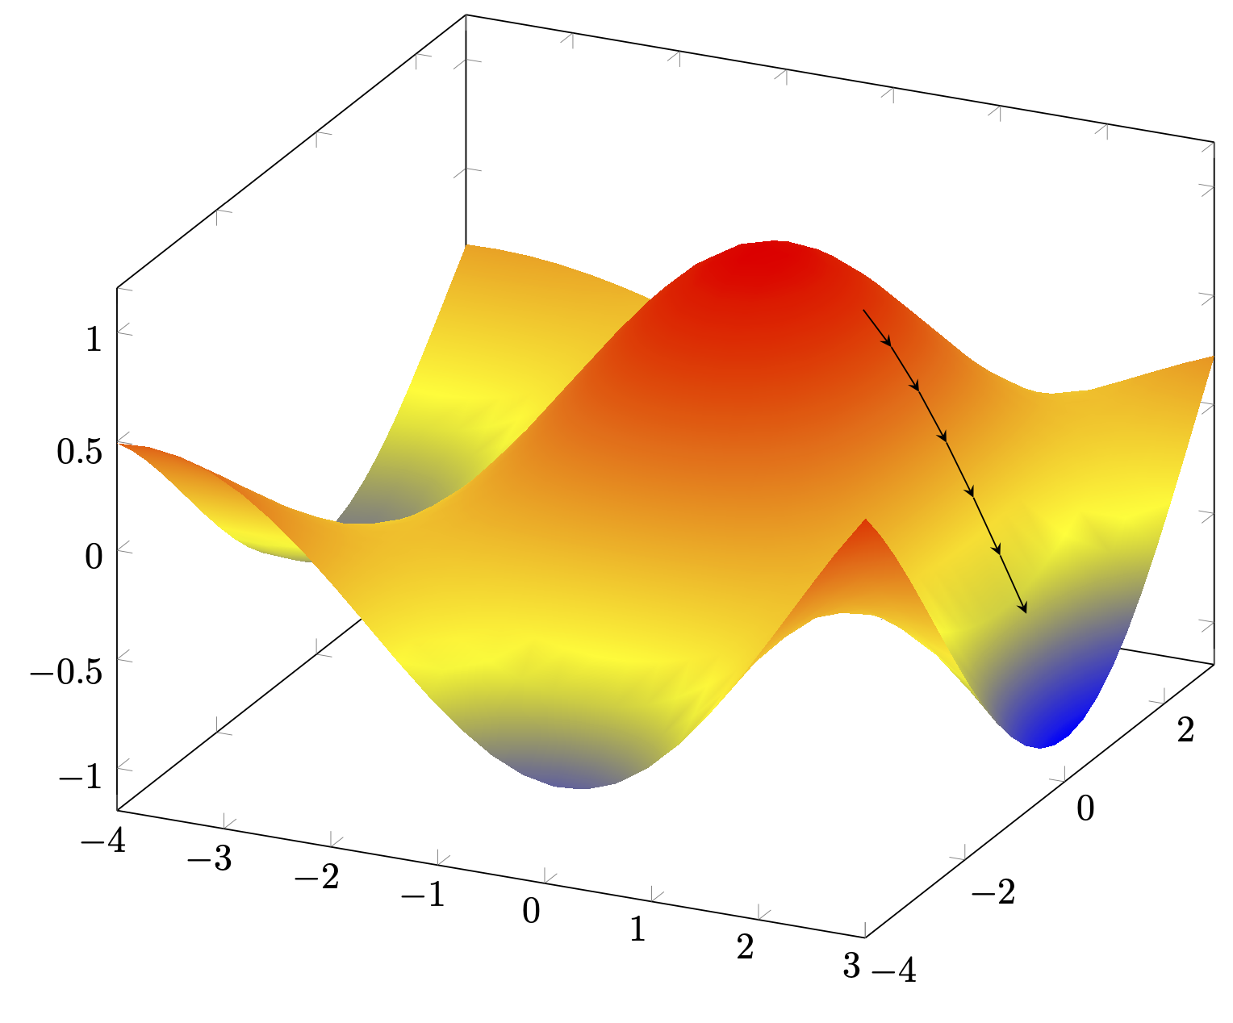
Stochastic Gradient Descent (SGD)
Most deep learning algorithms are based on the optimization algorithm SGD
Pseudocode of SGD:
Gradient Descent in 2D

Slide 21
What are hyperparameters?
Parameters chosen by users (not learned by the algorithm) are called hyperparameters
are constant, values are set before the learning process begins.
Hyperparameters in deep learning:
Type of activation functions
Number of hidden layers,
Number of nodes in a layer
Learning rate
Batch size in SGD

Slide 22
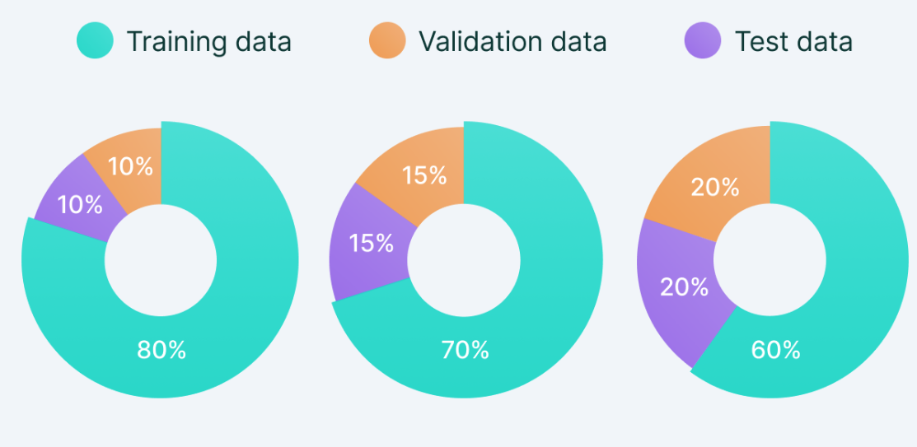
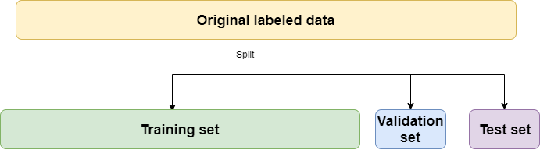
Training, validation, testing dataset
Full dataset is seperated to 3 subsets:
Training----directly used by the training algorithm
Validation---- used to guide the selection of hyperparameters
Testing---- not seen by the training algorithm.
Typical ratio between the 3 subsets: 80% : 10% : 10%

Slide 23
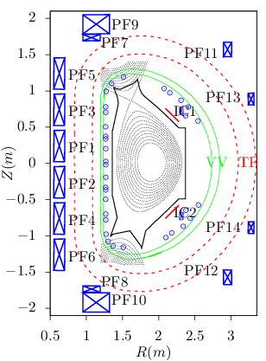
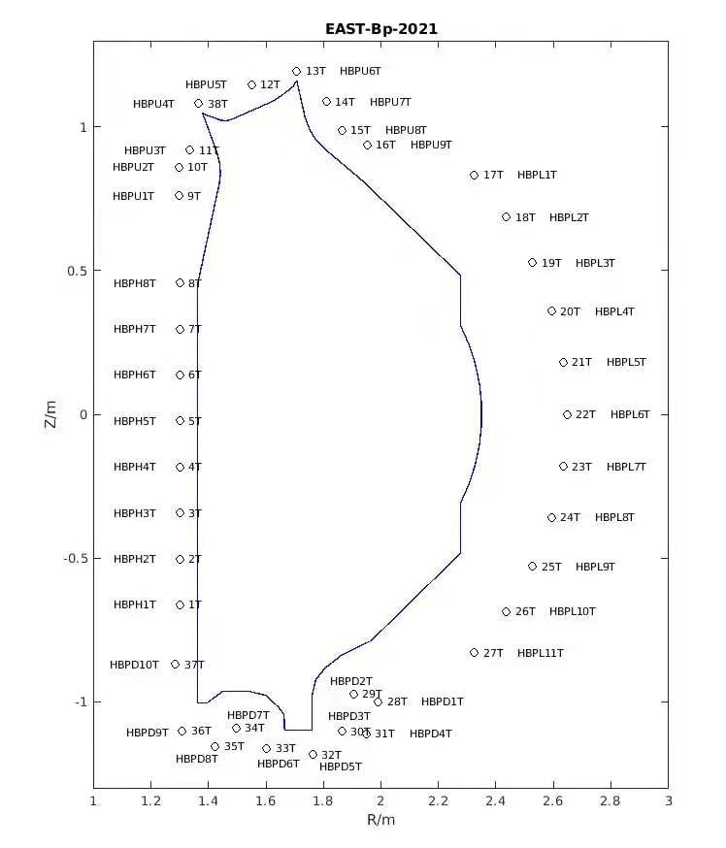
Deep learning for magnetic equilibrium reconstruction
Input: total 82 values per time slice
Equilibrium magnetic probe measurements (34 points)
Flux loop measuements (35 points)
PF coil currents (12 values)
Plasma current (1 value)
Output: Poildal flux values on 33x33 grids (1089 values)
Data are read from EAST MdSplus server using Python
Circles: Flux loop
Magnetic probes

Slide 24
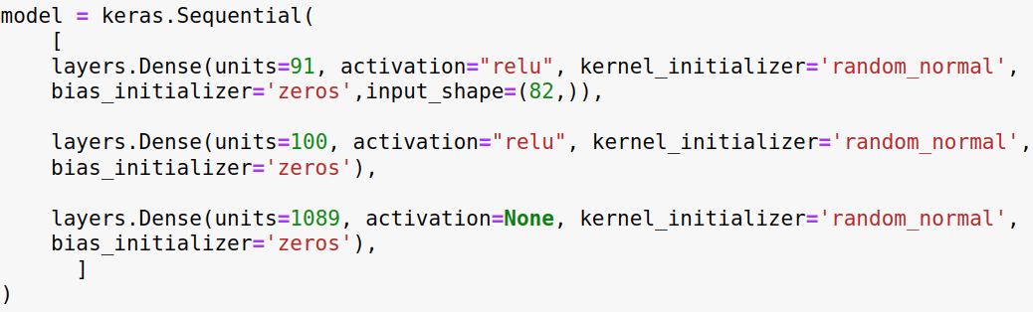
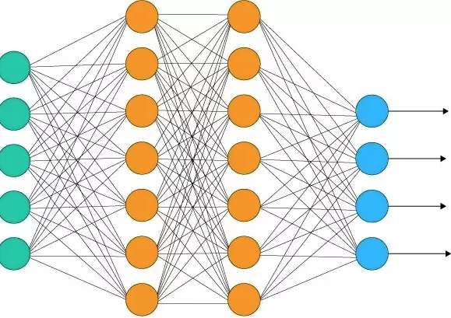
Deep learning network architecture used
91 nodes
100 nodes
82 nodes
1089 nodes

Slide 25
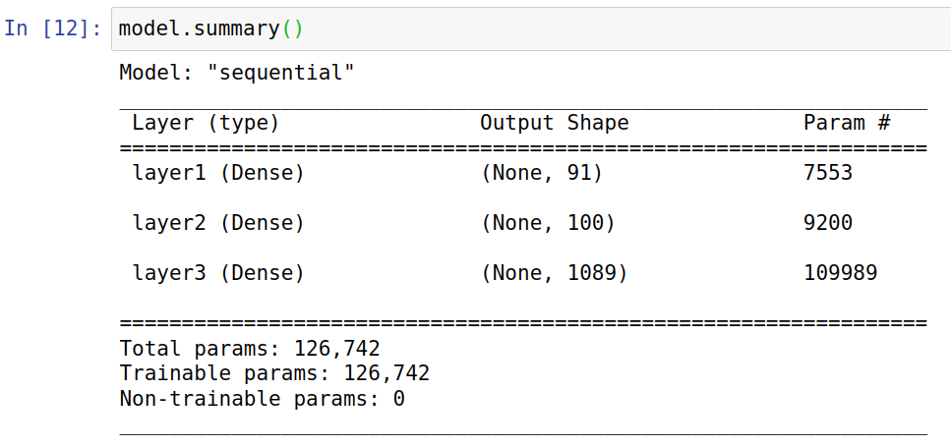
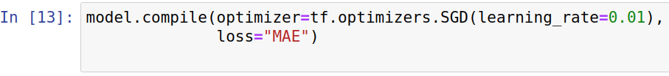

Slide 26
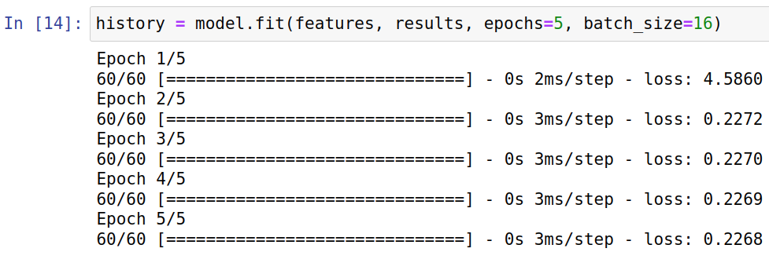
Training the model

Slide 27
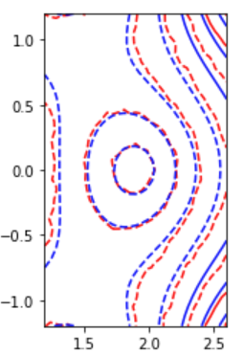

Comparison of poloidal magnetic flux between data and ML prediction
Data (blue)
Prediction (red)
Training data from EAST #109423:
958 time slices of magnetic measurements and Psi
Testing data from EAST # 109426
at an arbitrarily chosen time slice
To demonstrate that the prototype works,
not for demonstrating the accuracy
Z(m)
R(m)

Slide 28
Thank you for your attention!
Interested in ML?
Useful tools:
Python, Jupyter-notebook, tensorflow

Slide 29
This means that the goal of machine learning research is not to seek a universal learning algorithm or the absolute best learning algorithm. Instead, our goal is to understand what kinds of distributions are relevant to the “real world” that an AI agent experiences, and what kinds of machine learning algorithms perform well on data drawn from the kinds of data-generating distributions we care about.

Slide 30
A feedforward network deﬁnes a mapping y=f(x;w, b) and learns the value of the parameters (w,b) that result in the best function approximation.
These models are called feedforward because information ﬂows through thefunction being evaluated from x, through the intermediate computations used to deﬁnef, and ﬁnally to the outputy. There are no feed back connections in which outputs of the model are fed back into itself. When feedforward neural networksare extended to include feedback connections, they are called recurrent neuralnet works

Slide 31
The central challenge in machine learning is that our algorithm must perform well on new, previously unseen inputs—not just those on which our model was trained. The ability to perform well on previously unobserved inputs is called generalization
Typically, when training a machine learning model, we have access to a training set; we can compute some error measure on the training set, called the training error; and we reduce this training error. So far, what we have described is simply an optimization problem. What separates machine learning from optimization is that we want the generalization error, also called the test error, to be low as well.

Slide 32
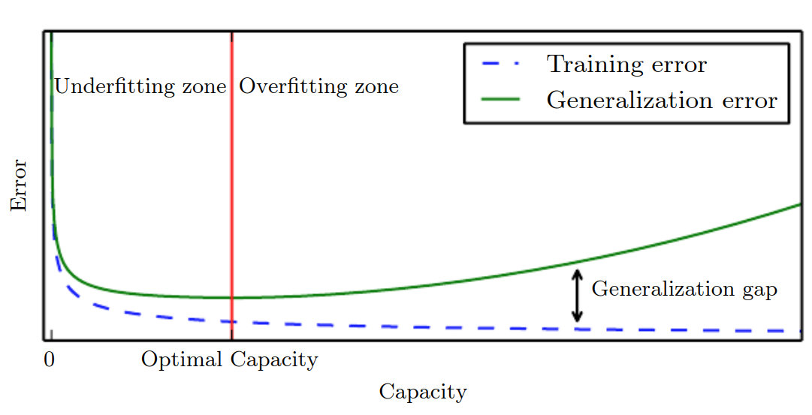

Slide 33
The ideal model is an oracle that simply knows the true probability distribution that generates the data.
Even such a model will still incur some error on many problems, because there may still be some noise in the distribution.
In the case of supervised learning, the mapping from x to y may be inherently stochastic,or y may be a deterministic function that involves other variables besides those included in x.
The error incurred by an oracle making predictions from the true distribution p(x, y) is called the Bayes error.

Slide 34
Linear models, such as logistic regression and linear regression, are appealing because they can be ﬁt eﬃciently and reliably, either in closed form or with convex optimization.

Slide 35
Unsupervised learning and supervised learning are not formally deﬁned terms. The lines between them are often blurred.

