Slide 1
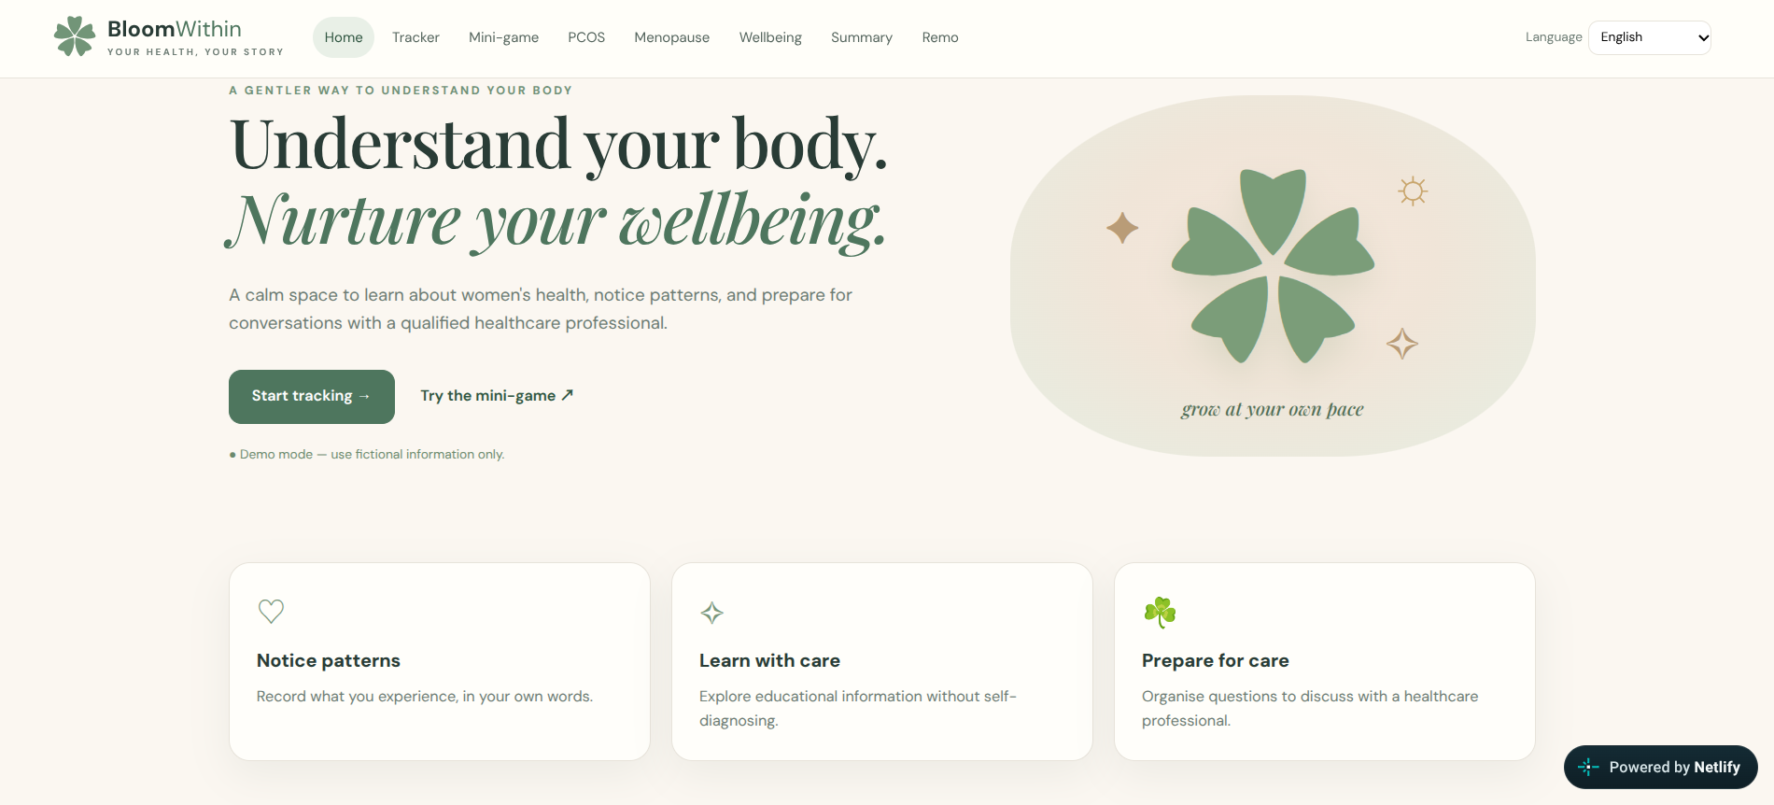
BloomWithin
Understand your body.
Nurture your wellbeing.
recHERsion’26 | Women’s Health
A web-based women’s health and wellbeing toolkit for learning, symptom awareness, reflection and preparing for healthcare conversations.
Homepage of the live prototype
bloomwithin-ypforwomen-ac01a5.netlify.app
Presented by : Youketha R And Pritika Madanraj
Notes:
Cover: project name, tagline, hackathon, team and the live homepage screenshot.

Slide 2








The challenge and our solution
The challenge
Our solution
Stigma and hesitation
Learn
Sensitive topics feel hard to raise.
PCOS and menopause basics
Information overload
Track
Online advice can be confusing.
Record symptom entries
Unclear symptoms
Reflect
Hard to know what to note or ask.
Mood check-in and mini-game
Overlooked wellbeing
Review
Stress is easy to forget.
Summary to prepare questions
Designed to support awareness and reflection, not to replace professional care.

Slide 3
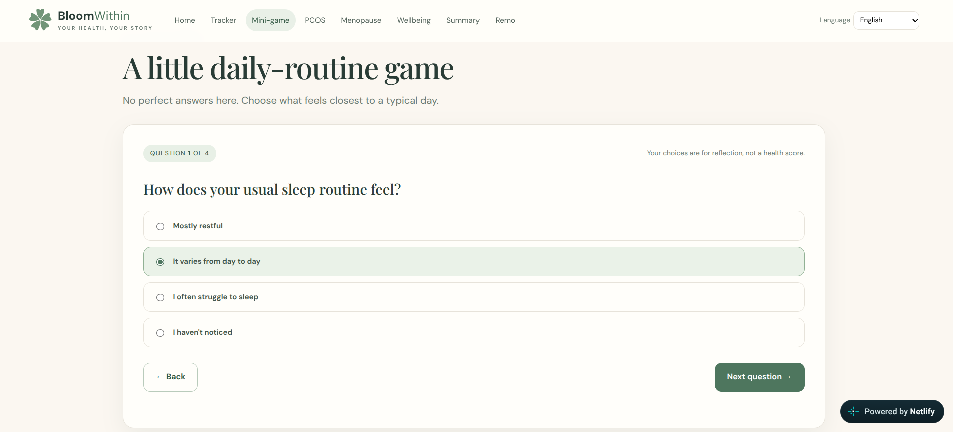
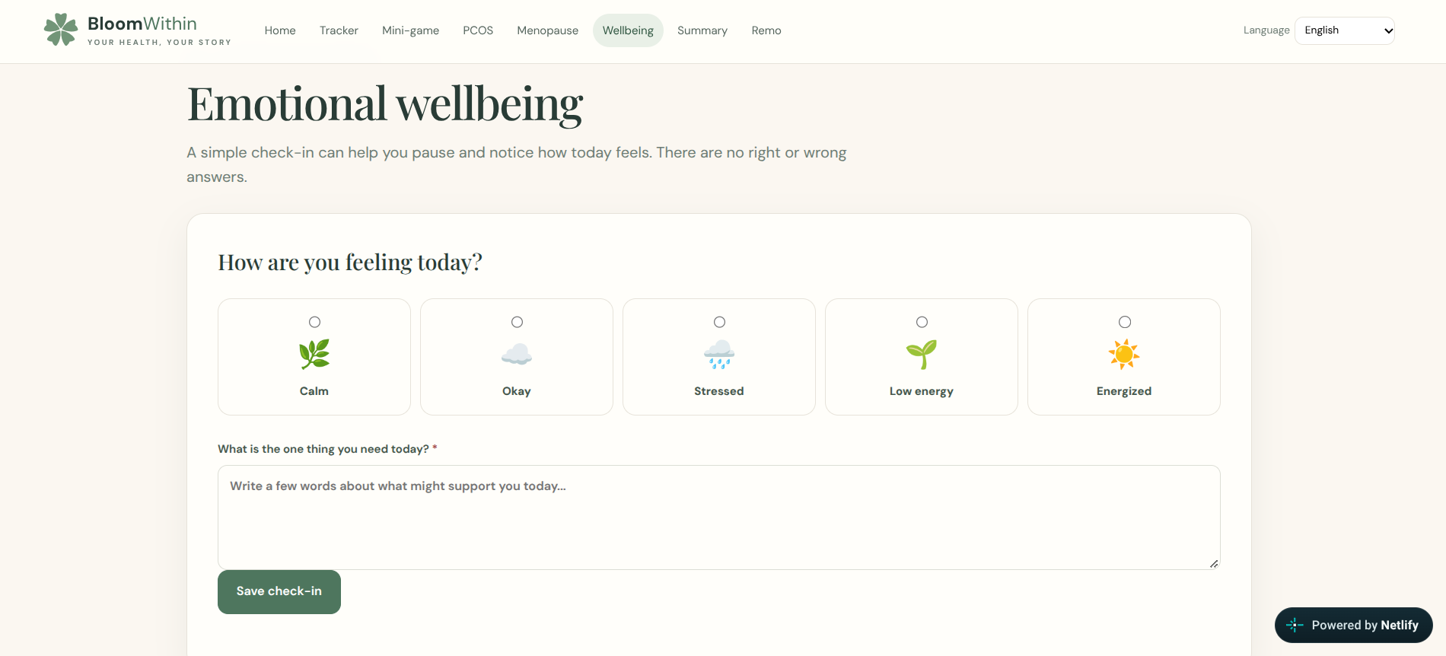

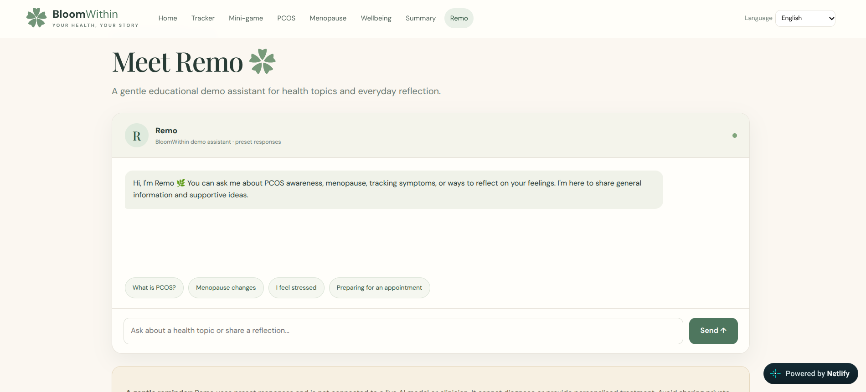
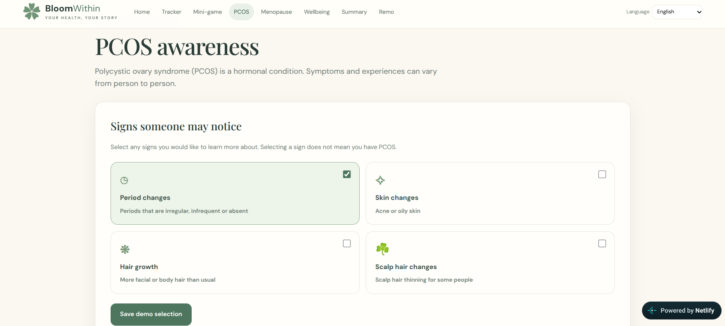
Explore the prototype
Educational prototype
It does not diagnose, predict or treat medical conditions. For health concerns, seek advice from a qualified healthcare professional.
Mini-game: four reflective questions
Wellbeing: mood check-in
Demo mode: use fictional information only.
Remo: preset-response assistant
Education: PCOS and menopause

Slide 4
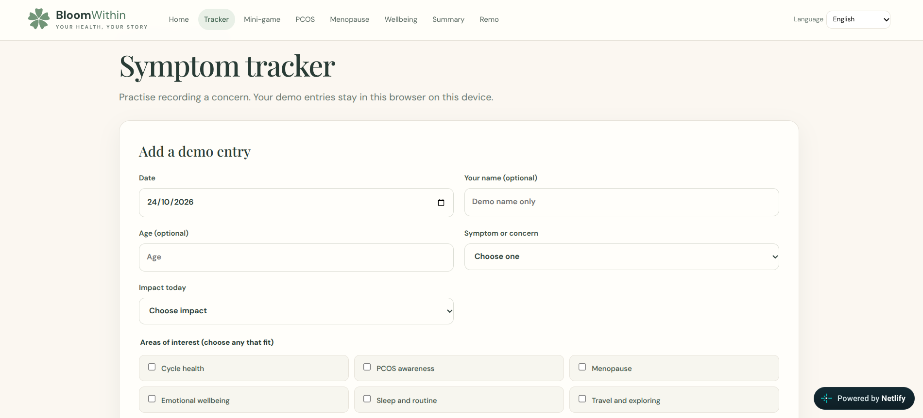
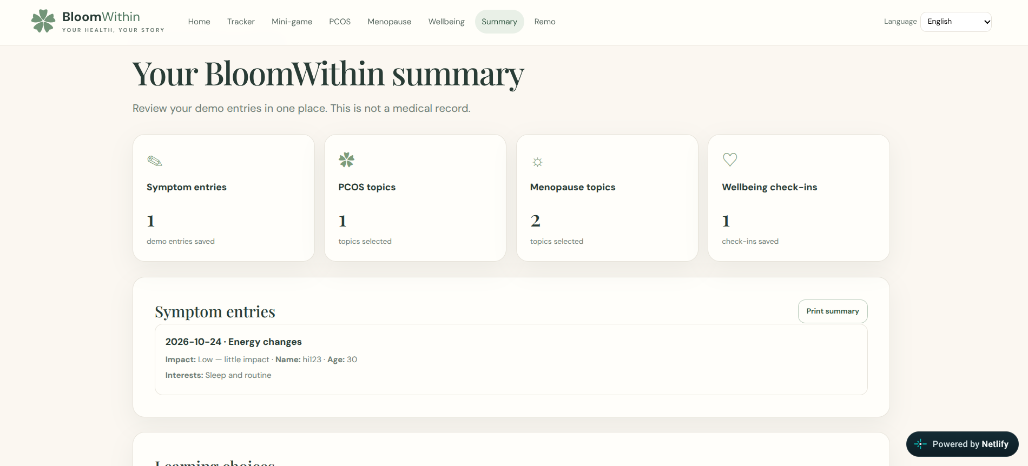
Symptom tracking and health summary
1 Symptom tracker
2 Health summary
Record a date, concern, impact and optional notes.
Entries appear with learning and wellbeing choices.
1 Enter a demo entry
2 Saved in the browser
3 Review in the summary
Demo entries stay in this browser and do not sync across devices. Please use fictional information.

Slide 5
How BloomWithin works
User
Web interface
Browser storage
Opens the site in a web browser
Tracker, mini-game, education, check-in and Remo (preset answers)
Demo entries stay on this device; no sync
Hosted on Netlify: hosting only, not evidence of a backend or database.
Future scope (not implemented)
Possible backend storage, external APIs or live AI integration.
Technologies used: HTML, CSS and JavaScript

Slide 6


Safety, privacy and limitations
Safety
Privacy
Limitations
Education, not diagnosis
Entries cannot confirm a condition
Remo uses preset answers, not live AI
Entries stay in this browser
No automatic sync across devices
Use fictional information only
Initial prototype, not clinically validated
No personalised treatment advice
Health content needs ongoing review
BloomWithin is an educational prototype. It does not diagnose, predict, or treat medical conditions. For health concerns, seek advice from an appropriate qualified healthcare professional.

Slide 7
Expected impact and future scope
Intended benefits
Future goals
Intended, not measured outcomes
Goals, not completed work
Education → Awareness
1
Confirm the actual technology stack
2
Review health content against credible sources
Symptom tracker → Organised notes
3
Review privacy and safeguarding requirements
Wellbeing check-in → Time to reflect
4
Improve mobile usability and accessibility
5
Evaluate the proposed doctor-preparation and verified support-directory features
Health summary → Prepared questions
6
Conduct usability testing and evaluate user understanding

Slide 8
References and project links
BloomWithin
Health references
recHERsion’26 · Women’s Health
WHO: Polycystic ovary syndrome
Team
Pritika Madanraj and Youketha R
WHO: Menopause
Live prototype
Ministry of Health and Family Welfare, India
bloomwithin-ypforwomen-ac01a5.netlify.app
Ministry of Women and Child Development, India
GitHub repository
https://github.com/Youketha2008-yka/BloomWithin
These organisations do not endorse BloomWithin.
Understand your body. Nurture your wellbeing.

