Slide 1
Exploring data from video sharing websites
Youmna Alsayed

Slide 2

Dataset

Slide 3
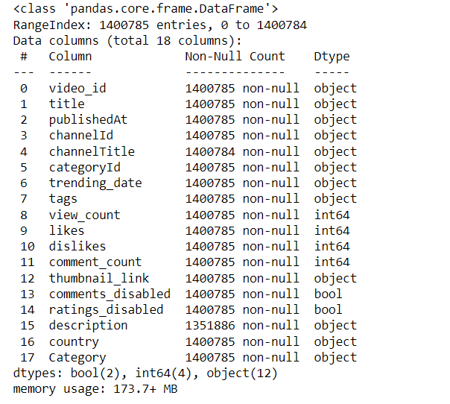
Dataset

Slide 4
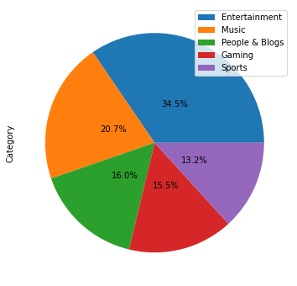
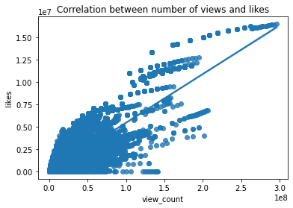
BASIC DATA EXPLORATION

Slide 5
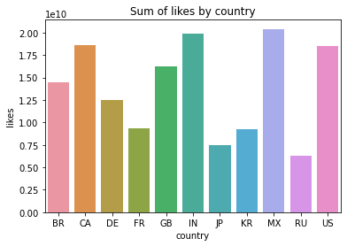
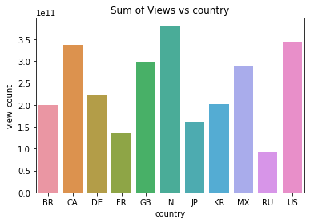
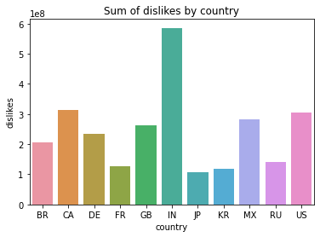
BASIC DATA EXPLORATION

Slide 6
Motivation
Categories’ importance → effect on the profit of the channels, and their position
Views count → effect on the profit of the channels
Does the coronavirus affect of the views and increased it in 2020 comparing to the other years (2021, 2022)?

Slide 7
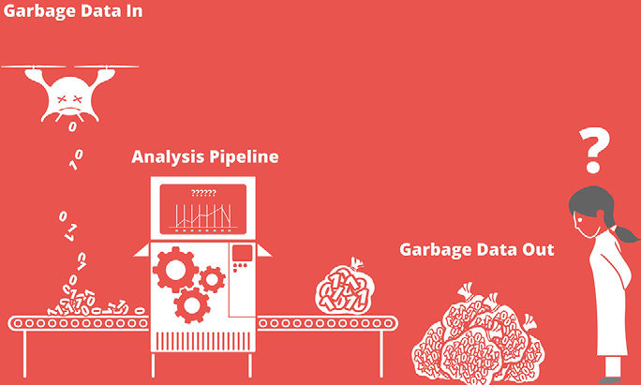

Slide 8
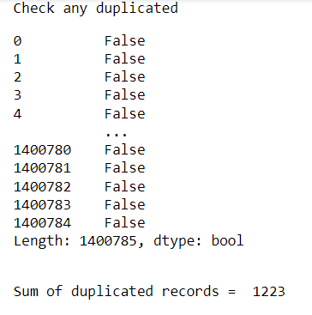
Analyzing the quality of the data
.drop_duplicates()
Sum of duplicated records after dropping= 0

Slide 9
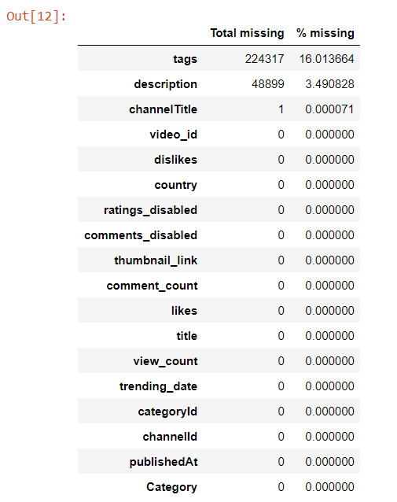
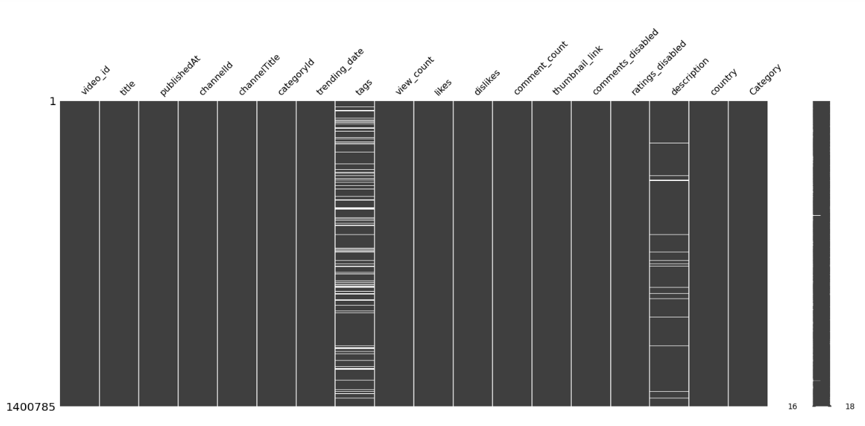
Analyzing the quality of the data

Slide 10
Feature Engineering
Handling missing data
New features extraction
Handling skewed data
Handling the duplicated videos (not duplicated in all features)
Converting categorical data into numerical data

Slide 11
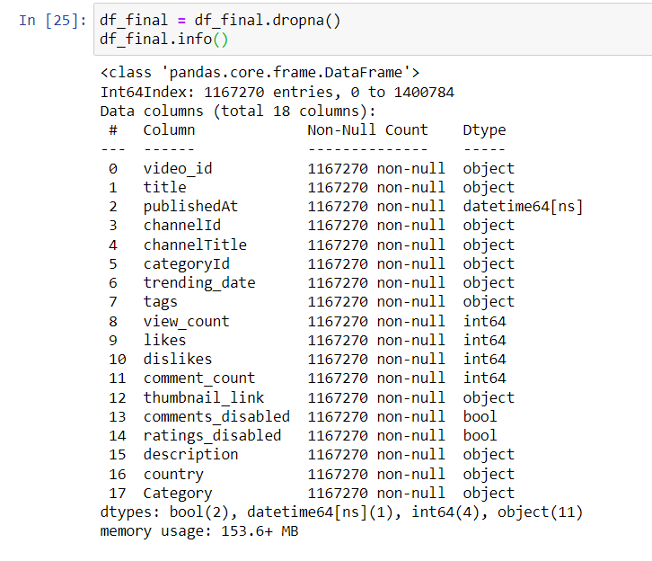
Feature Engineering (Handling missing data)
From our observations the missing values are Missing Not At Random (MNAR), as we think they depend on unobserved data, and we can not explain the pattern in the missing data. So, we are going to drop them.

Slide 12
Feature Engineering (New features extraction)
tags | trending_date | publishedAt
Amber|amber vtuber|genshi|genshi game|genshi impact|genshi video|genshin|genshin game|genshin impact|genshin impact 2020|genshin impact game|genshin impact good|genshin impact graphics|genshin impact introduction||MMO PlayStation | 2020-08-12 | 2020-08-11 22:21:49

Slide 13
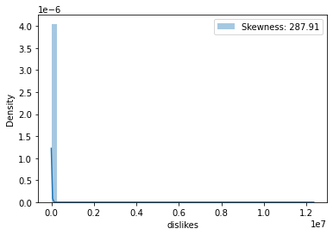
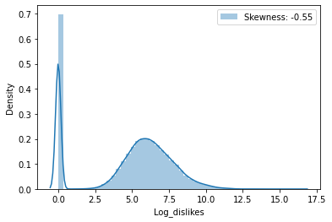
Feature Engineering (Handling skewed data)
Dislikes

Slide 14
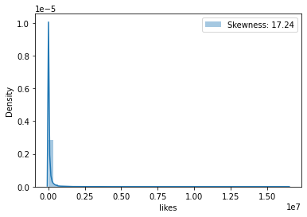
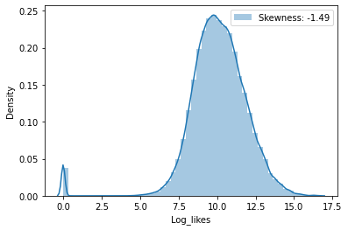
Feature Engineering (Handling skewed data)
likes

Slide 15
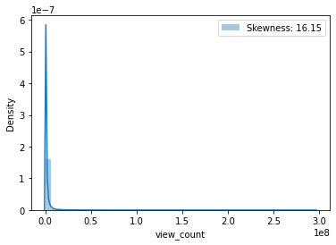
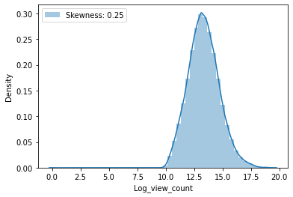
Feature Engineering (Handling skewed data)
Count views

Slide 16

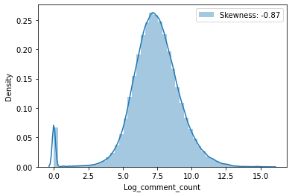
Feature Engineering (Handling skewed data)
Comments
count

Slide 17
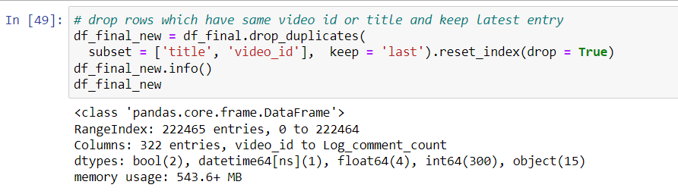
Feature Engineering (Handling the duplicated videos )
Drop the duplicated rows that have the same video id and same title with keeping the latest entry for them.

Slide 18
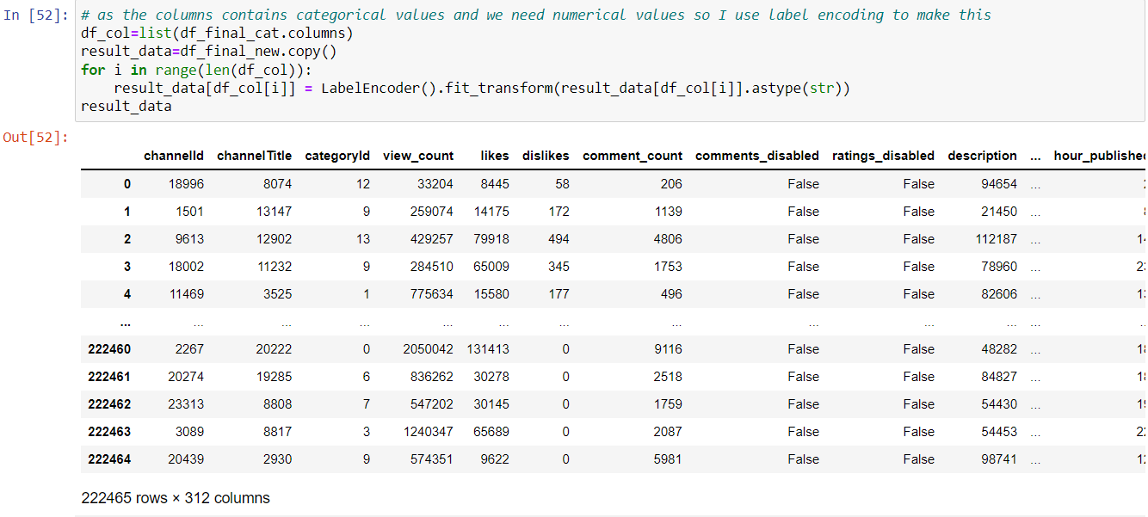
Feature Engineering (Categorical → numerical data)

Slide 19


Feature Selection
Working on all features → high computational & executed for the models
Select features for each model based on embedded method by RandomForestRegressor by (n_estimators = 50)

Slide 20
Classification model:
Classification
Categories
Random Forest & KNN

Slide 21
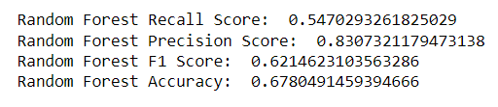
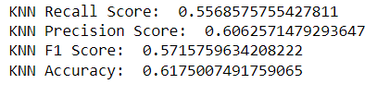
Results
Classification by Random Forest
Hyperparameter tuning: {'n_estimators': 150}
Classification by KNN
With k = 3

Slide 22
Limitations
Very huge dataset, so our hardwares couldn’t deal with (Memory crashing)
Much time in each algorithm
Data is updated daily

Slide 23
Conclusion
Data exploration or EDA is a good step to understand the data more.
Data cleaning, and feature extraction are an important steps, and have high effect on the results.
Choosing the hyperparameters effect on the model performance.

Slide 24


