Slide 1

University Of Science And Technology Houari Boumediene
Information and Communication Technologies

Slide 2

1) Introduction To TIC
2) Google Services
3) Microsoft Tools
4) Git Github
5) Conclusion
6) References

Slide 3

INTRODUCTION TO TIC

Slide 4

1) INTRODUCTION TO TIC :
TIC
ROUTING
RADIO
FREQUENCY
BAR
CODING
INVENTORY
MANAGEMENT
ADDRESS SYSTEMS
FREIGHT
AUDITING
Information and Communication Technologies (TIC) encompass a wide range of technologies used for handling telecommunications, data management, software development, and communication systems. Key components include Information Technology (IT) and Communication Technology (CT). TIC plays a crucial role in global connectivity, digital transformation, and economic growth. It impacts society and businesses by providing access to information, fostering innovation, and presenting challenges like cybersecurity. The continuous evolution of TIC shapes the future of technology and influences various aspects of our daily lives.

Slide 5

GOOGLE
SERVICES

Slide 6

2) GOOGLE SERVICES :
GMAIL
MAPS
CALENDAR
CHROME
DRIVE
SHEET
MEET
CLASSROOM

Slide 7
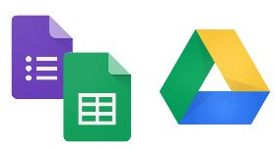


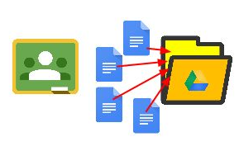
2) GOOGLE SERVICES :
SHARE TO DRIVE !
SHARE IN GMAIL !
LOCATE DOCUMENTS !
THE USES OF GOOGLE SERVICES
CLASSE IN FOLDERS !

Slide 8

MICROSOFT
TOOLS

Slide 9

3) MICROSOFT TOOLS :
MICROSOFT
TOOLS
MICROSOFT
SUITE
OutLook
OneDrive
MICROSOFT
AZURE
MICROSOFT
TEAMS
Microsoft is indeed a major player in the technology industry, providing a wide range of products and services, including operating systems, productivity software, cloud computing, hardware, and more. The company's diverse business model and commitment to innovation have made it a key influencer in shaping the way individuals and organizations interact with technology.

Slide 10






WORD
EXCEL
PowerPoint
PUBLISHER
ACCESS
PROJECT
3) MICROSOFT TOOLS :
MICROSOFT SUIT :
Word allows users to create, edit, format, and insert images and tables then save documents .
E
Excel is designed for creating, organizing, and analyzing data in tabular form.
To create slides with text, images, and multimedia elements to convey them in a dynamic way.
For creating various types of publications, brochures, newsletters, flyers, and others .
Allows users to design databases, enter data, and create forms and reports for data analysis and presentation..
To assist project managers in planning, tracking, and managing projects of various sizes and complexities.

Slide 11
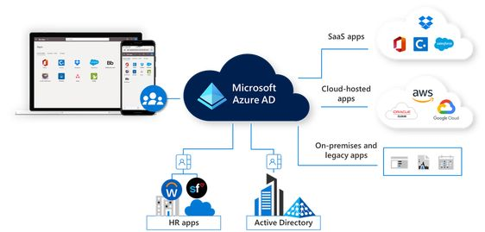

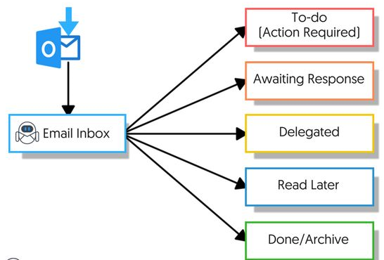

3) MICROSOFT TOOLS :
OUTLOOK
AZURE

Slide 12
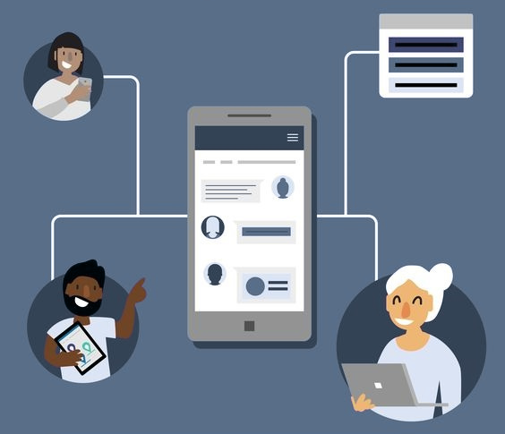

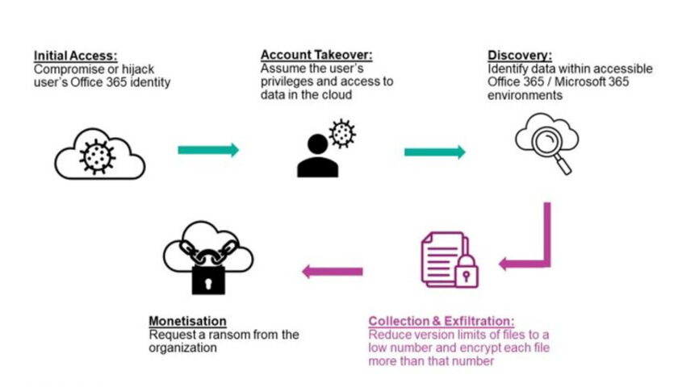

3) MICROSOFT TOOLS :
ONEDRIVE
TEAMS

Slide 13

GIT AND
GITHUB

Slide 14
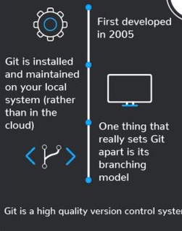






4) GIT GITHUB :
How github works :
Fork
Pull request
Push
Clone
Merged
Pull
Request
Commit
How git works :

Slide 15



4) GIT GITHUB :
It’s a service .
It’s hosted on web.
It provides a graphical interface.
It’s a space to upload a copy of the git repository.
It provides functionalities of Git like VSC , Source Code Management as well as adding few of its own features.
It’s a software.
It’s installed locally on the system.
It’s a command line Tool.
It’s a Tool to manage different versions of edits , made to files in a git repository.
It provides functionalities like Version Control System, Source Code Management.

Slide 16

CONCLUSION
REFRENCES

Slide 17
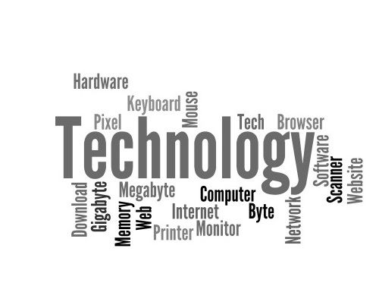
5) CONCLUSION :
Information and communication technologies (TIC) have revolutionized global connectivity, communication, and economic growth. Key components like data management and cybersecurity play vital roles. TIC's ongoing evolution presents challenges and opportunities, demanding adaptive responses . Ultimately , TIC has become integral to our socio-economic fabric , shaping the way we live and work , with continuous advancements shaping the future technological landscape .
IN CONCLUSION :

Slide 18
6) REFRENCES :
Google Official Blog:https://blog.google/
• Google Cloud Documentation:https://cloud.google.com/
• https://www.wikipedia.org/
• Stack Overflow Documentation
• https://www.microsoft.com/en-us/about

Slide 19





OUR TEAM MEMBER
OULAD SAID
KHADIDJA
She performed excel tasks .
CHELLAH
NAWEL
She performed powerpoint tasks.
BEZZAZ
MARIA
Our team leader .
She performed word tasks .
FERKANE
AHMED
He performed LaTex tasks.
BOUGADOUM
YOUNES
He performed LaTex tasks.
GROUPE 7

Slide 20
THANK YOU

