Slide 1
Microprocessor Microarchitecture
Branch Prediction
Lynn Choi
School of Electrical Engineering

Slide 2
Branch
Branch Instruction distribution (% dynamic instruction count)
  24% of integer SPEC benchmarks
  5% of FP SPEC benchmarks
  Among branch instructions
    80% conditional branches
Issues
  Before fetching the next instruction, we need to determine the following three:
    If the current instruction is a branch
    Branch target address has to be calculated
    Branch condition need to be resolved for conditional branches
  Without branch prediction,
    Instruction fetch must stop until the instruction is decoded
    Or until the target address is computed in the execution stage

Slide 3
Solution
Resolve the branch as early as possible
Branch prediction
  Input: PC, Output: 1. branch? 2. branch target 3. branch condition
  Predictions are made even before the branch is fetched or decoded
  A simple solution
    Implicitly prefetch the next sequential instruction assuming branch is not taken
  We need a more accurate prediction to reduce the misprediction penalty
    As pipelines become deeper and wider, the importance of branch misprediction will increase substantially!
  On a misprediction, the pipeline has to be flushed,
    Example
      With 10% misprediction rate, 4-issue 5-stage pipeline will waste ~23% of issue slots!
      With 5% misprediction rate, 13% of issue slots will be wasted.
  Speculative execution
    Before each branch is resolved, i.e. fetch/decode/executed, the instructions from the predicted path are fetched and executed

Slide 4
Branch Misprediction Flush Example
1 LD R1 <- A
2 LD R2 <- B
3 MULT R3, R1, R2
4 BEQ R1, R2, TARGET
5 SUB R3, R1, R4
ST A <- R3
TARGET: ADD R4, R1, R2
F
D
R
E
E
W
Branch Target is known
F
D
R
E
E
W
F
D
R
R
E
E
E
E
W
F
D
D
R
E
W
F
F
D
R
E
W
Speculative execution:
These instructions will be flushed
on branch misprediction
F
D
R
E
W
F
D
R
E
W
F
D
R
E
W

Slide 5
Branch Prediction
Branch condition prediction
  For conditional branches
  Static prediction vs. dynamic prediction (1-bit, 2-bit, two-level)
Branch target prediction
  Branch Target Buffer (BTB)
    Perform both target and condition prediction
    Store target address for each branch
    2-bit saturating counter for each branch
  Target Address Cache (TAC)
    Store target address for only taken branches
    Separate condition prediction (branch prediction tables)
  Return address stack (RAS)
    Store return address for procedure call
    Also called return stack buffer (RSB)

Slide 6
Branch Target Buffer
For BTB to make a correct prediction, we need
  BTB hit: the branch instruction should be in the BTB
  Prediction hit: the condition prediction should be correct
  Target match: the target address must not be changed from the last time
Example: BTB hit ratio of 96%, 97% prediction hit, 1.2% of target change,
  The overall prediction accuracy = 0.96 * 0.97 *0.988 = 92%
Implementation: Accessed with VA and need to be flushed on context switch
Branch Instruction
Address
Branch Target
Address
Two-bit Counter
.
.
.
.
.
.
.
.
.

Slide 7
Branch Target Buffer
Should we store target address for both taken and not-taken branches?
How about storing instructions rather than target addresses?
Branch folding
  Store one or more target instructions instead of the predicted target address
  Advantages
    On a BTB hit and if the branch is unconditional, the pipeline can substitute the instruction from the BTB in place of the instruction from the cache
    For highly predictable conditional branches, you can do the same
    This allows 0-cycle unconditional branches and sometimes 0-cycle conditional branches

Slide 8
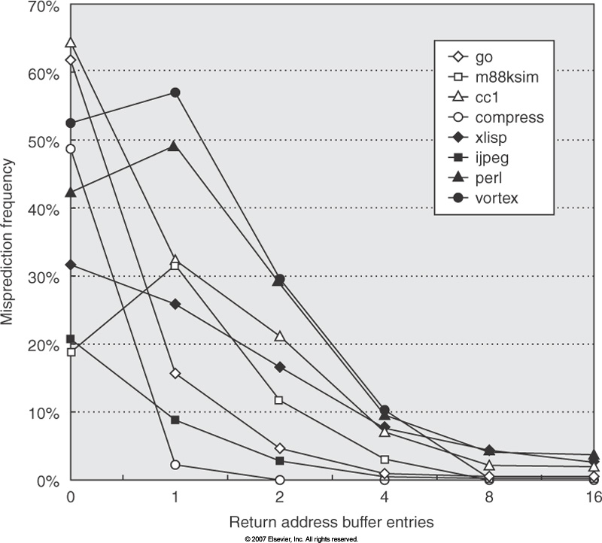
RAS Misprediction Rates versus Size

Slide 9
Static Branch Prediction
Assume all branches are taken
  60% of conditional branches are taken
Opcode information
  Backward Taken and Forward Not-taken scheme
    Quite effective for loop-bound programs
    Miss once for all iterations of a loop
    Does not work for irregular branches
    69% prediction hit rate
Profiling
  Measure the tendencies of the branches and preset a static prediction bit in the opcode
  Sample data sets may have different branch tendencies than the actual data sets
  92.5% hit rate
Static predictions are used as safety nets when the dynamic prediction structures need to be warmed up

Slide 10
Dynamic Branch Prediction
Dynamic schemes- use runtime execution history
  LT (last-time) prediction - 1 bit, 89%
  Bimodal predictors - 2 bit
    2-bit saturating up-down counters (Jim Smith), 93%
    Several different state transition implementations
    Used in Branch Target Buffer(BTB)
  Static training scheme (A. J. Smith), 92 ~ 96%
    Use both profiling and runtime execution history
      Statistics collected from a pre-run of the program
      A history pattern consisting of the last n runtime execution results of the branch
  Two-level adaptive training (Yeh & Patt), 97%
    First level, branch history register (BHR)
    Second level, pattern history table (PHT)

Slide 11
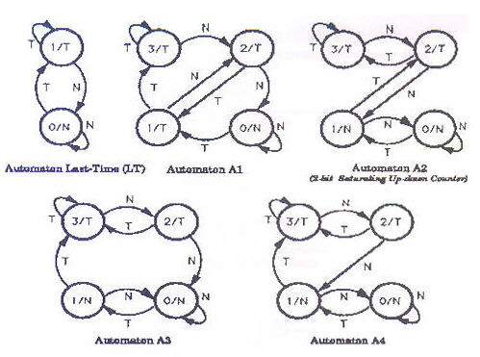
Bimodal Predictor
S(I): State at time I
G(S(I)) -> T/F: Prediction decision function
E(S(I), T/N) -> S(I+1): State transition function
Performance: A2 (usually best), A3, A4 followed by A1 followed by LT
IEEE All rights reserved

Slide 12
Two-level adaptive predictor
Motivated by
  Two-bit saturating up-down counter of BTB (J. Smith)
  Static training scheme (A. Smith)
    Profiling + history pattern of last k occurences of a branch
Organization
  Branch history register (BHR) table
    Indexed by instruction address (Bi)
    Branch history of last k branches
      Local predictor: The last k occurrences of the same branch (Ri,c-kRi,c-k+1….Ri,c-1)
      Global predictor: The last k branches encountered
    Implemented by k-bit shift register
  Pattern history table (PHT)
    Indexed by a history pattern of last k branches
    Prediction function z = λ(Sc)
      Prediction is based on the branch behavior for the last s occurrences of the pattern
    State transition function Sc+1 = δ(Sc, Ri,c)
      2b saturating up-down counter

Slide 13
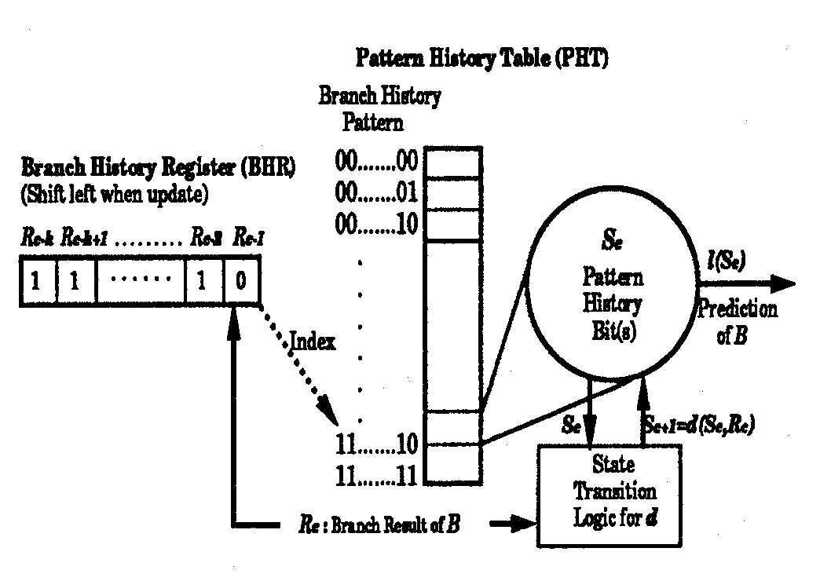
Structure of 2-level adaptive predictor
IEEE All rights reserved

Slide 14
Global vs. Local History
Global history schemes (global predictor)
  The last k conditional branches encountered
  Works well when the direction taken by sequentially executed branches is highly correlated
    EX) if (x >1) then .. If (x<=1) then ..
  These are also called correlating predictors
Local history schemes (local predictor)
  The last k occurrences of the same branch
  Works well for branches with simple repetitive patterns
  Two types of contention
    Aliasing: Branch history may reflect a mix of histories of all the branches that map to the same history entry
    Branch history depth: With 3 bits of history, cannot distinguish patterns of 0110 and 1110
      However, if the first pattern is executed many times then followed by the second pattern many times, the counters can dynamically adjust

Slide 15
Bimodal Predictor Structure
2b counter arrays
11
Predict taken
A simple array of counters (without
tags) often has better performance
for a given predictor size
PC

Slide 16
Local History Structure
History
Counts
110
11
Predict taken
PC

Slide 17
Global History Structure
2b counter arrays
11
Predict taken
GHR

Slide 18
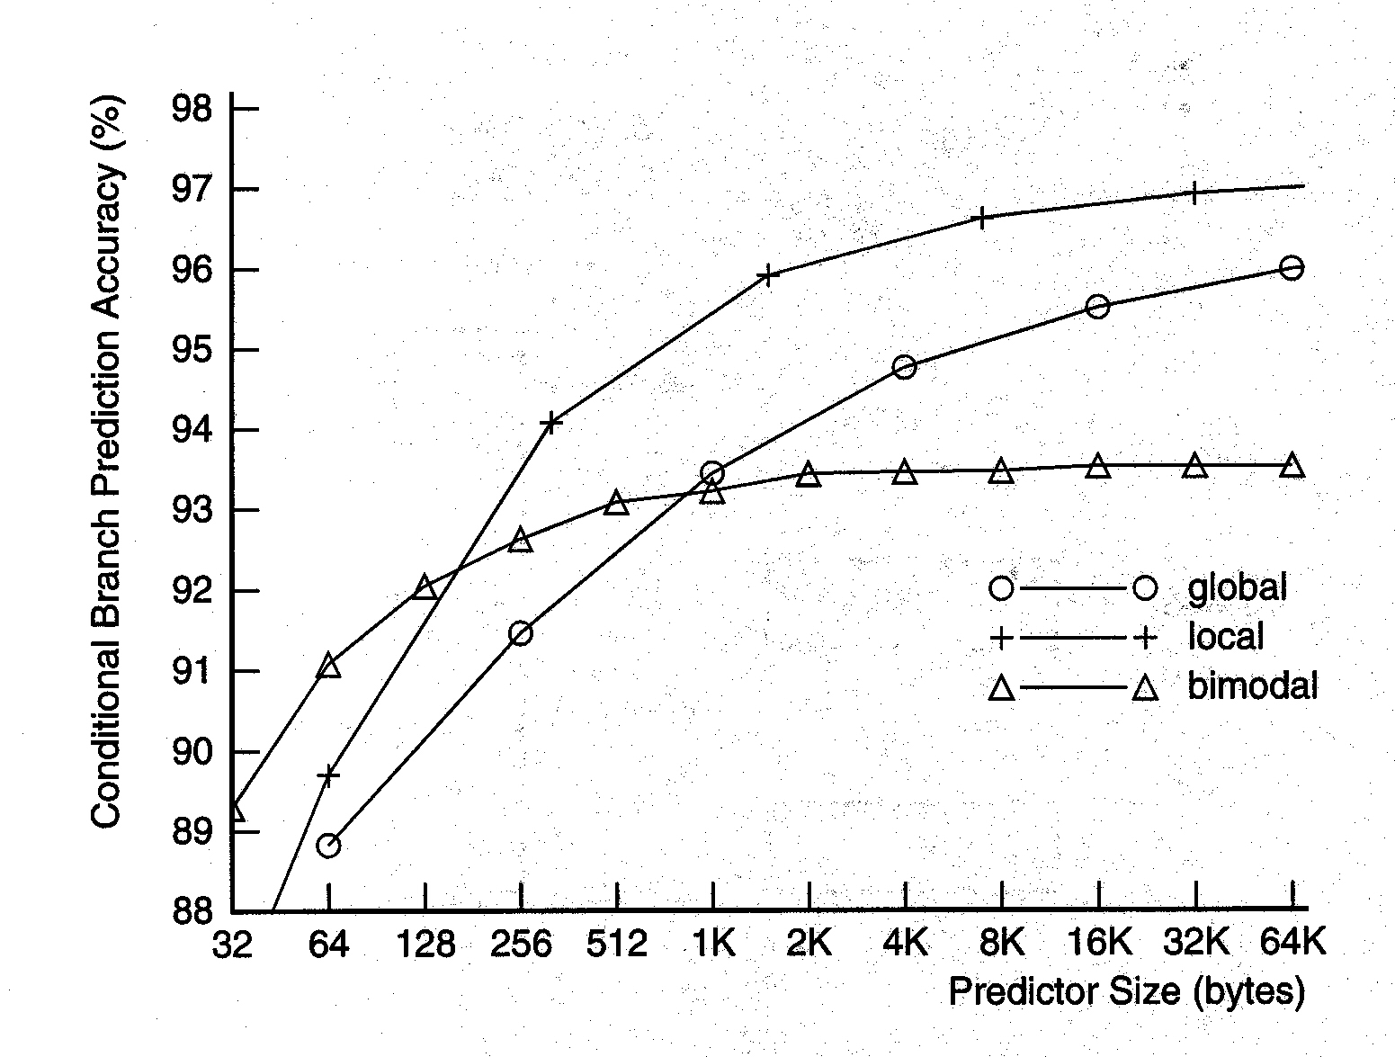
Global/Local/Bimodal Performance
IEEE All rights reserved

Slide 19
Global Predictors with Index Sharing
Global predictor with index selection (gselect)
  Counter array is indexed with a concatenation of global history and branch address bits
  For small sizes, gselect parallels bimodal prediction
  Once there are enough address bits to identify most branches, more global history bits can be used, resulting in much better performance than global predictor
Global predictor with index sharing (gshare)
  Counter array is indexed with a hashing (XOR) of the branch address and global history
    Eliminate redundancy in the counter index used by gselect

Slide 20
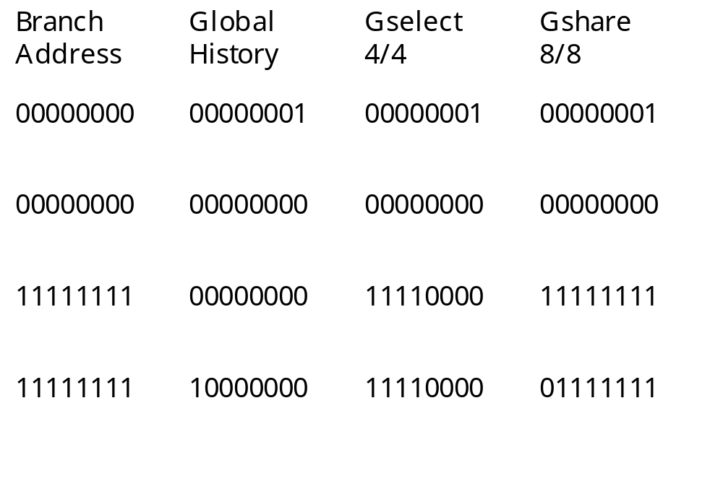
Gshare vs. Gselect

Slide 21
Gshare/Gselect Structure
gshare
GHR
m
n
m
XOR
11
Predict taken
n
n
m+n
PC
gselect

Slide 22
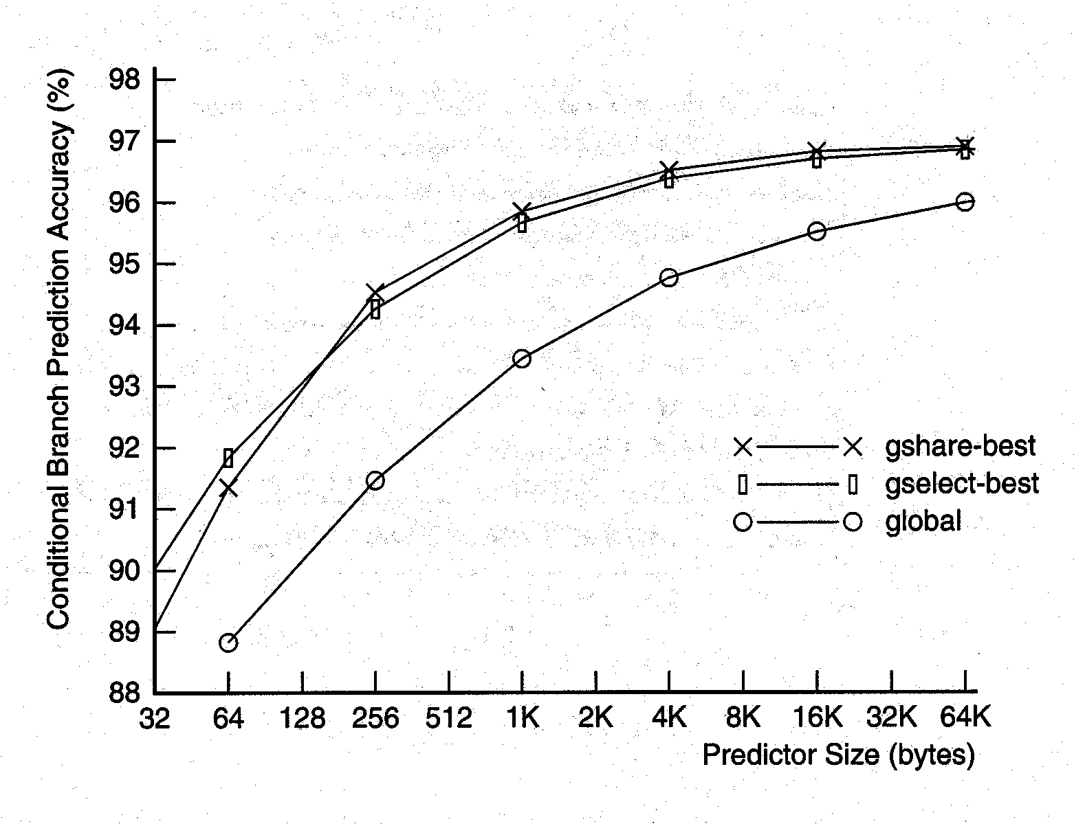
Global History with Index Sharing Performance
IEEE All rights reserved

Slide 23
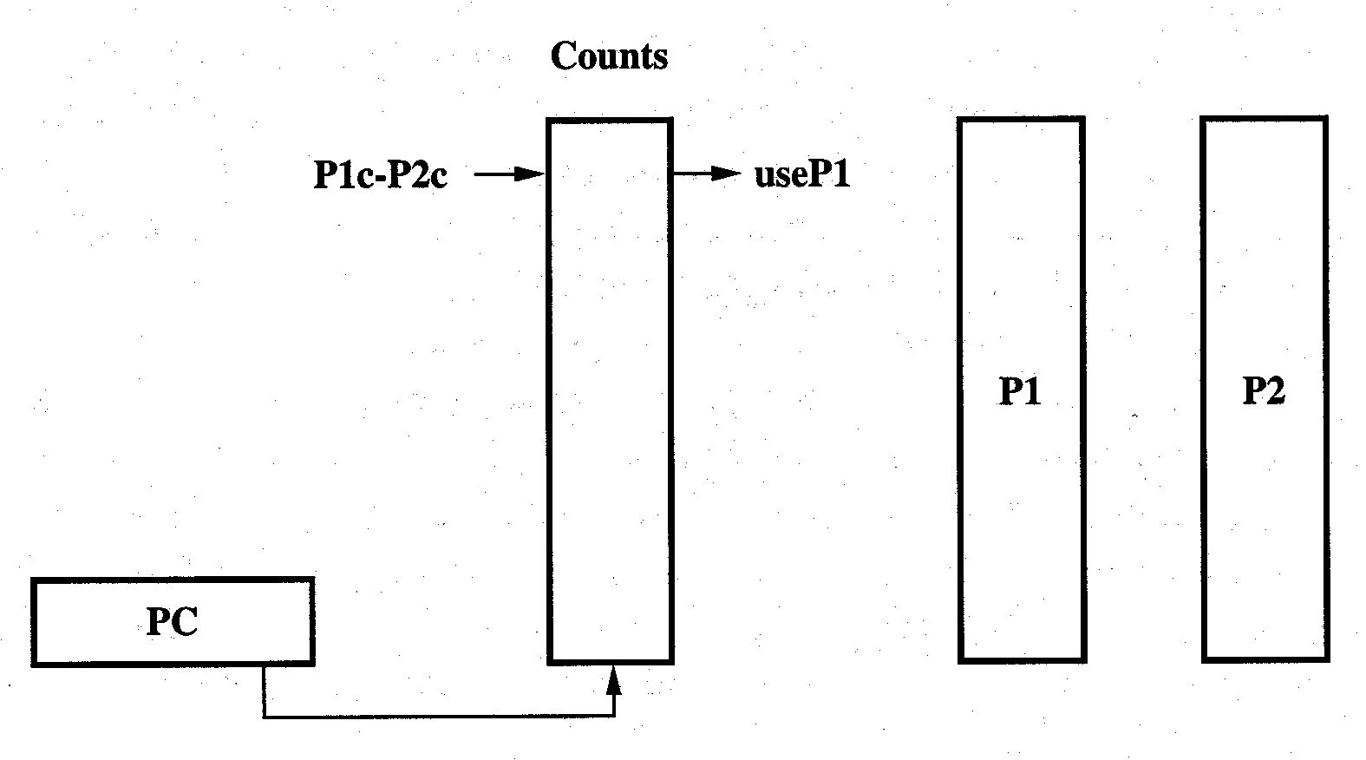
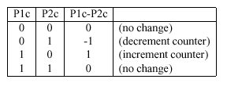
Combined Predictor Structure
These are also called tournament predictors
  Adaptively combine global and local predictors
IEEE All rights reserved

Slide 24
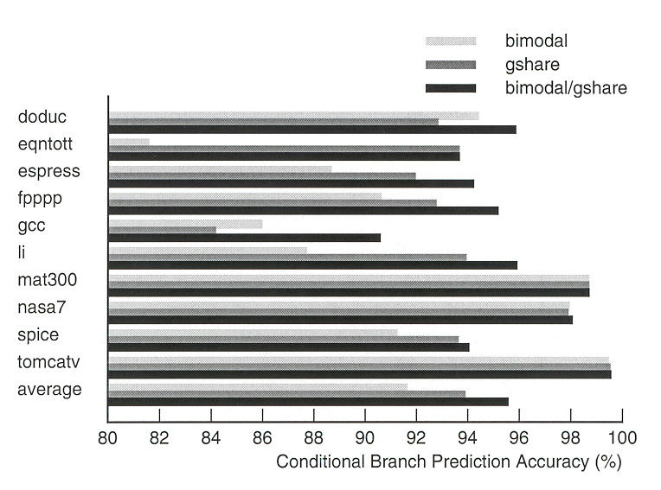
Combined Predictor Performance
IEEE All rights reserved

Slide 25
Exercises and Discussion
Intel’s Xscale processor uses bimodal predictor? What state would you initialize?
Y/N Questions. Explain why.
  Branch prediction is more important for FP applications. (Y/N) Why or Why not?
  Branch prediction is more difficult for conditional branches than indirect branches. (Y/N) Why or Why not?
  To predict branch targets, an instruction must be decoded first. (Y/N) Why or Why not?
  RAS stores target address of call instructions. (Y/N) Why or Why not?
  At the beginning of program execution, static branch prediction is more effective than dynamic branch prediction (Y/N) Why or Why not?

