Slide 1
Microprocessor Microarchitecture
Instruction Fetch
Lynn Choi
Dept. Of Computer and Electronics Engineering

Slide 2
Instruction Fetch w/ branch prediction
On every cycle, 3 accesses are done in parallel
  Instruction cache access
  Branch target buffer (target address cache) access
    If hit, determines that it is a branch and provides target address
    Else, use fall-through address (PC+4) for the next sequential access
  Branch prediction table access
    If taken, instructions after the branch are not sent to back end and next fetch starts from target address
    If not taken, next fetch starts from fall-through address

Slide 3
Motivation
Wider issue demands higher instruction fetch rate
However, instruction fetch bandwidth is limited by
  Basic block size
      Average block size is 4 ~ 5 instructions
      Need to increase basic block size!
  Taken branches
      The number of instructions between taken branches is 6 ~ 7
      Fetch mechanism for non-contiguous basic blocks
  Branch prediction throughput
      Multiple branch prediction per cycle is necessary for wide-issue superscalar!
        Can fetch multiple contiguous basic blocks
  Branch prediction hit rate
      Cost of redirecting fetching
      More accurate prediction is needed
  Instruction cache hit rate
      Instruction prefetching

Slide 4
Solutions
Solutions
  Increase basic block size (using a compiler)
    Trace scheduling, superblock scheduling, predication
  Hardware mechanism to fetch multiple non-consecutive basic blocks are needed!
    Multiple branch predictions per cycle
    Generate fetch addresses for multiple basic blocks
    Non-contiguous instruction alignment
      Need to fetch and align multiple noncontiguous basic blocks and pass them to the pipeline

Slide 5
Proposals
Existing schemes to fetch multiple basic blocks per cycle
  Branch address cache + multiple branch prediction - Yeh
    Branch address cache
      Natural extension of target address cache
      Provides the starting addresses of the next several non-contiguous target basic blocks
    Interleaved multi-bank instruction cache organization to fetch multiple basic blocks per cycle
  Trace cache - Rotenberg
    Caching of dynamic instruction sequences
      Exploit locality of dynamic instruction streams, eliminating the need to fetch multiple non-contiguous basic blocks and the need to align them to be presented to the pipeline

Slide 6
Branch Address Cache Yeh & Patt
Hardware mechanism to fetch multiple non-consecutive basic blocks are needed!
  Multiple branch prediction per cycle using two-level adaptive predictors
  Branch address cache to generate fetch addresses for multiple basic blocks
  Interleaved instruction cache organization to provide enough bandwidth to supply multiple non-consecutive basic blocks
  Non-contiguous instruction alignment
    Need to fetch and align multiple non-contiguous basic blocks and pass them to the pipeline

Slide 7
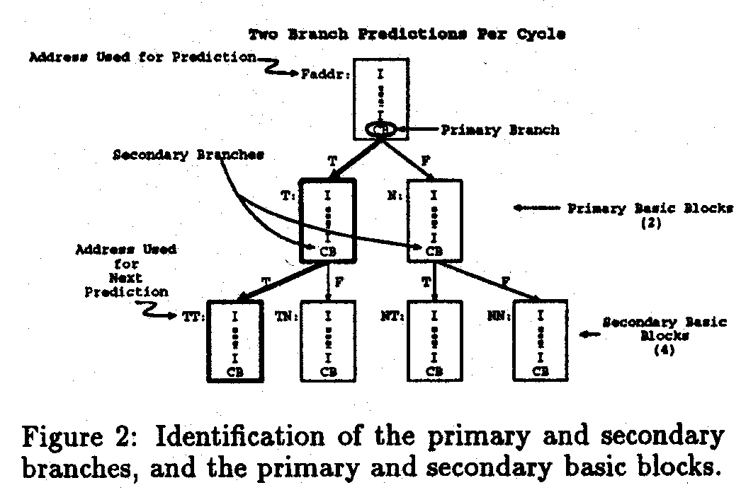
Multiple Branch Predictions
IEEE All rights reserved

Slide 8
Multiple Branch Predictor
Variations of global schemes are proposed
  Multiple Branch Global Adaptive Prediction using a Global Pattern History Table (MGAg)
  Multiple Branch Global Adaptive Prediction using a Per-Set Pattern History Table (MGAs)
Multiple branch prediction based on local schemes
  Require more complicated BHT access due to sequential access of primary/secondary/tertiary branches

Slide 9
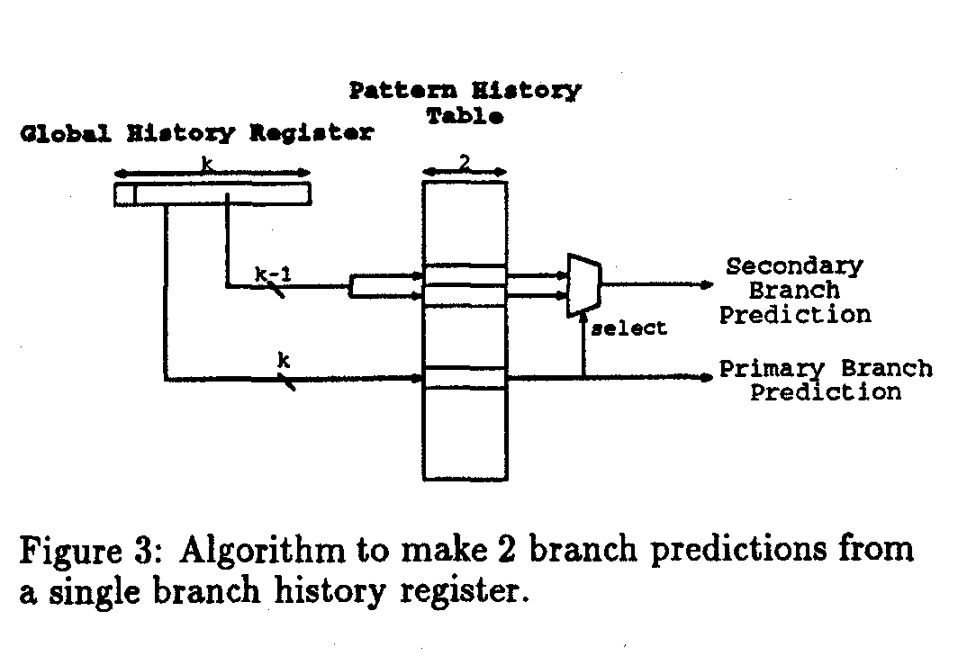
Multiple Branch Predictors
IEEE All rights reserved

Slide 10
Branch Address Cache
Only a single fetch address is used to access the BAC which provides multiple target addresses
  For each prediction level L, BAC provides 2^{L} of target address and fall-through address
    For example, 3 branch predictions per cycle, BAC provides 14 (2 + 4 + 8) target addresses
    For 2 branch predictions per cycle, TAC provides
      TAG
      Primary_valid, Primary_type
      Taddr, Naddr
      ST_valid, ST_type, SN_valid, SN_type
      TTaddr, TNaddr, NTaddr, NNaddr

Slide 11
ICache for Multiple BB Access
Two alternatives
  Interleaved (multi-bank) cache organization
    As long as there is no bank conflict
    Increasing the number of banks reduces conflicts
  Multi-ported cache
    Expensive
ICache miss rate increases
  Since more instructions are fetched each cycle, there are fewer cycles between Icache misses
    Increase associativity
    Increase cache size
    Prefetching

Slide 12
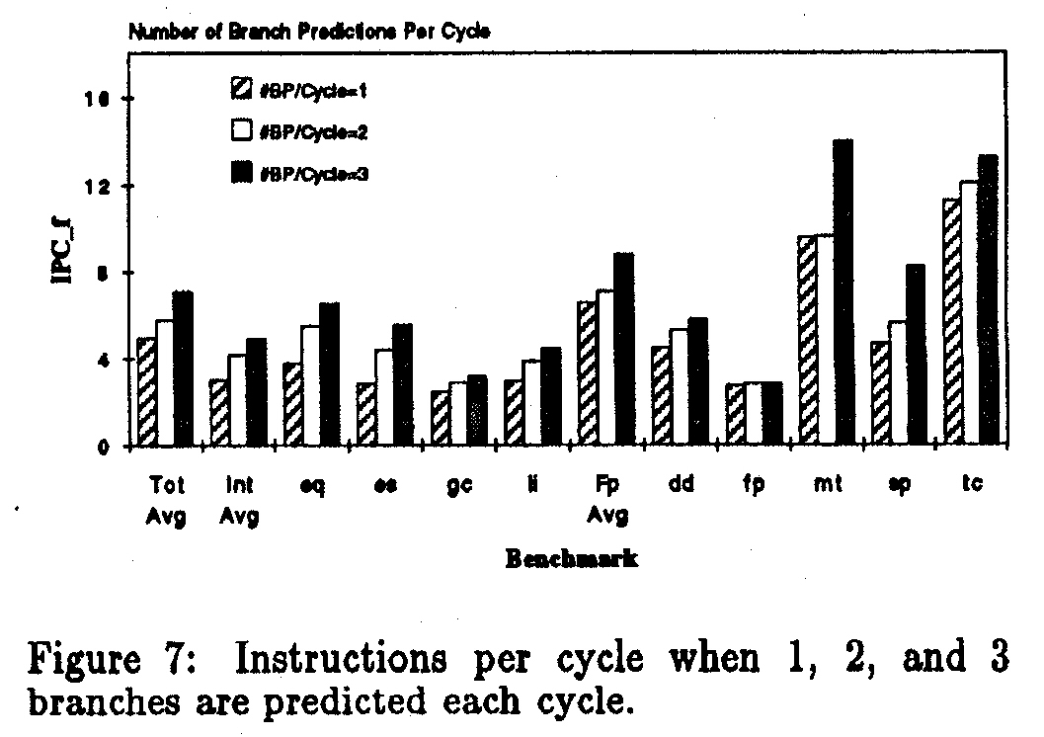
Fetch Performance
IEEE All rights reserved

Slide 13
Issues
Issues of branch address cache
  I cache to support simultaneous access to multiple non-contiguous cache lines
    Too expensive (multi-ported caches)
    Bank conflicts (interleaved organization)
  Complex shift and alignment logic to assemble non-contiguous blocks into sequential instruction stream
  The number of target addresses stored in branch address cache increases exponentially as you increase the branch prediction throughput

Slide 14
Trace Cache Rotenberg & Smith
Idea
  Caching of dynamic instruction stream (Icache stores static instruction stream)
  Based on the following two characteristics
    Temporal locality of instruction stream
    Branch behavior
      Most branches tend to be biased towards one direction or another
Issues
  Redundant instruction storage
      Same instructions both in Icache and trace cache
      Same instructions among trace cache lines

Slide 15
Trace Cache Rotenberg & Smith
Organization
  A special top-level instruction cache each line of which stores a trace, a dynamic instruction stream sequence
  Trace
    A sequence of the dynamic instruction stream
    At most n instructions and m basic blocks
      n is the trace cache line size
      m is the branch predictor throughput
      Specified by a starting address and m - 1 branch outcomes (called branch flags)
  Trace cache hit
    If a trace cache line has the same starting address and prediction matches branch outcomes
  Trace cache miss
    Fetching proceeds normally from instruction cache

Slide 16
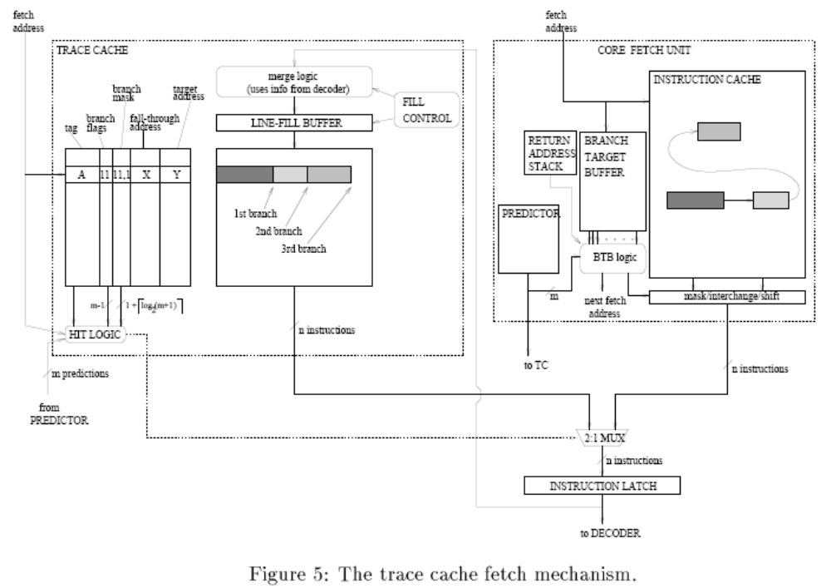
Trace Cache Organization
IEEE All rights reserved

Slide 17
Design Options
Associativity
Path associativity
  The number of traces that start at the same address
Partial matches
  When only the first few branch predictions match the branch flags, provide a prefix of trace
Indexing
  Fetch address vs. fetch address + predictions
Multiple fill buffers
Victim trace cache

Slide 18
Experimentation
Assumption
  Unlimited hardware resources
  Constrained by true data dependences
  Unlimited register renaming
  Full dynamic execution
Schemes
  SEQ1: 1 basic block at a time
  SEQ3: 3 consecutive basic blocks at a time
  TC: Trace cache
  CB: Collapsing buffer (Conte)
  BAC: Branch address cache (Yeh)

Slide 19
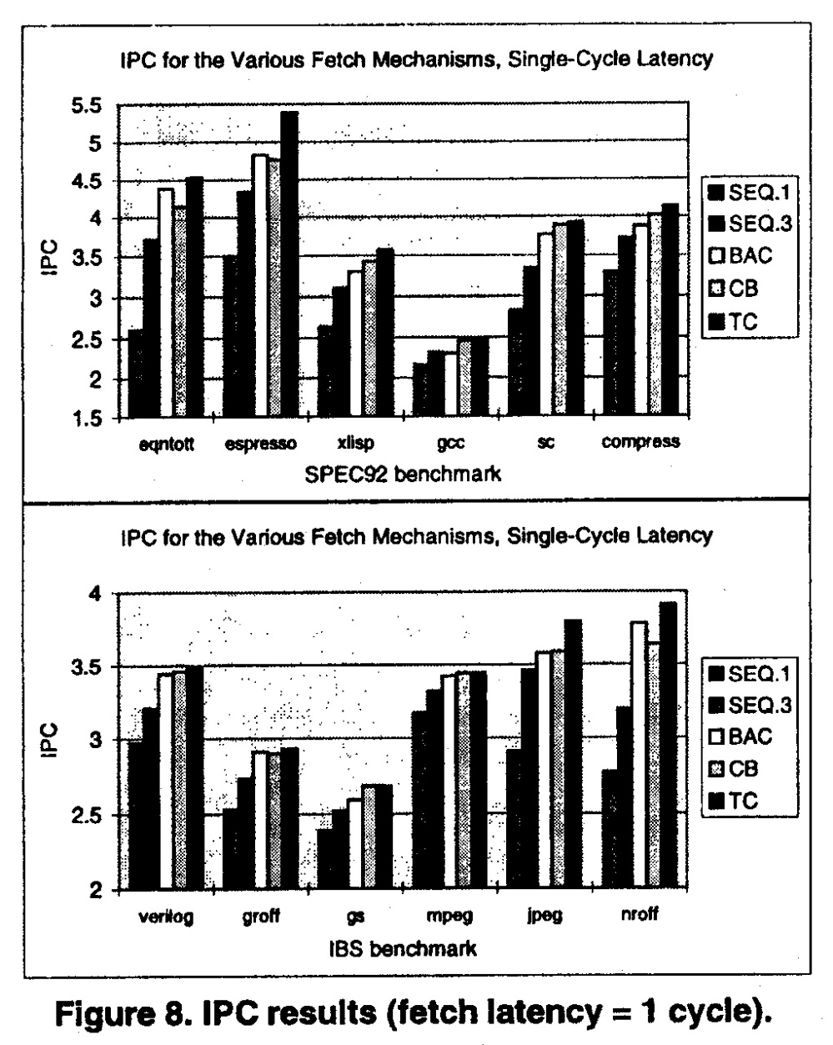
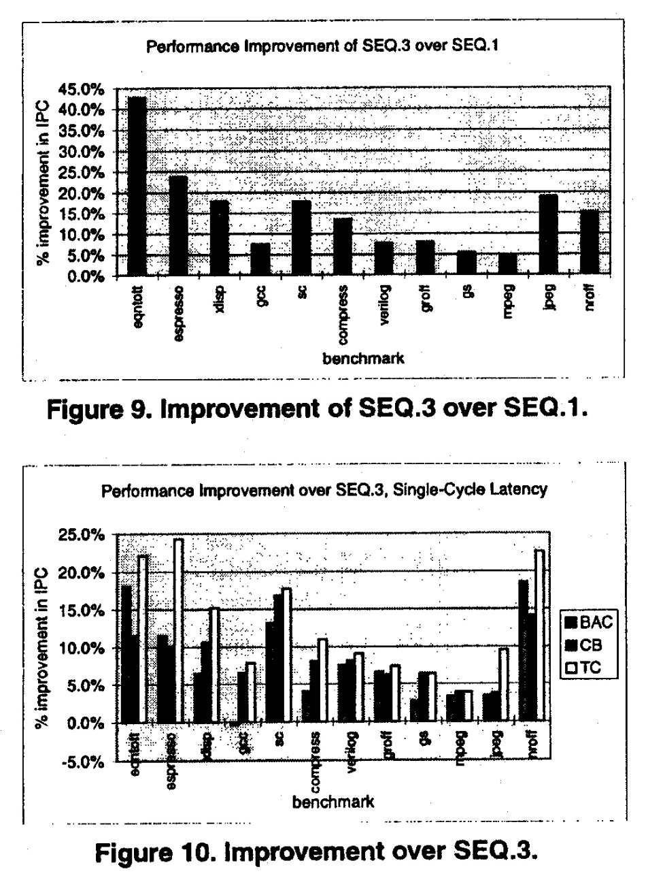
Performance
IEEE All rights reserved

Slide 20
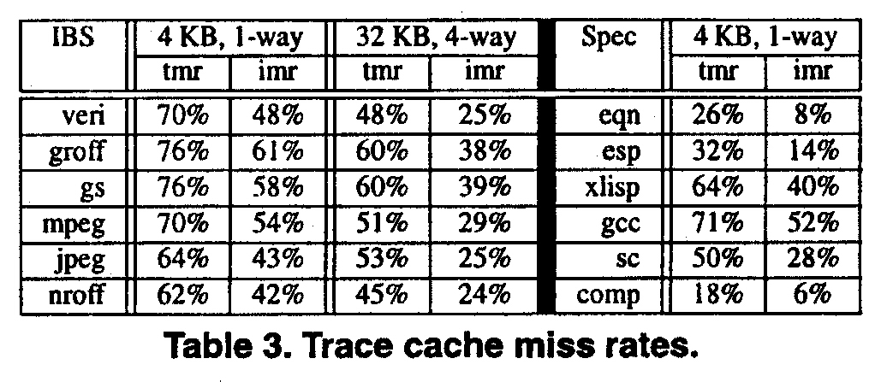
Trace Cache Miss Rates
  Trace Miss Rate - % accesses missing TC
  Instruction miss rate - % instructions not supplied by TC
IEEE All rights reserved

Slide 21
Exercises and Discussion
Itanium uses instruction buffer between FE and BE? What is the advantages of using this structure?
How can you add path associativity to the normal trace cache?

