Slide 1
Microprocessor Microarchitecture
Dependency and OOO Execution
Lynn Choi
School of Electrical Engineering

Slide 2
Three Forms of Dependence
True dependence (Read-After-Write)
  Also called flow dependence
  Require pipeline interlock
  Data bypass (forwarding) can reduce the producer latency
    Make values generated by FUs immediately available
Output dependence (Write-After-Write)
Anti dependence (Write-After-Read)
  Both of them are called false dependencies
  Require pipeline interlock or register renaming

Slide 3
In-Order Pipeline
In-order issue
  If an instruction is stalled in the pipeline, following instructions cannot proceed. However, once issued to FU, in general the instruction need not be stalled.
  Instruction can complete out-of-order
Dependency resolution mechanism
  Pipeline interlock
    Need reg-id comparators between sources and destinations of instructions in REG stage and the destinations of instructions in the EXE and WRB stages
    Comparators needed for both interlock and bypass
  Scoreboard
    A busy bit for each register
    For long latency operations such as MEM operations
    Instead of comparators, you need to check scoreboard for operand availability
    Comparators are still needed for bypass!

Slide 4
Example
FET-DEC-REG-EXE-WRB
What kind of dependence violations are possible?
  Single-issue 5-stage in-order pipeline with the following pipelined FUs
    2 INT unit (1 cycle INT operation)
    1 FP unit (4 cycle FP operation)
    2 MEM pipelines (2 cycle MEM operation)
    What’s wrong with this pipeline?
How many comparators do you need for the previous example?
    RAW
      2 srcs * 2 stages (E, W) * 2 INT = 8
      2 srcs * 5 stages (E1, E2, E3, E4, W) * 1 FP = 10
      2 srcs * 3 stages (E1, E2, W) * 2 MEM = 12
    WAW
      1 dest * 3 stages (E1, E2, E3) * 1 FP = 3
      1 dest * 1 stages (E1) * 2 MEM = 2
  WAW hazard can happen only for MEM and FP pipelines. Why?

Slide 5
Out-Of-Order Machines
Anti-dependence can happen in OOO machines
  DIV F0, F2, F4
  ADD F10, F0, F8
  SUB F8, F8, F14
Different approaches
  Scoreboarding
  Tomasulo’s Algorithm
  Register Update Unit

Slide 6
Scoreboarding - CDC6600 (1964) -
Scoreboard
  One bit per register indicates whether or not there is a pending update
Pipeline stalls on WAW and WAR dependences
FET-DEC/ISS-REG-EXE-WRB
  DEC/ISSUE stage: check for WAW and structural hazards
    (Centralized) instruction window between ISS and REG stages
    Pipeline stalls on output dependence by checking scoreboard
      Allows only 1 pending update
    Pipeline also stalls if there is no empty entry in the instruction window
    Instructions are issued in order.
  REG stage
    Resolve RAW hazards
    Instructions are sent to FUs out of order
    Instructions are dispatched out of order
  WRB stage:
    Once the execution completes, check for WAR hazards

Slide 7
Tomasulo’s Algorithm - Reservation Station
Used in IBM 360/91 floating point unit (1967)
Three ideas
  OOO execution using reservation stations (RS)
    Distributed instruction windows
  Register renaming to remove anti and output dependencies
    Read available input operands from RF and store them into RS (WAR removal)
    Assign new storage for output (WAW removal)
    Pipeline does not stall on WAW and WAR hazards
  Data forwarding using common data bus
    Bypass the data directly to the waiting instructions in RS
    Both register file and RS (source and dest) monitor the result bus and update data when a matching tag is found

Slide 8
Tomasulo’s Algorithm
FET-DEC/REN/ISS-REG-EXE-WRB-COM
  REN/ISS stage: check structural hazard (reservation station entry) and read available operands from register file (register renaming for WAR) and assign RS entry for destination (WAW hazard)
  REG stage: monitor common data bus and read operands into RS (resolve RAW hazard with bypass) if there is a match; determine highest priority operations among ready operations (wakeup)
  EXE: execute and forward result to RS and RF
Instruction buffers
  Instruction queue between FET and DEC/ISS stages
    Can be omitted
  Instruction window (reservation station) between ISS and REG stages
  Reorder buffer between WRB and COM stages
    not in original proposal (IBM 360/91)

Slide 9
Renaming
Removes anti and output dependencies
  Allows more than one pending update
Several forms of renaming
  Tomasulo’s algorithm
    Reservation station for additional storage for name dependencies and common data bus for data bypass
  Reorder buffer with associative lookup
    Associative lookup maps the reg id to the reorder buffer entry as soon as an entry is allocated
  Register map table with separate physical register file
    Register map table (DEC 21264)
    Register alias table (Intel P6)

Slide 10
Renaming
Assign one physical register for every instruction with a destination register
  With 80 instructions in flight (reorder buffer size)
  You need roughly 80 physical registers (except branch and stores)
  physical registers are single-assignment registers
Register renaming involves data dependence checking among the instructions that are simultaneously being renamed
  Renaming bandwidth limited by
    Data dependence checking
    Number of read ports needed for register map table

Slide 11
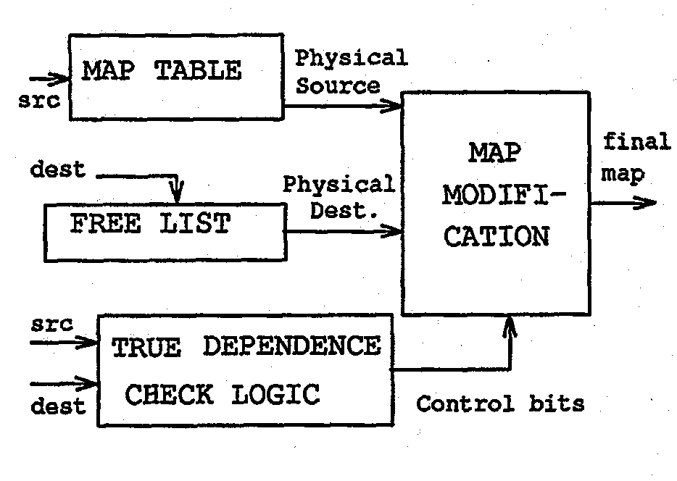
Renaming
IEEE All rights reserved

Slide 12
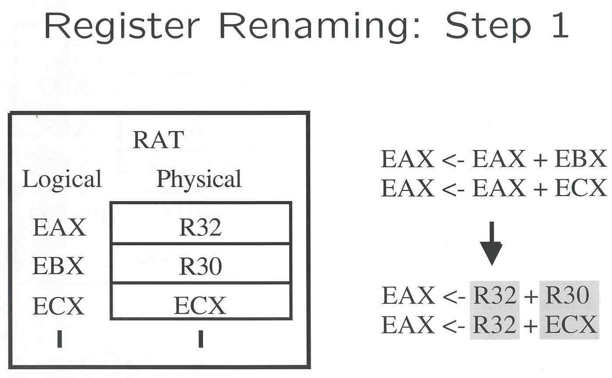
Rename Example (P6)
IEEE All rights reserved

Slide 13
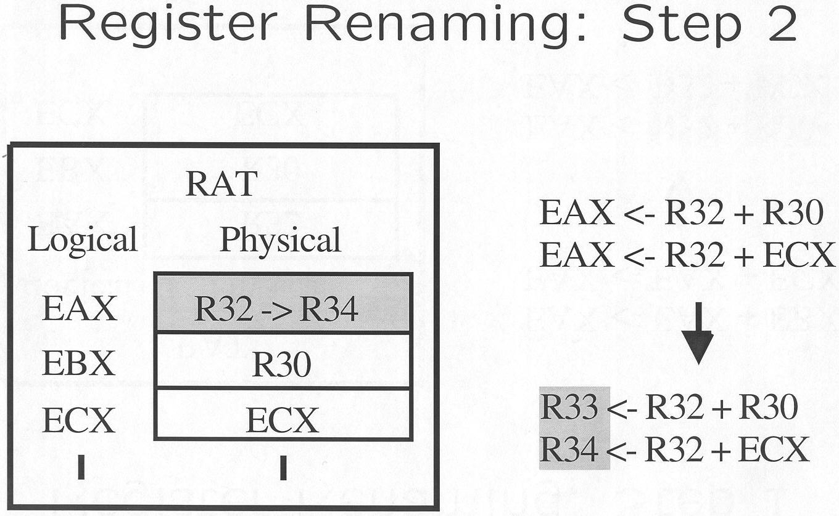
Rename Example (P6)
IEEE All rights reserved

Slide 14
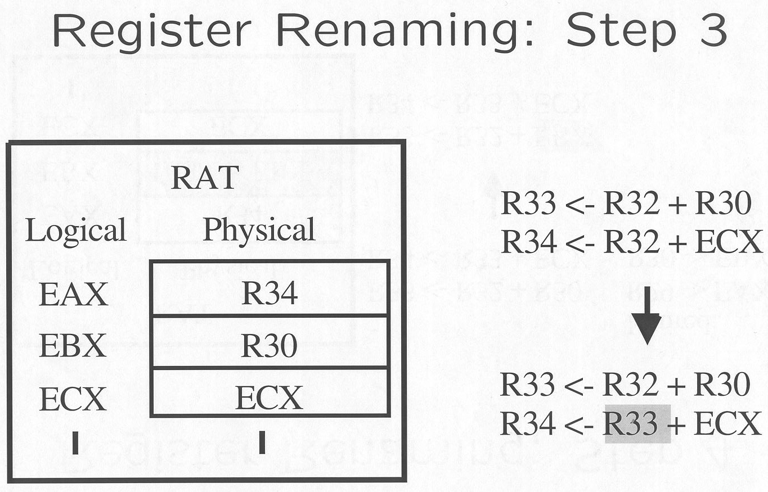
Rename Example (P6)
IEEE All rights reserved

Slide 15
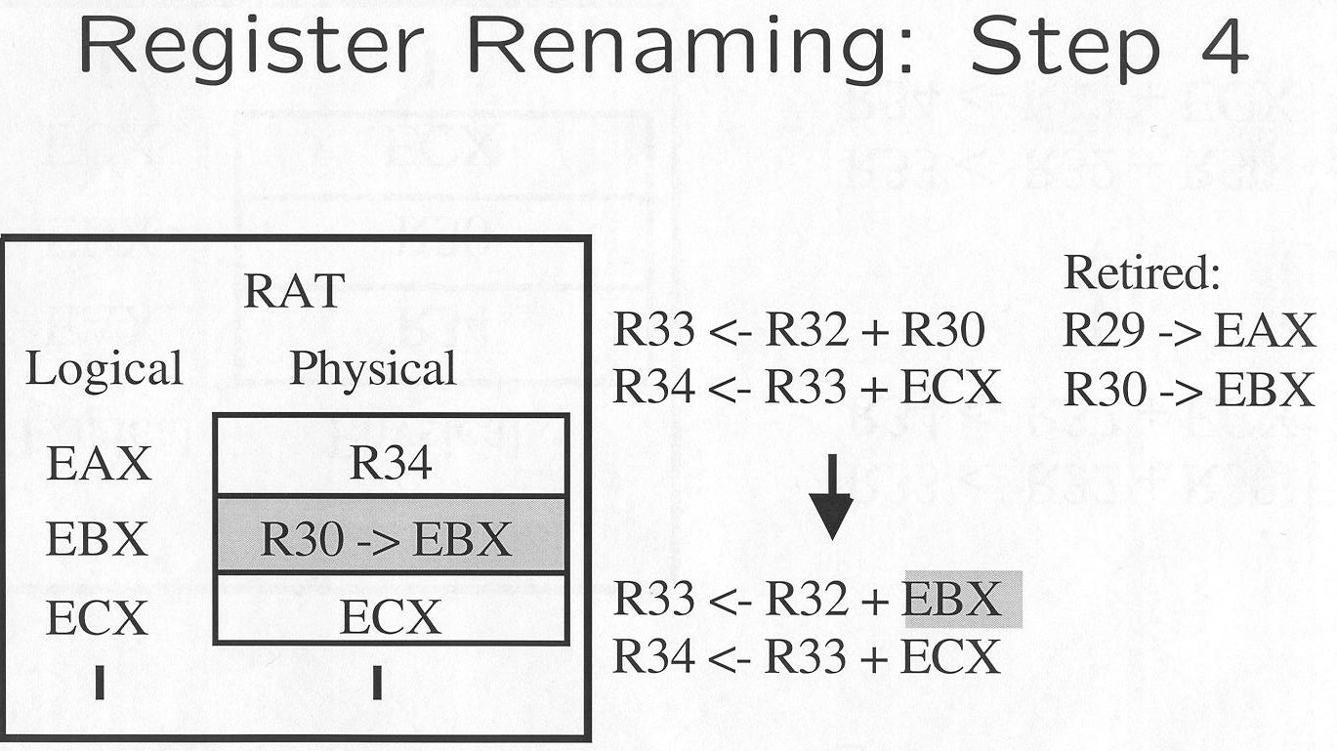
Rename Example (P6)
IEEE All rights reserved

Slide 16
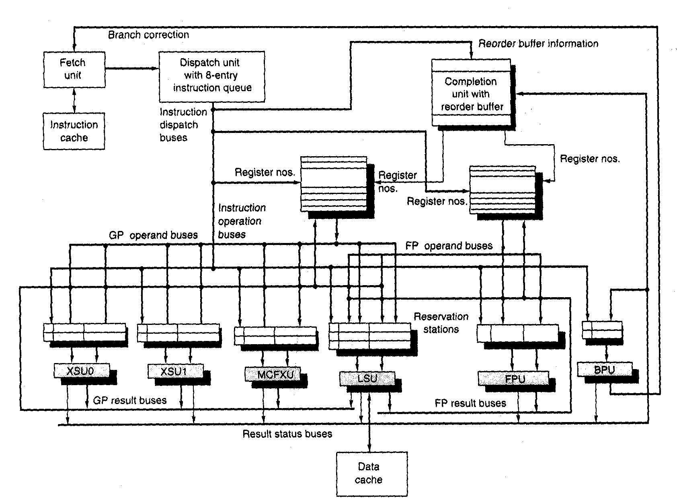
PowerPC 620 - OOO example -
IEEE All rights reserved

Slide 17
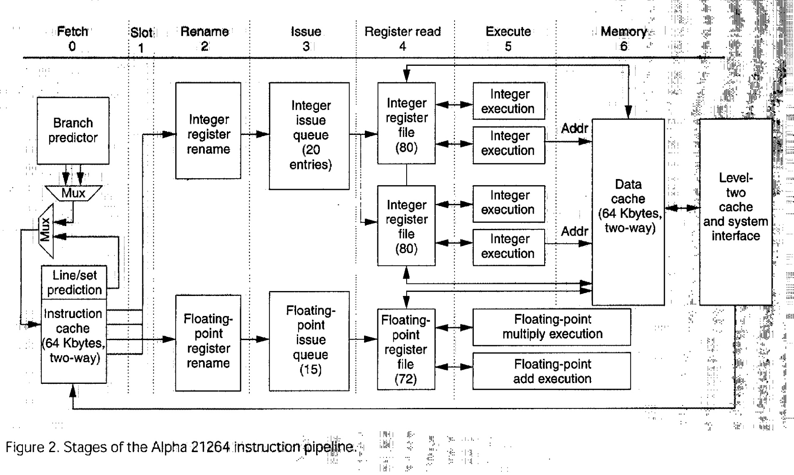
DEC 21264 - OOO example -
IEEE All rights reserved

Slide 18
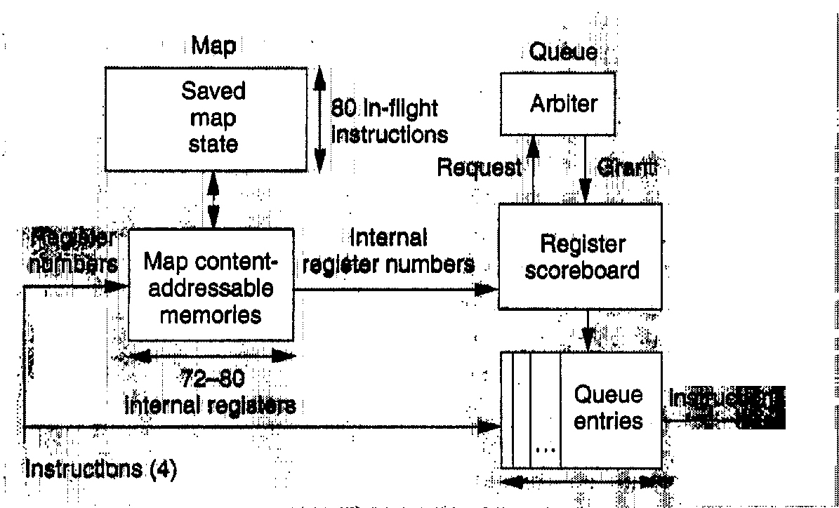
DEC 21264 - OOO example -
IEEE All rights reserved

Slide 19
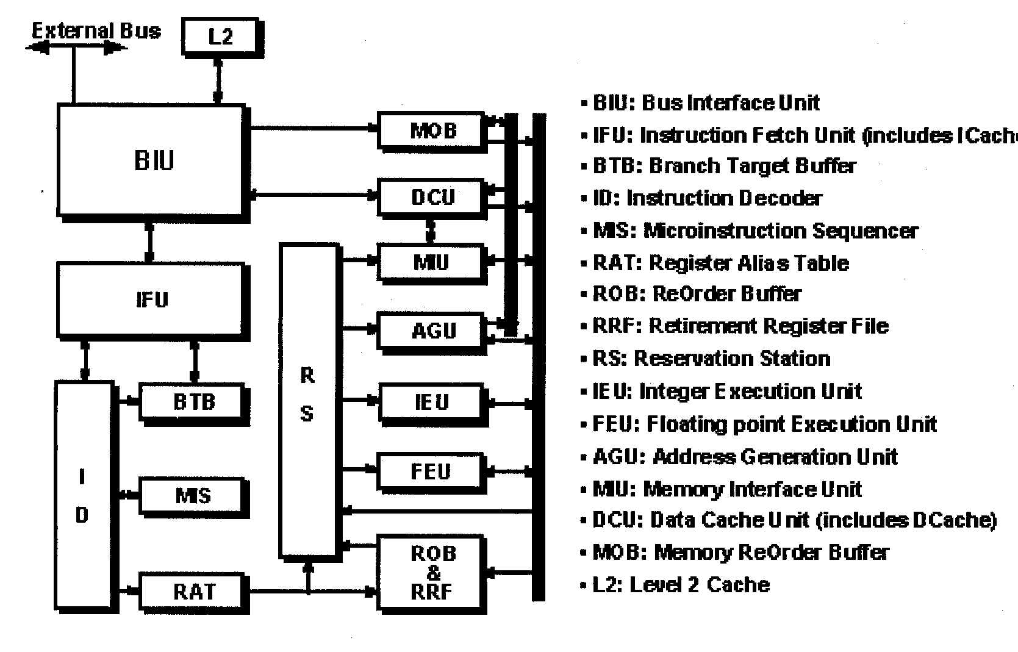
Intel P6 - OOO example -
IEEE All rights reserved

Slide 20
Exercises and Discussion
There can be many instruction buffers in an OOO processor. Name those buffers and explain their functions.
What happens on a branch misprediction in OOO processors?

Slide 21
Homework 2
Read Chapter 3
Exercise
  3.7
  3.8
  3.11
  3.12
  3.15
  3.17

