Slide 1
Microprocessor Microarchitecture
Interrupt and Precise Exception
Lynn Choi
Dept. Of Computer and Electronics Engineering

Slide 2
Interrupts
Interrupts
  Forced transfer of control to a procedure (handler) due to external events (interrupts) or due to an erroneous condition (exceptions)
  Exception
    Generated by an instruction in the currently running process due to an erroneous condition
    Synchronous, internal
  Interrupt
    Asynchronous, external events
Interrupt handling mechanism
  Allows interrupts/exceptions to be handled transparently to the executing process (application programs and operating system)
  Procedure
    When an interrupt is received or an exception condition is detected, the current task is suspended and transfer automatically goes to a handler
    After the handler is complete, the interrupted task resumes without loss of continuity, unless recovery is not possible or the interrupt/exception causes the currently running task to be terminated.

Slide 3
Exceptions
Exception Classification (processor-generated)
  Fault
    Unintentional but possibly recoverable exceptions
    Return to the faulting instruction
    Reported during the execution of the faulting instruction
    Virtual memory faults
      TLB miss, page fault, protection
    Illegal operations
      Arithmetic exceptions (i.e. divide by zero), invalid opcode, misaligned reference
  Trap
    Intentional exceptions
    Return to the next instruction (after the trapping instruction)
      For a JMP instruction, the next instruction should point to the target of the JMP instruction
    Reported immediately following the execution of the trapping instruction
    Examples: breakpoint, system calls
      Executing the syscall instruction causes a trap to an exception handler that decodes the argument and calls the appropriate kernel routine (run in kernel mode)

Slide 4
Exceptions
  Abort
    Unintentional and unrecoverable fatal errors
    Suspend the process at an unpredictable location
      Does not report the precise location of the instruction causing the exception
      Does not allow the restart of the program
    Severe errors or malfunctions
    Abort handlers are designed to collect diagnostic information about the processor’s state and then perform a graceful system shutdown
    Examples: bit error (parity error), inconsistent or illegal values in system tables
Software-generated exception
  INT n instruction generates an exception with an exception number (n) as an operand

Slide 5
Exception Handling
Exception (interrupt) vector
  Each exception or an interrupt is associated with an identification number, vector
Exception procedure
  Flush all the instructions fetched subsequent to the instruction causing the exception condition from the pipeline
  Drain the pipeline: complete all previous instructions
    Complete all outstanding write operations prior to the faulting instruction
  Save the PC of the next instruction to execute
  Also need to save the necessary registers and stack pointers to allow it to restore itself to its state
  Vector the interrupt
  Fetch instruction from the ISR and service the interrupt
  Return from the interrupt

Slide 6
(External) Interrupt
Interrupt
  Asynchronous
  Caused by external events, IO devices
  Return to the next instruction for a restart
Interrupt Classification
  Maskable interrupt
    Can be disabled/enabled by an instruction
    Generated by asserting INTR pin or sending interrupt messages over the APIC (Advanced Programmable Interrupt Controller) bus
    External interrupt controllers
      Intel 8259 PIC (programmable interrupt controller) delivers the interrupt vectors on the system bus during interrupt acknowledge cycle

Slide 7
Interrupt
  Non-maskable interrupt (NMI)
    Cannot be disabled by program
    Received on the processor’s NMI# input pin
  Software interrupt
    Generated by INT n instruction
      INT instruction can be used to generate an interrupt or an exception by using a vector number as an operand
    Viewed as an implicit call to interrupt handler of interrupt vector n
    No mechanism for masking interrupts

Slide 8
Interrupt Priority
Predefined order of different interrupts
  H/W Reset, Machine Check Abort
  External HW interventions
    INIT - like H/W reset without flushing caches)
    SMI (System (e.g. power) Management Interrupt)
  Traps on the previous instruction
  External Interrupts - NMI, MI
  Faults on executing an instruction
    DTLB faults
    FP exception, overflow, alignment
  Faults from fetching/decoding an instruction
    ITLB faults: page miss, access/protection violation
    Illegal opcode
Lower priority exceptions are regenerated after returning from the higher priority interrupt handler

Slide 9
Precise Interrupt
Definition: precise interrupt
  An interrupt is precise if the saved processor state corresponds to a sequential model of program execution before the interrupt occurs
    Out-of-order pipeline must preserve exception behavior in the sense that exactly those exceptions that would arise if the program were executed in strict program order actually do arise.
Precise exception model
  All integer/FP exceptions are reported on the faulting instruction
  All previous instructions are completed before the interruption point
  All subsequent operations are nullified
  After handling the exception, the execution resumes at the faulting instruction (fault) or at the next instruction (trap)
  Exceptions are reported in program order

Slide 10
Precise Interrupt
Precise interrupt is difficult to implement for
  Pipelined processors
    Because exceptions can be generated out of order in different pipeline stages
    For both in-order and OOO processors
  Out-of-order processors
    Because instructions may complete before an instruction issued earlier raises an exception
Precise interrupts are necessary to restart program execution after the unexpected event
  I/O and timer interrupts
  virtual memory related interrupts, i.e. page faults, TLB miss, etc.
  software debugging
  graceful recovery from arithmetic exceptions, I.e. underflow, overflow

Slide 11
Solutions for Precise Exceptions
In-order pipelines
  All instructions pass through pipeline in program order and exception conditions are reported in program order at the end of pipeline before the processor state is modified
    Instructions modify the processor state only when all previously issued instructions are known to be free of exceptions
Out-of-order pipelines
  Early O-O-O machines such as CDC6600 and IBM 360/91 did not support precise exceptions in favor of maximum parallelism
  Some machines such as early MIPS processor are restartable but did not support full precise interrupts. This requires implementation-dependent software shift through the machine dependent state and restore the pipeline state.

Slide 12
Exception Recovery & Restart
Motivation -
  Precise interrupts on exception
    Provide in-order state to the exception handler
Exception recovery
  Cancel the effects of instructions that should have not been issued
  Need to buffer states to restore the unspeculated states
  For some exceptions, the exception conditions are detected prior to execution
    Privilege interrupts, ITLB miss, etc.
    These exceptions should not report the exceptions until the end of pipeline
  Exception conditions may be detected out-of-order!
    But exceptions must be reported in program order

Slide 13
HW Schemes
Checkpoint repair - Hwu & Patt
Reorder buffer - Smith & Pleszkun
  Instructions complete out-of-order but must commit in order
Variations of Reorder buffer
  History buffer - Smith & Pleszkun
  Reorder buffer with Future file - Smith & Pleszkun

Slide 14
Buffering States
In-order state
  The most recent assignments performed by the longest continuous sequence of completed instructions
  Redundant assignments are superseded
  Necessary for in-order completion
Lookahead state
  All the pending assignments from the first uncompleted instruction to the end of the instruction sequence
  No value is superseded
Architectural state
  The most recently completed or pending assignment to each register
  State used by a following instruction
  Can be obtained by combining in-order & lookahead states

Slide 15
HW Schemes
Checkpoint repair
  Current logical space - architectural state
  Backup space - in-order state
Reorder buffer
  Register file - in-order state
  Reorder buffer - lookahead state
History buffer
  Register file - architectural state
  History buffer - in-order state
Reorder buffer with Future file
  Register file - in-order state
  Reorder buffer - lookahead state
  Future file - architectural state

Slide 16
Reorder Buffer - Smith & Pleszkun
Maintain two states
  Register file contains the in-order state
  Reorder buffer contains the lookahead state
    The architectural state is obtained by combining in-order and lookahead states.
    Multiple assignments can exist for a single register
    Managed as FIFO queue
      When an instruction is decoded, an entry is allocated on the top of the reorder buffer. After the instruction completes, the result is written to the entry.
        Instruction decoding stalls if there is no reorder buffer entry
      When the value reaches the bottom, it is written into the register file if there is no exception. If the instruction is not complete, the reorder buffer does not advance until the instruction completes.
      If there is an exception, the reorder buffer contents are discarded and then reverts to the in-order state in the register file.
    Each entry contains its PC to provide PC on exception
  On an exception
    Locate an exception point in the reorder buffer to know which entries to reset
  On a branch
      Allocate a reorder buffer entry for each branch, even though the branch does not produce result
    On a branch misprediction
      Should not discard the entire reorder buffer; some of the lookahead states are for instructions preceding the branch.

Slide 17
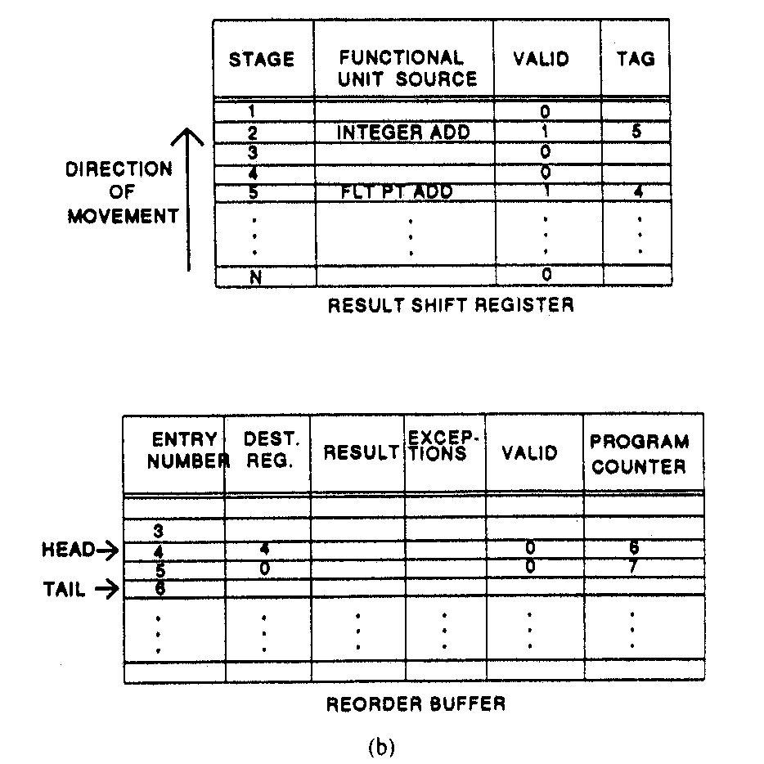
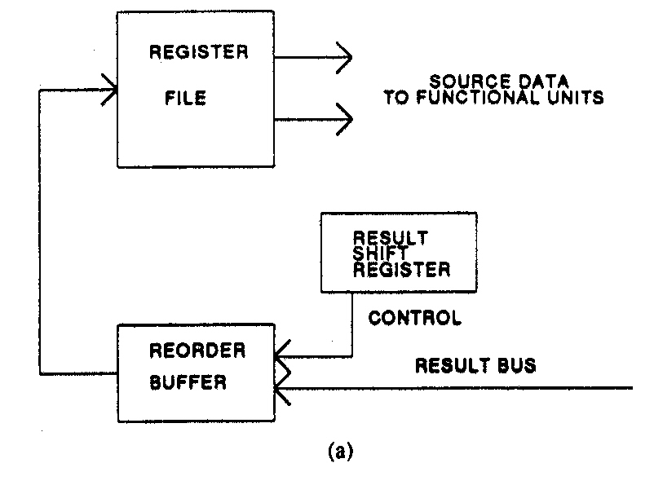
Reorder buffer
IEEE All rights reserved

Slide 18
Reorder Buffer
Disadvantages
  Require associative lookup to combine in-order and lookahead states
    It is possible for more than one entry in the reorder buffer to correspond to source register
      Only the latest reorder buffer entry need to be bypassed
    Can be solved by an additional buffer called future file
  The instruction dispatch logic does not know the original instruction order, and so the dispatch logic cannot prioritize instructions for issue based on this order.
Advantages
  No need to keep instructions ordered in the central window
    The window need not be compressed as instructions are issued. Instead, new instructions from the decoder are simply placed into the freed locations.
Reorder buffer used in
  HP PA-8000
  DEC Alpha 21264
  Intel P-Pro and Pentium II, III
  MIPS R10000
  Power PC620

Slide 19
Exercises and Discussion
Compare the following: TLB miss, PTE miss, page miss
Assume that you have a Pentium 4 processor, which has a 3-way superscalar 20-stage OOO pipeline. At a particular cycle, there are 1 exception (iTLB miss), 1 external interrupt from DMA, and 1 branch misprediction at the same time. How does the Pentium 4 handle these 3 events properly?

