Slide 1
Microprocessor Microarchitecture
Memory Hierarchy Optimization
Lynn Choi
Dept. Of Computer and Electronics Engineering

Slide 2
Memory Hierarchy
Motivated by
  Principles of Locality
  Speed vs. Size vs. Cost tradeoff
Locality principle
  Spatial Locality: nearby references are likely
    Example: arrays, program codes
    Access a block of contiguous words
  Temporal Locality: references to the same location is likely to occur soon
    Example: loops, reuse of variables
    Keep recently accessed data to closer to the processor
Speed vs. Size tradeoff
  Bigger memory is slower: SRAM - DRAM - Disk - Tape
  Fast memory is more expensive

Slide 3
Levels of Memory Hierarchy
Capacity/Access Time
Moved By
Faster/Smaller
100Bs
Registers
Instruction
Operands
Program/Compiler
1- 16B
KBs-MBs
Cache
H/W
16 - 512B
Cache Line
GBs
Main Memory
OS
512B – 64MB
Page
100GBs
Disk
User
any size
File
Infinite
Network
Slower/Larger

Slide 4
Cache
A small but fast memory located between processor and main memory
Benefits
  Reduce load latency
  Reduce store latency
  Reduce bus traffic (on-chip caches)
Cache Block Allocation (When to place)
  On a read miss
  On a write miss
    Write-allocate vs. no-write-allocate
Cache Block Placement (Where to place)
  Fully-associative cache
  Direct-mapped cache
  Set-associative cache

Slide 5
Fully Associative Cache
32b Word, 4 Word Cache Block
Physical Address Space
32 bit PA = 4GB (DRAM)
A memory block can be placed into
any cache block location!
0
32KB cache (SRAM)
0
2¹¹-1
Memory Block
Cache Block
(Cache Line)
2¹¹-1
2²⁸-1

Slide 6
Fully Associative Cache
TAG RAM
V
32KB DATA RAM
=
0
0
31
3 0
tag
offset
Yes
=
=
=
2¹¹-1
2¹¹-1
Data out
Word & Byte select
Data to CPU
Advantages Disadvantages
1. High hit rate 1. Very expensive
2. Fast
Cache Hit

Slide 7
Direct Mapped Cache
Physical Address Space
32 bit PA = 4GB (DRAM)
A memory block can be placed into
only a single cache block!
0
32KB cache (SRAM)
0
2¹¹
Memory Block
…..
2*2¹¹
2¹¹-1
(2¹⁷-1)*2¹¹
2²⁸-1

Slide 8
Direct Mapped Cache
TAG RAM
V
32KB DATA RAM
14
4
0
0
31
3 0
tag
index
offset
decoder
2¹¹-1
2¹¹-1
Data out
=
Yes
Word &
Byte select
Data to CPU
Disadvantages Advantages
1. Low hit rate 1. Simple HW
2. Reasonably Fast
Cache Hit

Slide 9
Set Associative Cache
In an M-way set associative cache,
A memory block can be placed into
M cache blocks!
0
32KB cache (SRAM)
2¹⁰
Memory Block
0
Way 0
2¹⁰ sets
2¹⁰-1
2*2¹⁰
2¹⁰
Way 1
2¹⁰ sets
2¹¹-1
(2¹⁸-1)*2¹⁰
2²⁸-1

Slide 10
Set Associative Cache
TAG RAM
V
32KB DATA RAM
13
4
0
0
31
3 0
tag
index
offset
decoder
2¹⁰-1
2¹⁰-1
Data out
=
=
Yes
Word &
Byte select
Wmux
Data to CPU
Most caches are implemented as
set-associative caches!
Cache Hit

Slide 11
3+1 Types of Cache Misses
Cold-start misses (or compulsory misses): the first access to a block is always not in the cache
  Misses even in an infinite cache
Capacity misses: if the memory blocks needed by a program is bigger than the cache size, then capacity misses will occur due to cache block replacement.
  Misses even in fully associative cache
Conflict misses (or collision misses): for direct-mapped or set-associative cache, too many blocks can be mapped to the same set.
Invalidation misses (or sharing misses): cache blocks can be invalidated due to coherence traffic

Slide 12
Cache Performance
Avg-access-time = hit time+miss rate*miss penalty
Improving Cache Performance
  Reduce miss rate
  Reduce miss penalty
  Reduce hit time

Slide 13
Reducing Miss Rates
Reducing compulsory misses
  Prefetching
    HW Prefetching: Instruction Streaming Buffer (ISB, DEC 21064)
      On an I-miss, fetches two blocks
      Target block goes to the Icache; Next block goes to ISB
      If the requested block hits ISB, it moves to Icache
      A single block ISB can catch 15-25% of misses
      Work well with instruction caches
      Can be applied to data caches as well
        8 entry stream buffers could capture 50 to 70% of all misses from a processor with 64KB 4-way set-associative instruction and data caches
      Intel Core i7 supports hardware prefetching for both L1 and L2
    SW (Compiler) Prefetching:
      Compiler inserts prefetch instructions to request data before use
      Load into caches (not to registers)
      Usually non-faulting instructions
      Works well for stride-based prefetching for loops
  Large cache block
    Implicit prefetching due to spatial locality

Slide 14
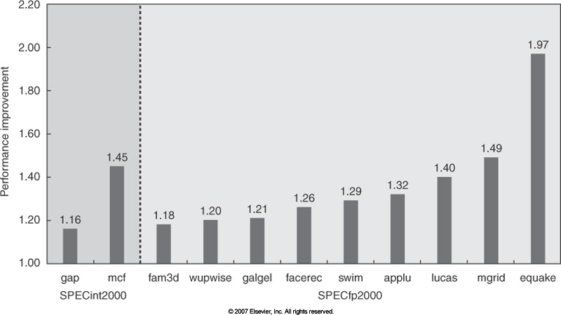
Hardware Prefetching on Pentium IV

Slide 15
Reducing Miss Rates
Reducing capacity misses
  Larger caches
Reducing conflict misses
  More associativity
  Larger caches
  Victim Cache
    Insert a small fully associative cache between the cache (usually direct-mapped) and the memory
    Access both the victim cache and regular cache at the same time
Impact of Cache Block Size
  Decrease compulsory misses
  Increase miss penalty
  Increase conflict misses

Slide 16
Cache Performance vs Block Size
_{Miss Penalty}
_{Miss Rate}
Transfer Time
Access Time
_{Block Size}
_{Block Size}
_{Average Access Time}
_{Sweet Spot}
_{Block Size}

Slide 17
Reducing Miss Penalty
Reduce read miss penalty:
  Start cache and memory (or next level) access in parallel
  Early restart and critical word first
    As soon as requested word arrives, pass it to CPU
    finish the line fill later
Reduce write miss penalty
  Write Buffer
    For a write miss, store the data into a buffer between the cache and the memory
    No need for the CPU to wait on a write
      Decrease write stalls
    Coalescing write buffer
      Merge redundant writes
    Associative write buffer for look up on a read
    Critical for write-through cache

Slide 18
Reduce Miss Penalty
Non-blocking cache (Tolerate miss penalty)
  Also called ‘lockup-free’ cache
  Do not stall CPU on a cache miss (hit under miss, miss under miss)
    Intel i7 supports both while ARM A8 supports only limited non-blocking support
  Allows multiple outstanding requests
  Pipelined memory system with out-of-order data return
    1st level instruction cache access took 1 cycle in Pentium, 2 cycles in Pentium Pro – Pentium III, and 4 cycles in Pentium IV and i7
Multiple memory ports (Tolerate miss penalty)
  Critical for multiple-issue processors
  multiple memory pipelines: e.g. 2 D ports, 1 I port
  multi-port vs. multi-bank solution for memory arrays
    Divide the cache into independent banks that can support simultaneous accesses
      Intel i7 has 4 banks in L1 (to support up to 2 memory accesses per clock) and 8 banks in L2
    Sequential interleaving
      Banking works best when the accesses naturally spread themselves across banks
      With 4 banks, bank 0 has all blocks with address mod 4 is 0, bank 1 with mod 1, etc.

Slide 19
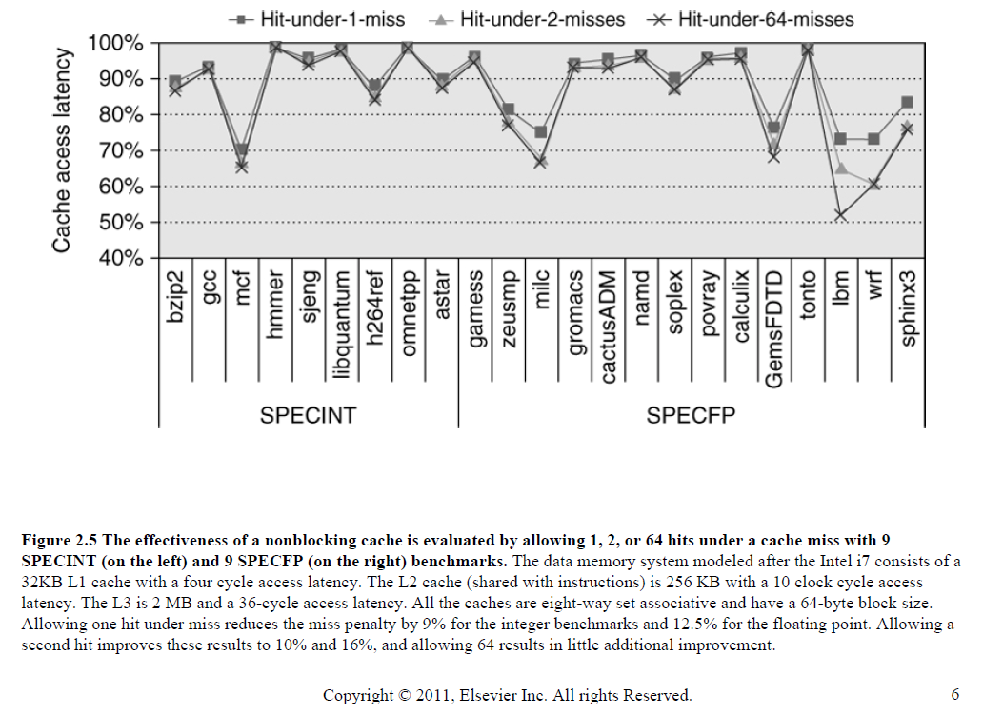
Non-blocking Cache: Hit under Miss

Slide 20
Reduce Miss Penalty - Multi-level Cache
For L1 organization,
  AMAT = Hit_Time + Miss_Rate * Miss_Penalty
For L1/L2 organization,
  AMAT = Hit_Time_{L1} + Miss_Rate_{L1} * (Hit_Time_{L2} + Miss_Rate_{L2} * Miss_Penalty_{L2})
Advantages
  For capacity misses and conflict misses in L1, a significant penalty reduction
Disadvantages
  For L1-L2 misses, miss penalty increases slightly
    L2 does not help compulsory misses
Design Issues
  Size(L2) >> Size(L1)
  Usually, Block_size(L2) > Block_size(L1)

Slide 21
Reducing Hit Time – Small/Simple L1
Small L1 is preferred
  Fast clock cycle requires a small L1 cache
Simple L1 is preferred
  Direct-mapped caches are faster than set-associative caches
    Direct-mapped caches can overlap the tag comparison with data transmission
  Lower levels of associativity can reduce both hit time and power since fewer lines are accessed
    Direct-mapped cache is slightly faster than 2-way set-associative cache
    2-way set-associative cache is 1.2 times faster than 4-way set-associative cache
    4-way set-associative cache is 1.4 times faster than 8-way set-associative cache
  Virtually-indexed physically-tagged caches are used for L1
    Index decoding and TLB access can be overlapped
Recent trend
  Due to the clock rate impact arising from a larger L1, the size of L1 has recently increased either slightly or not at all
  In recent processors, designers opted for more associativity rather than larger caches

Slide 22
Reducing Hit Time - Store Buffer
Write operation consists of 3 steps
  Read-Modify-Write
With byte-enables, write performed in 2 steps
  Determine Hit/Miss (tag check)
  Update cache with byte-enable
With store buffer,
  Determine Hit/Miss
  If hit, store address(index, way) and data into store buffer
  Finish cache update when cache is idle
Advantages
  Reduce write hit time
  Reduce read stalls

Slide 23
Reducing Hit Time
Fill Buffer: Prioritize reads over cache line fills
  Store cache block fetched from main memory before storing into cache
  Reduce stalls due to cache line refill
Way/Hit Prediction: Decrease hit time for set-associative caches
  Extra bits are kept in the cache to predict the way or a block within the set
    Way MUX is set early to select the desired block, resulting in faster hit time
  Way prediction accuracy is over 90% for 2-way, and over 80% for 4-way
    On a misprediction, trying another block increases hit time by an extra cycle
  First introduced in MIPS R10000 and popular since then
    ARM Cortex-A8 use way-prediction for its 4-way set-associative caches
Virtually-indexed physically-tagged cache
  Access TLB and cache in parallel
    If the cache index can be extracted from virtual address directly (i.e. from page offset), can perform address translation in parallel with cache index lookup
    Decrease hit time since TLB access can overlap with cache access

Slide 24
Review: Improving Cache Perf.
Techniques Miss Rate Miss Penalty Hit Time
Large Block Size + -
Higher Associativity + -
Victim Cache +
Prefetching +
Critical Word First +
Write Buffer +
L2 Cache +
Non-blocking Cache +
Multi-ports +
Simple L1 +
Fill Buffer +
Store Buffer +
Way/Hit Prediction +
Virtual Indexed Physically Addressed Cache +

Slide 25
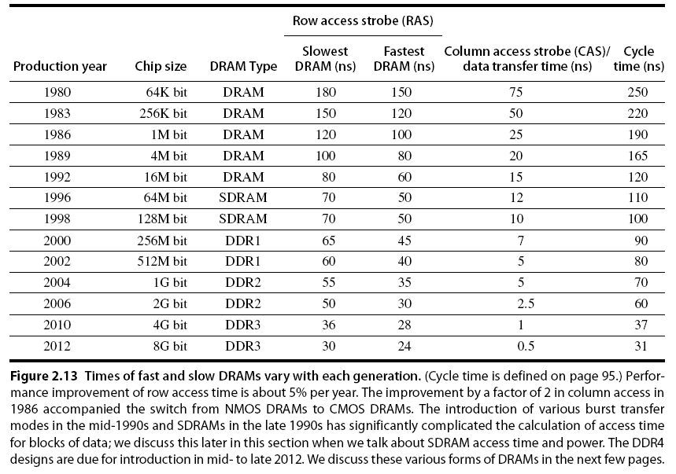
DRAM Technology
Elsevier Inc. All rights reserved

Slide 26
DDR SDRAM
DDR stands for ‘double data rate’
  Transfer data on both the rising edge and the falling edge of the DRAM clock
DDR2
  Lowers power by dropping the voltage from 2.5V to 1.8V
  Higher clock rates of 266MHz, 333MHz, and 400MHz
DDR3
  1.5V and up to 800MHz
DDR4
  1.2V and up to 1.6GHz
  2014
SDRAMs also introduce banks, breaking a single DRAM into 2 to 8 banks (in DDR3) that can operate independently
  Memory address now consists of bank number, row address, and column address

Slide 27
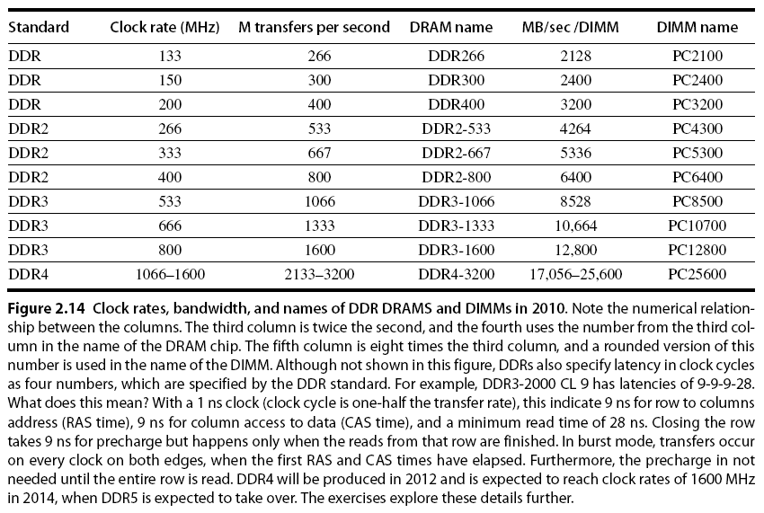
DDR Name Conventions
Elsevier Inc. All rights reserved

Slide 28
Homework 3
Read Chapter 5
Exercise
  2.1
  2.2
  2.3
  2.4
  2.19
  2.21
  2.30

