Slide 1
Microprocessor Microarchitecture
Limits of Instruction-Level Parallelism
Lynn Choi
Dept. Of Computer and Electronics Engineering

Slide 2
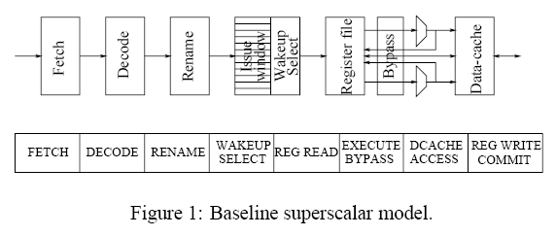
Complexity of Superscalar Processors
Baseline Superscalar Pipeline Model
Each pipe stage has a structure whose complexity is a function of issue width
  Fetch (Branch Predictor Throughput, Taken Branches)
  Decode/Rename (Renaming & Dependency Check)
  Register Read (Wakeup and Select)
  Execution (Bypass Logic)
IEEE All rights reserved

Slide 3
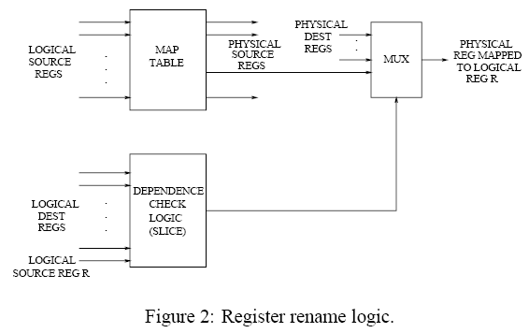
Pipeline Complexity: Renaming
Structure
  Map table
    RAM scheme (MIPS R10000)
      Logical register # is used as an index to access the physical register entry
    CAM scheme (DEC 21264)
      The number of entries in the CAM is equal to the number of physical registers
      CAM is less scalable than RAM since # physical registers increases as the issue width
  Dependency check logic
    The number of comparisons required for the dependency check increases quadratically as the issue width increases
Delay
  T_{decode} ,T_{wordline} ,T_{bitline} = c0 + c1 x IW + c2 x IW²
IEEE All rights reserved

Slide 4
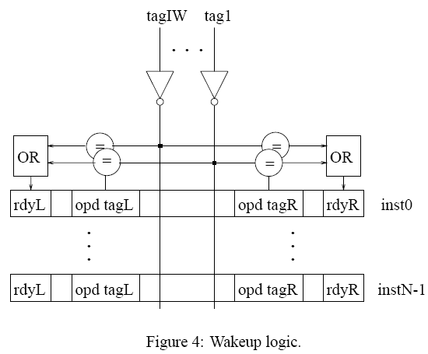
Pipeline Complexity: Wakeup
Structure
  Issue Window is a CAM array
  Each entry of the CAM has 2 x IW (issue width) comparators
Delay = T_{tagdrive} + T_{tagmatch} + T_{matchOR}
  The time taken to drive the tags depends on the length of the tag lines and the number of comparators on the tag lines
  T_{tagdrive} = c0 + (c1 + c2 x IW) x WINSIZE + (c3 + c4 x IW + c5 x IW²) x WINSIZE²
  T_{tagmatch} ,T_{matchOR} = c0 + c1 x IW + c2 x IW²
IEEE All rights reserved

Slide 5
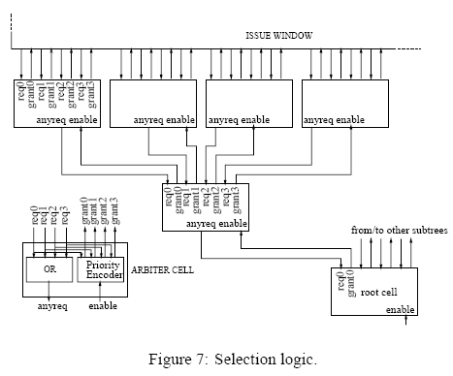
Pipeline Complexity: Select
Structure
  Selection logic consists of a tree of arbiters. request-grant mechanism.
  Selection policy : location based (left most entry have the highest priority)
Delay = T_{selection} = c0 + c1 x log4(WINSIZE)
  Delay depends on the height of the arbitration tree = log4(WINSIZE)
  Delay increases logarithmically with window size
IEEE All rights reserved

Slide 6
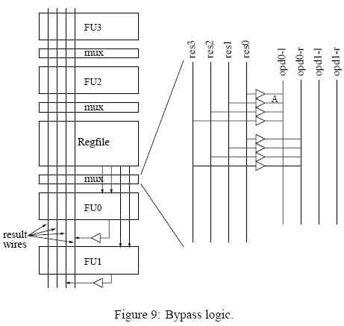
Pipeline Complexity: Bypass Logic
Structure
  The number of bypass paths is determined by the depth of the pipeline and issue width
  Nbypass_paths = 2 x IW² x S : ( S = # pipeline stages after the 1st result stage)
  Datapath : buffers are used to drive the bypass values
  Control : controlling the operand MUXes
Delay:
  T_{bypass} = 0.5 x Rmetal x Cmetal x L² where L is the length of the result wires.
  Increasing issue width increases the length of the result wires.
IEEE All rights reserved

Slide 7
Pipeline Complexity: Summary
The window logic and the bypasses seem to pose the largest problems
4-way superscalar
  Wakeup & selection logic has the greatest delay among all the structures considered
  Wakeup and select together constitute what appears to be an atomic operation.
  If they are divided into multiple pipeline stages, dependent instructions cannot be issued in consecutive cycles.
8-way superscalar
  The bypass delay grows by a factor of over 5, and is now worse than the (wakeup + select) delay
  Bypass delay can easily become a bottleneck for wider issue widths.

Slide 8
Limitations of ILP
Assume an ideal processor model
  Register renaming
    Infinite number of physical registers
    All WAW and WAR hazards can be removed
  Branch prediction
    Perfect branch prediction
  Jump prediction
    All jumps are perfectly predicted
  Memory address alias analysis
    All memory addresses are known exactly
  Perfect caches
    All memory accesses take 1 clock cycle

Slide 9
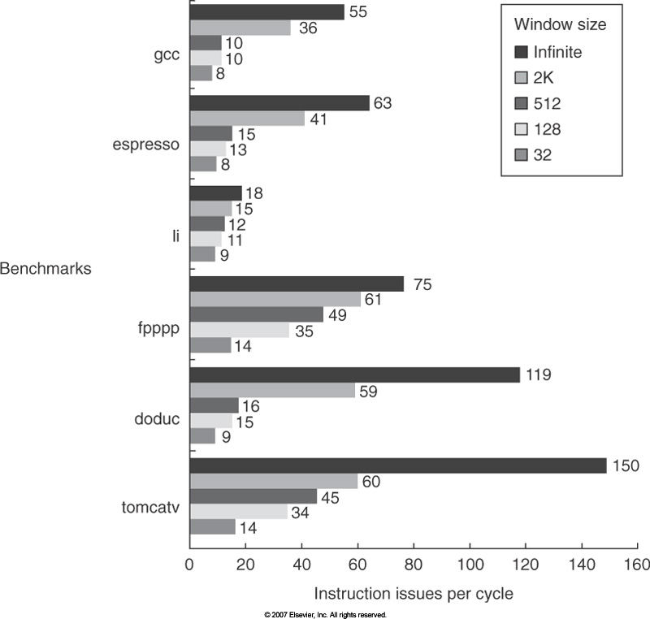
Impact of Window Size

Slide 10
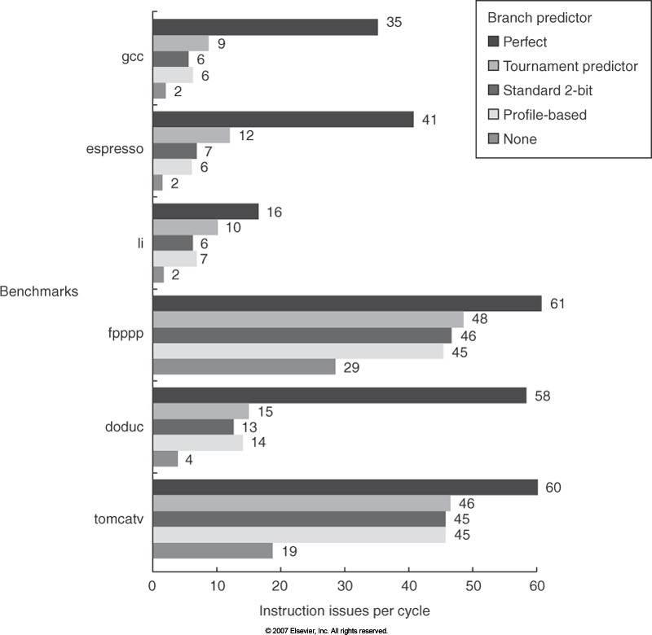
Impact of Branch Prediction
2K window
Max. 64 instruction issues per cycle

Slide 11
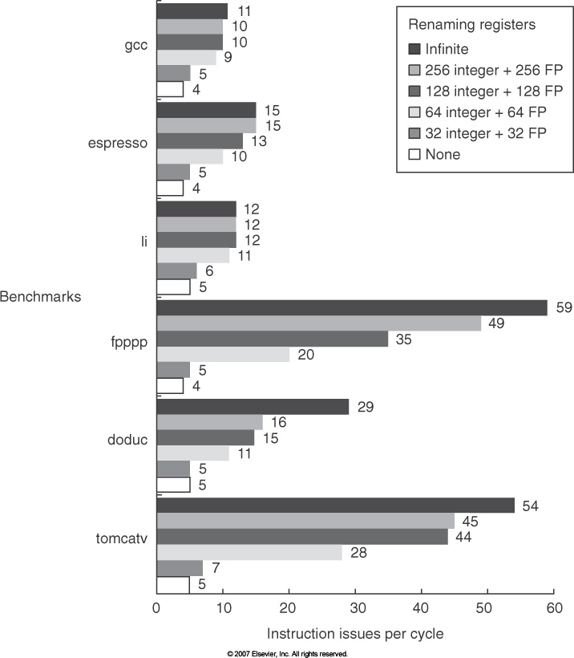
Impact of Finite Registers
2K window
Max. 64 instruction issues per cycle
8K entry tournament predictors
2K jump and return predictors

Slide 12
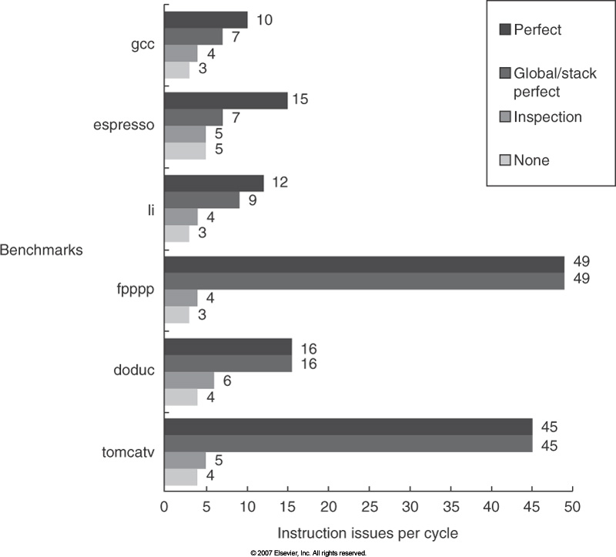
Impact of Imperfect Alias Analysis
2K window
Max. 64 instruction issues per cycle
8K entry tournament predictors
2K jump and return predictors
256 integer and 256 FP registers

Slide 13
Limits of Multiple-Issue Processors: Revisited
Doubling the issue rate above the current 3-6 issue, i.e. 6-12 issue requires
  Issue 3-4 data memory accesses per cycle
  Resolve two or three branches per cycle
  Rename and access more than 20 registers per cycle
  Fetch 12-24 instructions per cycle
  ➔ The complexity of implementing these capabilities would sacrifice the maximum clock rate
Another issue is power!
  Modern microprocessors are primarily power limited.
    Static power grows proportionally to the transistor count
    Dynamic power is proportional to the product of the number of switching transistors and the switching rate
  Microprocessors trying to achieve both a high IPC and a high CR must switch more transistors and switch them faster!

Slide 14
ILP Saturation – Power Inefficiency
Increasing issue rate is not energy efficient
  Multiple instruction issue incurs overhead in logic that grows faster than the issue rate increase
  Growing gap between peak issue rate and sustained performance
Increasing clock rate is also not energy efficient
  Increasing clock rate will increase transistor switching frequency
  Faster clock needs deeper pipeline, but the pipelining overhead grows faster
Speculation is inherently inefficient
  It can never be perfect, thus there is inherently waste in executing computations before we know that whether the path is taken or not
Hardware complexity & Power
Peak issue rate
Sustained issue rate & Performance

Slide 15
ILP Saturation – Temperature problem
Existing processors already reach the power limit
  1.6GHz Itanium 2 consumes 130W of power!
Temperature problem
  Pentium power density passes that of a hot plate (‘98) and would pass a nuclear reactor in 2005, and a rocket nozzle in 2010.
  Reliability issue
    Chip error rate doubles as the temperature increases by 10 degree
Higher IPC and higher clock speed have been pushed to their limit!

