Slide 1
Microprocessor Microarchitecture
Thread Level Parallelism
Lynn Choi
School of Electrical Engineering

Slide 2
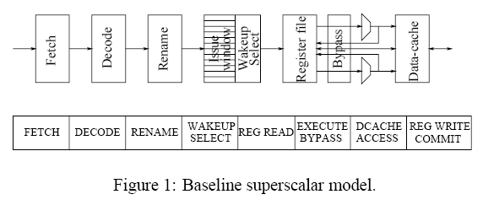
ILP Saturation I – Hardware Complexity
IEEE All rights reserved
Superscalar hardware is not scalable in terms of issue width!
  Limited instruction fetch bandwidth
  Renaming complexity ∝ issue width²
  Wakeup & selection logic ∝ instruction window²
  Bypass logic complexity ∝ # of FUs²
  Also, on-chip wire delays, # register and memory access ports, etc.
Higher IPC implies lowering the Clock Speed!

Slide 3
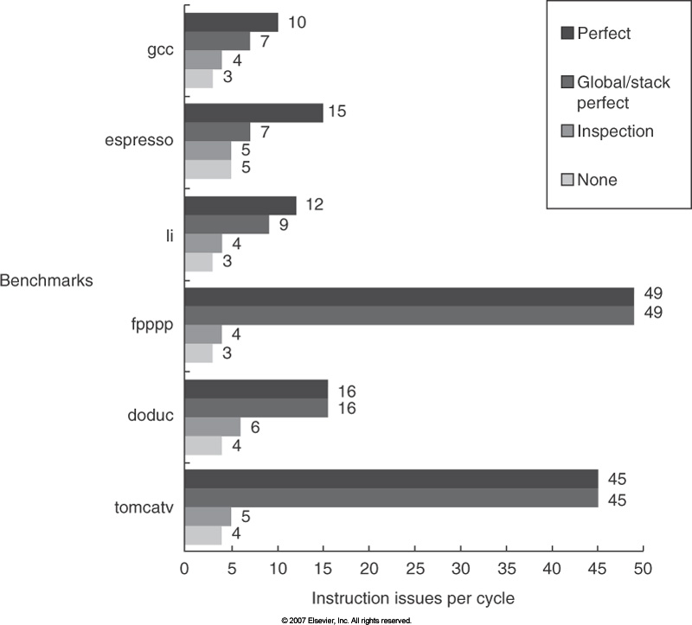
ILP Saturation II – Limits of ILP
Even with a very aggressive superscalar microarchitecture
2K window
Max. 64 instruction issues per cycle
8K entry tournament predictors
2K jump and return predictors
256 integer and 256 FP registers
Available ILP is only 3 ~ 6!

Slide 4
ILP Saturation III – Power Inefficiency
Increasing issue rate is not energy efficient
Increasing clock rate is also not energy efficient
  Increasing clock rate will increase transistor switching frequency
  Faster clock needs deeper pipeline, but the pipelining overhead grows faster
Existing processors already reach the power limit
  1.6GHz Itanium 2 consumes 130W of power!
  Temperature problem –Pentium power density passes that of a hot plate (‘98) and would pass a nuclear reactor in 2005, and a rocket nozzle in 2010.
Higher IPC and higher clock speed have been pushed to their limit!
  Diminishing returns in terms of performance/power and resource utilization
Hardware complexity & Power
Peak issue rate
Sustained issue rate & Performance

Slide 5
TLP Approaches
MP (Multiprocessor) approach
  Decentralize all resources
  Multiprocessing on a single chip
    Communicate through shared-memory: Stanford Hydra
    Communicate through messages: MIT RAW
MT (Multithreaded) approach
  More tightly coupled than MP
  Dependent threads vs. independent threads
    Dependent threads require HW for inter-thread synchronization and communication
      Examples: Multiscalar (U of Wisconsin), Superthreading (U of Minnesota), DMT, Trace Processor
    Independent threads: Fine-grain multithreading, SMT
  Centralized vs. decentralized architectures
    Decentralized multithreaded architectures
      Each thread has a separate pipeline
      Multiscalar, Superthreading
    Centralized multithreaded architectures
      Share pipelines among multiple threads
      TERA, SMT (throughput-oriented), Trace Processor, DMT (performance-oriented)

Slide 6
MT Approach
Multithreading of Independent Threads
  No inter-thread dependency checking and no inter-thread communication
  Threads can be generated from
    A single program (multithreaded application, or by a parallelizing compiler)
    Multiple programs (multiprogramming workloads)
  Fine-grain Multithreading
    Only a single thread active at a time
    Switch thread on a long latency operation (cache miss, stall)
      MIT April, Elementary Multithreading (Japan)
    Switch thread every cycle – TERA, HEP
  Simultaneous Multithreading (SMT)
    Multiple threads active at a time
    Issue from multiple threads each cycle
Multithreading of Dependent Threads
  Not adopted by commercial processors due to complexity and only marginal performance gain

Slide 7
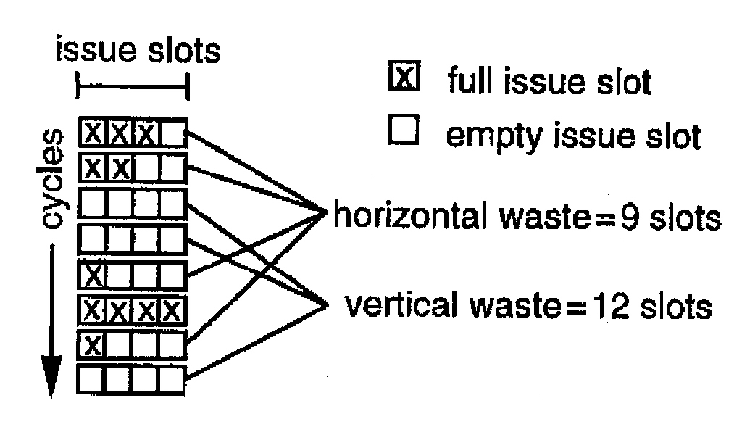
SMT (Simultaneous Multithreading)
Motivation
  Existing multiple-issue superscalar architectures do not utilize resources efficiently
    Intel Pentium III, DEC Alpha 21264, PowerPC, MIPS R10000
  Exhibit horizontal and vertical pipeline wastes
IEEE All rights reserved

Slide 8
SMT Motivation
Fine-grain Multithreading
  HEP, Tera, MASA, MIT Alewife
  Fast context switching among multiple independent threads
    Switch threads on cache miss stalls – Alewife
    Switch threads on every cycle – Tera, HEP
  Target vertical wastes only
    At any cycle, issue instructions from only a single thread
Single-chip MP
  Coarse-grain parallelism among independent threads in a different processor
  Also exhibit both vertical and horizontal wastes in each individual processor pipeline

Slide 9
SMT Idea
Idea
  Interleave multiple independent threads into the pipeline every cycle
  Eliminate both horizontal and vertical pipeline bubbles
  Increase processor utilization
  Require added hardware resources
    Each thread needs its own PC, register file, instruction retirement & exception mechanism
      How about branch predictors? - BTB, RAS, BPT
    Multithreaded scheduling of instruction fetch and issue
    More complex and larger shared cache structures (I/D caches)
  Share functional units and instruction windows
    How about instruction pipeline?
  Can be applied to MP architectures

Slide 10
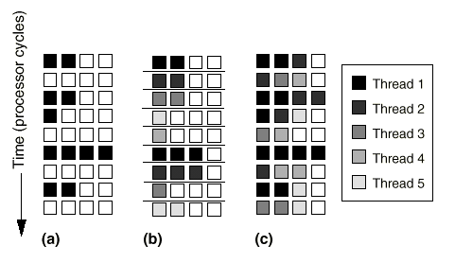
Multithreading of Independent Threads
IEEE All rights reserved
Fine-grained
Multithreading
Simultaneous
Multithreading
Superscalar
Comparison of pipeline issue slots in three different architectures

Slide 11
Experimentation
Simulation
  Based on Alpha 21164 with following differences
    Augmented for wider-issue superscalar and SMT
    Larger on-chip L1 and L2 caches
    Multiple hardware contexts for SMT
    2K-entry bimodal predictor, 12-entry RSB
  SPEC92 benchmarks
    Compiled by Multiflow trace scheduling compiler
  No extra pipeline stage for SMT
    Less than 5% impact
      Due to the increased (1 extra cycle) misprediction penalty
  SMT scheduling
    Context 0 can schedule onto any unit; context 1 can schedule on to any unit unutilized by context 0, etc.

Slide 12
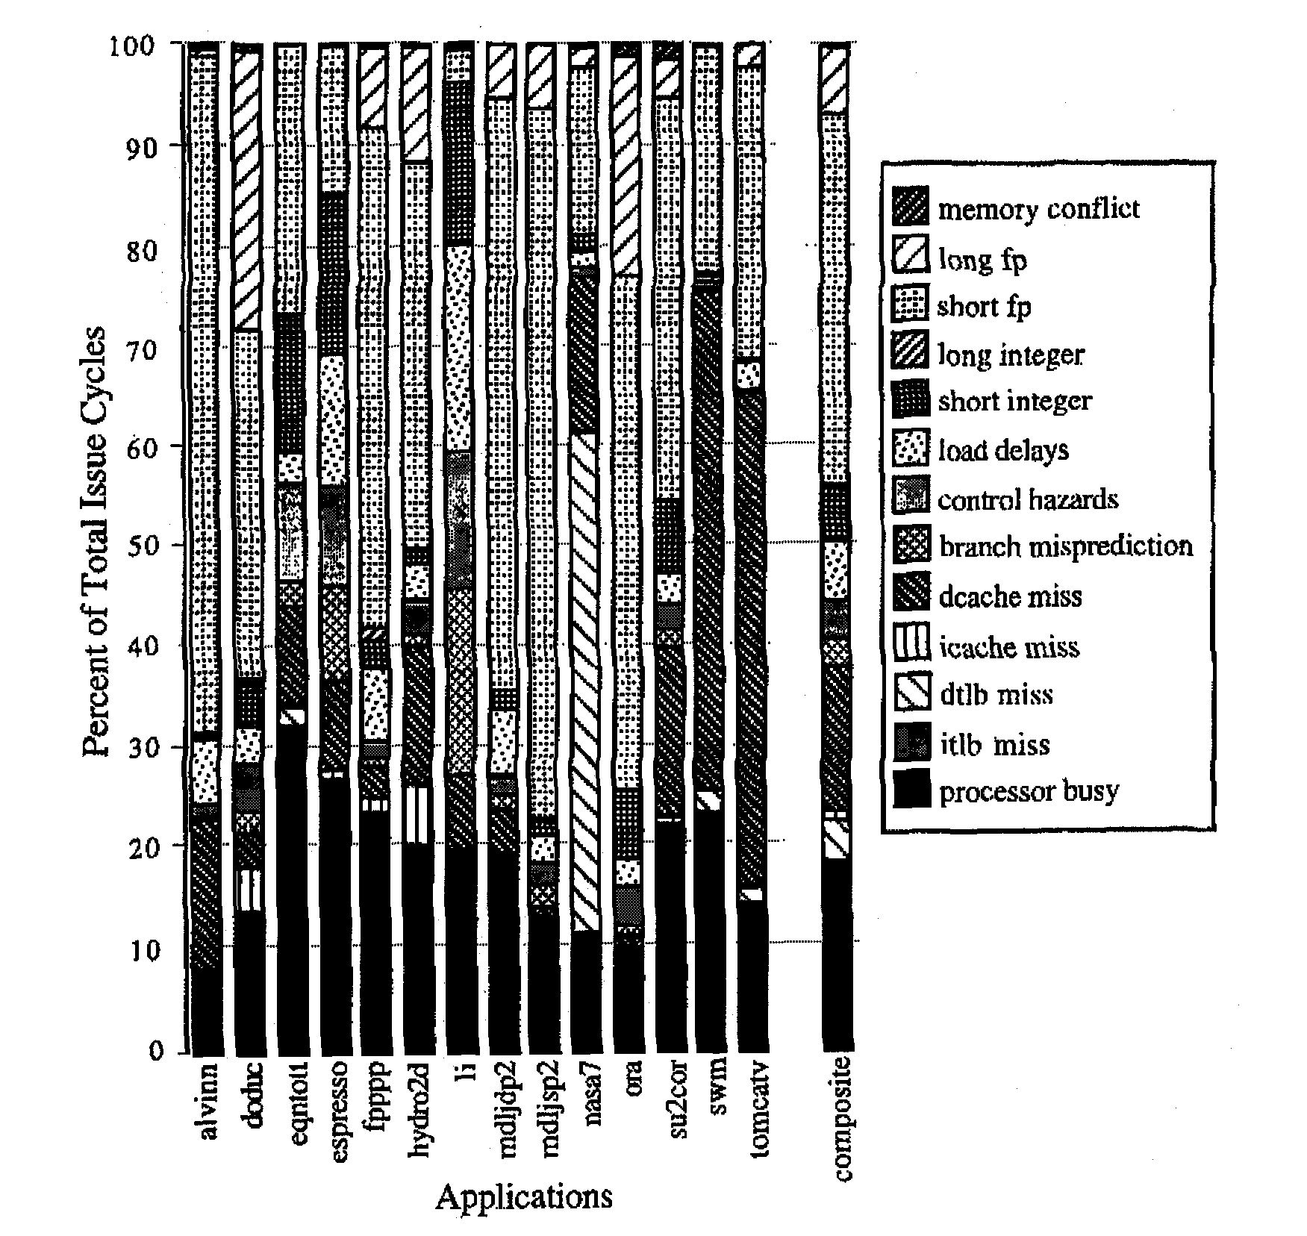
Where the wastes come from?
8-issue superscalar processor
execution time distribution
- 19% busy time (~ 1.5 IPC)
(1) 37% short FP dependences
(2) Dcache misses
(3) Long FP dependences
(4) Load delays
(5) Short integer dependences
(6) DTLB misses
(7) Branch misprediction
- 1+2+3 occupies 60%
- 61% wasted cycles are vertical
- 39% are horizontal
IEEE All rights reserved

Slide 13
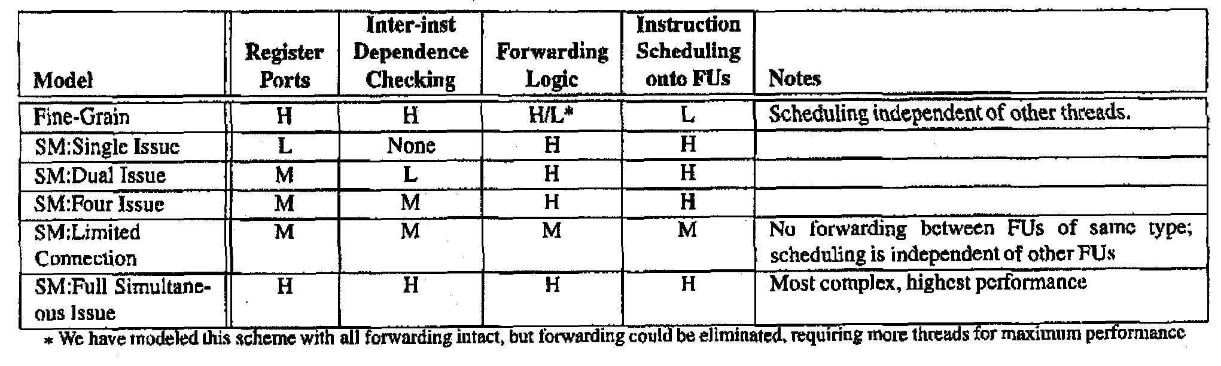
Machine Models
Fine-grain multithreading - one thread each cycle
SMT - multiple threads each cycle
    full simultaneous issue - each thread can issue up to 8 each cycle
    four issue - each thread can issue up to 4 each cycle
    dual issue - each thread can issue up to 2 each cycle
    single issue - each thread issue 1 each cycle
    limited connection - partition FUs to threads
      8 threads, 4 INT, each INT can receive from 2 threads
IEEE All rights reserved

Slide 14
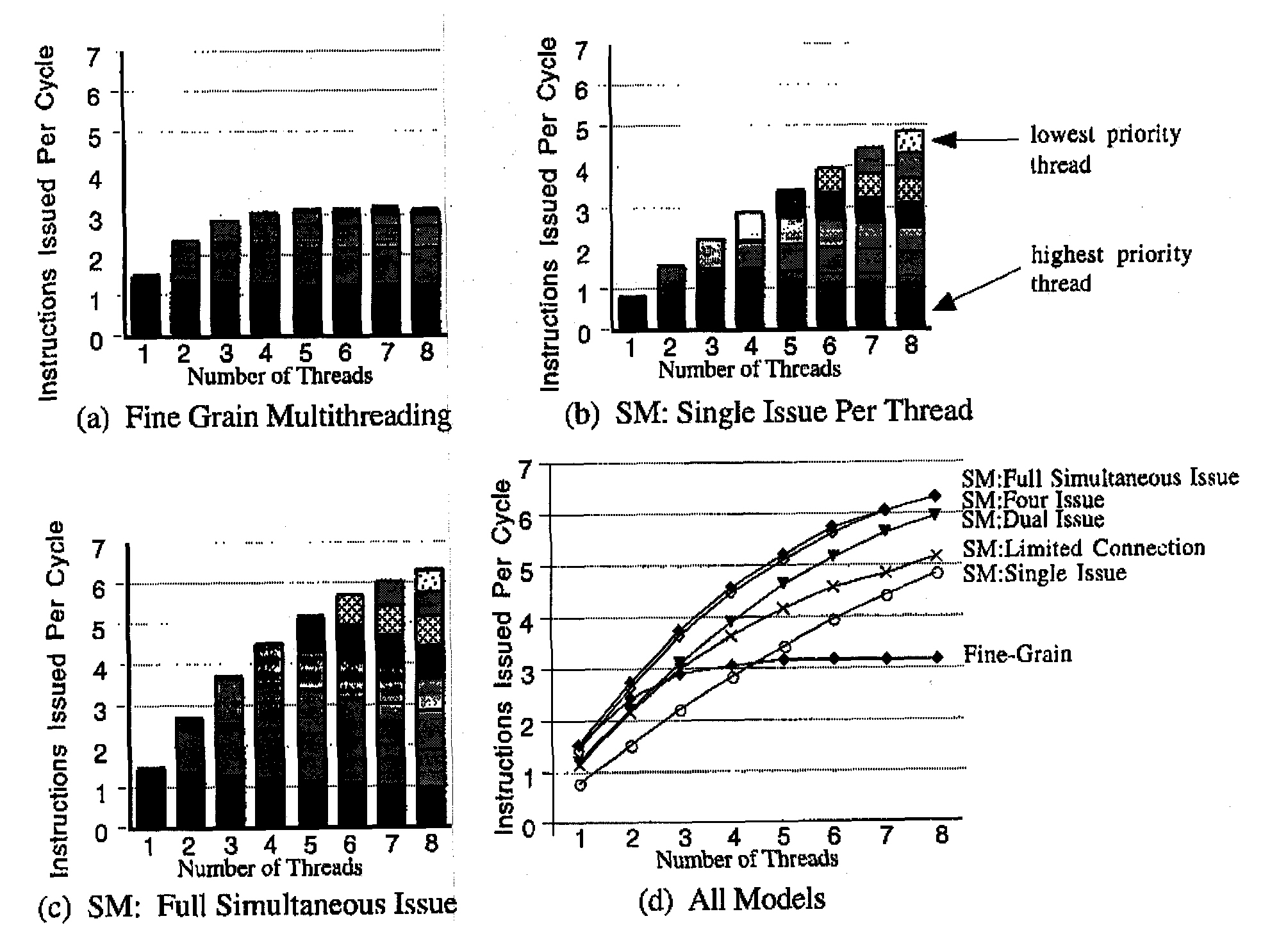
Performance
IEEE All rights reserved
Saturated at 3 IPC
bounded by vertical wastes
Sharing degrades performance:
35%slow down of 1st priority thread
due to competition
Each thread need not utilize
all resources; dual issue is
almost as effective as full issue

Slide 15
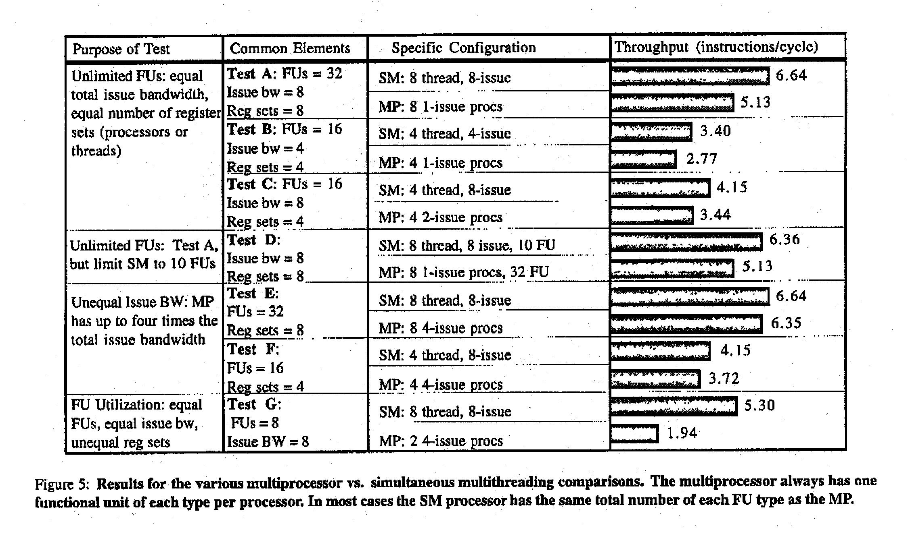
SMT vs. MP
MP’s advantage: simple scheduling, faster private cache access - both are not modeled
IEEE All rights reserved

Slide 16
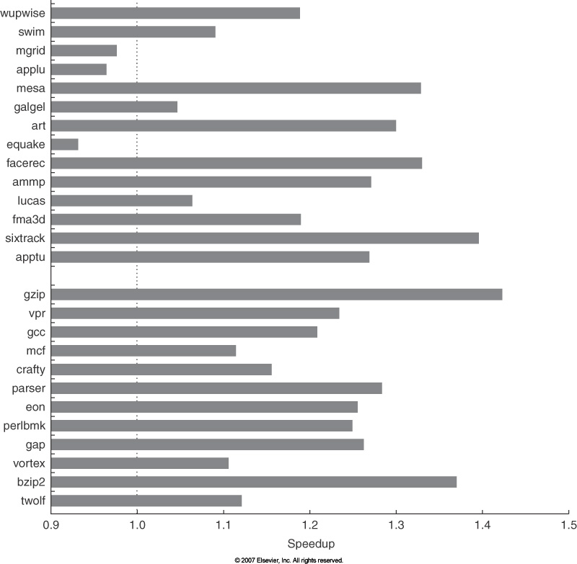
TLP Era I - Multithreading
IBM 8-processor Power 5 with SMT (2 threads per core)
  Run two copies of an application in SMT mode versus single-thread mode
  23% improvement in SPECintRate and 16% improvement in SPECfpRate

Slide 17
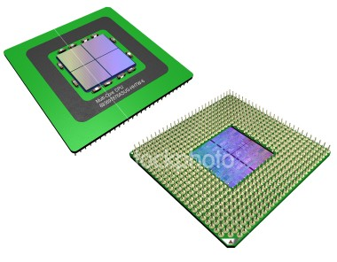
TLP Era II - Multicore
Multicore
  Single-chip multiprocessing
  Easy to design and verify functionally
  Core architecture
    Should be the most efficient in MIPS/watt and MIPS/silicon.
    Modestly pipelined (8~14 stages) superscalar pipelines
  Excellent performance/watt
    Dual core at half clock speed can achieve the same performance (throughput) but with only ¼ of the power consumption!
      Dual core consumes 2 * C * 0.5²V * 0.5F = 0.25 CV²F
  Packaging, cooling, reliability
    Power also determines the cost of packaging/cooling.
      Chip temperature must be limited to avoid reliability issue and leakage power
  Improved throughput with minor degradation in single program performance
    For multiprogramming workloads and multi-threaded applications

Slide 18
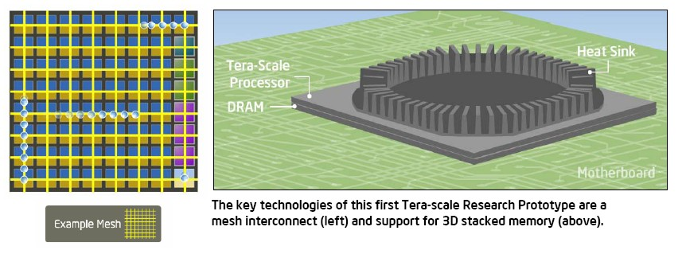
Intel Terascale processor (2007)
Features
  80 3.13 GHz processor cores, 1.01 TFLOPS at 1.0V, 62W, 100M transistors
  3D stacked memory
  Mesh interconnects – provides 80GB/s bandwidth
Challenges
  On-die power dissipation
  Off-chip memory bandwidth
  Cache hierarchy design and coherence
Intel Corp. All rights reserved

Slide 19
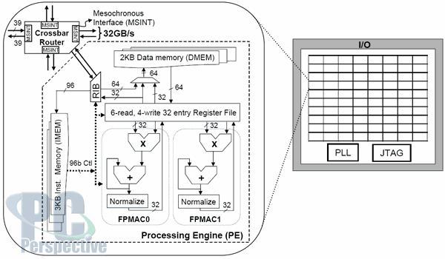
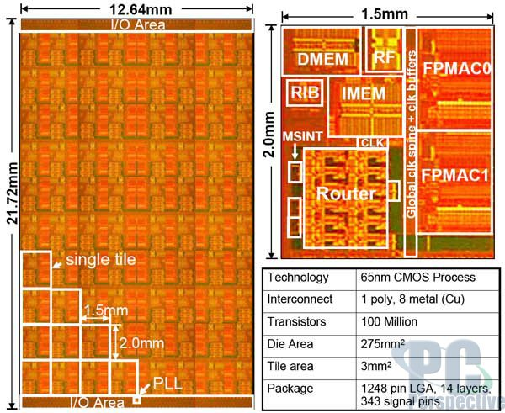
Intel Terascale processor
Intel Corp. All rights reserved

Slide 20
Trend - Change of Wisdoms
1. Power is free, but transistors are expensive.
  “Power wall”: Power is expensive, but transistors are “free”.
2. Regarding power, the only concern is dynamic power.
  For desktops/servers, static power due to leakage can be 40% of total power.
3. Can reveal more ILP via compilers/arch innovation.
  “ILP wall”: There are diminishing returns on finding more ILP.
4. Multiply is slow, but load and store is fast.
  “Memory wall”: Load and store is slow, but multiply is fast. 200 clocks to access DRAM, but FP multiplies may take only 4 clock cycles.
5. Uniprocessor performance doubles every 18 months.
  Power Wall + Memory Wall + ILP Wall: The doubling of uniprocessor performance may now take 5 years.
6. Don’t bother parallelizing your application, as you can just wait and run it on a faster sequential computer.
  It will be a very long wait for a faster sequential computer.
7. Increasing clock frequency is the primary method of improving processor performance.
  Increasing parallelism is the primary method of improving processor performance.

