Slide 1
Microprocessor Microarchitecture
Introduction
Lynn Choi
School of Electrical Engineering

Slide 2
Class Information
Lecturer
  Prof. Lynn Choi, 02-3290-3249, lchoi@korea.ac.kr, http://it.korea.ac.kr
Textbook
  Computer Architecture, A Quantitative Approach
    6th edition, John. L. Hennessy and David A. Patterson, Morgan Kaufmann, 2017
  Lecture slides (collection of research papers)
  Reading list (refer to the class homepage)
Content
  Introduction (Chapter 1)
  Branch Prediction (Chapter 3)
  Instruction Fetch (Chapter 3)
  Data Hazard and Dynamic Scheduling (Chapter 3)
  Exceptions (Chapter 3)
  Limits on ILP (Chapter 3)
  Memory Hierarchy Optimization (Chapter 2)
  Data Level Parallelism in Vector, SIMD, and GPU Architectures (Chapter 4)
  Thread Level Parallelism: Multithreading, Multicores (Chapter 5)

Slide 3
Class Information
Paper presentation
  Recent research papers in ISCA, ASPLOS, MICRO, HPCA, PACT, ICS
  Presentation of 2~3 papers in the subject
Evaluation
  Midterm : 40%
  Final: 40%
  Presentation: 20%
Class organization
  Lecture: 70%
  Presentation: 30% (after Midterm)

Slide 4
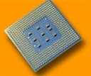
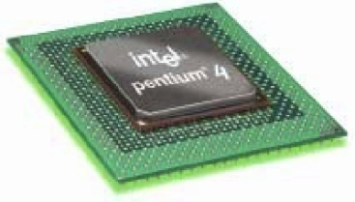

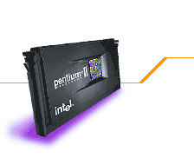
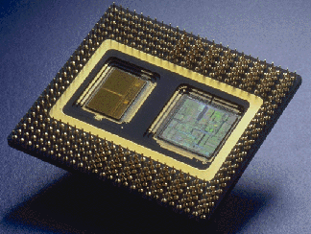

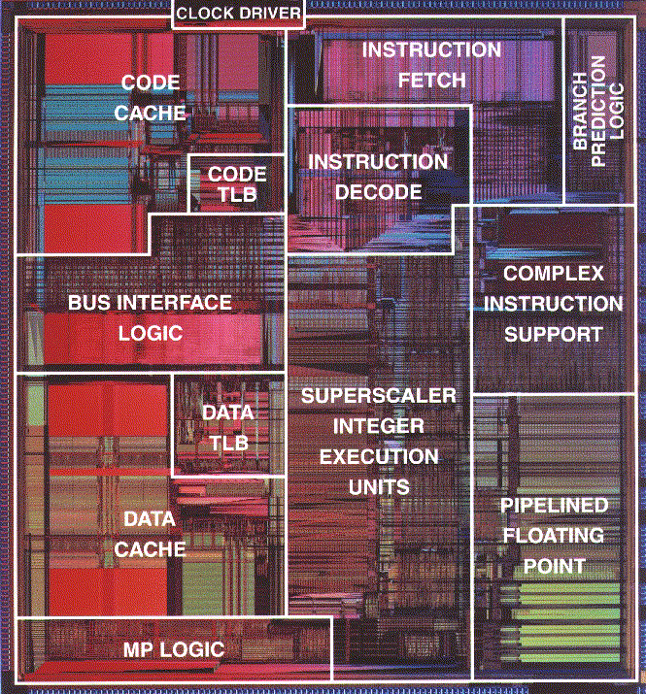
Advances in Intel Microprocessors
80
81.3 (projected)
Pentium IV 2.8GHz
(superscalar, out-of-order)
70
60
42X Clock Speed ↑
2X IPC ↑
45.2 (projected)
50
Pentium IV 1.7GHz
(superscalar, out-of-order)
SPECInt95 Performance
40
24
Pentium III 600MHz
(superscalar, out-of-order)
30
8.09
11.6
20
3.33
PPro 200MHz
(superscalar, out-of-order)
Pentium 100MHz
(superscalar, in-order)
1
Pentium II 300MHz
(superscalar, out-of-order)
80486 DX2 66MHz (pipelined)
10
Intel Corp. All rights reserved
1992 1993 1994 1995 1996 1997 1998 1999 2000

Slide 5
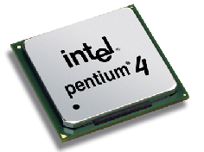
Intel® Pentium 4 Microprocessor
Intel Pentium IV Processor (2000-2005)
  Technology
    0.13μ process, 55M transistors, 82W
    3.2 GHz, 478pin Flip-Chip PGA2
  Performance
    1221 Ispec, 1252 Fspec on SPEC CPU 2000
      Relative performance to SUN 300MHz Ultra 5_10 workstation (100 Ispec/Fspec)
    40% higher clock rate, 10~20% lower IPC compared to P III
  Pipeline
    3-issue, 20-stage out-of-order (OOO) pipeline, hyperthreading
    2 ALUs run at 6.4GHz
  Cache hierarchy
    12K micro-op trace cache/8 KB on-chip D cache
    On-chip 512KB L2 ATC (Advanced Transfer Cache)
    Optional on-die 2MB L3 Cache
  800MHz system bus, 6.4GB/s bandwidth
    Implemented by quad-pumping on 200MHz system bus
Intel Corp. All rights reserved

Slide 6
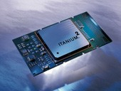
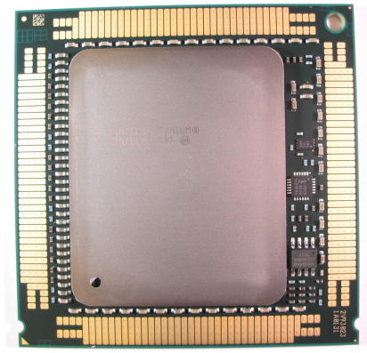
Intel® Itanium® 2 processor
Intel® Itanium® 2 processor (2002-2010)
  Technology
    1.5 GHz, 130W, 0.13μ process, 221M transistors
  Performance: 1322 Ispec, 2119 Fspec
  IA64 ISA - EPIC (Explicitly Parallel Instruction Computing) architecture
  Pipeline
    6-issue 8-stage in-order pipeline (10-stage in Itanium)
    6 INT, 4 MEM, 2 FP (4 SP), 1 SIMD, 3 BR (4 INT, 2 MEM in Itanium)
  Cache hierarchy
    32KB L1 cache, 256KB L2 cache, and up to 6MB L3 Cache
  Memory and System Interface
    50b PA, 64b VA, 400MHz 128-bit system bus, 6.4GB/s bandwidth
Itanium 9300 (2010)
  65n process, quad-core, 24MB L3, hyperthreading, QPI
Itanium 9500 (2012), 9700 (2017)
  32n process, 8-core, 16-threads, 12-issue, 32MB L3, 3.1B transistors
Intel Corp. All rights reserved

Slide 7
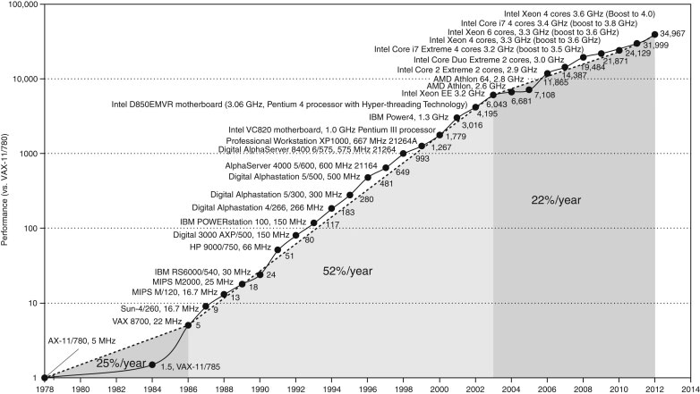

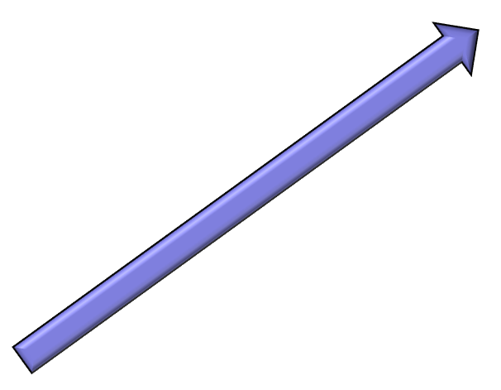
Microprocessor Performance Curve

Slide 8

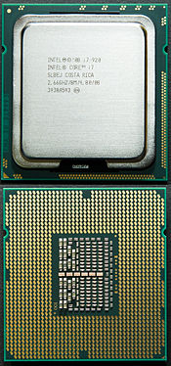
Today’s Microprocessor
Intel i7 Processor (2010)
  Technology
    32nm process, 130W, 239 mm² die, 1.17B transistors
    3.46 GHz, 64-bit 6-core 12-thread processor
    159 Ispec, 103 Fspec on SPEC CPU 2006
      296MHz UltraSparc II processor as a reference machine
  Core microarchitecture
    Next generation multi-core microarchitecture introduced in Q1 2006 (Derived from P6 microarchitecture)
    Optimized for multi-cores and lower power consumption
      14-stage 4-issue out-of-order (OOO) pipeline
    64bit Intel architecture (x86-64)
    Core i3 (entry), Core i5 (mainstream), Core i7 (high-end), Xeon (server)
  32KB L1 I/D cache, 256KB L2 cache/core, 12MB L3 Caches
  Integrated memory controller
Intel i7 Processor (2023)
  13th generation, 10n (Intel 7) process, 6(P)+8(E) cores, 20 threads, 2.4~5GHz, 45~115W, 100B+ transistors
Intel Corp. All rights reserved

Slide 9
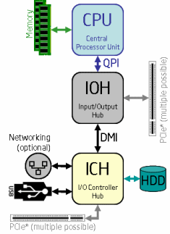
Intel i7 System Architecture
Integrated memory controller
  3 Channel, 3.2GHz, 25.6 GB/s memory bandwidth, 36 bit physical address
    Separate data paths for memory interconnects
    Faster memory access due to direct control
QuickPath Interconnect (QPI)
  Point-to-point processor interconnect, replacing the front side bus (FSB)
  64bit data every two clock cycles for two separate data paths (send, receive) up to 25.6GB/s, which doubles the theoretical bandwidth of 1600MHz FSB
Direct Media Interface (DMI)
  The link between Intel Northbridge and Intel Southbridge, sharing many characteristics with PCI-Express
IOH (Northbridge), ICH (Southbridge)
Intel Corp. All rights reserved

Slide 10
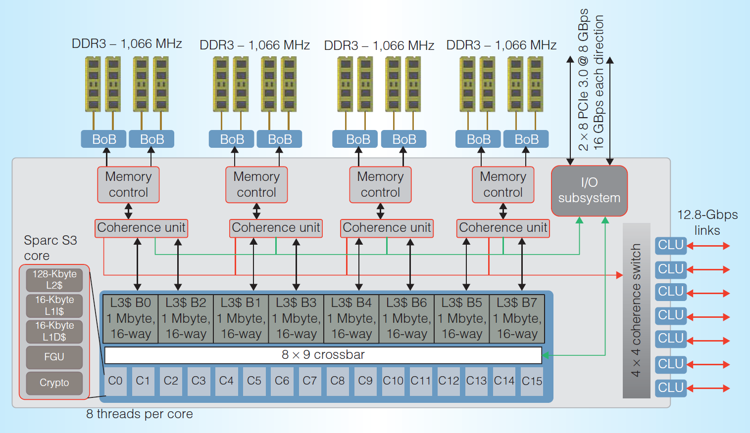
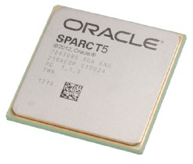
Today’s Microprocessor
Oracle SPARC T5 processor (2013)
  Multithreaded multicore technology
    16 3.6 GHz cores, 8 threads per core → total 128 threads
      The same SPARC S3 core (2-issue 16-stage OOO pipeline) used in UltraSPARC T4
    28nm process, 478mm² die, 1.5B transistors
  16KB L1-I/L1-D caches, 128KB L2 cache per core, shared 8MB L3 cache
  Scalable across 8 sockets, supporting 128 cores, 1024 threads
Oracle SPARC M8 processor (2017)
  20nm process, 5GHz, 32 cores, 256 threads (8 threads per core)
Oracle. All rights reserved

Slide 11
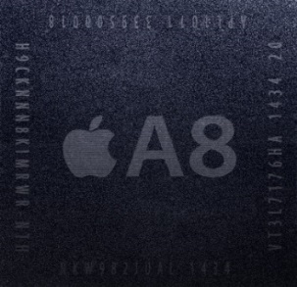
Today’s Microprocessor
Apple A8 Chip (2014)
  SoC designed by Apple and manufactured by TSMC
  20nm process, 89mm² die, 1.3W(estimated), 2B transistors
  1.4 GHz 64-bit ARM based dual-core CPU with integrated quad-core PowerVR GX6450 GPU
    Custom-designed dual-core CPU called Cyclone 2 (Typhoon)
      ARMv8-A compatible
      Rather than ARM-licensed CPU (ARM Cortex A9 in A5)
    6-issue OOO pipeline with 64KB L1-I/D, 1MB L2, 4MB L3
    25% improvement in CPU and 50% more performance in GPU performance with only 50% of power compared to A7
  Used for iPhone 6 and 6 Plus
Apple A9 (2015), A10 (2016), A11 (2017), … , A16 (2022)
      A10: 40% faster CPU and 50% faster graphics performance compared to A9
      A11 Bionic: 20% faster CPU and 30% faster graphics performance compared to A10
        64-bit six-core CPU, 10nm process, 4.3B transistors, neural engine for faceID
      A12 Bionic: 15% faster CPU and 50% faster graphics performance compared to A11
        64-bit six-core CPU (2 7-issue cores + 4 3-issue cores), 6.9B transistors, neural II
      A15 Bionic: 2+4 cores, 15B transistors, 5nm process, 3.24GHz, for iPhone 13 and 14
      A16 Bionic: 2+4 cores, 16B transistors, 5nm process, 3.46GHz, for iPhone 14 Pro, 15

Slide 12
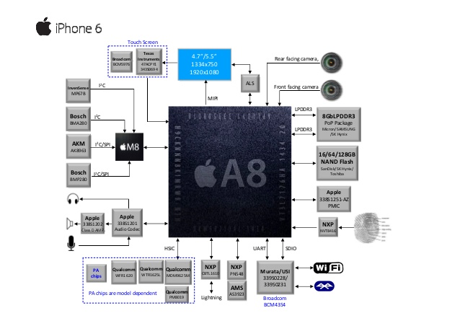
iPhone 6 System Architecture

Slide 13
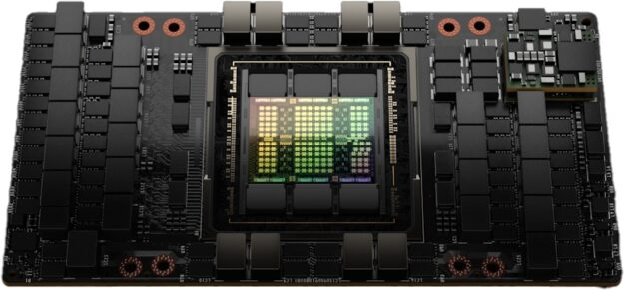
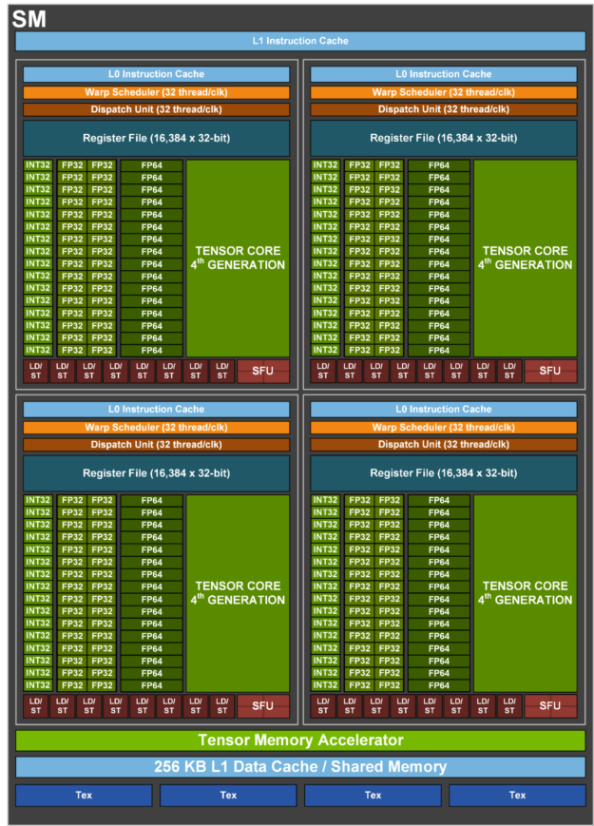
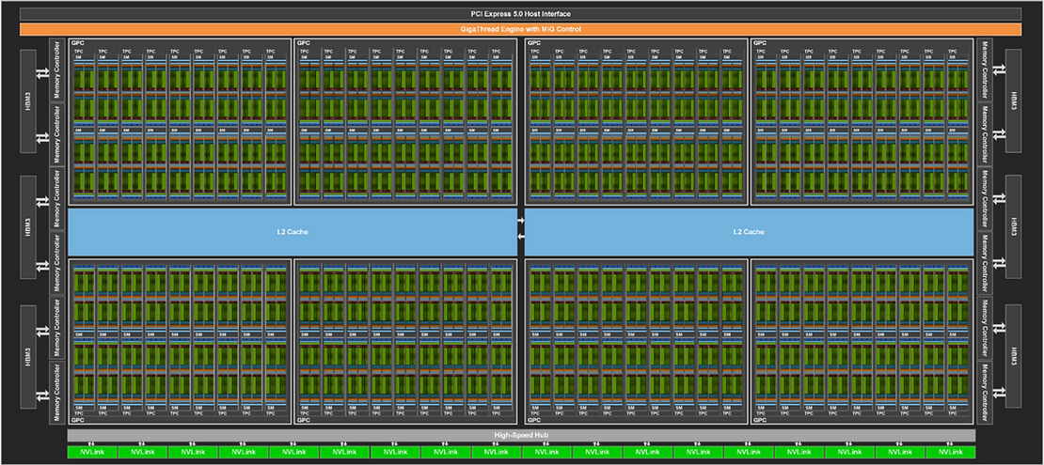
Today’s Processor
NVIDIA’s H100 (2022)
  Technology
    TSMC 4nm, 812mm², 700W, 80B transistors
    1.593 GHz, 144 streaming multiprocessors
    35,000 parts and weighs 70 lb (32 kg)
    For data centers (deep learning and HPC)
  Hopper microarchitecture
    The latest (9th) generation of GPU microarchitecture called Hopper
      Tesla-Fermi-Kepler-Maxwell-Pascal-Volta-Turing-Ampere-Hopper-Blackwell
    Supports HBM3 and HBM2e memory up to 80GB
      CoWoS (Chip on Wafer on Subtrate) packaging
      HBM3 supports 3 TB/s, an increase of 50% over the Ampere A100
    256KB L1 per SM, 50MB L2
  Streaming multiprocessor
    128 FP32 CUDA cores
    4 Tensor cores
      4th generation Tensor cores

Slide 14
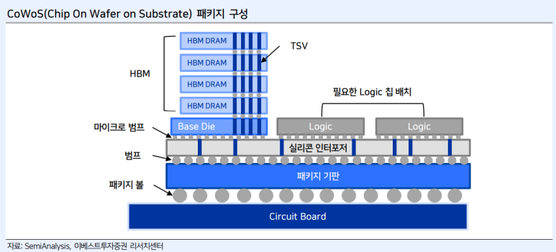
Today’s Processor
NVIDIA’s H100 Streaming Multiprocessor

Slide 15
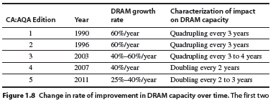
Trends in Technology
Integrated circuit technology
  Transistor density: 35%/year
  Die size: 10-20%/year
  Integration overall: 40-55%/year
DRAM capacity: 25-40%/year (slowing)
Flash capacity: 50-60%/year
  15-20X cheaper/bit than DRAM
Magnetic disk capacity: 40%/year
  15-25X cheaper/bit then Flash
  300-500X cheaper/bit than DRAM
Trends in Technology
Copyright © 2012, Elsevier Inc. All rights reserved.
Notes:
The University of Adelaide, School of Computer Science
Chapter 2 — Instructions: Language of the Computer

Slide 16
Bandwidth and Latency
Bandwidth or throughput
  Total work done in a given time
  10,000X improvement for network and 25,000X for processors
  300X improvement for disks and 1200X for memory
Latency or response time
  Time between start and completion of an event
  30X improvement for network and 80X for processors
  6X improvement for memory and 13X for disks
Feature size
  Minimum size of transistor or wire in x or y dimension
    The minimum length of the MOS transistor channel between the drain and the source, a.k.a. transistor gate length
  10 microns in 1971 to .032 microns in 2011 (0.14 microns in 2015)
  Transistor performance scales linearly
  Integration density scales (more than) quadratically
  However, wire delay scales poorly compared to transistor performance!
Trends in Technology
Copyright © 2012, Elsevier Inc. All rights reserved.
Notes:
The University of Adelaide, School of Computer Science
Chapter 2 — Instructions: Language of the Computer

Slide 17
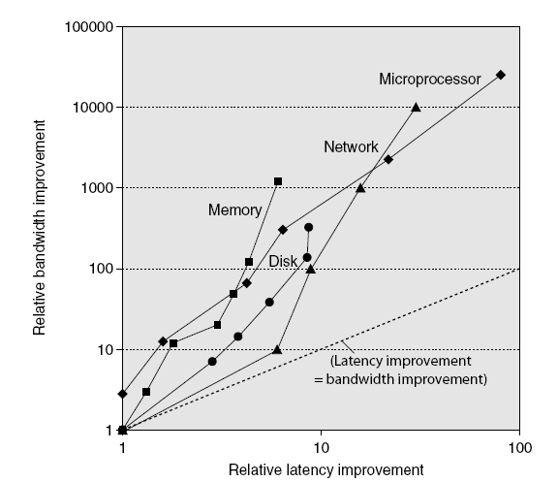
Bandwidth and Latency
Trends in Technology
Log-log plot of bandwidth and latency milestones
Copyright © 2012, Elsevier Inc. All rights reserved.

Slide 18
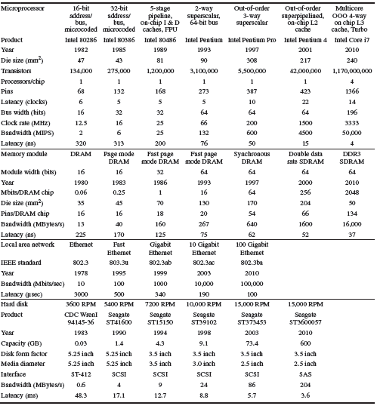
Performance Milestones over 30 Years
Copyright © 2012, Elsevier Inc. All rights reserved.

Slide 19
Dynamic Power
For CMOS chips, traditional dominant energy consumption has been in switching transistors, called dynamic power
  For a fixed task, slowing clock rate (frequency switched) reduces power, but not energy
  Dropping voltage helps both, so went from 5V to 1V
  Capacitive load is a function of number of transistors connected to output and technology determines capacitance of wires and transistors
To save energy & dynamic power, most CPUs use two techniques
  Clock gating: turn off clock of inactive modules (e.g. FPU)
  Dynamic voltage and frequency scaling (DVFS): reduce voltage and frequency at the same time to save both power and energy at the cost of reduced performance

Slide 20
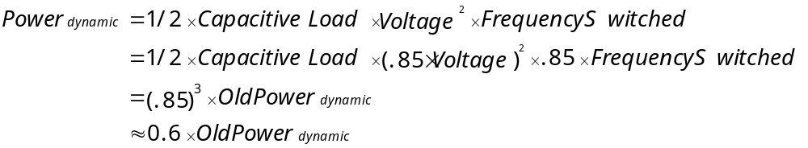
Example
Suppose 15% reduction in voltage results in 15% reduction in frequency. What is impact on dynamic power?

Slide 21

Static Power
Because leakage current flows even when a transistor is off, static power is important too
Leakage current increases in processors with smaller transistor sizes
In 2010, leakage power occupies 25% of total power consumption; high performance designs at 40%
Very low power systems even gate voltage to inactive modules to control loss due to leakage

Slide 22
Processor Performance Equation
T_{exe} (Execution time per program)
= NI * CPI_{execution} * T_{cycle}
  NI: # of instructions / program (program size)
    Small program is better
  CPI: clock cycles / instruction
    Small CPI is better. In other words, higher IPC is better
  T_{cycle} = clock cycle time
    Small clock cycle time is better. In other words, higher clock speed is better

Slide 23
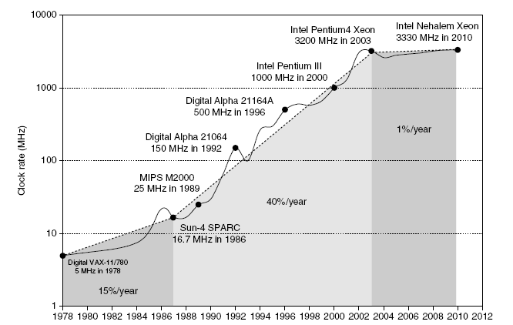
Clock Speed versus Power
Intel 80386 consumed ~ 2 W
3.3 GHz Intel Core i7 consumes 130 W
Heat must be dissipated from 1.5 x 1.5 cm chip
This is the limit of what can be cooled by air
Copyright © 2012, Elsevier Inc. All rights reserved.
Notes:
The University of Adelaide, School of Computer Science
Chapter 2 — Instructions: Language of the Computer

Slide 24
Definition: Performance
  Performance(x) = 1 Execution_time(x)
  " X is n times faster than Y" means
Performance(X) Execution_time(Y)
n = =
Performance(Y) Execution_time(X)

Slide 25
Performance: What to measure
To increase predictability, collections of benchmark applications, called benchmark suites, are popular
SPECCPU: popular benchmark suite for processor performance
    SPEC (Standard Performance Evaluation Corporation)
  Split between integer (PC) and floating point (Server) programs
  SPEC CPU 2006 has 12 integer, SPECfp2000 has 17 FP programs
  SPEC CPU 2017 are divided into SPECspeed2017 and SPECrate2017
    SPECspeed2017 has 10 integer + 10 FP benchmarks for single program perf.
    SPECrate2017 has 10 integer and 13 FP benchmarks to measure the throughput of multiprocessors by running multiple copies of each benchmark
TPC measures server performance for database applications
    TPC (Transaction Processing Performance Council)
  TPC-C : complex query for online transaction processing
  TPC-H : models ad hoc decision support
  TPC-W : transactional web benchmark
  TPC-App : application server and web services benchmark

Slide 26
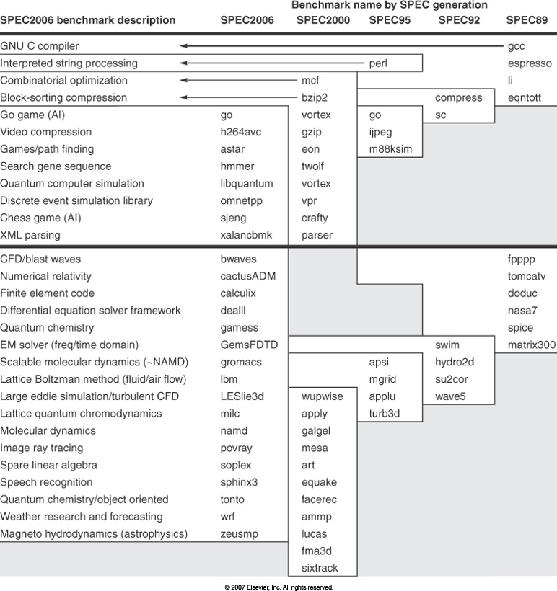
SPEC Benchmark Evolution

Slide 27
SPECspeed versus SPECrate
SPECspeed is a time-based metric while SPECrate is a throughput metric.
Calculating SPECspeed® Metrics | Calculating SPECrate® Metrics
1 copy of each benchmark in a suite is run. | The tester chooses how many concurrent copies to run
The tester may choose how many OpenMP threads to use. | OpenMP is disabled.
For each benchmark, a performance ratio is calculated as: time on a reference machine / time on the SUT | For each benchmark, a performance ratio is calculated as: number of copies * (time on a reference machine / time on the SUT)
Higher scores mean that less time is needed. | Higher scores mean that more work is done per unit of time.
Example: The reference machine ran 600.perlbench_s in 1775 seconds. A particular SUT took about 1/5 the time, scoring about 5. More precisely: 1775/354.329738 = 5.009458 | Example: The reference machine ran 1 copy of 500.perlbench_r in 1592 seconds. A particular SUT ran 8 copies in about 1/3 the time, scoring about 24. More precisely: 8*(1592/541.52471) = 23.518776
For both SPECspeed and SPECrate, in order to provide some assurance that results are repeatable, the entire process is repeated. The tester may choose: To run the suite of benchmarks three times, in which case the tools select the medians. Or to run twice, in which case the tools select the lower ratios (i.e. slower). New with CPU 2017
For both SPECspeed and SPECrate, the selected ratios are averaged using the Geometric Mean, which is reported as the overall metric

Slide 28
How Summarize Suite Performance (1/3)
Arithmetic average of execution time of all programs?
  But they vary by 4X in speed, so some would be more important than others in arithmetic average
Could add a weights per program, but how pick weight?
  Different companies want different weights for their products
SPECratio: Normalize execution times to reference computer, yielding a ratio proportional to performance
= time on reference computer
time on computer being rated

Slide 29
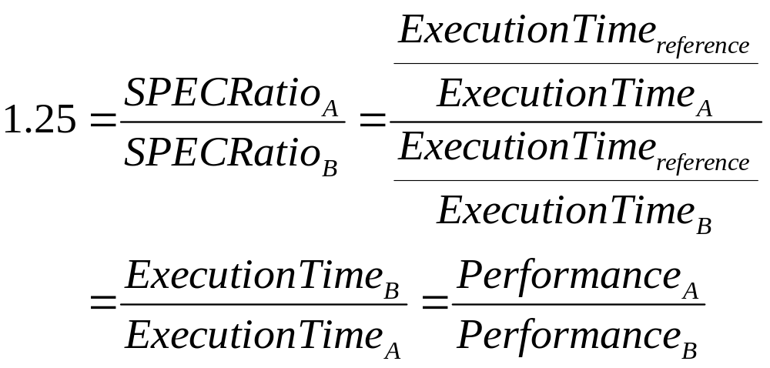
How Summarize Suite Performance (2/3)
If SPECRatio on Computer A is 1.25 times bigger than Computer B, then
Note that when comparing 2 computers as a ratio, execution times on the reference computer drop out, so choice of reference computer is irrelevant

Slide 30
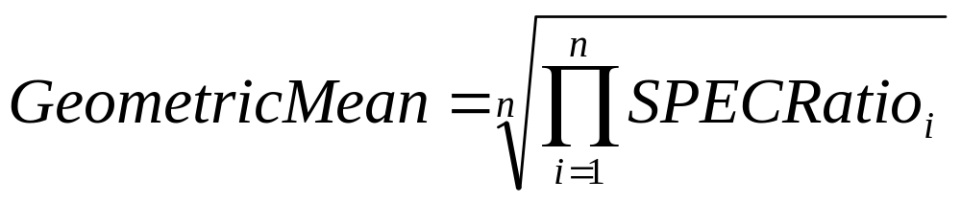
How Summarize Suite Performance (3/3)
Since we use ratios, proper mean is geometric mean
(SPECRatio unitless, so arithmetic mean meaningless)

Slide 31
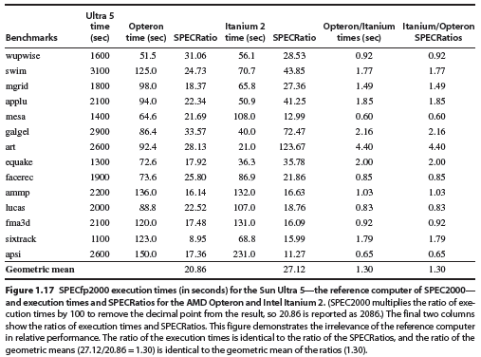
SPECfp2000 SPECRatio

Slide 32
Homework 1
Read Chapter 1 and Chapter 3
Exercise
  1.1
  1.4
  1.5
  1.7
  1.11
  1.14

