Slide 1
Operating System
Chapter 2. OS Overview
Lynn Choi
School of Electrical Engineering

Slide 2
Class Information
Lecturer
  Prof. Lynn Choi, School of Electrical Eng.
  Phone: 3290-3249, 공학관 411, lchoi@korea.ac.kr,
  TA: 손원준, 3290-3896, swj8905@korea.ac.kr
Time
  Mon 9am – 11:45am
Place
  창의관 205
Textbook
  “Operating Systems: Internals and Design Principles”, William Stallings, Pearson, 9th Edition, 2017.
References
  “Computer Systems: A Programmer’s Perspective”, Randal E. Bryant and David O’Hallaron, Prentice Hall, 3rd Edition, 2016.
Class homepage
  http:kulms.korea.ac.kr, http://it.korea.ac.kr : slides, announcements

Slide 3
Class Information
Course overview
  1. OS Overview
  2. Process
  3. Thread
  4. Mutual Exclusion and Synchronization
  5. Deadlock and Starvation
  6. Memory Management
  7. Virtual Memory
  8. Uniprocessor Scheduling
  9. Multiprocessor and Realtime Scheduling
  10. IO
  11. File Management
  12. Virtual Machine

Slide 4
Class Information
Evaluation
  Midterm : 35%
  Final: 35%
  Homework and Projects: 30%
  Class participation: extra 5%
    Attendance: no shows of more than 2 will get -5%
    Bonus points

Slide 5
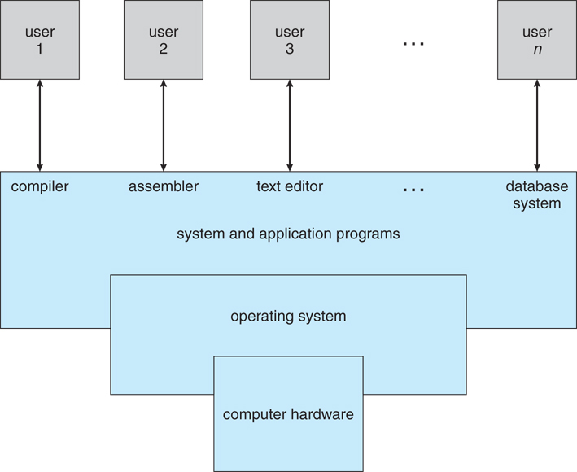
Abstract view of a computer system
Operating system controls the hardware and coordinates its use among
various application programs for various users

Slide 6

Operating system
  A layer of software between application programs and the hardware
  Three purposes
    Easy of use: Provide applications with simple and uniform interface to manipulate complicated and often widely different low-level hardware devices
    Sharing: Share the hardware resource from multiple processes/users and increase the resource utilization
    Protection: Protect the hardware from misuse by runaway applications
      Incorrect or malicious programs should not cause other programs to execute incorrectly
      Smartphone and PC operating systems emphasize easy of use while server and mainframe OSs emphasize sharing, protection, and fairness
  Commercial operating systems usually provide not only kernels (programs running at all times on the computer) but also system middleware, system programs, and application programs.
    Windows 76.5%, Mac OS 17.7%, Linux 1.7% (Mobile: Android 72%, IOS 27%)
  Use abstractions such as processes, virtual memory, and files
Notes:
A computer is a set of resources for the movement, storage, and processing of data
and for the control of these functions. The OS is responsible for managing these
resources.

Slide 7
Application programs
Software
Operating system
Processor
Main memory
I/O devices
Hardware
Layered view of a computer system
Processes
Virtual memory
Files
Processor
Main memory
I/O devices
Abstractions provided by an OS
Notes:
A computer is a set of resources for the movement, storage, and processing of data
and for the control of these functions. The OS is responsible for managing these
resources.

Slide 8
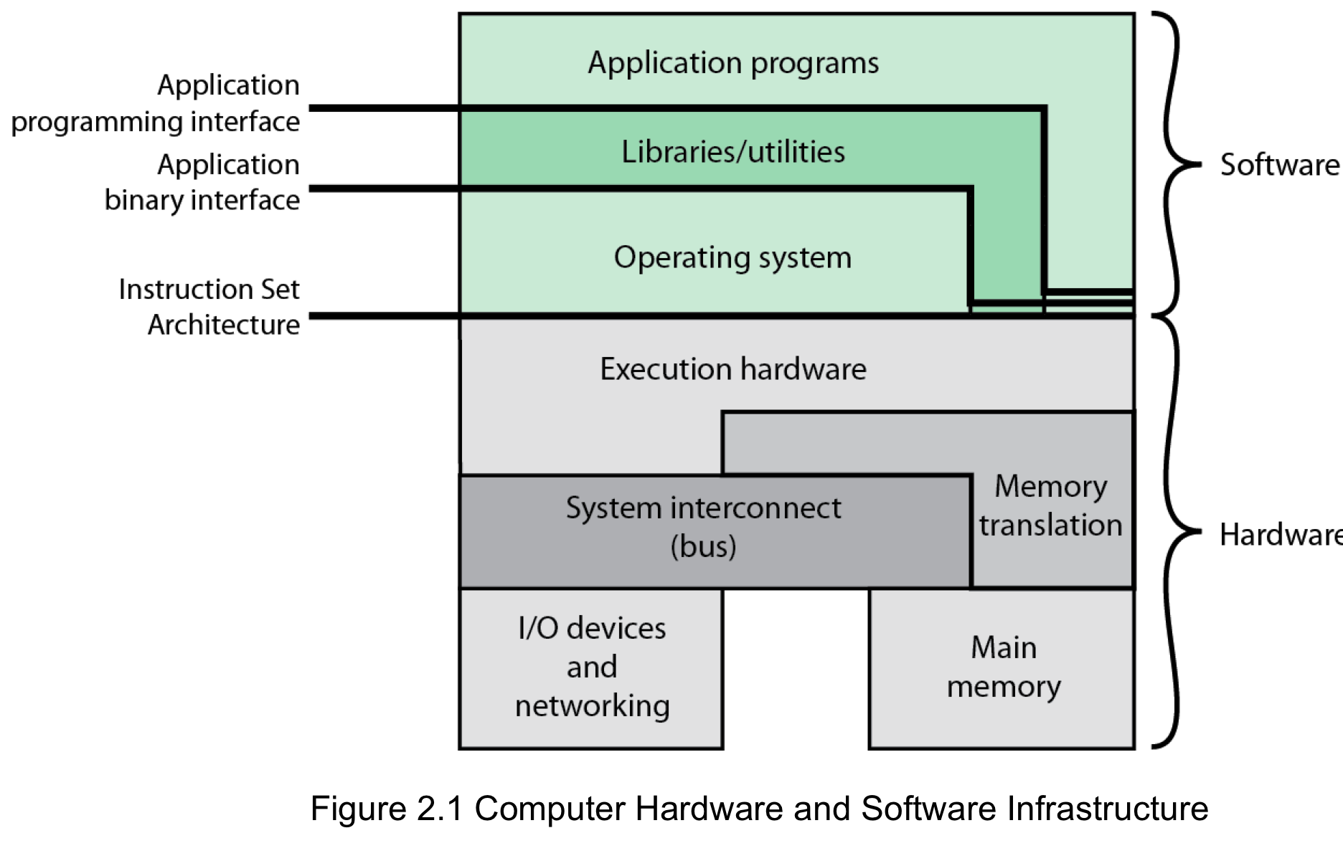
Operating System
An OS is a program that provides convenient services for application programs by managing hardware resources and acts as an interface between applications and the computer hardware
Source: Pearson
Notes:
An OS is a program that controls the execution of application programs and acts as
an interface between applications and the computer hardware. It can be thought of
as having three objectives:
• Convenience: An OS makes a computer more convenient to use.
• Efficiency: An OS allows the computer system resources to be used in an efficient
manner.
• Ability to evolve: An OS should be constructed in such a way as to permit the
effective development, testing, and introduction of new system functions without
interfering with service.

Slide 9
Key Interfaces
Instruction set architecture (ISA)
  Define the interface between SW and HW
    A set of machine language instructions
    Both application programs and utilities can access the ISA directly
Application binary interface (ABI)
  Define the system call interface to OS
Application programming interface (API)
  Define the program call interface to system services. System calls are performed through library calls.
    Enables application programs to be ported easily, through recompilation, to other systems that support the same API
Notes:
Figure 2.1 also indicates three key interfaces in a typical computer system:
• Instruction set architecture (ISA) : The ISA defines the repertoire of machine
language instructions that a computer can follow. This interface is the boundary
between hardware and software. Note that both application programs
and utilities may access the ISA directly. For these programs, a subset of the
instruction repertoire is available (user ISA). The OS has access to additional
machine language instructions that deal with managing system resources
(system ISA).
• Application binary interface (ABI) : The ABI defines a standard for binary
portability across programs. The ABI defines the system call interface to
the operating system and the hardware resources and services available in a
system through the user ISA.
• Application programming interface (API) : The API gives a program access
to the hardware resources and services available in a system through the user
ISA supplemented with high-level language (HLL) library calls. Any system
calls are usually performed through libraries. Using an API enables application
software to be ported easily, through recompilation, to other systems that
support the same API.

Slide 10
Terminology
Microprocessor: a single chip processor
    Intel i7, Pentium IV, AMD Ryzen, SPARC T5, ..
ISA (Instruction Set Architecture)
  Defines machine instructions and visible machine states (registers + memory)
  Examples
    IA32(x86), IA64, ARM, MIPS, SPARC, PowerPC
      x86 family: Intel Pentium, Pentium Pro, Pentium 4, AMD Athlon
      x86-64 family, Intel i3, i5, i7, i9
      IA64 family: Itanium, Itanium2, Itanium 9300/9500/9700
      ARM family: ARM7, ARM11, ARM Cortex-A53
Microarchitecture
  Implementation: HW design and implementation according to the ISA
    Pipelining, caches, branch prediction, buffers, out-of-order execution
    80386, 80486, Pentium, Pentium Pro, Pentium 4 are the 1st, 2nd, 3rd, 4th, 5th implementation (microarchitecture) of x86 ISA
  Invisible to programmers
    From the programmer’s perspective, both 80486 and Pentium 4 support the same ISA and show the same behavior for a machine instruction

Slide 11
Terminology
CISC (Complex Instruction Set Computer)
  Each instruction is complex
    Instructions of different sizes, many instruction formats, allow computations on memory data, …
  A large number of instructions in ISA
  Architectures until mid 80’s
    Examples: x86, VAX
RISC (Reduced Instruction Set Computer)
  Each instruction is simple
    Fixed size instructions, only a few instruction formats
  A small number of instructions in ISA
  Load-store architectures
    Computations are allowed only on registers
      Data must be transferred to registers before computation
  Most architectures built since 80’s
    Examples: MIPS, ARM, PowerPC, Alpha, SPARC, IA64, PA-RISC, etc.

Slide 12
Terminology
Word
  Default data size for computation
    Size of a GPR & ALU data path depends on the word size
      GPR stands for general purpose (integer) registers
      ALU stands for arithmetic and logic unit
  The word size determines if a processor is a 8b, 16b, 32b, or 64b processor
Address (or pointer)
  Points to a location in memory
  Each address points to a byte (byte addressable)
    If you have a 32b address, you can address 2³² bytes = 4GB
    If you have a 256MB memory, you need at least 28 bit address since 2²⁸ = 256MB
Caches
  Faster but smaller memory close to processor
    Fast since they are built using SRAMs
    Smaller since they are expensive
    Usually inside CPU chip (located between processor core and main memory)

Slide 13
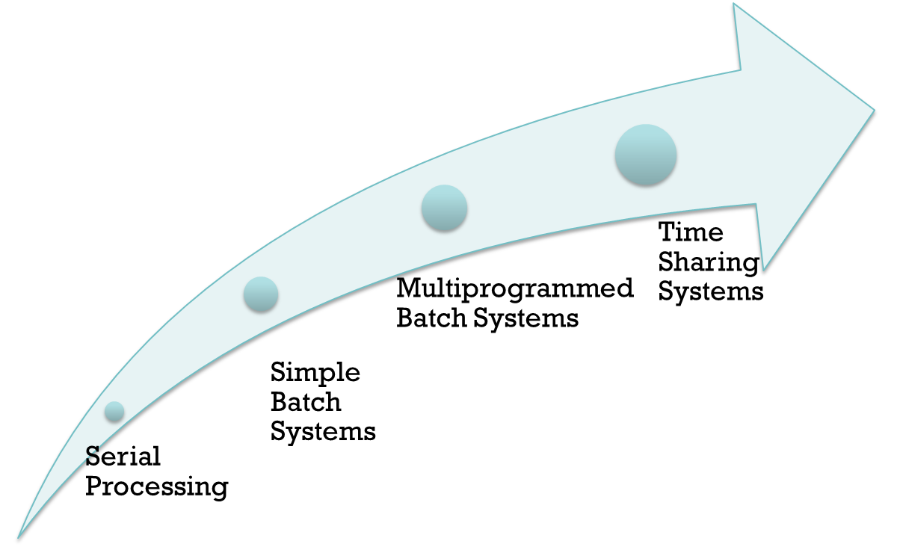
Evolution of Operating Systems
Source: Stallings Lecture Slide
Notes:
In attempting to understand the key requirements for an OS and the significance of the major features of a contemporary OS, it is useful to consider how operating systems have evolved over the years.

Slide 14

Earliest computers
  No operating system until mid 1950s
    Programmers interacted directly with the computer hardware
  Computers ran from a console with display lights, toggle switches, jumper cables, some form of input device, and a printer
Problems
  Scheduling
    Most installations used a hardcopy sign-up sheet to reserve computer time. However, time allocations could run short or long, resulting in wasted time
  Setup time
    A considerable amount of time was spent just on setting up the program to run. Compile/link/load require mounting tapes, setting up card decks, etc.
  Early computers were very expensive
    Important to maximize processor utilization
Notes:
With the earliest computers, from the late 1940s to the mid-1950s, the programmer
interacted directly with the computer hardware; there was no OS. These computers
were run from a console consisting of display lights, toggle switches, some form of
input device, and a printer. Programs in machine code were loaded via the input
device (e.g., a card reader). If an error halted the program, the error condition was
indicated by the lights. If the program proceeded to a normal completion, the output
appeared on the printer.
These early systems presented two main problems:
• Scheduling : Most installations used a hardcopy sign-up sheet to reserve computer
time. Typically, a user could sign up for a block of time in multiples of a
half hour or so. A user might sign up for an hour and finish in 45 minutes; this
would result in wasted computer processing time. On the other hand, the user
might run into problems, not finish in the allotted time, and be forced to stop
before resolving the problem.
• Setup time: A single program, called a job , could involve loading the compiler
plus the high-level language program (source program) into memory,
saving the compiled program (object program) and then loading and linking
together the object program and common functions. Each of these steps could
involve mounting or dismounting tapes or setting up card decks. If an error
occurred, the hapless user typically had to go back to the beginning of the
setup sequence. Thus, a considerable amount of time was spent just in setting
up the program to run.
This mode of operation could be termed serial processing , reflecting the fact
that users have access to the computer in series. Over time, various system software
tools were developed to attempt to make serial processing more efficient. These
include libraries of common functions, linkers, loaders, debuggers, and I/O driver
routines that were available as common software for all users.

Slide 15
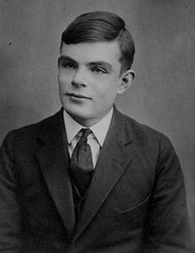
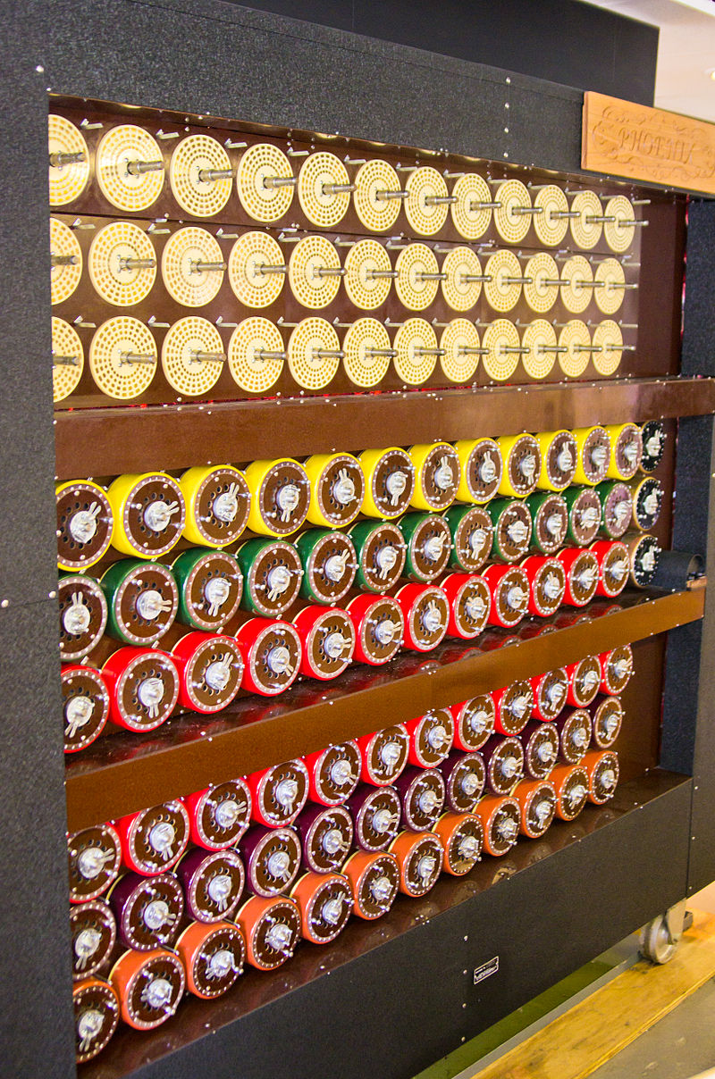

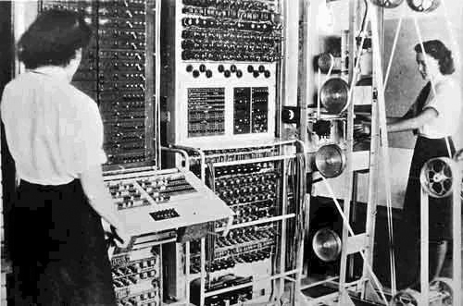
Alan Turing, Bombe and Colossus
Bletchley Park
Source: Wikipedia

Slide 16
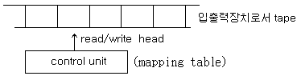
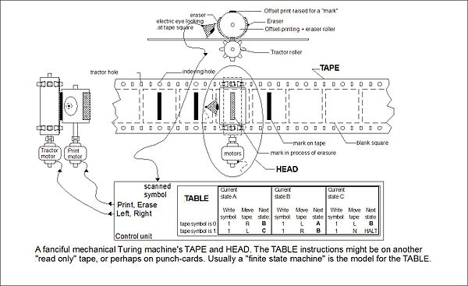
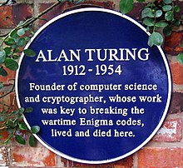
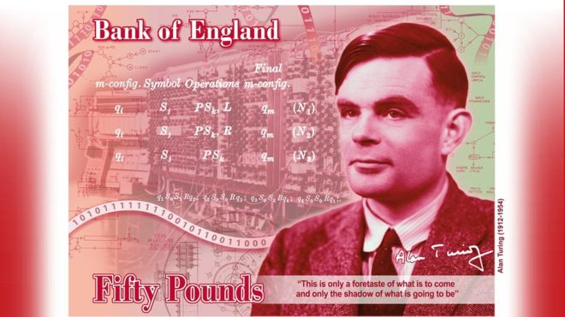
Alan Turing (1912 ~ 1954)
Turing Machine (1936)
  A new mathematical computing model
    An abstract machine that manipulates symbols on a tape according to a table of rules
  A symbol manipulating device that can simulate the logic of any computer
    Consists of infinite linear tape, read/write head, and control unit
  Theoretical background to modern computers
Bombe (1940)
  A electromechanical machine to decipher German’s Enigma
Turing Test (1950)
  A computer could be said to "think" if a human interrogator could not tell it apart, through conversation, from a human being
ACM Turing Award – the Novel prize in Computer Science

Slide 17
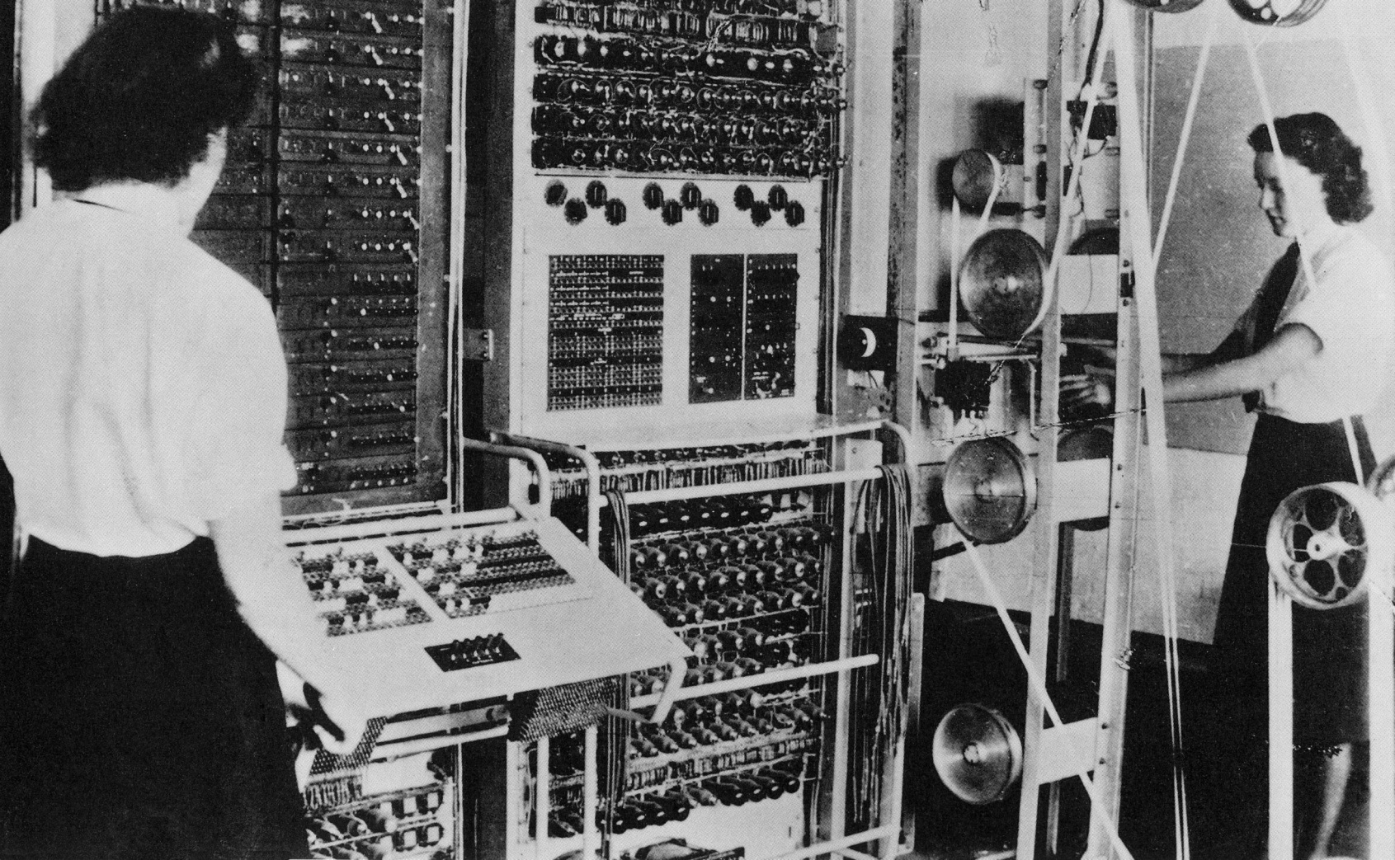
Colossus
Colossus (1943)
  The 1st programmable digital (electronic) computer built by Thomas Flowers in London

Slide 18
ENIAC
ENIAC (Electronic Numerical Integrator And Computer)
  Designed by John Mauchly and John Presper Eckert at University of Pennsylvania
  Funded by US BRL (Ballistic Research Lab) to develop range and trajectory tables for new weapons
    Until then, BRL employee more than 200 people with desktop calculators to solve the necessary ballistics equations
    The proposal accepted in 1943, the machine completed in 1946, and dismantled in 1955
  Used for H-bomb research
  Characteristics
    30 tons, 15000 square feet, 18000 vacuum tubes, 140 KW power dissipation
    Decimal machine
      20 accumulators each holding 10-digit decimal number
      Each digit is represented by a ring of 10 vacuum tubes
    Manually programmed by setting switches and plugging/unplugging cables
    5,000 additions per second

Slide 19
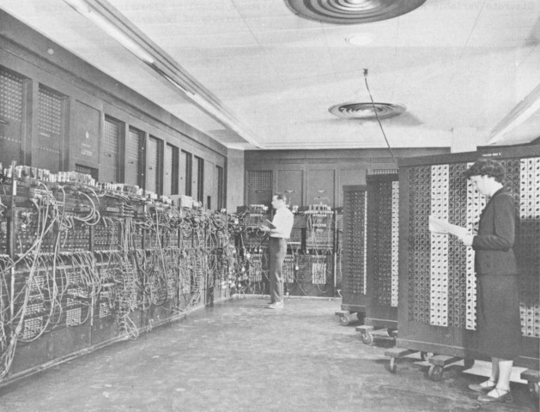
ENIAC
Source: Wikipedia

Slide 20
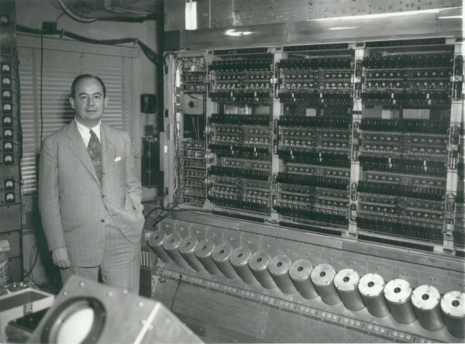
The Von Neumann Machine & IAS
1951
1903 - 1957
IAS (Institute for Advanced Studies) Machine
  The first modern computer with stored program (Von Neumann architecture)
  Characteristics
    450 kg, 1700 vacuum tubes, 140 KW power dissipation
    Binary computer with 40-bit word and 20-bit instructions
Source: IAS

Slide 21
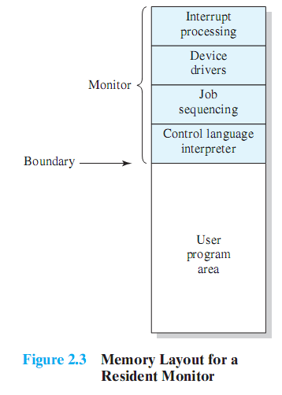
Simple Batch Systems
Monitor
  User submits the job on cards or tape to a computer operator, who batches them together sequentially and places them on an input device
  Monitor is a resident software in main memory
  Monitor reads in jobs one at a time from the input device.
  The current job is placed in the user program area
  The control is passed to the job.
  When the job is completed, it returns control to the monitor
    User no longer has direct access to the processor
History
  The first batch OS was developed by GM in the mid-1950s for use on IBM 701
  By the early 1960s, a number of vendors developed batch OS for their computer systems
Source: Pearson
Notes:
Early computers were very expensive, and therefore it was important to maximize
processor utilization. The wasted time due to scheduling and setup time was
unacceptable.
To improve utilization, the concept of a batch OS was developed. It appears
that the first batch OS (and the first OS of any kind) was developed in the mid-1950s
by General Motors for use on an IBM 701 [WEIZ81]. The concept was subsequently
refined and implemented on the IBM 704 by a number of IBM customers. By the
early 1960s, a number of vendors had developed batch operating systems for their
computer systems. IBSYS, the IBM OS for the 7090/7094 computers, is particularly
notable because of its widespread influence on other systems.
The central idea behind the simple batch-processing scheme is the use of a
piece of software known as the monitor . With this type of OS, the user no longer has
direct access to the processor. Instead, the user submits the job on cards or tape to a
computer operator, who batches the jobs together sequentially and places the entire
batch on an input device, for use by the monitor. Each program is constructed to
branch back to the monitor when it completes processing, at which point the monitor
automatically begins loading the next program.

Slide 22

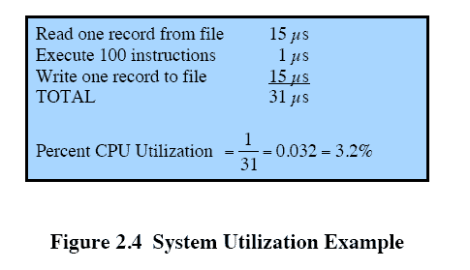

Processor is often idle
  Even with automatic job sequencing
  I/O devices are slow compared to processor
Source: Pearson
Notes:
Even with the automatic job sequencing provided by a simple batch OS, the processor
is often idle. The problem is that I/O devices are slow compared to the processor.
Figure 2.4 details a representative calculation. The calculation concerns a program
that processes a file of records and performs, on average, 100 machine instructions
per record. In this example, the computer spends over 96% of its time waiting for
I/O devices to finish transferring data to and from the file.

Slide 23

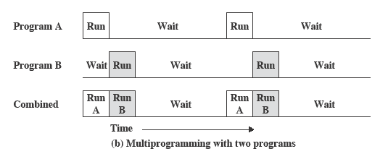
Source: Pearson
When one job needs to wait for I/O, the processor can switch to the other job, which is likely not waiting for I/O
  Also known as multitasking
  Memory can be expanded to hold three, four, or more programs
Notes:
This inefficiency is not necessary. We know that there must be enough
memory to hold the OS (resident monitor) and one user program. Suppose that
there is room for the OS and two user programs. When one job needs to wait for
I/O, the processor can switch to the other job, which is likely not waiting for I/O
( Figure 2.5b ).

Slide 24
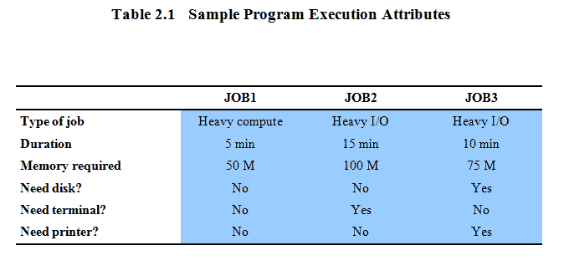
Multiprogramming Example
Source: Pearson
Notes:
To illustrate the benefit of multiprogramming, we give a simple example.
Consider a computer with 250 Mbytes of available memory (not used by the OS),
a disk, a terminal, and a printer. Three programs, JOB1, JOB2, and JOB3, are
submitted for execution at the same time, with the attributes listed in Table 2.1 .
We assume minimal processor requirements for JOB2 and JOB3 and continuous
disk and printer use by JOB3. For a simple batch environment, these jobs will be
executed in sequence. Thus, JOB1 completes in 5 minutes. JOB2 must wait until
the 5 minutes are over and then completes 15 minutes after that. JOB3 begins after
20 minutes and completes at 30 minutes from the time it was initially submitted.

Slide 25
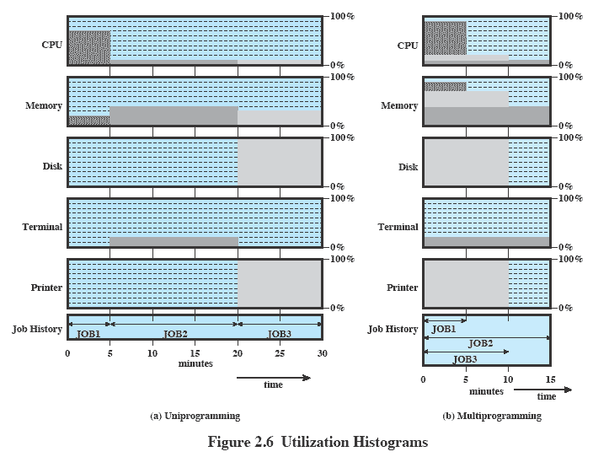
Utilization Histogram
Source: Pearson

Slide 26
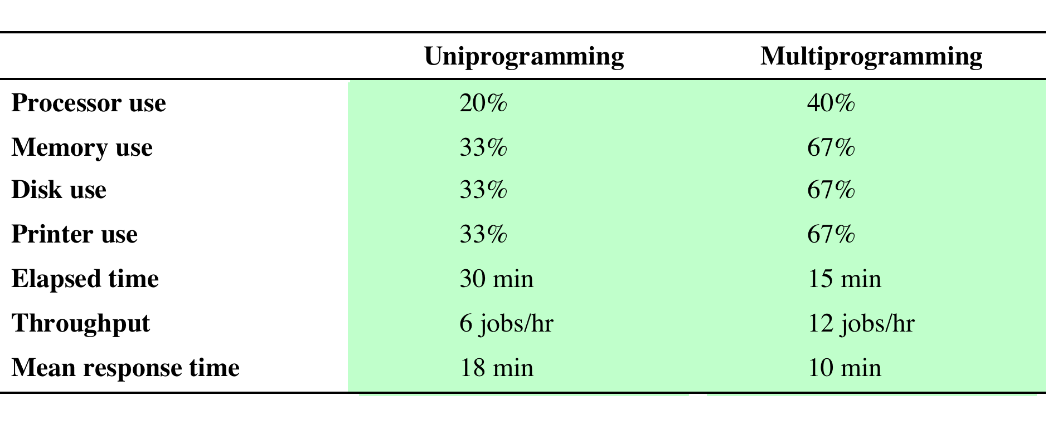
Effects on Resource Utilization
Table 2.2 Effects of Multiprogramming on Resource Utilization
Source: Pearson
Notes:
The average resource utilization, throughput, and response times are shown in the
uniprogramming column of Table 2.2 .

Slide 27

Can be used to handle multiple interactive jobs
  In a time-sharing system, several users share a computer system through terminals at the same time.
  In this system, minimizing response time is more important than maximizing throughput (processor utilization)
  OS interleaves the execution of each user program in time slice.
    Context switching occurs every time slice. The currently running job is suspended and a previously suspended job (or a new job) is resumed (is selected for execution).
  Short jobs or I/O intensive jobs do not have to wait for long compute-intensive jobs
Notes:
Just as multiprogramming allows the processor to handle multiple batch jobs
at a time, multiprogramming can also be used to handle multiple interactive jobs. In
this latter case, the technique is referred to as time sharing , because processor time is
shared among multiple users. In a time-sharing system, multiple users simultaneously
access the system through terminals, with the OS interleaving the execution of each
user program in a short burst or quantum of computation. Thus, if there are n users
actively requesting service at one time, each user will only see on the average 1/ n
of the effective computer capacity, not counting OS overhead. However, given the
relatively slow human reaction time, the response time on a properly designed system
should be similar to that on a dedicated computer.

Slide 28
Compatible Time-Sharing Systems
CTSS: One of the first time-sharing OS
  Developed at MIT by a group known as Project MAC
  Ran on a computer with 32,000 36-bit words of main memory, with the resident monitor consuming 5000 words
  To simplify both the monitor and memory management a program was always loaded to start at the location of the 5000th word
    First developed for IBM 709 in 1961 and later transferred to IBM 7094
    Running on 7094, CTSS supported 32 users
Time Slicing
  System clock generates interrupts at a rate of approximately one every 0.2 seconds
  At each interrupt OS regained control and could assign processor to another user
  Old user programs and data were written out to disk
  Old user program code and data were restored in main memory when that program was next given a turn
Notes:
One of the first time-sharing operating systems to be developed was the
Compatible Time-Sharing System (CTSS) [CORB62], developed at MIT by a
group known as Project MAC (Machine-Aided Cognition, or Multiple-Access
Computers). The system was first developed for the IBM 709 in 1961 and later
transferred to an IBM 7094.
Compared to later systems, CTSS is primitive. The system ran on a computer
with 32,000 36-bit words of main memory, with the resident monitor consuming 5000
of that. When control was to be assigned to an interactive user, the user’s program
and data were loaded into the remaining 27,000 words of main memory. A program
was always loaded to start at the location of the 5000th word; this simplified
both the monitor and memory management. A system clock generated interrupts
at a rate of approximately one every 0.2 seconds. At each clock interrupt, the OS
regained control and could assign the processor to another user. This technique is
known as time slicing . Thus, at regular time intervals, the current user would be
preempted and another user loaded in. To preserve the old user program status for
later resumption, the old user programs and data were written out to disk before the
new user programs and data were read in. Subsequently, the old user program code
and data were restored in main memory when that program was next given a turn.

Slide 29
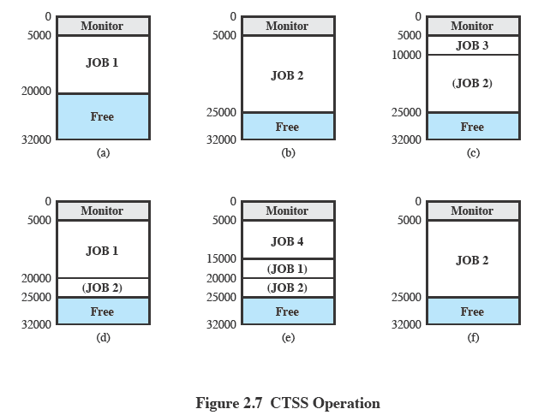

Source: Pearson
Notes:
To minimize disk traffic, user memory was only written out when the incoming
program would overwrite it. This principle is illustrated in Figure 2.7 . Assume that
there are four interactive users with the following memory requirements, in words:
• JOB1: 15,000
• JOB2: 20,000
JOB3: 5000
• JOB4: 10,000
Initially, the monitor loads JOB1 and transfers control to it (a). Later, the
monitor decides to transfer control to JOB2. Because JOB2 requires more memory
than JOB1, JOB1 must be written out first, and then JOB2 can be loaded (b).
Next, JOB3 is loaded in to be run. However, because JOB3 is smaller than JOB2,
a portion of JOB2 can remain in memory, reducing disk write time (c). Later, the
monitor decides to transfer control back to JOB1. An additional portion of JOB2
must be written out when JOB1 is loaded back into memory (d). When JOB4 is
loaded, part of JOB1 and the portion of JOB2 remaining in memory are retained
(e). At this point, if either JOB1 or JOB2 is activated, only a partial load will be
required. In this example, it is JOB2 that runs next. This requires that JOB4 and the
remaining resident portion of JOB1 be written out and that the missing portion of
JOB2 be read in (f).

Slide 30
Homework 1
Read Chapter 1
Read Chapter 2
Exercise 2.1
Exercise 2.2
Exercise 2.5
Read Chapter 3

