Slide 1
Digital System
Chapter I. Binary Numbers
고려대학교
전기전자공학부
최 린

Slide 2


Class Information
Lecturer
  Prof. Lynn Choi, School of Electrical Eng.
  Phone: 3290-3249, Engineering Building 411, lchoi@korea.ac.kr
  TA: 고영웅, 3290-3896, vhzptahs52@korea.ac.kr
Time
  Mon 9am – 11:45am
  Office Hour: by emails
Place
  Online (중간고사는 오프라인으로 하나과학관 지하 108호에서)
Textbook
  Digital Design with an Introduction to the Verilog, HDL, VHDL, and SystemVerilog, M. Morris Mano, Michael D. Ciletti, Pearson, Global Edition, 2019.
Class homepage
  http://it.korea.ac.kr, http://kulms.korea.ac.kr (Blackboard) : slides, announcements

Slide 3

Class Information
Project
  Verilog/VHDL programming
Evaluation
  Midterm : 35%
  Final: 35%
  Homework and Projects: 30%
  Class participation: +/- 5%
    Attendance: no shows of more than 3 will get -5%
    Bonus points and Quiz

Slide 4
Digital System
Digital system
  All the information in digital system is represented as binary numbers (logically)
    아날로그(Analog)란 어떤 양 또는 데이터를 연속적으로 변하는 물리량(전압, 전류 등)으로 표현 하는 것이고, 디지털(Digital)은 어떤 양 또는 데이터를 2진수로 표현하는 것을 말한다.
    디지털 시스템이란 디지털 신호를 입력으로 하여 디지털 신호를 출력시키는 전자 장치
    Base 2 with two digits: (11010)₂ = 1x2⁴ + 1x2³ + 0x2² + 1x2¹ + 1x2⁰ = (26)₁₀
Signals
  Discrete elements of information are represented in a digital system by physical quantities (such as voltages and currents) called signals
    신호란 일종의 정보를 전달하는 시간에 따라 변하는 양으로 전압 또는 전류로 표현
  Two discrete values: high & low (or true & false, 1 & 0)
    High (output) 4.0V~5.5V (input) 3.0V~5.5V
    Low (output) -0.5V~1.0V (input) -0.5V~2.0V
Bits and Bytes
  Digits in a binary numbers are called bits
    A binary digit is called a bit
  A group of 8 bits is called a byte (B): Byte is the basic unit of memory and storage
  Information is represented in group of bits
    Byte, KB (2¹⁰), MB (2²⁰), GB (2³⁰), TB (2⁴⁰)

Slide 5
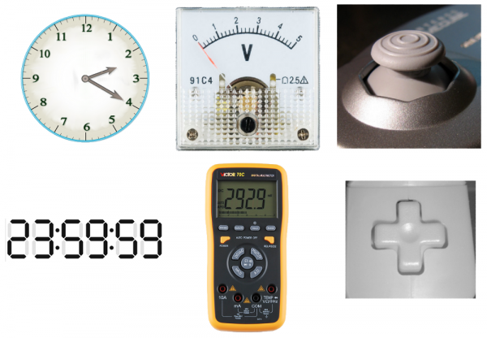
Digital vs Analog

Slide 6
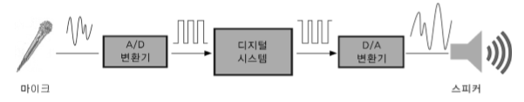
Digital System
Advantages of a digital system
  Strong resilience to noise: no loss of information
  Easy to design (switching logic) and simple HW
  Easy to store the information in memory and easy to manipulate
Nature is inherently made of analog signals
  Therefore, you need analog to digital and digital to analog converters.

Slide 7
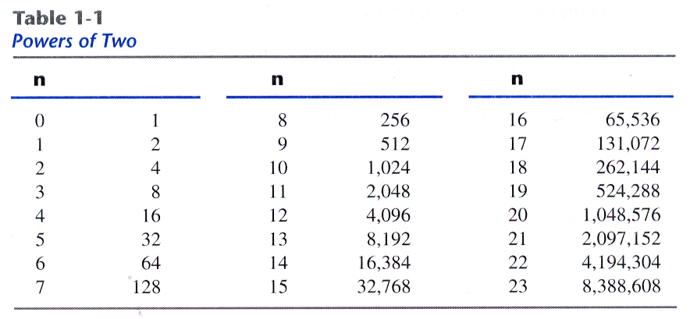

Group of Bits (Byte, KB, MB, GB)
  2¹⁰ = 1024 referred to as K (Kilo)
  2²⁰ as M (Mega); 2³⁰ as G (Giga); 2⁴⁰ as T (Tera); 2⁵⁰ as P (Peta); 2⁶⁰ as E (Exa);

Slide 8

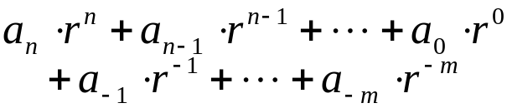


Number Systems
Base-r (or radix r) system
  Expressed with a power series in r
  where for all j
  Positional notation
    . is called radix point
  a_{n} is the most significant digit (msd)
  a_{-m} is the least significant digit (lsd)
  Enclose coefficients in parentheses and place a subscript
  (312.4)₅ = 3 x 5² + 1 x 5¹ + 2 x 5⁰ + 4 x 5⁻¹
    = 75 + 5 + 2 + 0.8 = (82.8)₁₀
  In computers, binary, octal, and hexadecimal is popular.

Slide 9
Number Systems
Octal numbers
  Base 8 (0, 1, ..., 6, 7)
  1 octal digit = 3 binary digits
  (001010111.100)₂ = (127.4)₈ =
  1x8² + 2x8¹ + 7x8⁰ + 4x8⁻¹ = (87.5 )₁₀
Hexadecimal numbers
  Base 16 (0,1,....,9,a,b,c,d,e,f)
  1 hexadecimal digit = 4 binary digits
  (1011011001011111)₂ = (B65F)₁₆ = xB65F
  11x16³ + 6x16² + 5x16¹ + 15x16⁰ = (46687)₁₀

Slide 10
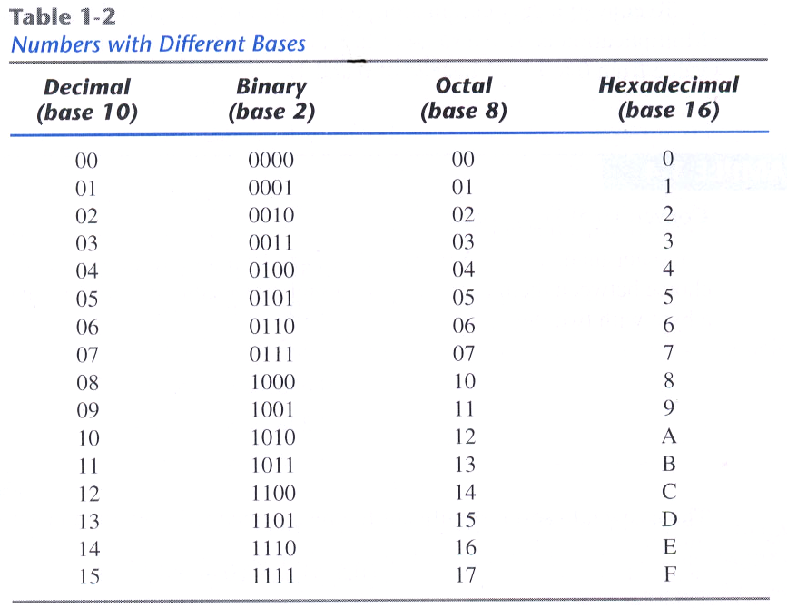
Number Systems

Slide 11
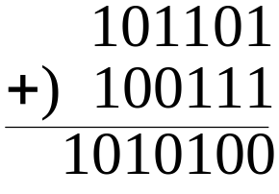
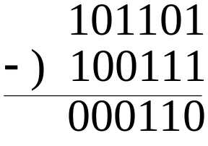
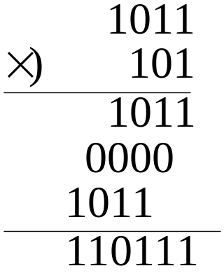
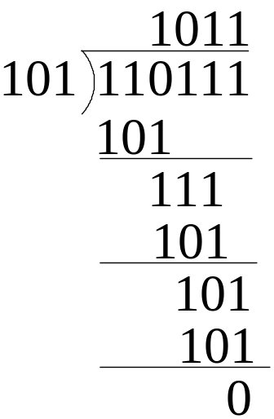
Arithmetic Operations
Addition, subtraction, and multiplication
  Same as for decimal numbers

Slide 12
Number Base Conversion
Binary to octal:
  10110001101011.111100000110 = (26153.7406)₈
Binary to hexadecimal:
  10110001101011.111100000110 = (2C6B.F06)₁₆
Octal to binary:
  (673.124)₈ = 110111011.001010100
Hexadecimal to binary:
  (306.D)₁₆ = 001100000110.1101

Slide 13
Decimal numbers and codes
Decimal number
  Base 10 or radix 10
  724.5 = 7 x 10² + 2 x 10¹ + 4 x 10⁰ + 5 x 10⁻¹
  In general,
    A_{n}A_{n-1}....A₁A₀.A₋₁A₂....A_{-m+1}A_{-m}
    Each A_{i} coefficient is (0, 1, 2, 3, 4, 5, 6, 7, 8, 9)
  Decimal vs. binary numbers
    Decimal numbers: people are accustomed to
    Binary numbers: natural for computer
2 ways
  Convert decimal numbers to binary
    Perform all arithmetic calculation in binary
    And then convert the binary results back to decimal
  Perform the arithmetic operations with decimal numbers
    When they are stored in coded form

Slide 14
Decimal-Binary Conversion
Conversion of decimal to binary
  Separate the number into an integer part and a fraction part
  Each part must be converted differently
Conversion of an integer part
  Successively divide the decimal number by 2
  (625)₁₀ = ( ? )₂
  2 625
  2 312 … 1
  2 156 … 0
  2 78 … 0
  2 39 … 0
  2 19 … 1
  2 9 … 1
  2 4 … 1
  2 2 … 0
  1 … 0
  (625)₁₀ = (1001110001)₂ = 2⁹ + 2⁶ + 2⁵ + 2⁴ + 2⁰
  Conversion to octal/hexadecimal can be done similarly

Slide 15
Binary-Decimal Conversion
Conversion of a fraction part
  Successively multiply the decimal number by 2
  Example 1-5: Convert decimal 0.6875 to binary
  0.6875 x 2 = 1.375
  0.375 x 2 = 0.75
  0.75 x 2 = 1.5
  0.5 x 2 = 1.0
  (0.6875)₁₀ = (0.1011)₂ = 2⁻¹ + 2⁻³ + 2⁻⁴
  Conversion of decimal to octal/hexadecimal can be done similarly

Slide 16
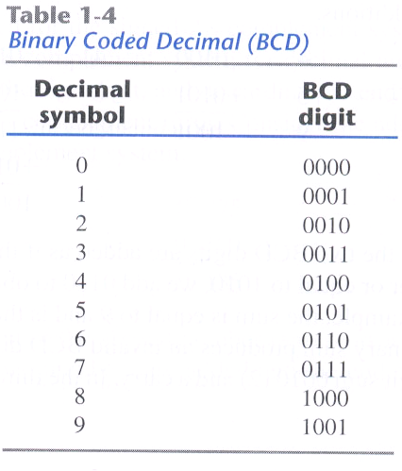
Decimal Codes
BCD (binary coded decimal)
  4-bit binary code (6 are unassigned)
  (185)₁₀ = (0001 1000 0101)_{BCD} = (101110001)₂
  BCD numbers are decimal numbers, not binary numbers

Slide 17
Decimal Codes
BCD addition
  4 0100 4 0100 8 1000
  +5 0101 +8 1000 + 9 1001
  9 1001 12 1100 17 1 0001
  +0110 +0110
  1 0010 1 0111
  Add two BCD numbers as if two binary numbers
  If sum is greater than or equal to 1010, add 0110

Slide 18
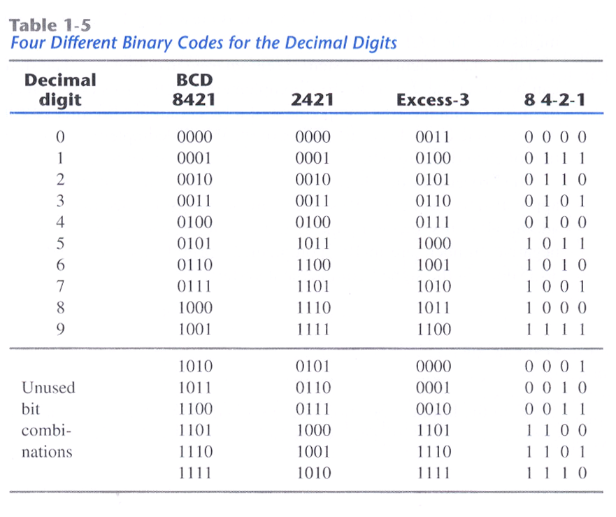
Other Decimal Codes

Slide 19
Negative Numbers
Two representative representations
  Sign-magnitude
  One’s complement
  Two’s complement
Sign-magnitude
  Left most bit is sign bit
    0 means positive
    1 means negative
  Example
    +18 = 00010010
    -18 = 10010010
  Problems
    Need to consider both sign and magnitude in arithmetic
    Two representations of zero (+0 and -0)

Slide 20
Complements
Complements
  Represent negative numbers
  Used for subtraction operation
Two types of complements for each base-r system
  Radix complement: r’s complement
  Diminished radix complement: (r-1)’s complement
(r-1)’s complements of N is (r^{n}-1)-N
  r=10, r-1=9, 9’complements of N is (10^{n}-1)-N
  Ex) the 9’s complements of 546700 is 999999-546700 = 453299
  the 9’s complements of 012398 is 999999-012398 = 987601
  1’complements of N is (2^{n}-1)-N
    For binary number, r=2, r-1=1
  Ex) the 1’s complements of 1011000 is 0100111
  the 1’s complements of 0101101 is 1010010

Slide 21
Complements
The r’s complement of an n-digit number N is
  r^{n}-N if N≠0
  0, if N = 0
r^{n}-N=[(r^{n}-1)-N]+1
  The r’s complements is obtained by adding 1 to the (r-1)’s complements
  Ex) The 10’s complements of 012398 is 987602
  The 10’s complements of 246700 is 753300
  The 2’s complements of 1101100 is 0010100
  The 2’s complements of 0110111 is 1001001

Slide 22
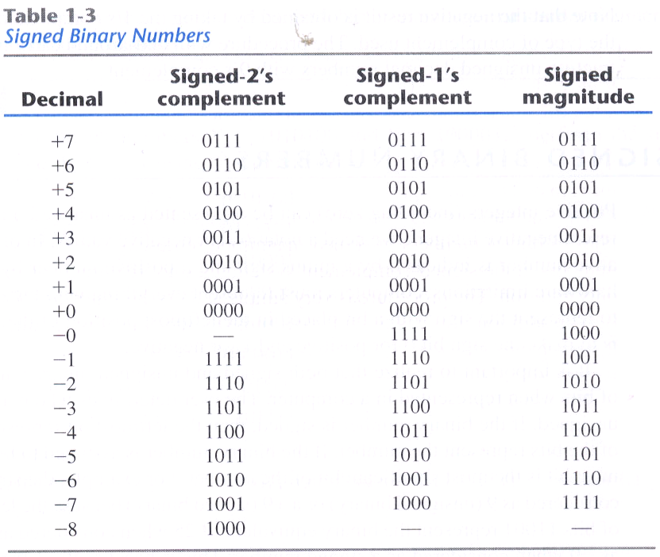
Negative Numbers

Slide 23
2’s Complement
Given N, 2’s complement of N with n bits
  2^{n} – N = (2^{n} – 1) – N + 1 = bit complement of N + 1
  32 bit number
    Positive numbers : 0 (x00000000) to 2³¹ –1 (x7FFFFFFF)
    Negative numbers : -1 (xFFFFFFFF) to – 2³¹ (x8000000)
  Like sign-magnitude, MSB represents the sign bit
Examples
  +3 = 011
  +2 = 010
  +1 = 001
  +0 = 000
  -1 = 111
  -2 = 110
  -3 = 101
  -4 = 100

Slide 24



Characteristics of 2’s Complement
A single representation of zero
Negation is fairly easy (bit complement of N + 1)
  3 = 00000011
  Boolean complement gives 11111100
  Add 1 to LSB 11111101
Overflow occurs only
  When the sign bit of two numbers are the same and if the result has the opposite sign (V = C_{n} ⊕ C_{n}-1)
Arithmetic works easily (see later)
    To perform A – B, take the 2’s complement of B and add it to A
    A + (2^{n} – B) = A – B + 2^{n} (if A >= B, ignore the carry)
    = 2^{n} – (B – A) (if B > A, 2’s complement of B – A)
Operation | A | B | Overflow Condition
A + B | + | + | -
A + B | - | - | +
A - B | + | - | -
A - B | - | + | +

Slide 25




Alphanumeric Codes
Handle text of letters and numbers
  Set of elements include 10 digits, 26 letters, special characters
  36 ~ 64 letters if only capital letters: need 6 bits
  64 ~ 128 letters if upper/lower letters: need 7 bits
ASCII character code
  American standard code for information exchange
  Standard binary code is ASCII (table 1.4)
  ASCII contain 94 graphic chars + 34 control chars
  ASCII is a seven-bit code but is stored in a byte.
Unicode
  Variable-length multi-byte character encodings for various languages
    UTF-8 : The most commonly used Unicode encoding
      Backward compatible with ASCII
      Up to 4 Byte encoding (1B for ASCII, 3B for 한글)
      UTF-8 accounts for on average 97.8% of all web pages
    Other encodings: UTF-16 (2B encodings for most characters), UTF-32
  1,112,064 code points,
    Represent the symbols and ideographs of the world's languages

Slide 26
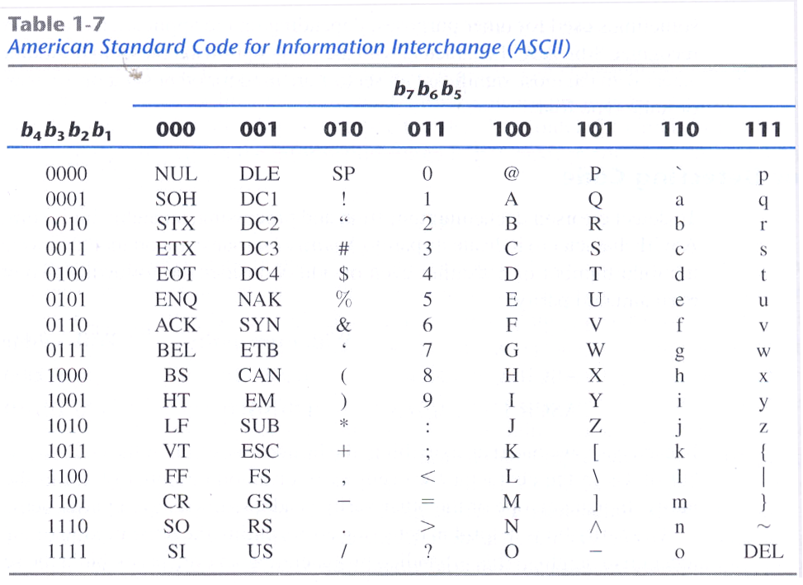
ASCII Codes

Slide 27

Parity bit
Parity bit
  Used to detect single bit errors during the transmission of information
  Even parity bit: total number of 1 is even
  Odd parity: total number of 1 is odd
  (Even parity) (odd parity)
  ASCII a = 1000001 01000001 11000001
  ASCII t = 1010100 11010100 01010100

Slide 28
Information Representation
Information representation in digital computers
Program (code)
  A sequence of instructions
  Instruction contains opcode and operands
Data
  Text (alphanumeric codes): ASCII (7b), Unicode (16b)
  Numbers
    Integer: unsigned, sign-magnitude, 2’s complement
    Floating point: sign-significand-exponent
      976,000,000,000,000 = 9.76 * 10¹⁴
      0.00000000000976 = 9.76 * 10⁻¹⁴
  Multimedia
    Image: 1024 x 768 pixels (1b ~ 3B per pixel)
    Video, audio: MPEG

Slide 29
Machine Instruction
MIPS Instruction:
  add $8,$9,$10
  Decimal number per field representation:
0
9
10
8
0
32
  Binary number per field representation:
000000
01001
01010
01000
00000
100000
_{hex}
  hex representation: 012A 4020₁₆
  decimal representation: 19,546,144₁₀
  Called a Machine Instruction

Slide 30
Homework I
Read Chapter 1 and Chapter 2
Chapter 1 PROBLEMS (due by 3/11)
  1.2
  1.3
  1.4
  1.9
  1.13
  1.17
  1.19
  1.23
  1.25
  1.29
  1.33

