Slide 1
Operating System
Chapter 11. I/O Management and
Disk Scheduling
Lynn Choi
School of Electrical Engineering

Slide 2
Evolution of I/O Function
Processor directly controls a peripheral device
Programmed I/O without interrupt
  An I/O controller or I/O module is added
Programmed I/O with interrupt
  Same configuration as step 2, but now interrupts are employed
DMA
  The I/O module is given direct control of memory via DMA
I/O channel
  The I/O module is enhanced to become a separate processor, with a specialized instruction set tailored for I/O
I/O processor
  The I/O module has a local memory of its own and is, in fact, a computer in its own right

Slide 3
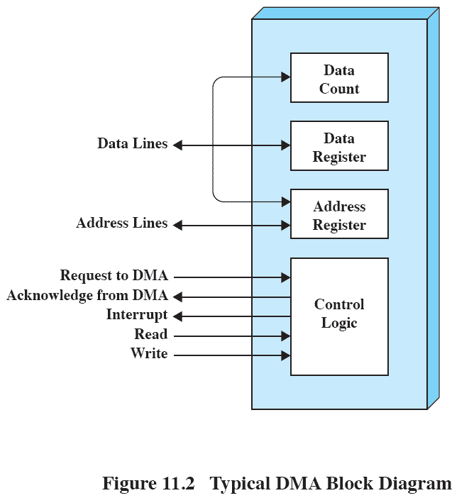
DMA Block Diagram
Direct Memory Access (DMA)
  The processor sends a request for a block transfer to the DMA module, which then controls the exchange of data between main memory and an I/O module. After the transfer, the DMA module interrupts the processor.
  Processor request contains the following info.
    Read or Write
    The address of IO device
    The starting address of memory
    The number of bytes to transfer
  DMA module transfers the entire block
  After completion, it interrupts the processor
Source: Pearson

Slide 4
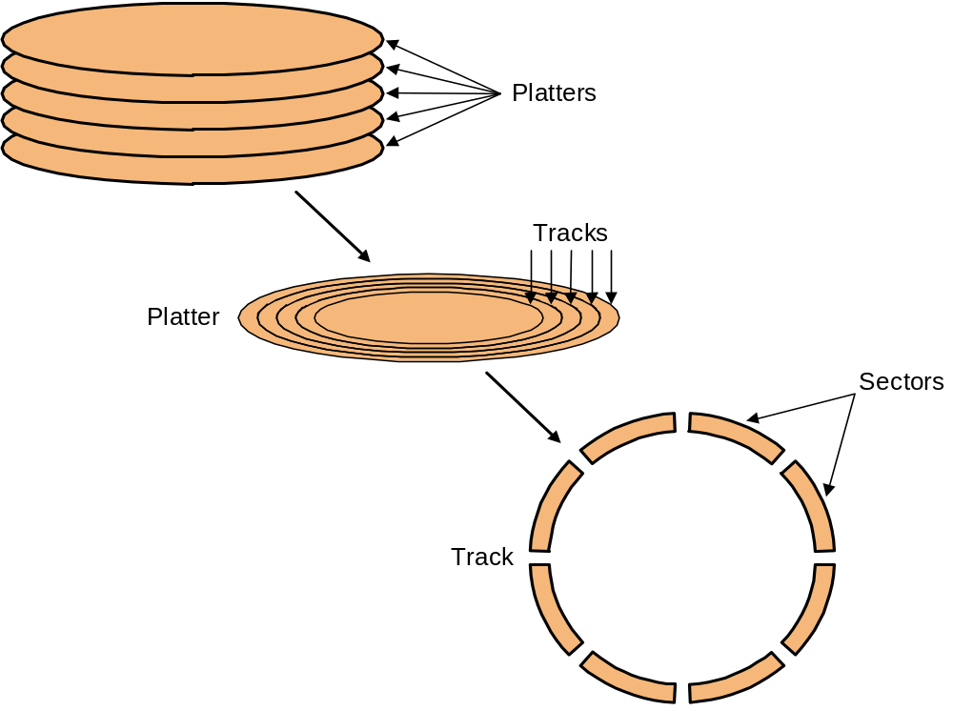
Magnetic Disk
A magnetic disk consists of a collection of platters, each of which has two recordable surfaces.
  The stack of flatters rotate at 5400 RPM to 15000 RPM
  The diameter of this aluminum platter is from 3 ~ 12 cm
Read/write heads
  To read or write, the read/write heads must be moved so that they are over the right track
  Disk heads for each surface are connected together and move in conjunction

Slide 5
Magnetic Disk
Cylinder: a set of tracks at a given radial position
  All the tracks under the heads at a given point on all surfaces
Track: each surface is divided into concentric circles
  10,000 to 50,000 tracks per surface
  ZBR (Zone Bit Recording)
    The number of sectors per track increases in outer zones
Sector - track is divided into fixed size sectors (100 ~ 500 sectors/track)
  Preamble - allows head to be synchronized before r/w
  Data - 512B - 4KB
  Error correcting code (ECC)
    Hamming code or Reed-Solomon code
  Inter-sector gap
  Formatted capacity does not count preamble/ecc/gap

Slide 6
Magnetic Disk
Performance
  Seek time
    To move the read/write head to the desired track
    3 ~ 14ms, consecutive tracks less than 1 ms
  Rotational latency
    To locate the desired sector under the read/write head
    On average, it takes a half of a single rotation time
    5400 ~ 16200 rpm (90 ~ 270 rotations/s), 2 ~ 6ms avg.
  Transfer time
    Depends on the rotation speed and data density
    30 ~ 40MB/s, 512B sector takes 12 ~ 16us
Disk Controller
  Accept commands from CPU
    read, write, format (write preambles), control the arm motion, detect/correct errors, convert byte to a serial bit pattern, buffering/caching,

Slide 7
Disk Access Time
Disk access time =
  Seek time + rotational latency + transfer time + controller overhead
For example,
  HDD with the following characteristics
    10,000 RPM
    Average seek time 6ms
    Transfer rate 50MB/s
    Controller overhead 0.2ms
    No disk idle time
  Average acceess time for a 512B sector =
    6ms + 0.5 rotation / 10000RPM + 0.5KB/50MB/s + 0.2ms = 6 + 3 + 0.01 + 0.2 = 9.2ms
    Usually seek time is only 25% ~ 33% of the advertised number due to locality of disk references
    Most disk controllers have a built-in cache and transfer rates from the cache are typically much higher and up to 320MB/s

Slide 8
Timing Comparison
Consider a disk with
  Seek time of 4ms
  Rotation speed of 7500 rpm
  512 byte sectors with 500 sectors per track
Read a file consisting of 2500 sectors (1.28MB)
Sequential organization
  The file occupies all the sectors of 5 adjacent tracks.
  Seek time = 4ms
  Rotational latency = 4ms
  Read 500 sectors = 8ms
  Total time = 16 + 4 * 12 = 64ms
Random access
  Seek time = rotational latency = 4ms
  Read 1 sector = 0.016ms
  Total time = 2500 * 8.016 = 20.04s
Which sectors are read from the disk has a tremendous impact on I/O performance!

Slide 9
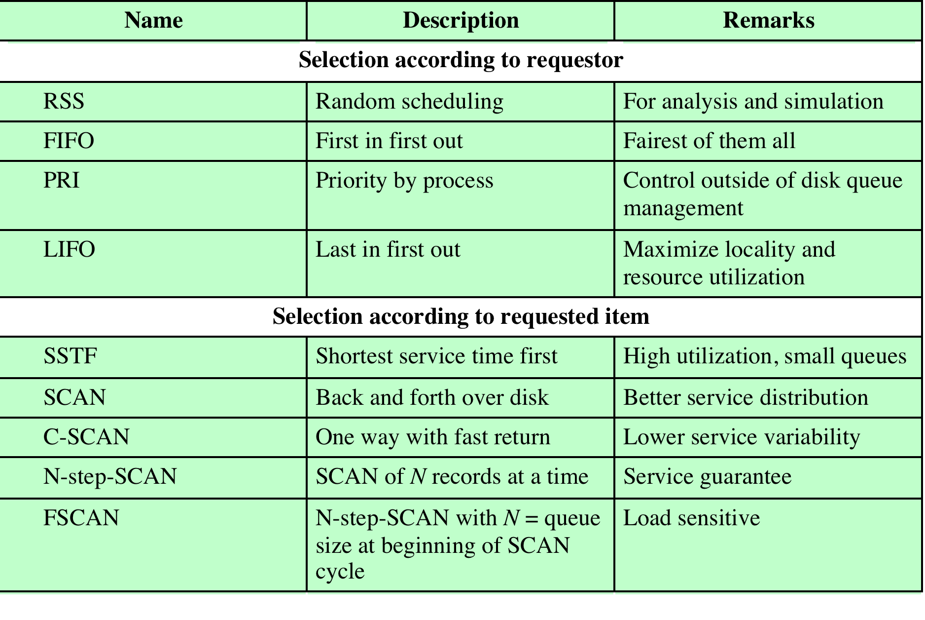
Disk Scheduling Algorithms
Source: Pearson

Slide 10
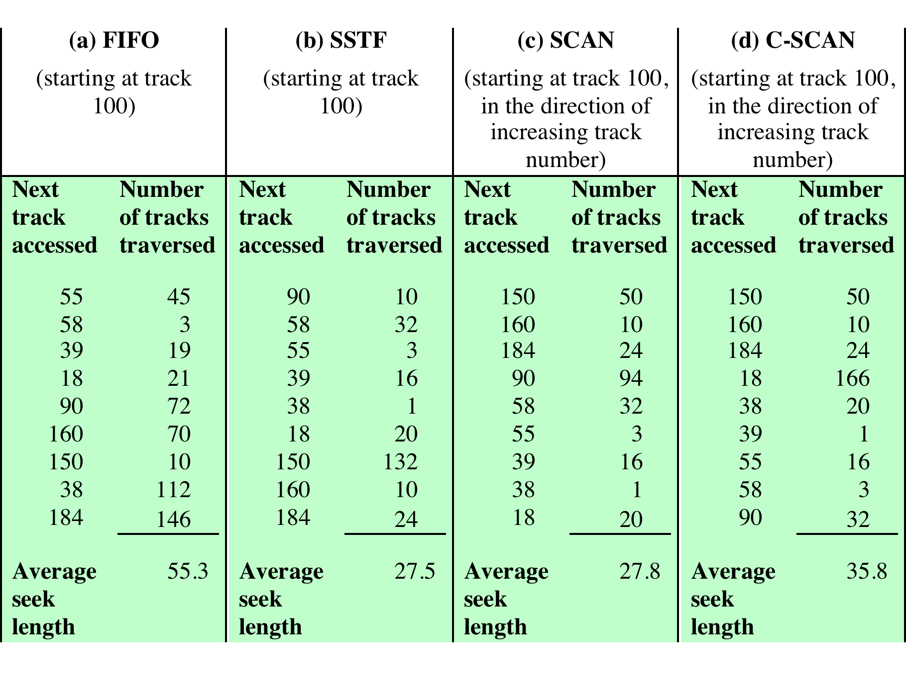
Comparison of Disk Scheduling Algorithms
Source: Pearson

Slide 11
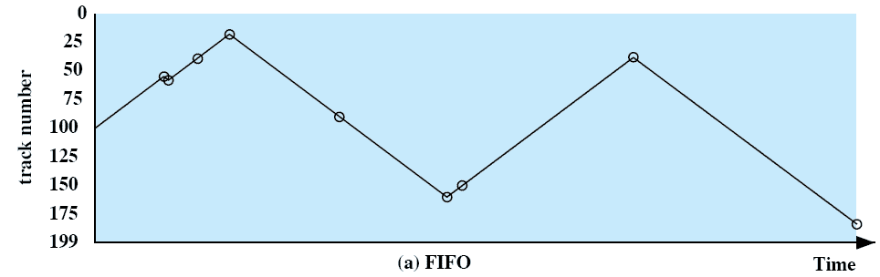
FIFO
Processes requests from the queue in sequential order
Fair to all processes
Approximate random scheduling in performance if there are many processes competing for the disk
Source: Pearson

Slide 12
Priority (PRI)
The control of the scheduling is outside the control of disk management software
Goal is not to optimize disk utilization but to meet other objectives
Often short batch jobs and interactive jobs are given higher priority
  Provides good interactive response time
  Longer jobs may have to wait an excessively long time

Slide 13
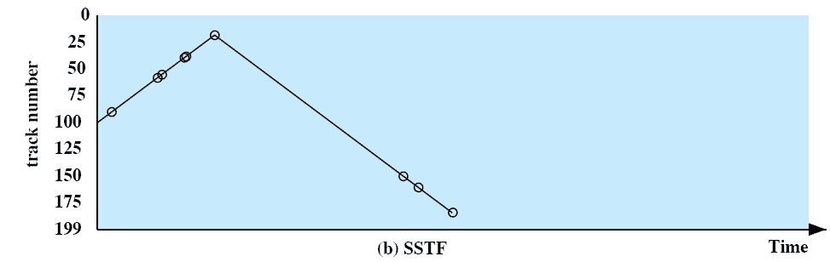
Shortest Service Time First (SSTF)
Select the disk I/O request that requires the least movement of the disk arm from its current position
Always choose the minimum seek time
  Does not guarantee that the average seek time to be minimum
  Close to optimum, but high variance in service time and starvation
Source: Pearson

Slide 14
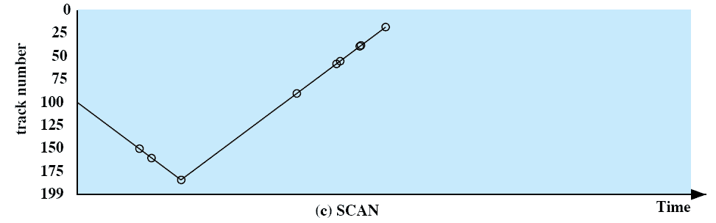
SCAN
Also known as the elevator algorithm
Arm moves in one direction until the last track
  Satisfies all outstanding requests until it reaches the last track in that direction then the direction is reversed
  Can avoid starvation that can happen in SSTF, LIFO, and PRI
Favors jobs to the tracks in the middle
  Biased against the innermost and outermost tracks
  Biased against the area most recently traversed (locality not exploited)
Source: Pearson

Slide 15
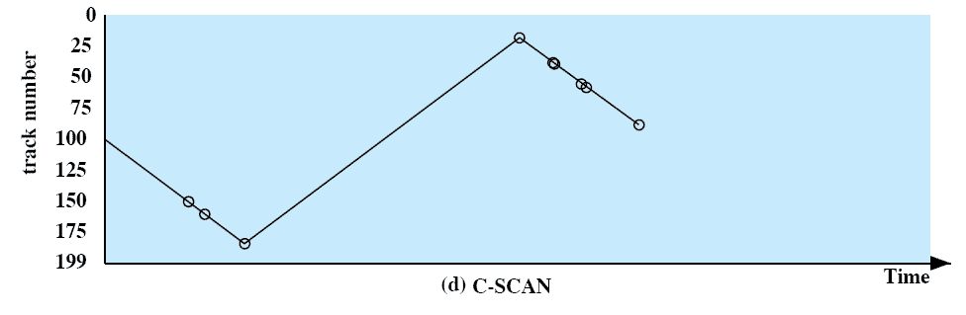
C-SCAN (Circular SCAN)
Restricts scanning to one direction only
When the last track has been visited in one direction, the arm is returned to the opposite end and the scan
  Reduce the maximum delay experienced by new requests
  Low variance in delay and more equal performance for all head positions
With SSTF, SCAN, and C-SCAN, the arm may not move for a considerable amount of time
  A few processes may have high access rates to one track, which can monopolize the entire device
Source: Pearson

Slide 16
N-Step-SCAN and FSCAN
N-Step-Scan
  Segment the disk request queue into subqueues of length N
  Subqueues are processed one at a time, using SCAN
    While a queue is being processed, new requests must be added to some other queue
  For a large value of N, the performance of N-Step-Scan approaches that of SCAN. For a value of N = 1, it is the same as FIFO.
FSCAN
  Uses two subqueues
  When a scan begins, all of the requests are in one of the queues, with the other empty
  During scan, all new requests are put into the other queue
  Service of new requests is deferred until all of the old requests have been processed

Slide 17
RAID
Motivation
  Disk seek time has continued to improve slowly over time
  1970 (50~100ms), 1990 (10ms), 2010 (3ms)
  The improvement is much slower compared to processors and memory
Ideas
  Performance - parallel processing with multiple disks
  Reliability – add redundancy to compensate for the decreased reliability due to multiple devices
RAID (Redundant Array of Independent Disks)
  Consists of seven levels, zero through six
  These levels denote different design architectures that share 3 characteristics
    RAID is a set of physical disk drives viewed by the operating system as a single logical drive
    Redundant disk capacity is used to store parity information, which guarantees data recoverability in case of a disk failure
    Data are distributed across the physical drives of an array in a scheme known as striping

Slide 18
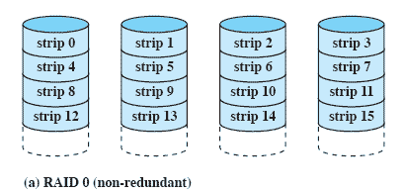
RAID Level 0
Stripping - distribute data over multiple disks
  With 4 disk drives, when a transferred block consists of 8 sectors, 2 sectors (strip) are distributed to a different disk drive
  If a block size is bigger than # drives * strip size, multiple requests are needed
  If a single request consists of multiple logically contiguous strips, then up to n strips for that request can be handled in parallel
No redundancy and no error detection/correction but widely used
Source: Pearson

Slide 19
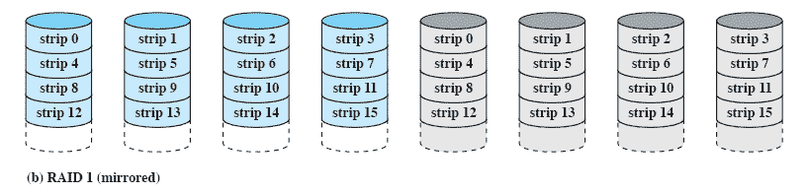
RAID Level 1 (Mirroring)
Redundancy is achieved by duplicating all the data
  Every disk in the array has a mirror disk
    When a drive fails the data may still be accessed from the second drive
Advantage
  A read request can be served by either of two disks.
  There is no “write penalty”.
    Write can be done in parallel. On a write, RAID levels 2-6 must compute and update parity bits as well as updating the actual strip.
Principal disadvantage is the cost
Source: Pearson

Slide 20
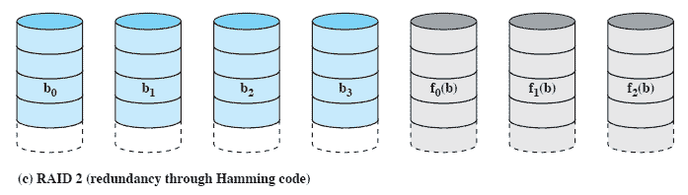
RAID Level 2
Distribute each byte/word over multiple disks
Add hamming code
  For example, for 4b nibbles, 3b extra
Issues
  Require all drives to be rotationally synchronized
    Each disk head should be in the same position on each disk
  Require a substantial number of drives
  On a write, all data disks and parity disk must be accessed
Effective choice where many disk errors occur
  Usually RAID2 is a overkill and is not implemented
Source: Pearson

Slide 21
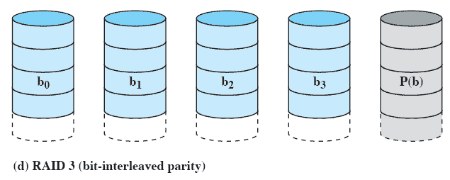
RAID Level 3
Distribute each byte/word over multiple disks
Add parity bit (bit-interleaved parity)
  Requires only a single redundant disk, no matter how large the disk array
  In case of a disk failure, the parity drive is accessed and data is reconstructed from the remaining devices.
    Parity for i^{th} bit: X4(i) = X3(i) ⊕ X2(i) ⊕ X1(i) ⊕ X0(i)
    Suppose drive X1 has failed. Then, X1 can be reconstructed as X1(i) = X4(i) ⊕ X3(i) ⊕ X2(i) ⊕ X0(i)
Can achieve very high data transfer rates
  Since any I/O request will involve the parallel transfer
But only one I/O request can be executed at a time
Source: Pearson

Slide 22
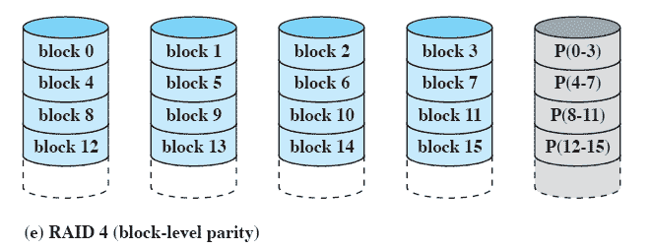
RAID Level 4
RAID 4~6 make use of an independent access technique
  Each member disk operates independently. Separate IO requests can be satisfied in parallel.
  Suitable for applications with high IO request rates but not suitable for applications with high data transfer rates
Block-interleaved parity
  A bit-by-bit parity strip is calculated across corresponding strips on each data disk, and the parity bits are stored in the corresponding strip on the parity disk
A write to disk X1 requires 2 reads of disk X1 and X4(parity) and 2 writes of disk X1 and X4
Source: Pearson

Slide 23
RAID 4 Level
Initially, the following relationship holds for each bit i
  X4(i) = X3(i) ⊕ X2(i) ⊕ X1(i) ⊕ X0(i)
After the write
  X4’(i) = X3(i) ⊕ X2(i) ⊕ X1’(i) ⊕ X0(i)
  = X3(i) ⊕ X2(i) ⊕ X1’(i) ⊕ X0(i) ⊕ X1(i) ⊕ X1(i)
  = X3(i) ⊕ X2(i) ⊕ X1(i) ⊕ X0(i) ⊕ X1(i) ⊕ X1’(i)
  = X4(i) ⊕ X1(i) ⊕ X1’(i)
Therefore, to calculate the new parity, it must read the old user data and the old user parity
  Every write operation must involve the parity disk, which can become a bottleneck.

Slide 24
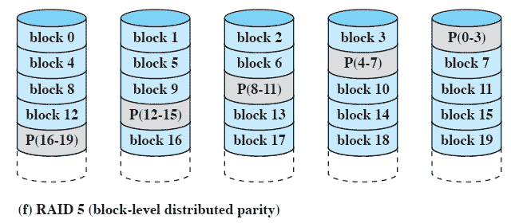
RAID Level 5
Similar to RAID-4 but distributes the parity bits across all disks
Typical allocation is a round-robin scheme
Has the characteristic that
  The loss of any one disk does not result in data loss
  Avoid the potential I/O bottleneck of the single parity disk
Widely used
Source: Pearson

Slide 25
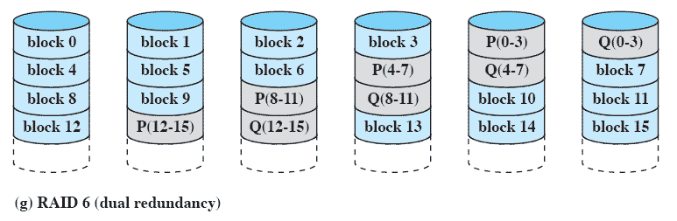
RAID Level 6
Two different parity calculations are carried out and stored in separate blocks on different disks
  One may use parity (exclusive-OR) and the other can be an independent algorithm
  This makes it possible to regenerate data even if two disks containing user data fail
Provides extremely high data availability
Incurs a substantial write penalty because each write affects two parity blocks
  Compared to RAID5, RAID6 can suffer more than a 30% drop in write performance
Source: Pearson

Slide 26
Disk Cache
Disk cache is a buffer in main memory for disk sectors
  Contains a copy of some of the sectors on the disk
When an I/O request is made for a particular sector, a check is made to determine if the sector is in the disk cache
  If Yes, the request is satisfied via the cache
  If No, the requested sector is read into the disk cache from the disk

Slide 27
LRU
The most commonly used algorithm
The block that has not been referenced for the longest time is replaced
A stack of pointers reference the cache
  Most recently referenced block is on the top of the stack
  When a block is referenced or brought into the cache, it is placed on the top of the stack

Slide 28
LFU (Least Frequently Used)
The block that has experienced the fewest references is replaced
A counter is associated with each block
Counter is incremented each time block is accessed
When replacement is required, the block with the smallest count is selected
Problematic when
  Certain blocks are referenced relatively infrequently overall, but when they are referenced, there are short intervals of repeated references due to locality, building up high reference counts. After such interval is over, the reference count may be misleading.

Slide 29
Homework 10
Exercise 11.3
Exercise 11.5
Exercise 11.7
Exercise 11.12

