Slide 1
Operating System
Chapter 12. File Management
Lynn Choi
School of Electrical Engineering

Slide 2
Files
In most applications, files are key elements
  For most systems except some real-time systems, files are used as inputs and outputs
  Virtually all the operating systems provide file systems
Desirable properties of files:
  Long-term existence
    Files are stored on disk or other secondary storage
  Sharable between processes
    Files have names and can have associated access permissions that permit controlled sharing
  Structure
    A file can have an internal structure tailored for a particular application. Also, files can be organized into hierarchical structure to reflect the relationships among files

Slide 3
File System
File system
  Provide a means to store data organized as files and it also provides a collection of functions that can be performed on files
  Typical operations include
    Create, delete, open, close, read, write
  Maintain a set of attributes associated with the file
    Owner, creation time, time last modified, access privileges, and so on.
File structure
  Four terms are commonly used
    Field
    Record
    File
    Database

Slide 4
Structure Terms
Field
  Basic element of data
  Contain a single value, such as name, date
  Characterized by length and data type
Record
  A collection of related fields that can be treated as a unit by an application program
  Example: employee record contains name, social security number, job, date of hire, etc.
File
  A collection of similar records
  Treated as a single entity by users and applications
  Maybe referenced by name
  Access control restrictions usually apply at the file level
Database
  A collection of related files (tables)
    It may contain all the information related to an organization or project
    Consist of one or more types of files
  Relationships among elements of data are explicit
  Designed for use by a number of different applications
  Managed by a database management system (DBMS), which is independent of OS

Slide 5
File System Objectives
File system
  A set of system software that provides service to users and applications in the use of files
  Typically, the only way that a user or application may access file is through the file system
    Relieve the user of developing special-purpose software for each application
    Provide the system with consistent, well-defined means of controlling the files
File system objectives
  Meet the data management needs of the user
  Guarantee that the data in the file are valid
  Optimize performance for throughput and response time
  Provide I/O support for various storage device types
  Minimize lost or destroyed data
  Provide a standardized set of I/O interface routines to user processes
  Provide I/O support for multiple users in the case of multiple-user systems

Slide 6
File System Requirements
Each user
  Should be able to create, delete, read, write and modify files
  May have controlled access to other users’ files
  May control what type of accesses are allowed to each file
  Should be able to restructure the files in a form appropriate to the problem
  Should be able to move data between files
  Should be able to back up and recover files in case of damage
  Should be able to access files by name than by numeric identifier

Slide 7
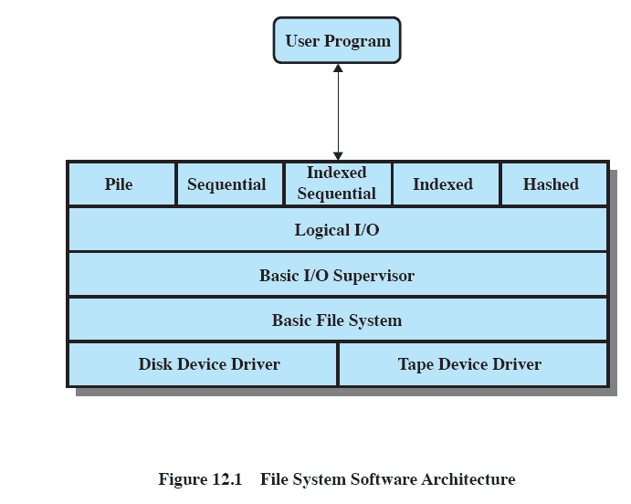
File System Architecture
Source: Pearson

Slide 8
File System Architecture
Device drivers
  Lowest level
  Communicates directly with peripheral devices or their controllers
  Responsible for starting/completion of I/O operations on a device
  Part of OS
Basic file system
  Also referred to as the physical I/O
  Primary interface with the environment outside the computer system
  Deals with data blocks that are exchanged with disk systems
  Deals with the placement of blocks on the secondary storage device
  Deals with buffering blocks in main memory
    Does not understand the content of data or the structure of the files
  Part of OS

Slide 9
File System Architecture
Basic I/O supervisor
  Responsible for file I/O initiation and termination
  Maintain control structures that deal with device I/O, scheduling, and file status
  Deals with disk scheduling to optimize performance
  Assign I/O buffers and allocate secondary memory
  Part of OS
Logical IO
  While basic file system deals with blocks, the logical I/O deals with file records
  Provide general-purpose record I/O capability and maintain basic data about files
Access method
  Level of the file system closest to the user
  Provide a standard interface between applications and the file systems
  Different access methods reflect different file structures and different ways of accessing and processing the data

Slide 10
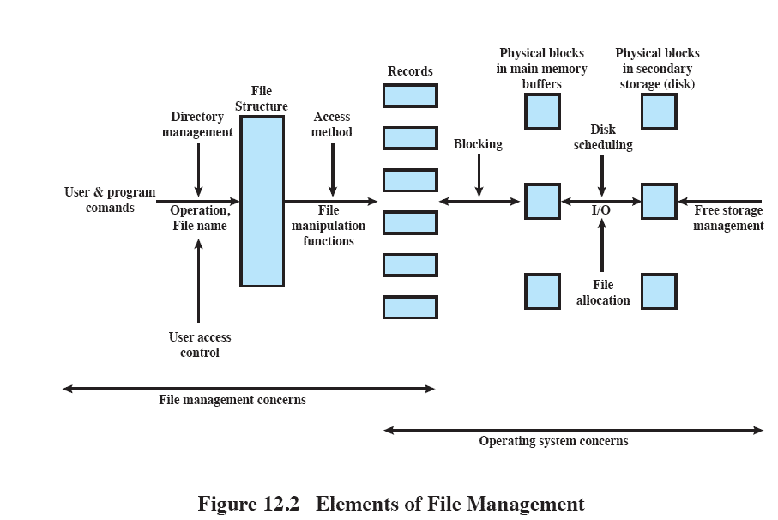
File System in Different Perspective
translate user commands to
file manipulation commands
translate records to blocks
locate the file
create, delete
optimize performance
Authorized users are allowed
to access particular files in particular ways
allocate free blocks to files
Source: Pearson

Slide 11
File Organization
File organization is the logical structuring of the records
  Physical structuring depends on the blocking and file allocation strategy
In choosing a file organization, several criteria are important
  Short access time
  Ease of update
  Economy of storage
  Simple maintenance
  Reliability
Priority of criteria depends on the application
  If a file is used only in batch mode, the rapid access of a single record is not important
  For a file on CD-ROM, the ease of update is not an issue
Five common file organization types are
  Pile, sequential file, direct or hashed file, indexed file, and indexed sequential file

Slide 12
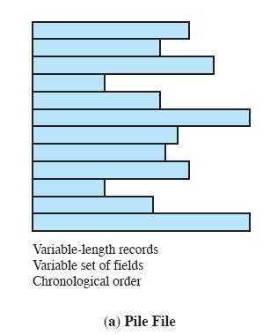
Pile
The least complicated form of file organization
  There is no file structure
Data are collected in the order in which they arrive
The purpose is simply to accumulate the mass of data and save it
Records may have different fields, or similar fields in different order
Record access is by exhaustive search
Source: Pearson

Slide 13
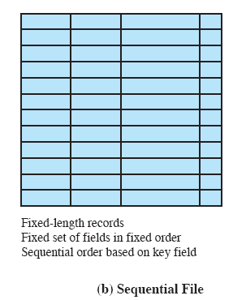
Sequential File
The most common form of file structure
A fixed format is used for records
  All records have the same length, consisting of the same number of fixed-size fields
Key field
  Uniquely identifies the record
  Records are stored sequentially based on the key field
Good for batch applications
Bad for interactive apps.
  Random access is slow due to sequential search
  Addition to a file is also slow
Source: Pearson

Slide 14
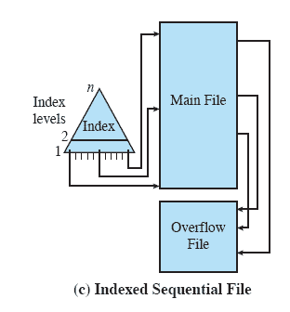
Indexed Sequential File
Two new features
  Adds an index to the file to support random access
  Adds an overflow file to speed up addition
Greatly reduces the time required to access a single record
  A sequential file with 1M records and1000-entry index requires
    500 accesses to the index file + 500 accesses to the main file compared to half million accesses in a sequential file
Multiple levels of indexing can be used to provide greater efficiency in access
Source: Pearson

Slide 15
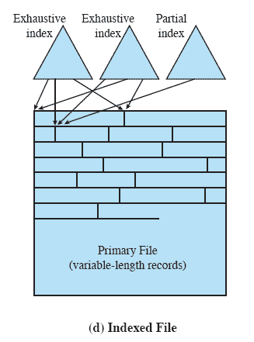
Indexed File
Problems of indexed sequential file
  Efficient processing is limited to the key field
Indexed file
  Multiple indexes for each field
  Records are accessed only through their indexes
    No restriction on the placement of records
    Variable-length records can be employed
Exhaustive index
  Contains one entry for every record in the main file
Partial index
  Contains entries to records where the field of interest exists
Used mostly in applications where timeliness of information is critical
Examples would be airline reservation systems and inventory control systems
Source: Pearson

Slide 16
Direct or Hashed File
Access directly any block of a known address
Makes use of hashing on the key value
Often used where
  Very rapid access is required
  Fixed-length records are used
  Records are always accessed one at a time
Examples are
  Directories
  Pricing tables
  Schedules

Slide 17
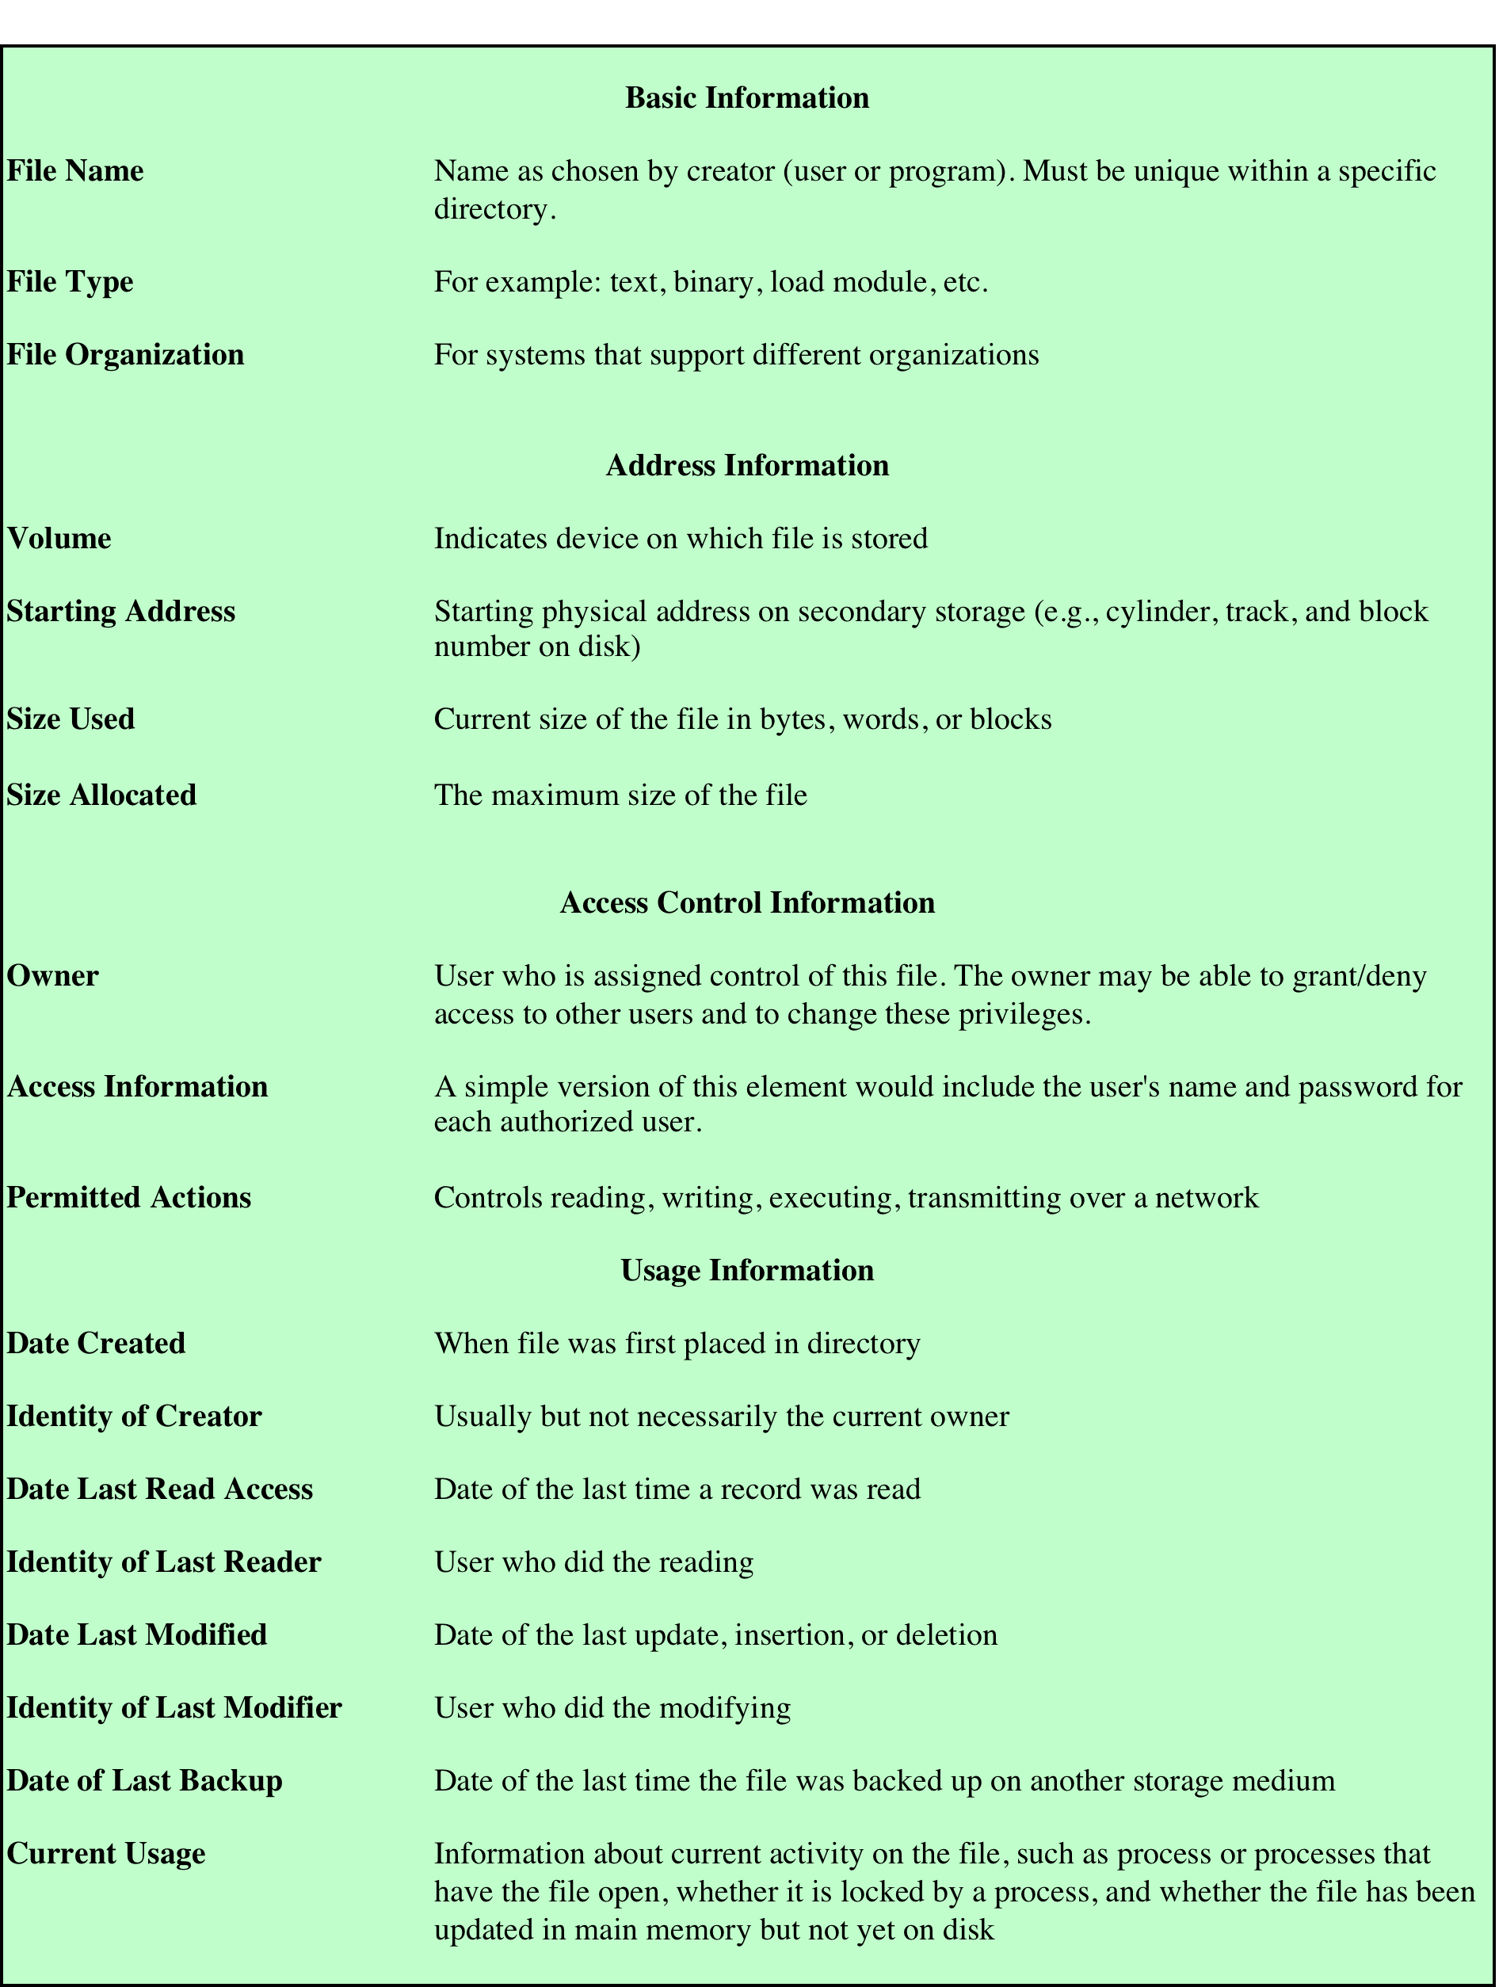
File Directories
File directory
  Contains information about the files, including attributes, location, and ownership
  The directory itself is a file
Directory operations
  Search
    Search the directory to find an entry for the file
  Create/delete file
    Add/delete an entry to the directory
  List directory
  Update directory
    A change in some file attribute requires a change in the directory entry
Source: Pearson

Slide 18
Directory Structure
Two-level scheme
  There is one directory for each user and a master directory
  Master directory
    Has an entry for each user directory
    Provide address and access control information
  User directory
    Each user directory is a simple list of the files of that user
    Names must be unique only within the collection of files of a single user
  File system can easily enforce access restriction on directories
Tree-structured directory
  Master directory with user directories underneath it
  Each user directory may have subdirectories and files as entries
Each directory can be organized as
  A sequential file or a hashed file (if the directory contains a very large number of entries

Slide 19
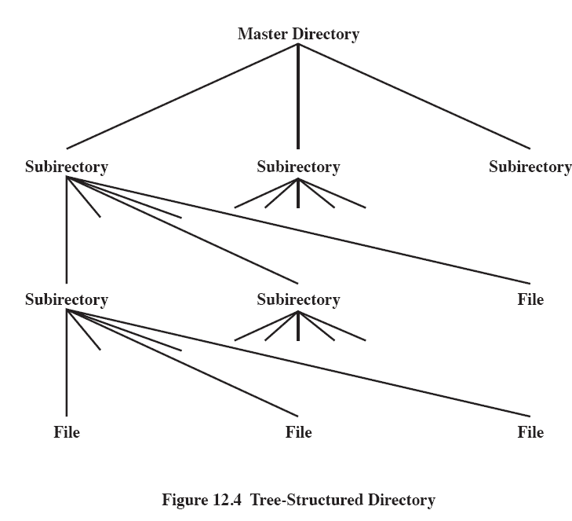
Tree Structured Directory
Source: Pearson

Slide 20
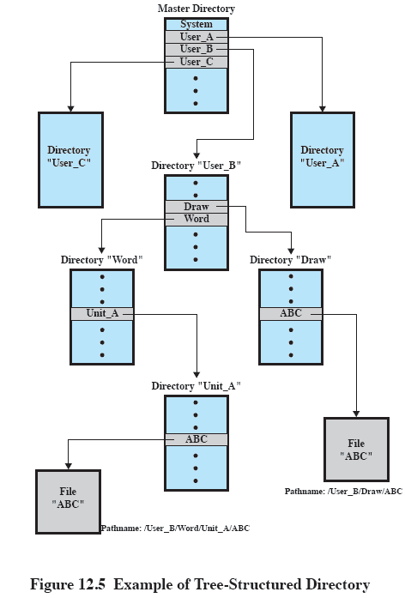
Example of Tree-Structured Directory
Source: Pearson

Slide 21
File Sharing
Two issues arise
  Access rights and the management of simultaneous access (mutual exclusion/deadlock)
Access rights
    Constitute a hierarchy with each right implying those preceding it
  None – May not even know the existence of the file. Cannot read the directory
  Knowledge – Know the file exists and who the owner is. Must ask the owner for access
  Execute – Can execute the program but cannot copy it
  Read – Can read the file, including copying and execution
  Append – Can add data to the file but cannot modify or delete
  Update – Can modify, delete, and add to the file’s data
  Change protection – Can change the access rights
  Delete – Can delete the file
Access can be provided to different class of users
  Owner – The person who initially created the file. Has all the access rights
  Specific user – Individual user designated by user ID
  User groups – A group of users
  All – All users

Slide 22
Record Blocking
Records are the logical unit of access for a structured file whereas blocks are the unit of I/O
  Thus, to perform I/O, records must be organized as blocks
Several issues to consider
  Should blocks be of fixed or variable length?
    In most systems, blocks are of fixed size, which simplify IO
  What should be the relative size of a block compared to an average record size?
    The larger the block, can speed up IO but may include unnecessary records
Three blocking methods can be used
  Fixed-Length Blocking – fixed-length records are used, and an integral number of records are stored in a block
  Variable-Length Spanned Blocking – variable-length records are used and are packed into blocks with no unused space
    Some records may span two blocks
  Variable-Length Unspanned Blocking – variable-length records are used, but spanning is not employed

Slide 23
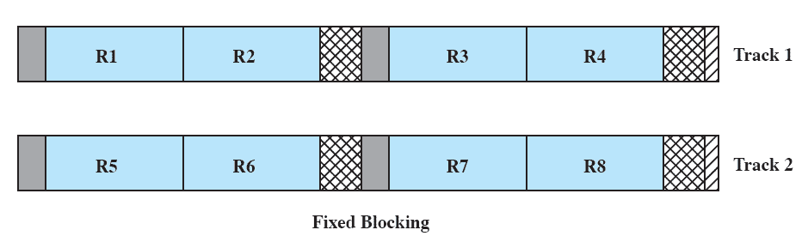
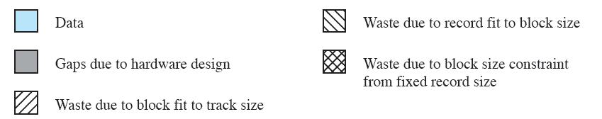
Fixed Blocking
Source: Pearson

Slide 24
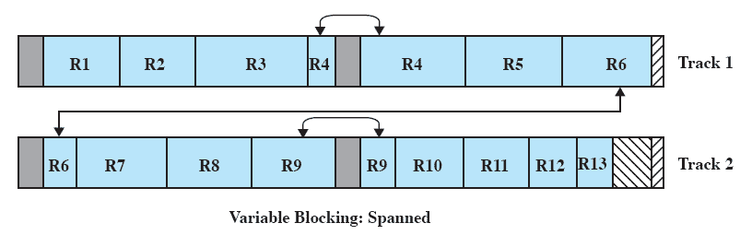
Variable Blocking: Spanned
Source: Pearson
Notes:
Records that span two blocks require two I/O operations, and files are difficult to update, regardless
of the organization.

Slide 25
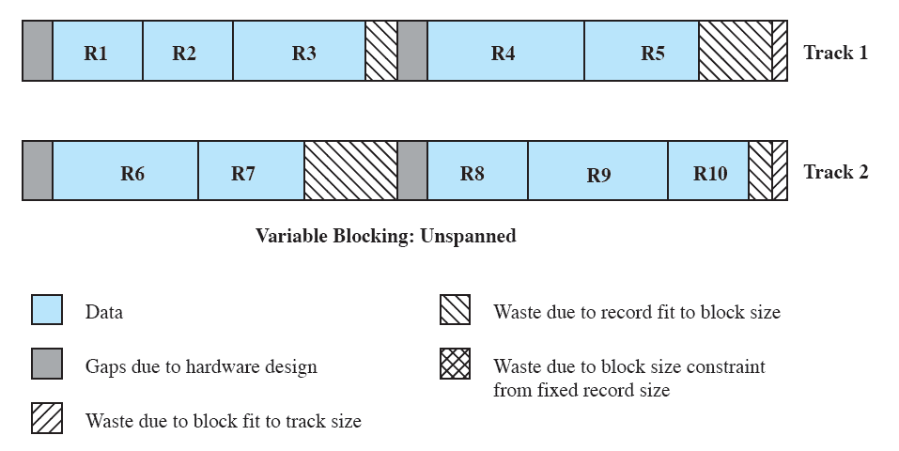
Variable Blocking: Unspanned
Source: Pearson
Notes:
Variable-length unspanned blocking results in wasted space
and limits record size to the size of a block.

Slide 26
File Allocation
A file consists of a collection of blocks
OS (file system) is responsible for allocating blocks to files
  OS allocates free blocks on secondary storage to files
  OS needs to keep track of free blocks
File allocation issues
  When a new file is created, should we allocate the maximum space for the file at once?
  OS assigns a contiguous set of free blocks (called a portion) to a file. What size should we use for the portion? It can range from a single block to the entire file.
  What kind of data structure is used to keep track of the portions assigned to a file?
    Example: FAT (File Allocation Table) on DOS

Slide 27
Preallocation vs. Dynamic Allocation
Preallocation
  Require the maximum file size to be declared at the file creation time
  For some applications, it is possible to estimate the maximum size
    Program compile, file transfer over the network
  But, for many applications, it is impossible to estimate the max. size
    Users and applications tend to overestimate the size, which results in storage waste
Dynamic allocation
  Allocate space as needed

Slide 28
Portion Size
The portion size ranges from a single block to the entire file
Need to consider the following:
  Contiguity of space increases the performance
  A large number of small portions increases the size of tables needed to manage the allocation information
  Fixed size portions simplifies the reallocation of spaces
  Variable size or small fixed-size portions minimizes the storage waste
Two main alternatives
  Variable, large contiguous portions
    (+) Better performance, avoid waste, small tables
    (-) Hard to reuse space (external fragmentation)
  Blocks
    (+) Greater flexibility, don’t have to be contiguous, blocks are allocated on demand, easy to reuse space
    (-) Large tables

Slide 29
File Allocation Methods
Contiguous allocation
Chained allocation
Indexed allocation

Slide 30
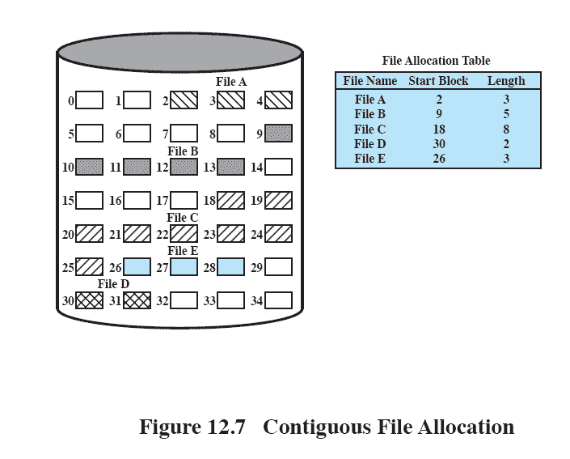
Contiguous File Allocation
A single contiguous set of blocks is allocated to a file at the time of file creation
Preallocation strategy using variable-size portions
Advantages
  Improve I/O performance for sequential processing
  FAT needs a single entry for each file
Disadvantages
  External fragmentation
    Compaction required
Source: Pearson

Slide 31
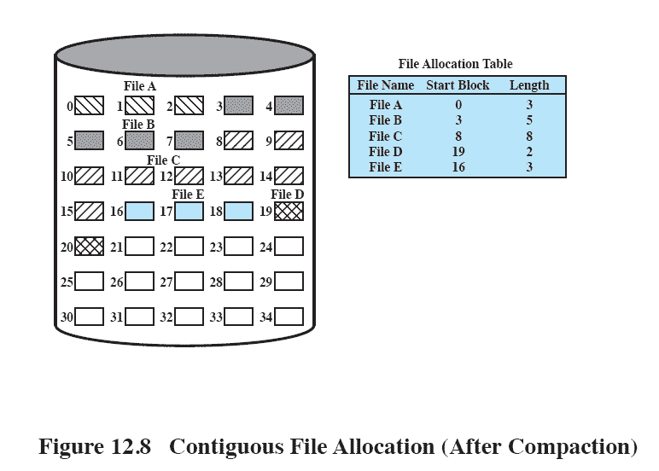
After Compaction
Source: Pearson
Notes:
From time to time, it will be necessary to perform a compaction algorithm to free up additional
space on the disk ( Figure 12.10 ). Also, with preallocation, it is necessary to declare
the size of the file at the time of creation, with the problems mentioned earlier.

Slide 32
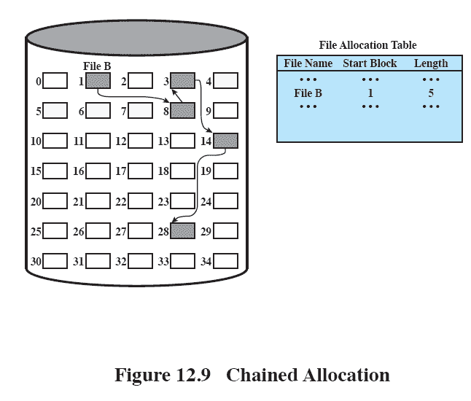
Chained Allocation
Allocation is on an individual block basis
Each block contains a pointer to the next block in the chain
FAT needs just a single entry for each file
No external fragmentation
Not good when we need to bring in multiple blocks since it requires a series of accesses to different parts of disk storage
  Locality cannot be exploited
  Require periodic consolidation
Source: Pearson

Slide 33
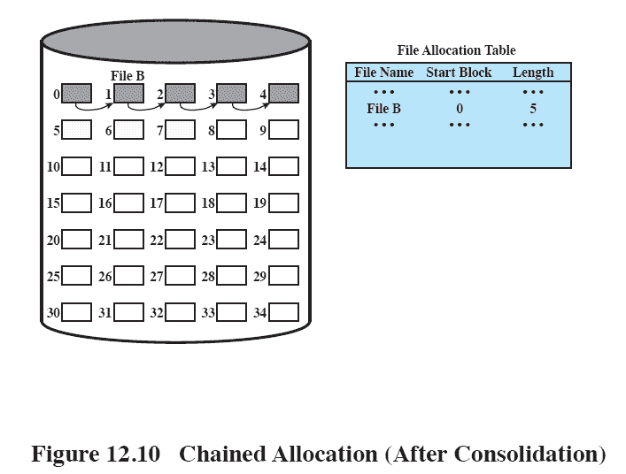
Chained Allocation After Consolidation
Source: Pearson
Notes:
One consequence of chaining, as described so far, is that there is no accommodation
of the principle of locality. Thus, if it is necessary to bring in several blocks of
a file at a time, as in sequential processing, then a series of accesses to different parts
of the disk are required. This is perhaps a more significant effect on a single-user
system but may also be of concern on a shared system. To overcome this problem,
some systems periodically consolidate files ( Figure 12.12 ).

Slide 34
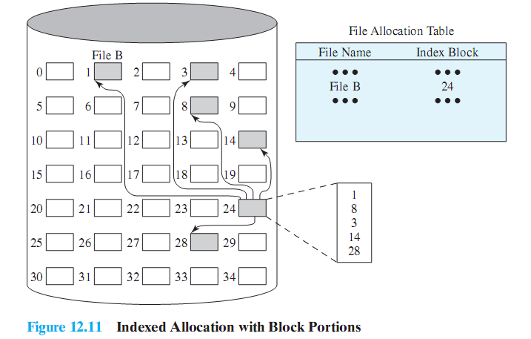
Indexed Allocation with Block Portions
Address the problems of contiguous and chained allocation
FAT entry for each file points to an index block, which has one entry for each portion allocated to the file
Source: Pearson
Notes:
Indexed allocation addresses many of the problems of contiguous and chained
allocation. In this case, the file allocation table contains a separate one-level index for
each file; the index has one entry for each portion allocated to the file. Typically, the
file indexes are not physically stored as part of the file allocation table. Rather, the
file index for a file is kept in a separate block, and the entry for the file in the file allocation
table points to that block. Allocation may be on the basis of either fixed-size
blocks ( Figure 12.13 ) or variable-size portions ( Figure 12.14 ). Allocation by blocks
eliminates external fragmentation, whereas allocation by variable-size portions
improves locality. In either case, file consolidation may be done from time to time.
File consolidation reduces the size of the index in the case of variable-size portions,
but not in the case of block allocation. Indexed allocation supports both sequential
and direct access to the file and thus is the most popular form of file allocation.

Slide 35
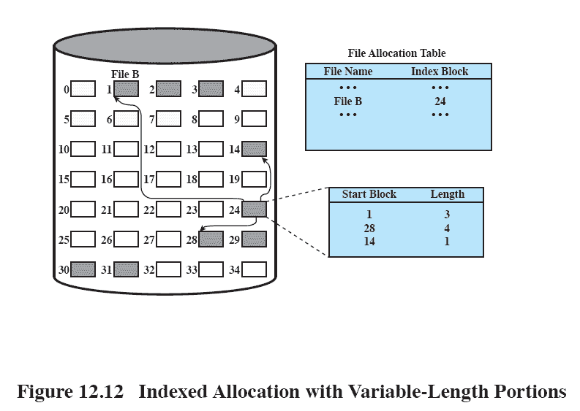
Indexed Allocation with Variable Length Portions
Source: Pearson
Notes:
Figure 12.14 Indexed allocation with Variable-Length Portions

Slide 36
Free Space Management
Just as the allocated space must be managed, so the unallocated space must be managed as well.
To perform file allocation, it is necessary to know which blocks are available
A disk allocation table is needed in addition to a file allocation table
Free space management methods
  Bit table
  Chained free portions
  Indexing
  Free block list

Slide 37
Free Space Management
Bit table
  A bit vector containing one bit for each block on the disk
  00110000111110000011111101100
  Each entry of a 0 corresponds to a free block, and each 1 corresponds to a block in use
  Works well with any file allocation method
  The size of the bit table is relatively small but can be still big!
    16GB disk with 512B blocks needs 4MB bit table, which requires 8000 disk blocks!
Chained free portions
  The free portions may be chained together by using a pointer and length value in each free portion
  Negligible space overhead because there is no need for a disk allocation table
  Suited to all file allocation methods

Slide 38
Free Space Management
  Disadvantages
    Leads to fragmentation
    Every time you allocate a block you need to read the block first to recover the pointer to the next free block before writing data to that block
      If many individual blocks are allocated at once, this greatly slows file creation
Indexing
  Treats free space as a file and uses an index table as it would for file allocation
  For efficiency, the index should be on the basis of variable-size portions rather than blocks
  This approach provides efficient support for all of the file allocation methods
Free block list
  Each block is assigned a number sequentially
  Free block list maintains a list of the numbers of all free blocks
  Assuming 32-bit block number and 512B blocks, less than 1% space overhead
  Effective techniques for storing a small part of the list in main memory
    LIFO stack with the first few thousand top entries kept in main memory
    FIFO queue with only the first few thousand head/tails in main memory

Slide 39
Volumes
A volume is a logical disk
  A collection of addressable sectors in secondary memory that an OS or application can use for data storage
  The sectors in a volume need not be consecutive on a physical storage device
    They need only appear that way to the OS or application
  A volume may be the result of assembling and merging smaller volumes
Examples
  In the simplest case, a single disk is one volume
  Frequently, a disk is divided into partitions, with each partition functioning as a separate volume
  Partitions on multiple disks as a single volume

Slide 40
Homework 11
Exercise 12.1
Exercise 12.2
Exercise 12.3
Exercise 12.8
Exercise 12.11

