Slide 1
Operating System
Virtual Machine
Lynn Choi
School of Electrical Engineering

Slide 2
Virtual Machine
Traditionally applications run on an OS on a PC/server
  The application has to be rewritten/recompiled to run on different OS/platform
Virtualization
  Enable a single PC/server to simultaneously run multiple OSs
  A machine can host numerous applications that run on different OSs on a single platform
  The host OS can support a number of virtual machines (VM), each of which has the characteristics of a particular OS and, in some versions of virtualization, the characteristics of a particular hardware platform
VM approach is becoming popular for business
  To deal with legacy applications and to optimize the hardware usage by maximizing the number of kinds of applications that a single computer can handle
    Most of servers were vastly underutilized, often consuming less than 5% of available resources

Slide 3
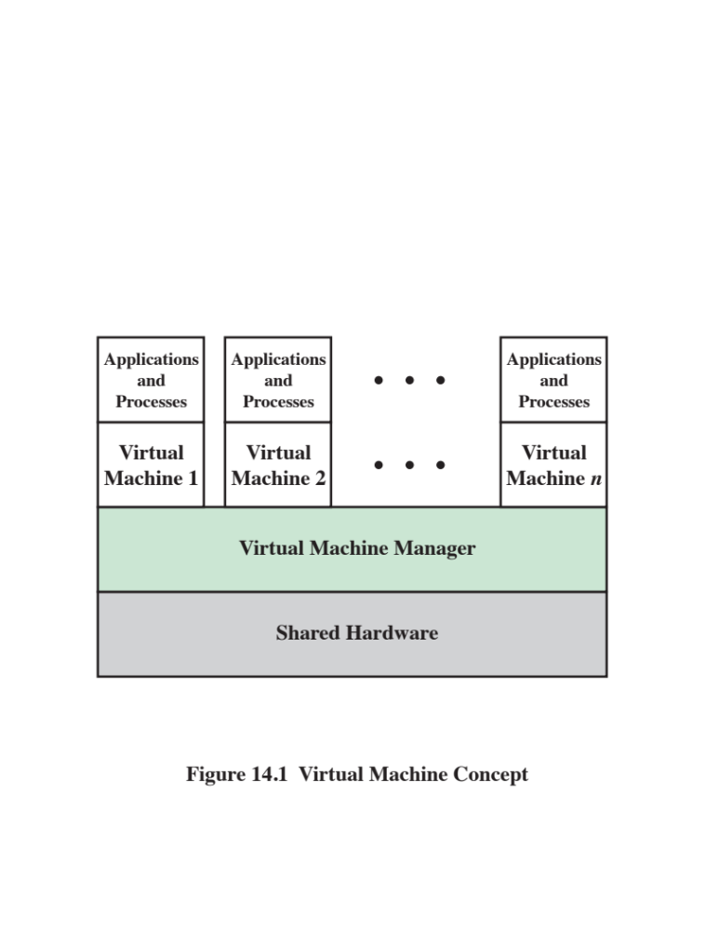
Typical VM Architecture
Each VM runs
a separate OS
Source: Pearson

Slide 4
Virtual Machine Monitor
VMM, also called hypervisor
  Virtual machine solution sits between the HW and the VMs
  Allow multiple VMs to safely coexist on a single physical server
  Consolidation ratio
    The number of guests that can exist on a single host
    A host supporting 6 VMs is said to have a consolidation ratio of 6 to 1 (6:1)
    Initial hypervisors provided consolidation ratios of between 4:1 and 12:1
  If a company virtualized all of their servers, they could remove 75% of servers
    Also less power, less cooling, fewer cables, fewer network switches, less space...
  Also can dynamically partition a single host into multiple independent servers
  Isolation
    Each VM is configured with some number of processors, some amount of RAM, storage resources, and network connectivity
    OS accesses only these resource that is presented to it by the hypervisor

Slide 5
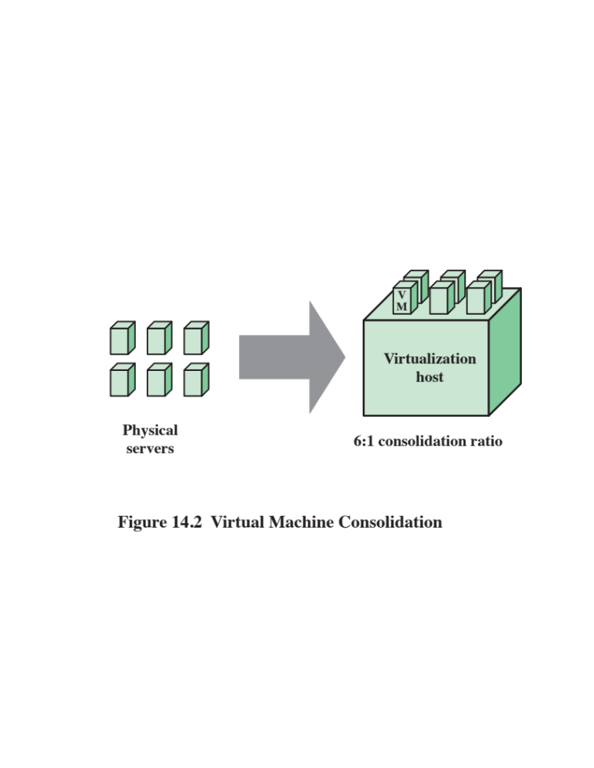
VM Consolidation
Source: Pearson

Slide 6
Other VM Advantages
Rapid provisioning
  A typical VM is made up of a few files
    Configuration file describes the server definitions, how many virtual processors are allocated, how much RAM, which IO devices the VM has access to, etc.
  Installing a new VM takes minutes or hours, as opposed to months
    By duplicating the files, a copy of the server is available in a few minutes. There are a few configuration changes to make, server name and IP address, etc.
    To create a physical server, additional HW needs to be acquired, installed, configured, loaded with OS, applications, and data, which can take weeks/months
Availability
  In the case of a physical server failure, the VMs on the failed host can be quickly and automatically restarted on another host
  Vmotion, or Live Migration
    The capability to move a running VM from one physical host to another, without interrupting, degradation, or impacting the users of that VM
    Maintenance can be performed anytime instead of scheduled downtime
    Migration can be automated depending on resources available

Slide 7
VM Architectures
Two types of hypervisors
  Type-1 hypervisor is loaded as a thin SW layer directly into a physical server, much like an OS
    Examples
      VMware ESXi, Microsoft Hyper-V, and Xen variants
  Type-2 hypervisor is loaded on top of host operating system, just like a traditional application
    Examples
      Vmware Workstation, Oracle VM Virtual Box
  Type-1 hypervisor can directly control the physical resources, whereas Type-2 hypervisor relies on the OS to handle HW interactions
  Type-1 hypervisor has much better performance than Type-2 hyperviosr
    Type-1 hypervisor does not compete for resources with OS
  Type-2 hypervisor allows a user to take advantage of virtualization without dedicating the server to virtualization
    Attractive for PC users

Slide 8
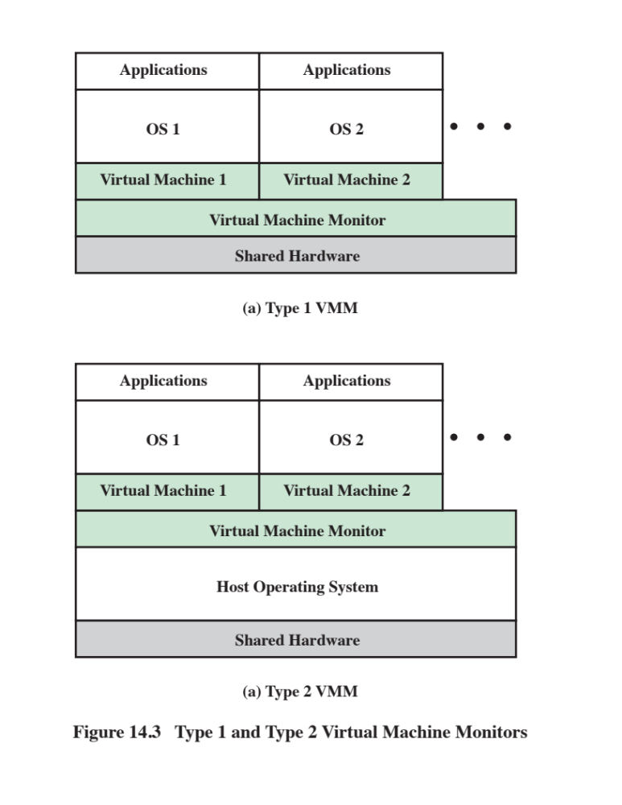
Virtual Machine Architecture
Source: Pearson

