Slide 1
Operating System
Chapter 3. Process
Lynn Choi
School of Electrical Engineering

Slide 2
Process
Def: A process is an instance of a program in execution.
  One of the most profound ideas in computer science.
  Not the same as “program” or “processor”
Process provides two key abstractions:
  Logical control flow
    Each process has an exclusive use of the processor.
  Private address space
    Each process has an exclusive use of private memory.
How are these Illusions maintained?
  Multiprogramming(multitasking): process executions are interleaved
    In reality, many other programs are running on the system.
    Processes take turns in using the processor
      Each time period that a process executes a portion of its flow is called a time slice
  Virtual memory: OS provides a private space for each process
    The private space is called the virtual address space, which is a linear array of bytes, addressed by n bit virtual address (0, 1, 2, 3, … 2^{n}-1)

Slide 3
Private Address Spaces
Each process has its own private address space.
0xffffffff
kernel virtual memory
(code, data, heap, stack)
memory
invisible to
user code
0xc0000000
user stack
(created at runtime)
%esp (stack pointer)
memory mapped region for
shared libraries
0x40000000
run-time heap
(managed by malloc)
brk
read/write segment
(.data, .bss)
loaded from the
executable file
read-only segment
(.init, .text, .rodata)
0x08048000
0
unused

Slide 4
Life and Scope of an Object
Life vs. scope
  Life of an object determines whether the object is still in memory (of the process) whereas the scope of an object determines whether the object can be accessed at this position
  It is possible that an object is live but not visible.
  It is not possible that an object is visible but not live.
Local variables
  Variables defined inside a function
  The scope of these variables is only within this function
  The life of these variables ends when this function completes
  So when we call the function again, storage for variables is created and
  values are reinitialized.
  Static local variables - If we want the value to be extent throughout the life of a program, we can define the local variable as "static."
    Initialization is performed only at the first call and data is retained between func calls.

Slide 5
Life and Scope of an Object
Global variables
  Variables defined outside a function
  The scope of these variables is throughout the entire program
  The life of these variables ends when the program completes
Static variables
  Static variables are local in scope to their module in which they are defined, but life is throughout the program.
  Static local variables: static variables inside a function cannot be called from outside the function (because it's not in scope) but is alive and exists in memory.
  Static variables: if a static variable is defined in a global space (say at beginning of file) then this variable will be accessible only in this file (file scope)
    If you have a global variable and you are distributing your files as a library and you want others not to access your global variable, you may make it static by just prefixing keyword static

Slide 6
Linux Run-time Memory Image
Memory
invisible to
user code
Kernel virtual memory
0xc0000000
User stack
(created at runtime)
%esp (stack pointer)
Memory-mapped region for
shared libraries
0x40000000
brk
Run-time heap
(created by malloc)
Read/write segment
(.data, .bss)
Loaded from the
executable file
Read-only segment
(.init, .text, .rodata)
0x08048000
0
Unused

Slide 7
Logical Control Flows
Each process has its own logical control flow
Process A
Process B
Process C
Time

Slide 8
Concurrent Processes
Concurrent processes
  Two processes run concurrently (are concurrent) if their flows overlap in time.
  Otherwise, they are sequential.
Examples:
  Concurrent: A & B, A & C
  Sequential: B & C
  Control flows for concurrent processes are physically disjoint in time.
  However, we can think of concurrent processes as logically running in parallel with each other.
Process A
Process B
Process C
Time
Process A
Process B
Process C
Time

Slide 9
Context Switching
Processes are managed by OS code called the kernel
  Important: the kernel is not a separate process, but rather runs as part of some user process
    Processors typically provide this capability with a mode bit in some control register
User mode and kernel mode
  If the mode bit is set, the process is running in kernel mode (supervisor mode), and can execute any instruction and can access any memory location
  If the mode bit is not set, the process is running in user mode and is not allowed to execute privileged instructions
    A process running application code is initially in user mode
    The only way to change from user mode to kernel mode is via an exception and exception handler runs in kernel mode

Slide 10
Context Switching
Context
  The kernel maintains a context for each process
    The context is the state of a process that the kernel needs to restart a preempted process
    Consist of PC, general purpose registers, FP registers, status registers, and various kernel data structures such as page table and file table
Context switching
  The OS kernel implements multitasking using an exceptional control flow
  At certain points during the execution of a process, the kernel decide to preempt the current process and restart a previously preempted process
    This is called scheduling and handled by code in the kernel called scheduler (or dispatcher)
  Context switching
    The kernel first saves the context of the current process
    The kernel restores the context of some previously preempted process
    Then, the kernel passes control to this newly restored process

Slide 11
Context Switching
Process A
code
Process B
code
user code
read
kernel code
context switch
Time
disk interrupt
user code
kernel code
context switch
return from read
user code

Slide 12
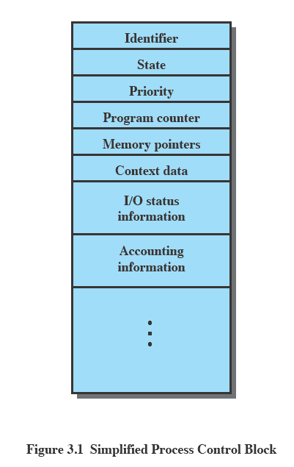
Process Control Block
Process Control Block
  A data structure in the OS kernel that contains the information needed to manage a particular process
  Process ID, state, priority, pointer to register save area, and status tables such as page tables, file tables, IO tables, etc.
  Created and managed by the operating system
Source: Pearson
Notes:
The information in the preceding list is stored in a data structure, typically
called a process control block ( Figure 3.1 ), that is created and managed by the OS.
The significant point about the process control block is that it contains sufficient
information so that it is possible to interrupt a running process and later resume
execution as if the interruption had not occurred. The process control block is
the key tool that enables the OS to support multiple processes and to provide for
multiprocessing. When a process is interrupted, the current values of the program
counter and the processor registers (context data) are saved in the appropriate fields
of the corresponding process control block, and the state of the process is changed
to some other value, such as blocked or ready (described subsequently). The OS is
now free to put some other process in the running state. The program counter and
context data for this process are loaded into the processor registers and this process
now begins to execute.
Thus, we can say that a process consists of program code and associated data
plus a process control block. For a single-processor computer, at any given time, at
most one process is executing and that process is in the running state.

Slide 13
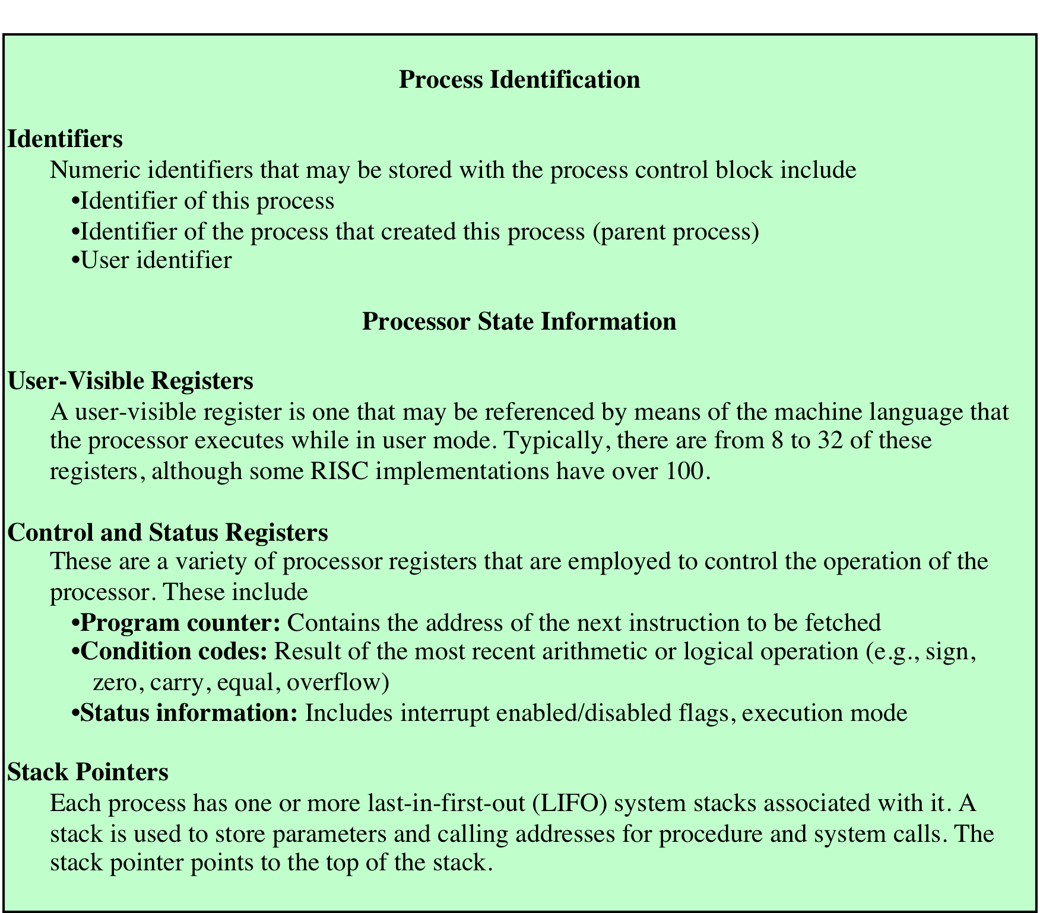
Process Control Block
Source: Pearson

Slide 14
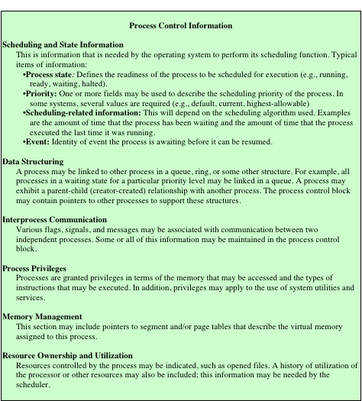
Process Control Block
Source: Pearson

Slide 15
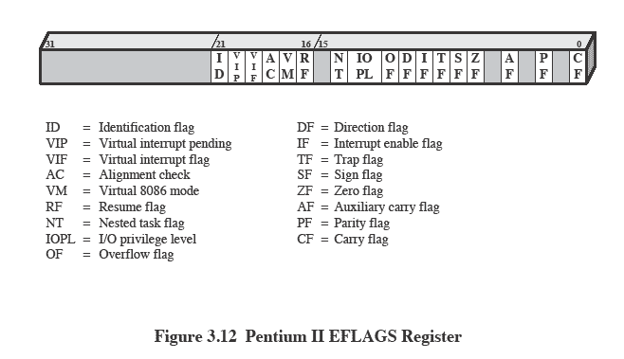
Program Status Word (PSW)
PSW
  Contains condition codes and other status information of the currently running process
  Example: EEFLAGS register on Intel x86 processors
Source: Pearson

Slide 16
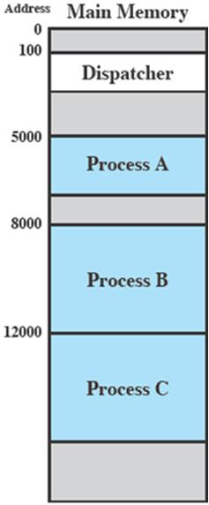
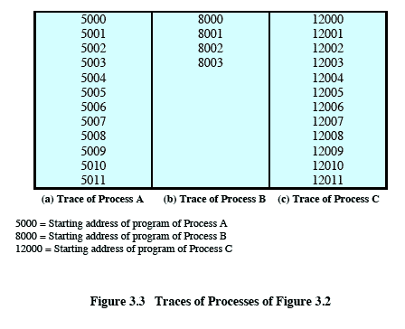
Process Execution and Traces
Source: Pearson
Notes:
Let us consider a very simple example. Figure 3.2 shows a memory layout
of three processes. To simplify the discussion, we assume no use of virtual memory;
thus all three processes are represented by programs that are fully loaded
in main memory. In addition, there is a small dispatcher program that switches
the processor from one process to another.

Slide 17
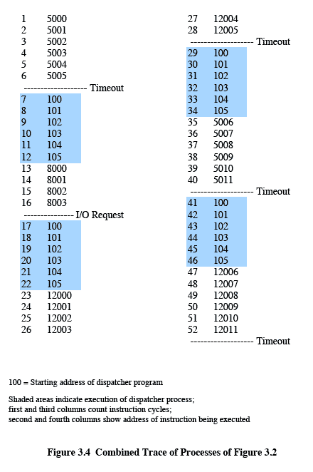

Process Execution and Traces
Source: Pearson
Notes:
Figure 3.3 shows the traces of each
of the processes during the early part of their execution. The first 12 instructions
executed in processes A and C are shown. Process B executes four instructions,
and we assume that the fourth instruction invokes an I/O operation for which the
process must wait.

Slide 18
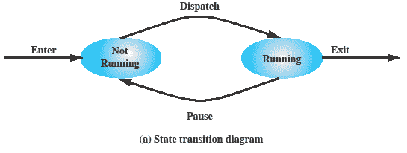
Two-State Process Model
A process may be in one of two states:
  Running
  Not Running
Source: Pearson
Notes:
The operating system’s principal responsibility is controlling the execution of
processes; this includes determining the interleaving pattern for execution and allocating
resources to processes. The first step in designing an OS to control processes
is to describe the behavior that we would like the processes to exhibit.
We can construct the simplest possible model by observing that, at any time, a
process is either being executed by a processor or not. In this model, a process may
be in one of two states: Running or Not Running, as shown in Figure 3.5a . When
the OS creates a new process, it creates a process control block for the process and
enters that process into the system in the Not Running state. The process exists,
is known to the OS, and is waiting for an opportunity to execute. From time to
time, the currently running process will be interrupted and the dispatcher portion
of the OS will select some other process to run. The former process moves from the
Running state to the Not Running state, and one of the other processes moves to
the Running state.

Slide 19
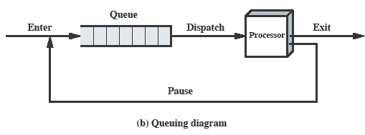
Queuing Diagram
Source: Pearson
Notes:
From this simple model, we can already begin to appreciate some of the design
elements of the OS. Each process must be represented in some way so that the OS
can keep track of it. That is, there must be some information relating to each process,
including current state and location in memory; this is the process control block.
Processes that are not running must be kept in some sort of queue, waiting their turn
to execute. Figure 3.5b suggests a structure. There is a single queue in which each
entry is a pointer to the process control block of a particular process. Alternatively,
the queue may consist of a linked list of data blocks, in which each block represents
one process; we will explore this latter implementation subsequently.
We can describe the behavior of the dispatcher in terms of this queuing
diagram. A process that is interrupted is transferred to the queue of waiting processes.
Alternatively, if the process has completed or aborted, it is discarded (exits
the system). In either case, the dispatcher takes another process from the queue to
execute.

Slide 20
Process Creation and Termination
Process spawning
  OS may create a process at the explicit request of another process
    A new process becomes a child process of the parent process
Process termination
  A process may terminate itself by calling a system call called EXIT
    A batch job include a HALT instruction for termination
    For an interactive application, the action of the user will indicate when the process is completed (e.g. log off, quitting an application)
  A process may terminate due to an erroneous condition such as memory unavailable, arithmetic error, or parent process termination, etc.
Notes:
As another example,
a server process (e.g., print server, file server) may generate a new process for each
request that it handles. When the OS creates a process at the explicit request of
another process, the action is referred to as process spawning .
When one process spawns another, the former is referred to as the parent
process , and the spawned process is referred to as the child process . Typically, the
“related” processes need to communicate and cooperate with each other. Achieving
this cooperation is a difficult task for the programmer; this topic is discussed in
Chapter 5 .

Slide 21
fork: Creating new processes
Process control
  Unix provides a number of system calls for manipulating processes
  Obtain Process ID, Create/Terminate Process, etc.
int fork(void)
  Creates a new process (child process) that is identical to the calling process (parent process)
  Returns 0 to the child process
  Returns child’s pid to the parent process
if (fork() == 0) {
printf("hello from child\n");
} else {
printf("hello from parent\n");
}
Fork is interesting
(and often confusing)
because it is called
once but returns twice

Slide 22
Fork Example #1
Parent and child both run the same code
  Distinguish parent from child by return value from fork
Duplicate but separate address space
  Start with same state, but each has private copy
  Relative ordering of their print statements undefined
Shared files
  Both parent and child print their output on the same screen
void fork1()
{
int x = 1;
pid_t pid = fork();
if (pid == 0) {
printf("Child has x = %d\n", ++x);
} else {
printf("Parent has x = %d\n", --x);
}
printf("Bye from process %d with x = %d\n", getpid(), x);
}

Slide 23
Fork Example #2
Both parent and child can continue forking
Process graph
  Each horizontal arrow corresponds to a process
  Each vertical arrow corresponds to the execution of a fork function
void fork2()
{
printf("L0\n");
fork();
printf("L1\n");
fork();
printf("Bye\n");
}
Bye
L1
Bye
Bye
L0
L1
Bye

Slide 24
Fork Example #3
Key Points
  Both parent and child can continue forking
void fork3()
{
printf("L0\n");
fork();
printf("L1\n");
fork();
printf("L2\n");
fork();
printf("Bye\n");
}
Bye
L2
Bye
Bye
L1
L2
Bye
Bye
L2
Bye
Bye
L0
L1
L2
Bye

Slide 25
Fork Example #4
void fork4()
{
printf("L0\n");
if (fork() != 0) {
printf("L1\n");
if (fork() != 0) {
printf("L2\n");
fork();
}
}
printf("Bye\n");
}
Bye
Bye
Bye
L0
L1
L2
Bye

Slide 26
Fork Example #5
void fork5()
{
printf("L0\n");
if (fork() == 0) {
printf("L1\n");
if (fork() == 0) {
printf("L2\n");
fork();
}
}
printf("Bye\n");
}
Bye
L2
Bye
L1
Bye
L0
Bye

Slide 27
exit: Destroying Process
void exit(int status)
  Terminate a process with an exit status
    Normally with status 0
  atexit() registers functions to be executed upon exit
void cleanup(void) {
printf("cleaning up\n");
}
void fork6() {
atexit(cleanup);
fork();
exit(0);
}

Slide 28
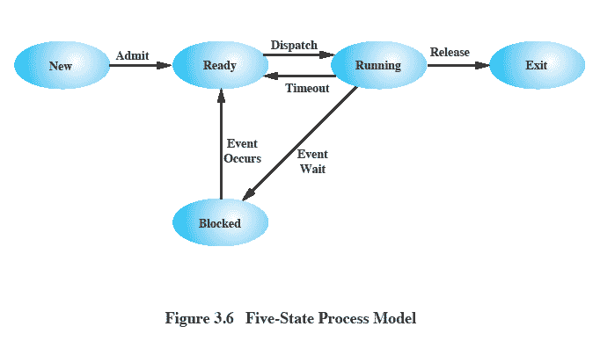
Five-State Process Model
Source: Pearson
Notes:
If all processes were always ready to execute, then the queuing discipline suggested
by Figure 3.5b would be effective. The queue is a first-in-first-out list and the processor
operates in round-robin fashion on the available processes (each process in
the queue is given a certain amount of time, in turn, to execute and then returned to
the queue, unless blocked). However, even with the simple example that we have
described, this implementation is inadequate: Some processes in the Not Running
state are ready to execute, while others are blocked, waiting for an I/O operation
to complete. Thus, using a single queue, the dispatcher could not just select the
process at the oldest end of the queue. Rather, the dispatcher would have to scan
the list looking for the process that is not blocked and that has been in the queue
the longest.
A more natural way to handle this situation is to split the Not Running state
into two states: Ready and Blocked. This is shown in Figure 3.6 .
The five states in this
new diagram are:
• Running: The process that is currently being executed. For this chapter, we
will assume a computer with a single processor, so at most one process at a
time can be in this state.
• Ready: A process that is prepared to execute when given the opportunity.
• Blocked/Waiting: 4 A process that cannot execute until some event occurs,
such as the completion of an I/O operation.
• New: A process that has just been created but has not yet been admitted to the
pool of executable processes by the OS. Typically, a new process has not yet
been loaded into main memory, although its process control block has been
created.
• Exit: A process that has been released from the pool of executable processes
by the OS, either because it halted or because it aborted for some reason.
Figure 3.6 indicates the types of events that lead to each state transition for a
process; the possible transitions are as follows:
• Null : New: A new process is created to execute a program. This event occurs
for any of the reasons listed in Table 3.1 .
• New : Ready: The OS will move a process from the New state to the Ready
state when it is prepared to take on an additional process. Most systems set
some limit based on the number of existing processes or the amount of virtual
memory committed to existing processes. This limit assures that there are not
so many active processes as to degrade performance.
• Ready : Running: When it is time to select a process to run, the OS chooses
one of the processes in the Ready state. This is the job of the scheduler or
dispatcher. Scheduling is explored in Part Four.
• Running : Exit: The currently running process is terminated by the OS if the
process indicates that it has completed, or if it aborts. See Table 3.2 .
• Running : Ready: The most common reason for this transition is that the
running process has reached the maximum allowable time for uninterrupted
execution; virtually all multiprogramming operating systems impose this type
of time discipline. There are several other alternative causes for this transition,
which are not implemented in all operating systems. Of particular importance
is the case in which the OS assigns different levels of priority to different
processes.
Running : Blocked: A process is put in the Blocked state if it requests something
for which it must wait. A request to the OS is usually in the form of a
system service call; that is, a call from the running program to a procedure
that is part of the operating system code. For example, a process may request
a service from the OS that the OS is not prepared to perform immediately. It
can request a resource, such as a file or a shared section of virtual memory,
that is not immediately available. Or the process may initiate an action, such
as an I/O operation, that must be completed before the process can continue.
When processes communicate with each other, a process may be blocked
when it is waiting for another process to provide data or waiting for a message
from another process.
• Blocked : Ready: A process in the Blocked state is moved to the Ready state
when the event for which it has been waiting occurs.
• Ready : Exit: For clarity, this transition is not shown on the state diagram. In
some systems, a parent may terminate a child’ process at any time. Also, if a parent
terminates, all child processes associated with that parent may be terminated.
• Blocked : Exit: The comments under the preceding item apply.

Slide 29
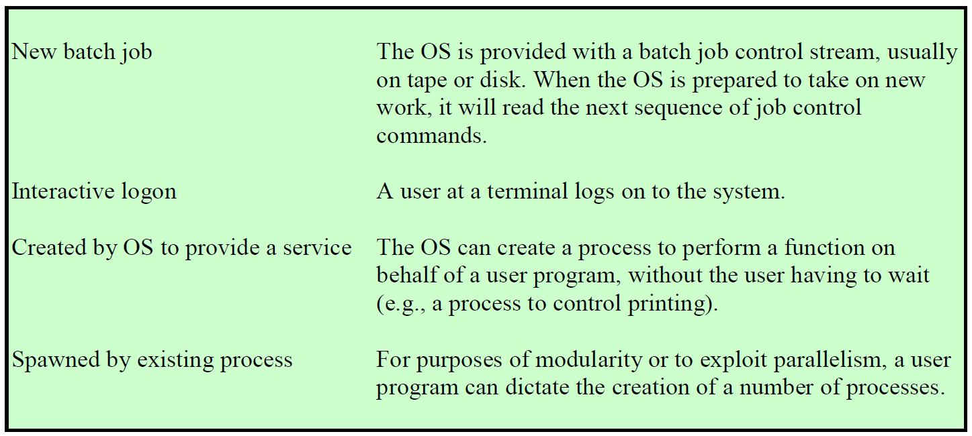
Reasons for Process Creation
Source: Pearson

Slide 30
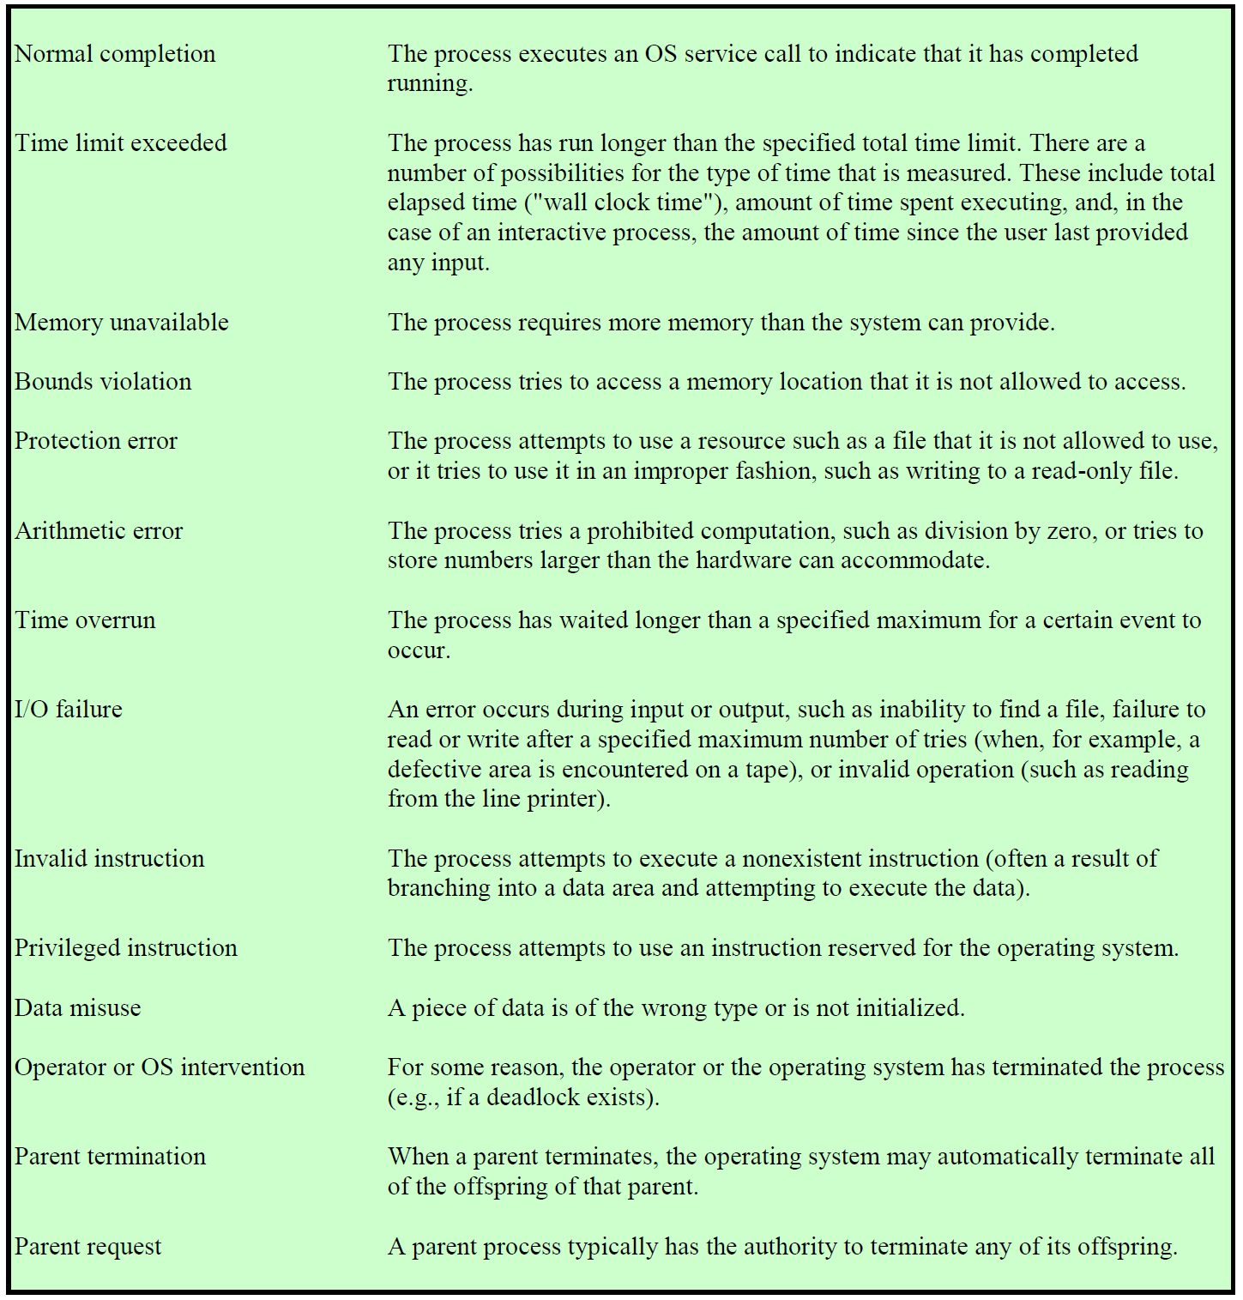
Reasons for Process Termination
Source: Pearson

Slide 31
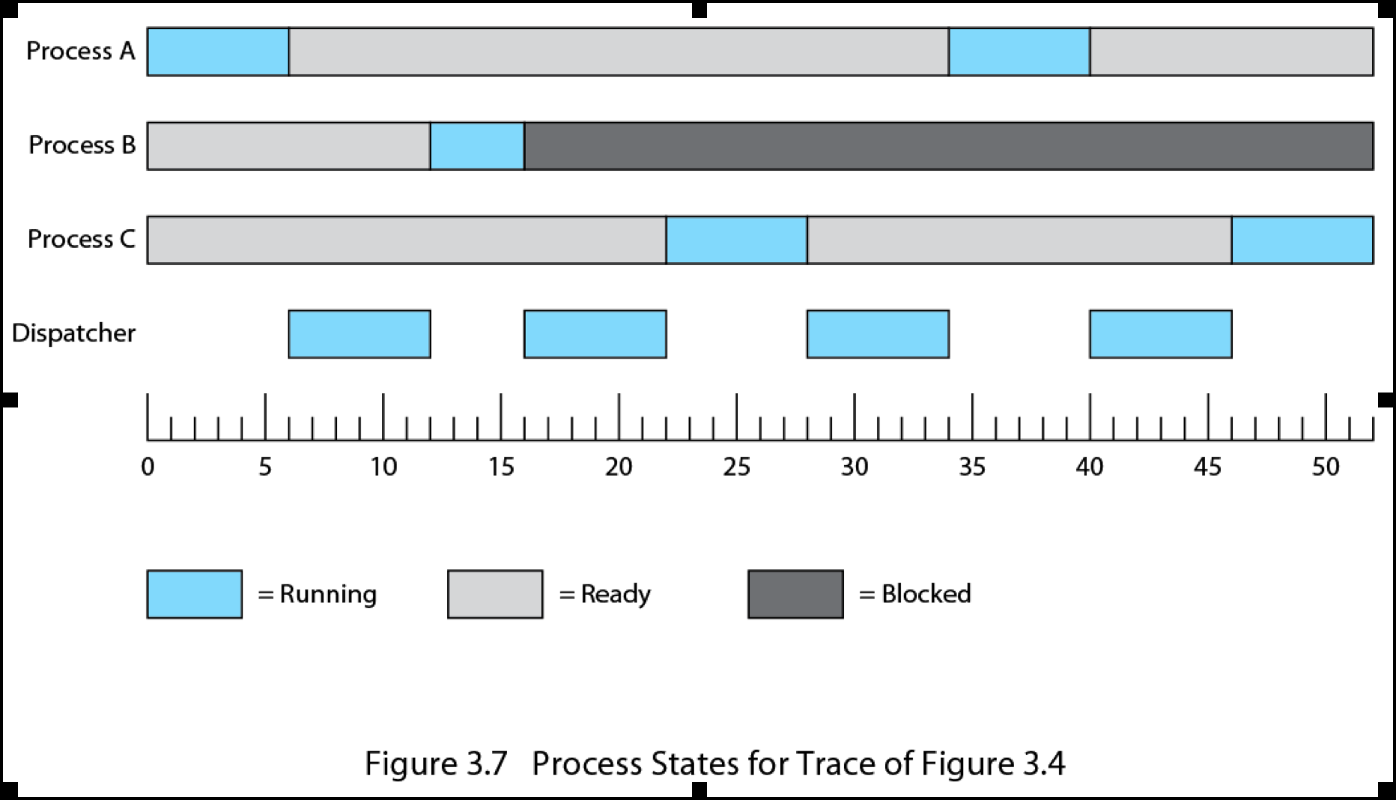
Process States for Trace of Figure 3.4
Example
Source: Pearson
Notes:
Returning to our simple example, Figure 3.7 shows the transition of each process
among the states.

Slide 32
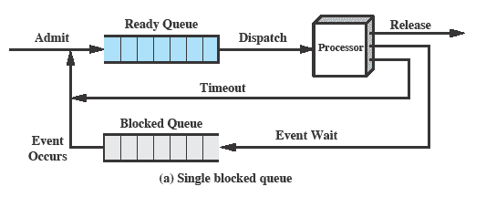
Using Two Queues
Source: Pearson
Notes:
Figure 3.8a suggests the way in which a queuing discipline
might be implemented with two queues: a Ready queue and a Blocked queue. As
each process is admitted to the system, it is placed in the Ready queue. When it is
time for the OS to choose another process to run, it selects one from the Ready
queue. In the absence of any priority scheme, this can be a simple first-in-first-out
queue. When a running process is removed from execution, it is either terminated
or placed in the Ready or Blocked queue, depending on the circumstances. Finally,
when an event occurs, any process in the Blocked queue that has been waiting on
that event only is moved to the Ready queue.

Slide 33
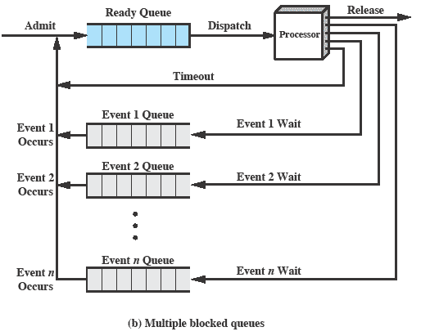
Multiple Blocked Queues
Source: Pearson
Notes:
This latter arrangement means that, when an event occurs, the OS must scan
the entire blocked queue, searching for those processes waiting on that event. In a
large OS, there could be hundreds or even thousands of processes in that queue.
Therefore, it would be more efficient to have a number of queues, one for each
event. Then, when the event occurs, the entire list of processes in the appropriate
queue can be moved to the Ready state ( Figure 3.8b ).
One final refinement: If the dispatching of processes is dictated by a priority
scheme, then it would be convenient to have a number of Ready queues, one for
each priority level. The OS could then readily determine which is the highest-priority
ready process that has been waiting the longest.

Slide 34
Suspended Processes
Swapping
  Sometimes, all the processes in memory are waiting for I/O
  Involves moving part or all of a process from main memory to disk
  Then, OS brings in another (new or suspended) process into memory
Suspended Process
  The process is swapped out and is not immediately available for execution
  The process was placed in a suspended state by an agent: either itself, a parent process, or the OS, for the purpose of preventing its execution
  The process may or may not be waiting on an event
Notes:
Recall that the reason for all of this elaborate machinery is that I/O activities
are much slower than computation and therefore the processor in a uniprogramming
system is idle most of the time. But the arrangement of Figure 3.8b does not entirely
solve the problem. It is true that, in this case, memory holds multiple processes and
that the processor can move to another process when one process is blocked. But the
processor is so much faster than I/O that it will be common for all of the processes in
memory to be waiting for I/O. Thus, even with multiprogramming, a processor could
be idle most of the time.
What to do? Main memory could be expanded to accommodate more processes.
But there are two flaws in this approach. First, there is a cost associated with
main memory, which, though small on a per-byte basis, begins to add up as we get
into the gigabytes of storage. Second, the appetite of programs for memory has
grown as fast as the cost of memory has dropped. So larger memory results in larger
processes, not more processes.
Another solution is swapping, which involves moving part or all of a process
from main memory to disk. When none of the processes in main memory is in the
Ready state, the OS swaps one of the blocked processes out on to disk into a suspend
queue. This is a queue of existing processes that have been temporarily kicked
out of main memory, or suspended. The OS then brings in another process from the
suspend queue, or it honors a new-process request. Execution then continues with
the newly arrived process.
Swapping, however, is an I/O operation, and therefore there is the potential
for making the problem worse, not better. But because disk I/O is generally the
fastest I/O on a system (e.g., compared to tape or printer I/O), swapping will usually
enhance performance.

Slide 35
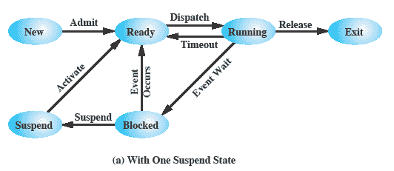
Suspend State
Source: Pearson
Notes:
Let us look now, in Figure 3.9b , at the state transition model that we have
developed. (The dashed lines in the figure indicate possible but not necessary transitions.)
Important new transitions are the following:
• Blocked : Blocked/Suspend: If there are no ready processes, then at least
one blocked process is swapped out to make room for another process that
is not blocked. This transition can be made even if there are ready processes
available, if the OS determines that the currently running process or a ready
process that it would like to dispatch requires more main memory to maintain
adequate performance.
• Blocked/Suspend : Ready/Suspend: A process in the Blocked/Suspend state
is moved to the Ready/Suspend state when the event for which it has been
waiting occurs. Note that this requires that the state information concerning
suspended processes must be accessible to the OS.
• Ready/Suspend : Ready: When there are no ready processes in main memory,
the OS will need to bring one in to continue execution. In addition, it
might be the case that a process in the Ready/Suspend state has higher priority
than any of the processes in the Ready state. In that case, the OS designer may
dictate that it is more important to get at the higher-priority process than to
minimize swapping.
• Ready : Ready/Suspend: Normally, the OS would prefer to suspend a
blocked process rather than a ready one, because the ready process can now
be executed, whereas the blocked process is taking up main memory space
and cannot be executed. However, it may be necessary to suspend a ready
process if that is the only way to free up a sufficiently large block of main
memory. Also, the OS may choose to suspend a lower–priority ready process
rather than a higher–priority blocked process if it believes that the blocked
process will be ready soon.

Slide 36
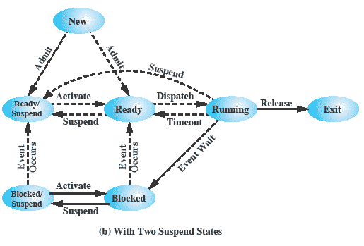
Two Suspend States
Source: Pearson
Notes:
Let us look now, in Figure 3.9b , at the state transition model that we have
developed. (The dashed lines in the figure indicate possible but not necessary transitions.)
Important new transitions are the following:
• Blocked : Blocked/Suspend: If there are no ready processes, then at least
one blocked process is swapped out to make room for another process that
is not blocked. This transition can be made even if there are ready processes
available, if the OS determines that the currently running process or a ready
process that it would like to dispatch requires more main memory to maintain
adequate performance.
• Blocked/Suspend : Ready/Suspend: A process in the Blocked/Suspend state
is moved to the Ready/Suspend state when the event for which it has been
waiting occurs. Note that this requires that the state information concerning
suspended processes must be accessible to the OS.
• Ready/Suspend : Ready: When there are no ready processes in main memory,
the OS will need to bring one in to continue execution. In addition, it
might be the case that a process in the Ready/Suspend state has higher priority
than any of the processes in the Ready state. In that case, the OS designer may
dictate that it is more important to get at the higher-priority process than to
minimize swapping.
• Ready : Ready/Suspend: Normally, the OS would prefer to suspend a
blocked process rather than a ready one, because the ready process can now
be executed, whereas the blocked process is taking up main memory space
and cannot be executed. However, it may be necessary to suspend a ready
process if that is the only way to free up a sufficiently large block of main
memory. Also, the OS may choose to suspend a lower–priority ready process
rather than a higher–priority blocked process if it believes that the blocked
process will be ready soon.

Slide 37
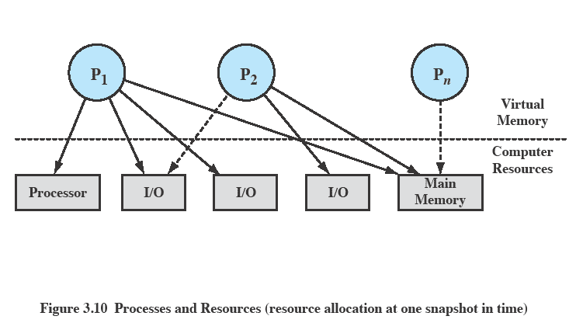
Processes and Resources
Source: Pearson
Notes:
The OS controls events within the computer system. It schedules and dispatches
processes for execution by the processor, allocates resources to processes, and
responds to requests by user processes for basic services. Fundamentally, we can
think of the OS as that entity that manages the use of system resources by processes.
This concept is illustrated in Figure 3.10 . In a multiprogramming environment,
there are a number of processes (P 1 ,…, P n ) that have been created and exist in
virtual memory. Each process, during the course of its execution, needs access to
certain system resources, including the processor, I/O devices, and main memory. In
the figure, process P 1 is running; at least part of the process is in main memory, and
it has control of two I/O devices. Process P 2 is also in main memory but is blocked
waiting for an I/O device allocated to P 1 . Process P n has been swapped out and is
therefore suspended.

Slide 38
Interrupt/Exception
Interrupts
  Forced transfer of control to a procedure (handler) due to external events (interrupt) or due to an internal erroneous condition during program execution (exception)
  Exception
    Generated by an instruction in the currently running process due to an erroneous condition
    Synchronous, internal
  Interrupt
    Asynchronous, external events
Interrupt handling mechanism
  Should allow interrupts/exceptions to be handled transparently to the executing process (application programs and operating system)
  Procedure
    When an interrupt is received or an exception condition is detected, the current task is suspended and the control automatically transfers to a handler
    After the handler is complete, the interrupted task resumes without loss of continuity, unless recovery is not possible or the interrupt causes the currently running task to be terminated.

Slide 39
(Synchronous) Exceptions
Caused by an event that occurs as a result of executing an instruction:
Traps
  Intentional exceptions
  Examples: system calls, breakpoints (debug)
  Returns control to “next” instruction
Faults
  Unintentional but possibly recoverable
  Examples: page faults (recoverable), protection faults (unrecoverable), arithmetic exceptions (i.e. divide by zero, NaN).
  Either re-executes faulting (“current”) instruction or terminate the process
Aborts
  Unintentional and unrecoverable fatal errors
  Examples: parity error, machine check abort.
  Aborts the current process, and probably the entire system

Slide 40
(Asynchronous) Interrupt
Caused by an event external to the processor
  Indicated by setting the processor’s interrupt pins (#INT, #NMI)
  Handler returns to “next” instruction.
Examples:
  I/O interrupts
    Hitting ctl-c at the keyboard, arrival of a packet from the network, arrival of a data sector from a disk
  Hard reset interrupt: hitting the reset button
  Soft reset interrupt: hitting ctl-alt-delete on a PC
(2) Control passes
to handler after current
instruction finishes
(1) Interrupt pin
goes high during
execution of
current instruction
I_{curr}
I_{next}
(3) Interrupt
handler runs
(4) Handler
returns to
next instruction

Slide 41
(External) Interrupt
Interrupt Classification
  Maskable interrupt
    Can be disabled/enabled by an instruction
    Generated by asserting INT pin
  Non-maskable interrupt (NMI)
    Cannot be disabled by program
    Received on the processor’s NMI pin
  Software interrupt
    Generated by INT n instruction
      INT instruction can be used to generate an interrupt or an exception by using a vector number as an operand
    Viewed as an implicit call to interrupt handler of interrupt vector n
    No mechanism for masking interrupts

Slide 42
UNIX System V Process Management
Two categories of processes
  System Process
    Run in kernel mode and execute OS code
    Perform administrative and housekeeping functions such as memory allocation and process swapping
  User Process
    Run in user mode to execute user programs
    Enter kernel mode by issuing a system call, by an exception or by an interrupt
Process states
  9 states with the following characteristics
    2 running states: ‘kernel running’, ‘user running’
    A distinction is made between ‘Ready to run in memory’ and ‘preempted’ states
      They are essentially the same state

Slide 43
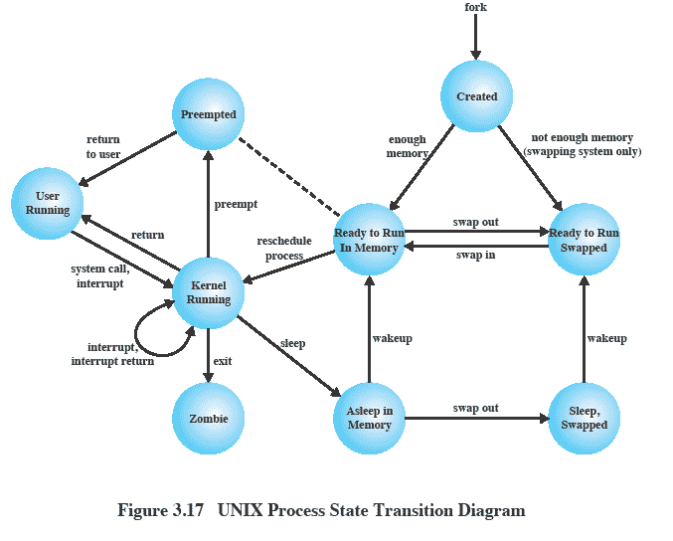
UNIX Process States
Source: Pearson
Notes:
UNIX Process State Transition Diagram
This figure is similar to Figure 3.9b , with the two
UNIX sleeping states corresponding to the two blocked states. The differences are
as follows:
• UNIX employs two Running states to indicate whether the process is executing
in user mode or kernel mode.
• A distinction is made between the two states: (Ready to Run, in Memory) and
(Preempted). These are essentially the same state, as indicated by the dotted
line joining them. The distinction is made to emphasize the way in which the
preempted state is entered. When a process is running in kernel mode (as a
result of a supervisor call, clock interrupt, or I/O interrupt), there will come
a time when the kernel has completed its work and is ready to return control
to the user program. At this point, the kernel may decide to preempt the current
process in favor of one that is ready and of higher priority. In that case,
the current process moves to the preempted state. However, for purposes of
dispatching, those processes in the Preempted state and those in the (Ready to
Run, in Memory) state form one queue.
Preemption can only occur when a process is about to move from kernel mode
to user mode. While a process is running in kernel mode, it may not be preempted.
This makes UNIX unsuitable for real-time processing. Chapter 10 discusses the
requirements for real-time processing.
Two processes are unique in UNIX. Process 0 is a special process that is created
when the system boots; in effect, it is predefined as a data structure loaded
at boot time. It is the swapper process. In addition, process 0 spawns process 1,
referred to as the init process; all other processes in the system have process 1 as
an ancestor. When a new interactive user logs on to the system, it is process 1 that
creates a user process for that user. Subsequently, the user process can create child
processes in a branching tree, so that any particular application can consist of a
number of related processes.

Slide 44
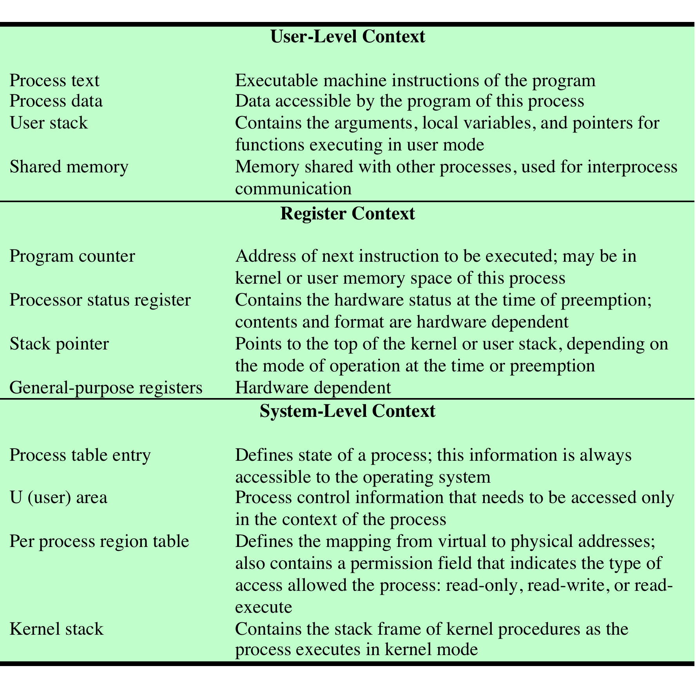
UNIX Process Context
Source: Pearson
Notes:
A process in UNIX is a rather complex set of data structures that provide the OS
with all of the information necessary to manage and dispatch processes. Table 3.10
summarizes the elements of the process image, which are organized into three parts:
user-level context, register context, and system-level context.
The user-level context contains the basic elements of a user’s program and
can be generated directly from a compiled object file. The user’s program is separated
into text and data areas; the text area is read-only and is intended to hold
the program’s instructions. While the process is executing, the processor uses the
user stack area for procedure calls and returns and parameter passing. The shared
memory area is a data area that is shared with other processes. There is only one
physical copy of a shared memory area, but, by the use of virtual memory, it appears
to each sharing process that the shared memory region is in its address space. When
a process is not running, the processor status information is stored in the register
context area.
The system-level context contains the remaining information that the OS
needs to manage the process. It consists of a static part, which is fixed in size and
stays with a process throughout its lifetime, and a dynamic part, which varies in
size through the life of the process. One element of the static part is the process
table entry. This is actually part of the process table maintained by the OS, with
one entry per process. The process table entry contains process control information
that is accessible to the kernel at all times; hence, in a virtual memory system, all
process table entries are maintained in main memory. Table 3.11 lists the contents
of a process table entry. The user area, or U area, contains additional process control
information that is needed by the kernel when it is executing in the context of
this process; it is also used when paging processes to and from memory. Table 3.12
shows the contents of this table.
The distinction between the process table entry and the U area reflects the
fact that the UNIX kernel always executes in the context of some process. Much
of the time, the kernel will be dealing with the concerns of that process. However,
some of the time, such as when the kernel is performing a scheduling algorithm
preparatory to dispatching another process, it will need access to information about
other processes. The information in a process table can be accessed when the given
process is not the current one.
The third static portion of the system-level context is the per process region
table, which is used by the memory management system. Finally, the kernel stack is
the dynamic portion of the system-level context. This stack is used when the process
is executing in kernel mode and contains the information that must be saved and
restored as procedure calls and interrupts occur.

Slide 45
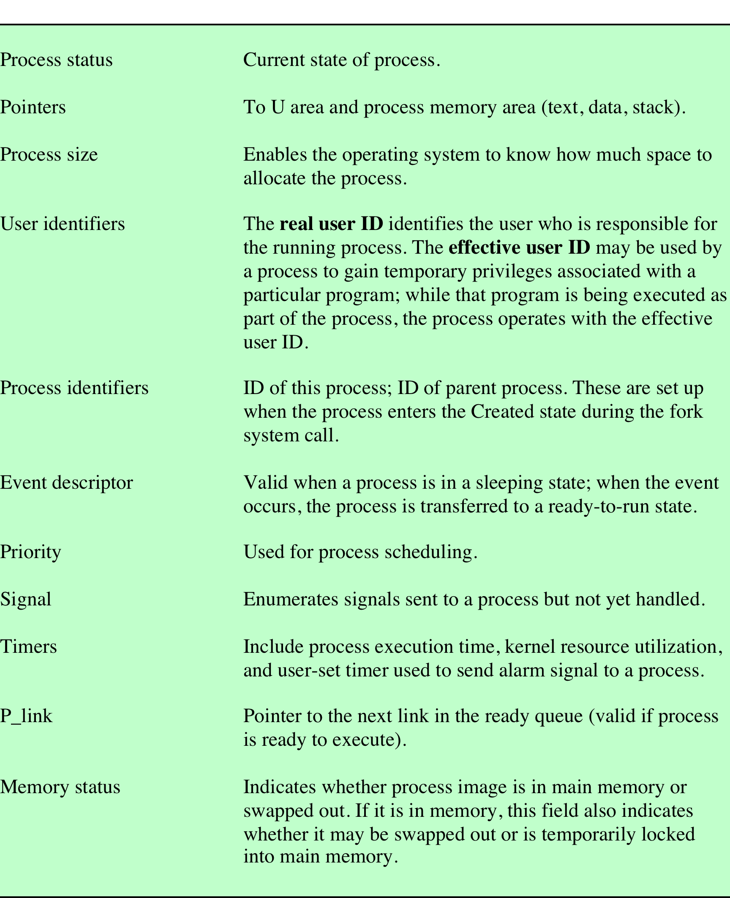
UNIX Process Table Entry
Source: Pearson
Notes:
Table 3.11 lists the contents
of a process table entry. The user area, or U area, contains additional process control
information that is needed by the kernel when it is executing in the context of
this process; it is also used when paging processes to and from memory.

Slide 46
Homework 2
3.1
3.2
3.3
3.4
3.5
Read Chapter 4

