Slide 1
Operating System
Chapter 4. Threads
Lynn Choi
School of Electrical Engineering

Slide 2
Motivation
So far, we assumed that a process is running with a single thread of control
However, most SW applications that run on modern computers are multithreaded
  An application is typically implemented as a separate process with several threads of control.
    A web browser might have one thread display portal news site while another thread shows a baseball broadcast
    A word processor may have a thread for displaying graphics, another thread for responding to keystrokes from the user, and a third thread for performing grammar checking in the background
    A web server may create a separate thread that can handle each individual request from clients and resume listening for additional requests
      If the web server run as a single-threaded process, it would be able to service only one client at a time and a client may have to wait for a long time
      Process creation was in common use before threads become popular. However, it is time consuming and resource intensive. If the new process will perform the same tasks as the existing process, why incur all that overhead?
Virtually all modern operating systems provide features enabling a process to contain multiple threads of control

Slide 3
Process Characteristics
Resource ownership
  A process may be allocated control or ownership of resources including main memory, I/O devices, and files
    OS performs protection to prevent unwanted interferences among processes with respect to resources
  A process includes a virtual address space (process image)
Scheduling unit
  Process is the entity that is scheduled and dispatched by OS
    Has an execution state (Ready, Run) and schedule priority
    The execution path (trace) may be interleaved with those of other processes
Two characteristics are independent
  The scheduling unit can be treated independently by OS
    In OS that supports threads, the scheduling unit is usually referred to as a thread or lightweight process.
    The unit of resource ownership is referred to as a process or task

Slide 4
Multithreading
Multithreading
  The ability of an OS to support multiple, concurrent paths of execution within a single process
    Process is the unit of resource allocation and protection
    Thread is the unit of dispatching with the following state
      Thread execution state (Ready, Run, Blocked)
      Thread context
      Thread execution stack
Single-threaded approach
  Traditional approach of a single thread of execution per process
  No concept of thread
    Examples: MS-DOS, old UNIX
Multi-threaded approach
  One process with multiple threads of execution
    Example: Java run-time environment
  Multiple processes with each of which supports multiple threads
    Examples: Windows, Solaris, modern UNIX

Slide 5
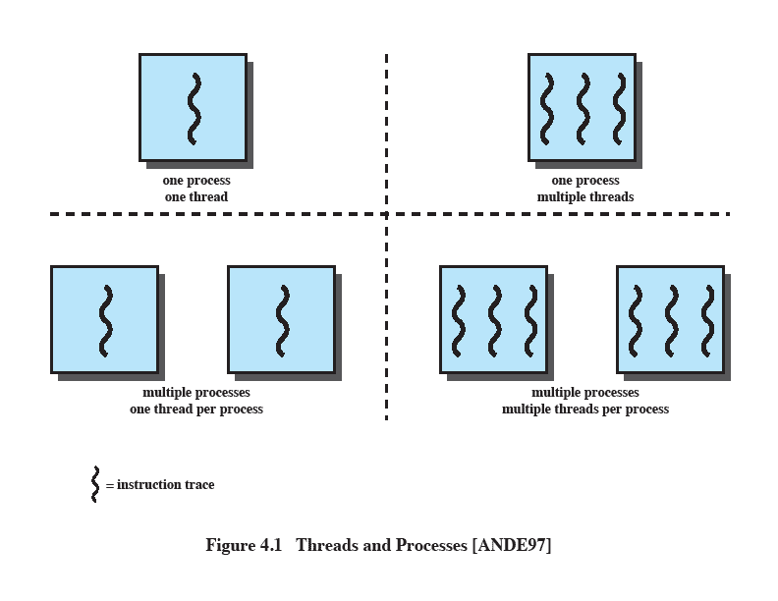
Single-threaded vs. Multithreaded Approaches
Source: Pearson
Notes:
The traditional approach of a single thread of execution per process, in which the concept of a thread is not recognized, is referred to as a single-threaded approach. The two arrangements shown in the left half of Figure 4.1 are single-threaded approaches. MS-DOS is an example of an OS that supports a single user process and a single thread.

Slide 6
Multithreaded Process Model
A process is a unit of resource allocation & protection, and has
  Virtual address space (process image on memory)
  Protected access to processors, files, and I/O devices
Each thread within a process has
  Thread control block
    Thread context: register values (PC, stack pointers)
    Thread state, priority, and other thread-related state information
  Execution stack (user stack, kernel stack)
All the threads of a process
  Share the same address space and share the resources of that process
    When one thread alters the data item in memory, other threads see the results when they access the item.
    If one thread opens a file with read privileges, other threads can also read from that file.

Slide 7
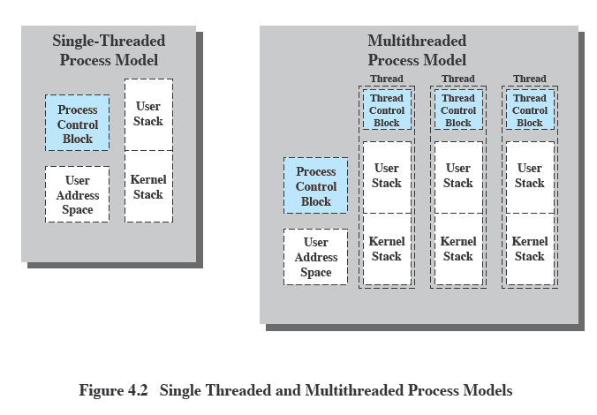
Threads vs. Processes
Source: Pearson
Notes:
Figure 4.2 illustrates the distinction between threads and processes from the point of view of process management. In a single-threaded process model (i.e., there is no distinct concept of thread), the representation of a process includes its process control block and user address space, as well as user and kernel stacks to manage the call/return behavior of the execution of the process. While the process is running, it controls the processor registers. The contents of these registers are saved when the process is not running. In a multithreaded environment, there is still a single process control block and user address space associated with the process, but now there are separate stacks for each thread, as well as a separate control block for each thread containing register values, priority, and other thread-related state information.

Slide 8
Multithreading
Advantages of threads compared to process
  Less time to create a new thread in an existing process
    Thread creation is 10 times faster than process creation in UNIX
  Less time to terminate a thread
    You don’ t have to release I/O devices or memory
  Less time to switch between two threads
  Less time to communicate between two threads
    Communication between processes require the kernel intervention to provide protection and communication (signal)
    Threads can communicate without kernel through shared memory
In OS with multithreading, scheduling and execution state is maintained at the thread-level, however some actions affect all the threads in the process
    Suspending (swapping) a process involves suspending all the threads of the process
    Termination of a process involves terminating all the threads with the process

Slide 9
Multithreaded Applications
File server
  A new thread can be spawned for each new file request
    Since a server handles many requests, many threads will be created/destroyed
  On a multiprocessor environment, multiple threads within the same process can run simultaneously on different processors
  Faster to use threads to share files and coordinate their actions through shared memory
    Processes/threads in a file server must share file data and coordinate actions

Slide 10
Multithreaded Applications
Other examples in a single-user system
  Foreground and background jobs
    In a spreadsheet program, one thread can display menus and read user input while another thread executes user commands and update the spreadsheet
      Increase the perceived speed of the application by prompting for the next command before the previous command is complete
  Asynchronous processing
    In a word processor, a separate thread can perform periodic backup from RAM buffer to disk
      No need for fancy code in the main program to provide for time checks or to coordinate I/O
  Batch processing
    One thread may process a batch job while another is reading the next batch
      Even though one thread may be blocked for I/O, another thread may be executing

Slide 11
Benefits of Multithreading
Faster Response
  A process can continue running even if part of it is blocked or takes a long time
Parallel Processing
  The benefits of multithreading is even greater in a multicore system since threads can run in parallel on different processor cores
Efficient sharing of memory and resources
  Threads can share code and data since they are in the same address space
  Threads can communicate through shared-memory rather than kernel-supported signals
  Threads can also share resources of the process to which they belong
Economy
  Thread creation, switching, termination, and communication cost much less than process counterparts

Slide 12
Thread State
Thread State
  Ready, Run, Blocked
  Suspended: does not make sense since it is process-level state
Thread operations that affects the state
  Spawn
    When a new process is spawned, a thread for that process is also spawned
    A thread may spawn another thread within the same process
      The new thread is provided with its own register context and stack space and placed on the ready queue
  Block
    When a thread needs to wait for an event, it will block (save its PC and registers)
    The processor may switch to another ready thread in the same or different process
  Unblock
    When the event occurs, the thread moves to the ready queue
  Finish
    When a thread completes, the register context and stacks are deallocated

Slide 13
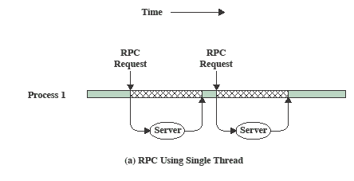
RPC Using Single Thread
2 RPCs to 2 hosts to obtain a combined result
Single-threaded program
  Each RPC has to wait for a response from each server sequentially
Source: Pearson
Notes:
A significant issue is whether the blocking of a thread results in the blocking of the entire process. In other words, if one thread in a process is blocked, does this prevent the running of any other thread in the same process even if that other thread is in a ready state? Clearly, some of the flexibility and power of threads is lost if the one blocked thread blocks an entire process.
We return to this issue subsequently in our discussion of user-level versus kernel-level threads, but for now let us consider the performance benefits of threads that do not block an entire process. Figure 4.3 (based on one in [KLEI96]) shows a program that performs two remote procedure calls (RPCs) 2 to two different hosts to obtain a combined result. In a single-threaded program, the results are obtained in sequence, so the program has to wait for a response from each server in turn. Rewriting the program to use a separate thread for each RPC results in a substantial speedup. Note that if this program operates on a uniprocessor, the requests must be generated sequentially and the results processed in sequence; however, the program waits concurrently for the two replies.

Slide 14
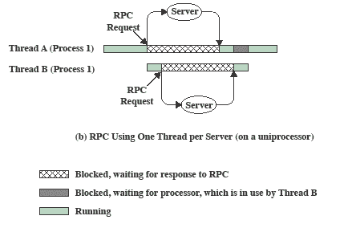
RPC Using One Thread per Server
Multi-threaded program
  Each RPC request must be generated sequentially
  Each request wait concurrently for the two replies
Source: Pearson
Notes:
A significant issue is whether the blocking of a thread results in the blocking of the entire process. In other words, if one thread in a process is blocked, does this prevent the running of any other thread in the same process even if that other thread is in a ready state? Clearly, some of the flexibility and power of threads is lost if the one blocked thread blocks an entire process.
We return to this issue subsequently in our discussion of user-level versus kernel-level threads, but for now let us consider the performance benefits of threads that do not block an entire process. Figure 4.3 (based on one in [KLEI96]) shows a program that performs two remote procedure calls (RPCs) 2 to two different hosts to obtain a combined result. In a single-threaded program, the results are obtained in sequence, so the program has to wait for a response from each server in turn. Rewriting the program to use a separate thread for each RPC results in a substantial speedup. Note that if this program operates on a uniprocessor, the requests must be generated sequentially and the results processed in sequence; however, the program waits concurrently for the two replies.

Slide 15
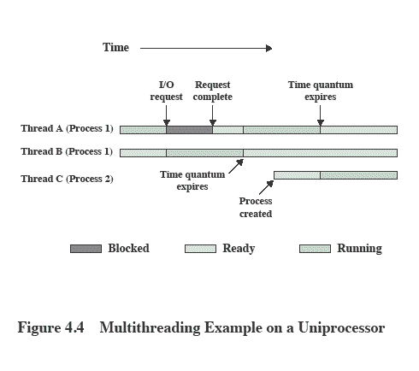
Interleaving of Multiple Threads
Within Multiple Processes
3 threads of 2 processes are interleaved on a processor
Thread switching occurs when the current thread is blocked or its time slice expires
Source: Pearson
Notes:
A significant issue is whether the blocking of a thread results in the blocking of the entire process. In other words, if one thread in a process is blocked, does this prevent the running of any other thread in the same process even if that other thread is in a ready state? Clearly, some of the flexibility and power of threads is lost if the one blocked thread blocks an entire process.
We return to this issue subsequently in our discussion of user-level versus kernel-level threads, but for now let us consider the performance benefits of threads that do not block an entire process. Figure 4.3 (based on one in [KLEI96]) shows a program that performs two remote procedure calls (RPCs) 2 to two different hosts to obtain a combined result. In a single-threaded program, the results are obtained in sequence, so the program has to wait for a response from each server in turn. Rewriting the program to use a separate thread for each RPC results in a substantial speedup. Note that if this program operates on a uniprocessor, the requests must be generated sequentially and the results processed in sequence; however, the program waits concurrently for the two replies.

Slide 16
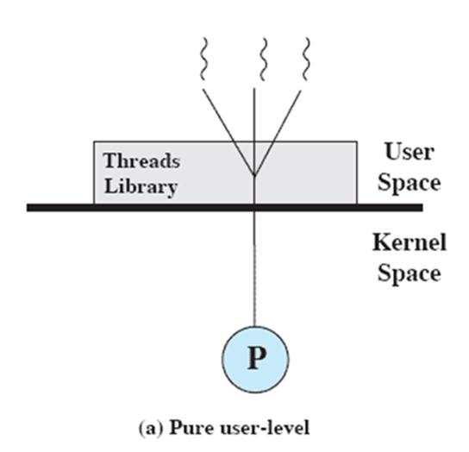
User-Level Threads (ULTs)
All thread management is done by the application
  The threads library contains code for creating and destroying threads, scheduling thread execution, saving and restoring thread contexts, and passing messages between threads
The kernel is not aware of the existence of threads
Source: Pearson

Slide 17
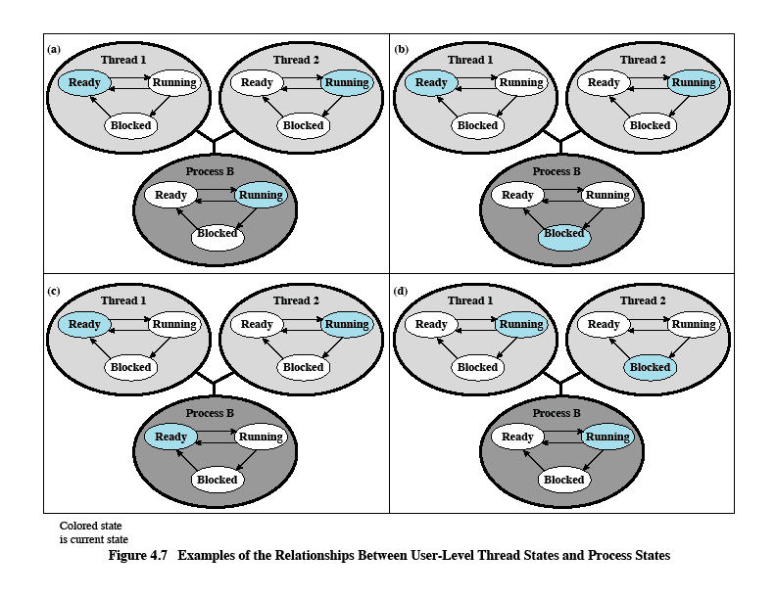
ULT States and Process States
Source: Pearson
Notes:
All of the activity described in the preceding paragraph takes place in user space and within a single process. The kernel is unaware of this activity. The kernel continues to schedule the process as a unit and assigns a single execution state (Ready, Running, Blocked, etc.) to that process. The following examples should clarify the relationship between thread scheduling and process scheduling. Suppose that process B is executing in its thread 2; the states of the process and two ULTs that are part of the process are shown in Figure 4.6a . Each of the following is a possible occurrence:
1. The application executing in thread 2 makes a system call that blocks B. For
example, an I/O call is made. This causes control to transfer to the kernel. The kernel invokes the I/O action, places process B in the Blocked state, and switches to another process. Meanwhile, according to the data structure maintained by the threads library, thread 2 of process B is still in the Running state. It is important to note that thread 2 is not actually running in the sense of being executed on a processor; but it is perceived as being in the Running state by the threads library. The corresponding state diagrams are shown in Figure 4.6b .
2. A clock interrupt passes control to the kernel and the kernel determines
that the currently running process (B) has exhausted its time slice. The kernel places process B in the Ready state and switches to another process. Meanwhile, according to the data structure maintained by the threads library, thread 2 of process B is still in the Running state. The corresponding state diagrams are shown in Figure 4.6c .
3. Thread 2 has reached a point where it needs some action performed by thread
1 of process B. Thread 2 enters a Blocked state and thread 1 transitions from Ready to Running. The process itself remains in the Running state. The corresponding state diagrams are shown in Figure 4.6d .
In cases 1 and 2 ( Figures 4.6b and 4.6c ), when the kernel switches control back to process B, execution resumes in thread 2. Also note that a process can be interrupted, either by exhausting its time slice or by being preempted by a higher priority process, while it is executing code in the threads library. Thus, a process may be in the midst of a thread switch from one thread to another when interrupted. When that process is resumed, execution continues within the threads library, which completes the thread switch and transfers control to another thread within that process.

Slide 18
User-Level Threads
Advantages
  Thread switching does not require kernel mode privileges (faster switching)
  Scheduling algorithm can be tailored to the application without disturbing OS scheduler
    One application may benefit most from a simple round robin scheduling while another might benefit from a priority-based scheduling
  ULTs can run on any OS. No changes are required to the underlying kernel
Disadvantages
  In a typical OS, many system calls are blocked
    As a result, when a ULT executes a system call, not only the thread is blocked, but also all the other threads within the process are blocked.
  A multithreaded application cannot take advantage of multiprocessing
    A kernel assigns only one processor to a process. Therefore, only a single thread can execute at a time

Slide 19
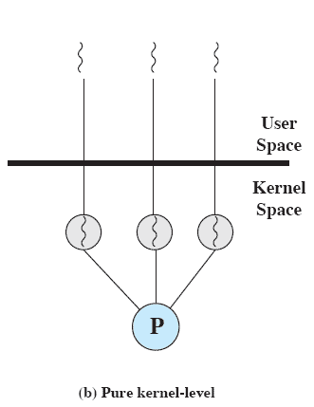
Kernel-Level Threads (KLTs)
Thread management is done by the kernel
  No thread management is done by the application
    Simply an API to the kernel thread facility
    Example: Windows
Advantages
  The kernel can simultaneously schedule multiple threads from the same process on multiple processors
  If one thread is blocked, the kernel can schedule another thread of the same process
  Kernel routines can be multithreaded
Source: Pearson

Slide 20
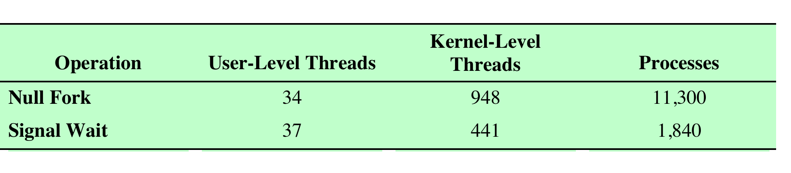
Disadvantage of KLTs
Disadvantages
  Thread switching within the same process requires a mode switch to the kernel
  More than an order of magnitude difference between ULTs and KLTs and similarly between KLTs and processes
  Null Fork: create a new process/thread that invokes null procedure
  Signal Wait: signal a waiting process/thread and wait on a condition (overhead of synchronizing two processes/threads)
Source: Pearson
Notes:
The principal disadvantage of the KLT approach compared to the ULT approach is that the transfer of control from one thread to another within the same process requires a mode switch to the kernel. To illustrate the differences, Table 4.1 shows the results of measurements taken on a uniprocessor VAX computer running a UNIX-like OS. The two benchmarks are as follows: Null Fork, the time to create, schedule, execute, and complete a process/thread that invokes the null procedure (i.e., the overhead of forking a process/thread); and Signal-Wait, the time for a process/thread to signal a waiting process/thread and then wait on a condition (i.e., the overhead of synchronizing two processes/threads together). We see that there is
an order of magnitude or more of difference between ULTs and KLTs and similarly between KLTs and processes.

Slide 21
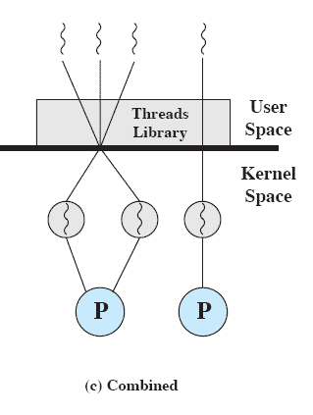
Combined Approach
Thread creation is done completely in the user space
  Multiple ULTs from a single application are mapped onto the same or smaller number of KLTs
    To achieve the best overall results, the programmer adjust the number of KLTs for a particular application
  Multiple threads within the same process can run in parallel on multiple processors
    A blocking system call need not block the entire process
  If properly designed, can combine the advantages of both ULT and KLT approach while minimizing the disadvantages.
Example: Solaris
Source: Pearson

Slide 22
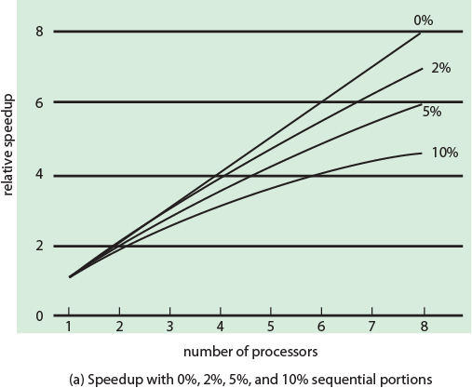
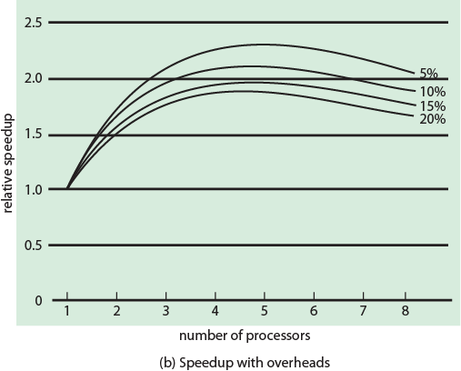
Performance Impact of Multicores
Amdahl’s law
  Speedup = time to execute a program on a single processor / time to execute the program on N processors = 1 / ((1 – f) + f / N) where (1 – f) is an inherently serial fraction
Source: Pearson
  If 10% is inherently serial (f = 0.9)
    Speedup on 8 processors is only 4.7
  In real systems, overheads come from
    Communication, workload distribution, and cache coherence
Notes:
The potential performance benefits of a multicore organization depend on the ability to effectively exploit the parallel resources available to the application. Let us focus first on a single application running on a multicore system. Amdahl’s law (see Appendix E ) states that:
Speedup = time to execute program on a single processor time to execute program on N parallel processors
= 1 (1 - f ) + f N
The law assumes a program in which a fraction (1 - f) of the execution time involves code that is inherently serial and a fraction f that involves code that is infinitely
parallelizable with no scheduling overhead. This law appears to make the prospect of a multicore organization attractive. But as Figure 4.7a shows, even a small amount of serial code has a noticeable impact. If only 10% of the code is inherently serial ( f = 0.9) , running the program on a multicore system with eight processors yields a performance gain of only a factor of 4.7. In addition, software typically incurs overhead as a result of communication and distribution of work to multiple processors and cache coherence overhead. This
results in a curve where performance peaks and then begins to degrade because of the increased burden of the overhead of using multiple processors. Figure 4.7b ,
from [MCDO07], is a representative example.
However, software engineers have been addressing this problem and there are numerous applications in which it is possible to effectively exploit a multicore system. [MCDO07] reports on a set of database applications, in which great attention

Slide 23
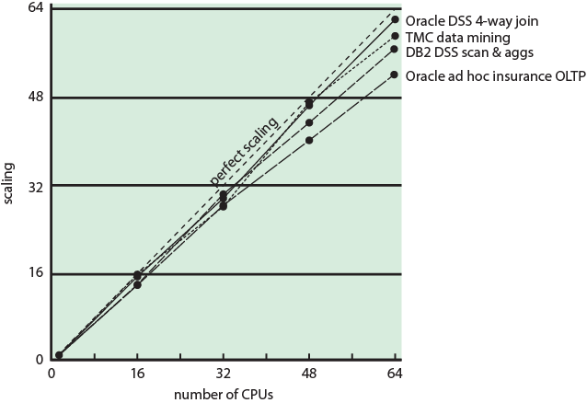
Database Workloads on Multicores
  Software engineers have been addressing this problem to effectively exploit the multicore
  There are numerous applications that can effectively exploit multicores
    Database workloads
      Great attention was paid to reduce the serial fraction within HW, OS, middleware, and DB applications
    Servers typically handle numerous independent transactions in parallel
Source: Pearson
Figure 4.8 Scaling of Database Workloads on Multiple Processor Hardware
Notes:
However, software engineers have been addressing this problem and there are numerous applications in which it is possible to effectively exploit a multicore system. [MCDO07] reports on a set of database applications, in which great attention was paid to reducing the serial fraction within hardware architectures, operating systems, middleware, and the database application software. Figure 4.8 shows the result. As this example shows, database management systems and database applications are one area in which multicore systems can be used effectively. Many kinds of servers can also effectively use the parallel multicore organization, because servers typically handle numerous relatively independent transactions in parallel.

Slide 24
Applications for Multicores
Multithreaded native applications
  Characterized by having a small number of highly threaded processes
    IBM (Lotus) Domino, Oracle (Siebel) CRM (Customer Relationship Manager)
Multiprocess applications
  Characterized by the presence of many single-threaded processes
    Oracle database, SAP
Java applications
  Java language facilitate multithreaded applications
  Java Virtual Machine is also a multithreaded process that provides scheduling and memory management for Java applications
    Sun’s Java Application Server, IBM’s Websphere, all applications based on J2EE (Java 2 Enterprise Edition) application server
Multi-instance applications
  Can achieve speedup by running multiple instances of the same application in parallel

Slide 25
Solaris
Solaris provides four thread-related objects
  Process
    Normal UNIX process
    Includes user’s address space, stack, and process control block
  User-level thread (ULT)
    Implemented by a threads library at the application-level
    Invisible to the OS
  Lightweight process (LWP)
    Can be viewed as a mapping between ULTs and kernel threads
    Each LWP maps to one kernel thread
    LWPs are scheduled by the kernel independently and may execute in parallel on multiprocessors
  Kernel thread
    These are fundamental entities that can be scheduled and dispatched to run on any processors
    There are kernel threads that are not associated with LWPs
      The use of kernel threads to implement system functions reduces the overhead of switching within the kernel (from a process switch to a thread switch)

Slide 26
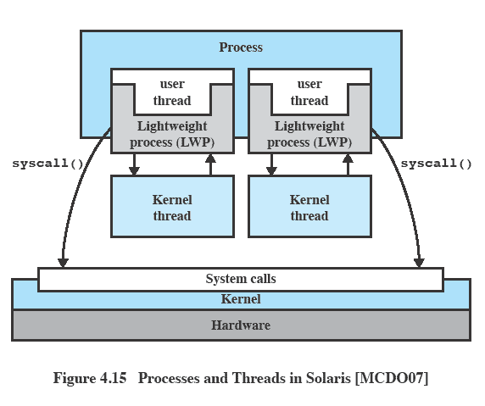
Processes and Threads in Solaris
Source: Pearson
  A process may consist of a single ULT bound to a single LWP
    A single thread of execution, corresponding to a traditional UNIX process
  A process may contain multiple threads, each bound to a single LWP, which in turn is bound to a single kernel thread
    When an application requires concurrency
Notes:
Figure 4.13 illustrates the relationship among these four entities. Note that there is always exactly one kernel thread for each LWP. An LWP is visible within a process to the application. Thus, LWP data structures exist within their respective process address space. At the same time, each LWP is bound to a single dispatchable kernel thread, and the data structure for that kernel thread is maintained within the kernel’s address space.
A process may consist of a single ULT bound to a single LWP. In this case, there is a single thread of execution, corresponding to a traditional UNIX process. When concurrency is not required within a single process, an application uses this process structure. If an application requires concurrency, its process contains multiple threads, each bound to a single LWP, which in turn are each bound to a single kernel thread.
In addition, there are kernel threads that are not associated with LWPs. The kernel creates, runs, and destroys these kernel threads to execute specific system functions. The use of kernel threads rather than kernel processes to implement system functions reduces the overhead of switching within the kernel (from a process switch to a thread switch).

Slide 27
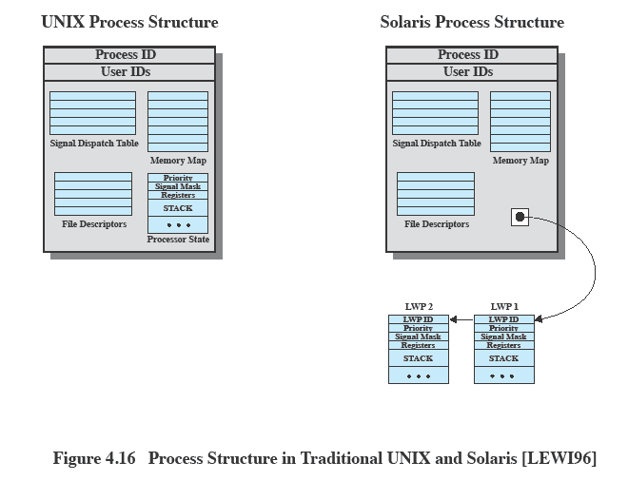
Traditional Unix vs Solaris
Source: Pearson
Notes:
Figure 4.14 compares, in general terms, the process structure of a traditional UNIX system with that of Solaris. On a typical UNIX implementation, the process structure includes the process ID; the user IDs; a signal dispatch table, which the kernel uses to decide what to do when sending a signal to a process; file descriptors, which describe the state of files in use by this process; a memory map, which defines the address space for this process; and a processor state structure, which includes the kernel stack for this process. Solaris retains this basic structure but replaces the processor state block with a list of structures containing one data block for each LWP.

Slide 28
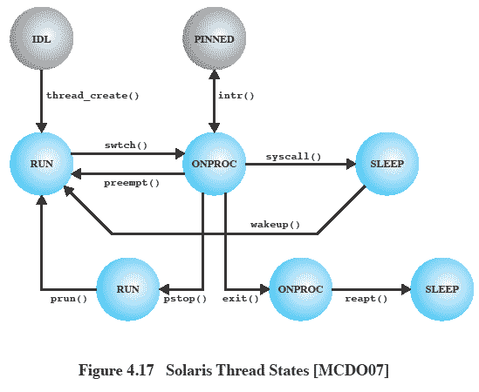
Solaris Thread States
  Preemption by a higher priority thread or due to time slice
  SLEEP means blocked to wait for an event
  STOP might be done for debugging purpose
  FREE is awaiting removal from OS thread data structure
  When an interrupt occurs, the currently running thread is pinned.
    A PINNED thread cannot move to another processor
    It is simply suspended until the interrupt is processed
STOP
ZOMBIE
FREE
Source: Pearson
Notes:
Figure 4.15 shows a simplified view of both thread execution states. These states reflect the execution status of both a kernel thread and the LWP bound to it. As mentioned, some kernel threads are not associated with an LWP; the same execution diagram applies. The states are as follows:
• RUN: The thread is runnable; that is, the thread is ready to execute.
• ONPROC: The thread is executing on a processor.
• SLEEP: The thread is blocked.
• STOP: The thread is stopped.
• ZOMBIE: The thread has terminated.
• FREE: Thread resources have been released and the thread is awaiting removal from the OS thread data structure.
A thread moves from ONPROC to RUN if it is preempted by a higher-priority thread or because of time slicing. A thread moves from ONPROC to SLEEP if it is blocked and must await an event to return the RUN state. Blocking occurs if the thread invokes a system call and must wait for the system service to be performed. A thread enters the STOP state if its process is stopped; this might be done for debugging purposes.

Slide 29
Homework 3
4.1
4.2
4.4
4.5
4.7
Read Chapter 5

