Slide 1
Operating System
Chapter 5. Concurrency:
Mutual Exclusion and Synchronization
Lynn Choi
School of Electrical Engineering

Slide 2
Process Interaction
In a single-processor system,
  Process executions are interleaved to increase CPU utilization
  The relative speed of execution of processes cannot be predicted
    It depends on the activities of other processes, the way OS handles interrupts, and the scheduling policies
  The following difficulties arise
    Mutual exclusion
    Deadlock
    Starvation
    Race condition
The same problems exist in a multiprocessor system
  Process executions are overlapped (run in parallel)
  Again, the relative speed of execution of processes is unpredictable

Slide 3
Competing Processes
Sharing of global resources can create
  Need for mutual exclusion
  Deadlock
  Starvation
Mutual exclusion
  Suppose two processes require access to a single printer
  Printer is a nonsharable resource
    Without care, lines from competing processes will be interleaved
  During the course of execution, only one process should be allowed to access the resource at a time.
    The portion of program that accesses the resource is called a critical section of the program.
    Only one process at a time is allowed in its critical section
  How to enforce mutual exclusion?

Slide 4
Competing Processes
Deadlock
  Consider two processes P1 and P2, and two resources R1 and R2
  Each process needs to access both resources to complete its function
  Suppose the following scenario:
    OS assigns R1 to P2 and R2 to P1
    Each process is waiting for the other resource
    Neither will release the resource until it acquires the other resource
    Two processes are deadlocked!
Starvation (Indefinite postponement)
  Consider three processes P1, P2, and P3.
  Each process requires access to resource R.
  Suppose the following scenario:
    P1 has R and both P2 and P3 wait for R
    OS grants access to P3, then P1, then P3, …
    P2 may be indefinitely postponed to access the resource

Slide 5
Cooperating Processes
Sharing of global data may lead to race condition
Race condition
  Consider the following two processes
  P1: a = a + 1;
  b = b + 1;
  P2: b = 2 * b;
  a = 2 * a;
  If we start with a = b, each process taken separately will leave a = b
  Now consider the following concurrent execution:
    Two processes respect mutual exclusion on each individual data item
  a = a + 1;
  b = 2 * b;
  b = b + 1;
  a = 2 * a;
  If we start with a = b = 1, at the end we have a = 4, b = 3.
  The problem can be avoided by declaring the entire sequence in each process to be a critical section

Slide 6
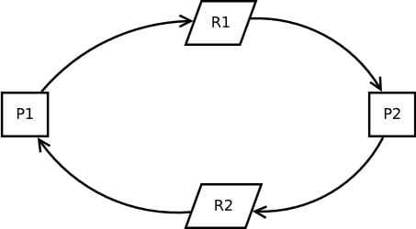
Deadlock & Starvation
Deadlock
  A situation where two or more competing processes are waiting for the other to release a resource
Starvation (Infinite Postponement)
  A situation where the progress of a process is indefinitely postponed by the scheduler
Livelock
  A situation where two or more processes continuously change their states without making progress

Slide 7
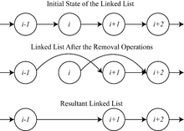
Race Condition
Race condition occurs
  When two or more processes/threads access shared data and they try to change it at the same time. Because thread/process scheduling algorithm can switch between threads, you don’t know which thread will access the shared data first. In this situation, both threads are ‘racing’ to access/change the data.
  Operations upon shared data are critical sections that must be mutually exclusive in order to avoid harmful collision between processes or threads.
    Regarded as a programming error
    Difficult to locate this kind of programming errors as results are nondeterministic and not reproducible
Example
  Two processes attempt to remove two nodes simultaneously from a singly-linked list
    Only one node is removed instead of two.
Source: Wikipedia

Slide 8
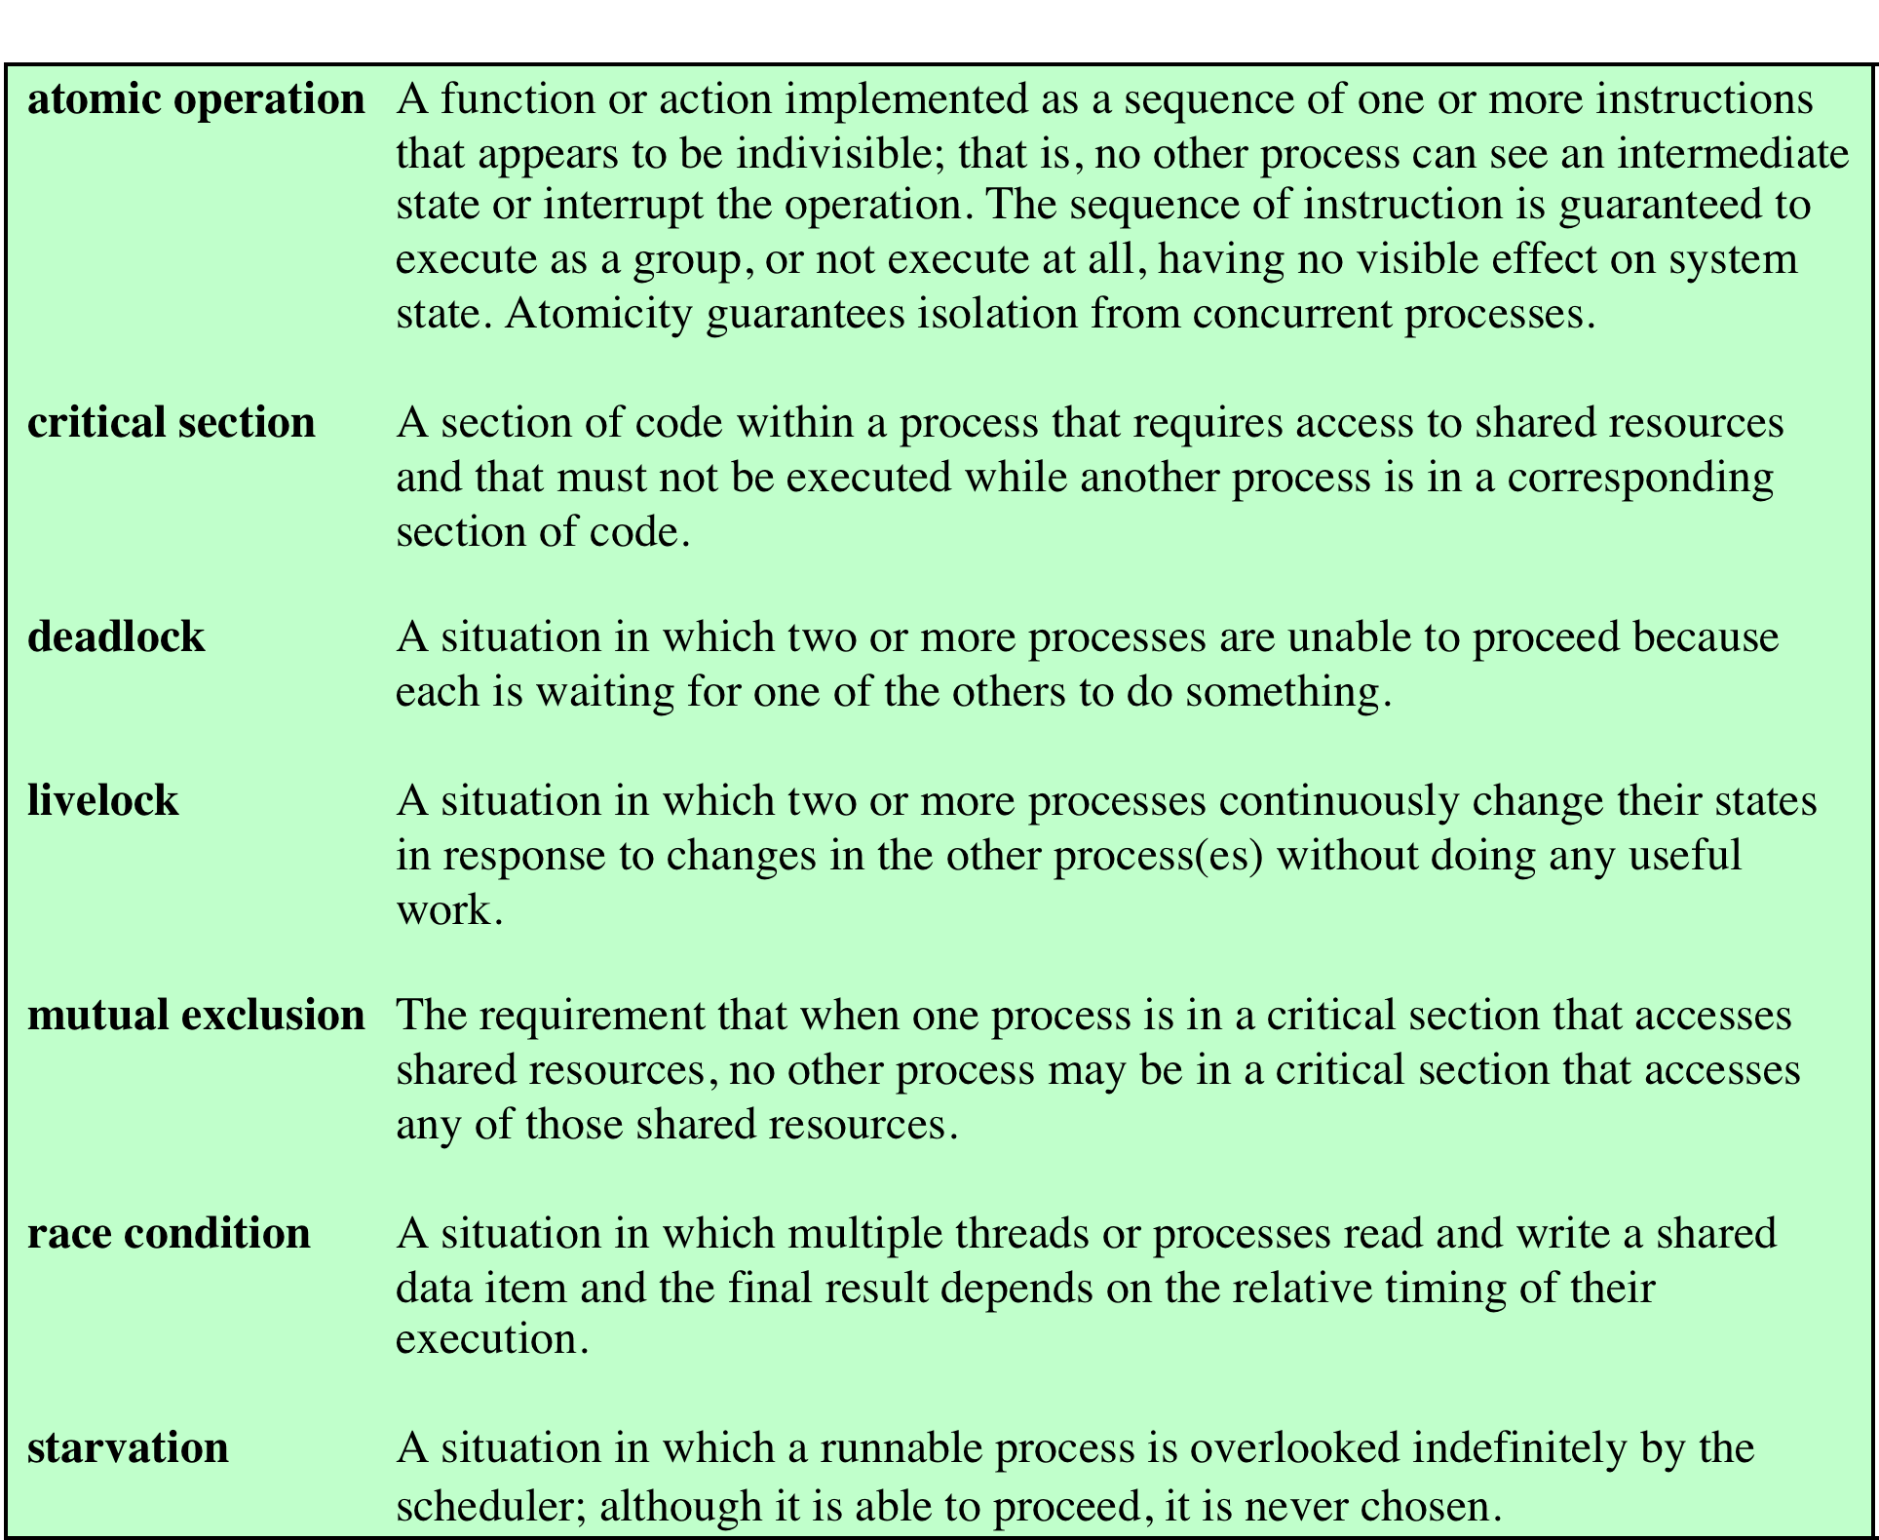
Concurrency: Key Terminologies
Source: Pearson
Table 5.1 Some Key Terms Related to Concurrency
Notes:
Key terms related to concurrency.

Slide 9
Atomic Operation
“Atomic” means
  Indivisible, uninterruptable
  Must be performed atomically, which means either “success” or “failure”
    Success: successfully change the system state
    Failure: no effect on the system state
Atomic operation
  A function or action implemented as a single instruction or as a sequence of instructions that appears to be indivisible
    No other processes can see an intermediate state
  Can be implemented by hardware or by software
  HW-level atomic operations
    Test-and-set, fetch-and-add, compare-and-swap, load-link/store-conditional
  SW-level solutions
    Running a group of instructions in a critical section

Slide 10
HW Support for Mutual Exclusion
In a uniprocessor,
  A process continues to run until it invokes an OS service or until it is interrupted.
  Therefore, to guarantee mutual exclusion, it is sufficient to prevent a process from being interrupted.
Disable interrupt on an entry to a critical section
    While (true) {
    /* disable interrupt */
    /* critical section */
    /* enable interrupt */
    /* remainder */
    }
  The simplest approach - No context switching guarantees mutual exclusion
Problem
  Performance degradation
  Only for a uniprocessor
    Disabling interrupt does not affect other cores/processors
    Other cores are free to run any code
      Can enter a critical section for the same shared resource

Slide 11
HW Support for Mutual Exclusion
Special machine instructions
  Carry out two operations atomically, such as reading and writing of a single memory location
  Test-and-set, fetch-and-add, compare-and-swap etc.
    Access to a shared memory location is exclusive and atomic
    Test-and-set is supported by most processor families
      x86, IA64, SPARC, IBM z series, etc.
  These are atomic operations supported by the machine instructions
  Can be used to implement semaphores and other SW solutions
  Can also be used for multiprocessors
  Problem
    Busy waiting
      Other process or thread accessing the same memory location must wait and retry until the previous access is complete
    Deadlock and starvation can also happen

Slide 12
Compare and Swap Instruction
“Compare and Swap” instruction
  A compare is made between a memory value and a test value
    int compare_and_swap (int *word, int testval, int newval)
    {
    int oldval;
    oldval = *word
    if (oldval == testval) *word = newval;
    return oldval;
    }
  Some version of this instruction is available on nearly all processor families (x86, IA64, SPARC, IBM z series, etc.)
      Atomicity is guaranteed by HW

Slide 13
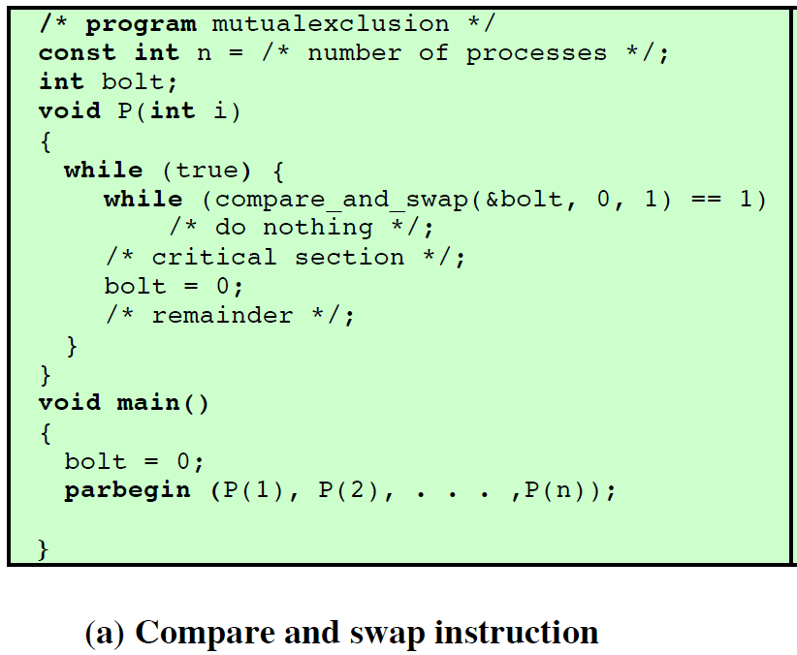
Critical Section using Compare and Swap
Source: Pearson

Slide 14
Exchange Instruction
“Exchange” instruction
  Exchange the content of a register with that of a memory location.
    void exchange (int *register, int *memory)
    {
    int temp;
    temp = *memory;
    *memory = *register;
    *register = temp;
    }
  x86 and IA-64 support XCHG instruction

Slide 15
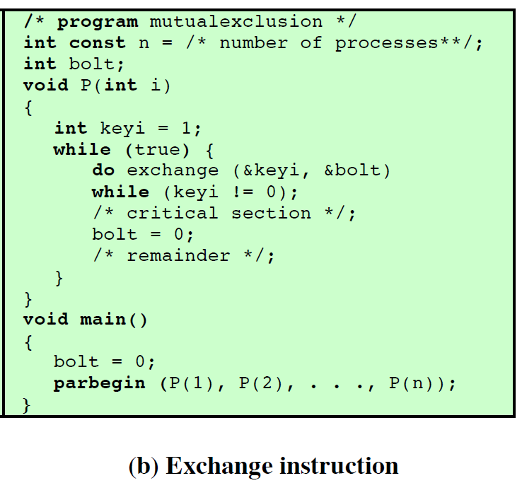
Critical Section using Exchange
Source: Pearson
Notes:
Figure 5.2b shows a mutual exclusion protocol based on the use of an exchange instruction. A shared variable bolt is initialized to 0. Each process uses a local variable key that is initialized to 1. The only process that may enter its critical section is one that finds bolt equal to 0. It excludes all other processes from the critical section by setting bolt to 1. When a process leaves its critical section, it resets bolt to 0, allowing another process to gain access to its critical section.

Slide 16
Special Instructions: +/−
Advantages
  Applicable to any number of processes on either a single processor or multiple processors sharing main memory
  Simple and easy to verify
  It can be used to support multiple critical sections; each critical section can be defined by its own variable
Disadvantages
  Busy-waiting
  Starvation is possible when a process leaves a critical section and more than one process is waiting
    The selection of a waiting process is arbitrary
  Deadlock is possible
    Process P1 executes compare and swap and enter its critical section
    P1 is then interrupted and give control to P2 who has higher priority.
    P2 will be denied access due to mutual exclusion and go to busy waiting loop.
    P1 will never be dispatched since it has lower priority than P2.

Slide 17
Semaphore
Semaphore
  A variable that provides a simple abstraction for controlling access to a common resource in a programming environment
  The value of the semaphore variable can be changed by only 2 operations
    V operation (also known as “signal”)
      Increment the semaphore
    P operation (also known as “wait”)
      Decrement the semaphore
    The value of the semaphore S is usually the number of units of the resource that are currently available.
Type of semaphores
  Binary semaphore
    Have a value of 0 or 1
      0 (locked, unavailable)
      1 (unlocked, available)
  Counting semaphore
    Can have an arbitrary resource count

Slide 18
Semaphore
A variable that has an integer value upon which only three operations are defined
May be initialized to a nonnegative integer value
The semWait (P) operation decrements the value
The semSignal (V) operation increments the value
There is no way to inspect or manipulate semaphores other than these three operation

Slide 19
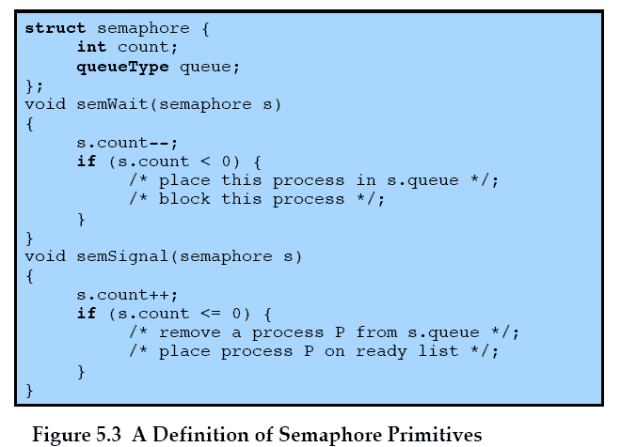
Semaphore Primitives
Source: Pearson
Notes:
Figure 5.3 suggests a more formal definition of the primitives for semaphores. The semWait and semSignal primitives are assumed to be atomic.

Slide 20
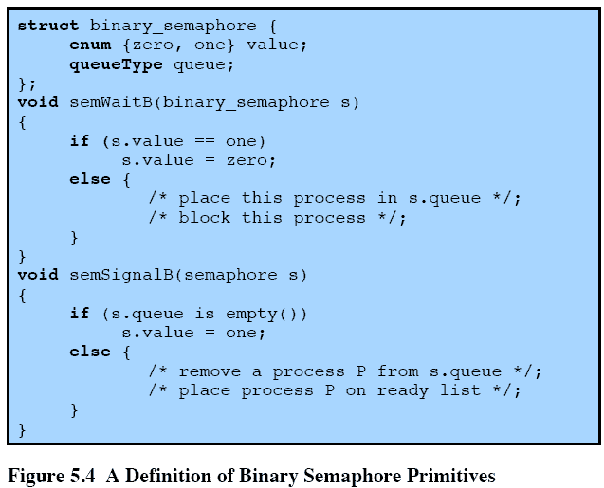
Binary Semaphore Primitives
Source: Pearson
Notes:
A more restricted version, known as the binary semaphore , is defined in Figure 5.4 . A binary semaphore may only take on the values 0 and 1 and can be defined by the
following three operations:
1. A binary semaphore may be initialized to 0 or 1.
2. The semWaitB operation checks the semaphore value. If the value is zero, then the process executing the semWaitB is blocked. If the value is one, then the value is changed to zero and the process continues execution.
3. The semSignalB operation checks to see if any processes are blocked on this semaphore (semaphore value equals 0). If so, then a process blocked by a semWaitB operation is unblocked. If no processes are blocked, then the value of the semaphore is set to one.
In principle, it should be easier to implement the binary semaphore, and it can be shown that it has the same expressive power as the general semaphore (see Problem 5.17). To contrast the two types of semaphores, the nonbinary semaphore is often referred to as either a counting semaphore or a general semaphore .
A concept related to the binary semaphore is the mutex . A key difference between the two is that the process that locks the mutex (sets the value to zero) must be the one to unlock it (sets the value to 1). In contrast, it is possible for one process to lock a binary semaphore and for another to unlock it.

Slide 21
Strong/Weak Semaphores
A queue is used to hold processes waiting on the semaphore
Strong semaphore
  The process that has been blocked the longest is released from the queue first (FIFO)
Weak semaphore
  The order in which processes are removed from the queue is not specified

Slide 22
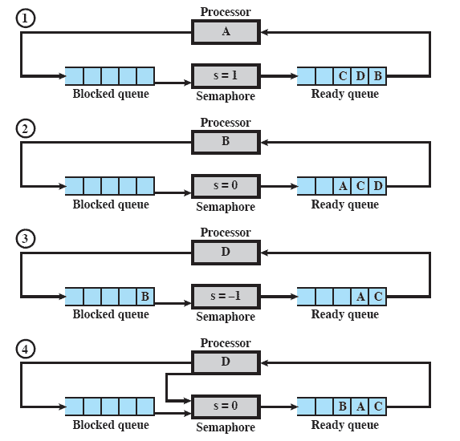
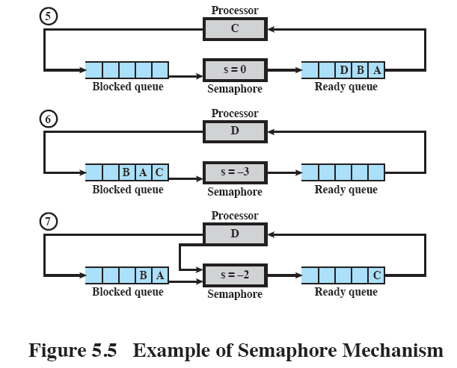
Example of Semaphore Mechanism
Wait
Wait/Wait/Wait
Wait
Signal
Signal
Source: Pearson
Notes:
Figure 5.5 , based on one in [DENN84], is an example of the operation of a strong semaphore. Here processes A, B, and C depend on a result from process D. Initially (1), A is running;
B, C, and D are ready; and the semaphore count is 1, indicating that one of D’s results is available. When A issues a semWait instruction on semaphore s , the semaphore decrements to 0, and A can continue to execute; subsequently it rejoins the ready queue. Then B runs (2), eventually issues a semWait instruction, and is blocked, allowing D to run (3). When D completes a new result, it issues a semSignal instruction, which allows B to move to the ready queue (4). D rejoins the ready queue and C begins to run (5) but is blocked when it issues a semWait instruction. Similarly, A and B run and are blocked on the semaphore, allowing D to resume execution (6). When D has a result, it issues a semSignal , which transfers C to the ready queue. Later cycles of D will release A and B from the Blocked state.

Slide 23
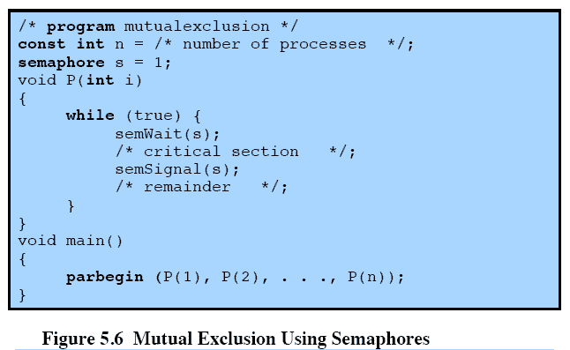
Mutual Exclusion
Source: Pearson
Notes:
For the mutual exclusion algorithm discussed in the next subsection and illustrated in Figure 5.6 , strong semaphores guarantee freedom from starvation, while weak semaphores do not. We will assume strong semaphores because they are more convenient and because this is the form of semaphore typically provided by operating systems.
Figure 5.6 shows a straightforward solution to the mutual exclusion problem using a semaphore s (compare Figure 5.1 ). Consider n processes, identified in the array P ( i ), all of which need access to the same resource. Each process has a critical section used to access the resource. In each process, a semWait(s) is executed just before its critical section. If the value of s becomes negative, the process is blocked. If the value is 1, then it is decremented to 0 and the process immediately enters its critical section; because s is no longer positive, no other process will be able to enter its critical section.
The semaphore is initialized to 1. Thus, the first process that executes a semWait will be able to enter the critical section immediately, setting the value of s to 0. Any other process attempting to enter the critical section will find it busy and will be blocked, setting the value of s to –1. Any number of processes may attempt entry; each such unsuccessful attempt results in a further decrement of the value of s . When the process that initially entered its critical section departs, s is incremented and one of the blocked processes (if any) is removed from the queue of blocked processes associated with the semaphore and put in a Ready state. When it is next scheduled by the OS, it may enter the critical section.

Slide 24

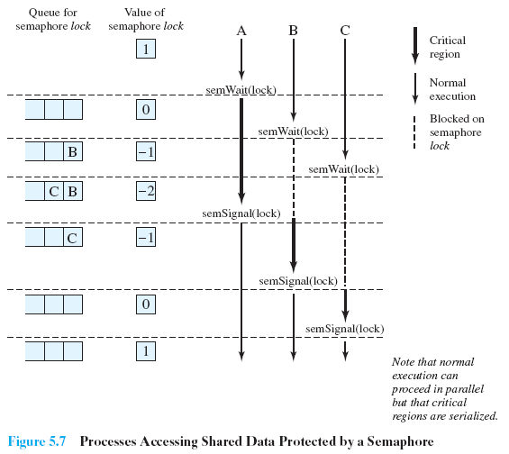
Source: Pearson
Notes:
Figure 5.7 , based on one in [BACO03], shows a possible sequence for three processes using the mutual exclusion discipline of Figure 5.6 . In this example three processes (A, B, C) access a shared resource protected by the semaphore lock . Process A executes semWait( lock ) ; because the semaphore has a value of 1 at the time of the semWait operation, A can immediately enter its critical section and the semaphore takes on the value 0. While A is in its critical section, both B and CFigure 5.7 , based on one in [BACO03], shows a possible sequence for three processes using the mutual exclusion discipline of Figure 5.6 . In this example three processes (A, B, C) access a shared resource protected by the semaphore lock .
Process A executes semWait( lock ) ; because the semaphore has a value of 1 at the time of the semWait operation, A can immediately enter its critical section and the semaphore takes on the value 0. While A is in its critical section, both B and C perform a semWait operation and are blocked pending the availability of the semaphore. When A exits its critical section and performs semSignal( lock ) , B, which was the first process in the queue, can now enter its critical section.

Slide 25
Producer/Consumer Problem
General Situation
  One or more producers
    Produce data item and insert it in a buffer
  One consumer
    Delete it from the buffer and consume the data item
  Only one producer or consumer may access the buffer at any time
The problem
  Ensure that the producer can’t add data into a full buffer
  Consumer can’t remove data from an empty buffer

Slide 26
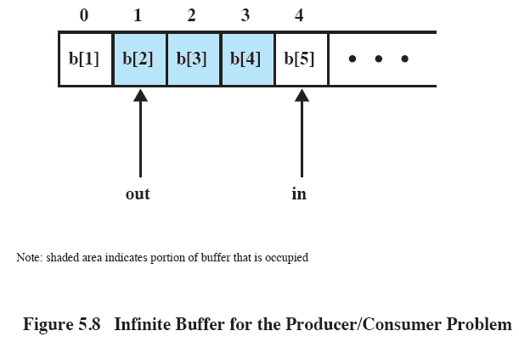
Buffer Structure
Source: Pearson
Notes:
Figure 5.8 illustrates the structure of buffer b . The producer can generate items and store them in the buffer at its own pace. Each time, an index ( in ) into the buffer is incremented. The consumer proceeds in a similar fashion but must make sure that it does not attempt to read from an empty buffer. Hence, the consumer makes sure that the producer has advanced beyond it ( in > out ) before proceeding.

Slide 27
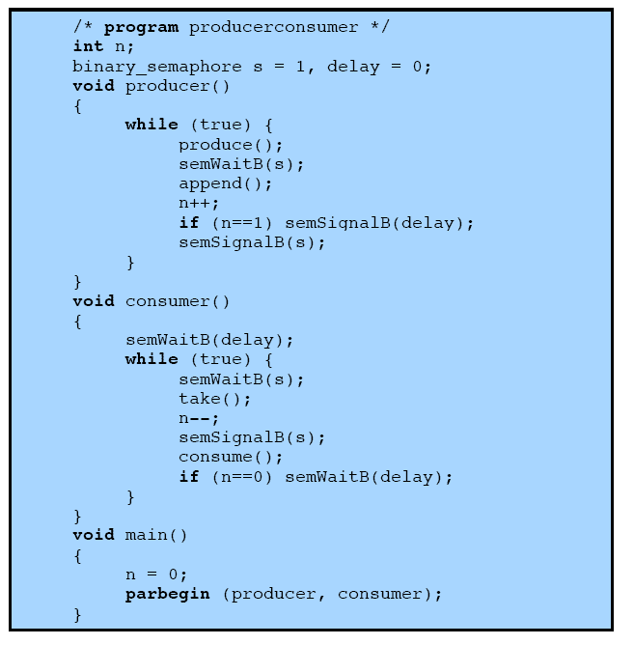
Incorrect Solution
Source: Pearson
Figure 5.9 An Incorrect Solution to the Infinite-Buffer Producer/Consumer Problem Using Binary Semaphores
Notes:
Let us try to implement this system using binary semaphores. Figure 5.9 is a first attempt. Rather than deal with the indices in and out , we can simply keep track of the number of items in the buffer, using the integer variable n (= in – out ). The semaphore s is used to enforce mutual exclusion; the semaphore delay is used to force the consumer to semWait if the buffer is empty.
This solution seems rather straightforward. The producer is free to add to the buffer at any time. It performs semWaitB(s) before appending and semSignalB(s) afterward to prevent the consumer or any other producer from accessing the buffer during the append operation. Also, while in the critical section, the producer increments the value of n . If n = 1, then the buffer was empty just prior to this append, so the producer performs semSignalB(delay) to alert the consumer of this fact. The consumer begins by waiting for the first item to be produced,
using semWaitB(delay) . It then takes an item and decrements n in its critical section. If the producer is able to stay ahead of the consumer (a common situation), then the consumer will rarely block on the semaphore delay because n will usually be positive. Hence both producer and consumer run smoothly.
There is, however, a flaw in this program. When the consumer has exhausted the buffer, it needs to reset the delay semaphore so that it will be forced to wait until the producer has placed more items in the buffer. This is the purpose of the statement: if n == 0 semWaitB(delay) .

Slide 28
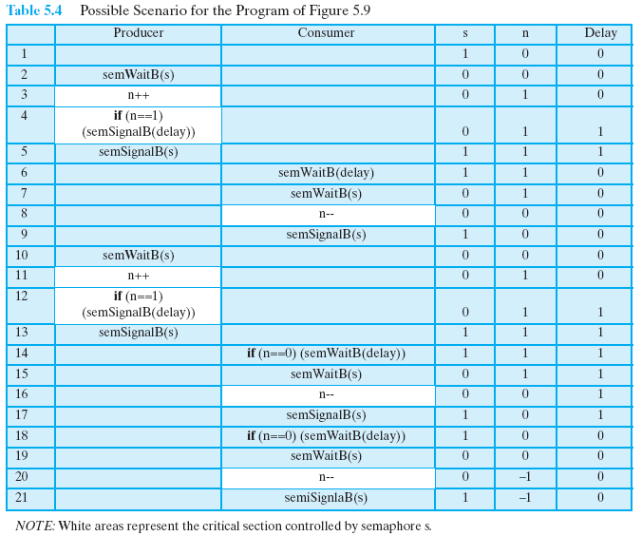
Possible Scenario
Source: Pearson
Notes:
Consider the scenario outlined in Table 5.4 . In line 14, the consumer fails to execute the semWaitB operation. The consumer did indeed exhaust the buffer and set n to 0 (line 8), but the producer has incremented n before the consumer can test it in line 14. The result is a semSignalB not matched by a prior semWaitB . The value of –1 for n in line 20 means that the consumer has consumed an item from the buffer that does not exist. It would not do simply to move the conditional statement inside the critical section of the consumer because this
could lead to deadlock (e.g., after line 8 of Table 5.4 ).

Slide 29
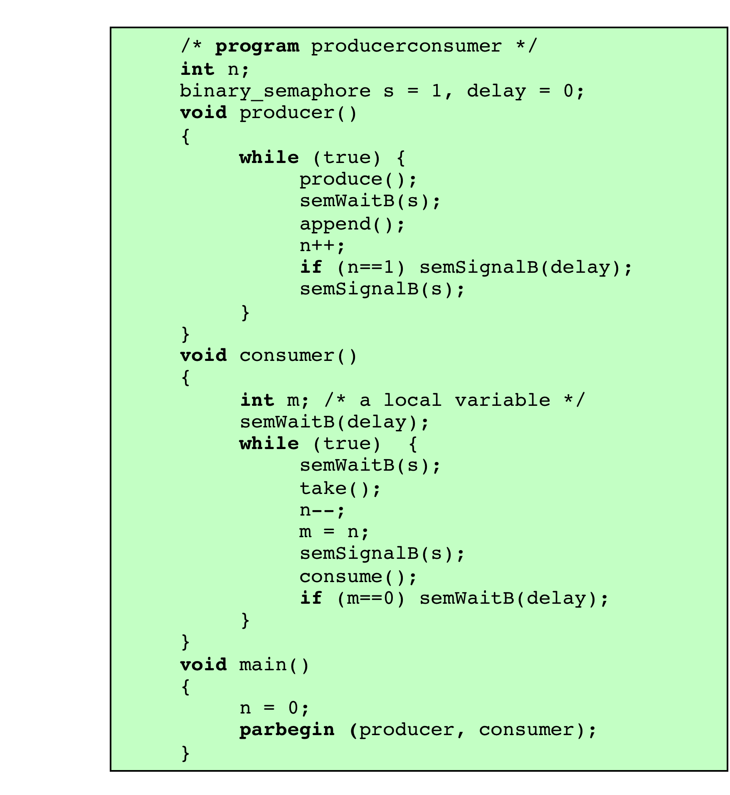
Correct Solution with Binary Semaphore

Slide 30
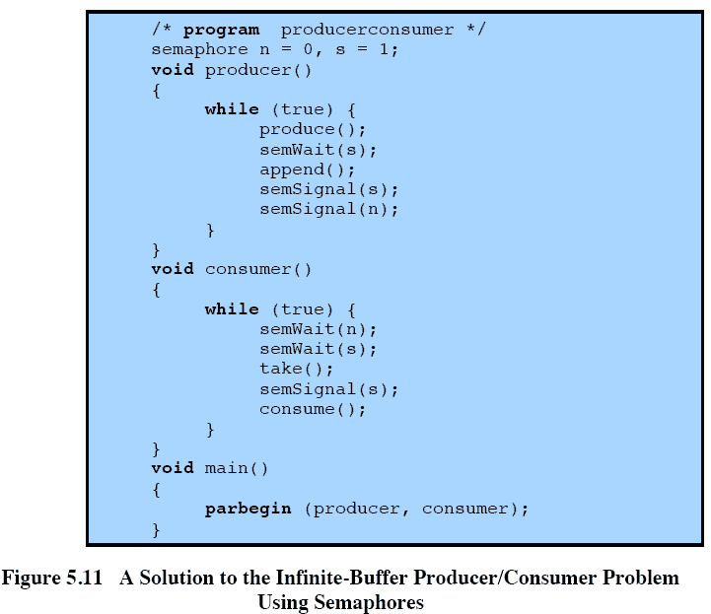
Correct Solution with Counting Semaphore
Source: Pearson
Notes:
A somewhat cleaner solution can be obtained if general semaphores (also called counting semaphores) are used, as shown in Figure 5.11 . The variable n is now a semaphore. Its value still is equal to the number of items in the buffer. Suppose now that in transcribing this program, a mistake is made and the operations semSignal(s) and semSignal(n) are interchanged. This would require that the semSignal(n) operation be performed in the producer’s critical section without interruption by the consumer or another producer. Would this affect the program? No, because the consumer must wait on both semaphores before proceeding in any case.

Slide 31
Scenario
 | Producer | Consumer | s | n
1 |  |  | 1 | 0
2 | Wait(s) |  | 0 | 0
3 | Signal(s) |  | 1 | 0
4 | Signal(n) |  | 1 | 1
5 |  | Wait(n) | 1 | 0
6 |  | Wait(s) | 0 | 0
7 |  | Signal(s) | 1 | 0
8 | Wait(s) |  | 0 | 0
9 | Signal(s) |  | 1 | 0
10 | Signal(n) |  | 1 | 1
11 |  | Wait(n) | 1 | 0
12 |  | Wait(s) | 0 | 0
13 |  | Signal(s) | 1 | 0
14 | Wait(s) |  | 0 | 0
15 | Signal(s) |  | 1 | 0
16 | Signal(n) |  | 1 | 1
17 |  | Wait(n) | 1 | 0
18 |  | Wait(s) | 0 | 0
19 |  | Signal(s) | 1 | 0
Source: Pearson

Slide 32
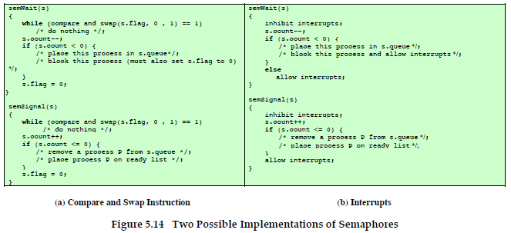
Implementation of Semaphores
Source: Pearson

Slide 33
Monitor
Motivation
  Semaphore
    It is not easy to produce a correct program using semaphores
    semWait and semSignal operations may be scattered throughout a program and it is not easy to see the overall effect of these operations
Monitor
  Programming language construct that provides equivalent functionality to that of semaphores and is easier to control
  Implemented in a number of programming languages
    Including Concurrent Pascal, Pascal-Plus, Modula-2, Modula-3, and Java
  Monitor consists of one or more procedures, an initialization code, and local data
    Local data variables are accessible only by the monitor’s procedures and not by any external procedure
    Process enters the monitor by invoking one of its procedures
    Only one process may be executing in the monitor at a time

Slide 34
Synchronization with Monitor
Condition variable
  Monitor supports synchronization by the use of condition variables that are contained within the monitor and accessible only within the monitor
  Condition variables are operated by two functions
    cwait(c): suspend the execution of the calling process on condition c
    csignal(c): resume the execution of a process blocked on the same condition
      If there are so such processes, the signal is lost (do nothing)

Slide 35
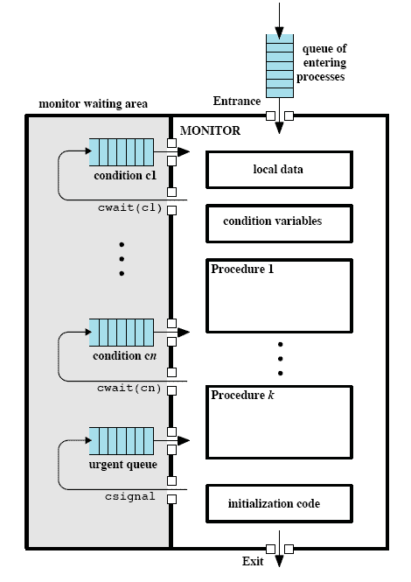
Structure of a Monitor
Source: Pearson
Notes:
Figure 5.15 illustrates the structure of a monitor. Although a process can enter the monitor by invoking any of its procedures, we can think of the monitor as having a single entry point that is guarded so that only one process may be in the monitor at a time. Other processes that attempt to enter the monitor join a queue of processes blocked waiting for monitor availability. Once a process is in the monitor, it may temporarily block itself on condition x by issuing cwait(x) ; it is then placed in a queue of processes waiting to reenter the monitor when the condition changes, and resume execution at the point in its program following the cwait(x) call. If a process that is executing in the monitor detects a change in the condition variable x , it issues csignal(x) , which alerts the corresponding condition queue that the condition has changed.

Slide 36

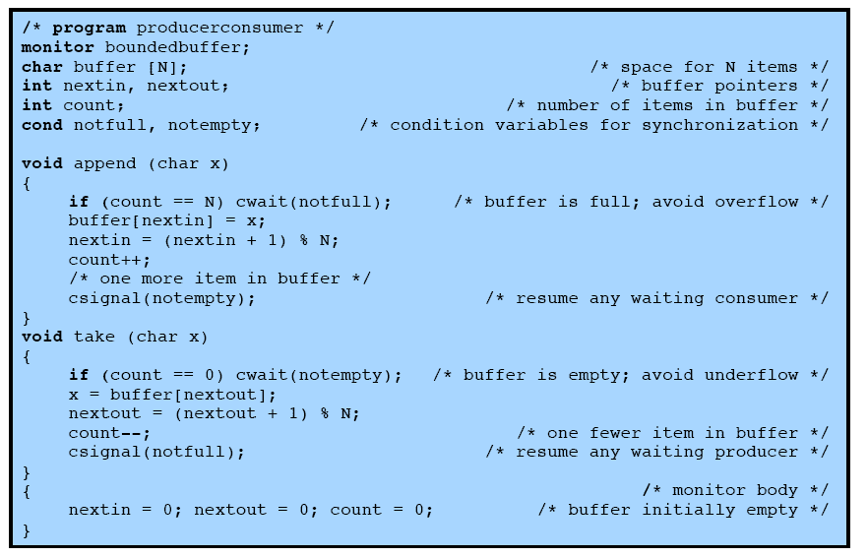
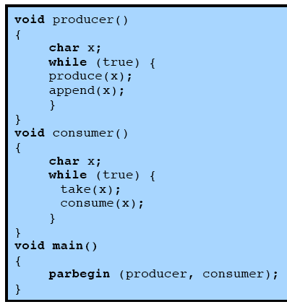
Source: Pearson
Figure 5.16 A Solution to the Bounded-Buffer Producer/Consumer Problem Using a Monitor
Notes:
As an example of the use of a monitor, let us return to the bounded-buffer producer/consumer problem. Figure 5.16 shows a solution using a monitor. The monitor module, boundedbuffer , controls the buffer used to store and retrieve characters. The monitor includes two condition variables (declared with the construct cond ): notfull is true when there is room to add at least one character to the buffer, and notempty is true when there is at least one character in the buffer.
A producer can add characters to the buffer only by means of the procedure append inside the monitor; the producer does not have direct access to buffer . The procedure first checks the condition notfull to determine if there is space available in the buffer. If not, the process executing the monitor is blocked on that condition. Some other process (producer or consumer) may now enter the monitor. Later, when the buffer is no longer full, the blocked process may be removed from the queue, reactivated, and resume processing. After placing a character in the buffer, the process signals the notempty condition. A similar description can be made of the consumer function.
This example points out the division of responsibility with monitors compared to semaphores. In the case of monitors, the monitor construct itself enforces mutual exclusion: It is not possible for both a producer and a consumer simultaneously to access the buffer. However, the programmer must place the appropriate cwait and csignal primitives inside the monitor to prevent processes from depositing items in a full buffer or removing them from an empty one. In the case of semaphores, both mutual exclusion and synchronization are the responsibility of the programmer.
Note that in Figure 5.16 , a process exits the monitor immediately after executing the csignal function. If the csignal does not occur at the end of the procedure, then, in Hoare’s proposal, the process issuing the signal is blocked to make the monitor available and placed in a queue until the monitor is free. One possibility at this point would be to place the blocked process in the entrance queue, so that it would have to compete for access with other processes that had not yet entered the monitor. However, because a process blocked on a csignal function has already partially performed its task in the monitor, it makes sense to give this process precedence over newly entering processes by setting up a separate urgent queue ( Figure 5.15 ). One language that uses monitors, Concurrent Pascal, requires that csignal only appear as the last operation executed by a monitor procedure.
If there are no processes waiting on condition x , then the execution of csignal( x ) has no effect.

Slide 37
Message Passing
When processes interact with one another, the following actions must be satisfied by the system
  Mutual exclusion
  Synchronization
  Communication
Message passing is one approach to provide these functions and
  Works with shared memory and distributed memory multiprocessors, uniprocessors, and distributed systems
The actual function is normally provided in the form of a pair of primitives
  send (destination, message)
    A process sends information in the form of a message to another process designated by a destination
  receive (source, message)
    A process receives information by executing the receive primitive, indicating the source and the message

Slide 38
Synchronization
Communication of a message between two processes implies synchronization between the two
  The receiver cannot receive a message until it has been sent by another process
Both sender and receiver can be blocking or nonblocking
  When a send primitive is executed, there are two possibilities
    Either the sending process is blocked until the message is received, or it is not
  When a receive primitive is executed there are also two possibilities
    If a message has previously been sent, the message is received and the execution continues
    If there is no waiting message, the process is blocked until a message arrives or the process continues to execute, abandoning the attempt to receive

Slide 39
Blocking/Nonblocking Send/Receive
Blocking send, blocking receive
  Both sender and receiver are blocked until the message is delivered
  Sometimes referred to as a rendezvous
  Allows for tight synchronization between processes
Nonblocking send, blocking receive
  Sender continues on but receiver is blocked until the requested message arrives
  The most useful combination
  It allows a process to send one or more messages to a variety of destinations as quickly as possible
Nonblocking send, nonblocking receive
  Neither party is required to wait

Slide 40
Addressing
Schemes for specifying processes in send and receive primitives fall into two categories
Direct addressing
  Send primitive includes a specific identifier of the destination process
  Receive primitive can be handled in one of two ways
    Explicit addressing
      Require that the process explicitly designate a sending process
      Effective for cooperating concurrent processes
    Implicit addressing
      Source parameter of the receive primitive possesses a value returned when the receive operation has been performed
Indirect addressing
  Messages are sent to a shared data structure consisting of queues that can temporarily hold messages
  Queues are referred to as mailboxes
  One process sends a message to the mailbox and the other process picks up the message from the mailbox
  Allows for greater flexibility in the use of messages

Slide 41
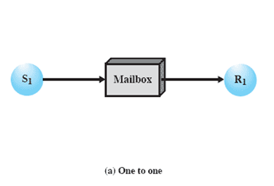
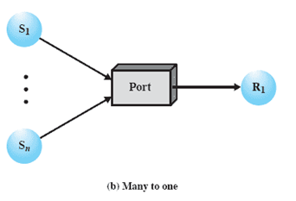
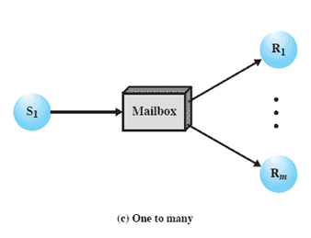
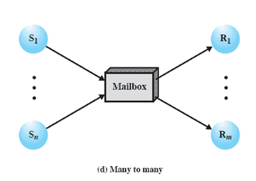
Indirect Process Communication
Source: Pearson
Notes:
The relationship between senders and receivers can be one to one, many to one, one to many, or many to many ( Figure 5.18 ). A one-to-one relationship allows a private communications link to be set up between two processes. This insulates their interaction from erroneous interference from other processes. A many-to-one relationship is useful
for client/server interaction; one process provides service to a number of other processes. In this case, the mailbox is often referred to as a port . A one-to-many relationship allows for one sender and multiple receivers; it is useful for applications where a message or some information is to be broadcast to a set of processes. A many-to-many relationship allows multiple server processes to provide concurrent service to multiple clients.
1) A one-to-one relationship
allows a private communications link to be set up between two processes.
This insulates their interaction from erroneous interference from other processes.
2) A many-to-one relationship is useful for client/server interaction;
one process provides service to a number of other processes.
In this case, the mailbox is often referred to as a port.
3) A one-to-many relationship allows for one sender and multiple receivers;
it is useful for applications where a message or some information is to be broadcast to a set of processes.
4) A many-to-many relationship
allows multiple server processes to provide concurrent service to multiple clients.
The association of processes to mailboxes can be either static or dynamic. Ports are often statically associated with a particular process; that is, the port is created and assigned to the process permanently. Similarly, a one-to-one relationship is typically defined statically and permanently. When there are many senders, the association of a sender to a mailbox may occur dynamically. Primitives such as connect and disconnect may be used for this purpose.
A related issue has to do with the ownership of a mailbox. In the case of a port, it is typically owned by and created by the receiving process. Thus, when the process is destroyed, the port is also destroyed. For the general mailbox case, the OS may offer a create-mailbox service. Such mailboxes can be viewed either as being owned by the creating process, in which case they terminate with the process, or as being owned by the OS, in which case an explicit command will be required to destroy the mailbox.

Slide 42
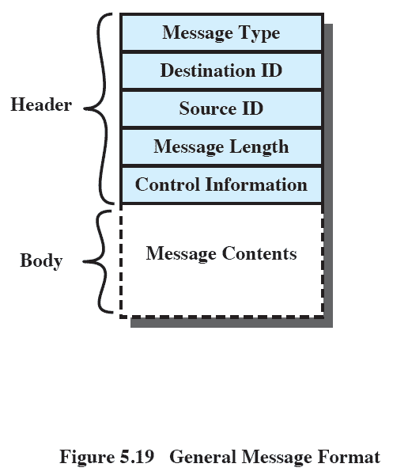
General Message Format
Source: Pearson
Notes:
The format of the message depends on the objectives of the messaging facility and whether the facility runs on a single computer or on a distributed system. For some
operating systems, designers have preferred short, fixed-length messages to minimize processing and storage overhead. If a large amount of data is to be passed, the data can be placed in a file and the message then simply references that file. A more flexible approach is to allow variable-length messages.
Figure 5.19 shows a typical message format for operating systems that support variable-length messages.
The message is divided into two parts:
a header, which contains information about the message.
The header may contain an identification of the source and intended destination of the message, a length field, and a type field to discriminate among various types of messages.
additional control information, e.g. pointer field so a linked list of messages can be created; a sequence number, to keep track of the number and order of messages passed between source and destination; and a priority field.
a body, which contains the actual contents of the message.

Slide 43
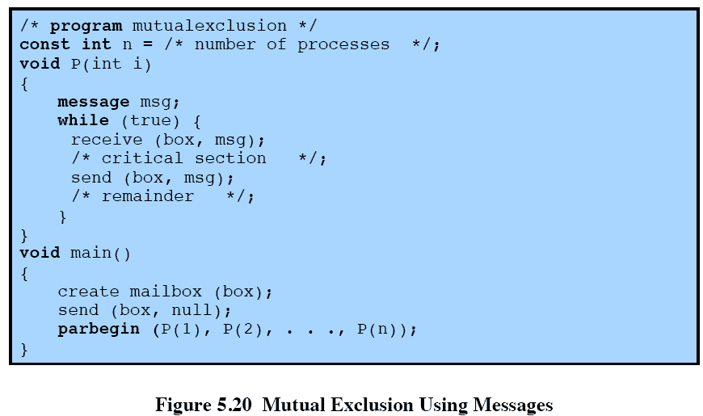
Mutual Exclusion
Source: Pearson
Notes:
Figure 5.20 shows one way in which message passing can be used to enforce mutual exclusion (compare Figures 5.1 , 5.2 , and 5.6 ). We assume the use of the blocking receive primitive and the nonblocking send primitive. A set of concurrent processes share a mailbox, box , which can be used by all processes to send and receive.
The mailbox is initialized to contain a single message with null content. A process wishing to enter its critical section first attempts to receive a message. If the mailbox is empty, then the process is blocked. Once a process has acquired the message, it performs its critical section and then places the message back into the mailbox. Thus, the message functions as a token that is passed from process to process.
The preceding solution assumes that if more than one process performs the receive operation concurrently, then:
• If there is a message, it is delivered to only one process and the others are
blocked, or
• If the message queue is empty, all processes are blocked; when a message is
available, only one blocked process is activated and given the message.
These assumptions are true of virtually all message-passing facilities.

Slide 44
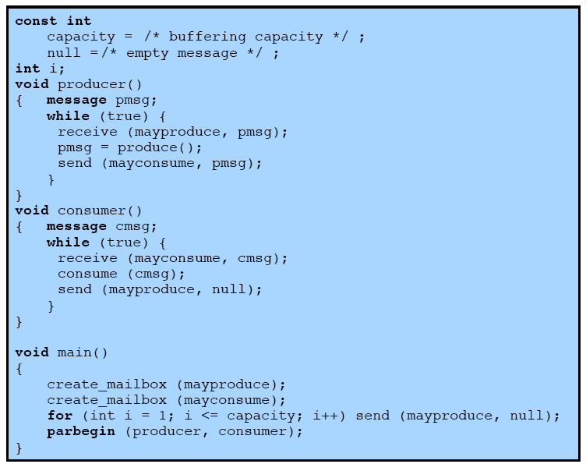
Producer Consumer with Message
Source: Pearson
Notes:
As an example of the use of message passing, Figure 5.21 is a solution to the bounded-buffer producer/consumer problem. Using the basic mutual-exclusion power of message passing, the problem could have been solved with an algorithmic structure similar to that of Figure 5.13 . Instead, the program of Figure 5.21 takes advantage of the ability of message passing to be used to pass data in addition to signals. Two mailboxes are used. As the producer generates data, it is sent as messages to the mailbox mayconsume . As long as there is at least one message in that mailbox, the consumer can consume. Hence mayconsume serves as the buffer; the data in the buffer are organized as a queue of messages. The “size” of the buffer is
determined by the global variable capacity . Initially, the mailbox mayproduce is filled with a number of null messages equal to the capacity of the buffer. The number of messages in mayproduce shrinks with each production and grows with each consumption. This approach is quite flexible. There may be multiple producers and consumers, as long as all have access to both mailboxes. The system may even be distributed, with all producer processes and the mayproduce mailbox at one site and all the consumer processes and the mayconsume mailbox at another.

Slide 45
Homework 4
Exercise 5.1
Exercise 5.2
Exercise 5.6
Exercise 5.7
Exercise 5.9
Exercise 5.10

