Slide 1
Operating System
Chapter 6. Concurrency:
Deadlock and Starvation
Lynn Choi
School of Electrical Engineering

Slide 2
Deadlock
Definition
  A set of processes is deadlocked when each process in the set is blocked awaiting an event (or a resource) that can only be triggered (released) by another blocked process in the set
Examples
  4 cars arrive at a four-way stop
Two general categories of resources
  Reusable resource
    Can be safely used by only one process at a time and is not depleted by that use
    Examples: processors, memory, I/O devices, files, databases and semaphores
  Consumable resource
    Can be created (produced) and destroyed (consumed)
    Typically, there is no limit on the number of consumable resources
    Examples: interrupts, signals, messages, data in I/O buffers

Slide 3

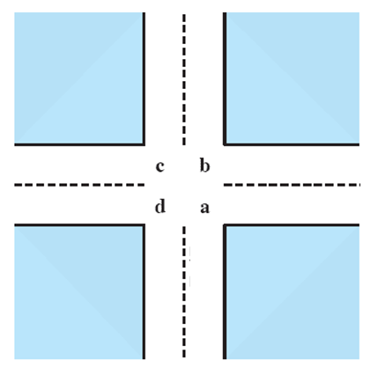
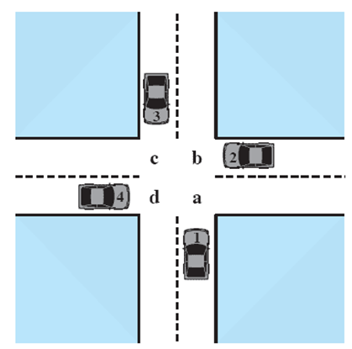
Potential Deadlock
I need quad C and D
I need quad B and C
I need quad A and B
I need quad D and A
Source: Pearson
Notes:
Animated Slide
Click 1 Cars approach intersection
Then Cars announce their resource needs
All deadlocks involve conflicting needs for resources by two or more processes. A common example is the traffic deadlock. Figure 6.1a shows a situation in which four cars have arrived at a four-way stop intersection at approximately the same time. The four quadrants of the intersection are the resources over which control is needed. In particular, if all four cars wish to go straight through the intersection, the resource requirements are as follows:
• Car 1, traveling north, needs quadrants a and b.
• Car 2 needs quadrants b and c.
• Car 3 needs quadrants c and d.
• Car 4 needs quadrants d and a.
The typical rule of the road in the United States is that a car at a four-way stop should defer to a car immediately to its right. This rule works if there are only two or three cars at the intersection. For example, if only the northbound and westbound cars arrive at the intersection, the northbound car will wait and the westbound car proceeds. However, if all four cars arrive at about the same time, each will refrain from entering the intersection, this causes a potential deadlock. The deadlock is only potential, not actual, because the necessary resources are available for any of the cars to proceed. If one car eventually does proceed, it can do so.

Slide 4
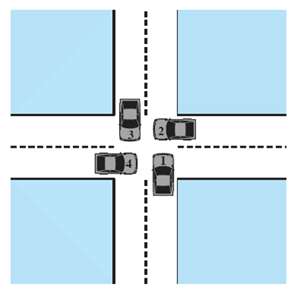



Actual Deadlock
HALT until D is free
HALT until C is free
HALT until B is free
HALT until A is free
Source: Pearson
Notes:
Animated Slide
Click 1 Cars move to deadlock
Then Cars announce their resource need
However, if all four cars ignore the rules and proceed (cautiously) into the intersection at the same time, then each car seizes one resource (one quadrant) but cannot proceed because the required second resource has already been seized by another car. This is an actual deadlock.

Slide 5
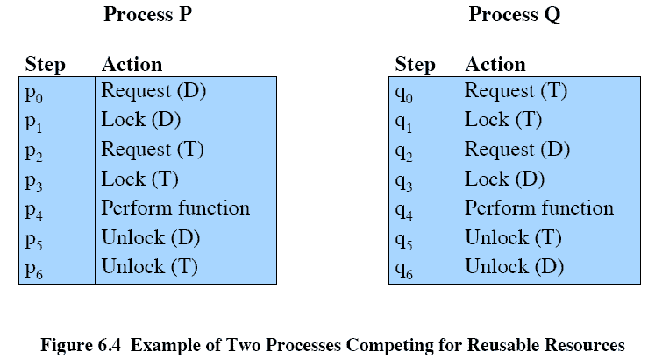
Reusable Resource Example
p₀p₁q₀q₁p₂q₂ leads to a deadlock!
Source: Pearson
Notes:
As an example of deadlock involving reusable resources, consider two processes that compete for exclusive access to a disk file D and a tape drive T. The programs engage in the operations depicted in Figure 6.4 . Deadlock occurs if each process holds one resource and requests the other. For example, deadlock occurs if the multiprogramming system interleaves the execution of the two processes as follows:
p 0 p 1 q 0 q 1 p 2 q 2
It may appear that this is a programming error rather than a problem for the OS designer. However, we have seen that concurrent program design is challenging. Such deadlocks do occur, and the cause is often embedded in complex program logic, making detection difficult. One strategy for dealing with such a deadlock is to impose system design constraints concerning the order in which resources can be requested.

Slide 6
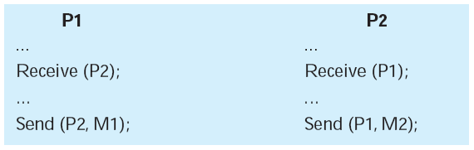
Consumable Resource Example
Consider a pair of processes, in which each process attempts to receive a message from the other process and then send a message to the other process
Deadlock occurs if the Receive is blocking
Source: Pearson

Slide 7
Conditions for Deadlock
Mutual exclusion
  Only one process may use a resource at a time
Hold and wait
  A process may hold allocated resources while waiting for the other resources
No preemption
  No resource can be forcibly removed from a process holding it
Circular wait
  A closed chain of processes exists such that each process holds at least one resource needed by the next process in the chain
Note that
  The first three conditions are necessary but not sufficient conditions for a deadlock.
    The fourth condition is actually a consequence of the first three.
  Given that the first three conditions exist, a sequence of events may occur that lead to an unresolvable circular wait.

Slide 8
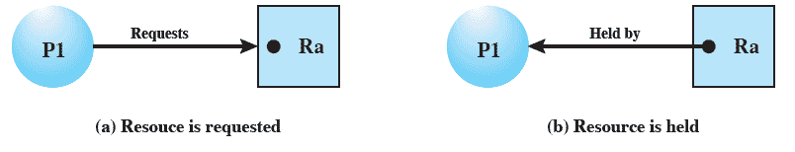
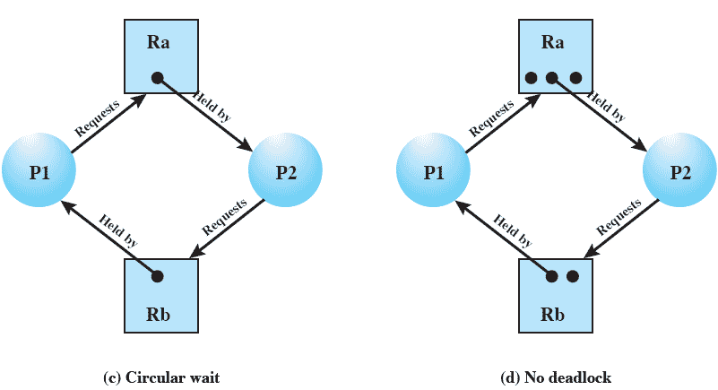
Resource Allocation Graphs
Source: Pearson
Notes:
A useful tool in characterizing the allocation of resources to processes is the resource allocation graph , introduced by Holt [HOLT72]. The resource allocation graph is a directed graph that depicts a state of the system of resources and processes, with each process and each resource represented by a node. A graph edge directed from a process to a resource indicates a resource that has been requested by the process but not yet granted ( Figure 6.5a ). Within a resource node, a dot is shown for each instance of that resource. Examples of resource types that may have multiple instances are I/O devices that are allocated by a resource management module in the OS. A graph edge directed from a reusable resource node dot to a process indicates a request that has been granted ( Figure 6.5b ); that is, the process has been assigned one unit of that resource. A graph edge directed from a consumable
resource node dot to a process indicates that the process is the producer of that
resource.
Figure 6.5c shows an example deadlock. There is only one unit each of resources Ra and Rb. Process P1 holds Rb and requests Ra, while P2 holds Ra but requests Rb. Figure 6.5d has the same topology as Figure 6.5c , but there is no deadlock because multiple units of each resource are available.

Slide 9
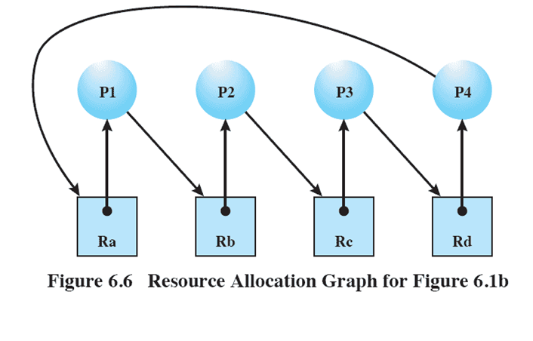
Circular Wait Example
Source: Pearson
Notes:
The resource allocation graph of Figure 6.6 corresponds to the deadlock situation in Figure 6.1b . Note that in this case, we do not have a simple situation in which two processes each have one resource the other needs. Rather, in this case, there is a circular chain of processes and resources that results in deadlock.

Slide 10
Three Approaches for Deadlocks
Deadlock prevention
  Adopt a policy that eliminates one of the conditions 1 through 4
Deadlock avoidance
  Make the appropriate choices dynamically based on the current state of resource allocation
Deadlock detection
  Allow the deadlock to occur, attempt to detect the presence of deadlock, and recover if a deadlock is detected

Slide 11
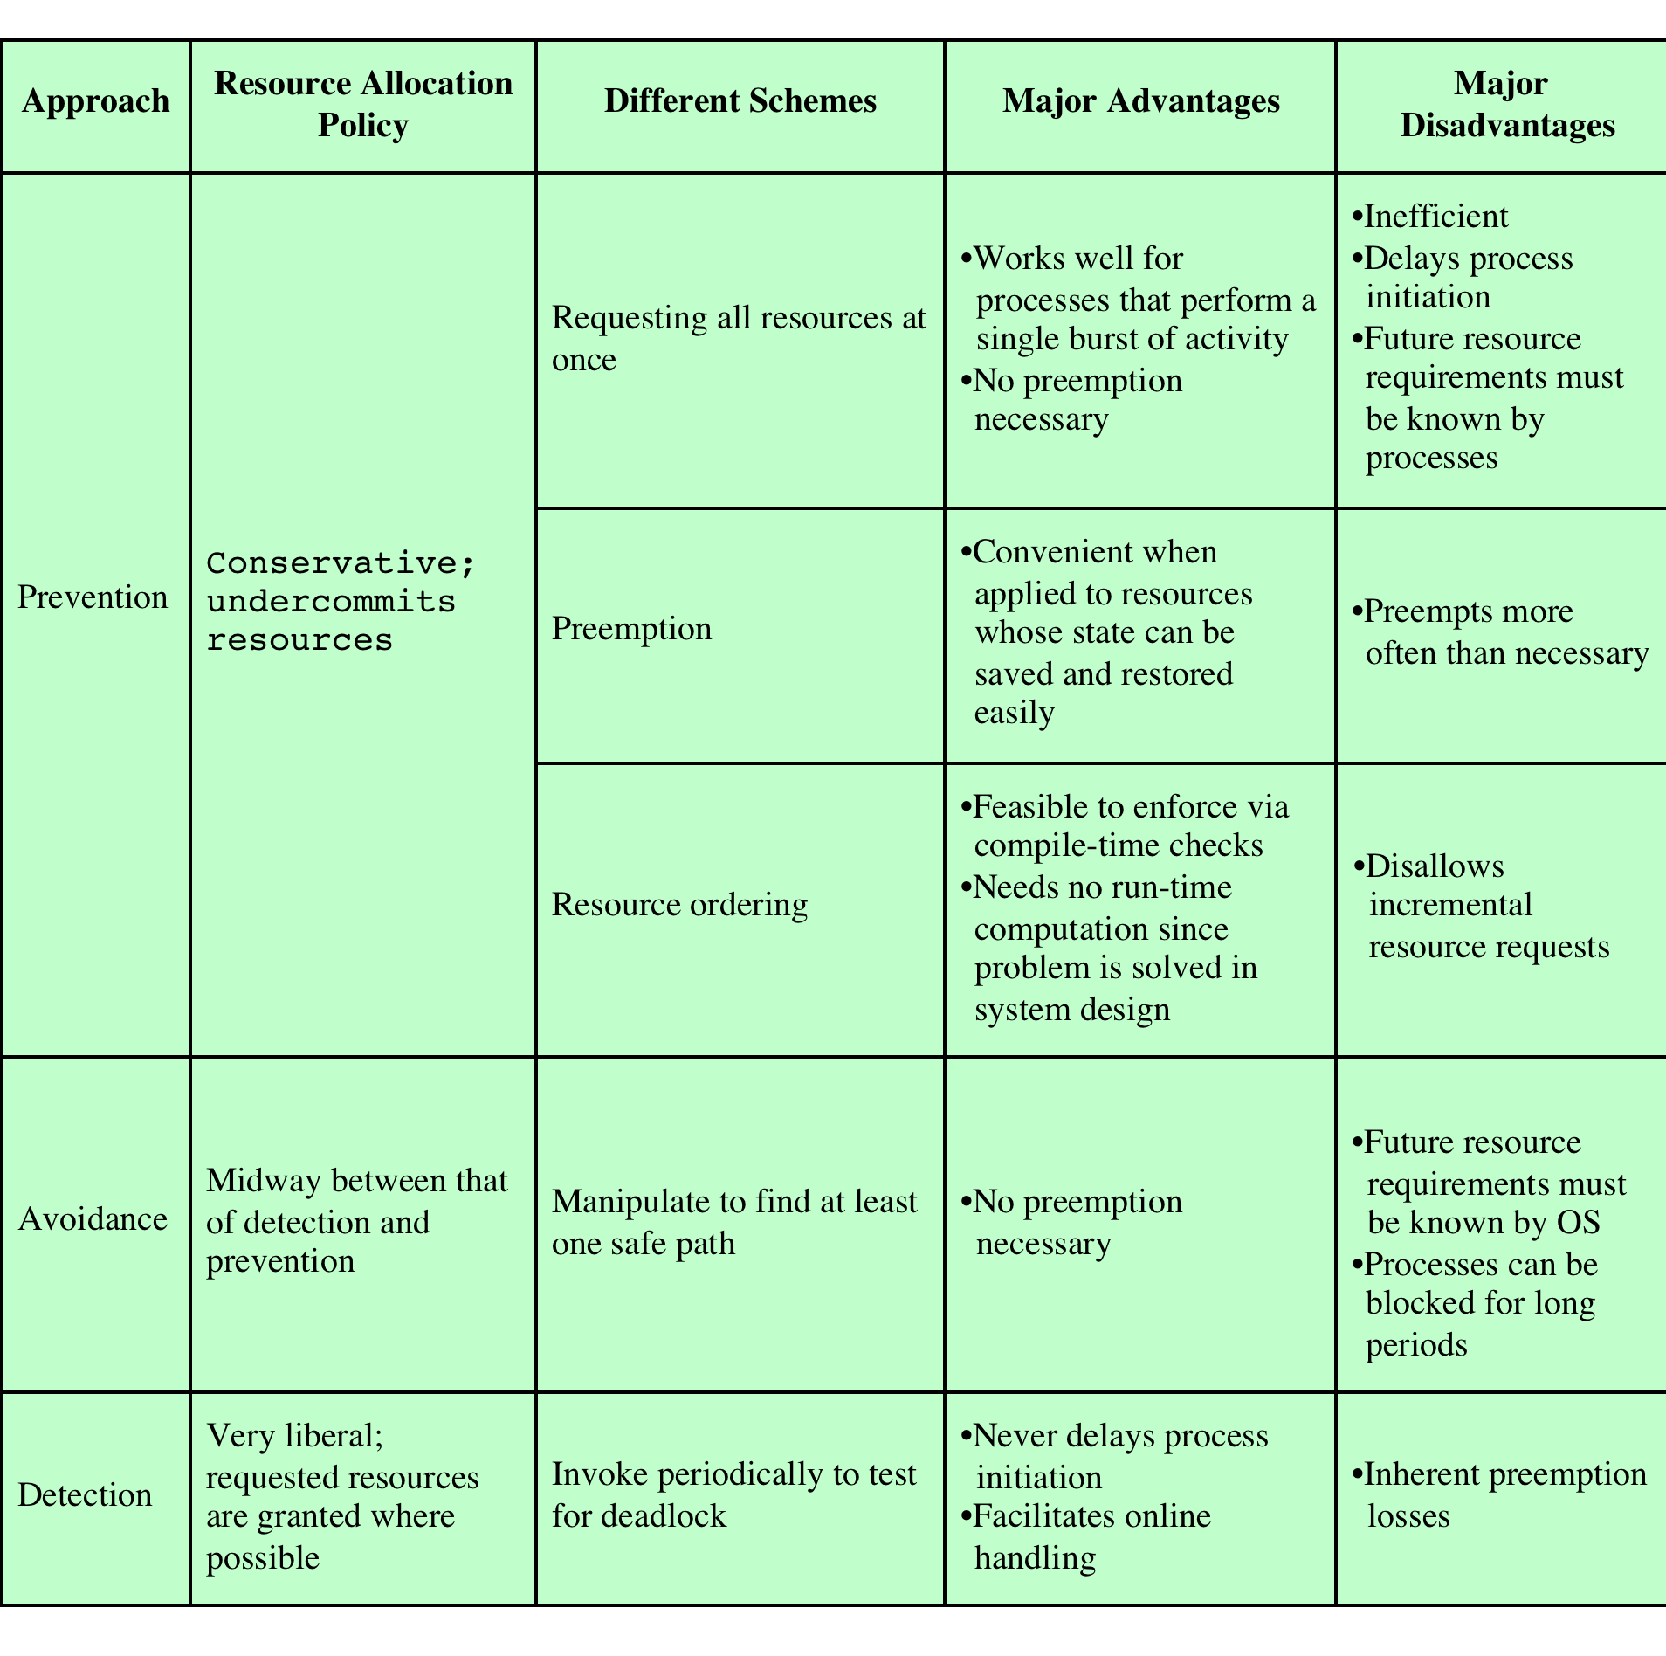
Deadlock Detection, Prevention, Avoidance
Source: Pearson
Notes:
There is no single effective strategy that can deal with all types of deadlock. Table 6.1 summarizes the key elements of the most important approaches that have been developed: prevention, avoidance, and detection. We examine each of these in turn, after first introducing resource allocation graphs and then discussing the conditions for deadlock.

Slide 12
Deadlock Prevention
Mutual exclusion
  We cannot prevent this first condition
    If access to a resource requires mutual exclusion, then mutual exclusion must be supported by the system
Hold and wait
  Require that a process request all of its required resources at once and block the process until all the requests can be granted simultaneously
No preemption
  If a process holding certain resources is denied a further request, that process must release its original resources and request them again
  Alternatively, if a process requests a resource that is currently held by another process, OS may preempt the second process
Circular wait
  Define a linear ordering of resource types
  If a process has been allocated resources of type R, than it may subsequently request only those resources of types following R in the ordering

Slide 13
Deadlock Avoidance
Deadlock avoidance
  A decision is made dynamically whether the current resource allocation request will, if granted, potentially lead to a deadlock
    Requires knowledge of future resource requests
Two approaches
  Process initiation denial
    Do not start a process if its demands may lead to a deadlock
  Resource allocation denial
    Do not grant a resource request to a process if this allocation might lead to a deadlock
Advantages
  It is less restrictive than deadlock prevention
  It is not necessary to preempt and rollback processes, as in deadlock detection
Require
  The maximum resource requirement must be known in advance

Slide 14
Process Initiation Denial
    Consider a system of n processes and m different types of resources
    Let’s define the following vectors and matrices:
  Resource = R = (R₁, R₂, . . . , R_{m})
  Available = V = (V₁, V₂, . . . , V_{m})
  C₁₁ C₁₂ . . . . C_{1m}
  Claim = C = C₂₁ C₂₂ . . . . C_{2m}
  . . .
  C_{n1} C_{n2} . . . . C_{nm}
  A₁₁ A₁₂ . . . . A_{1m}
  Allocation = A = A₂₁ A₂₂ . . . . A_{2m}
  . . .
  A_{n1} A_{n2} . . . . A_{nm}

Slide 15
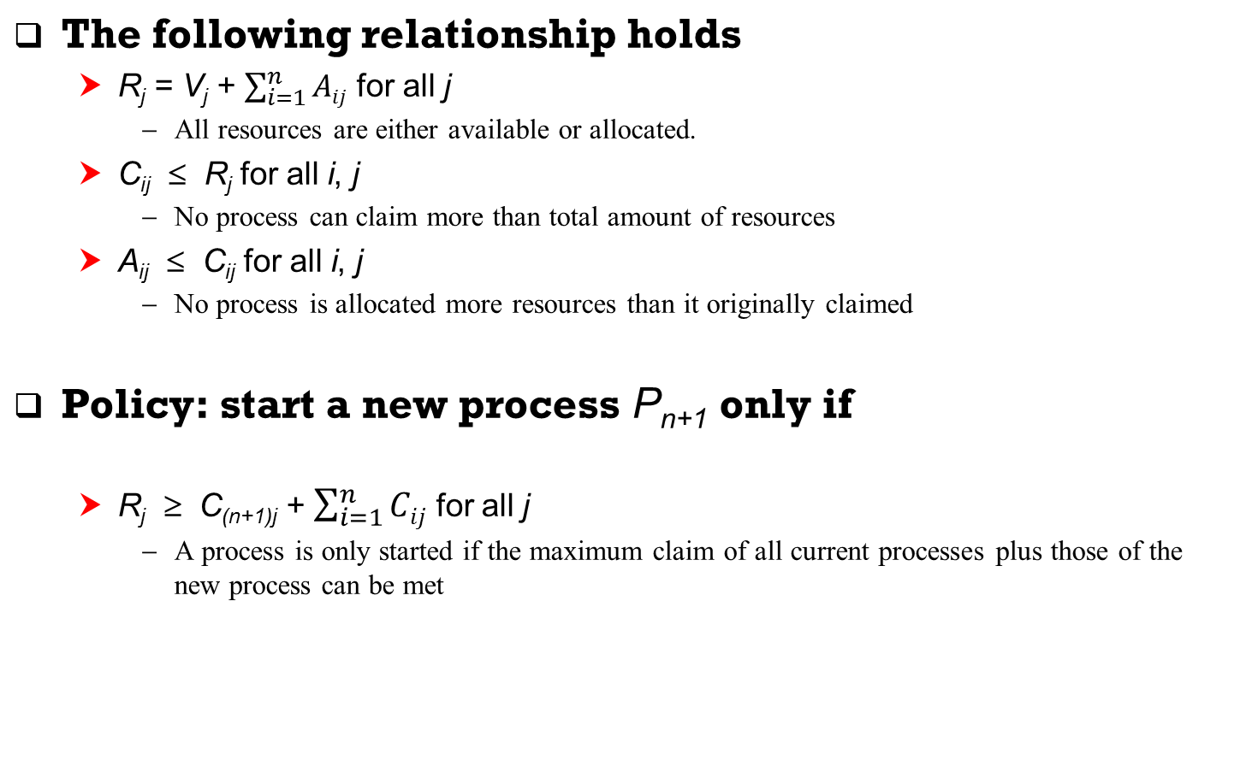
Process Initiation Denial

Slide 16
Resource Allocation Denial
Referred to as the banker’s algorithm
  State of the system reflects the current allocation of resources to processes
  Safe state is one in which there is at least one sequence of resource allocations to processes that does not result in a deadlock
  Unsafe state is a state that is not safe

Slide 17
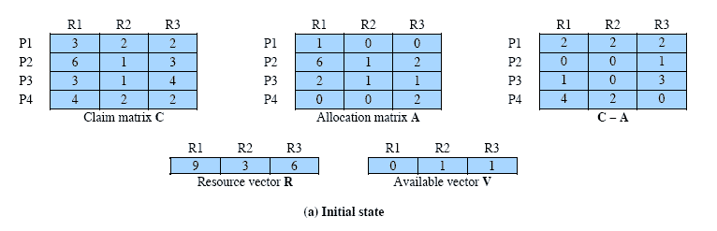
Determination of a Safe State
System state consists of 4 processes and 3 resources
Is this a safe state?
  Can any of 4 processes run to completion?
    P2 can run to completion!
Source: Pearson
Notes:
Animation: Callouts explain resource parts of figure
The following example illustrates these concepts. Figure 6.7a shows the state of a system consisting of four processes and three resources. The total amount of resources R1, R2, and R3 are 9, 3, and 6 units, respectively. In the current state allocations have been made to the four processes, leaving 1 unit of R2 and 1 unit of R3 available. Is this a safe state? To answer this question, we ask an intermediate question: Can any of the four processes be run to completion with the resources available? That is, can the difference between the maximum requirement and current allocation for any process be met with the available resources? In terms of the matrices and vectors introduced earlier, the condition to be met
for process i is:
Cij - Aij … Vj, for all j

Slide 18
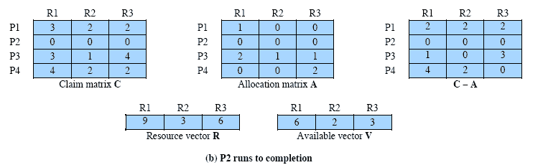
P2 Runs to Completion
After P2 completes, P2 releases its resources
Then, we can run any of P1, P3, or P4
Assume we select P1
Source: Pearson

Slide 19
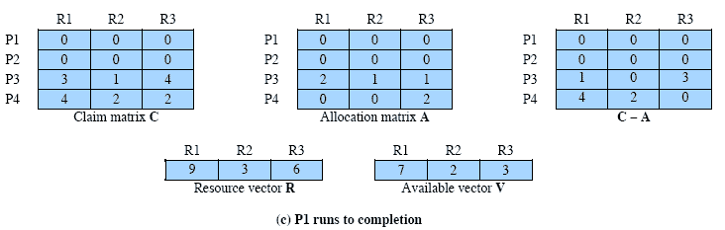
P1 Runs to Completion
Source: Pearson
Notes:
Suppose we choose P1, allocate the required resources, complete P1, and return all of P1’s resources to the available pool. We are left in the state shown in Figure 6.7c .

Slide 20
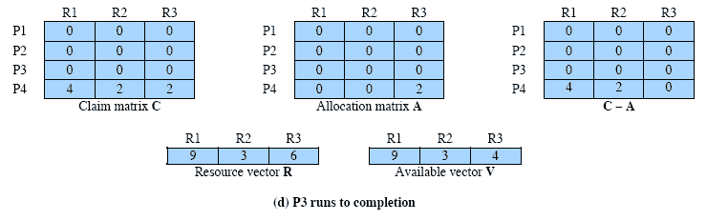
P3 Runs to Completion
Source: Pearson
Notes:
Next, we can complete P3, resulting in the state of Figure 6.7d . Finally, we can complete P4. At this point, all of the processes have been run to completion. Thus, the state defined by Figure 6.7a is a safe state.
These concepts suggest the following deadlock avoidance strategy, which ensures that the system of processes and resources is always in a safe state. When a process makes a request for a set of resources, assume that the request is granted, update the system state accordingly, and then determine if the result is a safe state. If so, grant the request and, if not, block the process until it is safe to grant the request.

Slide 21
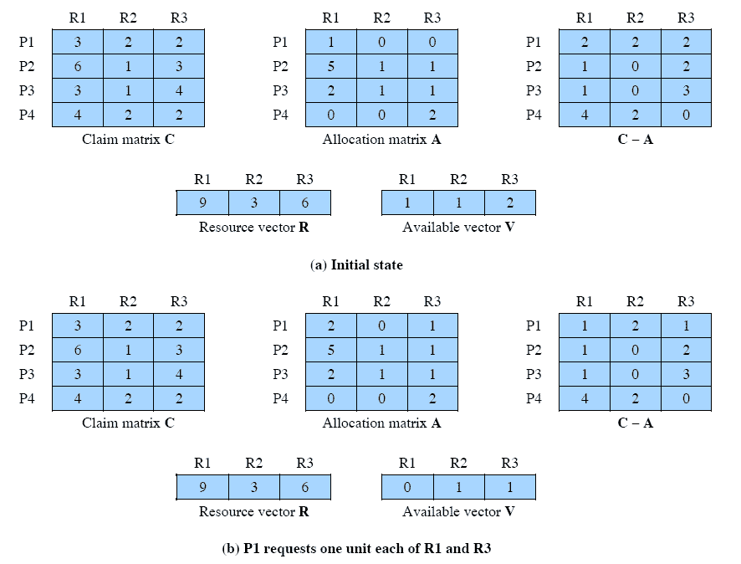
Determination of an Unsafe State
Is this a safe state?
Source: Pearson
Notes:
Consider the state defined in Figure 6.8a . Suppose P2 makes a request for one additional unit of R1 and one additional unit of R3. If we assume the request is granted, then the resulting state is that of Figure 6.7a . We have already seen that this is a safe state; therefore, it is safe to grant the request. Now let us return to the state of Figure 6.8a and suppose that P1 makes the request for one additional unit each of R1 and R3; if we assume that the request is granted, we are left in the state of Figure 6.8b . Is this a safe state? The answer is no, because each process will need at least one additional unit of R1, and there are none available. Thus, on the basis of deadlock avoidance, the request by P1 should be denied and P1 should be blocked.
It is important to point out that Figure 6.8b is not a deadlocked state. It merely has the potential for deadlock. It is possible, for example, that if P1 were run from this state it would subsequently release one unit of R1 and one unit of R3 prior to needing these resources again. If that happened, the system would return to a safe state. Thus, the deadlock avoidance strategy does not predict deadlock with certainty; it merely anticipates the possibility of deadlock and assures that there is never such a possibility.

Slide 22
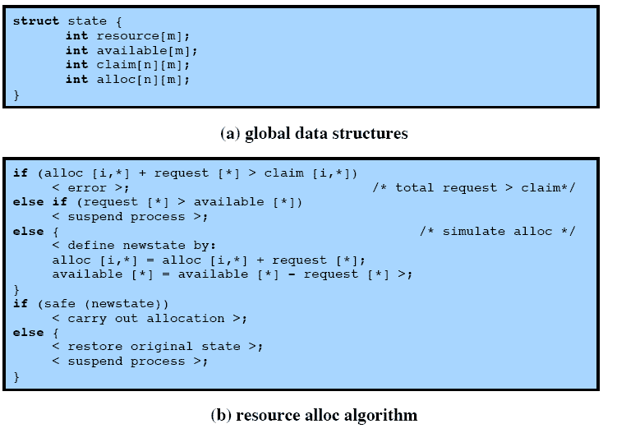
Deadlock Avoidance Logic
Source: Pearson
Notes:
Figure 6.9 gives an abstract version of the deadlock avoidance logic. The main algorithm is shown in part (b). With the state of the system defined by the data structure state , request[*] is a vector defining the resources requested by process i . First, a check is made to assure that the request does not exceed the original claim of the process. If the request is valid, the next step is to determine if it is possible to fulfill the request (i.e., there are sufficient resources available). If it is not possible, then the process is suspended. If it is possible, the final step is to
determine if it is safe to fulfill the request. To do this, the resources are tentatively assigned to process i to form newstate .

Slide 23
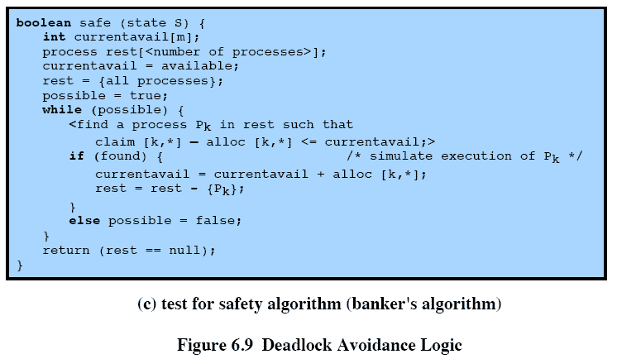
Deadlock Avoidance Logic
Source: Pearson
Notes:
Then a test for safety is made using the algorithm in Figure 6.9c.

Slide 24
Deadlock Detection
Deadlock prevention is very conservative
  Limit access to resources by imposing restrictions on processes
Deadlock detection does the opposite
  Resource requests are granted whenever possible
A check for deadlock can be made
  As frequently as each resource request
    (+) Lead to early detection
    (+) Can employ a relatively simple detection algorithm because it is based on incremental changes to the system state
    (–) Consume considerable processor time
  Or less frequently depending on how likely it is for a deadlock to occur

Slide 25
Deadlock Detection Algorithm
Instead of Claim (C), a Request (Q) matrix is defined
  Q_{ij} represents the amount of resources of type j requested by process i
Initially, all processes are unmarked (deadlocked)
The algorithm proceeds by marking processes that are not deadlocked.
Then, the following steps are performed
  Mark each process that has a row of all zeros in the Allocation matrix
  Initialize a temporary vector W to equal the Available vector
  Find an index i such that process is currently unmarked and the i^{th} row of Q is less than or equal to W. If no such row is found, terminate the algorithm
  If such a row is found, mark process i and add the corresponding row of the allocation matrix to W. Return to step 3
A deadlock exists if and only if there are unmarked processes at the end of the algorithm

Slide 26
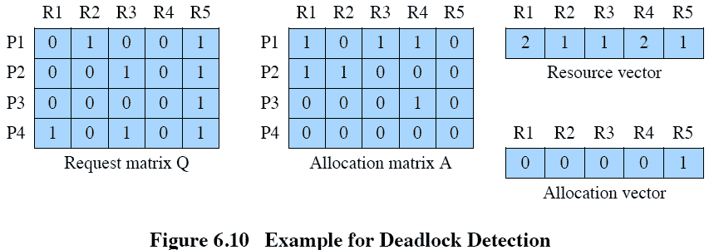
Deadlock Detection Algorithm
  Mark P4 because P4 has no allocated resources
  Set W = (0 0 0 0 1)
  The request of P3 is less than or equal to W, so mark P3 and set
    W = W + (0 0 0 1 0) = (0 0 0 1 1)
  No other unmarked process has a row in Q that is less than or equal to W. Therefore, terminate the algorithm. P1 and P2 are deadlocked!
Available
Source: Pearson

Slide 27
Deadlock Recovery
Recovery options in order of increasing sophistication
  Abort all deadlocked processes.
    The most common solution adopted by OS
  Backup each deadlocked process to a previous checkpoint and restart
    Require rollback and restart mechanism
    The original deadlock may recur
    However, the nondeterminism of concurrent processing may ensure that this does not happen
  Successively abort deadlocked process until deadlock no longer exists
    After each abortion, the detection algorithm must be re-invoked
  Successively preempt resources until deadlock no longer exists
    A process that has a resource preempted must be rolled back to a prior point before its acquisition of the resource

Slide 28
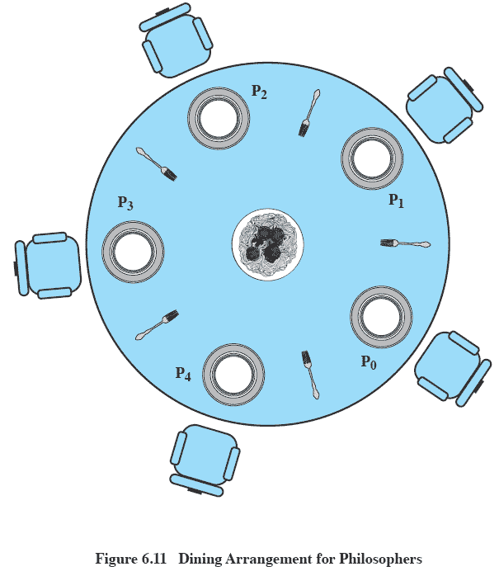
Dining Philosophers Problem
No two philosophers can use the same fork at the same time
  Mutual exclusion
No philosopher must starve to death
  Avoid starvation and deadlock
Source: Pearson
Notes:
We now turn to the dining philosophers problem, introduced by Dijkstra [DIJK71]. Five philosophers live in a house, where a table is laid for them. The life of each philosopher consists principally of thinking and eating, and through years of thought, all of the philosophers had agreed that the only food that contributed to their thinking efforts was spaghetti. Due to a lack of manual skill, each philosopher requires two forks to eat spaghetti.
The eating arrangements are simple ( Figure 6.11 ): a round table on which is set a large serving bowl of spaghetti, five plates, one for each philosopher, and five forks. A philosopher wishing to eat goes to his or her assigned place at the table and, using the two forks on either side of the plate, takes and eats some spaghetti. The problem: Devise a ritual (algorithm) that will allow the philosophers to eat. The algorithm must satisfy mutual exclusion (no two philosophers can use the same fork at the same time) while avoiding deadlock and starvation (in this case, the term has literal as well as algorithmic meaning!).
This problem may not seem important or relevant in itself. However, it does illustrate basic problems in deadlock and starvation. Furthermore, attempts to develop solutions reveal many of the difficulties in concurrent programming (e.g., see [GING90]). In addition, the dining philosophers problem can be seen as representative of problems dealing with the coordination of shared resources, which may occur when an application includes concurrent threads of execution. Accordingly, this problem is a standard test case for evaluating approaches to synchronization.
Possible solutions are on the following slides.

Slide 29
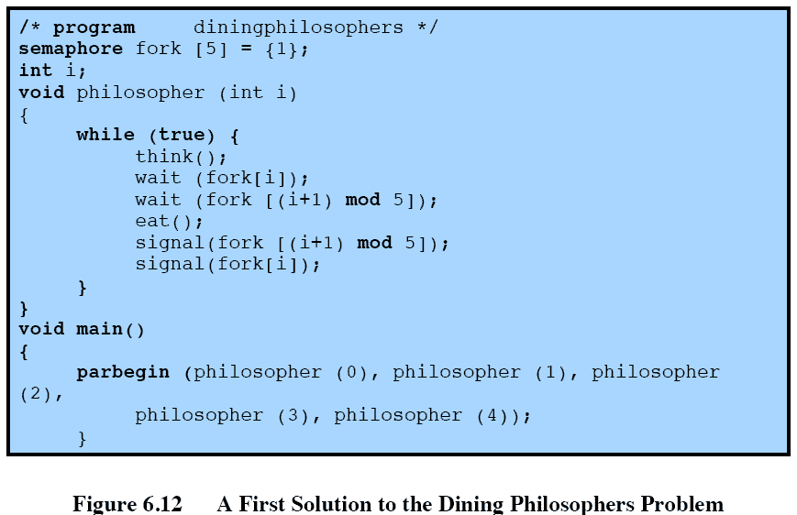
Solution I using Semaphore
Source: Pearson

Slide 30
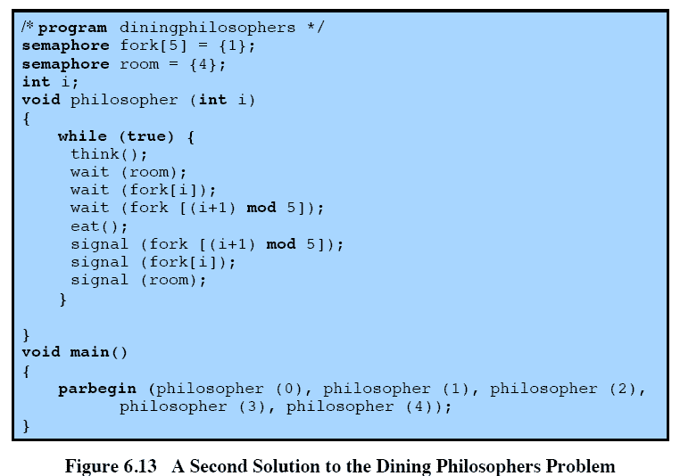
Solution II using Semaphore
Source: Pearson

Slide 31
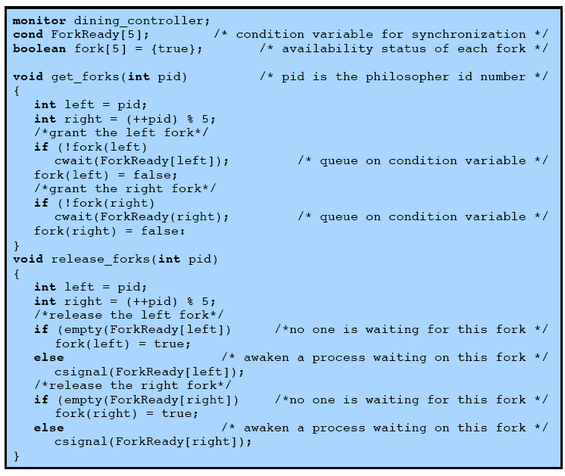

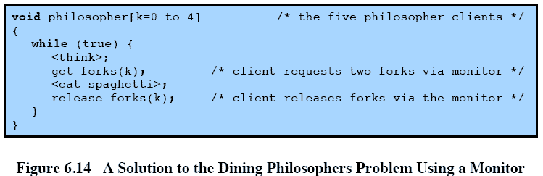
Source: Pearson
Notes:
Figure 6.14 shows a solution to the dining philosophers problem using a monitor. A vector of five condition variables is defined, one condition variable per fork. These condition variables are used to enable a philosopher to wait for the availability of a fork. In addition, there is a Boolean vector that records the availability status of each fork ( true means the fork is available). The monitor consists of two procedures. The get_forks procedure is used by a philosopher to seize his or her left and right forks. If either fork is unavailable, the philosopher process is queued on the appropriate condition variable. This enables another philosopher process to enter the monitor. The release-forks procedure is used to make two forks available. Note that the structure of this solution is similar to that of the semaphore solution proposed in Figure 6.12 . In both cases, a philosopher seizes first the left fork and then the right fork. Unlike the semaphore solution, this monitor solution does not suffer from deadlock, because only one process at a time may be in the monitor. For example, the first philosopher process to enter the monitor is guaranteed that it can pick up the right fork after it picks up the left fork before the next philosopher to the right has a chance to seize its left fork, which is this philosopher’s right fork.

Slide 32
UNIX Concurrency Mechanisms
UNIX provides a variety of mechanisms for interprocess communication and synchronization including:
  Pipes
    First-in-first-out queue, written by one process and read by another
    Implemented by a circular buffer, allowing two processes to communicate on the producer-consumer model
    Example: ls | more, ps | sort, etc.
  Messages
    UNIX provides msgsnd and msgrcv system calls for processes to engage in message passing
    A message is a block of bytes
    Each process is associated a message queue, which functions like a mailbox
Notes:
UNIX provides a variety of mechanisms for interprocessor communication and synchronization.
Here, we look at the most important of these:
• Pipes
• Messages
• Shared memory
• Semaphores
• Signals
Pipes, messages, and shared memory can be used to communicate data between
processes, whereas semaphores and signals are used to trigger actions by other
processes.

Slide 33
UNIX Concurrency Mechanisms
  Shared memory
    Common block of virtual memory shared by multiple processes
    Fastest form of interprocess communication
    Mutual exclusion is provided for each location in shared-memory
    A process may have read-only or read-write permission for a memory location
  Semaphores
    Generalization of the semWait and semSignal primitives defined in Chapter 5
    Increment and decrement operations can be greater than 1
      Thus, a single semaphore operation may involve incrementing/decrementing a semaphore and waking up/suspending processes.
      Provide considerable flexibility in process synchronization
Notes:
UNIX provides a variety of mechanisms for interprocessor communication and synchronization.
Here, we look at the most important of these:
• Pipes
• Messages
• Shared memory
• Semaphores
• Signals
Pipes, messages, and shared memory can be used to communicate data between
processes, whereas semaphores and signals are used to trigger actions by other
processes.

Slide 34
UNIX Concurrency Mechanisms
  Signals
    A software mechanism that informs a process of the occurrence of asynchronous events (similar to a hardware interrupt)
    Sending a signal
      Kernel sends (delivers) a signal to a destination process by updating some state in the context of the destination process.
      Kernel sends a signal for one of the following reasons:
        Kernel has detected a system event such as divide-by-zero (SIGFPE) or the termination of a child process (SIGCHLD)
        Another process has invoked the kill system call to explicitly request the kernel to send a signal to the destination process.
    Receiving a signal
      A destination process receives a signal when it is forced by the kernel to react in some way to the delivery of the signal.
      Two possible ways to react:
        Default action (ignore, terminate the process, terminate & dump)
        Catch the signal by executing a user-level function called a signal handler.
      Akin to a hardware exception handler being called in response to an asynchronous interrupt.
Notes:
UNIX provides a variety of mechanisms for interprocessor communication and synchronization.
Here, we look at the most important of these:
• Pipes
• Messages
• Shared memory
• Semaphores
• Signals
Pipes, messages, and shared memory can be used to communicate data between
processes, whereas semaphores and signals are used to trigger actions by other
processes.

Slide 35
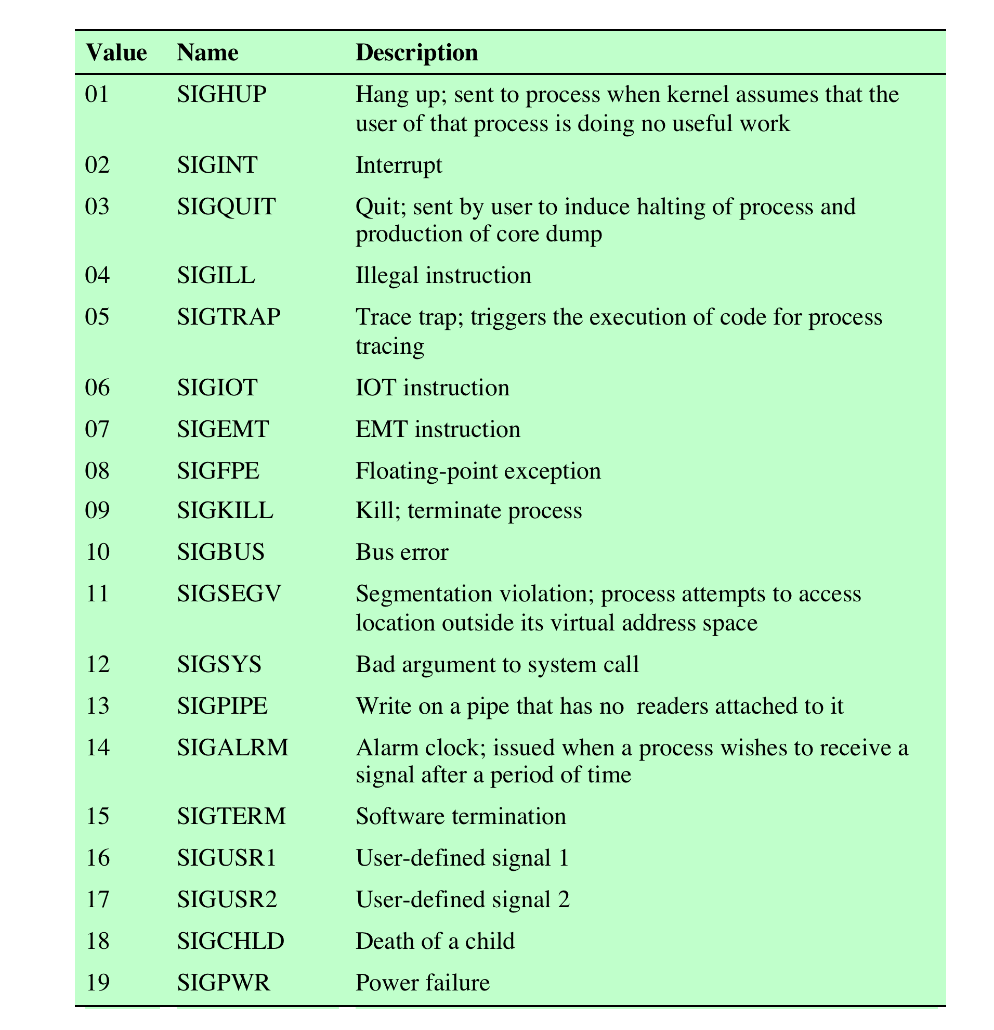
UNIX Signals
Source: Pearson
Notes:
Table 6.2 lists signals defined for UNIX SVR4.

Slide 36
Signal Concepts (cont)
A signal is pending if it has been sent but not yet received.
  There can be at most one pending signal of any particular type.
  Important: Signals are not queued
    If a process has a pending signal of type k, then subsequent signals of type k that are sent to that process are discarded.
A process can block the receipt of certain signals.
  Blocked signals can be delivered, but will not be received until the signal is unblocked.
Kernel maintains pending and blocked bit vectors in the context of each process.
  pending – represents the set of pending signals
    Kernel sets bit k in pending whenever a signal of type k is delivered.
    Kernel clears bit k in pending whenever a signal of type k is received
  blocked – represents the set of blocked signals
    Can be set and cleared by the application using the sigprocmask function.

Slide 37
Receiving Signals
Suppose kernel is returning from exception handler and is ready to pass control to process p.
Kernel computes pnb = pending & ~blocked
  The set of pending nonblocked signals for process p
If (pnb == 0)
  Pass control to next instruction in the logical flow for p.
Else
  Choose least nonzero bit k in pnb and force process p to receive signal k.
  The receipt of the signal triggers some action by p
  Repeat for all nonzero k in pnb.
  Pass control to next instruction in logical flow for p.

Slide 38
Installing Signal Handlers
The signal function modifies the default action associated with the receipt of signal signum:
  handler_t *signal(int signum, handler_t *handler)
Different values for handler:
  SIG_IGN: ignore signals of type signum
  SIG_DFL: revert to the default action on receipt of signals of type signum.
  Otherwise, handler is the address of a user-defined function called signal handler
    Called when process receives signal of type signum
    Changing the default action by passing the address of a handler to the signal function is known as “installing” the handler.
    The invocation of the handler is called “catching” the signal
    The execution of the handler is referred as “handling” the signal.
    When the handler executes its return statement, control passes back to instruction in the control flow of the process that was interrupted by receipt of the signal.

Slide 39
Signal Handling Example
#include "csapp.h"
void handler(int sig) {
static int beeps = 0;
printf("BEEP\n");
if (++beeps < 5) Alarm(1); /* next SIGALRM will be delivered in 1s */
else {
printf("BOOM!\n");
exit(0);
}
}
int main() {
Signal(SIGALRM, handler); /* install SIGALRM handler */
Alarm(1); /* next SIGALRM will be delivered in 1s */
while (1) { ; /* signal handler returns control here each time */ }
exit(0);
}
linux> ./alarm
BEEP
BEEP
BEEP
BEEP
BEEP
BOOM!
linux>
Source: Pearson

Slide 40
Homework 5
Exercise 6.2
Exercise 6.5
Exercise 6.7
Exercise 6.11
Exercise 6.14
Exercise 6.18

