Slide 1
Operating System
Chapter 8. Virtual Memory
Lynn Choi
School of Electrical Engineering

Slide 2
Memory Hierarchy
Motivated by
  Principles of Locality
  Speed vs. size vs. cost tradeoff
Locality principle
  Spatial Locality: nearby references are likely to occur soon
    Example: arrays, program codes
    Access a block of contiguous words
  Temporal Locality: the same reference is likely to occur soon
    Example: loops, reuse of variables
    Keep recently accessed data to closer to the processor
Speed vs. Size tradeoff
  Bigger memory is slower: SRAM - DRAM - Disk - Tape
  Fast memory is more expensive

Slide 3
Levels of Memory Hierarchy
Capacity/Access Time
Moved By
Faster/Smaller
100-KBs
Registers
Instruction
Operands
Programmer/Compiler
1- 16B
KBs-MBs
Cache
H/W
16 - 512B
Cache Line
MBs-GBs
Main Memory
OS
512B – 256MB
Page
100GBs
Disk
User
any size
File
Infinite
Network/Cloud
Slower/Larger

Slide 4
Cache
A small but fast memory located between processor and main memory
Benefits
  Reduce load latency
  Reduce store latency
  Reduce bus traffic (on-chip caches)
Cache Block Allocation (When to place)
  On a read miss
  On a write miss
    Write-allocate vs. no-write-allocate
Cache Block Placement (Where to place)
  Fully-associative cache
  Direct-mapped cache
  Set-associative cache

Slide 5
Fully Associative Cache
32b Word, 4 Word Cache Block
Physical Address Space
32 bit PA = 4GB (DRAM)
A memory block can be placed into
any cache block location!
0
32KB cache (SRAM)
0
Memory Block
Cache Block
(Cache Line)
2¹¹-1
2²⁸-1

Slide 6
Fully Associative Cache
TAG RAM
V
32KB DATA RAM
=
0
0
31
3 0
tag
offset
Yes
=
=
=
2¹¹-1
2¹¹-1
Data out
Word & Byte select
Data to CPU
Advantages Disadvantages
1. High hit rate 1. Very expensive
2. Fast
Cache Hit

Slide 7
Direct Mapped Cache
Physical Address Space
32 bit PA = 4GB (DRAM)
A memory block can be placed into
only a single cache block!
0
32KB cache (SRAM)
0
2¹¹
Memory Block
…..
2*2¹¹
2¹¹-1
(2¹⁷-1)*2¹¹
2²⁸-1

Slide 8
Direct Mapped Cache
TAG RAM
V
32KB DATA RAM
14
4
0
0
31
3 0
tag
index
offset
decoder
2¹¹-1
2¹¹-1
Data out
=
Yes
Word &
Byte select
Data to CPU
Disadvantages Advantages
1. Low hit rate 1. Simple HW
2. Fast Implementation
Cache Hit

Slide 9
Set Associative Cache
In an M-way set associative cache,
A memory block can be placed into
M cache blocks!
0
32KB cache (SRAM)
2¹⁰
Memory Block
0
Way 0
2¹⁰ sets
2¹⁰-1
2*2¹⁰
2¹⁰
Way 1
2¹⁰ sets
2¹¹-1
(2¹⁸-1)*2¹⁰
2²⁸-1

Slide 10
Set Associative Cache
TAG RAM
V
32KB DATA RAM
13
4
0
0
31
3 0
tag
index
offset
decoder
2¹⁰-1
2¹⁰-1
Data out
=
=
Yes
Word &
Byte select
Wmux
Data to CPU
Most caches are implemented as
set-associative caches!
Cache Hit

Slide 11
Cache Block Replacement
Random
  Just pick one and replace it
  Pseudo-random: use simple hash algorithm using address
LRU (least recently used)
  need to keep timestamp
  expensive due to global compare
  Pseudo-LRU: use LFU using bit tags
Replacement policy critical for small caches

Slide 12
3+1 Types of Cache Misses
Cold-start misses (or compulsory misses): the first access to a block is always not in the cache
  Misses even in an infinite cache
Capacity misses: if the memory blocks needed by a program is bigger than the cache size, then capacity misses will occur due to cache block replacement.
  Misses even in fully associative cache
Conflict misses (or collision misses): for direct-mapped or set-associative cache, too many blocks can be mapped to the same set.
Invalidation misses (or sharing misses): cache blocks can be invalidated due to coherence traffic

Slide 13
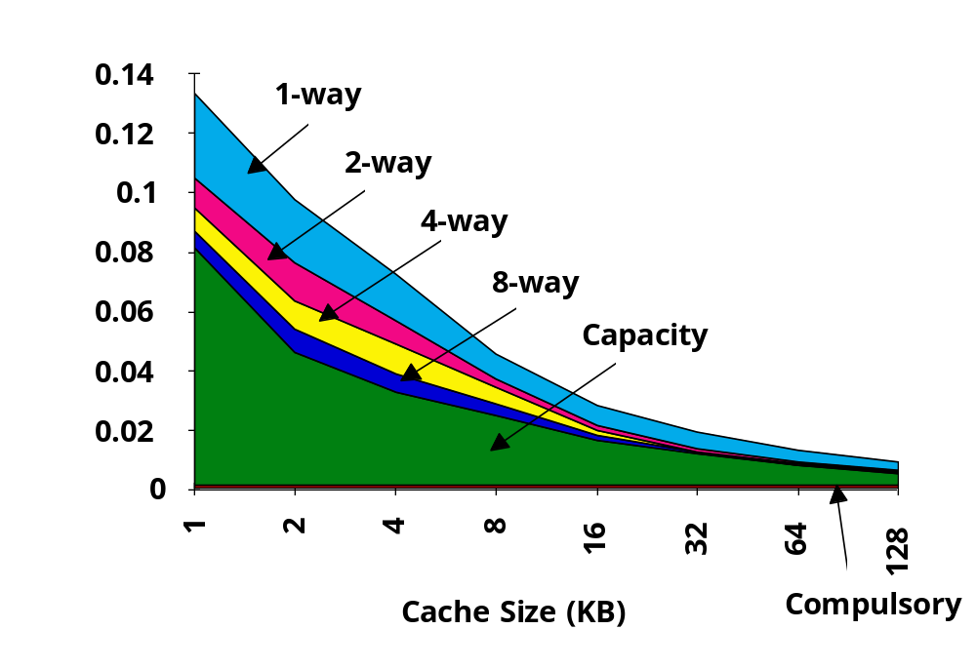
Miss Rates (SPEC92)
Source: Elsevier

Slide 14
Virtual Memory
Virtual memory
  Programmer’s view of memory
  Each process has its own virtual memory
  A linear array of bytes addressed by the virtual address
Physical memory
  Machine’s physical memory (DRAM)
    Caches are parts of physical memory
  Also, called main memory
Virtual address
  The address of a program
Physical address
  The address of a DRAM

Slide 15
Virtual Memory
Functions
  Large address space
    Easy to program
    Provide the illusion of infinite amount of memory
    Program (including both code and data) can exceed the main memory capacity
    Processes partially resident in memory
  Protection
    Access rights: read/modify/execute permission
      Each segment/page has its own access rights
    Privilege level
  Sharing
  Portability
  Increased CPU utilization
    More programs can run at the same time

Slide 16
Virtual Memory
Require the following functions
  Memory allocation (Placement)
    Any virtual page can be placed in any page frame
  Memory deallocation (Replacement)
    LRU, Clock algorithm
  Memory mapping (Translation)
    Virtual address must be translated to physical address to access main memory and caches
Memory management
  Automatic movement of data between main memory and secondary storage
    Done by operating system with the help of processor HW
    Main memory contains only the most frequently used portions of a process’s address space
  Illusion of infinite memory (size of secondary storage) but access time is equal to main memory
  Usually use demand paging
    Bring a page on demand

Slide 17
Paging
Divide address space into fixed size pages
  VA consists of (VPN, offset)
  PA consists of (PPN, offset)
Map a virtual page to a physical page frame at runtime
Each process has its own page table
  The page table contains mapping between VPN and PPN
  VPN is used as an index into the page table
Page table entry (PTE) contains
  PPN (Physical Page Number or Frame Number)
  Presence bit – 1 if this page is in main memory
  Modified bit – 1 if this page has been modified
  Reference bits – reference statistics info used for page replacement
  Access control – read/write/execute permissions
  Privilege level – user-level page versus system-level page
  Disk address
Internal fragmentation

Slide 18
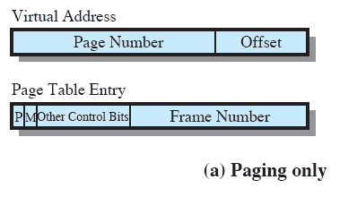
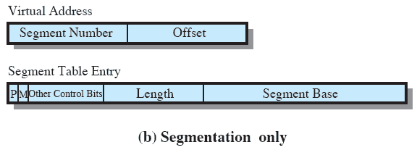
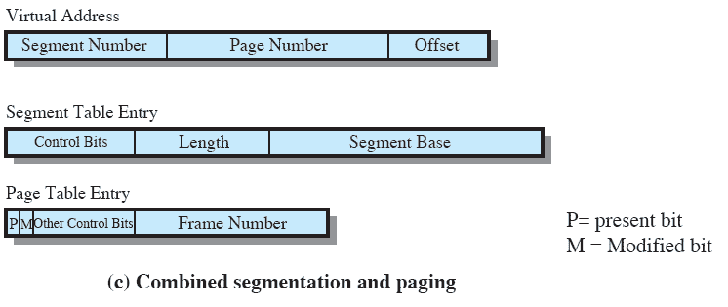
Virtual Address and PTE
Source: Pearson
Notes:
Again, it is typical to associate a unique page table with each process. In this case, however,
the page table entries become more complex ( Figure 8.2a ). Because only some of
the pages of a process may be in main memory, a bit is needed in each page table
entry to indicate whether the corresponding page is present (P) in main memory or
not. If the bit indicates that the page is in memory, then the entry also includes the
frame number of that page.
The page table entry includes a modify (M) bit, indicating whether the contents
of the corresponding page have been altered since the page was last loaded
into main memory. If there has been no change, then it is not necessary to write the
page out when it comes time to replace the page in the frame that it currently occupies.
Other control bits may also be present. For example, if protection or sharing is
managed at the page level, then bits for that purpose will be required.

Slide 19
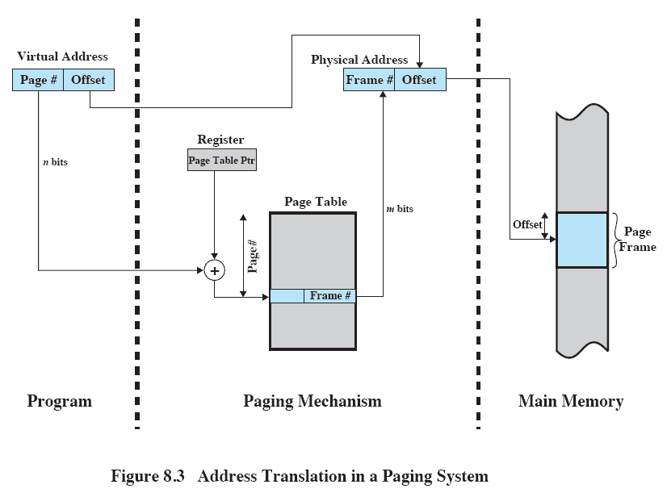
Virtual to Physical Address Translation
Source: Pearson
Notes:
PAGE TABLE STRUCTURE The basic mechanism for reading a word from memory
involves the translation of a virtual, or logical, address, consisting of page number
and offset, into a physical address, consisting of frame number and offset, using a
page table. Because the page table is of variable length, depending on the size of the
process, we cannot expect to hold it in registers. Instead, it must be in main memory
to be accessed. Figure 8.3 suggests a hardware implementation. When a particular
process is running, a register holds the starting address of the page table for that
process. The page number of a virtual address is used to index that table and look
up the corresponding frame number. This is combined with the offset portion of the
virtual address to produce the desired real address. Typically, the page number field
is longer than the frame number field ( n m ).

Slide 20
Paging
Page table organization
  Linear: one PTE per virtual page
  Hierarchical: tree structured page table
    Page table itself can be paged due to its size
      For example, 32b VA, 4KB page, 16B PTE requires 16MB page table
    Page directory tables
      PTE contains descriptor (i.e. index) for page table pages
    Page tables - only leaf nodes
      PTE contains descriptor for page
  Inverted: PTEs for only pages in main memory
  Page table entries are dynamically allocated as needed

Slide 21
Multi-Level Page Tables
Given:
  4KB (2¹²) page size
  32-bit address space
  4-byte PTE
Problem:
  Would need a 4 MB page table!
    2²⁰ *4 bytes
Common solution
  multi-level page tables
  e.g., 2-level table (P6)
    Level 1 table: 1024 entries, each of which has a translation entry for Level 2 page table page.
      This is called page directory
    Level 2 table: 1024 entries, each of which has a translation entry for a page
Level 2
Tables
Level 1
Table
...

Slide 22
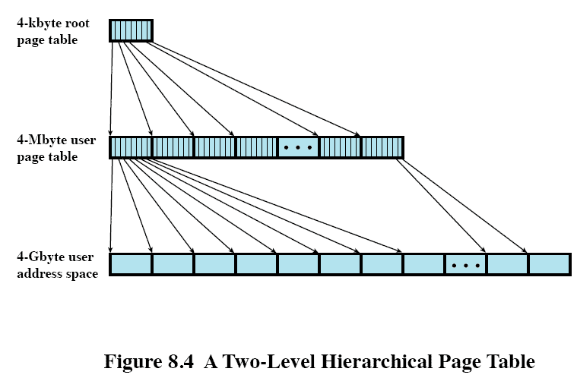
Two-Level Hierarchical Page Table
Source: Pearson
Notes:
Figure 8.4 shows an example of a two-level scheme typical for use with a
32-bit address. If we assume byte-level addressing and 4-kbyte (2 12 ) pages, then the
4-Gbyte (2 32 ) virtual address space is composed of 2 20 pages. If each of these pages
is mapped by a 4-byte page table entry, we can create a user page table composed of
2 20 PTEs requiring 4 Mbytes (2 22 ). This huge user page table, occupying 2 10 pages,
can be kept in virtual memory and mapped by a root page table with 2 10 PTEs occupying
4 Kbyte (2 12 ) of main memory.

Slide 23

PTEs for only pages in main memory
VPN is mapped into a hash value, which points to an inverted page table entry
  Fixed proportion of physical memory is required for the page tables regardless of the number of processes
Notes:
INVERTED PAGE TABLE A drawback of the type of page tables that we have been
discussing is that their size is proportional to that of the virtual address space.
An alternative approach to the use of one or multiple-level page tables is the
use of an inverted page table structure. Variations on this approach are used on
the PowerPC, UltraSPARC, and the IA-64 architecture. An implementation of the
Mach operating system on the RT-PC also uses this technique.
In this approach, the page number portion of a virtual address is mapped into a
hash value using a simple hashing function. 1 The hash value is a pointer to the inverted
page table, which contains the page table entries. There is one entry in the inverted
page table for each real memory page frame rather than one per virtual page. Thus,
a fixed proportion of real memory is required for the tables regardless of the number
of processes or virtual pages supported. Because more than one virtual address may
map into the same hash table entry, a chaining technique is used for managing the
overflow. The hashing technique results in chains that are typically short—between
one and two entries. The page table’s structure is called inverted because it indexes
page table entries by frame number rather than by virtual page number.

Slide 24

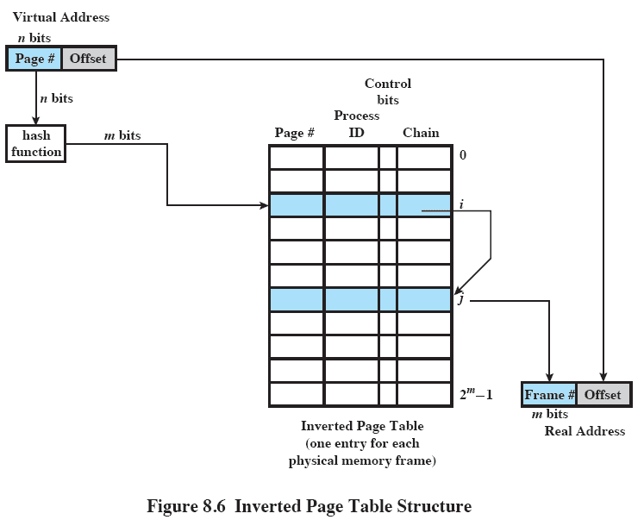
Source: Pearson
Notes:
Figure 8.6 shows a typical implementation of the inverted page table approach.
For a physical memory size of 2 m frames, the inverted page table contains 2 m entries,
so that the i th entry refers to frame i .
In this example, the virtual address includes an n -bit page number, with n > m .
The hash function maps the n -bit page number into an m -bit quantity, which is used
to index into the inverted page table.

Slide 25
TLB
TLB (Translation Lookaside Buffer)
  Cache of page table entries (PTEs)
  On TLB hit, can do virtual to physical translation without accessing the page table
  On TLB miss, must search the page table for the missing entry
TLB configuration
  ~100 entries, usually fully associative cache
  Often multi-level TLBs
    usually separate I-TLB and D-TLB at the 1st level, accessed every cycle
    Unified TLB at the second level
  Miss handling
    On a TLB miss, exception handler (with the help of operating system) search page table for the missed TLB entry and insert it into TLB
      Software managed TLBs - TLB insert/delete instructions
      Flexible but slow: TLB miss handler ~ 100 instructions
    Sometimes, to accelerate the TLB miss handling, HW page walker can be employed

Slide 26
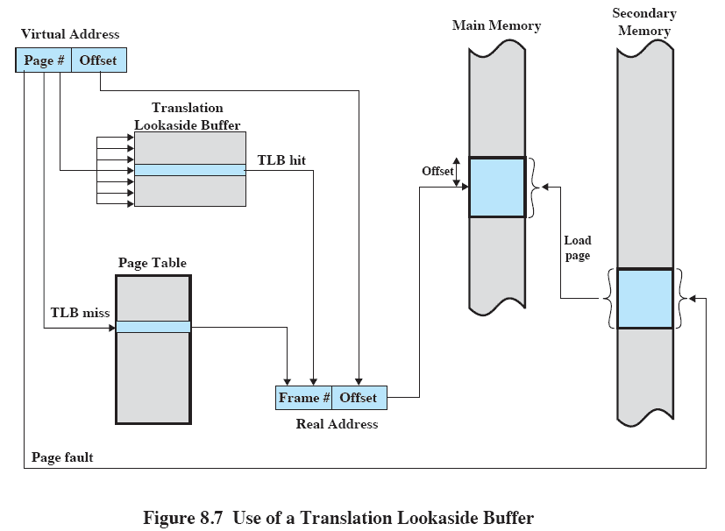

Source: Pearson
Notes:
The organization of
the resulting paging hardware is illustrated in Figure 8.7 . Given a virtual address,
the processor will first examine the TLB. If the desired page table entry is present
( TLB hit ), then the frame number is retrieved and the real address is formed. If the
desired page table entry is not found ( TLB miss ), then the processor uses the page
number to index the process page table and examine the corresponding page table
entry. If the “present bit” is set, then the page is in main memory, and the processor
can retrieve the frame number from the page table entry to form the real address.
The processor also updates the TLB to include this new page table entry. Finally,
if the present bit is not set, then the desired page is not in main memory and a
memory access fault, called a page fault , is issued. At this point, we leave the realm
of hardware and invoke the operating system, which loads the needed page and
updates the page table.

Slide 27

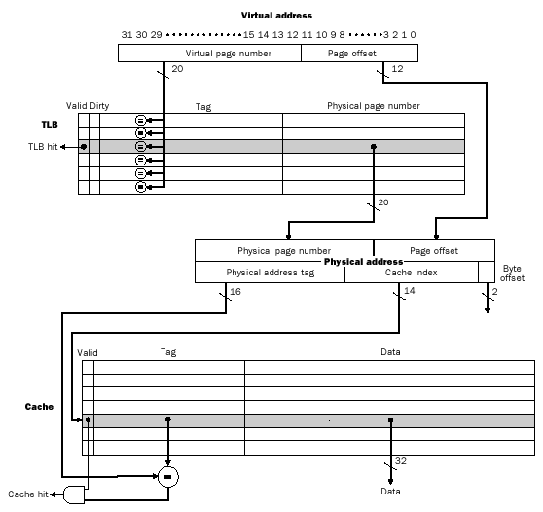
Source: Morgan Kaufmann

Slide 28

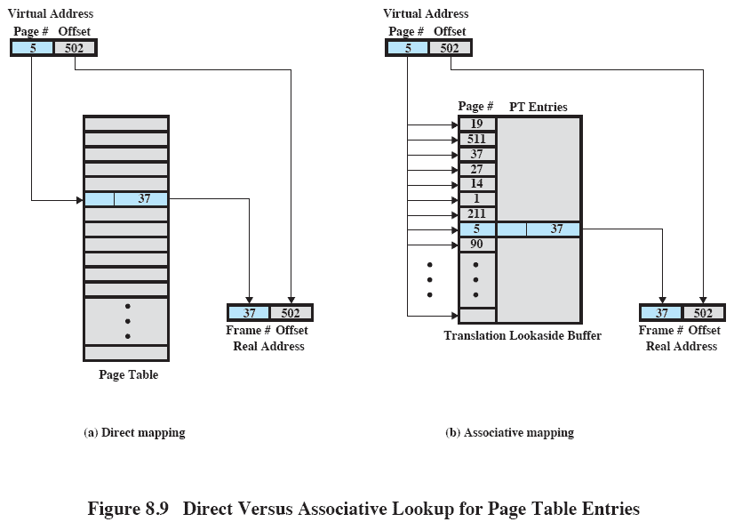
Source: Pearson
Notes:
Figure 8.9 Direct Versus Associative Lookup for Page Table Entries
This slide contrasts associative mapping with direct mapping or indexing, used for lookup in the page table.
The design of the TLB also must consider the way in which entries are organized in the TLB and which entry to replace when a new entry is brought in.
These issues must be considered in any hardware cache design.

Slide 29
Virtual Memory Faults
Different virtual memory faults
  TLB miss - PTE not in TLB
  PTE miss - PTE not in main memory
    A kind of page miss
  Page miss - page not in main memory
  Access violation
  Privilege violation

Slide 30
Page Size
The smaller the page size, the lesser the amount of internal fragmentation
  However, more pages are required per process
  More pages per process means larger page tables
    For large programs, portion of the page tables of active processes must be in secondary storage instead of main memory
  The physical characteristics of most secondary-memory devices favor a larger page size for more efficient block transfer
Notes:
PAGE SIZE An important hardware design decision is the size of page to be used.
There are several factors to consider. One is internal fragmentation. Clearly, the
smaller the page size, the lesser is the amount of internal fragmentation. To optimize
the use of main memory, we would like to reduce internal fragmentation. On the
other hand, the smaller the page, the greater is the number of pages required per
process. More pages per process means larger page tables. For large programs in
a heavily multiprogrammed environment, this may mean that some portion of the
page tables of active processes must be in virtual memory, not in main memory.
Thus, there may be a double page fault for a single reference to memory: first to
bring in the needed portion of the page table and second to bring in the process page.
Another factor is that the physical characteristics of most secondary-memory devices,
which are rotational, favor a larger page size for more efficient block transfer of data.

Slide 31
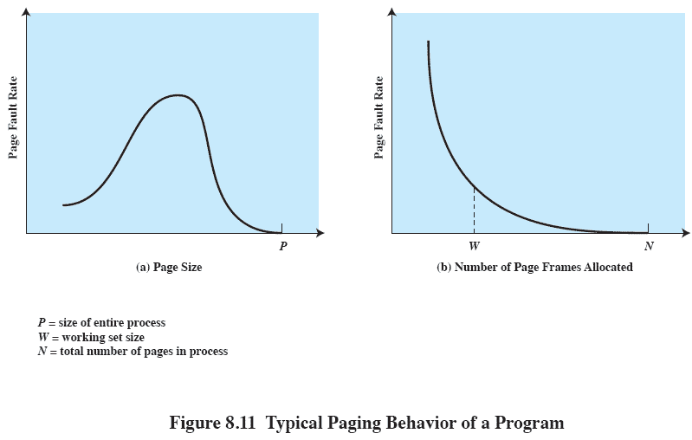
Paging Behavior of a Program
As page size increases, each page will contain locations further away from recent references, increasing the page fault rate, but the fault rate begin to fall as the page size approaches the size of the entire process
Source: Pearson
Notes:
Complicating these matters is the effect of page size on the rate at which page
faults occur. This behavior, in general terms, is depicted in Figure 8.11a and is based
on the principle of locality. If the page size is very small, then ordinarily a relatively
large number of pages will be available in main memory for a process. After a time,
the pages in memory will all contain portions of the process near recent references.
Thus, the page fault rate should be low. As the size of the page is increased, each
individual page will contain locations further and further from any particular recent
reference. Thus the effect of the principle of locality is weakened and the page fault
rate begins to rise. Eventually, however, the page fault rate will begin to fall as the
size of a page approaches the size of the entire process (point P in the diagram).
When a single page encompasses the entire process, there will be no page faults.
A further complication is that the page fault rate is also determined by the
number of frames allocated to a process. Figure 8.11b shows that, for a fixed page
size, the fault rate drops as the number of pages maintained in main memory grows. 3
Thus, a software policy (the amount of memory to allocate to each process) interacts
with a hardware design decision (page size).

Slide 32
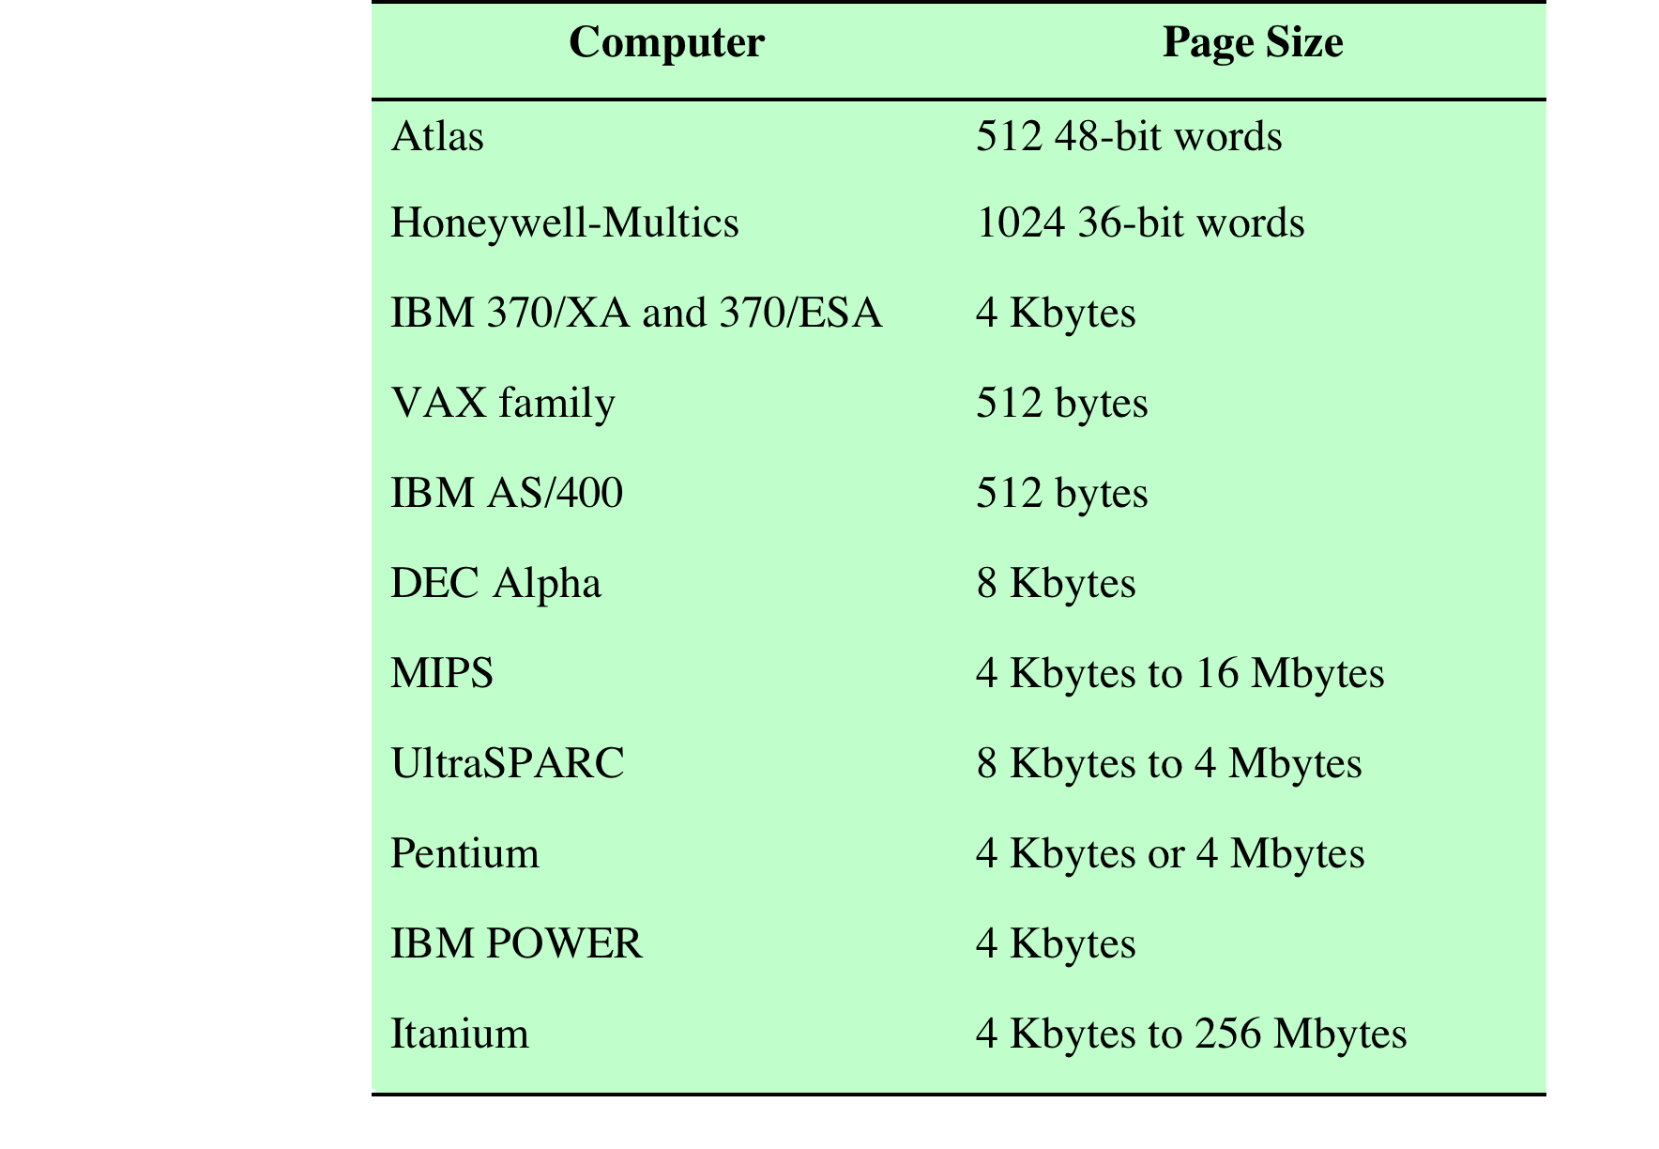
Example: Page Sizes
Source: Pearson
Notes:
Table 8.3 lists the page sizes used on some machines.

Slide 33
Segment Organization
Segmentation allows a programmer to view a virtual memory as a collection of segments
Advantages
  Simplify the handling of growing data structures
  Facilitate sharing among processes
Segment table entry contains
  Base address of the corresponding segment in main memory
  Length of the segment
  Presence bit – 1 if this segment is in main memory
  Modified bit – 1 if this segment has been modified
Notes:
ORGANIZATION In the discussion of simple segmentation, we indicated that each
process has its own segment table, and when all of its segments are loaded into main
memory, the segment table for a process is created and loaded into main memory.
Each segment table entry contains the starting address of the corresponding segment
in main memory, as well as the length of the segment. The same device, a segment
table, is needed when we consider a virtual memory scheme based on segmentation.
Again, it is typical to associate a unique segment table with each process. In this
case, however, the segment table entries become more complex ( Figure 8.2b ).
Because only some of the segments of a process may be in main memory, a bit is
needed in each segment table entry to indicate whether the corresponding segment
is present in main memory or not. If the bit indicates that the segment is in memory,
then the entry also includes the starting address and length of that segment.
Another control bit in the segmentation table entry is a modify bit, indicating
whether the contents of the corresponding segment have been altered since the segment
was last loaded into main memory. If there has been no change, then it is not
necessary to write the segment out when it comes time to replace the segment in the
frame that it currently occupies. Other control bits may also be present. For example,
if protection or sharing is managed at the segment level, then bits for that purpose
will be required.

Slide 34
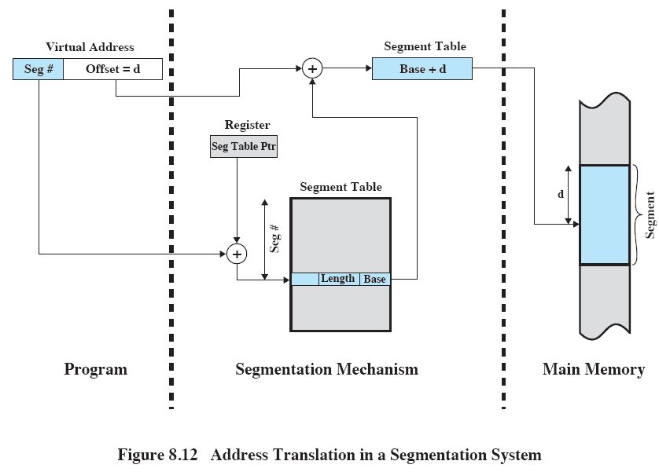
Address Translation
Source: Pearson
Notes:
The basic mechanism for reading a word from memory involves the translation
of a virtual, or logical, address, consisting of segment number and offset, into a physical
address, using a segment table. Because the segment table is of variable length,
depending on the size of the process, we cannot expect to hold it in registers. Instead,
it must be in main memory to be accessed. Figure 8.12 suggests a hardware implementation
of this scheme (note similarity to Figure 8.3 ). When a particular process
is running, a register holds the starting address of the segment table for that process.
The segment number of a virtual address is used to index that table and look up the
corresponding main memory address for the start of the segment. This is added to
the offset portion of the virtual address to produce the desired real address.

Slide 35
Paged Segmentation
Virtual address space is broken up into a number of segments. Each segment is broken up into a number of fixed-sized pages.
Source: Pearson

Slide 36
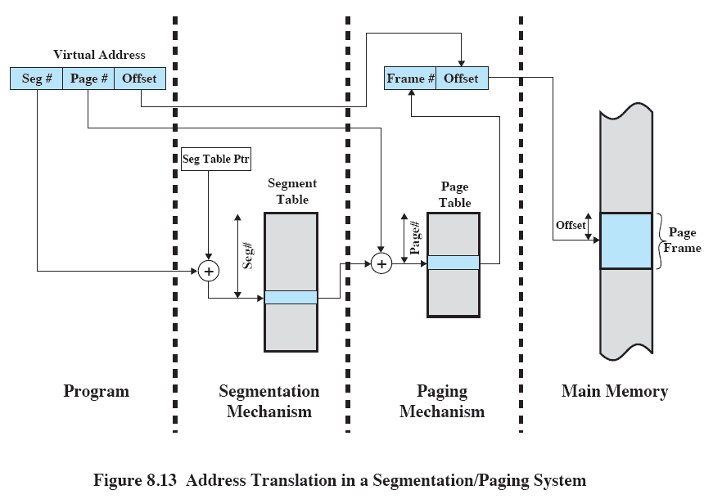
Address Translation
Source: Pearson
Notes:
Figure 8.13 suggests a structure to support combined paging/segmentation
(note similarity to Figure 8.5 ). Associated with each process is a segment table and
a number of page tables, one per process segment. When a particular process is
running, a register holds the starting address of the segment table for that process.
Presented with a virtual address, the processor uses the segment number portion to
index into the process segment table to find the page table for that segment. Then
the page number portion of the virtual address is used to index the page table and
look up the corresponding frame number. This is combined with the offset portion
of the virtual address to produce the desired real address.

Slide 37
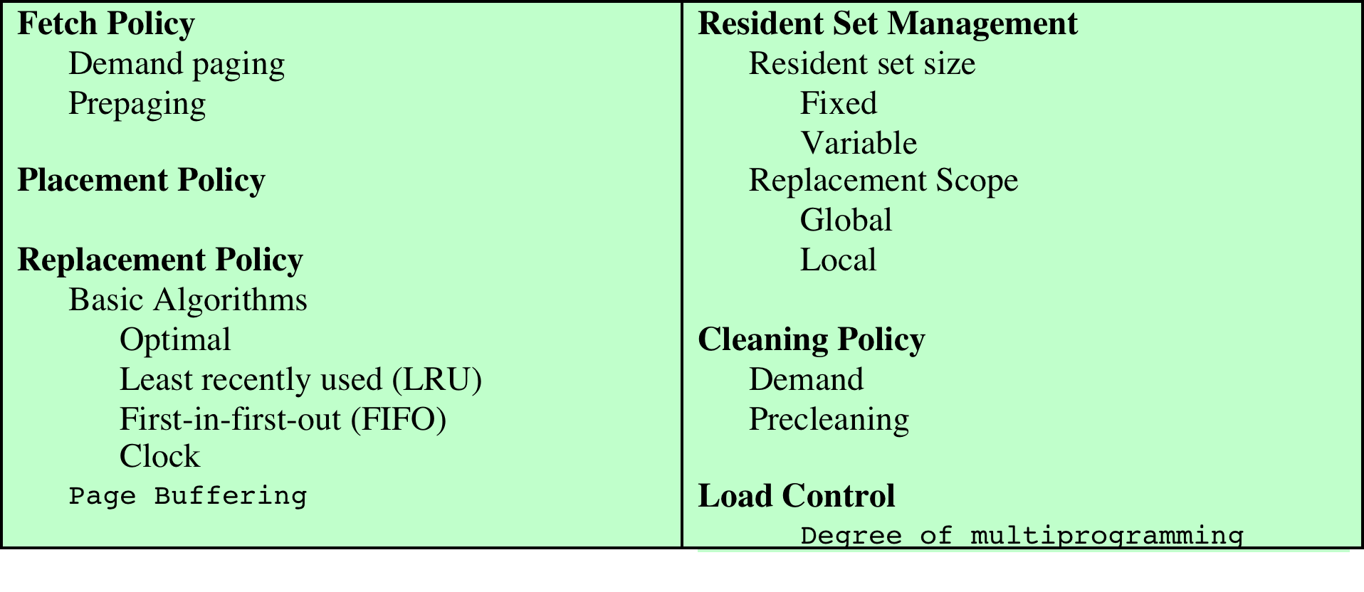
Virtual Memory Policies
Key issues: Performance
  Minimize page faults
Source: Pearson

Slide 38

Demand Paging
  Bring a page into main memory only on a page miss
  Generate many page faults when process is first started
    Principle of locality suggests that as more and more pages are brought in, most future references will be to pages that have recently been brought in, and page faults should drop to a very low level
Prepaging
  Pages other than the one demanded by a page fault are brought in
  If pages of a process are stored contiguously in secondary memory it is more efficient to bring in a number of pages at one time
  Ineffective if extra pages are not referenced
Notes:
The fetch policy determines when a page should be brought into main memory. The
two common alternatives are demand paging and prepaging.

Slide 39
Frame Locking
When a frame is locked, the page currently stored in that frame should not be replaced
  OS kernel and key control structures are locked
  I/O buffers and time-critical areas may be locked
  Locking is achieved by associating a lock bit with each frame

Slide 40

Optimal
  Select the page for which the time to the next reference is the longest
LRU
  Select the page that has not been referenced for the longest time
FIFO
  Page that has been in memory the longest is replaced
Clock
  Associate a use bit with each frame
  When a page is first loaded or referenced, the use bit is set to 1
  Any frame with a use bit of 1 is passed over by the algorithm
  Page frames visualized as laid out in a circle
Notes:
BASIC ALGORITHMS Regardless of the resident set management strategy (discussed
in the next subsection), there are certain basic algorithms that are used for the
selection of a page to replace. Replacement algorithms that have been discussed in
the literature include
• Optimal
• Least recently used (LRU)
• First-in-first-out (FIFO)
• Clock

Slide 41
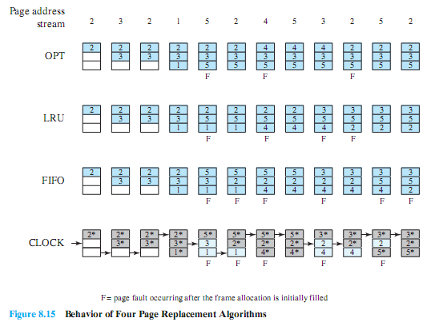
Combined Examples
Source: Pearson

Slide 42

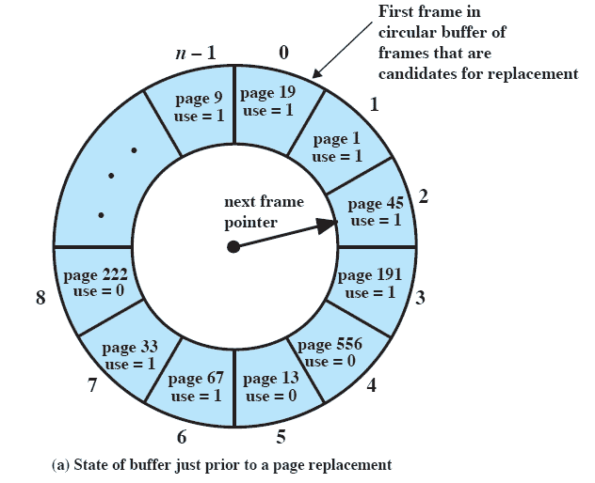
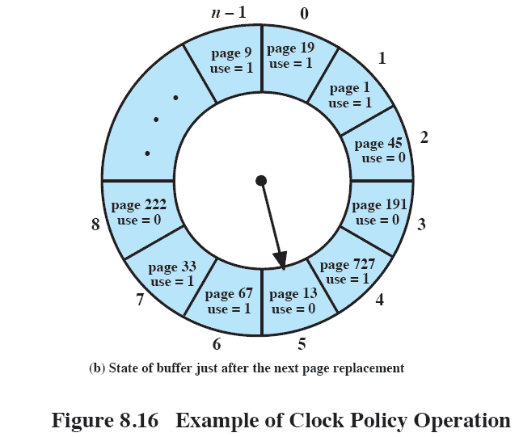
Source: Pearson
Notes:
Figure 8.16 provides an example of the simple clock policy mechanism. A circular
buffer of n main memory frames is available for page replacement. Just prior
to the replacement of a page from the buffer with incoming page 727 , the next frame
pointer points at frame 2, which contains page 45 . The clock policy is now executed.
Because the use bit for page 45 in frame 2 is equal to 1, this page is not replaced.
Instead, the use bit is set to 0 and the pointer advances. Similarly, page 191 in frame
3 is not replaced; its use bit is set to 0 and the pointer advances. In the next frame,
frame 4, the use bit is set to 0. Therefore, page 556 is replaced with page 727 . The
use bit is set to 1 for this frame and the pointer advances to frame 5, completing the
page replacement procedure.

Slide 43

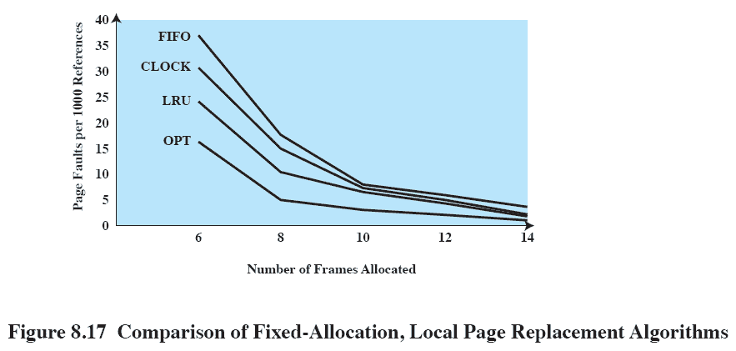
Source: Pearson
Notes:
Figure 8.17 shows the results of an experiment reported in [BAER80], which
compares the four algorithms that we have been discussing; it is assumed that the
number of page frames assigned to a process is fixed. The results are based on the
execution of 0.25 °— 106 references in a FORTRAN program, using a page size of 256
words. Baer ran the experiment with frame allocations of 6, 8, 10, 12, and 14 frames.
The differences among the four policies are most striking at small allocations, with
FIFO being over a factor of 2 worse than optimal. All four curves have the same shape
as the idealized behavior shown in Figure 8.11b . In order to run efficiently, we would
like to be to the right of the knee of the curve (with a small page fault rate) while
keeping a small frame allocation (to the left of the knee of the curve). These two constraints
indicate that a desirable mode of operation would be at the knee of the curve.
The clock algorithm has also been compared to these other algorithms when
a variable allocation and either global or local replacement scope (see the following
discussion of replacement policy) is used [CARR81, CARR84]. The clock algorithm
was found to approximate closely the performance of LRU.

Slide 44
Page Buffering
When a page is replaced, the page is not physically moved
  Instead, the PTE for this page is removed and placed in either the free or modified page list
  Free page list is a list of page frames available for reading in pages
    When a page is to be replaced, it remains in memory and its page frame is added to the tail of the free page list
    Thus, if the process references the page, it is returned to the resident set of that process at little cost.
    When a page is to be read in, the page frame at the head of the list is used, destroying the page that was there
  Modified page list is a list of page frames that have been modified
    When a modified page is replaced, the page frame is added to the tail of the modified page list
    Modified pages are written out in clusters rather than one at a time, significantly reducing the number of I/O operations.

Slide 45

The OS must decide how many pages to bring in
  The smaller the amount of memory allocated to each process, the more processes can reside in memory
  Small number of pages loaded increases page faults
  Beyond a certain size, further allocations of pages will not affect the page fault rate
Fixed allocation
  Allocate a fixed number of frames to a process
    That number is decided at initial load time and may be determined on the type of process.
  On a page fault, one of the pages of that process must be replaced
Variable allocation
  Allow the number of page frames allocated to a process to be varied over the lifetime of the process
    Processes with high fault rates are given additional frames while processes with extremely low fault rates are given a reduced allocation
Notes:
With paged virtual memory, it is not necessary and indeed
may not be possible to bring all of the pages of a process into main memory to
prepare it for execution. Thus, the operating system must decide how many pages to
bring in, that is, how much main memory to allocate to a particular process. Several
factors come into play:
• The smaller the amount of memory allocated to a process, the more processes
that can reside in main memory at any one time. This increases the probability
that the operating system will find at least one ready process at any given time
and hence reduces the time lost due to swapping.
• If a relatively small number of pages of a process are in main memory, then,
despite the principle of locality, the rate of page faults will be rather high (see
Figure 8.11b ).
• Beyond a certain size, additional allocation of main memory to a particular
process will have no noticeable effect on the page fault rate for that process
because of the principle of locality.

Slide 46
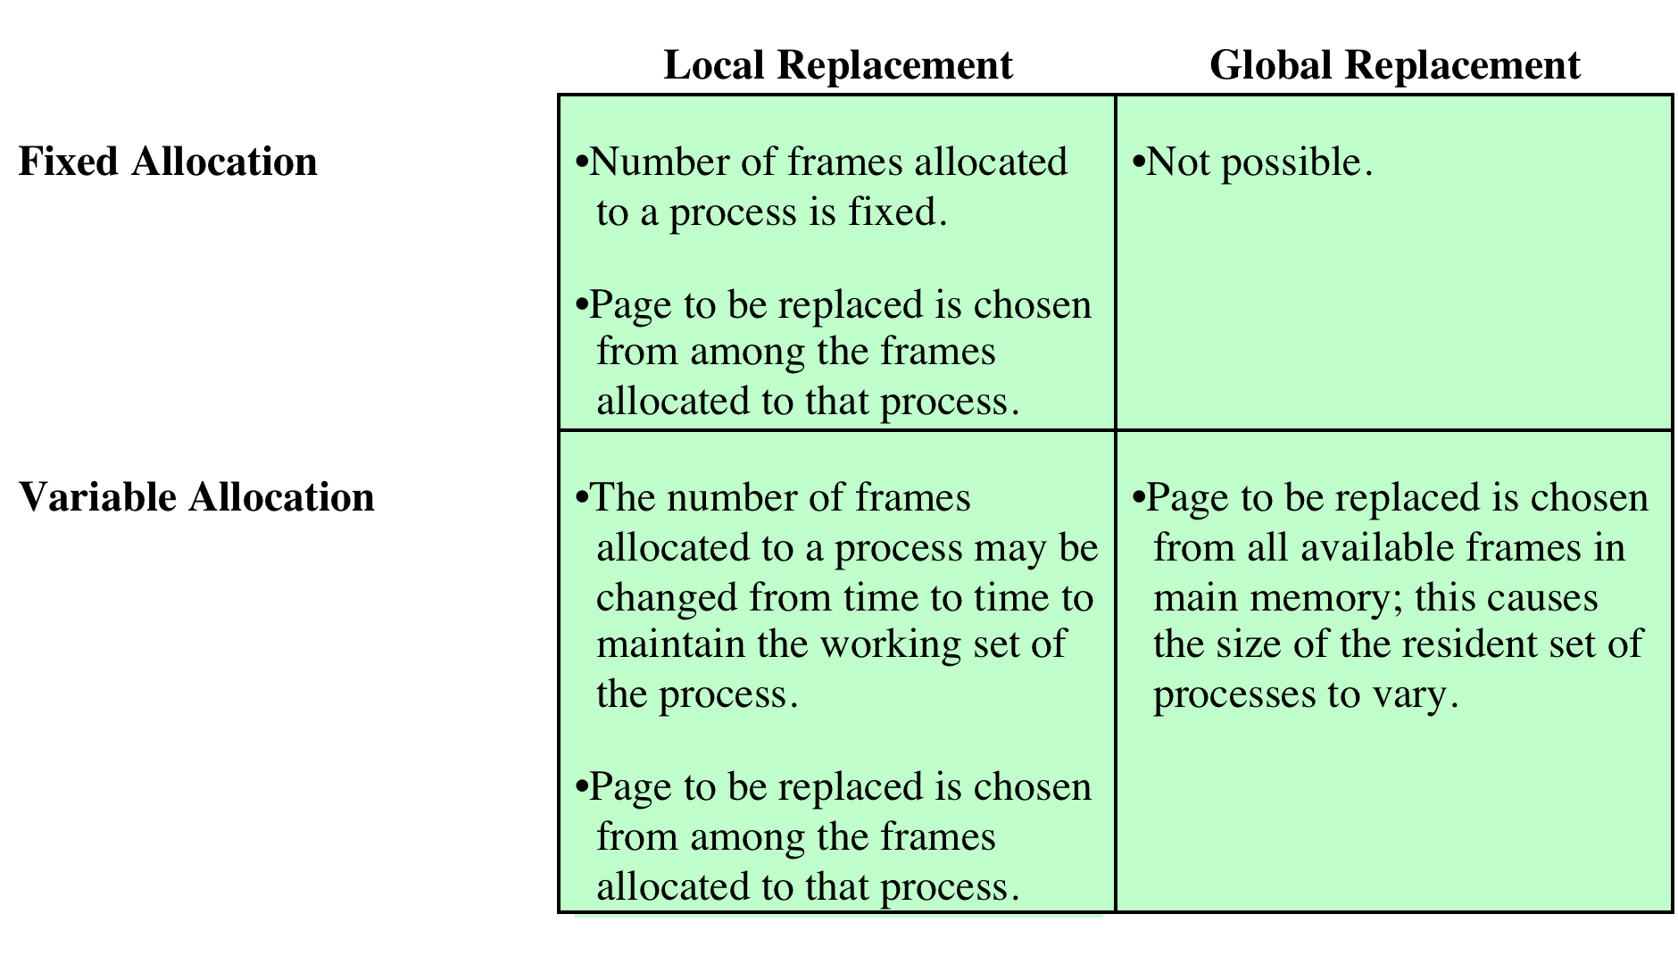
Replacement Scope
The scope of a replacement strategy can be global or local
Local scope
  Choose only among the resident pages of the process generating the fault
Global scope
  Consider all unlocked pages in main memory
Source: Pearson

Slide 47
Fixed Allocation, Local Scope
Necessary to decide ahead of time the amount of allocation to a process
If allocation is too small, there will be a high page fault rate
If allocation is too large, there will be too few processes in main memory
  Increase processor idle time
  Increase time spent in swapping
Notes:
With a fixed-allocation policy, it is necessary to decide ahead of time the amount
of allocation to give to a process. This could be decided on the basis of the type
of application and the amount requested by the program. The drawback to this
approach is twofold: If allocations tend to be too small, then there will be a high page
fault rate, causing the entire multiprogramming system to run slowly. If allocations
tend to be unnecessarily large, then there will be too few programs in main memory
and there will be either considerable processor idle time or considerable time spent
in swapping.

Slide 48

When a new process is loaded into main memory, allocate to it a certain number of page frames according to its working set
When a page fault occurs, select the page to replace from among the resident set of the process that suffers the fault
Reevaluate the allocation provided to the process and increase or decrease it to improve overall performance
  Decision to increase or decrease a working set size is based on the assessment of future demands
Notes:
The variable-allocation, local-scope
strategy attempts to overcome the problems with a global-scope strategy. It can be
summarized as follows:
1. When a new process is loaded into main memory, allocate to it a certain
number of page frames as its resident set, based on application type, program
request, or other criteria. Use either prepaging or demand paging to fill up the
allocation.
2. When a page fault occurs, select the page to replace from among the resident
set of the process that suffers the fault.
3. From time to time, reevaluate the allocation provided to the process, and
increase or decrease it to improve overall performance.

Slide 49
Variable Allocation, Global Scope
Easiest to implement
  Adopted in many operating systems
OS maintains a list of free frames
Free frame is added to working set of a process when a page fault occurs
  Thus, a process experiencing page faults will gradually grow in size
If no frames are available, the OS must choose a page currently in memory, except the locked frames
Notes:
This combination is perhaps the easiest
to implement and has been adopted in a number of operating systems. At any given
time, there are a number of processes in main memory, each with a certain number
of frames allocated to it. Typically, the operating system also maintains a list of
free frames. When a page fault occurs, a free frame is added to the resident set of
a process and the page is brought in. Thus, a process experiencing page faults will
gradually grow in size, which should help reduce overall page faults in the system.
The difficulty with this approach is in the replacement choice. When there
are no free frames available, the operating system must choose a page currently in
memory to replace. The selection is made from among all of the frames in memory,
except for locked frames such as those of the kernel. Using any of the policies
discussed in the preceding subsection, the page selected for replacement can belong
to any of the resident processes; there is no discipline to determine which process
should lose a page from its resident set. Therefore, the process that suffers the
reduction in resident set size may not be optimum.
One way to counter the potential performance problems of a variable-allocation,
global-scope policy is to use page buffering. In this way, the choice of which page to
replace becomes less significant, because the page may be reclaimed if it is referenced
before the next time that a block of pages are overwritten.

Slide 50
Working Set
Working set W(t, Δ) for a process at virtual time t
  The set of pages that the process has referenced in the last Δ time units (i.e. from t - Δ to t)
  W(t, Δ+1) ⊇ W(t, Δ)
    The larger the window size, the larger the working set.
    In addition, at the same virtual time, the working set with larger window includes the working set with smaller window
  1 ≤ | W(t, Δ) | ≤ min(Δ, N)
    The working set can grow as large as the number of pages N of the process
Working set strategy
  Monitor the working set of each process
  Periodically remove the pages not in its working set, i.e. LRU policy
  A process may execute only if its working set is in main memory
  Flaws
    The past does not predict the future. Working set will change over time
    A true measurement of working set for each process is impractical
    The optimal value of Δ is unknown and would vary

Slide 51
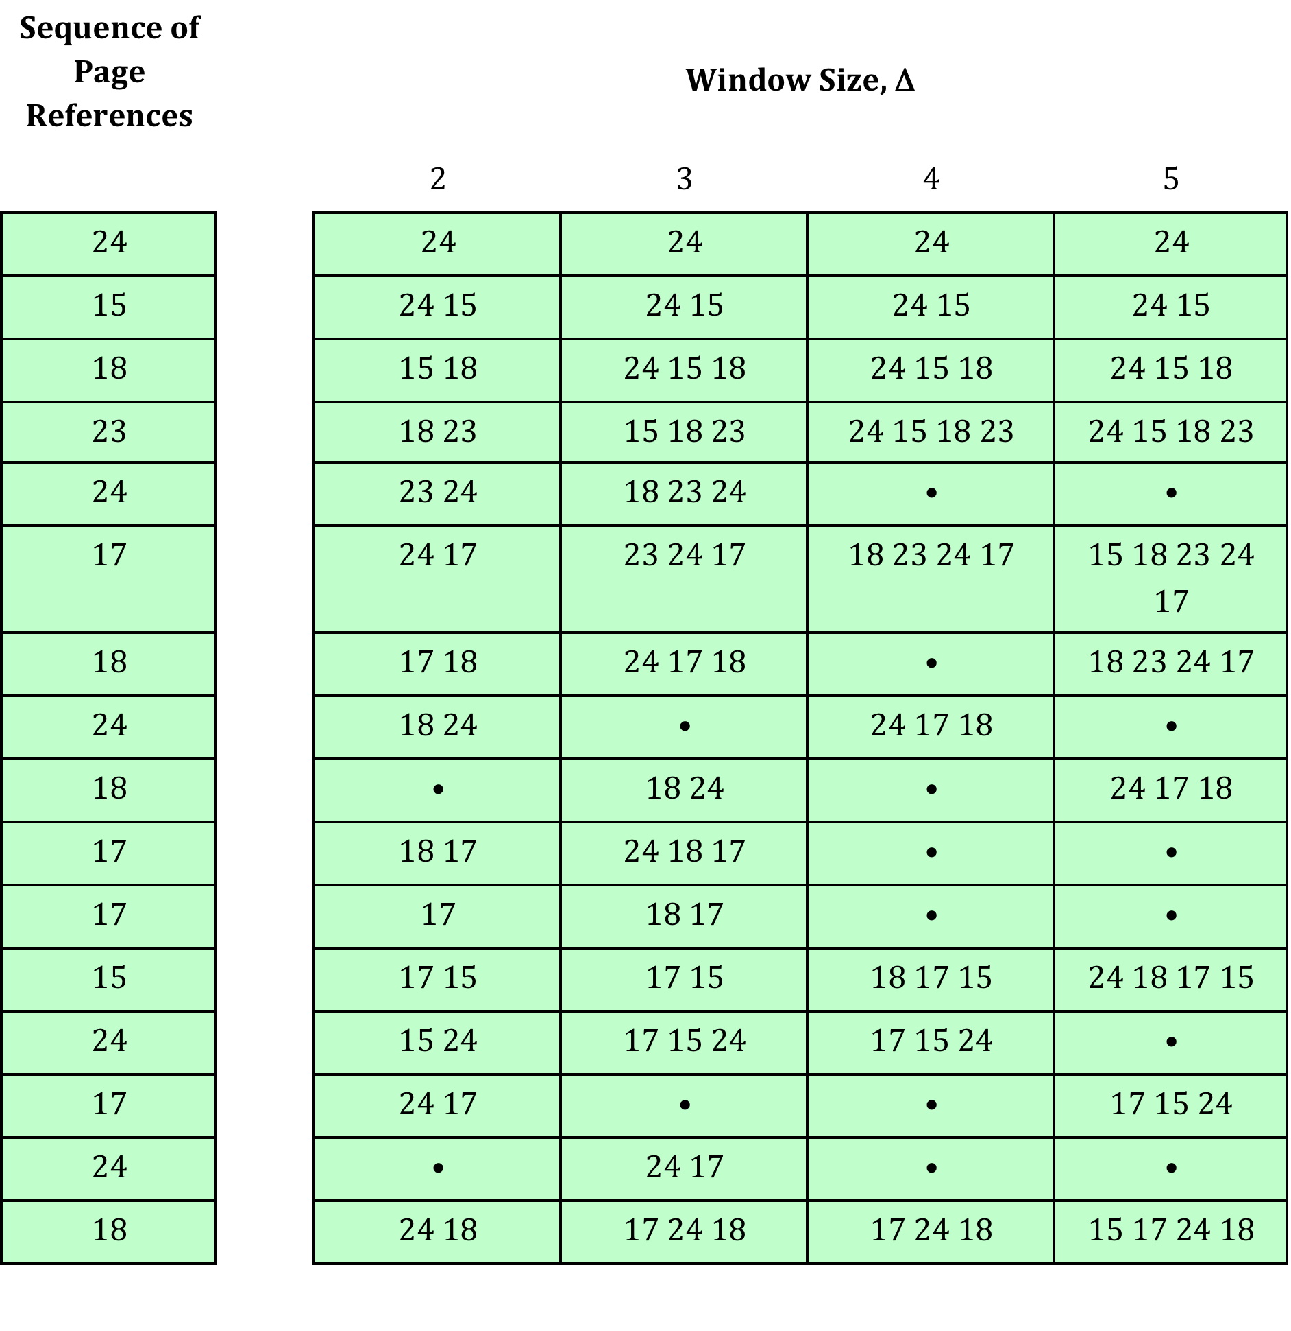
Working Set of a Process
Source: Pearson
Notes:
Figure 8.19
(based on [BACH86]), shows a sequence of page references for a process.
The dots indicate time units in which the working set does not change. Note that the
larger the window size, the larger is the working set.

Slide 52
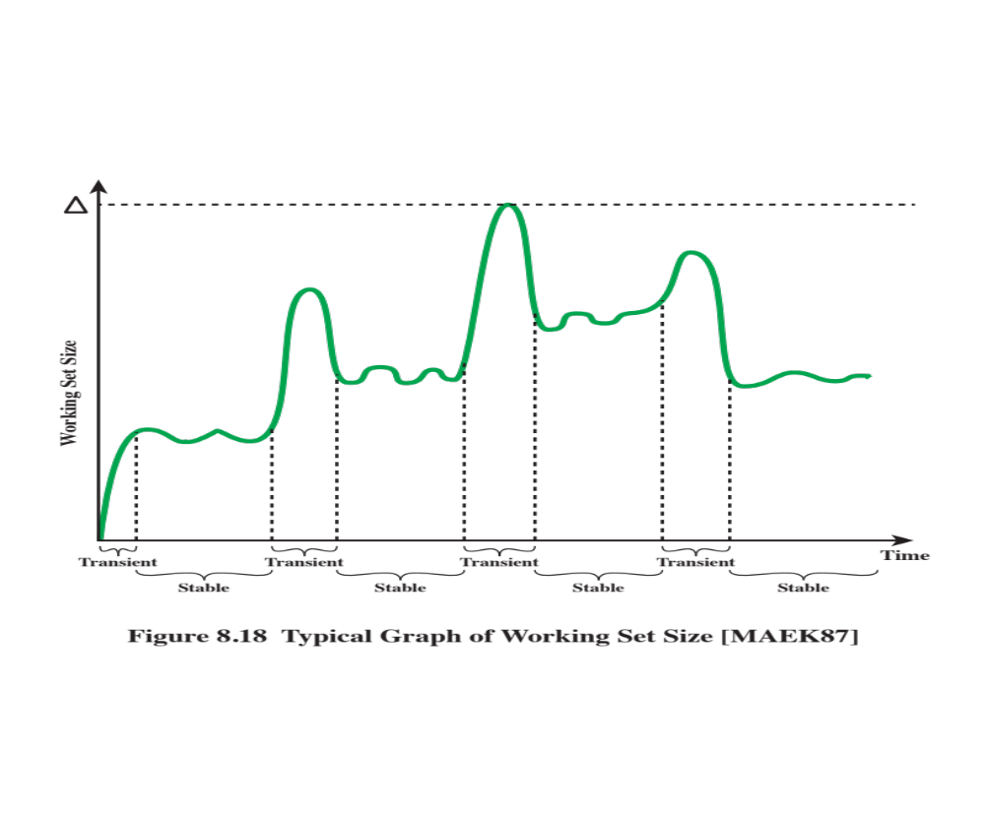
Working Set Size Variation
Source: Pearson

Slide 53
Page Fault Frequency (PFF)
Requires a use bit to be associated with each page in memory
  Bit is set to 1 when that page is accessed
  When a page fault occurs, the OS notes the virtual time since the last page fault for that process
  If the amount of time since the last page fault is less than a threshold, then a page is added to the working set of the process
  Otherwise, discard all pages with a use bit of 0, and shrink the working set accordingly. At the same time reset the use bit on the remaining pages
  The strategy can be refined by using 2 thresholds: An upper threshold is used to trigger a growth in the working set size while a lower threshold is used to trigger a shrink in the working set size.
Does not perform well during the transient periods when there is a shift to a new locality
Notes:
An algorithm that follows this strategy is the page fault frequency (PFF) algorithm
[CHU72, GUPT78]. It requires a use bit to be associated with each page in
memory. The bit is set to 1 when that page is accessed. When a page fault occurs, the
operating system notes the virtual time since the last page fault for that process; this
could be done by maintaining a counter of page references. A threshold F is defined.
If the amount of time since the last page fault is less than F , then a page is added to
the resident set of the process. Otherwise, discard all pages with a use bit of 0, and
shrink the resident set accordingly. At the same time, reset the use bit on the remaining
pages of the process to 0. The strategy can be refined by using two thresholds: an
upper threshold that is used to trigger a growth in the resident set size, and a lower
threshold that is used to trigger a contraction in the resident set size.
The time between page faults is the reciprocal of the page fault rate. Although
it would seem to be better to maintain a running average of the page fault rate, the
use of a single time measurement is a reasonable compromise that allows decisions
about resident set size to be based on the page fault rate. If such a strategy is supplemented
with page buffering, the resulting performance should be quite good.
Nevertheless, there is a major flaw in the PFF approach, which is that it does
not perform well during the transient periods when there is a shift to a new locality.
With PFF, no page ever drops out of the resident set before F virtual time units have
elapsed since it was last referenced. During interlocality transitions, the rapid succession
of page faults causes the resident set of a process to swell before the pages
of the old locality are expelled; the sudden peaks of memory demand may produce
unnecessary process deactivations and reactivations, with the corresponding undesirable
switching and swapping overheads.

Slide 54
Cleaning Policy
Concerned with determining when a modified page should be written out to secondary memory
Demand cleaning
  A page is written out to secondary memory only when it has been selected for replacement
Precleaning
  Write modified pages before they are replaced
  The pages may be modified again before they are replaced

Slide 55
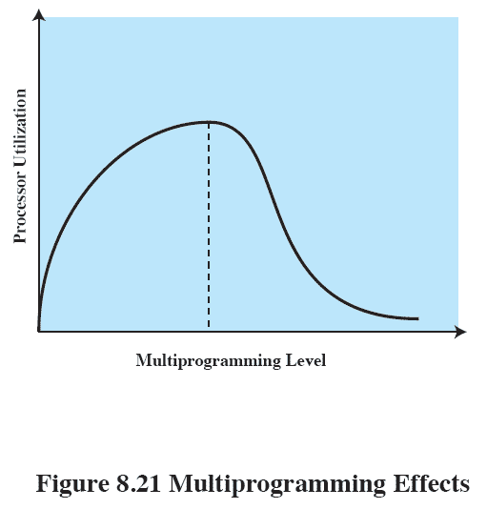
Multiprogramming
Load control
  Determine the number of processes that will be resident in main memory
  This number is called multiprogramming level
Too few processes lead to swapping
  Since all the processes can be blocked
Too many processes, lead to insufficient working set size, resulting in thrashing (frequent faults)
Swapping
Thrashing
Source: Pearson
Notes:
Thrashing is illustrated in Figure 8.21 . As the
multiprogramming level increases from a small value, one would expect to see
processor utilization rise, because there is less chance that all resident processes
are blocked. However, a point is reached at which the average resident set is
inadequate. At this point, the number of page faults rises dramatically, and
processor utilization collapses.

Slide 56

If the degree of multiprogramming is to be reduced,
  One or more of the currently resident processes must be swapped out
Six possibilities
  Lowest-priority process
  Faulting process
    It is likely that the faulting process may not have its working set resident
  Last process activated
    It is least likely that it has its working set resident
  Process with the smallest working set
    Require the least future effort to reload
  Largest process
    Obtain the most free frames in an overcommitted memory
  Process with the largest remaining execution window
    Approximate the shortest processing time first scheduling policy
Notes:
If the degree of multiprogramming is to be reduced, one
or more of the currently resident processes must be suspended (swapped out).
[CARR84] lists six possibilities:
• Lowest-priority process: This implements a scheduling policy decision and is
unrelated to performance issues.
• Faulting process: The reasoning is that there is a greater probability that the
faulting task does not have its working set resident, and performance would
suffer least by suspending it. In addition, this choice has an immediate payoff
because it blocks a process that is about to be blocked anyway and it eliminates
the overhead of a page replacement and I/O operation.
• Last process activated: This is the process least likely to have its working set
resident.
• Process with the smallest resident set: This will require the least future effort
to reload. However, it penalizes programs with strong locality.
• Largest process: This obtains the most free frames in an overcommitted
memory, making additional deactivations unlikely soon.
• Process with the largest remaining execution window: In most process scheduling
schemes, a process may only run for a certain quantum of time before
being interrupted and placed at the end of the Ready queue. This approximates
a shortest-processing-time-first scheduling discipline.

Slide 57
Unix
Intended to be machine independent
  Early Unix: variable partitioning with no virtual memory scheme
  Current implementations of UNIX and Solaris make use of two separate memory management schemes
    Paging system for user processes and disk I/O
    Kernel memory allocator to manage memory allocation for the kernel
      Paged virtual memory may not be appropriate for kernel memory management due to small tables and buffers frequently created/destroyed by the kernel
      Instead, a modified version of the buddy system is employed
Notes:
Because UNIX is intended to be machine independent, its memory management
scheme will vary from one system to the next. Earlier versions of UNIX simply used
variable partitioning with no virtual memory scheme. Current implementations of
UNIX and Solaris make use of paged virtual memory.
In SVR4 and Solaris, there are actually two separate memory management
schemes.

Slide 58
Homework 7
Exercise 8.1
Exercise 8.3
Exercise 8.6
Exercise 8.10
Exercise 8.15

