Slide 1
Operating System
Chapter 9. Uniprocessor Scheduling
Lynn Choi
School of Electrical Engineering

Slide 2
Processor Scheduling
Scheduling
  Assign system resource (CPU, IO device, etc.) to processes/threads to meet system objectives (response time, turnaround time, throughput, or fairness..)
    In practice, these goals often conflict
Three types of processor scheduling
  Long-term scheduling (admission scheduler)
    Decide which jobs/processes to be admitted to the system
      Control the degree of multiprogramming
    Once admitted, a job or user program becomes a process
      The process may be added to the ready queue for the short-term scheduler or to a queue for the medium-term scheduler in a swapped-out condition
  Mid-term scheduling (swapper)
    Remove processes from main memory and place them on secondary memory, or vice versa
    Swap in/out processes
  Short-term scheduling (dispatcher)
    Decide which of the ready, in-memory processes to be executed by the processor following a clock interrupt, IO interrupt, or OS call
    Execute most frequently

Slide 3
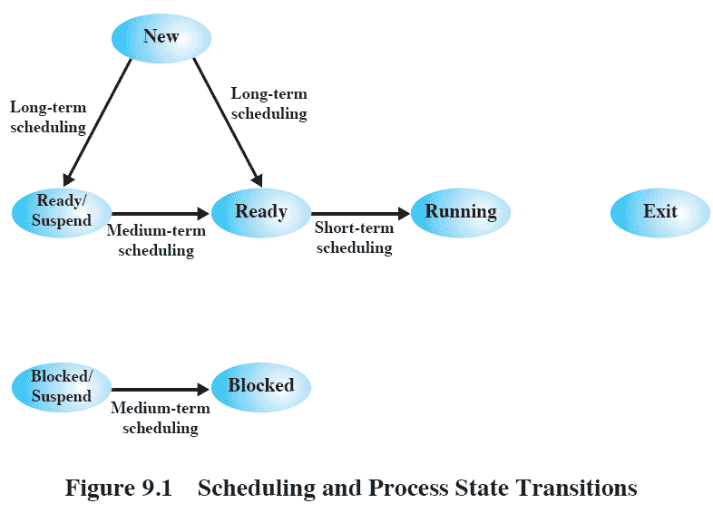
Source: Pearson
Notes:
Figure 9.1 relates the scheduling functions to the process state transition
diagram (first shown in Figure 3.9b ). Long-term scheduling is performed when a
new process is created. This is a decision whether to add a new process to the set
of processes that are currently active. Medium-term scheduling is a part of the
swapping function. This is a decision whether to add a process to those that are at
least partially in main memory and therefore available for execution. Short-term
scheduling is the actual decision of which ready process to execute next.

Slide 4
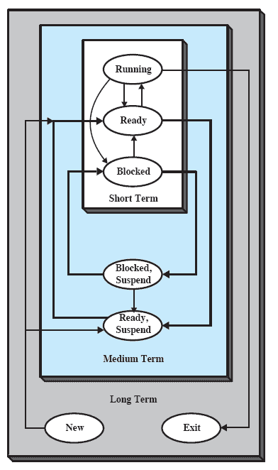
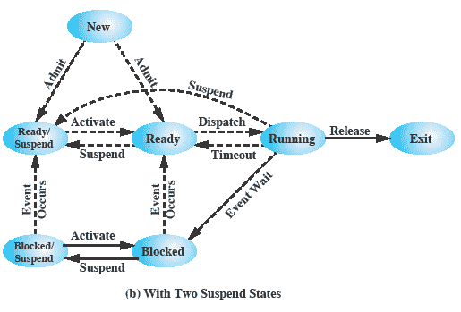
Nesting of Scheduling Functions
Source: Pearson

Slide 5
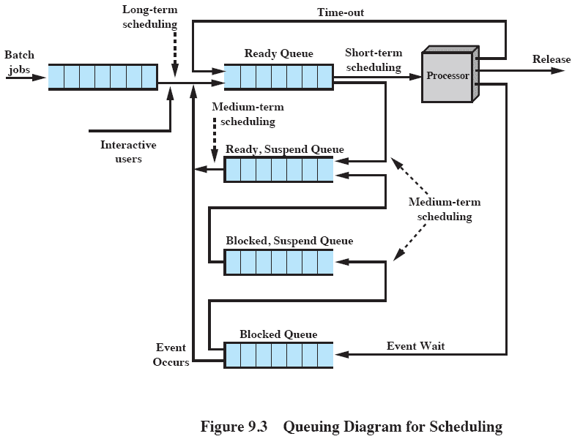
Queuing Diagram
Source: Pearson

Slide 6
Long-Term Scheduler
Determine which programs are admitted to the system for processing
  Once admitted a user program becomes a process
Control the degree of multiprogramming
  The more processes that are created, the smaller the percentage of time that each process can be executed
    May limit the degree of multiprogramming to provide satisfactory service to the current set of processes
    Or, may increase the degree of multiprogramming if CPU is idle too long
Which jobs to admit next can be
  First come, first served (FCFS), or
  Priority, expected execution time, I/O requirements
For interactive programs in a time-sharing system
  OS will accept all authorized comers until the system is saturated

Slide 7
Short-Term Scheduling Criteria
The main objective of short-term scheduling is to allocate processor time to optimize system behaviour
Can be categorized into two dimensions
  User-oriented criteria
    Relate to the behaviour of the system as perceived by the individual user or process (such as response time in an interactive system)
    Important on virtually all systems
  System-oriented criteria
    Focus on efficient utilization of the processor such as throughput
    Generally of minor importance on single-user systems
  Performance-related criteria
    Quantitative and can be measured
    Example: response time, throughput
  Non-performance-related criteria
    Qualitative and hard to measure
    Example: predictability, priority

Slide 8
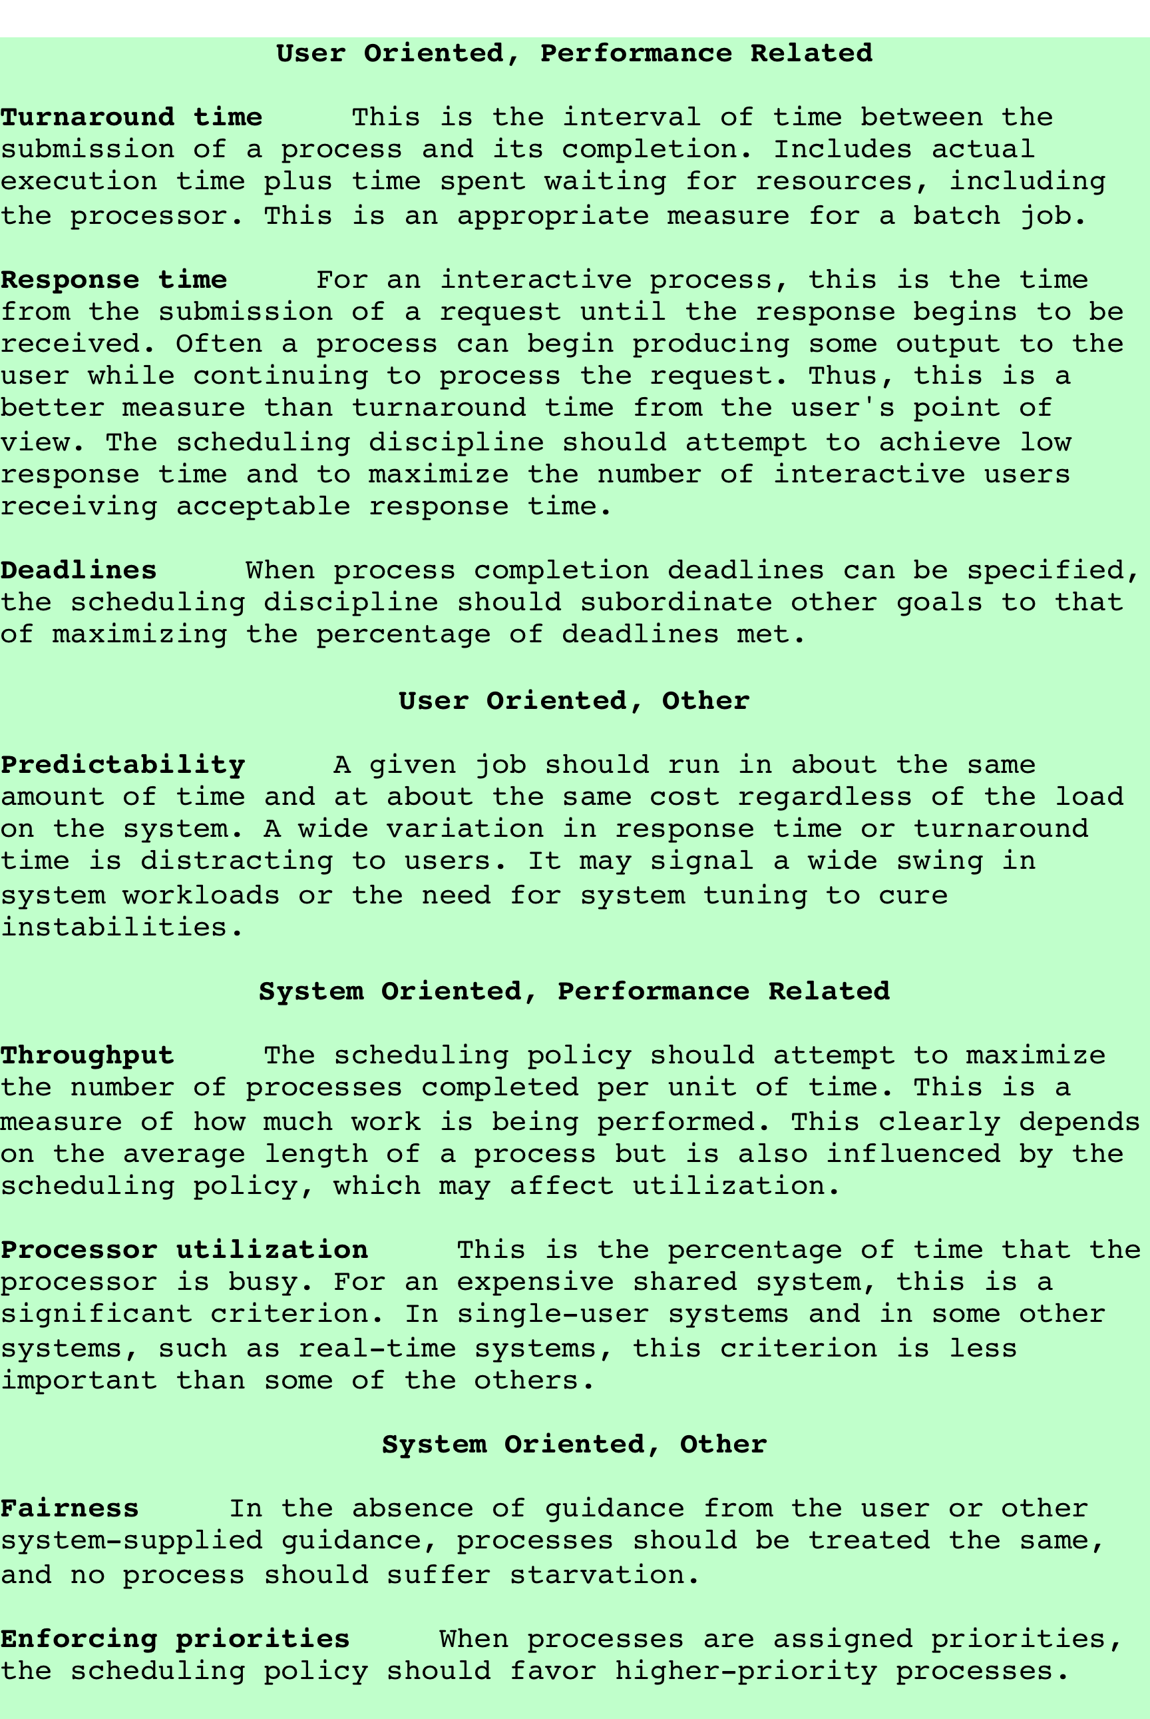
Scheduling Criteria
Source: Pearson

Slide 9
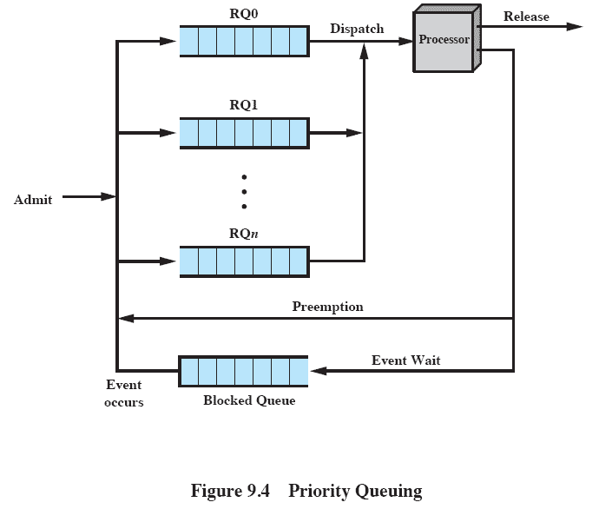
Priority Queuing
Ready queue with the highest priority
Ready queue with the lowest priority
May suffer from starvation!
Source: Pearson

Slide 10
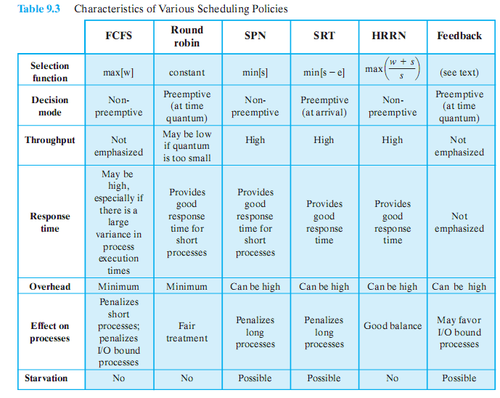
Various Scheduling Policies
Source: Pearson

Slide 11
Selection Function
Determine which process, among ready processes, is selected next for execution
May be based on priority, resource requirements, or the execution characteristics of the process
If based on execution characteristics then important quantities are
  w = time spent in system so far (waiting)
  e = time spent in execution so far
  s = total service time required by the process, including e; generally, this quantity must be estimated or supplied by the user

Slide 12
Decision Mode
Specifies the instant in time at which the selection function is exercised
Two categories
  Nonpreemptive
    Once a process is in the running state, it will continue until it terminates or blocks itself for I/O
  Preemptive
    Currently running process may be interrupted by the scheduler and moved to ready state
    Preemption may occur anytime (when new process arrives, when an interrupt occurs that places a blocked process in the Ready queue, or periodically based on a clock interrupt)

Slide 13
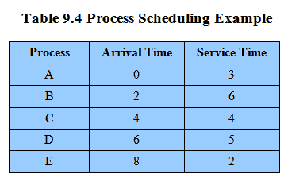
Process Scheduling Example
Source: Pearson

Slide 14
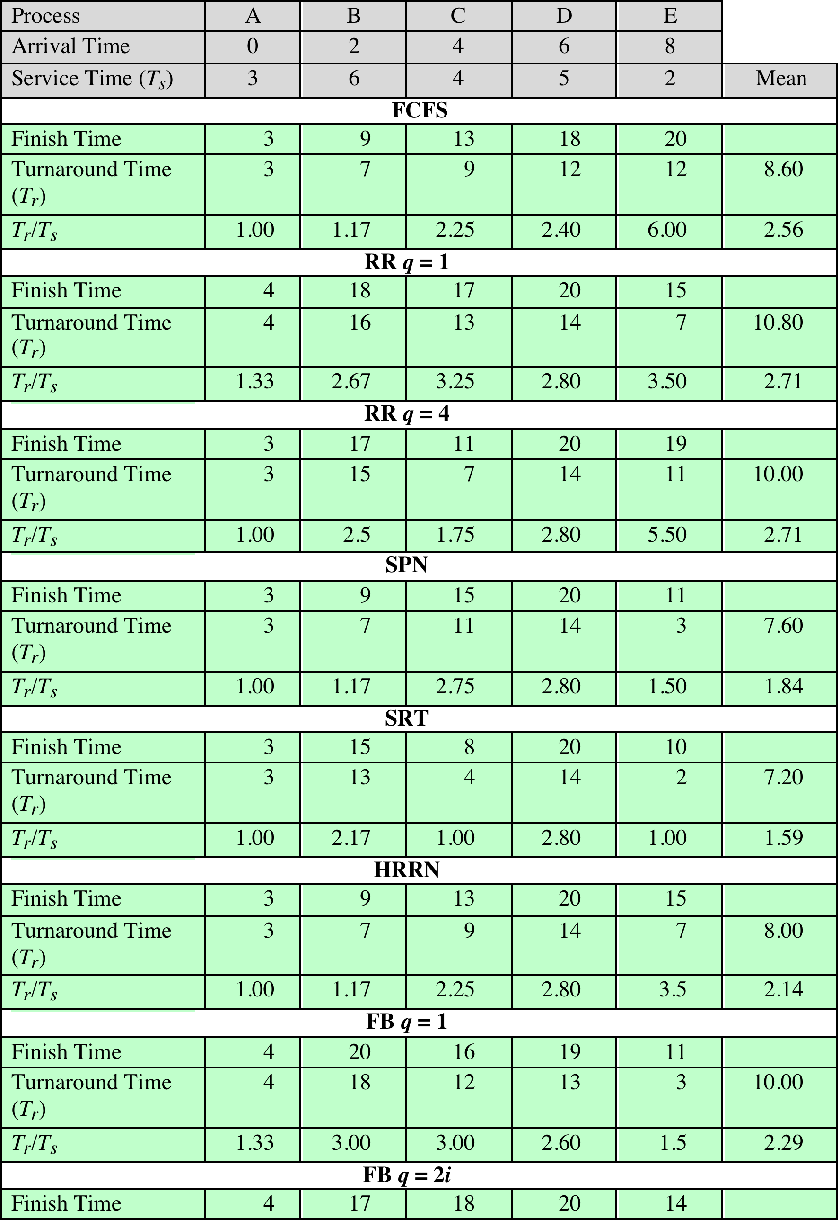
Comparison of Scheduling Policies
Source: Pearson

Slide 15
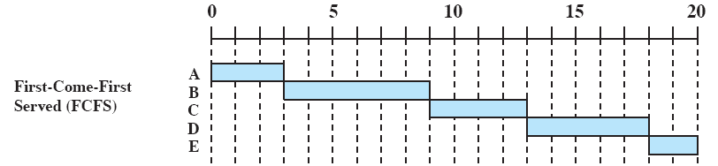
First-Come First-Served (FCFS)
Simplest scheduling policy
Also known as first-in-first-out (FIFO)
When the current process ceases to execute, the oldest process in the Ready queue is selected
Performs much better for long processes than short ones
  Whenever a short process arrives just after a long one, it waits too long
Tends to favor CPU-bound processes over IO-bound ones
  When a CPU-bound process is running, all the IO-bound processes must wait
May result in inefficient use of both CPU and IO devices
Source: Pearson

Slide 16
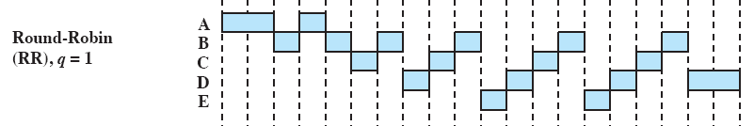
Round Robin
Uses preemption based on a clock interrupt
Also known as time slicing because each process is given a slice of time before being preempted
Principal design issue is the length of the time quantum, or slice, to be used
  Time quantum should be slightly longer than a typical interaction
Particularly effective in a general-purpose time-sharing system or transaction processing system
One drawback: CPU-bound processes receive a complete quantum while IO-bound ones may not
Source: Pearson

Slide 17
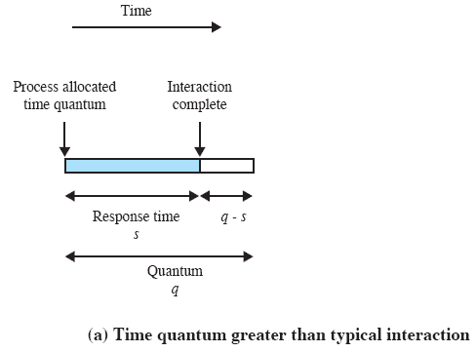
Effect of Preemption Time Quantum Size
Source: Pearson

Slide 18
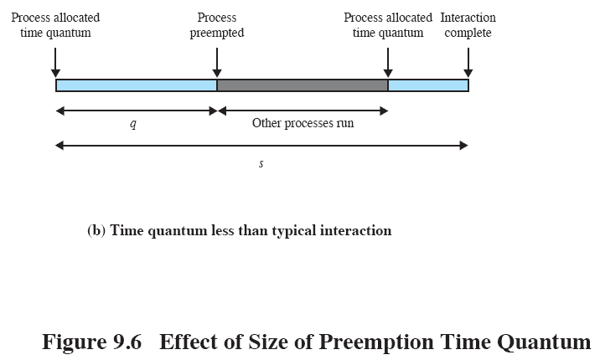
Effect of Preemption
Source: Pearson

Slide 19
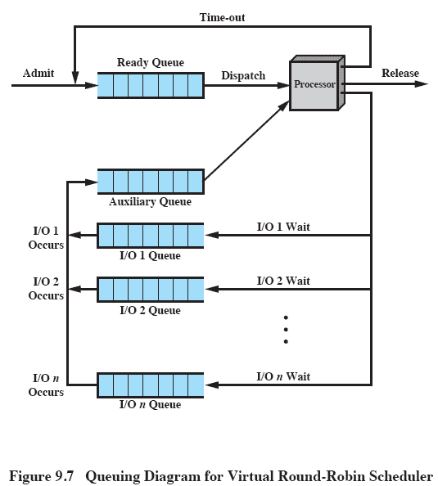
Virtual Round Robin (VRR)
Avoid the unfairness of IO-bound processes
When an IO-bound process is released from IO block, it is moved to the auxiliary queue
Processes in the auxiliary queue get preference over those in the ready queue

Slide 20
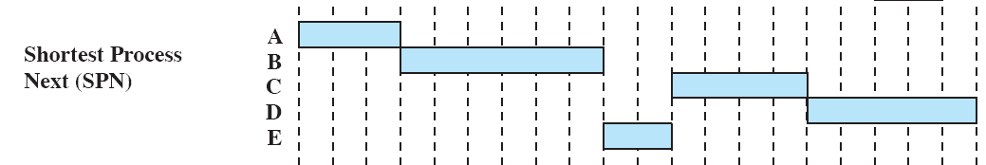
Shortest Process Next (SPN)
Also called SJF (Shortest Job First)
  Nonpreemptive policy in which the process with the shortest expected processing time is selected next
  A short process will jump to the head of the queue
  Possibility of starvation for longer processes
  One difficulty is the need to know, or at least estimate, the required processing time of each process
  If the programmer’s estimate is substantially under the actual running time, the system may abort the job
Exponential averaging
  For interactive processes, OS may compute a running average of each process run
Source: Pearson

Slide 21
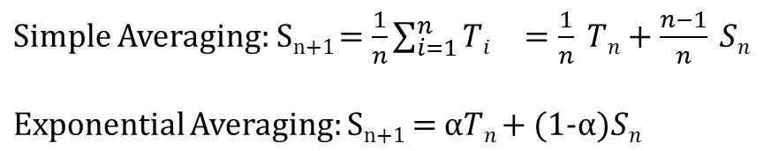
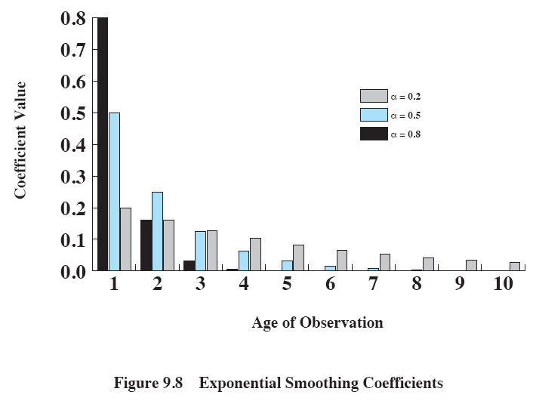
Exponential Smoothing Coefficients
Source: Pearson

Slide 22
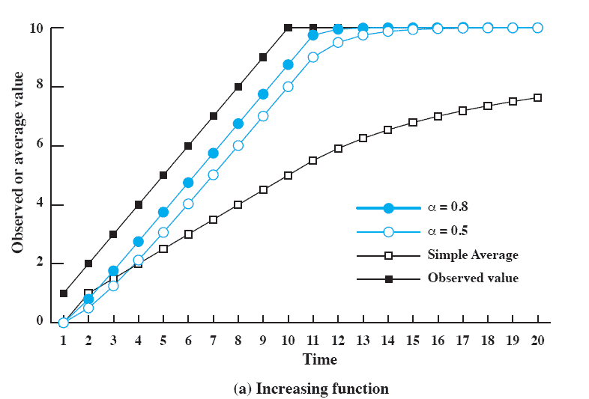
Use Of Exponential Averaging
Source: Pearson
Notes:
Figure 9.9 compares simple averaging with exponential averaging (for two different values of α).
Here (Figure 9.9a), the observed value begins at 1, grows gradually to a value of 10, and then stays there.

Slide 23
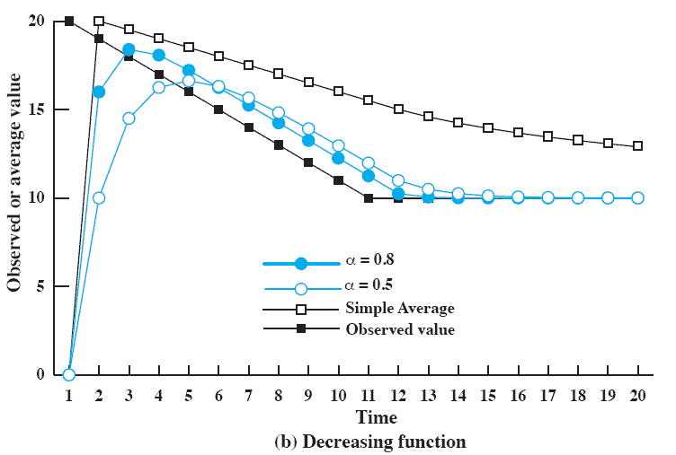
Use Of Exponential Averaging
Source: Pearson
Notes:
While here (Figure 9.9b), the observed value begins at 20, declines gradually to 10, and then stays there.
In both cases, we start out with an estimate of S₁ = 0.
This gives greater priority to new processes.
Note that exponential averaging tracks changes in process behavior faster than does simple averaging and that the larger value of α results in a more rapid reaction to the change in the observed value.

Slide 24
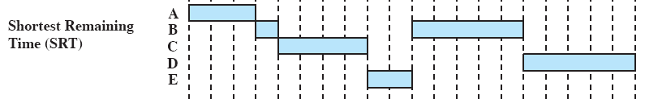
Shortest Remaining Time (SRT)
Preemptive version of SPN
  Scheduler always chooses the process that has the shortest expected remaining time
    The scheduler may preempt the current process when a new process with a short expected processing time becomes ready
  Risk of starvation for longer processes
  Should give superior turnaround time performance to SPN because a short job is given immediate preference to a running longer job
Source: Pearson

Slide 25

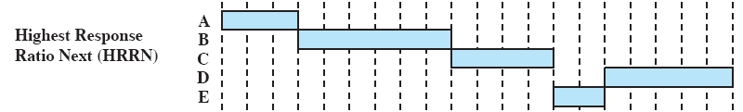
Highest Response Ratio Next (HRRN)
When the current process completes or is blocked (non-preemptive policy), choose the next process with the greatest ratio (normalized turnaround time)
Attractive because it considers the aging of a process
While shorter jobs are favored, aging without service increases the ratio so that a long process will eventually win the competition against shorter jobs
Source: Pearson

Slide 26
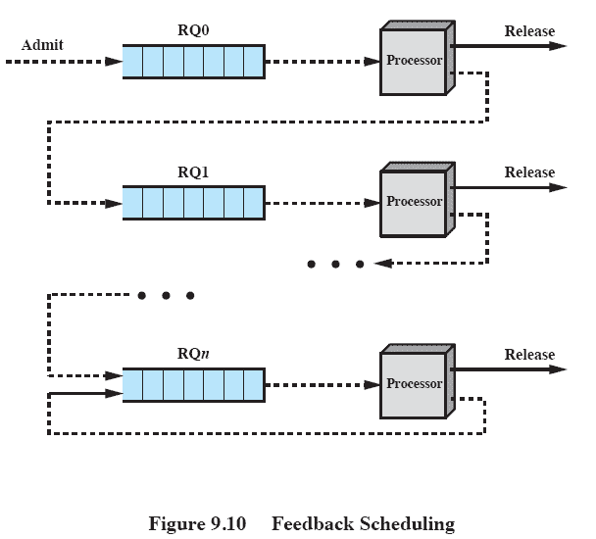
Feedback Scheduling
Also known as multilevel feedback queue
  Penalize jobs that have been running longer by placing these jobs into lower priority queues
  When a process enters the system, it is placed in RQ0. After its first preemption, it is demoted to RQ1.
  Short processes will complete quickly while long processes may starve
  To avoid starvation and long turnaround time, RQi may be assigned 2^{i} time units
Source: Pearson

Slide 27
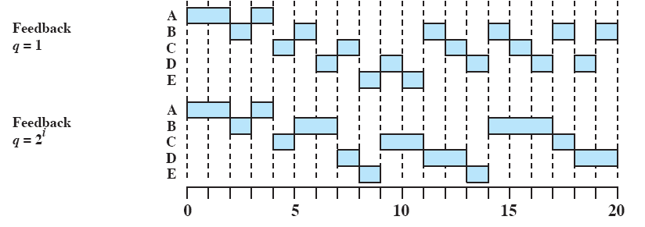
Feedback Performance
Source: Pearson

Slide 28
Fair-Share Scheduling
Scheduling decisions are made based on sets of processes rather than each individual process
  An individual application may be organized as multiple processes/threads
  From the user perspective, the concern is not how a particular process performs but rather how his/her application (set of processes) performs
Each user is assigned a share of the processor
Objective is to monitor usage to give fewer resources to users who have had more than their fair share and more to those who have had less than their fair share
Scheduling is done on the basis of priority, which considers the process priority, its recent processor usage, and the recent processor usage of the group it belongs.

Slide 29
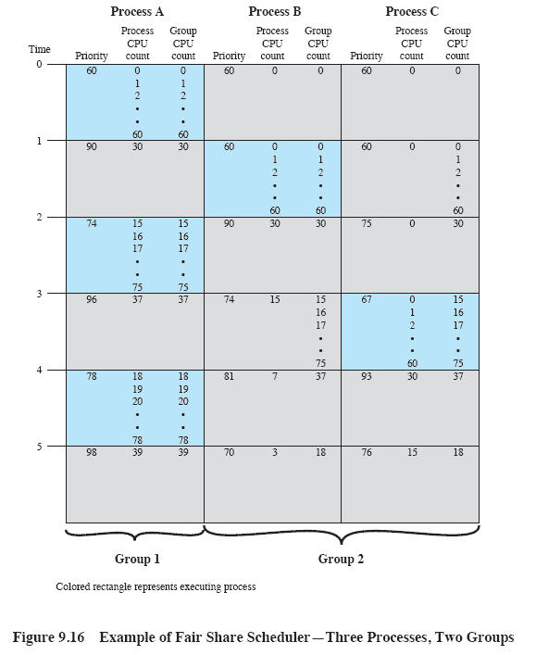
Fair-Share Scheduler
CPU_{j}(i) = CPU_{j}(i-1)/2
  CPU utilization by process j during interval i
GCPU_{k}(i) = GCPU_{k}(i-1)/2
  CPU utilization of group k during interval i
P_{j}(i) = Base_{i} + CPU_{j}(i)/2 + GCPU_{k}(i)/(4 * W_{k})
  Base_{i} : base priority of process j
  W_{k} : weight assigned to group k
Source: Pearson

Slide 30
Traditional Unix Scheduling
Used in both SVR3 and 4.3 BSD UNIX
  These systems are primarily targeted at the time-sharing interactive environment
Designed to provide good response time for interactive users while ensuring that low-priority background jobs do not starve
  Employs multilevel feedback queue using round robin within each of the priority queues
  If a running process does not block or complete within one second, it is preempted.
  Priority is based on process type and execution history

Slide 31
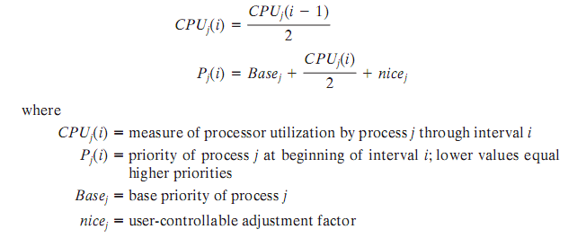
Scheduling Formula

Slide 32
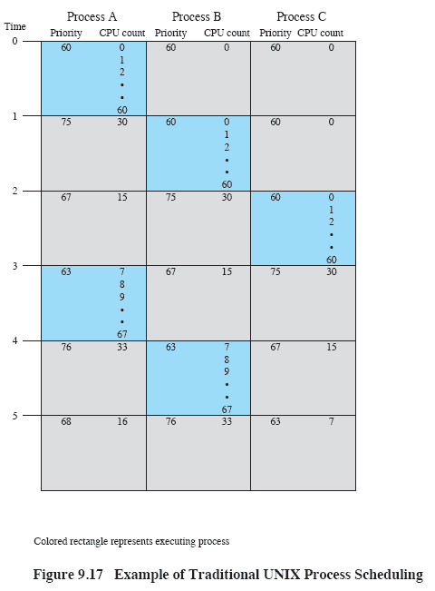
Examples of Traditional UNIX Process Scheduling
Source: Pearson

Slide 33
Homework 8
Exercise 9.1
Exercise 9.2
Exercise 9.3
Exercise 9.7
Exercise 9.9

