Slide 1
Operating System
Chapter 9. Multiprocessor and
Real Time Scheduling
Lynn Choi
School of Electrical Engineering

Slide 2
Classification of Multiprocessors
Shared-memory multiprocessors
  Processors share a common shared main memory
    Any processor can access shared memory via load/store instructions
  Most of multicores and servers
  Sometimes called tightly coupled multiprocessors
Distributed-memory multiprocessors
  A collection of processors, each with its own private memory
    Two processors can communicate via message passing
  Some manycores and supercomputers
  Also called (message-passing) multicomputers
Heterogeneous multiprocessors
  A master, general-purpose processor + special slave coprocessors such as DSP, graphic processors
Distributed systems
  A set of autonomous systems connected through networks/internets

Slide 3
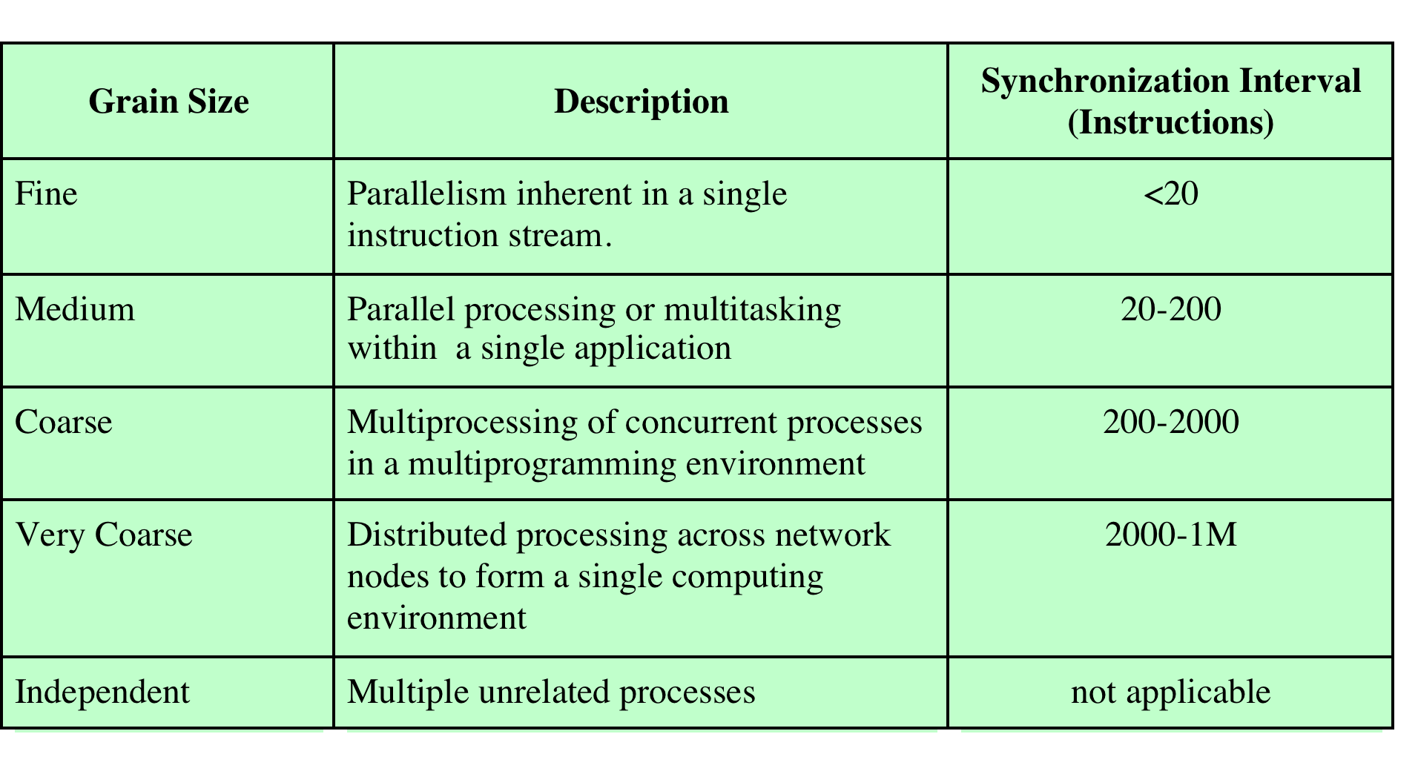
Parallelism and Synchronization Granularity
Synchronization granularity
  Frequency of synchronization between processes
    Applications are classified according to how often their subtasks need to synchronize or communicate with each other
Source: Pearson
Source: Pearson

Slide 4
Independent Parallelism
No explicit synchronization among processes
  Each represents a separate, independent application or job
  Typical use is in a time-sharing system
  Each user is performing a particular application
Multiprocessor provides the same service as multiprogrammed uniprocessor
  Average response time will be reduced because more than one processor is available

Slide 5
Coarse and Very Coarse Grained Parallelism
Synchronization among processes, but at a very gross level
A set of concurrent processes with infrequent synchronization
  Can run on a multiprogrammed uniprocessor easily
  Also can be supported on a multiprocessor with little or no change to user software (and also little or no impact on the scheduling function)
    In the case of very infrequent interaction among processes, a distributed system can provide good support
    If the interaction is more frequent, the multiprocessor organization provides the most effective support

Slide 6

Single application can be effectively implemented as a collection of threads within a single process
  Programmer must explicitly specify the potential parallelism of an application
  There needs to be a high degree of coordination and interaction among the threads of an application, leading to a medium-grain level of synchronization
Because the various threads of an application interact so frequently, scheduling decisions concerning one thread may affect the performance of the entire application
  Thus, we need to reexamine scheduling when dealing with the scheduling of threads

Slide 7
Fine-Grained Parallelism
Represents a much more complex use of parallelism than is found in the use of threads
Although much work has been done on highly parallel applications, this is so far for a specialized and fragmented area with many different approaches

Slide 8
Design Issues
Scheduling on a multiprocessor involves three interrelated issues:
  Assignment of processes to processors
  The use of multiprogramming on individual processors
  Process dispatching
    The actual selection of a process to run
The approach taken will depend on the degree of granularity of applications and the number of processors available

Slide 9
Assignment of Processes to Processors
Assuming all processors are equal
  It is simplest to treat processors as a pooled resource and assign processes to processors on demand
Static assignment
  A process is permanently assigned to one processor from activation until its completion with a dedicated queue for each processor
    Advantage
      Less scheduling overhead since processor assignment is made once and for all
    Disadvantage
      One processor can be idle with an empty queue, while another processor has a backlog
    To prevent this situation, a common queue can be used.
      In this case over the lifetime of a process, the process may be executed on different processors at different times
Dynamic assignment: dynamic load balancing
  Threads are moved from a queue for one processor to a queue for another processor. Linux uses this approach.

Slide 10
Master/Slave Architecture
Another issue is where the scheduling is performed
  Master/slave architecture
  Peer architecture
Master/slave architecture
  Master processor
    Run key kernel functions
    Responsible for scheduling
    Has control of all memory and IO resources
  Slave processors
    Run user programs
    Send service request to the master for IO and system services
  Advantage
    Simple and requires little enhancement to a uniprocessor multiprogramming operating system
  Disadvantage
    Failure of master brings down the whole system
    Master can become a performance bottleneck

Slide 11
Peer Architecture
Peer architecture
  Kernel can execute on any processor
  Each processor does self-scheduling from the pool of available processes
  Complicate the operating system
    Operating system must ensure that two processors do not choose the same process and need to resolve and synchronize competing claims to resources
There is a spectrum of approaches between these two extremes
  For example, a subset of processors can be dedicated to kernel processing instead of just one.

Slide 12
Use of Multiprogramming
In the traditional multiprocessor with coarse-grained or independent synchronization granularity
  It is clear that each individual processor should be able to switch among a number of processes to achieve high utilization.
However, for medium-grained applications running on a multiprocessor with many processors, the situation is not clear.
  With many processors available, it is no longer paramount that every single processor be busy as much as possible
  Rather, we are concerned to provide the best performance for the applications.
  An application that consists of many threads may run poorly unless all of its threads run simultaneously.

Slide 13
Process Dispatching
The actual selection of a process to run
  On a multiprogrammed uniprocessor, the use of priorities or sophisticated scheduling based on past usage may improve performance over a simple FCFS strategy
  For multiprocessors, these complexities may be unnecessary or even counterproductive
    A simpler approach may be more effective with less overhead
    In the case of thread scheduling, new issues come into play that may be more important than priorities or execution histories

Slide 14
Process Scheduling
For multiprocessors, the impact of sophisticated scheduling algorithm is not as important as in uniprocessors
  As the number of processors increases, this is more evident
  Thus, a simple FCFS algorithm or the use of FCFS with a static priority scheme may suffice for multiprocessors

Slide 15
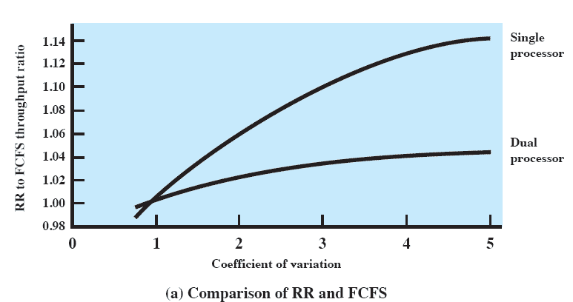
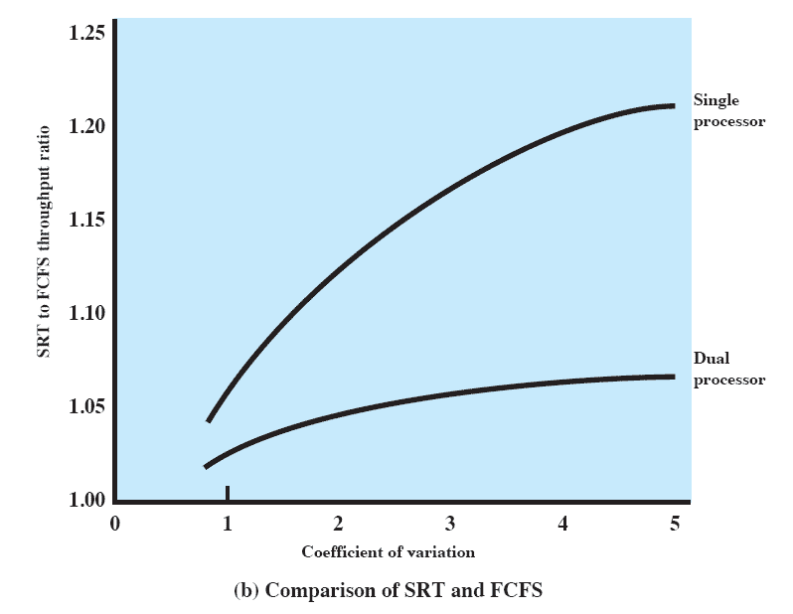
Comparison of Single and Dual Processors
C_{s} measures the coefficient of variation.
  C_{s} is calculated as σ/T_{s} where σ is the standard deviation of the service time and T_{s} is the mean service time
Source: Pearson
  C_{s} = 0 corresponds to the case where the service times of all processes are equal.
  The larger the C_{s}, the more variation in the service time
  Values of C_{s} of 5 or more are not unusual
Source: Pearson

Slide 16
Thread Scheduling
On a uniprocessor
  Threads can be used as a program structuring aid and to overlap I/O with processing
In a multiprocessor system
  Threads can be used to exploit true parallelism in an application
  Dramatic performance gains are possible in multiprocessor systems
    When various threads of an application run simultaneously on separate processors
  For applications that require significant interaction among threads (medium-grain parallelism)
    Small differences in thread management and scheduling can have a significant performance impact

Slide 17
Approaches to Thread Scheduling
Load sharing
  A global queue of ready threads is maintained. Each processor, when idle, selects a thread from the queue
Gang scheduling
  A set of related threads is scheduled to run on a set of processors at the same time
Dedicated processor assignment
  Each program, for the duration of execution, is allocated a number of processors equal to the number of threads in the program.
  When the program terminates, the processors return to the general pool for possible allocation to another program
  The opposite of the load sharing approach
Dynamic scheduling
  The number of threads in a process can be altered during the course of execution

Slide 18
Load Sharing
The simplest approach and carries over most directly from a uniprocessor environment
Advantages
  Load is distributed evenly across the processors
  No centralized scheduler is required. When a processor is available, the scheduler can run on that processor to select the next thread. Thus, it is sometimes called “self-scheduling”.
  The global queue can be organized and accessed using any of the scheduling algorithms discussed in Chapter 9
Versions of load sharing
  First-come-first-served
    When a job arrives, its threads are placed at the end of the shared queue. An idle processor selects the next ready thread, which it executes until completion or blocking.
  Smallest number of threads first
    The shared ready queue is organized as a priority queue with highest priority given to threads from jobs with smallest number of unscheduled threads.
  Preemptive smallest number of threads first

Slide 19
Load Sharing
Disadvantages
  Central queue occupies a region of memory that must be accessed in a manner that enforces mutual exclusion
    Can lead to bottlenecks, especially for many processors
  Preemptive threads are unlikely to resume execution on the same processor
    Caching can become less efficient
  If all threads are treated as a common pool of threads, it is unlikely that all of the threads of a program will gain access to processors at the same time
    If a high degree of coordination is required between threads, the process switches may seriously compromise performance
Despite its disadvantages, it is one of the most commonly used schemes

Slide 20
Gang Scheduling
Simultaneous scheduling of the threads that make up a single process on a set of processors
Advantages
  If closely related threads execute in parallel, synchronization blocking may be reduced, less thread switching, and performance will increase
  Scheduling overhead may be reduced because a single decision affects a number of processors and threads at one time
Useful for medium-grained to fine-grained parallel applications
  Whose performance severely degrades when any part of the application is not running while other parts are ready to run
Also beneficial for any parallel application
The need for gang scheduling is widely recognized and implementations exist on a variety of multiprocessor operating systems

Slide 21
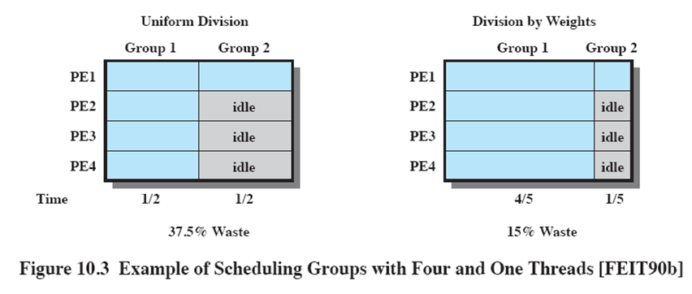
Processor Allocation for Gang Scheduling
Source: Pearson

Slide 22
Dedicated Processor Assignment
Dedicate a group of processors to an application
  When an application is scheduled, allocate a number of processors that is equal to the number of threads in the application.
    Each processor that remains dedicated to that thread until the application runs to completion
  If a thread of an application is blocked waiting for I/O or for synchronization with another thread, then that thread’s processor remains idle
    Waste of processor time: there is no multiprogramming of processors
Defense of this strategy:
  In a highly parallel system, with tens or hundreds of processors, processor utilization is no longer so important as a metric for effectiveness or performance
  The total avoidance of process switching during the lifetime of a program should result in a substantial speedup of that program

Slide 23
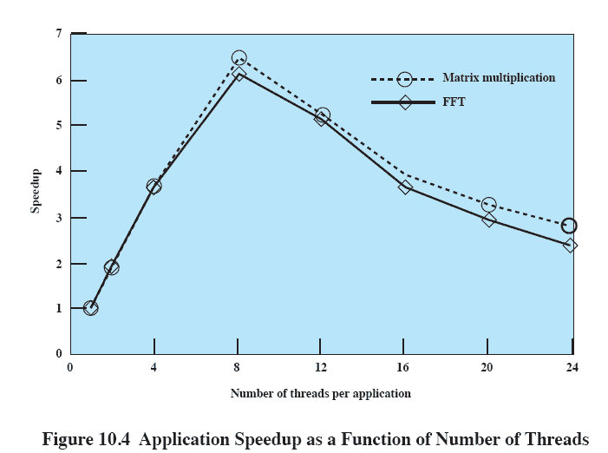
Application Speedup vs. Number of Threads
The performance worsens considerably when the total number of threads exceeds the number of processors.
Source: Pearson

Slide 24
Dynamic Scheduling
For some applications it is possible to provide language and system tools that permit the number of threads in the process to be altered dynamically
Both the operating system and the application are involved in making scheduling decisions
  Operating system is responsible for partitioning processors among jobs
  Each job uses the processors in its partition to execute some subset of its runnable tasks by mapping these tasks to threads
    Application decides which thread to run and which thread to suspend
  When a job requests one or more processors,
    If there are idle processors, assign them to satisfy the request
    Otherwise, if the job is a new arrival, allocate it a single processor by taking one away from any job currently allocated more than one processor
    If any of the request cannot be satisfied, it remains outstanding until either a processor become available or the job rescinds the request
    Upon release of one or more processors, scan the current queue of unsatisfied requests and assign a single processor to each job in the list
Only for applications that can take advantage of it, but the overhead may negate the performance advantage.

Slide 25
Real-Time Systems
Examples of real-time systems
  Control of laboratory experiments
  Process control in industrial plants
  Robotics
  Air traffic control
  Telecommunications
  Military command and control systems
Correctness of the system depends not only on the logical result of the computation but also on the time at which the results are produced
  Real-time tasks attempt to control or react to events that take place in the outside world
  Because these events occur in “real time” and tasks must be able to keep up with the events in time

Slide 26
Classification of Real Time Tasks
A hard real time task
  Must meet its deadline
  Otherwise, it will cause unacceptable damage or a fatal error to the system
A soft real time task
  Has an associated deadline that is desirable but not mandatory
  It still makes sense to schedule and complete the task even if it has passed its deadline
An aperiodic task
  Has a deadline by which it must finish or start
  May have a constraint on both start and finish time
A periodic task
  Has a requirement that may be stated as:
    Once per period T, or
    Exactly T units apart

Slide 27
Characteristics of Real Time Systems
Real-time operating systems have requirements in five general areas
  Determinism
  Responsiveness
  User control
  Reliability
  Fail-soft operation

Slide 28
Determinism
An operating system is deterministic if it performs at fixed, predetermined times or within predetermined time intervals
  When multiple processes are competing for resources and processor time, no system will be fully deterministic
The extent to which an operating system can deterministically satisfy requests depends on:
  The speed with which it can respond to interrupts
  Whether the system has sufficient capacity to handle all requests within the required time
One useful measure of the ability of OS to function deterministically is the maximum delay from the arrival of a high-priority interrupt to when the service begins
  In non-real-time OS, this delay may be in the range of tens to hundreds of milliseconds
  In real-time OS, this delay may have an upper bound from a few microseconds to a millisecond

Slide 29
Responsiveness
Determinism is concerned with how long an OS delays before acknowledging an interrupt while responsiveness is concerned with how long it takes an OS to service the interrupt after the acknowledgment
  The amount of time required to initially handle the interrupt and begin execution of the ISR. This includes context switching.
  The amount of time required to perform ISR
  The effect of interrupt nesting. If an ISR can be interrupted by another interrupt, the service will be delayed.
Determinism and responsiveness together make up the response time to external events
  Critical for real-time systems that must meet timing requirements imposed by individuals, devices, and data flows external to the system

Slide 30
User Control
In a typical non-real-time OS, the user has no control over the scheduling, or only provide broad guidance such as grouping users into more than one priority class.
In a real-time OS, it is essential to allow the user fine-grained control over task priority.
  The user distinguish between hard and soft real-time tasks.
  The user specify relative priorities within each priority class.
May allow user to specify such characteristics as
  Paging or process swapping
  What processes must always be resident in main memory
  What disk transfer algorithms are to be used
  What rights the processes in each priority class have

Slide 31
Reliability
More important for real-time systems than non-real time systems
  In a non-real-time system, a transient failure may result in a reduced level of service. And, it can be often solved by rebooting the system.
However, in real-time systems, loss or degradation of performance may have catastrophic consequences such as:
  Financial loss
  Major equipment damage
  Loss of life

Slide 32
Fail-Soft Operation
A characteristic that refers to the ability of a system to fail in such a way as to preserve as much capability and data as possible
Important aspect is stability
  A real-time system is stable if the system will meet the deadlines of its most critical, highest-priority tasks even if some less critical task deadlines are not always met

Slide 33
Real-Time OS Characteristics
To meet the requirements, real-time OS has the following features in general
  Fast process/thread switching
  Small size
  Ability to respond to external events quickly
  Preemptive scheduling based on priority
  Minimize intervals during which interrupts are disabled
  Short-term scheduler optimized for real-time tasks
    Fairness and minimizing average response time is not important
    What is important is that all hard real-time tasks must complete (or start) by their deadline and soft real-time tasks must also complete by their deadline as much as possible

Slide 34
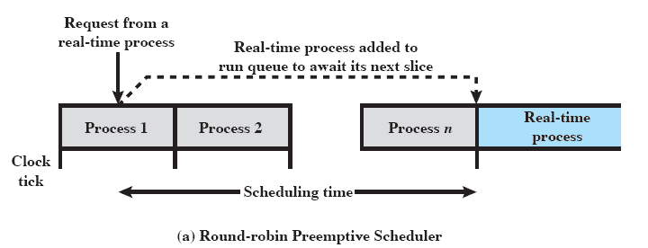
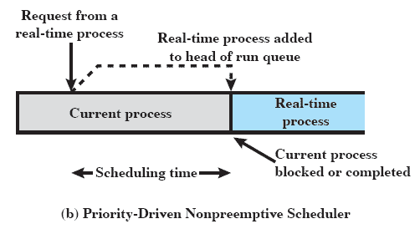
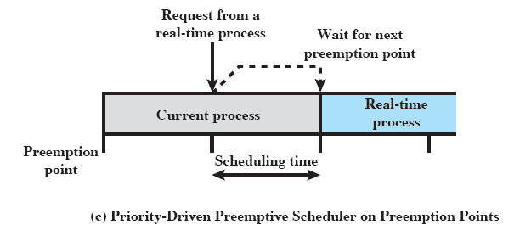
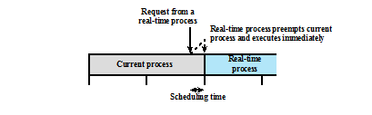
Real Time Scheduling of Processes
(d) Immediate preemptive scheduler
Source: Pearson

Slide 35
Real-Time Scheduling
Real-time scheduling is one of the most active areas of research in computer science
Scheduling approaches depend on
  Whether a system performs schedulability analysis
    If it does, whether it is done statically or dynamically
  Whether the result of the analysis itself produces a schedule
    According to which tasks are dispatched at run time

Slide 36
Classes of Real-Time Scheduling Algorithms
Static table-driven approaches
  Perform a static analysis of feasible schedules of dispatching
  Result is a schedule that determines when a task must begin execution
  Applicable to periodic tasks whose arrival time, execution time, deadlines are predictable
    Example – Earliest deadline scheduling
Static priority-driven preemptive approaches
  A static analysis is performed but no schedule is drawn up
  Analysis is used to assign priorities to tasks so that a traditional priority-driven preemptive scheduler can be used
    Example - RMS
  Common in most non-real-time systems
Dynamic planning-based approaches
  Feasibility is determined at run time rather than offline prior to the start of execution
  An arriving task is accepted for execution only if it is feasible to meet its time constraints
  The analysis produces a schedule
Dynamic best effort approaches
  No feasibility analysis is performed
    Priority-based preemptive scheduling or earliest deadline scheduling can be used
  Try to meet all deadlines and abort any started process whose deadline is missed
  Used by many commercial real-time systems

Slide 37
Deadline Scheduling
Real-time operating systems are designed with the objective of starting real-time tasks as rapidly as possible and emphasize rapid interrupt handling and task dispatching
Real-time applications are generally not concerned with sheer speed but rather with completing (or starting) tasks at the most valuable times
Priorities provide a crude tool and do not capture the requirement of completion (or initiation) at the most valuable time

Slide 38
Information Used for Deadline Scheduling
Ready time
  Time at which task becomes ready for execution
Starting deadline
  Time by which task must begin
Completion deadline
  Time by which task must be completed
Processing time
  Time required to execute the task to completion
Resource requirements
  Resources required by the task while it is executing
Priority
  Measures the relative importance of the task
Subtask structure
  A task may be decomposed into a mandatory subtask and an optional subtask. Only the mandatory subtask possesses a hard deadline

Slide 39
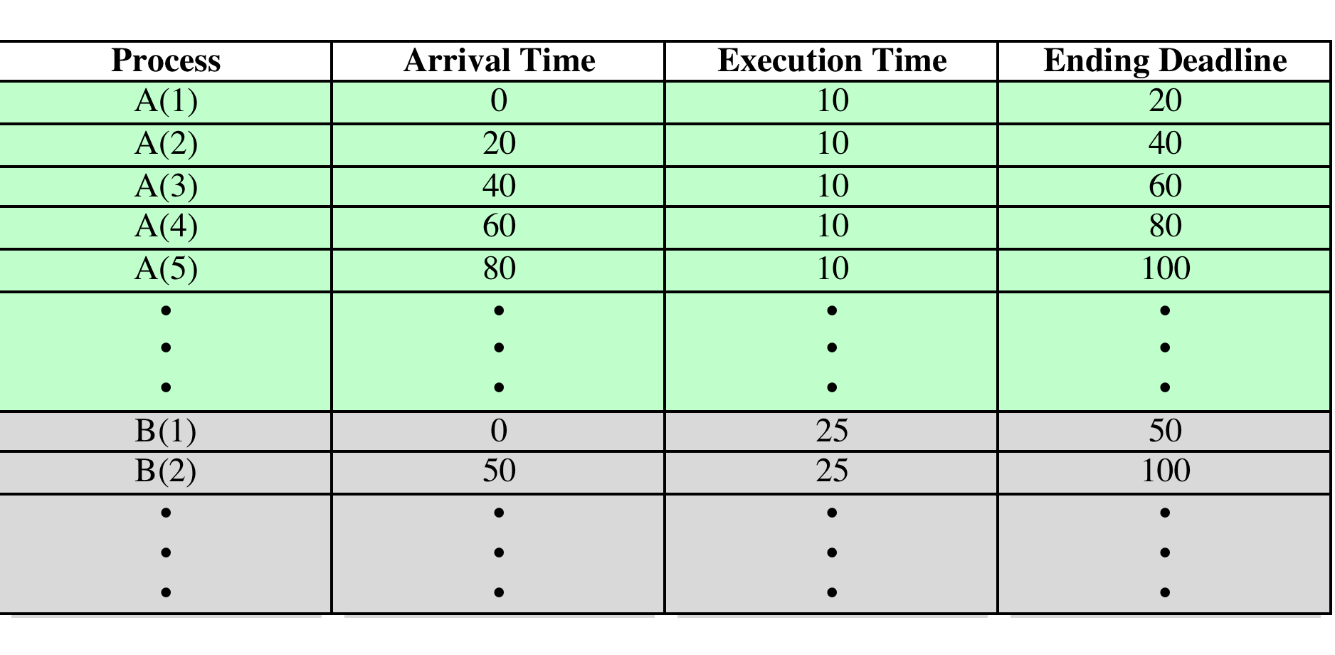
Execution Profile of Two Tasks
Source: Pearson

Slide 40
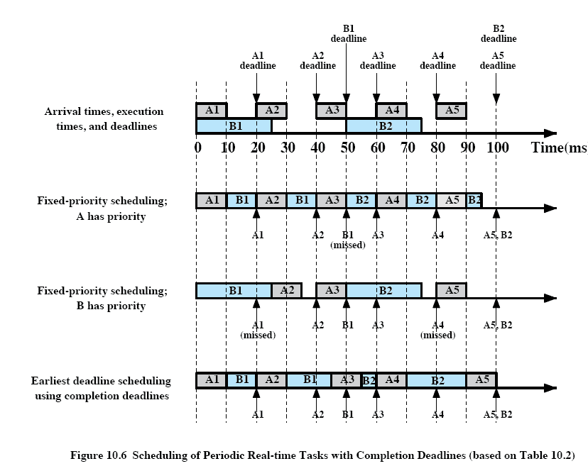
Scheduling of Periodic Tasks with Completion Deadlines
Source: Pearson

Slide 41
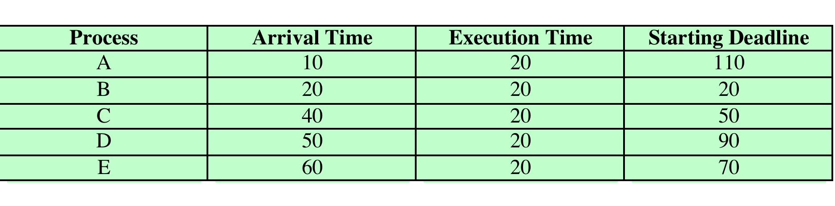
Execution Profile of 5 Aperiodic Tasks
Source: Pearson

Slide 42
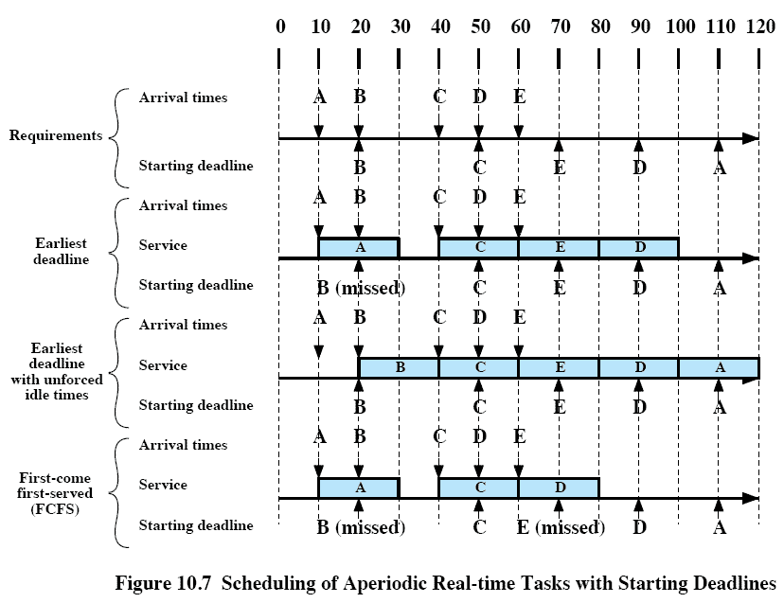
Scheduling of Aperiodic Tasks with Starting Deadlines
nonpreemptive
If deadlines can be known in advance
Source: Pearson

Slide 43
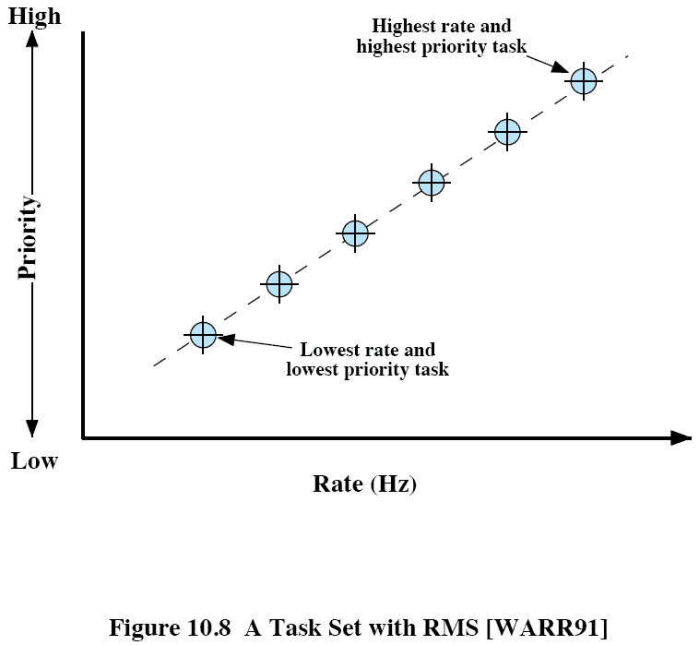
Rate Monotonic Scheduling
RMS
  Popular scheduling algorithm for periodic tasks
  The highest priority is given to a process with the shortest period
  The 2nd highest priority is given to a process with the second shortest period
  The priority is a monotonically increasing function of their rate
Source: Pearson

Slide 44
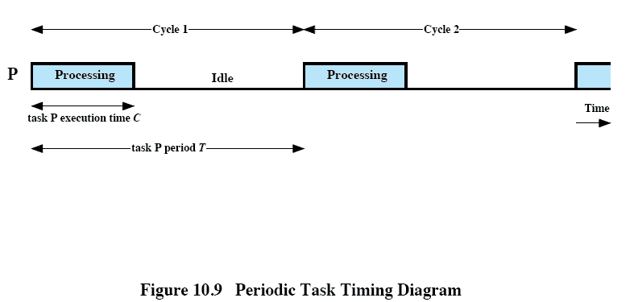
Periodic Task Timing Diagram
For example, a task with a period of 50ms occurs at a rate of 20Hz!
Typically, the end of a task’s period is also the task’s hard deadline
Source: Pearson

Slide 45
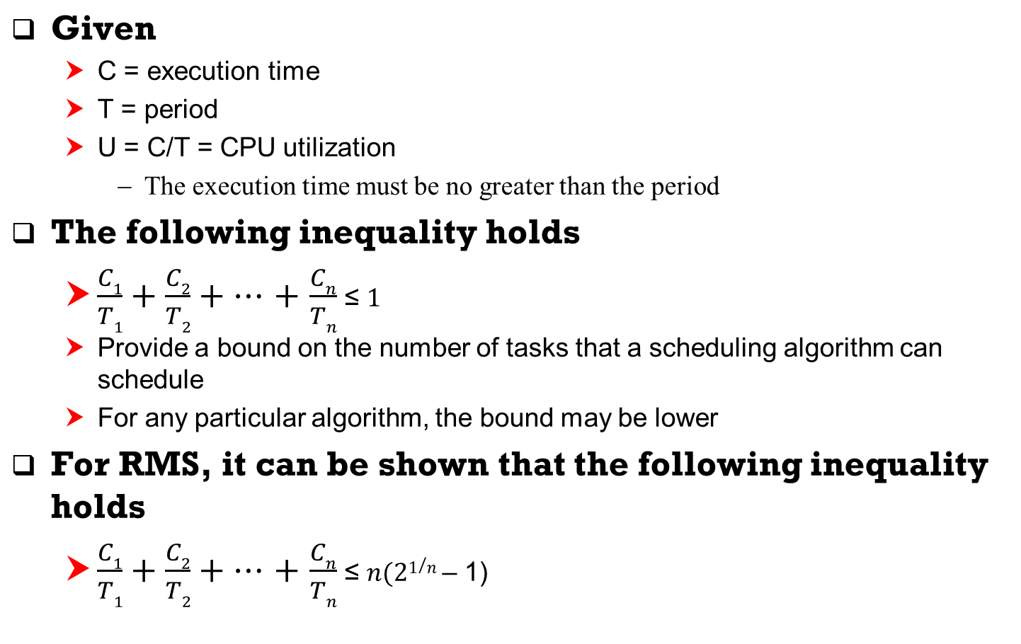
RMS Analysis

Slide 46
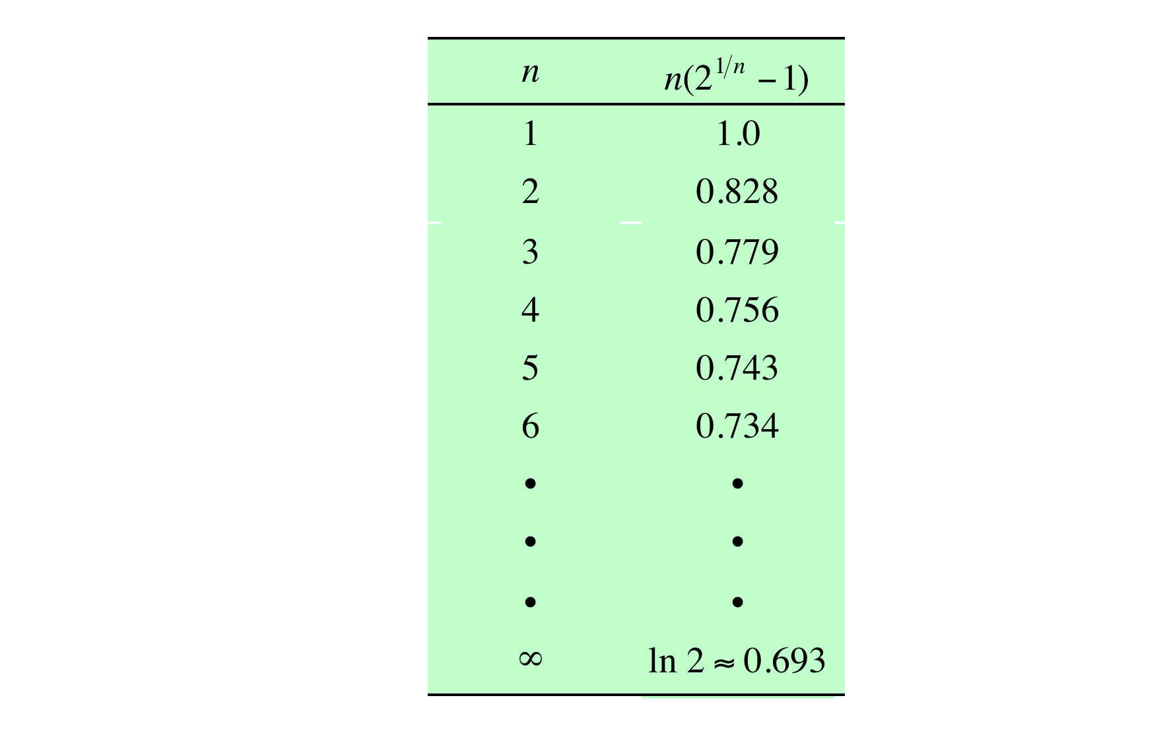
Value of the RMS Upper Bound
Source: Pearson

Slide 47
Priority Inversion
Can occur in any priority-based preemptive scheduling scheme
  Best-known instance was the Mars Pathfinder mission. This rover robot landed on Mars on July 4, 1997 and began gathering and transmitting voluminous data back to Earth. But a few days into the mission, the software began experiencing system resets, each resulting in losses of data. The problem was traced to priority inversion.
Priority inversion occurs when circumstances within the system force a higher priority task to wait for a lower priority task
  A simple example occurs if a lower-priority task has locked a resource and a higher priority task attempts to lock the same resource. The higher priority task will block until the resource is available.
A more serious condition is referred as an unbounded priority inversion
  The duration of a priority inversion depends not only on the time required to handle a shared resource, but also on the unpredictable actions of other unrelated tasks. The pathfinder software was a good example.

Slide 48
Pathfinder Example
Pathfinder software included the following 3 tasks in decreasing order of priority
  T1: periodically check the health of the spacecraft system and software
  T2: process image data
  T3: perform an occasional test on equipment status
After T1 executes, it reinitializes a timer to a maximum
If this timer ever expires,
  It is assumed that the system integrity has been compromised
  The CPU is halted, all devices are reset, and the software is reloaded, and the spacecraft system starts over.
  This recovery sequence does not complete until the next day.
T1 and T3 share a common data structure protected by a binary semaphore

Slide 49
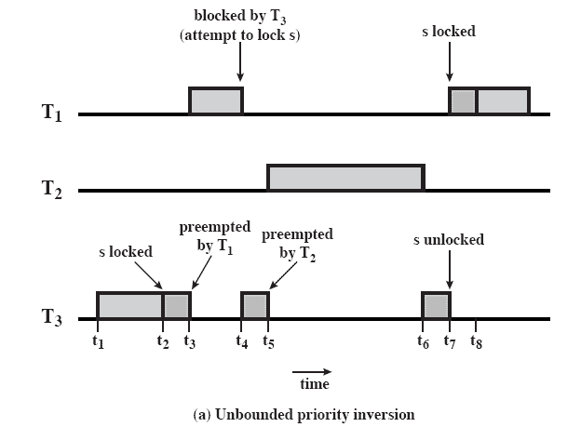
Unbounded Priority Inversion
t1: T3 begin executing.
t2: T3 locks semaphore s
t3: T1 (higher priority) preempt T3 and begin executing.
t4: T1 is blocked since the semaphore s is locked by T3. T3 resume execution.
t5: T2 preempt T3
t6: T2 is suspended for some reason and T3 resumes
t7: T3 unlocks s and T1 preempts T3
=> T1 must wait for both T2 and T3 to complete and fails to reset the timer before it expires!
Source: Pearson

Slide 50
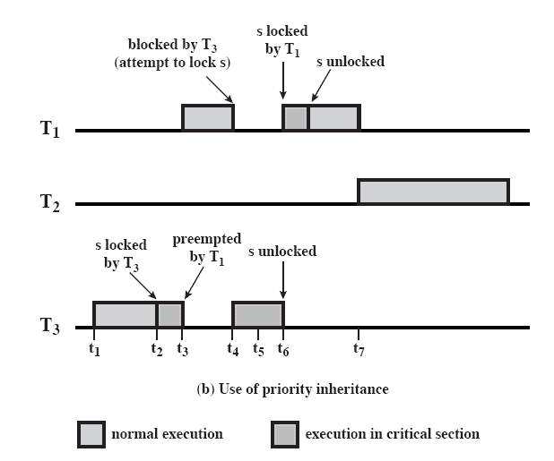
Priority Inheritance
A lower priority task inherits the priority of any higher priority task pending on a resource they share
This priority change takes place as soon as the higher priority task blocks on the resource and it should end when the resource is released by the lower priority task.
Source: Pearson

Slide 51
Homework 9
Exercise 10.1
Exercise 10.3
Exercise 10.4
Exercise 10.7

