Slide 1
Computer Architecture
Introduction
Lynn Choi
Korea University

Slide 2


Class Information
Lecturer
  Prof. Lynn Choi, School of Electrical Eng.
  Phone: 3290-3249, 공학관 411, lchoi@korea.ac.kr
  TA: 손원준, 3290-3896, swj8905@korea.ac.kr
Time
  Mon/Wed 2pm – 3:15pm
  Office Hour: By emails
Place
  아산이학관 535
Textbook
  Computer Organization and Design (MIPS Edition): The Hardware/Software Interface, D. Patterson, J. Hennessy, Elsevier, 6th Edition, 2020.
Textbook 2
  Computer Systems: A Programmer’s Perspective”, Randal E. Bryant and David O’Hallaron, Prentice Hall, 3rd Edition, 2016.
Class homepage
  http://it.korea.ac.kr, http://kulms.korea.ac.kr (Blackboard) : slides, announcements

Slide 3

Class Information
Video lecture archives
  http://kuocw.korea.ac.kr (OCW), http://youtube.com: search “컴퓨터구조” and “최린＂
Project
  MIPS assembly programming
Evaluation
  Midterm : 35%
  Final: 35%
  Homework and Projects: 30%
  Class participation: +/- 5%
    Attendance: no shows of more than 3 will get -5%
    Bonus points and Quiz

Slide 4
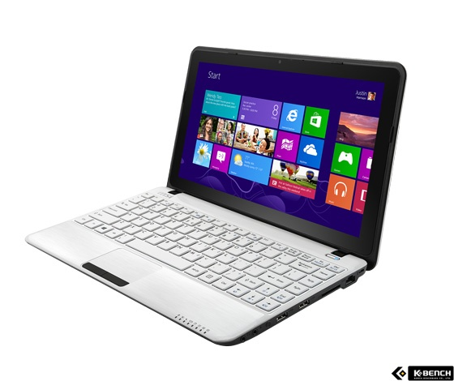
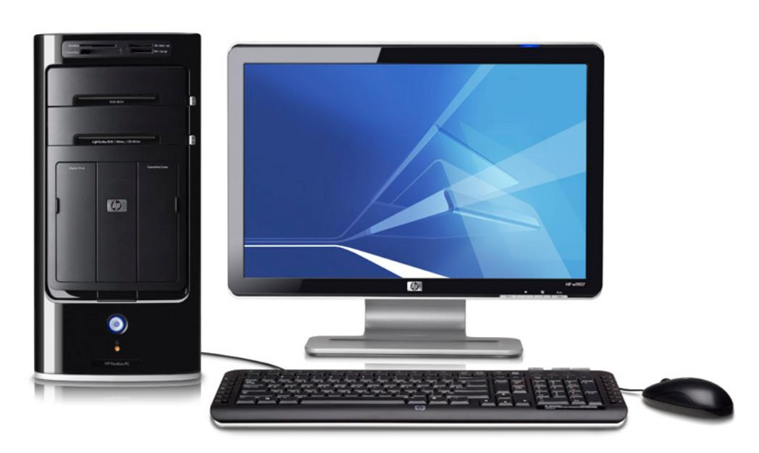

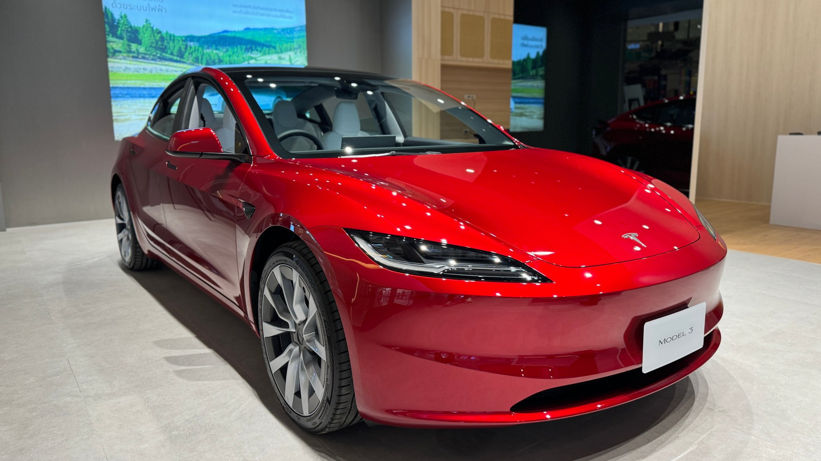
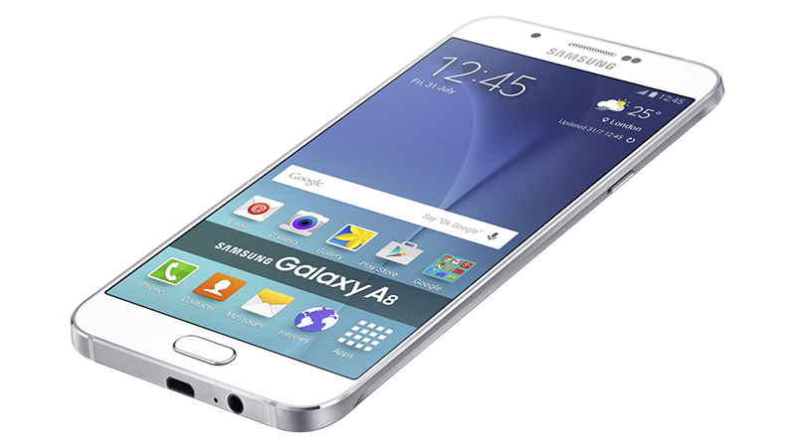
What is a Computer?

Slide 5
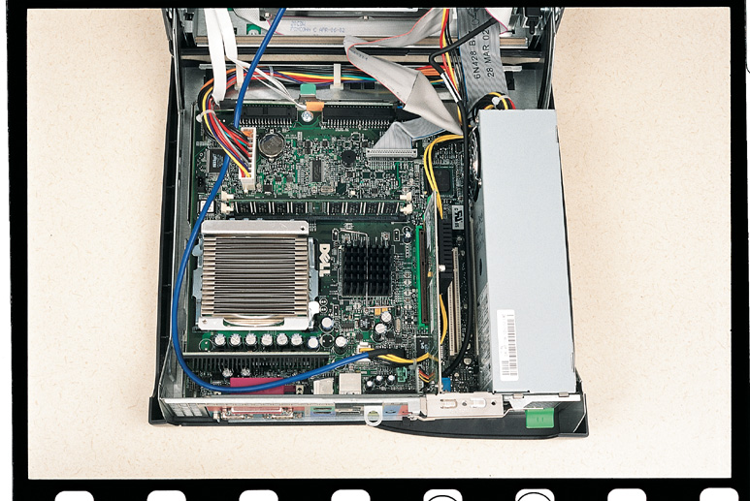
What’s Inside a Computer?

Slide 6
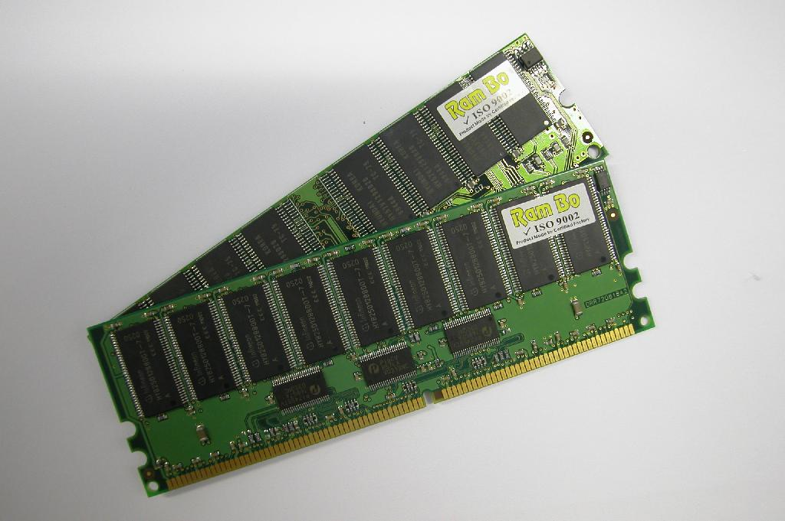
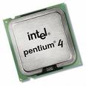
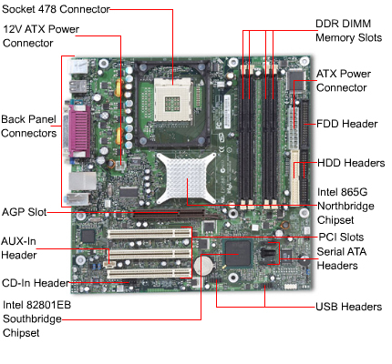
Computer Components

Slide 7
Basics: What is inside Computer?
Processor
  a.k.a. CPU (Central Processing Unit)
  Fetch instructions from memory
  Decode and execute instructions
  Transfers data from/to memory
Memory
  Caches, main memory, HDD, CD-ROM, DVD, ROM, FLASH, ..
  Stores program (instructions and data)
Input devices
  Mouse, keyboard, camera, pen, touch screen, barcode reader, scanner, microphone, …
Output devices
  Printer, monitor, speaker, beam projector, ..
Interconnects: buses
Motherboards, chipsets, …

Slide 8
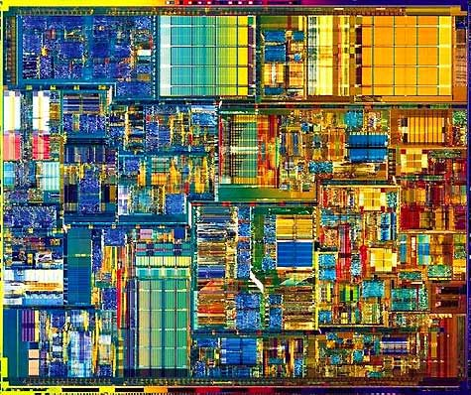
What’s inside a CPU?
Pentium 4 Processor Die on 0.18 micron (42M transistors)
400MHz
system bus
Advanced
Transfer Cache
Pipeline
Trace cache
FP/MMX

Slide 9
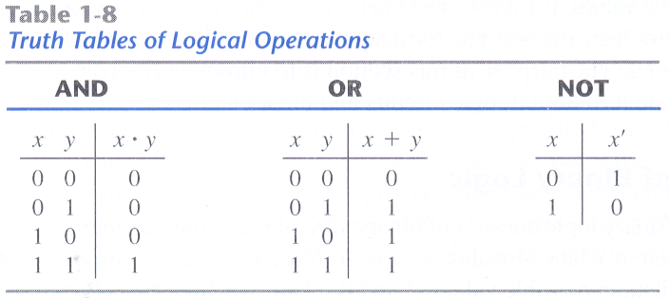


Logic Level : Gates

Slide 10
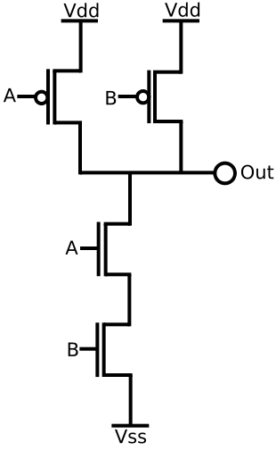
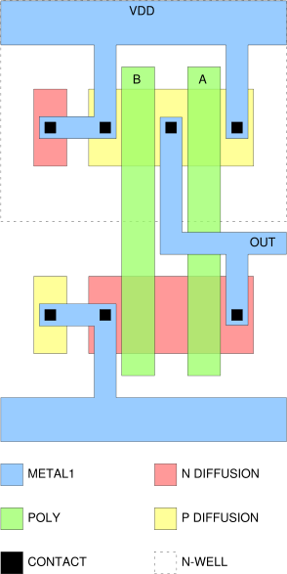
Circuit Level: Transistors
CMOS NAND Gate

Slide 11
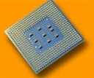
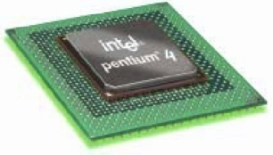

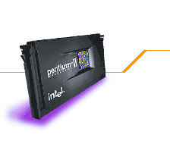
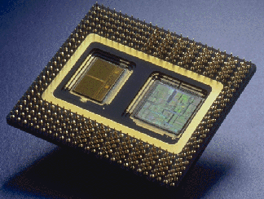

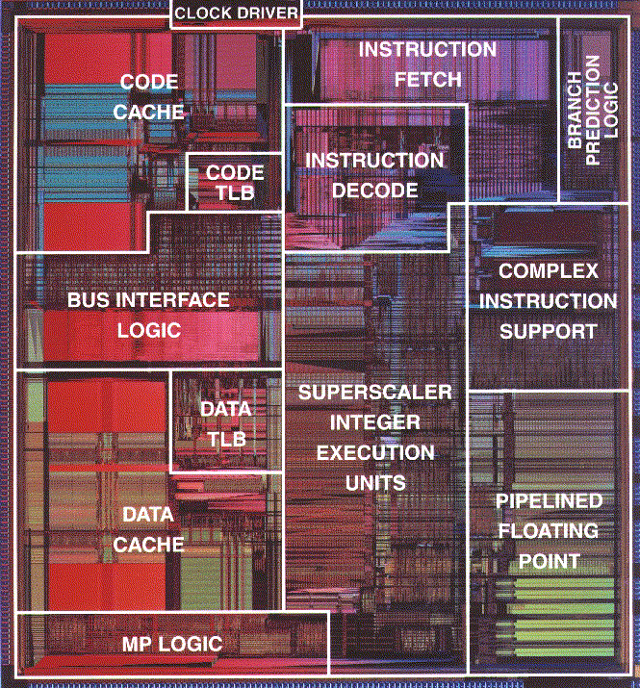
Advances in Intel Microprocessors
80
81.3 (projected)
Pentium IV 2.8GHz
(superscalar, out-of-order)
70
60
42X Clock Speed ↑
2X IPC ↑
45.2 (projected)
50
Pentium IV 1.7GHz
(superscalar, out-of-order)
SPECInt95 Performance
40
24
Pentium III 600MHz
(superscalar, out-of-order)
30
8.09
11.6
20
3.33
PPro 200MHz
(superscalar, out-of-order)
Pentium 100MHz
(superscalar, in-order)
1
Pentium II 300MHz
(superscalar, out-of-order)
80486 DX2 66MHz (pipelined)
10
1992 1993 1994 1995 1996 1997 1998 1999 2002

Slide 12

Terminology
Microprocessor: a single chip processor
    i7, Pentium IV, AMD Athlon, SUN Ultrasparc, ARM, MIPS, ..
ISA (Instruction Set Architecture)
  Define machine instructions (machine language)
  Also, define visible machine states such as registers and memory
  Examples
    x86(IA32): 386 ~ Pentium III, Pentium IV
    IA64: Itanium, Itanium2
    Others: PowerPC, SPARC, MIPS, ARM
Microarchitecture
  Implementation according to the ISA
    Pipelining, caches, branch prediction, buffers
    Invisible to programmers
    With the same ISA, performance and power may differ depending on the microarchitecture
  Examples
    x86 : 80386 (1st gen), 80486 (2nd), Pentium (3rd), Pentium Pro (4th), Pentium IV (5th )

Slide 13

Terminology
CISC (Complex Instruction Set Computer)
  Each instruction is complex
    Instructions of different sizes, many instruction formats, allow computations on memory data, …
  A large number of instructions in ISA
  Architectures until mid 80’s
    Examples: x86, VAX
RISC (Reduced Instruction Set Computer)
  Each instruction is simple
    Fixed size instructions, only a few instruction formats
  A small number of instructions in ISA
  Load-store architectures
    Computations are allowed only on registers
      Data must be transferred to registers before computation
  Most architectures built since 80’s
    Examples: MIPS, ARM, PowerPC, Alpha, SPARC, IA64, PA-RISC, etc.

Slide 14
Terminology
Word
  Default data size for computation
    Size of a GPR & ALU data path depends on the word size
  The word size determines if a processor is a 8b, 16b, 32b, or 64b processor
Address (or pointer)
  Points to a location in memory
  Each address points to a byte (byte addressable)
  If you have a 32b address, you can address 2³² bytes = 4GB
  If you have a 256MB memory, you need at least 28 bit address since 2²⁸ = 256MB
Caches
  Faster but smaller memory close to processor
    Fast since they are built using SRAMs, but more expensive

Slide 15
Terminology
Moore’s law
  # of transistors integrated on a single chip would double every 18 months
  Stated by Gordon Moore, one of Intel founders
Minimum feature size (λ)
  The minimum length of the MOS transistor channel between the drain and the source, a.k.a. transistor gate length
  Defines the scaling of the semiconductor technology
  Between 1970 and 2015, the gate length shrank from 10μm to 14nm
Parallelism
  ILP (Instruction Level Parallelism)
    Superscalar processors, VLIW (Very Long Instruction Word)
  DLP (Data Level Parallelism, also known as SIMD)
    MMX (Multimedia Extensions), SSE (Streaming SIMD Extensions), vector processors, GPU (Graphic Processing Unit)
  TLP (Thread Level Parallelism, also known as MIMD)
    multithreaded processors, multicores, multiprocessors

Slide 16
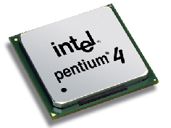

Pentium 4 Microprocessor
Intel Pentium IV Processor
  Technology
    0.13μ process, 55M transistors, 82W
    3.2 GHz, 478pin Flip-Chip PGA2
  Performance
    1221 Ispec, 1252 Fspec on SPEC CPU 2000
      Relative performance to SUN 300MHz Ultrasparc (100)
    40% higher clock rate, 10~20% lower IPC compared to P III
  Pipeline
    3-issue, 20-stage out-of-order (OOO) pipeline, hyperthreading
  Cache hierarchy
    12K micro-op trace cache/8 KB on-chip D cache
    On-chip 512KB L2 ATC (Advanced Transfer Cache)
    Optional on-die 2MB L3 Cache
  800MHz system bus, 6.4GB/s bandwidth
    Compared with 1.06GB/s on P III 133MHz bus
    Implemented by quad-pumping on 200MHz system bus

Slide 17
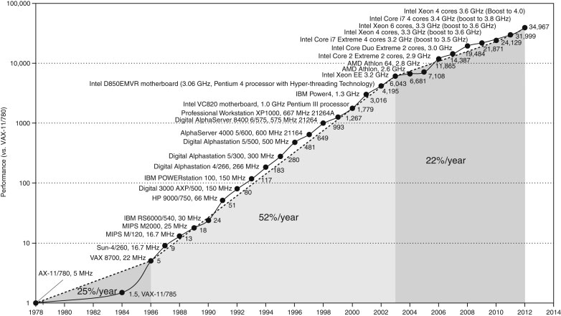


Microprocessor Performance Curve

Slide 18

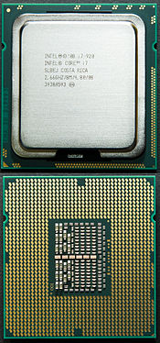
Today’s Microprocessor
Intel i7 Processor (2010)
  Technology
    32nm process, 130W, 239 mm² die, 1.17B transistors
    3.46 GHz, 64-bit 6-core 12-thread processor
    159 Ispec, 103 Fspec on SPEC CPU 2006
      296MHz UltraSparc II processor as a reference machine (1)
  Core microarchitecture
    Next generation multi-core microarchitecture introduced in Q1 2006 (Derived from P6 microarchitecture)
    Optimized for multi-cores and lower power consumption
      4-issue 14-stage out-of-order (OOO) pipeline
    64bit Intel architecture (x86-64)
    Core i3 (entry), Core i5 (mainstream), Core i7 (high-end), Xeon (server)
  32KB L1 data/instruction, 256KB L2 cache/core, 12MB L3 Caches
  Integrated memory controller
    36bit physical address, 3.2GHz clock, 25.6 GB/s memory bandwidth
Intel i7 Processor (2023)
  13th generation, 10n (Intel 7) process, 8+8 cores, 24 threads, 2.5~5.4GHz, 125~253W

Slide 19
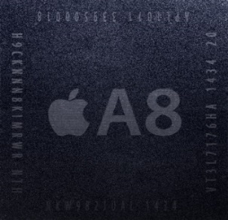

Today’s Microprocessor
Apple A8 Chip (2014)
  SoC designed by Apple and manufactured by TSMC
  20nm process, 89mm² die, 1.3W(estimated), 2B transistors
  1.4 GHz 64-bit ARM based dual-core CPU with integrated quad-core PowerVR GX6450 GPU
    Custom-designed dual-core CPU called Cyclone 2 (Typhoon)
      ARMv8-A compatible
      Rather than ARM-licensed CPU (ARM Cortex A9 in A5)
    6-issue OOO pipeline with 64KB L1-I/D, 1MB L2, 4MB L3
    25% improvement in CPU and 50% more performance in GPU performance with only 50% of power compared to A7
  Used for iPhone 6 and 6 Plus
Apple A9 (2015), A10 (2016), A11 (2017), … , A16 (2022)
      A10: 40% faster CPU and 50% faster graphics performance compared to A9
      A11 Bionic: 20% faster CPU and 30% faster graphics performance compared to A10
        64-bit six-core CPU, 10nm process, 4.3B transistors, neural engine for faceID
      A12 Bionic: 15% faster CPU and 50% faster graphics performance compared to A11
        64-bit six-core CPU (2 7-issue cores + 4 3-issue cores), 6.9B transistors, neural II
      A15 Bionic: 2+4 cores, 15B transistors, 5nm process, 3.24GHz, for iPhone 13 and 14
      A16 Bionic: 2+4 cores, 16B transistors, 5nm process, 3.46GHz, for iPhone 14 Pro, 15

Slide 20
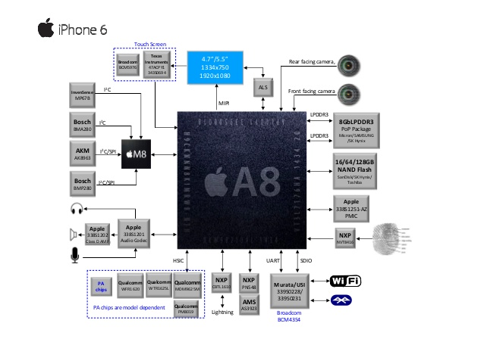
iPhone 6 System Architecture

Slide 21
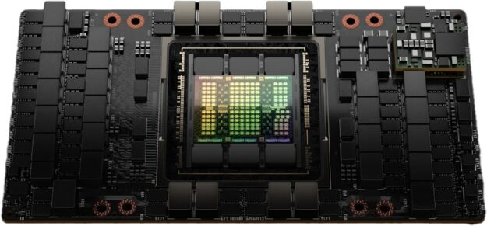
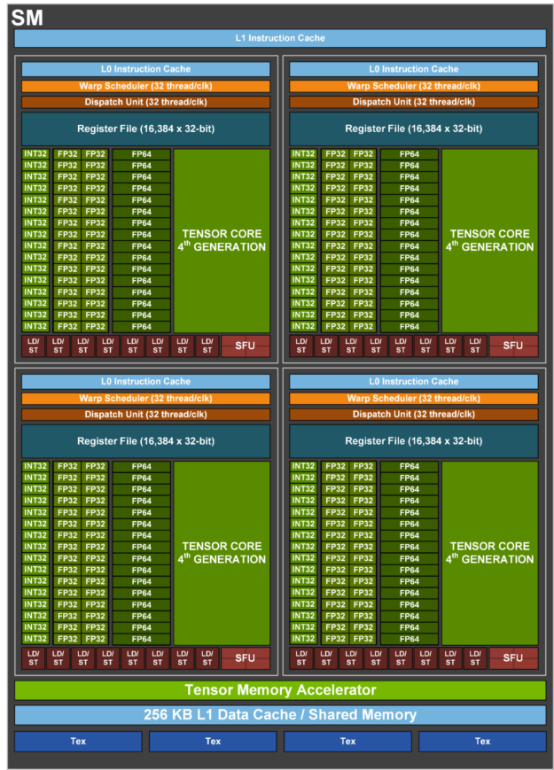
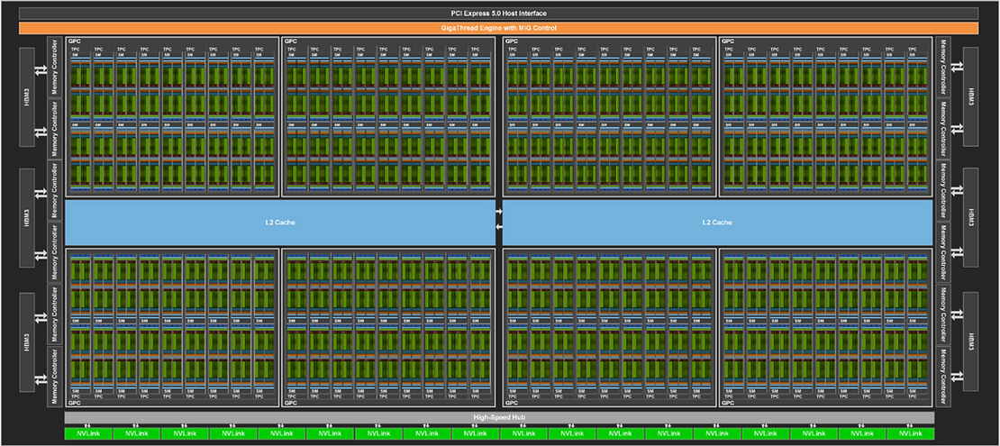
Today’s Processor
NVIDIA’s H100 (2022)
  Technology
    TSMC 4nm process, 700W, 80B transistors
    1.593 GHz, 144 streaming multiprocessors
      4th generation Tensor cores, Transformer engine
    35,000 parts and weighs 70 lb (32 kg)
    For data centers (deep learning and HPC)
  Hopper microarchitecture
    The latest (9th) generation of GPU microarchitecture called Hopper
      Tesla-Fermi-Kepler-Maxwell-Pascal-Volta-Turing-Ampere-Hopper-Blackwell
    Supports HBM3 and HBM2e memory up to 80GB
      HBM3 supports 3 TB/s, an increase of 50% over the Ampere A100
    256KB L1 per SM, 50MB L2
  Streaming multiprocessor
    128 FP32 CUDA cores
    4 Tensor cores

Slide 22
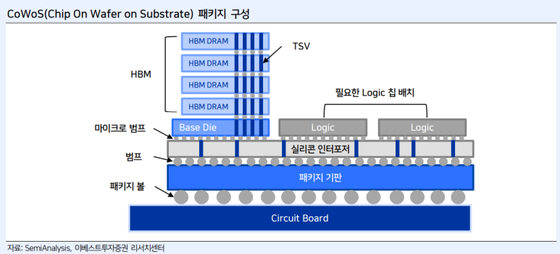
Today’s Processor
NVIDIA’s H100 Streaming Multiprocessor

Slide 23
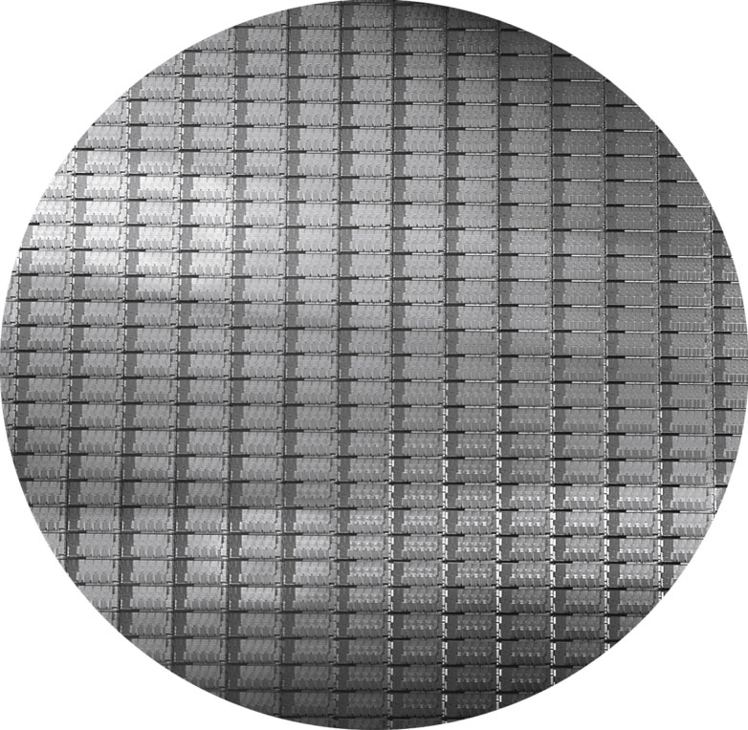
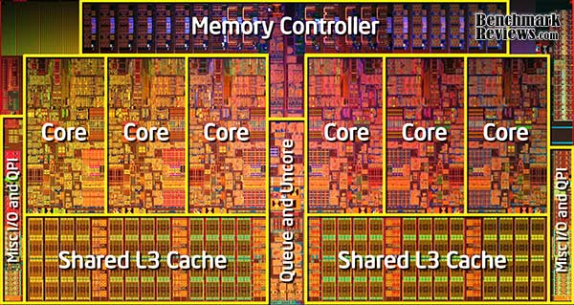
12-inch wafer and Die photo of Intel Core i7
The number of dies on this 300mm (12inch) wafer
At 100% yield is 280, each 20.7 by 10.5mm.

Slide 24


Processor Performance Equation
T_{exe} (Execution time per program)
= NI * CPI_{execution} * T_{cycle}
  NI: # of instructions / program (program size)
    Small program is better
  CPI: clock cycles / instruction
    Small CPI is better. In other words, higher IPC is better
  T_{cycle} = clock cycle time
    Small clock cycle time is better. In other words, higher clock speed is better

Slide 25
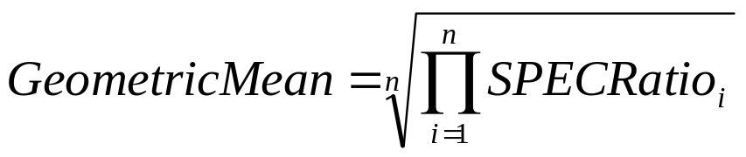
SPEC (Standard Performance Evaluation Corporation)
Non-profit organization to endorse a standardized set of benchmarks
  SPEC CPU2006, SPECviewperf, SPECweb, etc.
SPECCPU: provide performance measurements for compute-intensive workloads
  SPEC CPU2006 has two benchmark suites
    CINT2006: 12 integer applications for PC
    CFP2006: 17 FP applications for servers
  SPEC CPU2017 has 10 integer and 13 FP applications
  SPECratio: Normalize execution time to a reference computer
    = Time on reference computer
    Time on target machine
  Since we use ratios, proper mean is geometric mean

Slide 26
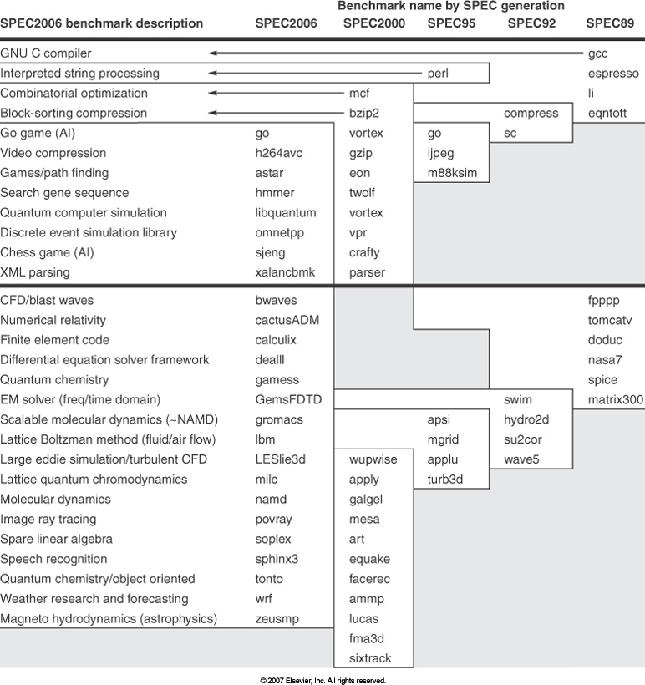
SPEC Benchmark Evolution

Slide 27
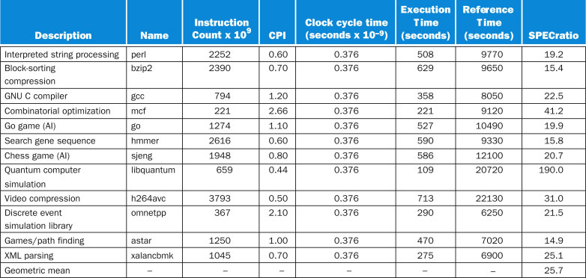
CINT2006 running on 2.66GHz i7

Slide 28
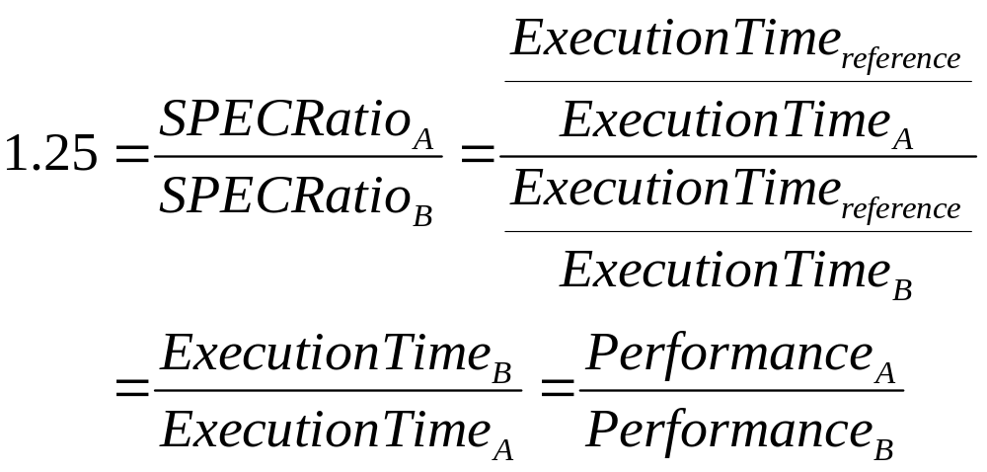
Comparing Performance
If SPECRatio on Computer A is 1.25 times bigger than Computer B, then
Note that when comparing 2 computers as a ratio, execution times on the reference computer drop out, so choice of reference computer is irrelevant

Slide 29

Class Information
Class content
  Introduction (Chapter 1)
  Instruction Set Architecture (Chapter 2)
  Linking (Ch. 7)
  Computer Arithmetic (Chapter 3)
  Pipelining (Chapter 4)
  Caches and Memory Hierarchy (Chapter 5)
  Virtual Memory (Ch. 9)
  Exceptions, Interrupts and Signals (Ch. 8)
  Multicores and IO (Chapter 6, Ch. 10)

Slide 30
Homework 1
Read Chapter 1 and Chapter 2
Exercise
  1.2
  1.5
  1.6
  1.8
  1.10
  1.12
  1.14

