Slide 1
Computer Architecture
Instruction Set Architecture
Lynn Choi
Korea University

Slide 2





Machine Language
Programming language
  High-level programming languages
    Procedural (imperative) languages: C, PASCAL, FORTRAN
    Object-oriented languages: C++, C#, Objective-C, Java, Python, Kotlin
    Functional (declarative) languages: Lisp, Scheme
    Multiple paradigms (hybrid):
  Machine languages: binary (1’s and 0’s), IA32, IA64, ARM, MIPS, PowerPC
    Assembly programming languages: symbolic machine languages
Translator
  Compiler: translate a high-level language program into a machine language program
    Assembler: translate an assembly language program into a machine language program
      A part of a compiler
  Interpreter: translate and execute programs directly
    JVM(Java virtual machine): translate/execute Java bytecode to native machine instructions
      cf. Java compiler translate Java program to Java bytecode

Slide 3
Compiler
Compiler
  A program that translates a source program (written in language A) into an equivalent target program (written in language B)
  Source program
    Usually written in high-level programming languages (called source language) such as C, C++, Java, FORTRAN, Python
  Target program
    Usually written in machine languages (called target language) such as x86, Alpha, MIPS, SPARC, or ARM instructions
What qualities do you want in a compiler?
    Generate correct code
    Target code runs fast
    Compiler runs fast
    Support for separate compilation, good diagnostics for errors
Source
Program
Compiler
Target
Program

Slide 4
Compilation Process
Source program
Preprocessor
Expands macros and header files into the source program
Expanded Source Program
Compiler
Assembly Program
Assembler
Relocatable code (object file)
Libraries, other relocatable
object files
Linker
Target program (executable file)

Slide 5
Compiler Phases
Source
Program
Lexical Analyzer
Tokens
Front-End : language dependent
Syntax Analyzer
Tree
Intermediate
Code Generator
I.C. : Intermediate Code
O.C. : Optimized Code
I.C.
Code Optimizer
Back-End : machine dependent
O.C.
Object
Program
Target
Code Generator

Slide 6

Machine State
ISA defines machine states and instructions
Registers
  CPU internal storage to store data fetched from memory
    Can be read or written (usually) in a single cycle
    Arithmetic and logic operations are usually performed on registers
    MIPS ISA has 32 32-bit registers: Each register consists of 32 flip-flops
  Top level of the memory hierarchy
    Registers <-> caches <-> memory <-> hard disk
      Registers are visible to programmers and maintained by programmers
      Caches are invisible to programmers and maintained by HW
Memory
  A large, single dimensional array, starting at address 0
    To access a data item in memory, an instruction must supply an address.
  Store programs (which contains both instructions and data)
  To transfer data, use load (memory to register) and store (register to memory) instructions

Slide 7
Data Size & Alignment
Data size
  Word : the default data size for computation
    32b for 32b ISA, 64b for 64b ISA
  Double word: 64b data, Half word: 16b data, Byte: 8b data
    Load/store instructions can designate data sizes transferred: ldw, lddw, ldhw, ldb
Byte addressability
  Each byte has an address
Alignment
  Objects must start at addresses that are multiple of their size
  Object addressed Aligned addresses Misaligned addresses
  Byte 0, 1, 2, 3, 4, 5, 6, 7 Never
  Half Word 0, 2, 4, 6 1, 3, 5, 7
  Word 0, 4 1, 2, 3, 5, 6, 7
  Double Word 0 1, 2, 3, 4, 5, 6, 7

Slide 8

Machine Instruction
Opcode : specifies the operation to be performed
  EX) ADD, MULT, LOAD, STORE, JUMP
Operands : specifies the location of data
  Source operands (input data)
  Destination operands (output data)
  The location can be
    Memory operand specified by a memory address : EX) 8(R2), x1004F
    Register operand specified by a register number : R1

Slide 9
Instruction Types
Arithmetic and logic instructions
  Performs actual computation on operands
  EX) ADD, MULT, XOR, SHIFT, FDIVIDE, FADD
Data transfer instructions (memory instructions)
  Move data from memory to registers (LOAD) or vice versa (STORE)
  Input/Output instructions are usually implemented by memory instructions (memory-mapped IO)
    IO devices are mapped to memory address space
Control transfer instructions (branch instructions)
  Change the program control flow (i.e. change the PC)
    Determine the address of the next instruction to be fetched
      Program Counter (PC): A special register that holds the address of the next instruction to execute
  Unconditional jumps and conditional branches
  Direct branches and indirect branches
  EX) JUMP, CALL, RETURN, BEQ

Slide 10
MIPS Instruction Format
6 5 5 5 5 6
  Op: Opcode, basic operation of the instruction
  Rs: 1st source register
  Rt: 2nd source register
  Rd: destination register
  shamt: shift amount (immediate operand)
  funct: function code, the specific variant of the opcode
  Used for arithmetic/logic instructions
  Rs: base register, Rt : destination register for load and source register for store
  Address: +/- 2¹⁵ bytes offset (a.k.a displacement)
  Used for loads/stores and conditional branches
R-type
op
rs
rt
rd
shamt
funct
6 5 5 16
I-type
op
rs
rt
address

Slide 11
MIPS Addressing Modes
Register addressing
  Address is in a register
  jr $ra (indirect branches)
Base addressing
  Address is the sum of a register (base register) content and a constant (offset)
  ldw $s0, 100($s1)
Immediate addressing
  For constant operand (immediate operand)
  add $t1, $t2, 3
PC-relative addressing
  Address is the sum of PC and a constant (offset)
  beq $s0, $s1, L1
Pseudodirect addressing
  Address is the 26 bit offset concatenated with the upper bits of PC
  j L1

Slide 12
MIPS Instruction formats
    Arithmetic instructions
    Data transfer, conditional branch, immediate format instructions
    Jump instructions
R-type
6 5 5 5 5 6
op
rs
rt
rd
shamt
funct
I-type
6 5 5 16
op
rs
rt
address/immediate
J-type
6 26
op
address

Slide 13
MIPS Instruction Example: R-format
MIPS Instruction:
  add $8,$9,$10
  Decimal number per field representation:
0
9
10
8
0
32
  Binary number per field representation:
000000
01001
01010
01000
00000
100000
_{hex}
  hex representation: 012A 4020_{hex}
Elsevier Inc. All rights reserved
  decimal representation: 19,546,144_{ten}
  Called a Machine Language Instruction

Slide 14
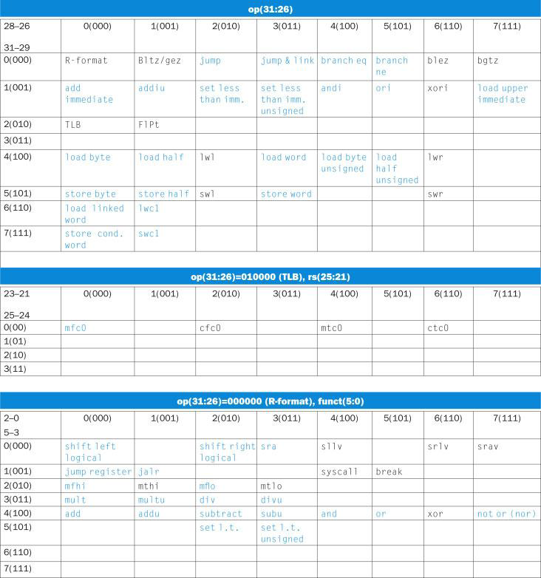
MIPS Instruction Opcode Table
Elsevier Inc. All rights reserved

Slide 15
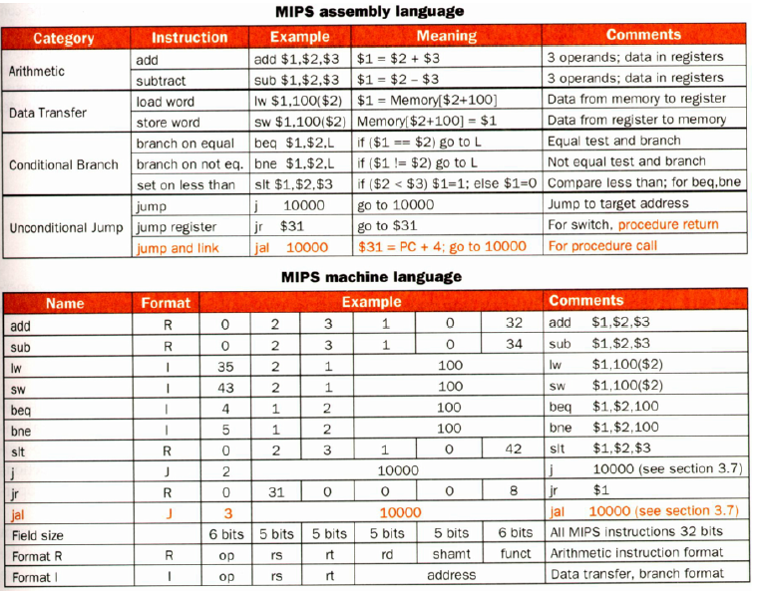
MIPS Instruction Examples
Elsevier Inc. All rights reserved

Slide 16




Procedure Call & Return
Steps of procedure call & return
  Place parameters in a place where the callee can access
    $a0 - $a3: four argument registers
  Transfer control to the callee
    jal callee_address : jump and link instruction
      Put return address (PC+4) in $ra and jump to the callee
  Acquire the storage (stack frame) needed for the callee
  Perform the desired task
  Place the result value in a place where the caller can access
    $v0 - $v1: two value registers to return values
  Return control to the caller
    jr $ra

Slide 17
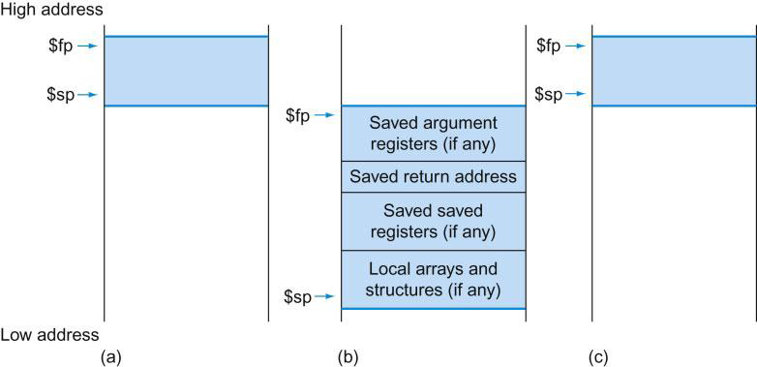
Stack
Stack frame (a.k.a activation record) of a procedure
  Store variables local to a procedure
    Procedure’s saved registers
      Arguments, return address, saved registers, local variables
  Stack pointer ($sp) : point to the top of the stack
  Frame pointer ($fp) : point to the bottom of the top stack frame
Elsevier Inc. All rights reserved

Slide 18
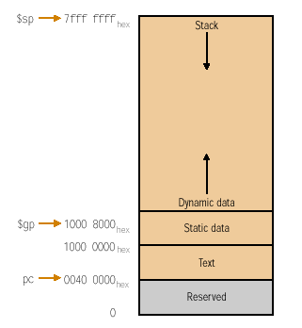
MIPS Memory Allocation
Elsevier Inc. All rights reserved

Slide 19
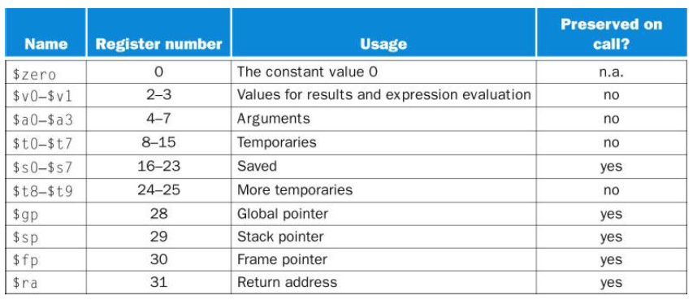
MIPS Register Convention
Elsevier Inc. All rights reserved

Slide 20
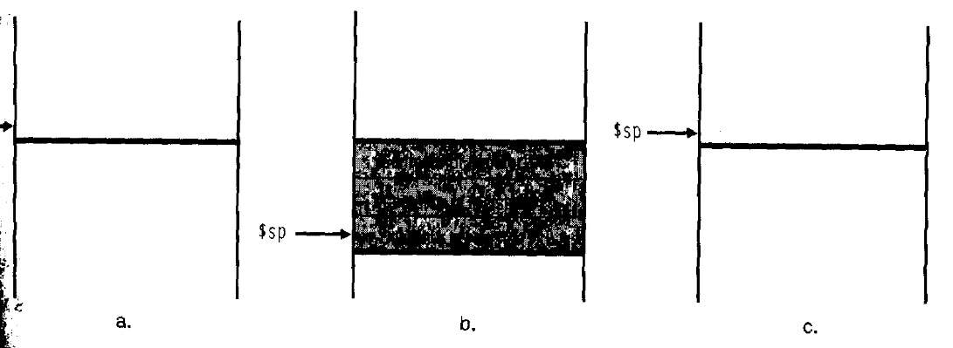
MIPS Example : Procedure
    int leaf_example (int g, int h, int i, int j)
    { int f;
    f = (g + h) – ( i + j);
    return f;}
Assembly code
    leaf_example:
    sub $sp, $sp, 8
    sw $t1, 4($sp) # save register $t1, $t0 onto stack
    sw $t0, 0($sp)
    add $t0, $a0, $a1 # $t0 = g + h
    add $t1, $a2, $a3 # $t1 = i + j
    sub $v0, $t0, $t1 # $v0 = (g + h) – (i + j)
    lw $t0, 0($sp) # restore $t0, $t1 for caller
    lw $t1, 4($sp)
    add $sp, $sp, 8
    jr $ra
Elsevier Inc. All rights reserved

Slide 21
MIPS Example : Recursion
    int fact (int n)
    { if (n <2) return 1;
    else return n * fact (n – 1); }
Assembly code
    fact: addi $sp, $sp, -8 # adjust stack pointer for 2 items
    sw $ra, 4($sp) # save return address and argument n
    sw $a0, 0($sp)
    slt $t0, $a0, 2 # if n < 2, then $t0 = 1
    beq $t0, $zero, L1 # if n >=2, go to L1
    addi $v0, $zero, 1 # return 1
    addi $sp, $sp, 8 # pop 2 items off stack
    jr $ra
    L1: addi $a0, $a0, -1 # $a0 = n - 1
    jal fact # call fact(n – 1)
    lw $a0, 0($sp) # pop argument n and return address
    lw $ra, 4($sp)
    addi $sp, $sp, 8 # pop 2 items off stack
    mul $v0, $a0, $v0 # return n * fact(n – 1)
    jr $ra

Slide 22
Homework 2
Read Chapter 7 (from Computer Systems textbook)
Exercise
  2.2
  2.4
  2.7
  2.8
  2.10
  2.15
  2.18
  2.27
  2.31
  2.32

