Slide 1
Computer Architecture
Computer Arithmetic
Lynn Choi
Korea University

Slide 2
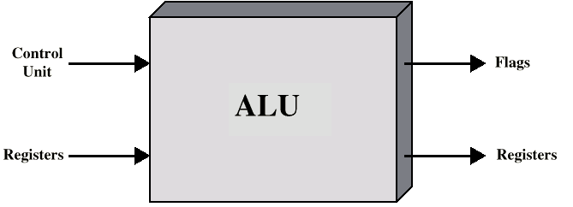


Arithmetic & Logic Unit
Roles of ALU
  Does the (integer arithmetic) computations
  Everything else in the computer is there to service this unit
FPU (floating point unit)
  Arithmetic unit that handles floating point (real) numbers
  Operations on separate floating point registers
Implementation
  All microprocessors has integer ALUs
  Most of recent microprocessors including mobile chips now has on-chip FPU
ALU inputs and outputs

Slide 3
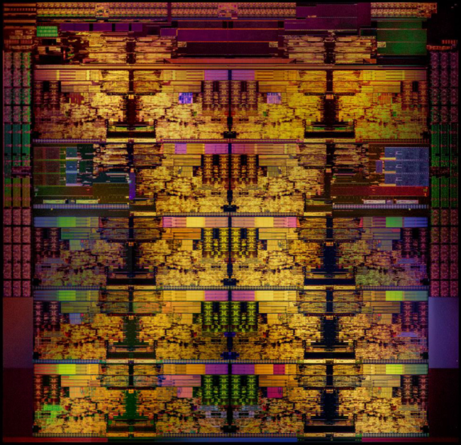
Intel i9 Die Photo

Slide 4
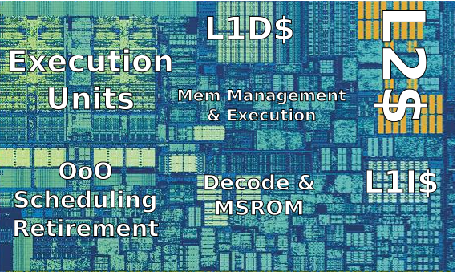
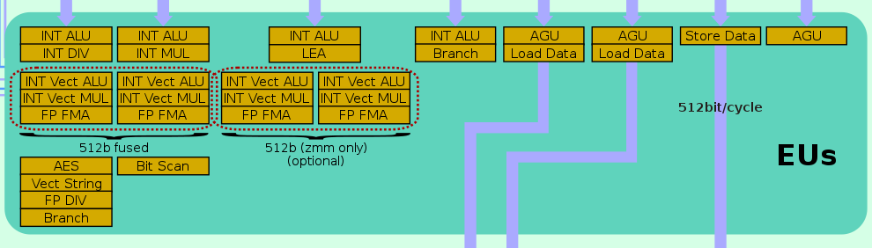
Intel i9 Core

Slide 5


Integer Representation
Only have 0 & 1 to represent everything
Two representative representations
  Sign-magnitude
  Two’s compliment
Sign-magnitude
  Left most bit is sign bit
    0 means positive
    1 means negative
  Example
    +18 = 00010010
    -18 = 10010010
  Problems
    Need to consider both sign and magnitude in arithmetic
    Two representations of zero (+0 and -0)

Slide 6
2’s Complement
Given N, 2’s complement of N with n bits
  2^{n} – N = (2^{n} – 1) – N + 1 = bit complement of N + 1
  32 bit number
    Positive numbers : 0 (x00000000) to 2³¹ –1 (x7FFFFFFF)
    Negative numbers : -1 (xFFFFFFFF) to – 2³¹ (x8000000)
  Like sign-magnitude, MSB represents the sign bit
Examples
  +3 = 011
  +2 = 010
  +1 = 001
  +0 = 000
  -1 = 111
  -2 = 110
  -3 = 101
  -4 = 100

Slide 7
Characteristics of 2’s Complement
A single representation of zero
Negation is fairly easy (bit complement of N + 1)
    3 = 00000011
    Boolean complement gives 11111100
    Add 1 to LSB 11111101
Overflow occurs only
  When the sign bit of two numbers are the same but the result has the opposite sign (V = C_{n} ⊕ C_{n}-1)
Arithmetic works easily (see later)
    To perform A – B, take the 2’s complement of B and add it to A
    A + (2^{n} – B) = A – B + 2^{n} (if A >= B, ignore the carry)
    = 2^{n} – (B – A) (if B > A, 2’s complement of B – A)
Operation | A | B | Overflow Condition
A + B | + | + | -
A + B | - | - | +
A - B | + | - | -
A - B | - | + | +

Slide 8
Range of Numbers
8 bit 2’s complement
  +127 = 01111111 = 2⁷ -1
  -128 = 10000000 = -2⁷
16 bit 2’s complement
  +32767 = 011111111 11111111 = 2¹⁵ - 1
  -32768 = 100000000 00000000 = -2¹⁵
N bit 2’s complement
  - 2^{n-1} ~ 2^{n-1} - 1

Slide 9
Conversion Between Lengths
Positive number – pack with leading zeros
  +18 = 00010010
  +18 = 00000000 00010010
Negative numbers – pack with leading ones
  -18 = 10010010
  -18 = 11111111 10010010
Sign-extension
  i.e. pack with MSB (sign bit)

Slide 10
Addition and Subtraction
Addition
  Normal binary addition
  Monitor sign bit for overflow
Subtraction
  Take the two’s complement of subtrahend and add to minuend
    i.e. a - b = a + (-b)
  So we only need adder and complement circuits

Slide 11
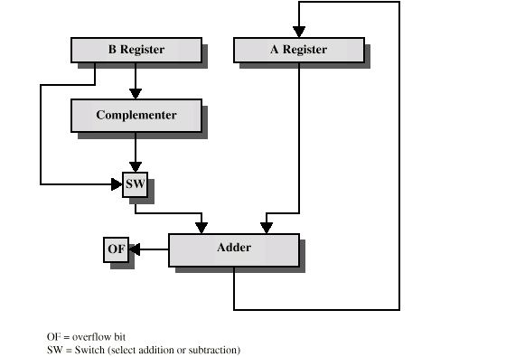
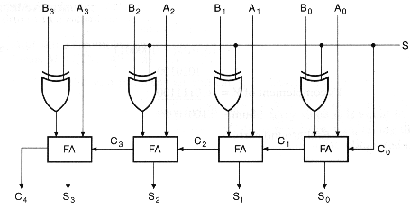
Adder/Subtractor Hardware

Slide 12
Multiplication
Example
1011 Multiplicand (11 decimal)
x 1101 Multiplier (13 decimal)
1011 Partial products
0000 Note: if multiplier bit is 1 then copy multiplicand (place value)
1011 otherwise put zero
1011
10001111 Product (143 decimal)
Principles
  Work out partial product for each digit
  Shift each partial product
  Add partial products
  Note: need double length result

Slide 13
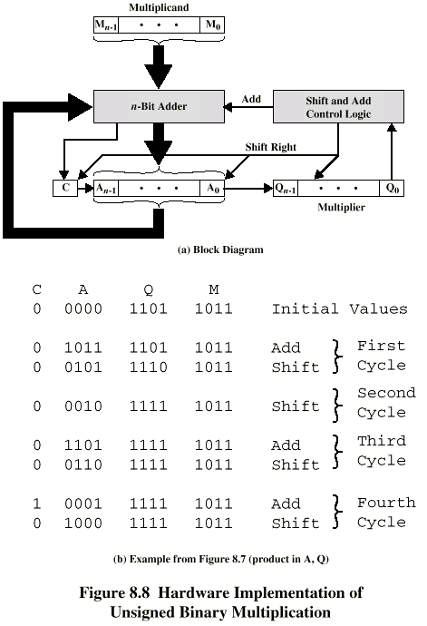
Binary Multiplier (Unsigned)

Slide 14
Execution of Example

Slide 15
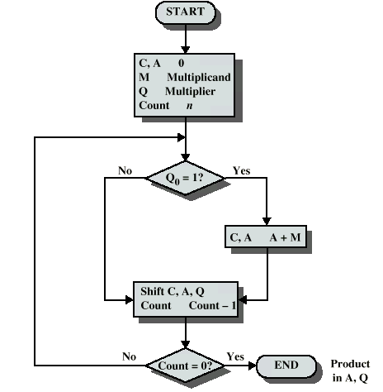
Flowchart for Unsigned Binary Multiplication

Slide 16
Signed Multiplication
Unsigned binary multiplication algorithm
  Does not work for signed multiplication!
Solution 1
  Convert to positive if required
  Multiply as above
  If signs were different, negate answer
Solution 2
  Booth’s algorithm

Slide 17
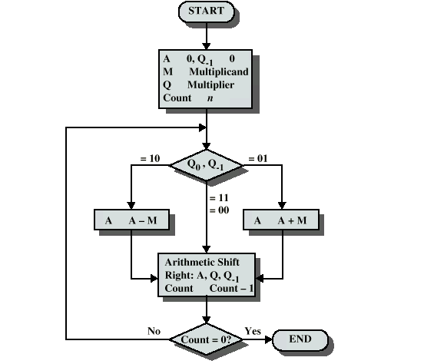
Booth’s Algorithm

Slide 18
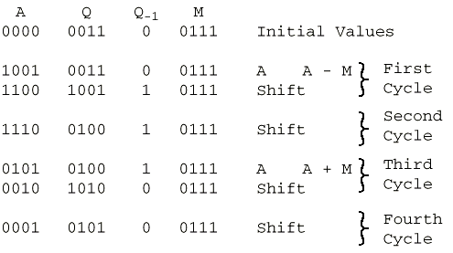
Example of Booth’s Algorithm

Slide 19
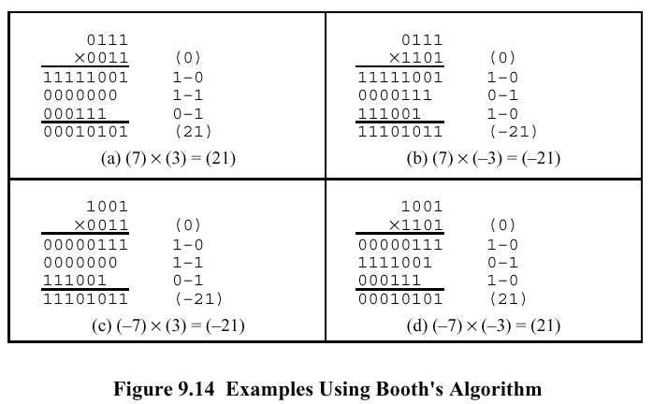
Examples

Slide 20
Division
Unsigned binary division
  Can be implemented by shift and subtract
Signed binary division
  More complex than multiplication
  The unsigned binary division algorithm can be extended to negative numbers.

Slide 21
Division of Unsigned Binary Integers
Unsigned binary division
  Can be implemented by shift and subtract
  The multiplication hardware can be used for the division as well
00001101
Quotient
Divisor
1011
10010011
Dividend
1011
001110
Partial
Remainders
1011
001111
1011
Remainder
100
Dividend = Quotient * Divisor + Remainder

Slide 22
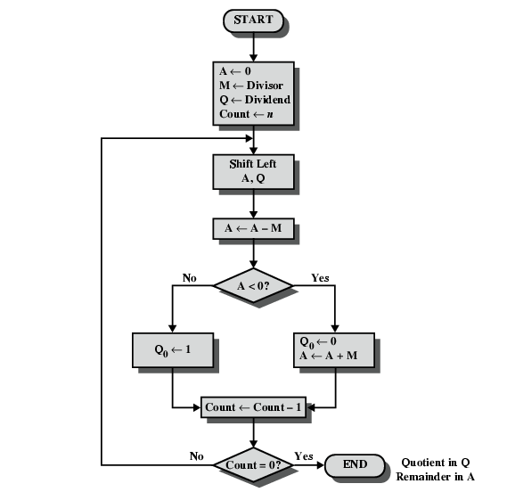
Flowchart for Unsigned Binary Division

Slide 23

Signed Division
Signed binary division
  More complex than multiplication
  The unsigned binary division algorithm can be extended to negative numbers.
    1. Load the divisor into M and the dividend into A, Q
      The dividend must be expressed as a 2n-bit 2’s complement number
    2. Shift A, Q left by 1 bit position
    3. If M and A have the same signs, perform A <- A – M; otherwise A + M
    4. If the sign of A is the same as before or A = 0, Q0 <- 1; Otherwise Q0 <- 0 and restore the previous value of A
    5. Repeat 2 through 4 n times
    6. Remainder in A. If the signs of the divisor and dividend are the same, the quotient is in Q; Otherwise, the quotient is the 2’s complement of Q

Slide 24
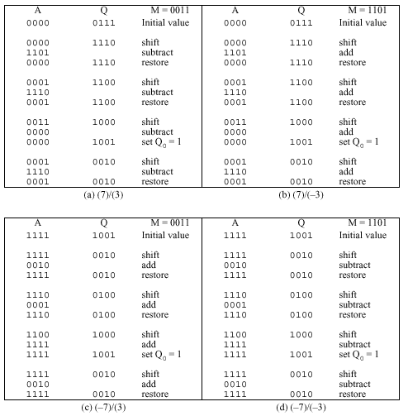
Examples of Signed Division

Slide 25
Real Numbers
Numbers with fractions
Could be done in pure binary
  1001.1010 = 2³ + 2⁰ +2⁻¹ + 2⁻³ =9.625
Where is the binary point?
Fixed? (Fixed-point)
  Very limited
    Very large numbers cannot be represented
    Very small fractions cannot be represented
    The same applies to results after computation
Moving? (Floating-point)
  How do you show where it is?
  Use the exponent to slide (place) the binary point
  Example
    976,000,000,000,000 = 9.76 * 10¹⁴
    0.00000000000976 = 9.76 * 10⁻¹⁴

Slide 26


Floating Point Representation
Sign bit
Biased
Exponent (E)
Significand or Mantissa (S)
± S x B^{±E}
  Base B
    Implicit and need not be stored since it is the same (2) for all numbers
  Exponent E
    Exponent indicates binary point position
    Biased representation
      A fixed value called bias (typically 2^{k-1} – 1 when k is the length of the exponent) is subtracted to get the true exponent value
      For 8-bit exponent, a bias of 127 is used and can represent –127 to 128
      Nonnegative FP numbers can be treated as integers for comparison purposes
  Significand (or Mantissa) S
    Normalized representation
      The most significant digit of the significand is nonzero
      +/- 1.bbb…b x 2^{+/-E}
      Since the MSB is always 1, it is unnecessary to store this bit
      Thus, a 23-bit significand is used to store a 24-bit significand with a value in [1, 2)
    Point is actually fixed between sign bit and body of mantissa

Slide 27
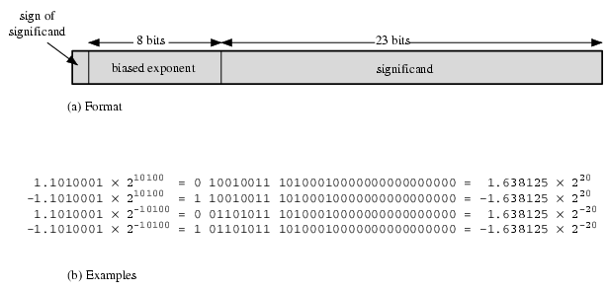
Floating Point Examples

Slide 28
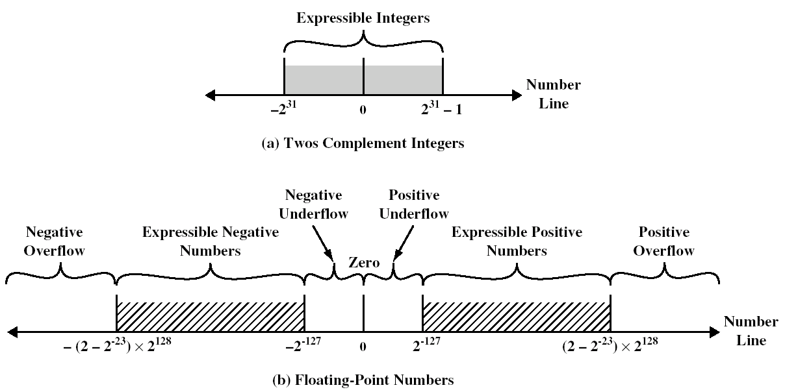
Expressible Numbers

Slide 29
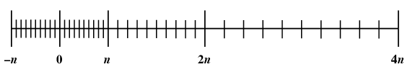
Density of FP Numbers
Note that
  The maximum number of different values that can be represented with 32 bits is still 2³².
  FP numbers are not spaced evenly along the number line
    Larger numbers are spaced more sparsely than smaller numbers

Slide 30
IEEE 754
Standard for floating point numbers
  To facilitate the portability of FP programs among different processors
  Supported by virtually all commercial microprocessors
IEEE 754 formats
  32-bit single precision
    8b exponent, 23b fraction
  64-bit double precision
    11b exponent, 52b fraction
  Half-precision (16), Quadruple precision (128), Octuple precision (256)
Characteristics
  Range of exponents : single (-126 ~ 127), double (-1022 ~ 1023)
  Zero is represented by all 0’s (exponent 0 and fraction 0)
  An exponent of all 1’s with a fraction of 0 represents +∞, -∞
  An exponent of 0 with a nonzero fraction represents a denormalized number
  An exponent of all 1’s with a nonzero fraction represents a NaN (Not a Number) which is used to signal various exceptions

Slide 31



NaN (Not a Number)
The following practices may cause NaNs.
  All mathematical operations with a NaN as at least one operand
  The divisions 0/0, ∞/∞, ∞/-∞, -∞/∞, and -∞/-∞
  The multiplications 0×∞ and 0×-∞
  The additions ∞ + (-∞), (-∞) + ∞ and equivalent subtractions.
  Applying a function to arguments outside its domain
    Taking the square root of a negative number
    Taking the logarithm of zero or a negative number
    Taking the inverse sine or cosine of a number which is less than -1 or greater than +1.

Slide 32
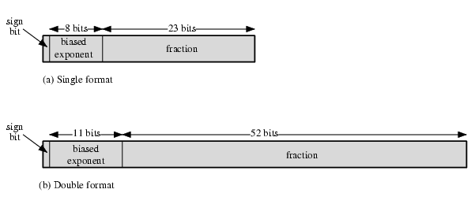
IEEE 754 Formats

Slide 33
FP Arithmetic +/-
4 Phases
  Check for zeros
  Align the significand of a smaller number (adjust the exponent)
  Add or subtract the significands
  Normalize the result

Slide 34
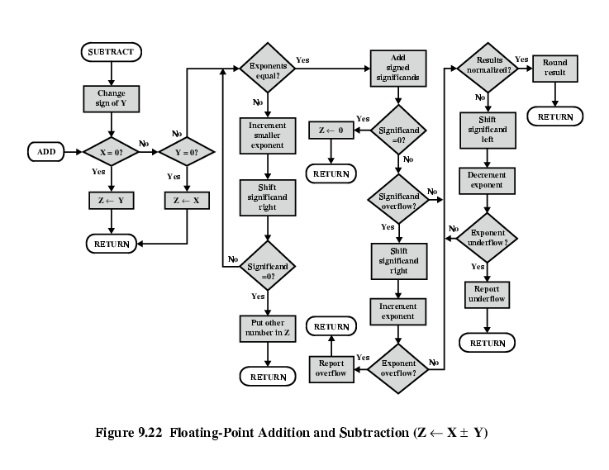
FP Addition & Subtraction Flowchart

Slide 35
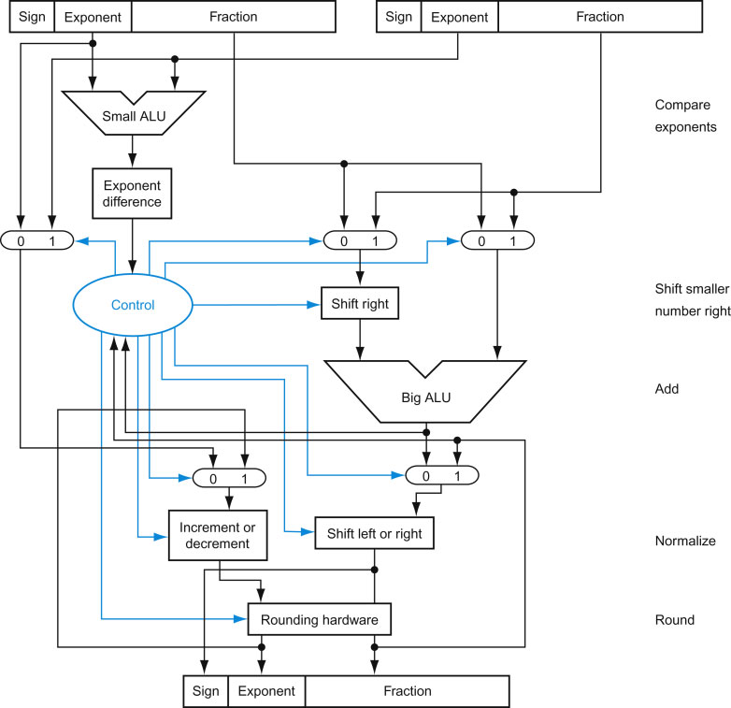
FP Adder
FIGURE 3.15 Block diagram of an arithmetic unit dedicated to floating-point addition. The steps of Figure 3.14 correspond to each block, from top to bottom. First, the exponent of one operand is subtracted from the other using the small ALU to determine which is larger and by how much. This difference controls the three multiplexors; from left to right, they select the larger exponent, the significand of the smaller number, and the significand of the larger number. The smaller significand is shifted right, and then the significands are added together using the big ALU. The normalization step then shifts the sum left or right and increments or decrements the exponent. Rounding then creates the final result, which may require normalizing again to produce the actual final result.

Slide 36
FP Arithmetic x/÷
Consists of the following phases
  Check for zero
  Add/subtract exponents
  Multiply/divide significands (watch sign)
  Normalize and round

Slide 37
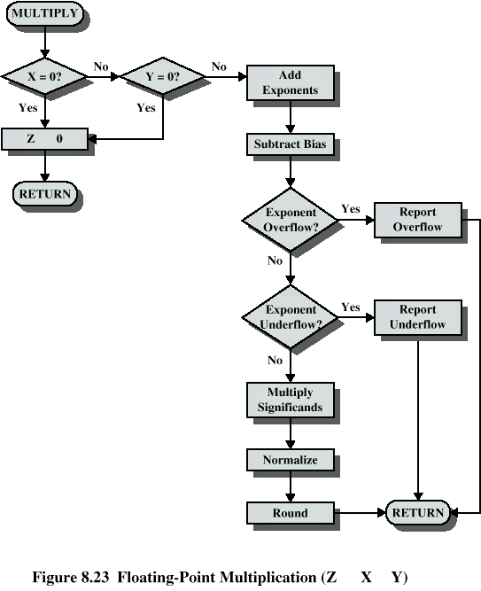
Floating Point Multiplication

Slide 38
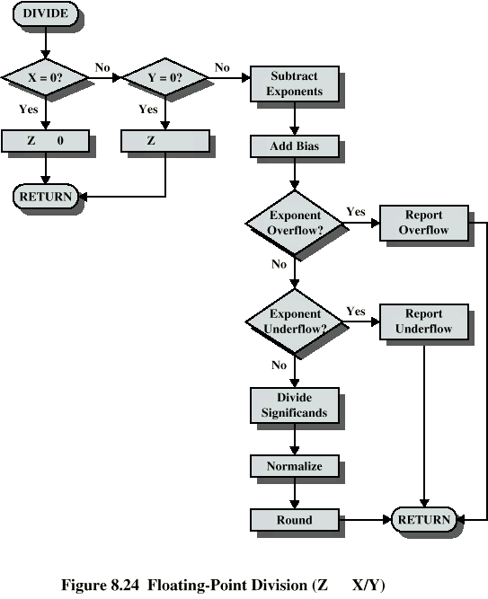
Floating Point Division

Slide 39
Homework 4
Read Chapter 4 (from Computer Organization and Design Textbook)
Exercise
  3.7
  3.10
  3.14
  3.19
  3.27
  3.30
  3.33
  3.38
  3.42

