Slide 1
Computer Architecture
Pipeline
Lynn Choi
Korea University

Slide 2




Motivation
Non-pipelined design
  Single-cycle implementation
    The cycle time depends on the slowest instruction
    Every instruction takes the same amount of time
  Multi-cycle implementation
    Divide the execution of an instruction into multiple steps
    Each instruction may take a variable number of steps (clock cycles)
Pipelined design
  Divide the execution of an instruction into multiple steps (stages)
  Overlap the execution of different instructions in different stages
    Each cycle different instructions are executed in different stages
    For example, 5-stage pipeline (Fetch-Decode-Read-Execute-Write),
      5 instructions are executed concurrently in 5 different pipeline stages
      Complete the execution of one instruction every cycle (instead of every 5 cycle)
      Can increase the throughput of the machine by 5 times

Slide 3
Pipeline Example
LD R1 <- A
ADD R5, R3, R4
LD R2 <- B
SUB R8, R6, R7
ST C <- R5
5 stage pipeline:
Fetch – Decode – Read – Execute - Write
Non-pipelined processor: 25 cycles = number of instrs (5) * number of stages (5)
F
D
R
E
W
F
D
R
E
W
F
D
R
E
W
F
D
R
E
W
Pipelined processor: 9 cycles = start-up latency (4) + number of instrs (5)
F
F
D
R
E
W
Draining the
pipeline
F
D
R
E
W
F
D
R
E
W
Filling the
pipeline
F
D
R
E
W
F
D
R
E
W

Slide 4
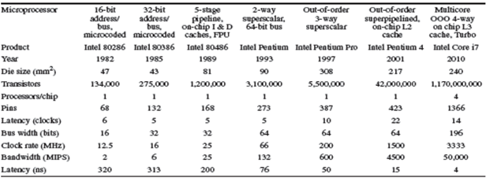
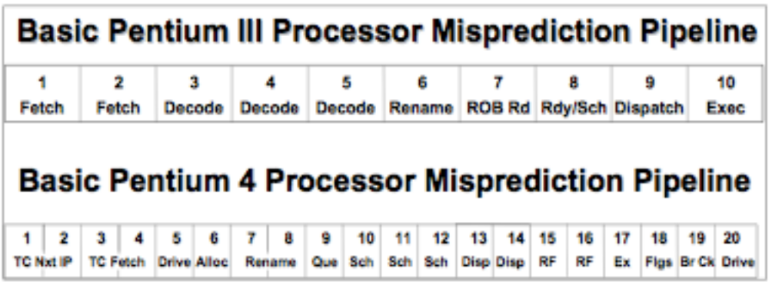
Evolution of x86 Processor Pipelines

Slide 5
Data Dependence & Hazards
Data Dependence
  Read-After-Write (RAW) dependence
    True dependence
    Must consume data after the producer produces the data
  Write-After-Write (WAW) dependence
    Output dependence
    The result of a later instruction can be overwritten by an earlier instruction
  Write-After-Read (WAR) dependence
    Anti dependence
    Must not overwrite the value before its consumer
  Notes
    WAW & WAR are called false dependences, which happen due to storage conflicts
    All three types of dependences can happen for both registers and memory locations
    Characteristics of programs (not machines)
    Must be preserved during execution to produce the correct output

Slide 6
Example 1
1 LD R1 <- A
2 LD R2 <- B
3 MULT R3, R1, R2
4 ADD R4, R3, R2
5 SUB R3, R3, R4
6 ST A <- R3
RAW dependence:
1->3, 2-> 3, 2->4, 3 -> 4, 3 -> 5, 4-> 5, 5-> 6
WAW dependence:
3-> 5
WAR dependence:
4 -> 5, 1 -> 6 (memory location A)
Execution Time: 18 cycles = start-up latency (4) + number of instrs (6)
+ number of pipeline bubbles (8)
F
D
R
E
W
F
D
R
E
W
F
D
R
R
R
E
W
F
D
D
D
R
R
R
R
E
W
F
F
F
D
D
D
R
R
R
E
W
F
F
F
D
D
D
R
R
R
E
W
Pipeline bubbles due to RAW dependences (Data Hazards)

Slide 7
Example 2
1 LD R1 <- A
2 LD R2 <- B
3 MULT R3, R1, R2
4 ADD R4, R5, R6
5 SUB R3, R1, R4
6 ST A <- R3
Changes:
1. Assume that MULT execution takes
6 cycles Instead of 1 cycle
2. Assume that we have separate ALUs
for MULT and ADD/SUB
Execution Time: 18 cycles = start-up latency (4) + number of instrs (6)
+ number of pipeline bubbles (8)
Dead
Code
F
D
R
E
W
F
D
R
E
W
due to RAW
due to WAW
F
D
R
R
R
E
E
E
E
E
E
W
Out-of-order (OOO)
Completion
F
D
D
D
R
R
E
W
F
F
F
D
R
R
R
R
R
E
W
F
D
D
D
D
D
R
R
R
E
W
Multi-cycle execution like MULT can cause out-of-order completion

Slide 8
Pipeline stalls
Need reg-id comparators for
  RAW dependences
    Reg-id comparators between the sources of a consumer instruction in REG stage and the destinations of producer instructions in EXE, WRB stages
  WAW dependences
    Reg-id comparators between the destination of an instruction in REG stage and the destinations of instructions in EXE stage (if the instruction in EXE stage takes more execution cycles than the instruction in REG)
  WAR dependences
    Can never cause the pipeline to stall since register read of an instruction always happens earlier than the write of a following instruction
If there is a match, recycle dependent instructions
    The current instruction in REG stage need to be recycled and all the instructions in FET and DEC stage need to be recycled as well
Also, called pipeline interlock

Slide 9
Data Bypass (Forwarding)
Motivation
  Minimize the pipeline stalls due to data dependence (RAW) hazards
Idea
  Let’s propagate the result as soon as the result is available from ALU or from memory (in parallel with register read)
  Requires
    Data path from ALU output to the input of execution units (input of integer ALU, address or data input of memory pipeline, etc.)
    Register Read stage can read data from register file or from the output of the previous execution stage
      Require MUX in front of the input of execution stage

Slide 10
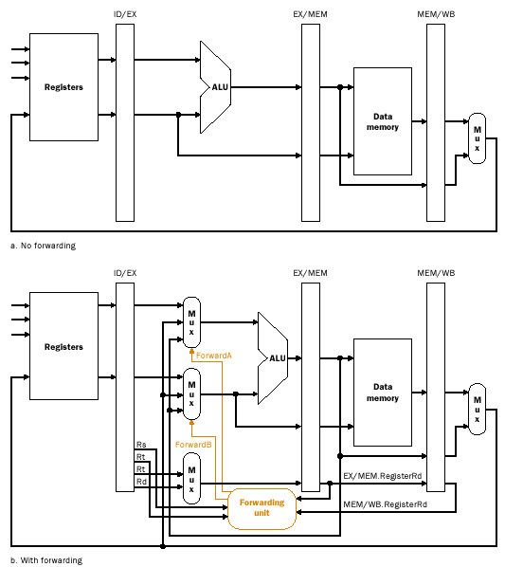
Datapath w/ Forwarding

Slide 11
Example 1 with Bypass
1 LD R1 <- A
2 LD R2 <- B
3 MULT R3, R1, R2
4 ADD R4, R3, R2
5 SUB R3, R3, R4
6 ST A <- R3
Execution Time: 10 cycles = start-up latency (4) + number of instrs (6)
+ number of pipeline bubbles (0)
F
D
R
E
W
F
D
R
E
W
F
D
R
E
W
F
D
R
E
W
F
D
R
E
W
F
D
R
E
W

Slide 12
Example 2 with Bypass
1 LD R1 <- A
2 LD R2 <- B
3 MULT R3, R1, R2
4 ADD R4, R5, R6
5 SUB R3, R1, R4
6 ST A <- R3
F
D
R
E
W
F
D
R
E
W
Pipeline bubbles
due to WAW
F
D
R
E
E
E
E
E
E
W
F
D
R
E
W
F
D
R
R
R
R
R
E
W
F
D
D
D
D
D
R
E
W

Slide 13
Pipeline Hazards
Data Hazard
  Caused by data (RAW, WAW, WAR) dependences
  Require
    Pipeline interlock (stall) mechanism to detect dependences and generate machine stall cycles
      Reg-id comparators between instructions in REG stage and instructions in EXE/WRB stages
  Stalls due to RAW hazards can be reduced by bypass network
    Reg-id comparators + data bypass paths + mux
Structural Hazard
  Caused by resource constraints
  Require pipeline stall mechanism to detect structural constraints
Control (Branch) Hazard
  Caused by branches
    24% of integer SPEC benchmark instructions
  Instruction fetch of a next instruction has to wait until the target (including the branch condition) of the current branch instruction is resolved
  Use
    Predict the next target address (branch prediction) and if wrong, flush all the speculatively fetched instructions from the pipeline

Slide 14
Structural Hazard Example
Assume that
We have 1 memory unit and 1 integer ALU unit
LD takes 2 cycles and MULT takes 4 cycles
1 LD R1 <- A
2 LD R2 <- B
3 MULT R3, R1, R2
4 ADD R4, R5, R6
5 SUB R3, R1, R4
6 ST A <- R3
F
D
R
E
E
W
F
D
R
R
E
E
W
F
D
D
R
R
E
E
E
E
W
F
F
D
D
R
R
R
R
E
W
F
F
D
D
D
D
R
E
W
Structural
Hazards
F
F
F
F
D
R
E
W
RAW
Structural Hazards

Slide 15
Structural Hazard Example
1 LD R1 <- A
2 LD R2 <- B
3 MULT R3, R1, R2
4 ADD R4, R5, R6
5 SUB R3, R1, R4
6 OR R10 <- R3, R1
Assume that
We have 1 memory pipelined unit and
and 1 integer add unit and 1 integer multiply unit
2. LD takes 2 cycles and MULT takes 4 cycles
F
D
R
E
E
W
F
D
R
E
E
W
F
D
R
R
E
E
E
E
W
F
D
D
R
E
W
F
F
D
R
E
W
F
D
R
E
E
W
RAW
Structural Hazards due to write port

Slide 16
Control Hazard Example (Stall)
1 LD R1 <- A
2 LD R2 <- B
3 MULT R3, R1, R2
4 BEQ R1, R2, TARGET
5 SUB R3, R1, R4
ST A <- R3
TARGET:
F
D
R
E
E
W
F
D
R
E
E
W
F
D
R
R
E
E
E
E
W
F
D
D
R
E
W
F
F
F
F
F
D
R
E
W
F
D
R
E
W
RAW
Control Hazards
Branch Target is known

Slide 17
Control Hazard Example (Flush)
1 LD R1 <- A
2 LD R2 <- B
3 MULT R3, R1, R2
4 BEQ R1, R2, TARGET
5 SUB R3, R1, R4
ST A <- R3
TARGET: ADD R4, R1, R2
F
D
R
E
E
W
Branch Target is known
F
D
R
E
E
W
F
D
R
R
E
E
E
E
W
F
D
D
R
E
W
F
F
D
R
E
W
Speculative execution:
These instructions will be flushed
on branch misprediction
F
D
R
E
W
F
D
R
E
W
F
D
R
E
W

Slide 18
Branch Prediction
Branch Prediction
  Predict
    If the current PC points to a branch instruction
    branch condition if it is a conditional branch
    branch target
  Predictions are made even before the branch is fetched and decoded
  Prefetch from the branch target before the branch is resolved
    This is called Speculative Execution
  A simple solution: PC <- PC + 4, prefetch the next sequential instruction
Branch condition (Path) prediction
  Only for conditional branches
    Among branch instructions, 80% of them are conditional branches
  Branch Predictor
    Static prediction – at compile time by a compiler
    Dynamic prediction – at runtime by HW using execution history

Slide 19

Branch Prediction
Branch target prediction
  Branch Target Buffer (BTB) or Target Address Cache (TAC)
    Store target address for each branch and accessed with current PC
    Organized as a table (cache)
    If hit, it means that the current instruction is a branch instruction
    Store target address for only taken branches
      Do not store fall-through address since it is PC +4 for most branches
    BTB combines branch target prediction with condition prediction (bimodal predictor)
      This is commonly used in early processors and embedded processors
    TAC stores target addresses only
      Separate condition prediction is more accurate and common in recent processors
  Return Address Stack (RAS) or also called Return Stack Buffer (RSB)
    Store return address (fall-through address) for procedure calls
    Push return address on a call and pop the stack on a return

Slide 20
Branch Target Buffer
For BTB to make a correct prediction, we need
  BTB hit: the branch instruction should be in the BTB
  Prediction hit: the condition prediction should be correct
  Target match: the target address must not be changed from last time
    For direct branches, the target address is never changed
Example: BTB hit ratio of 98%, 93% prediction hit, 1.2% of target change,
  The overall prediction accuracy = 0.96 * 0.93 *0.988 = 90%
Implementation: Accessed with VA and need to be flushed on context switch
Branch Instruction
Address
Branch Target
Address
Branch Condition
Prediction (bimodal)
.
.
.
.
.
.
.
.
.

Slide 21
Branch Prediction
Static prediction
  Assume all branches are taken : 60% of conditional branches are taken
  Backward Taken and Forward Not-taken scheme: 69% hit rate
  Profiling
    Measure the tendencies of the branches and preset a prediction bit in the opcode
    Sample data sets may have different branch tendencies than the actual data sets
    92.5% hit rate
  Used as safety nets when the dynamic prediction structures need to be warmed up
Dynamic schemes- use runtime execution history
  LT (last-time) prediction - 1 bit, 89%
  Bimodal predictors - 2 bit
    2-bit saturating up-down counters (Jim Smith), 93%
  Two-level adaptive training (Yeh & Patt), 97%
    First level, branch history register (BHR)
    Second level, pattern history table (PHT)

Slide 22
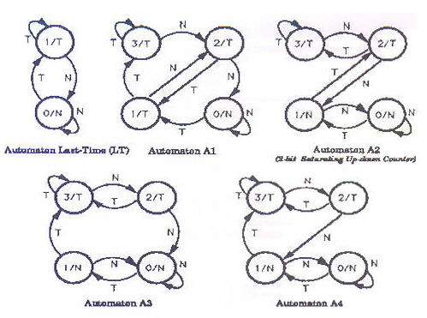
Bimodal Predictor
S(I): State at time I
G(S(I)) -> T/F: Prediction decision function
E(S(I), T/N) -> S(I+1): State transition function
Performance: A2 (usually best), A3, A4 followed by A1 followed by LT

Slide 23
Superscalar Processors
Exploit instruction level parallelism (ILP)
  Fetch, decode, and execute multiple instructions per cycle
  Today’s microprocessors issue 2 ~ 6 instructions per cycle
In-order pipeline versus Out-of-order pipeline
  In-order pipeline
    When there is a data hazard stall, all the instructions following the stalled instruction must be stalled as well
  Out-of-order pipeline (dynamic scheduling)
    After the instruction fetch and decode phases, instructions are put into buffers called instruction windows. Instructions in the windows can be executed out-of-order when their operands are available
Examples
  Pentium IV: 3-way OOO superscalar
  i7: 4-way OOO superscalar
  Itanium: 6-way in-order superscalar
  ARM core (Cyclone 2) in A8 chip: 6-way OOO superscalar

Slide 24
Superscalar Example
Assume 2-way superscalar processor with the following pipeline:
1 ADD/SUB ALU pipeline (1-Cycle INT-OP)
1 MULT/DIV ALU pipelines (4-Cycle INT-OP such as MULT)
2 MEM pipelines (1-Cycle (L1 hit) and 4-Cycle (L1 miss) MEM OP)
Show the pipeline diagram for the following codes assuming the bypass network:
LD R1 <- A (L1 hit); LD R2 <- B (L1 miss)
MULT R3, R1, R2; ADD R4, R1, R2
SUB R5, R3, R4; ADD R4, R4, 1
ST C <- R5; ST D <- R4
F
D
R
E
W
F
D
R
L1
L2
L2
L2
W
F
D
R
R
R
R
E1
E2
E3
E4
W
F
D
R
R
R
R
E
W
F
D
D
D
D
R
R
R
R
E
W
F
D
D
D
D
R
E
W
F
F
F
F
D
D
D
D
R
E
W
F
F
F
F
D
D
D
D
R
E
W

Slide 25
Out-Of-Order Pipeline
Anti-dependence can happen in OOO machines
  DIV F0, F2, F4
  ADD F10, F0, F8
  SUB F8, F8, F14
Different approaches
  Scoreboarding
  Tomasulo’s Algorithm

Slide 26
Scoreboarding - CDC6600 (1964) -
Scoreboard
  One bit per register indicates whether or not there is a pending update
Pipeline stalls on WAW and WAR dependences
FET-DEC/ISS-REG-EXE-WRB
  DEC/ISSUE stage: check for WAW and structural hazards
    (Centralized) instruction window between ISS and REG stages
    Pipeline stalls on output dependence by checking scoreboard
      Allows only 1 pending update
    Pipeline also stalls if there is no empty entry in the instruction window
    Instructions are issued in order.
  REG stage
    Resolve RAW hazards
    Instructions are sent to FUs out of order
    Instructions are dispatched out of order
  WRB stage:
    Once the execution completes, check for WAR hazards

Slide 27
Tomasulo’s Algorithm – IBM 360/91 (1967)
Three ideas
  OOO execution using reservation stations (RS)
    Distributed instruction windows
  Register renaming to remove anti and output dependencies
    Read available input operands from RF and store them into RS (WAR removal)
    Assign new storage for output (WAW removal)
    Pipeline does not stall on WAW and WAR dependences
  Data forwarding using common data bus
    Bypass the data directly to the waiting instructions in RS
    Both register file and RS (source and dest) monitor the result bus and update data when a matching tag is found

Slide 28
OOO Pipeline - Tomasulo’s Algorithm
FET-DEC/REN/ISS-REG-EXE-WRB
  REN/ISS stage: check structural hazard (reservation station entry) and read available operands from register file (register renaming for WAR) and assign RS entry for destination (WAW hazard)
  REG stage: monitor common data bus and read operands into RS (resolve RAW hazard with bypass) if there is a match; determine highest priority operations among ready operations (wakeup)
  EXE: execute and forward result to RS and RF

Slide 29
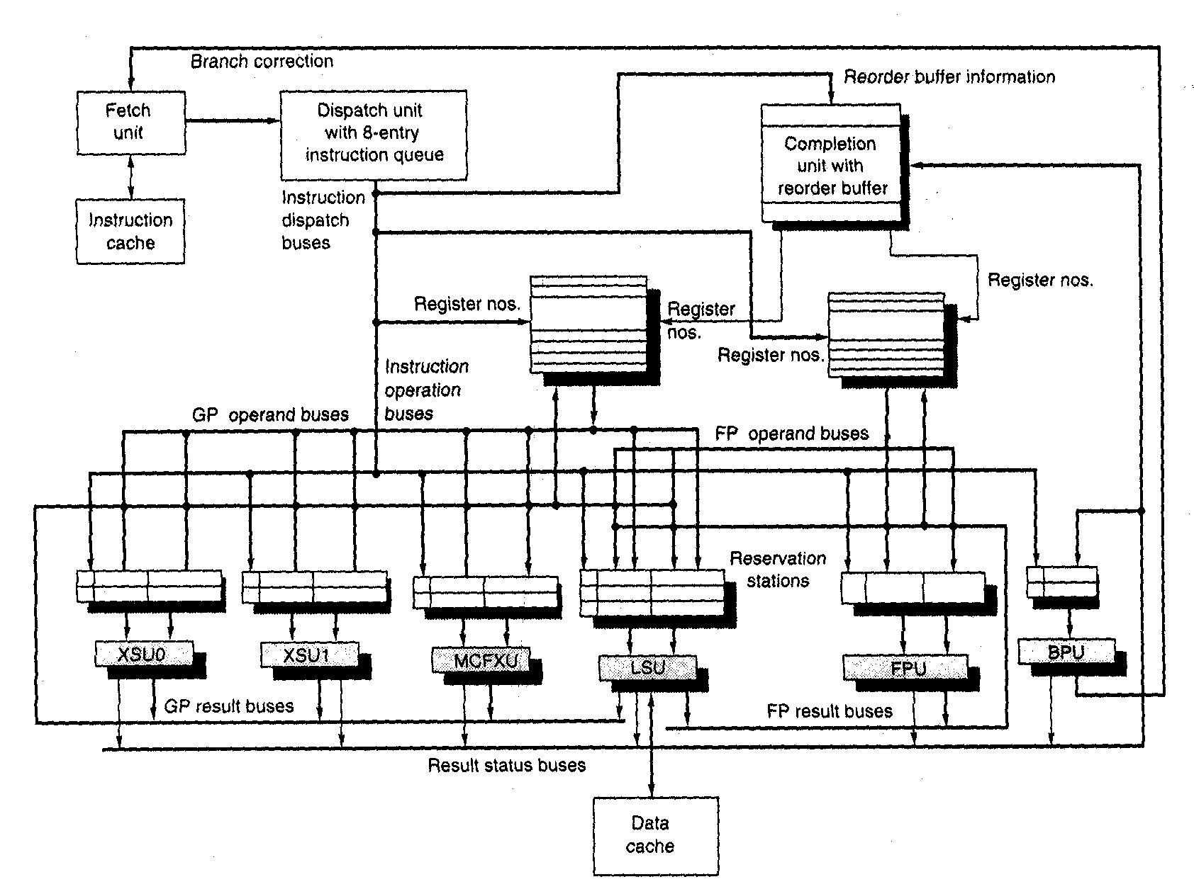
PowerPC 620 - OOO example -
IEEE All rights reserved

Slide 30

Exercises and Discussion
WAR dependence violation cannot happen in in-order pipeline. Prove why?
What is pipeline interlock? Explain the difference between pipeline interlock HW and data bypass HW.
How do execution pipelines such as FPU pipeline affect the processor performance as compared to the non-pipelined FPU?

Slide 31
Homework 5
Read Chapter 5
Exercise
  4.3
  4.5
  4.7
  4.10
  4.15
  4.19
  4.22
  4.27

