Slide 1
Computer Architecture
Memory Hierarchy
Lynn Choi
Korea University

Slide 2



Memory Hierarchy
Motivated by
  Principles of Locality
  Speed vs. Size vs. Cost tradeoff
Locality principle
  Temporal Locality: reference to the same location is likely to occur soon
    Example: loops, reuse of variables
    Keep recently accessed data/instruction to closer to the processor
  Spatial Locality: nearby references are likely
    Example: arrays, program codes
    Access a block of contiguous bytes
Speed vs. Size tradeoff
  Bigger memory is slower but cheaper: SRAM - DRAM - Disk - Tape
  Fast memory is more expensive but faster

Slide 3
Memory Wall
100000
10000
CPU performance
2x every 18 months
1000
100
DRAM performance
7% per year
10
80 81 82 83 84 85 86 87 88 89 90 91 92 93 94 95 96 97 98 99 2000

Slide 4
Levels of Memory Hierarchy
Capacity/Access Time
Moved By
Faster/Smaller
100Bs
Registers
Instruction
Operands
Program/Compiler
1- 16B
KBs-MBs
Cache
H/W
16 - 512B
Cache Line
GBs
Main Memory
OS
512B – 64MB
Page
100GBs
Disk
User
any size
File
Infinite
Network
Slower/Larger

Slide 5
Cache
A small but fast memory located between processor and main memory
Benefits
  Reduce load latency
  Reduce store latency
  Reduce bus traffic (on-chip caches)
Cache Block Placement (Where to place)
  Fully-associative cache
  Direct-mapped cache
  Set-associative cache

Slide 6
Fully Associative Cache
32b Word, 4 Word Cache Block
Physical Address Space
32 bit PA = 4GB (DRAM)
A memory block can be placed into
any cache block location!
0
32KB cache (SRAM)
0
2¹¹-1
Memory Block
Cache Block
(Cache Line)
2¹¹-1
2²⁸-1

Slide 7
Fully Associative Cache
TAG RAM
V
32KB DATA RAM
=
0
0
31
3 0
tag
offset
Yes
=
=
=
2¹¹-1
2¹¹-1
Data out
Word & Byte select
Data to CPU
Advantages Disadvantages
1. High hit rate 1. Very expensive
2. Fast
Cache Hit

Slide 8
Direct Mapped Cache
Physical Address Space
32 bit PA = 4GB (DRAM)
A memory block can be placed into
only a single cache block!
0
32KB cache (SRAM)
0
2¹¹
Memory Block
…..
2*2¹¹
2¹¹-1
(2¹⁷-1)*2¹¹
2²⁸-1

Slide 9
Direct Mapped Cache
TAG RAM
V
32KB DATA RAM
14
4
0
0
31
3 0
tag
index
offset
decoder
2¹¹-1
2¹¹-1
Data out
=
Yes
Word &
Byte select
Data to CPU
Disadvantages Advantages
1. Low hit rate 1. Simple HW
2. Fast Implementation
Cache Hit

Slide 10
Set Associative Cache
In an M-way set associative cache,
A memory block can be placed into
M cache blocks!
0
32KB cache (SRAM)
2¹⁰
Memory Block
0
Way 0
2¹⁰ sets
2¹⁰-1
2*2¹⁰
2¹⁰
Way 1
2¹⁰ sets
2¹¹-1
(2¹⁸-1)*2¹⁰
2²⁸-1

Slide 11
Set Associative Cache
TAG RAM
V
32KB DATA RAM
13
4
0
0
31
3 0
tag
index
offset
decoder
2¹⁰-1
2¹⁰-1
Data out
=
=
Yes
Word &
Byte select
Wmux
Data to CPU
Most caches are implemented as
set-associative caches!
Cache Hit

Slide 12
Block Allocation and Replacement
Block Allocation (When to place)
  On a read miss, always allocate
  On a write miss
    Write-allocate: allocate cache block on a write miss
    No-write-allocate
Replacement Policy
  LRU (least recently used)
    Need to keep timestamp
    Expensive due to global compare
    Pseudo-LRU: use LFU using bit tags
  Random
    Just pick one and replace it
    Pseudo-random: use simple hash algorithm using address
  Replacement policy critical for small caches

Slide 13
Write Policy
Write-through
  Write to cache and to next level of memory hierarchy
  Simple to design, memory consistent
  Generates more write traffic
  With no write allocate policy
Write-back
  Only write to cache (not to lower level)
  Update memory when a dirty block is replaced
  Less write traffic, write independent of main memory
  Complex to design, memory inconsistent
  With write allocate policy

Slide 14
Review: 4 Questions for Cache Design
Q1: Where can a block can be placed in? (Block Placement)
  Fully-associative, direct-mapped, set-associative
Q2: How is a block found in the cache? (Block Indentification)
  Tag/Index/Offset
Q3: Which block should be replaced on a miss? (Block Replacement)
  Random, LRU
Q4: What happens on a write? (Write Policy)

Slide 15
3+1 Types of Cache Misses
Cold-start misses (or compulsory misses)
  The first access to a block is always not in the cache
  Misses even in an infinite cache
Capacity misses
  If the memory blocks needed by a program is bigger than the cache size, then capacity misses will occur due to cache block replacement.
  Misses even in fully associative cache
Conflict misses (or collision misses)
  For direct-mapped or set-associative cache, too many blocks can be mapped to the same set.
Invalidation misses (or sharing misses): cache blocks can be invalidated due to coherence traffic

Slide 16
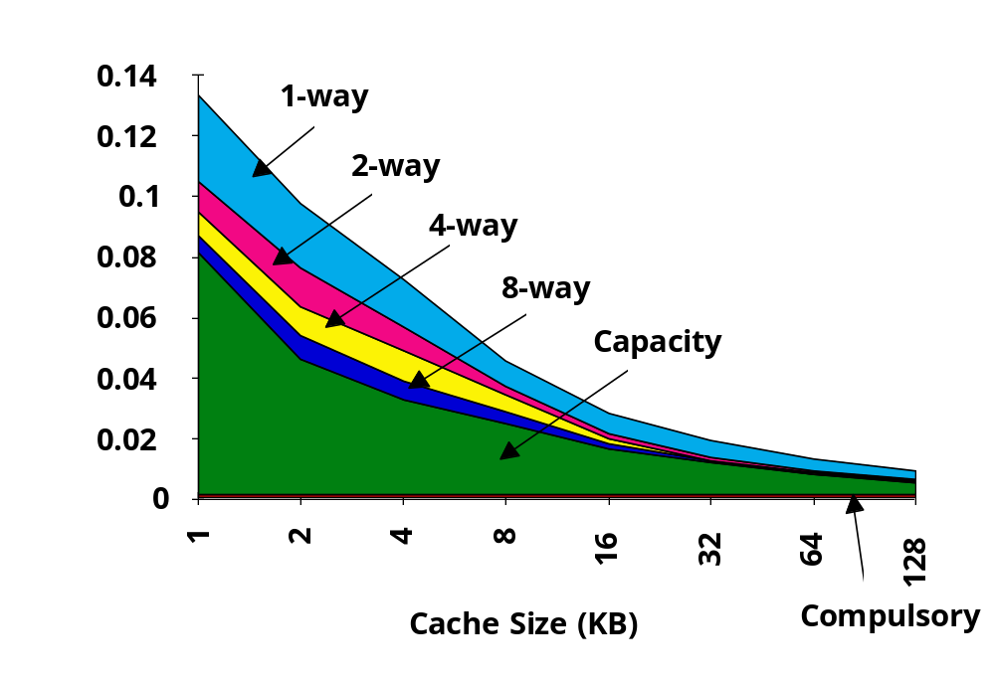
Miss Rates (SPEC92)

Slide 17
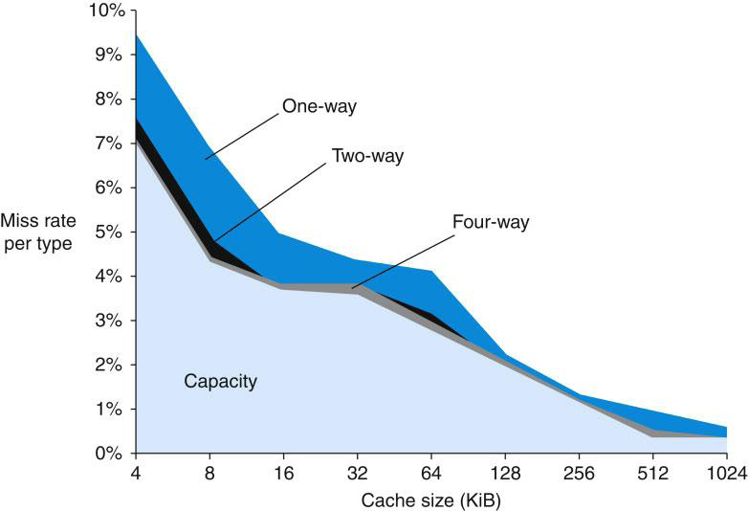
Miss Rates (SPEC CPU2000 Integer)

Slide 18
Cache Performance
Average Memory Access Time (AMAT)
  AMAT = Hit_Time + Miss_Rate * Miss_Penalty
  Example
    HT = 1 cycle, MR = 5%, MP = 200 cycles
    AMAT = 1 + 0.05 * 200 = 11
For L1/L2 organization,
  AMAT = Hit_Time_{L1} + Miss_Rate_{L1} * (Hit_Time_{L2} + Miss_Rate_{L2} * Miss_Penalty_{L2})
  Example
    HT_{L2} = 4 cycle, MR_{L2} = 1%
    AMAT(L1/L2) = 1 + 0.05 * (4 + 0.01 *200) = 1.3
Design Issues
  Size(L2) > Size(L1)
  Usually, Block_size(L2) > Block_size(L1)

Slide 19
Cache Performance vs Block Size
_{Miss Penalty}
_{Miss Rate}
Transfer Time
Access Time
_{Block Size}
_{Block Size}
_{Average Access Time}
_{Sweet Spot}
_{Block Size}

Slide 20
Random Access Memory
Static vs. Dynamic Memory
  Static RAM (at least 6 transistor)
    State can be retained while power is supplied
    Use latched storage
    Speed: access time 8~16X faster than DRAM
    Used for registers, buffers, on-chip and off-chip caches
  Dynamic RAM (usually 1 transistor)
    State is discharged as time goes by
    Use dynamic storage of charge on a capacitor
    Require refresh of each cell every few milliseconds
    Density: 8~16X SRAM size at the same feature size
    Multiplexed address lines - RAS, CAS
    Complex interface logic due to refresh, precharge
    Used for main memory

Slide 21
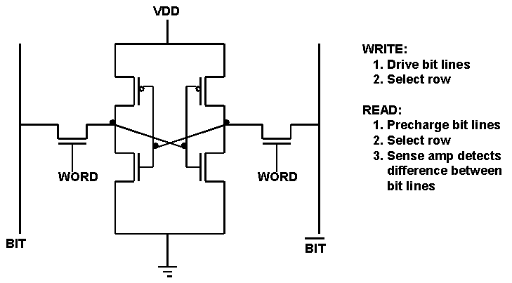
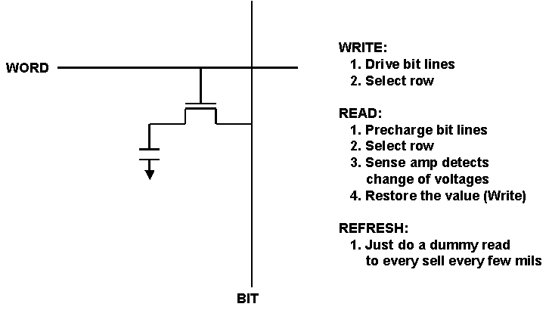
SRAM Cell versus DRAM Cell
DRAM Cell
SRAM Cell

Slide 22
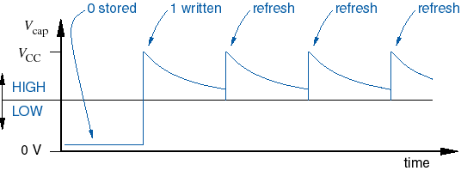

DRAM Refresh
Typical devices require each cell to be refreshed once every 4 to 64 ms.
During “suspended” operation, notebook computers use power mainly for DRAM refresh.

Slide 23
DRAM Structure
2^{N}
Row
Address
Row Decoder
Memory Array
M
2^{M}
Column Decoder
Data
2^{K}
N-K
Column
Address

Slide 24
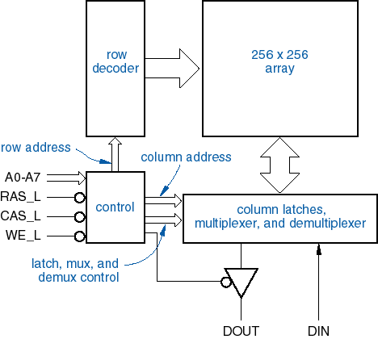
DRAM Chip Internal Organization
64K x 1 bit DRAM

Slide 25
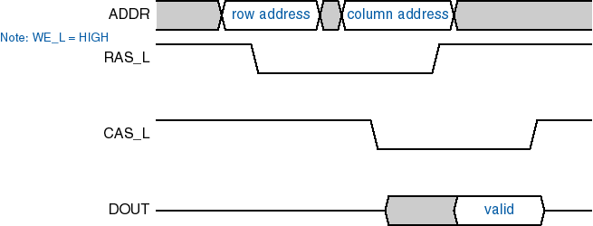

RAS/CAS Operation
Row Address Strobe, Column Address Strobe
  n address bits are provided in two steps using n/2 pins, referenced to the falling edges of RAS_L and CAS_L
  Traditional method of DRAM operation for 20 years.
DRAM read timing

Slide 26
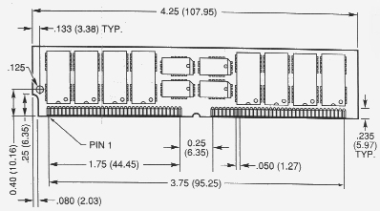
DRAM Packaging
Typically, 8 or 16 memory chips are mounted on a tiny printed circuit board
  For compatibility and easier upgrade
  SIMM (Single Inline Memory Module)
    Connectors on one side
    32 pins for 8b data bus
    72 pins for 32b data bus
  DIMM (Dual Inline Memory Module)
    For 64b data bus (64, 72, 80)
    84 pins at both sides, total of 168 pins
    Ex) 16 16M*4 bit DRAM constitutes 128MB DRAM module with 64b data bus
  SO-DIMM (Small Outline DIMM) for notebooks
    72 pins for 32b data while 144pins for 64b data bus

Slide 27
Memory Performance Parameters
Access Time
  The time elapsed from asserting an address to when the data is available on the output
    Row Access Time: The time elapsed from asserting RAS to when the row is available in the row buffer
    Column Access Time - the time elapsed from asserting CAS to when the valid data is present on the output pins
Cycle Time
  The minimum time between two different requests to memory
Latency
  The time to access the first byte of a block
Bandwidth
  Transmission rate (bytes per second)

Slide 28
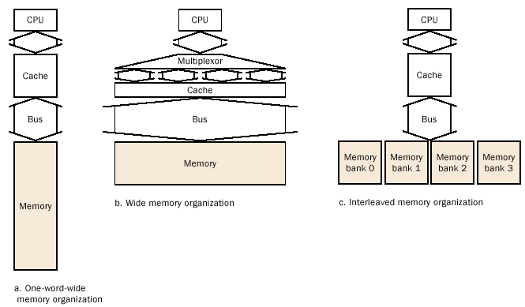
Memory Organization
Assuming 4 word cache block access with1 cycle to send the address
15 cycles for each DRAM access
1 cycle to return a word of data
1 + 2 (15 + 1) = 33 cycles (2 word wide)
1 + 1 (15 + 1) = 17 cycles (4 word wide)
1 + 15 + 4 = 20 cycles
1 + 4 (15 + 1) = 65 cycles

Slide 29
Pentium III Example
Pentium III Processor
16KB
I-Cache
Pentium III
Core Pipeline
256 KB 8-way
2nd-level Cache
16KB
D-Cache
800 MHz
256b data
System Bus
FSB (133 MHz 64b data & 32b address)
Memory
Bus
Multiplexed
(RAS/CAS)
AGP
Host to PCI
Bridge
Main
Memory
Graphics
DIMMs: 16 16M*4b 133 MHz
SDRAM constitutes 128MB
DRAM module with 64b data bus

Slide 30
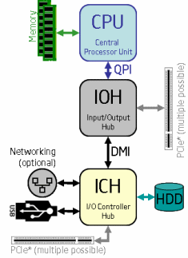
Intel i7 System Architecture
Integrated memory controller
  3 Channel, 3.2GHz clock, 25.6 GB/s memory bandwidth (memory up to 24GB DDR3 SDRAM), 36 bit physical address
QuickPath Interconnect (QPI)
  Point-to-point processor interconnect, replacing the front side bus (FSB)
  64bit data every two clock cycles, up to 25.6GB/s, which doubles the theoretical bandwidth of 1600MHz FSB
Direct Media Interface (DMI)
  The link between Intel Northbridge and Intel Southbridge, sharing many characteristics with PCI-Express
IOH (Northbridge)
ICH (Southbridge)

Slide 31
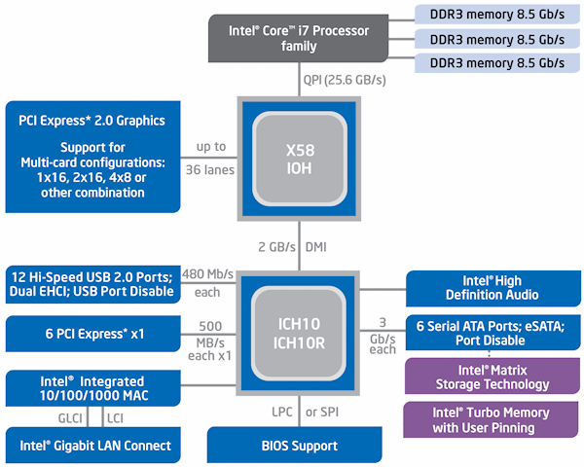
Intel i7 System Architecture

Slide 32
Virtual Memory
Virtual memory
  Programmer’s view of memory (virtual address space)
  Virtual address = program’s address (instruction/data address)
Physical memory (a.k.a main memory)
  Machine’s physical memory (physical address space)
  Physical address = DRAM’s address
Objective
  Large address space -> easy programming
    Provide the illusion of infinite amount of memory
    Program code/data can exceed the main memory size
    Processes partially resident in memory
  Increased CPU utilization: More programs can run at the same time
  Improve software portability
  Protection: access rights (r/w/x permission, privilege level)
  Sharing of codes and data

Slide 33
Virtual Memory
Memory management
  Automatic movement of data between main memory and secondary storage
    Done by HW (TLB) and SW (OS) with exception handling
  Usually implemented by demand paging
    Bring a page on a page miss
    Exploit spatial and temporal locality
  Main memory contains only the most frequently used portions of a process’s address space

Slide 34
Paging
Divide both virtual and physical memory space into fixed size pages
  VA consists of (VPN, page offset)
  PA consists of (PPN, page offset)
Operating system maintains page table for each process
For each virtual page, page table entry (PTE) contains
  PPN (physical page number, a.k.a. page frame number)
  Disk address
  Presence bit – 1 if this page is in main memory
  Reference bits – reference statistics info used for page replacement
  Dirty bit – 1 if this page has been modified
  Access control – read/write/execute permissions
  Privilege level – user-level page versus system-level page

Slide 35
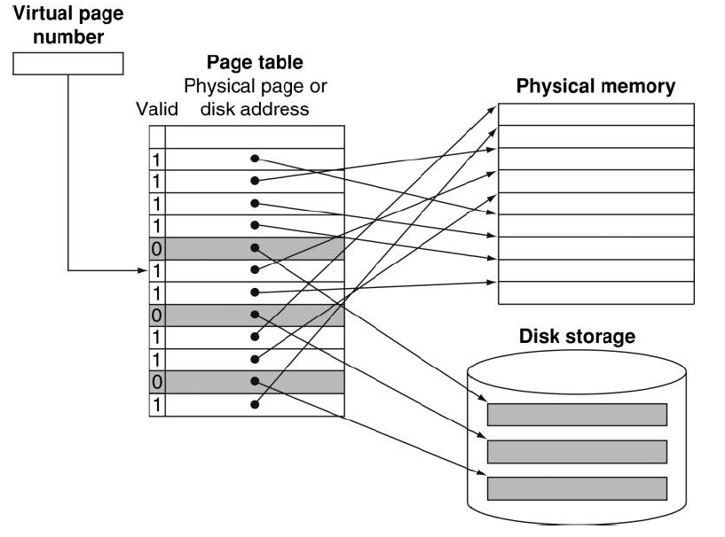
Virtual Memory with Paging

Slide 36
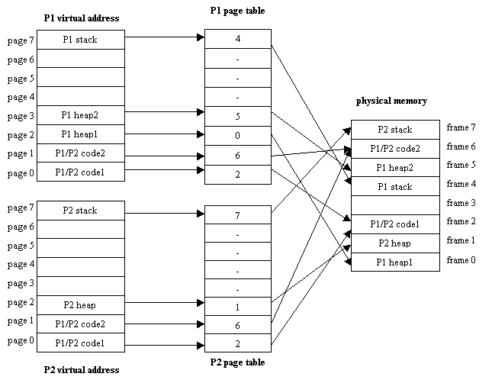
Virtual Memory with Paging

Slide 37
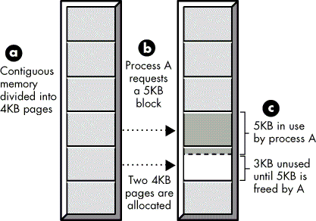

Paging
Perform the following functions
  Memory allocation (Placement)
    A virtual page can be placed into any physical page frame
  Memory deallocation (Replacement)
    Once all the page frames are used, one of the existing virtual page need to be replaced
  Memory mapping (Translation)
    Virtual address needs to be translated into physical address
      VPN needs to be translated into PPN
      Page table contains VA to PA translation information
Internal fragmentation
  A fixed size block allocation such as paging may generate internal fragmentation in the last page allocated

Slide 38
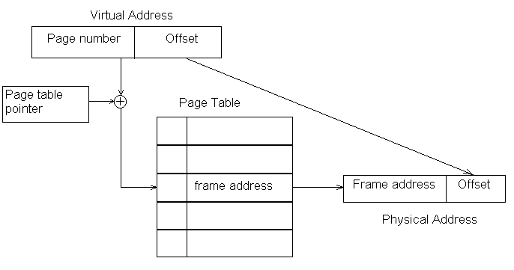
Virtual to Physical Translation

Slide 39
Process
Def: A process is an instance of a program in execution.
  One of the most profound ideas in computer science.
  Not the same as “program” or “processor”
Process provides each program with two key abstractions:
  Logical control flow
    Each program seems to have exclusive use of the CPU.
  Private address space
    Each program seems to have exclusive use of main memory.
How are these Illusions maintained?
  Multitasking: process executions are interleaved
    In reality, many other programs are running on the system.
    Processes take turns in using the processor
    Each time period that a process executes a portion of its flow is called a time slice
  Virtual memory: a private space for each process
    The private space is also called the virtual address space, which is a linear array of bytes, addressed by n bit virtual address (0, 1, 2, 3, … 2^{n}-1)

Slide 40
Page Table
Page table organization
  Linear: one PTE per virtual page
  Hierarchical: tree structured page table
    Page table itself can be paged due to its size
      For example, 32b VA, 4KB page, 16B PTE requires 16MB page table
    Page directory tables
      PDE contains descriptor for page table page
    Page tables - only leaf nodes
      PTE contains descriptor for page
Different virtual memory faults (exceptions)
  TLB miss - PTE not in TLB
  PTE miss - PTE not in main memory
  page miss - page not in main memory
  access violation
  privilege violation

Slide 41

Multi-Level Page Tables
Given:
  4KB (2¹²) page size
  32-bit virtual address
    20 bit VPN, 12 bit page offset
  4-byte PTE
Problem:
  Would need a 4 MB page table!
    2²⁰ *4 bytes
Common solution
  multi-level page tables
  e.g., 2-level table (P6)
    Level 1 table: 1024 entries, each of which points to a Level 2 page table.
      This is called page directory
    Level 2 table: 1024 entries, each of which points to a page
Level 2
Tables
Level 1
Table
...

Slide 42

P6 2-level Page Table Structure
Given
  32 bit virtual address
  32 bit physical address
  4KB (or 4MB page)
Page directory
  A single 4KB page can contain 1024 4-byte page directory entries (PDEs) that point to level 2 page tables
  One page directory per process.
  Page directory must be in memory when its process is running
  Always pointed to by PDBR
Page tables:
  Up to 1024 pages each of which contains 1024 4-byte page table entries (PTEs) that point to pages
  Page tables can be paged in and out
Up to 1024 page tables
Virtual Page number
1024
PTEs
10
10
page directory
...
PDBR
⊕
1024
PDEs
⊕
1024
PTEs
...
1024
PTEs

Slide 43
P6 Page Table Entry (PTE)
31
12
11
9
8
7
6
5
4
3
2
1
0
Page physical base address
Avail
G
0
D
A
CD
WT
U/S
R/W
P=1
Page base address: 20 most significant bits of physical address (PPN) (forces pages to be 4 KB aligned)
Avail: available for system programmers
G: global page (don’t evict from TLB on task switch)
D: dirty (set by MMU on writes)
A: accessed (set by MMU on reads and writes)
CD: cache disabled or enabled
WT: write-through or write-back cache policy for this page
U/S: user/supervisor
R/W: read/write
P: page is present in physical memory (1) or not (0)
31
1
0
Available for OS (page location in secondary storage)
P=0

Slide 44
P6 Page Directory Entry (PDE)
31
12
11
9
8
7
6
5
4
3
2
1
0
Page table physical base addr
Avail
G
PS
A
CD
WT
U/S
R/W
P=1
Page table physical base address: 20 most significant bits of physical page table address (forces page tables to be 4KB aligned)
Avail: These bits available for system programmers
G: global page (don’t evict from TLB on task switch)
PS: page size 4K (0) or 4M (1)
A: accessed (set by MMU on reads and writes, cleared by software)
CD: cache disabled (1) or enabled (0)
WT: write-through or write-back cache policy for this page table
U/S: user or supervisor mode access
R/W: read-only or read-write access
P: page table is present in memory (1) or not (0)
31
1
0
Available for OS (page table location in secondary storage)
P=0

Slide 45
TLB
TLB (Translation Lookaside Buffer)
  Cache of page table entries (PTEs)
  On TLB hit, can do virtual to physical translation without accessing the page table
  On TLB miss, must search the page table for the missing entry
TLB configuration
  ~100 entries, often fully associative cache
  usually separate I-TLB and D-TLB, accessed every cycle
  sometimes mutil-level TLBs, TLB shootdown (coherence) issue
  Miss handling
    On a TLB miss, exception handler (with the help of operating system) search page table for the missed TLB entry and insert it into TLB
      Software managed TLBs - TLB insert/delete instructions
      Flexible but slow: TLB miss handler ~ 100 instructions
    Sometimes, by HW - HW page walker

Slide 46
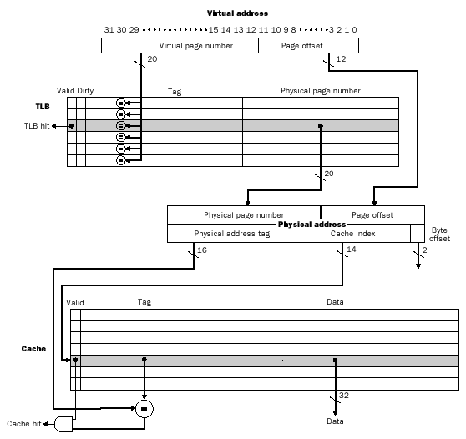
TLB and Cache
Implementation of
DECStation 3100

Slide 47

Virtually-Indexed Physically Tagged Cache
Virtually-indexed physically-tagged cache
  Commonly used scheme to bypass the translation
  Use lower bits (page offsets) of VA to access the L1 cache
    Page offset field of VA does not change during translation
      If the index can be extracted from the page offset, then index decoding for cache access can occur in parallel with TLB access
    With 8K page size, use the 13 low order bits to access 8KB directed-mapped, 16KB 2-way, 32KB 4-way set-associative caches
  Access TLB and L1 in parallel using VA and do tag comparison after fetching the PPN from TLB

Slide 48
Program Start Scenario
Before starting the process
  Load the page directory into physical memory
  Load the PDBR (page directory base register) with the beginning of the page directory
  Load the PC with the start address of code
When the 1st reference to code triggers
  iTLB miss (translation failed for instruction address)
    Exception handler looks up PTE1
  dTLB miss (translation failed for PTE1)
    Exception handler looks up PTE2
    Lookup page directory and find PTE2
    Add PTE2 to dTLB
  dTLB hit, but page miss (PTE1 not in memory)
  Load page containing PTE1
    Lookup page table and find PTE1
    Add PTE1 to iTLB
  iTLB hit, but page miss (code page not present in memory)
  Load the instruction page
  Cache miss, but memory returns the instruction

Slide 49
P6 Memory System
32 bit address space
4 KB page size
L1, L2, and TLBs
  4-way set associative
inst TLB
  32 entries
  8 sets
data TLB
  64 entries
  16 sets
L1 i-cache and d-cache
  16 KB
  32 B line size
  128 sets
L2 cache
  unified
  128 KB -- 2 MB
DRAM
external system bus (e.g. PCI)
L2
cache
cache bus
bus interface unit
inst
TLB
data
TLB
instruction
fetch unit
L1
i-cache
L1
d-cache
processor package

Slide 50
Overview of P6 Address Translation
CPU
32
L2 and DRAM
result
20
12
virtual address (VA)
VPN
VPO
L1
hit
L1
miss
16
4
TLBT
TLBI
TLB
hit
L1 (128 sets, 4 lines/set)
TLB
miss
...
...
10
10
TLB (16 sets, 4 entries/set)
VPN1
VPN2
20
12
20
7
5
PPN
PPO
CT
CI
CO
physical
address (PA)
PDE
PTE
PDBR
Page tables

Slide 51
Segment Organization
Segmentation allows a programmer to view a virtual memory as a collection of segments
Advantages
  Simplify the handling of growing data structures
  Facilitate sharing among processes
Segment table entry contains
  Base address of the corresponding segment in main memory
  Length of the segment
  Presence bit – 1 if this segment is in main memory
  Dirty bit – 1 if this segment has been modified
Notes:
ORGANIZATION In the discussion of simple segmentation, we indicated that each
process has its own segment table, and when all of its segments are loaded into main
memory, the segment table for a process is created and loaded into main memory.
Each segment table entry contains the starting address of the corresponding segment
in main memory, as well as the length of the segment. The same device, a segment
table, is needed when we consider a virtual memory scheme based on segmentation.
Again, it is typical to associate a unique segment table with each process. In this
case, however, the segment table entries become more complex ( Figure 8.2b ).
Because only some of the segments of a process may be in main memory, a bit is
needed in each segment table entry to indicate whether the corresponding segment
is present in main memory or not. If the bit indicates that the segment is in memory,
then the entry also includes the starting address and length of that segment.
Another control bit in the segmentation table entry is a modify bit, indicating
whether the contents of the corresponding segment have been altered since the segment
was last loaded into main memory. If there has been no change, then it is not
necessary to write the segment out when it comes time to replace the segment in the
frame that it currently occupies. Other control bits may also be present. For example,
if protection or sharing is managed at the segment level, then bits for that purpose
will be required.

Slide 52
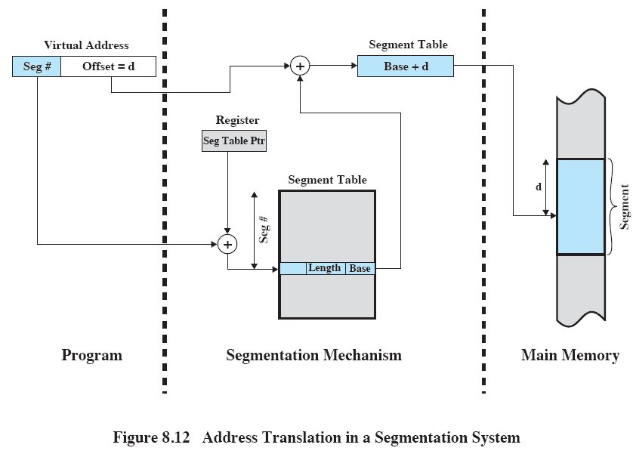
Address Translation
Source: Pearson
Notes:
The basic mechanism for reading a word from memory involves the translation
of a virtual, or logical, address, consisting of segment number and offset, into a physical
address, using a segment table. Because the segment table is of variable length,
depending on the size of the process, we cannot expect to hold it in registers. Instead,
it must be in main memory to be accessed. Figure 8.12 suggests a hardware implementation
of this scheme (note similarity to Figure 8.3 ). When a particular process
is running, a register holds the starting address of the segment table for that process.
The segment number of a virtual address is used to index that table and look up the
corresponding main memory address for the start of the segment. This is added to
the offset portion of the virtual address to produce the desired real address.

Slide 53


FLASH
Nonvolatile electronic (solid state) semiconductor storage
A variation of EEPROM (electrically erasable PROM)
  15-20X cheaper/bit than DRAM
  100-1000X faster than disk
  Smaller, lower power, more robust
  But more (15-25X) expensive than disk (between disk and DRAM)

Slide 54


FLASH
NAND flash
  Bit cell like a NAND gate
  Read and written in blocks (while EPROM had to be completely erased before being rewritten)
  Denser and cheaper per GB than NOR flash
    Used for USB keys, media storage, …
NOR flash
  Bit cell like a NOR gate
  Read and written in words (bytes)
    Used for configuration data such as BIOS or for instruction memory in embedded systems
Flash bits wears out after 1000’s of accesses
  Not suitable for direct RAM or disk replacement
  Wear leveling: remap data to less used blocks

Slide 55

Exercises and Discussion
Which one is the fastest among 3 cache organizations?
Which one is the slowest among 3 cache organizations?
Which one is the largest among 3 cache organizations?
Which one is the smallest among 3 cache organizations?
What will happen in terms of cache/TLB/page misses right after context switching?

Slide 56
Homework 6
Read Chapter 9 from Computer System Textbook
Exercise
  5.1
  5.2
  5.4
  5.5
  5.8
  5.11
  5.15
  5.18

