Slide 1
Computer Architecture
Inputs and Outputs
Lynn Choi
School of Electrical Engineering

Slide 2
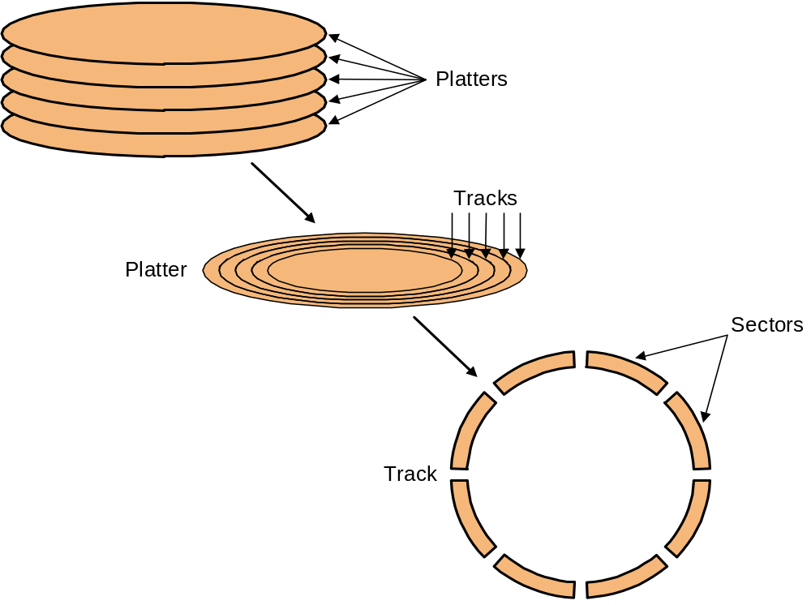
Magnetic Disk
A magnetic disk consists of a collection of platters, each of which has two recordable surfaces.
  The stack of flatters rotate at 5400 RPM to 15000 RPM
  The diameter of this aluminum platter is from 3 ~ 12 cm

Slide 3
Magnetic Disk
Organization
  Read/write heads
    To read or write, the read/write heads must be moved so that they are over the correct location
    Disk heads for each surface are connected together and move in conjunction
  Cylinder: a set of tracks at a given radial position
    All the tracks under the heads at a given point on all surfaces
  Track: each surface is divided into concentric circles
    10,000 to 50,000 tracks per surface
    ZBR (Zone Bit Recording)
      The number of sectors per track increases in outer zones
  Sector - track is divided into fixed size sectors (100 ~ 500 sectors/track)
    Preamble - allows head to be synchronized before r/w
    Data - 512B - 4KB
    Error correcting code (ECC)
      Hamming code
      Reed-Solomon code
    Inter-sector gap
    Formatted capacity does not count preamble/ecc/gap

Slide 4
Magnetic Disk
Performance
  Seek time
    To move to the right radial position (cylinder/track)
    3 ~ 14ms, consecutive tracks less than 1 ms
  Rotational latency
    To rotate the desired sector under the head
    5400 ~ 16200 rpm (90 ~ 270 rotations/s), 2 ~ 6ms avg.
  Transfer time
    Depends on the rotation speed and data density
    30 ~ 40MB/s, 512B sector takes 12 ~ 16us
Disk Controller
  Accept commands from CPU
    read, write, format (write preambles), control the arm motion, detect/correct errors, convert byte to a serial bit pattern, buffering/caching, remapping bad sectors

Slide 5
Disk Access Time
Disk access time =
  Seek time + rotational latency + transfer time + controller overhead
For example,
  HDD with the following characteristics
    10,000 RPM
    Average seek time 6ms
    Transfer rate 50MB/s
    Controller overhead 0.2ms
    No disk idle time
  Average time for a 512B sector =
    6ms + 0.5 rotation / 10000RPM + 0.5KB/50MB/s + 0.2ms = 6 + 3 + 0.01 + 0.2 = 9.2ms
    Usually seek time is only 25% ~ 33% of the advertised number due to locality of disk references
    Most disk controllers have a built-in cache and transfer rates from the cache are typically much higher and up to 320MB/s

Slide 6
Optical Disks (CD-ROM)
CD-ROM (Compact Disk – Read Only Memory)
  4.75 inch disk that can store 650MB of data (or 74 minutes of audio)
  Injection-molded polycarbonate disks (with aluminum coating) containing pits and lands that are illuminated by a laser diode and read by a photodetector
Organization
  pits and lands are written in a spiral starting near the hole, making 22188 revolutions and 5.6km long
  Variable speed rotation to give a uniform streaming rate of 120 cm/s
    530 RPM at the center, 200 rpm outside
  Sector
    2352B:16B preamble, 2048B data, 288B ECC (Reed-Solomon)
      This byte-level ECC is only for data-format (not for audio)
    1 sector consists of 98 588b frames (98 * 24B = 2352B)
  Frame
    192b data and 396b for ECC and control
      This bit-level ECC makes CD-ROM resilient to data loss; bits of dust or dirt on the surface of the disk, or even small scratches
    Consists of 42 symbols (42 * 14b = 588b)
  Symbol - encode 1 byte into a 14-b symbol

Slide 7
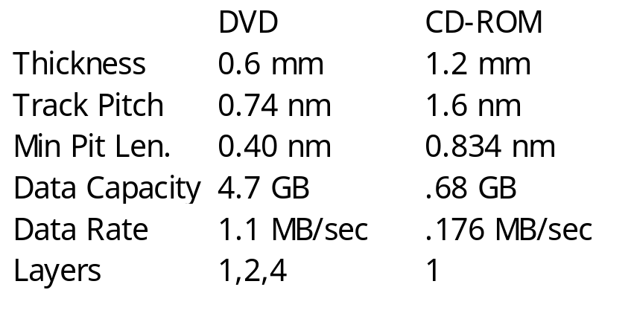
CD-ROM/ DVD
Performance
  Single-speed CD-ROM - 150KB/s
  32X CD-ROM - 4.8MB/s (still slower than magnetic disks)
DVD (Digital Versatile Disk)
  A DVD can hold a minimum of 4.7 GB, enough for a full-length movie
    Smaller pit size, tighter track spacing, and multiple layers enables 4.7GB space
  MPEG-2 is used to compress video data for storage on a DVD
  DVD drives are backward-compatible and can play CD-ROMs.
  4 DVD construction formats
    Single-sided, single-layered: 4.7GB
    Single-sided, dual-layered: 8.5GB
    Double-sided, single-layered: 9.4GB
    Double-sided, dual-layered: 17GB
  DVD application formats
    DVD-Video, DVD-Audio, DVD-ROM
    Recordable DVDs

Slide 8
Input Devices
Keyboard
  When a key is depressed, it closes a circuit or induces a current through magnet, creating an interrupt to CPU
  OS keyboard interrupt handler reads a hardware register inside keyboard controller to get the key number
Mouse
  Mechanical - measure distance moved in each direction
  Optical - for laptops, plastic pad containing grid of lines
    photodetector senses light changes from LED
  Mouse sends 3B every time it moves a minimum distance
    1st B - x direction, 2nd B - y direction, 3rd B - state
  Mouse driver converts this relative movement sent by mouse to an absolute position, then displays the position on the screen

Slide 9
Direct Memory Access
DMA
  I/O device can access main memory directly independent of CPU
    The I/O device is given direct control of memory via DMA
    Without DMA CPU is using programmed I/O
      CPU is fully occupied for the entire duration of read or write operation
  With DMA, CPU first initiates the transfer, then it does other operations while the transfer is in progress
DMA procedure
  The processor sends a request for a block transfer to the DMA module with the following information
    Read or Write
    The address of IO device
    The starting address of memory
    The number of bytes to transfer
  Then, DMA module transfers the entire block
  After completion, it interrupts the processor

Slide 10
Direct Memory Access
DMA procedure
  IO device(eg. disk controller) requests DMA (8237 DMA controller) by asserting DREQ
  DMA requests system bus control by asserting HOLD to CPU
  CPU complete current bus cycle and responds to DMA by asserting HLDA (hold acknowledge) and releasing bus
  DMA will assert DACK (DMA acknowledge) to IO
  DMA transfers data between memory and IO by
    Putting address, memory read/write & IO write/read
    Decrement counter, increment address
    Until the count reaches zero
  DMA deactivate HRQ, releasing bus to CPU
To transfer a byte from memory to IO
  8088 takes 39 clocks while DMA takes only 4 clocks

Slide 11
DMA
8237 DMA controller chip
  4 channels, 8b data transfer
    Each channel can transfer data for a separate IO device such as floppy disk, hard disk, etc.
    Each channel is programmed separately by setting base address and count for the data transfer
    Each channel contains 16b base address register and 16b count register
  286, 386, 486, Pentium use two 8237s for 16b data transfer and allows 7 channels
Two DMA transfer modes
  Third-party DMA
    DMA controllers on the motherboard coordinate the DMA transfers
    Old and very slow--basically unchanged since the earliest days of PC
  First-party DMA
    Peripheral device itself does the work of transferring data to and from memory, with no external DMA controller involved.
    Requires bus mastering, because when such transfers are occurring the device becomes the "master of the bus“
    Modern IDE/ATA hard disks use first-party DMA transfers

Slide 12
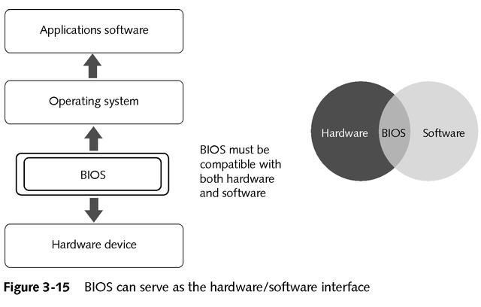
BIOS (Basic Input Output System)
The lowest level of OS code that interfaces hardware directly and resides on motherboard (as a ROM or FLASH)
A kind of firmware
  Software that is permanently stored on a chip
  Instructions for hardware
  Interface between higher-level software and hardware
Contains all the routines required to control I/O functions
  Keyboard
  Display
  Disk drives
  Serial communications
  A number of miscellaneous functions

Slide 13
BIOS Functions
Performs POST (Power-On Self Test)
  Perform diagnostics and initialize system components
  Identify and display system configuration
    Video card information, BIOS version, count memory and system configuration
      processor, FDD, display type, memory size
      HDD type, serial/parallel ports, cache size, etc.
  POST errors
    DRAM refresh failure, parity failure, memory failure within 64KB, system timer failure, processor failure, virtual mode failure, ROM BIOS checksum failure, CMOS memory, external cache failure
Boot OS from FDD or HDD
Provides HW interface to the OS in the form of a library of interrupt handlers
  A new device requires a BIOS and a device driver for the OS to use it

Slide 14
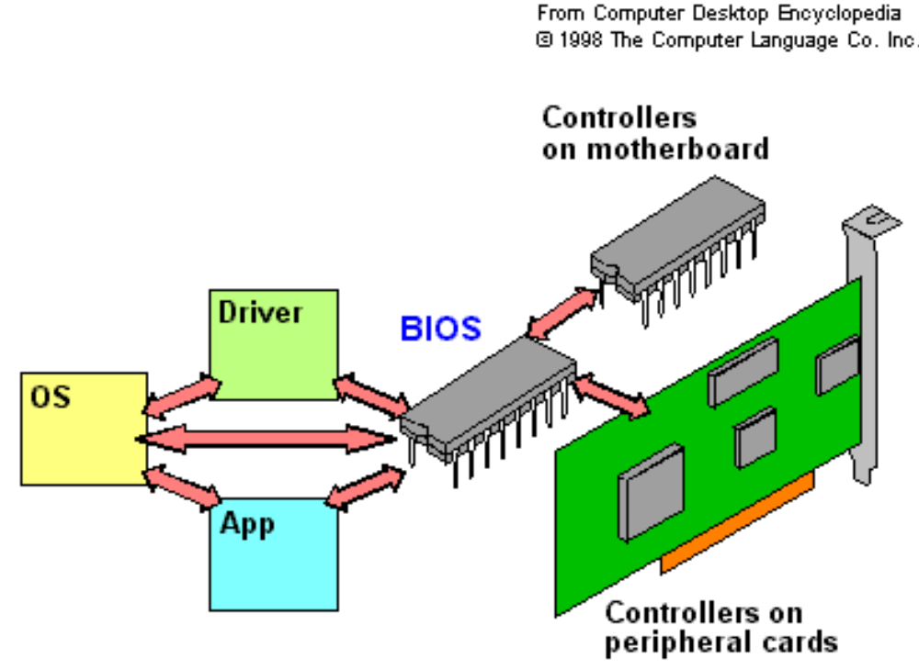
BIOS

