Slide 1
elevator anomaly detection system
Written by Young Sang kwon

Slide 2
Agenda
Project Overview
2. Abnomality Detecton Scenario
3. Machine Learning
4. Implementation
5. Enhancements and Improvements
6. Q & A

Slide 3
Project overview
Constructing a system to proactively manage elevator anomalies using AWS SageMaker's Machine Learning, based on information obtained from sensors in elevators.

Slide 4
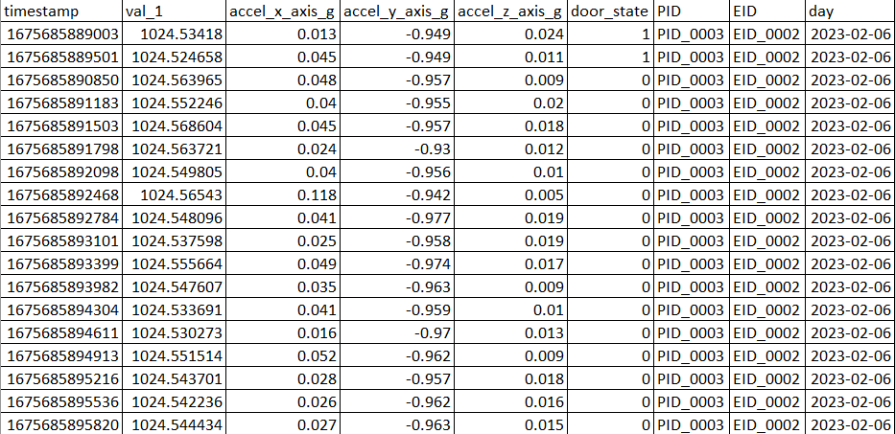
2. ABNORMALITY DETECTION SCENARIO
Data Set ※ timestamp, air_pressure, accel_x/y/z, door state, PID, EID

Slide 5
2. abnormality detection Scenario
2) Elevator abnormality detection scenario
Create a scenario for the data needed for abnormal detection
[Case 1] Detection of x/y/z acceleration abnormalities while elevator is
moving or stopping
[Case 2] Detection of abnormal movement speed between elevator floors
(Phenomena that goes faster or slower than the normal value)

Slide 6
2. ABNORMALITY DETECTION SCENARIO
Detection of x/y/z acceleration abnormalities while elevator is moving or stopping
[1] Occurs when the acceleration is greater than the normal
(ex) Nomal value: 1.0~4.5, value: 5.0
[2] Abnormal symptoms of overall value increase
(ex) daily average 3.2, daily average increasing

Slide 7
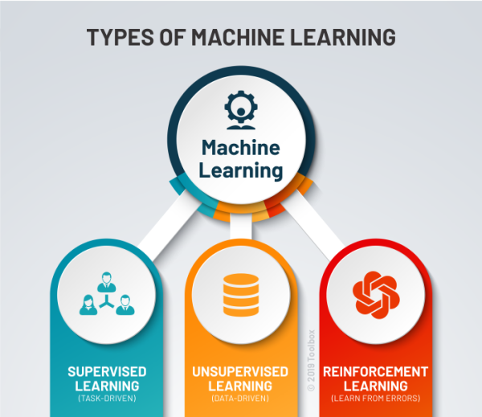
3. Machine learning
Machine Learning Type
Supervised Learning
: Training a model with labeled data
Unsupervised Learning
: Discovering patterns in data
without predefined labels.
Reinforcement Learning
: Learning through trial and error to achieve a specific goal.
https://www.potentiaco.com/what-is-machine-learning-definition-types-applications-and-examples/

Slide 8
3. Machine learning
Machine Learning Type > Unsupervised Learning
Clustering: Groups similar data points together (e.g., K-means, DBSCAN).
Association Rule Learning: Discovers relationships between data items (e.g., Apriori, Eclat algorithms).
Dimensionality Reduction: Reduces the number of features while preserving important information (e.g., PCA, t-SNE).
Anomaly Detection: Identifies data points that differ significantly from the majority of data (e.g., Isolation Forest, Autoencoders).

Slide 9
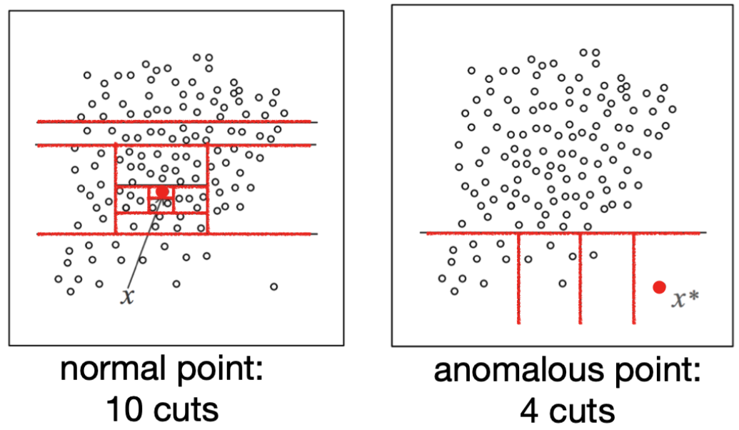
3. Machine learning
Machine Learning Type > Unsupervised Learning > Anomaly Detection
※ Random Cut Forest Algorithm
https://opensearch.org/blog/real-time-anomaly-detection-in-open-distro-for-elasticsearch/​

Slide 10
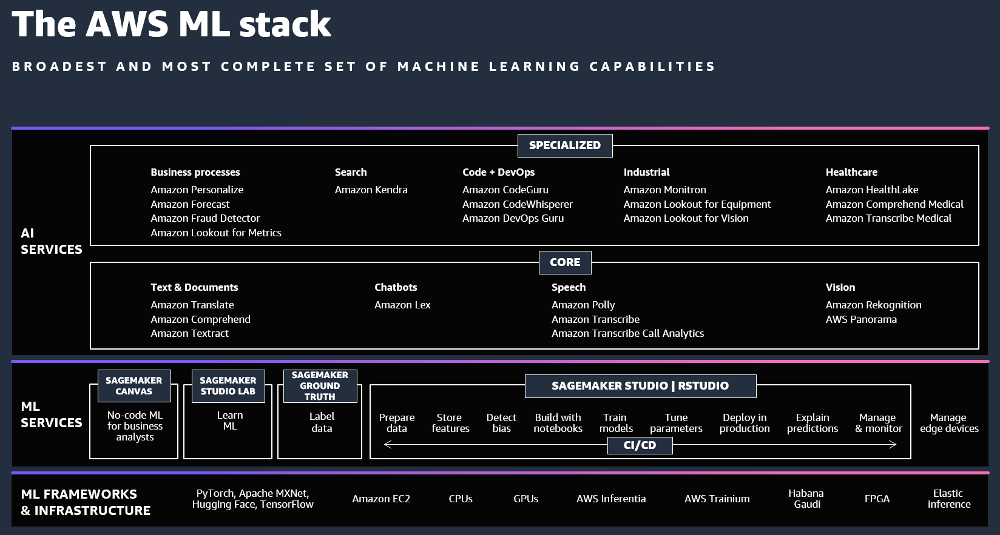
4. Implementation
https://aws.amazon.com/blogs/machine-learning/celebrate-over-20-years-of-ai-ml-at-innovation-day/

Slide 11
4. Implementation
Sagemakers Studio
Data Format Changing and S3 Initialization
Fetching and Storing Data from S3
Training the RCF (Random Cut Forest) Model with Train Data
Testing the Model with Test Data
Comparing Training and Testing Data
※ Refer to AWS Sagemaker.

Slide 12
5. Enhancements and Improvements
Develop machine learning models by discovering additional anomaly detection scenarios and matching algorithms.
Develop a system to regularly(daily, weekly) receive and evaluate new data using the created Machine Learning model.

Slide 13
Q & A

