Slide 1

FINANCIALS 2017
Young Scandinavians Club

Slide 2
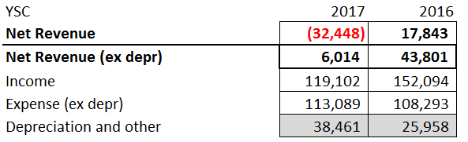
Total P&L 2017

Slide 3
Major posts
Tree Removal Tahoe $7,000
Flooding Clear Lake - reduced activity
New Website – 2017 $6,850 + 2016 $11,841
Legal Fees, LLC Consultation $2,500
Ski Boat Net Loss $4,400
Depreciation catch-up $15,048

Slide 4
Treasury talking points
Website
eCommerce system - WooCommerce
‘Powered by Python’: Integration of
eCommerce,
Bank & Merchant Accounts,
QuickBooks Online
Schwab CDs
GSuite for document storage

Slide 5
Accounting talking points
Migrated to QuickBooks Online
Some reconciliation problems… $1,345
Depreciation moved out to Other Expenditures
Consolidated events
Events = SF Events + Outside Activities
New Tax CPA
Adam Ladwig, Anspach Financial Group

Slide 6
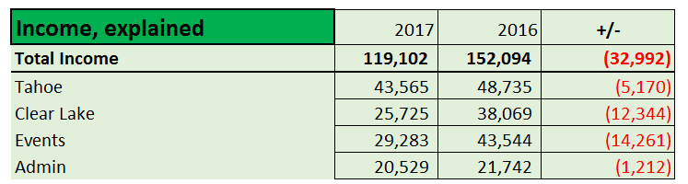
Total P&L 2017

Slide 7
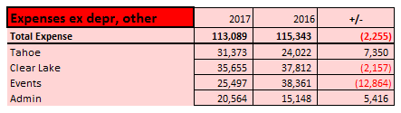
Total P&L 2017

Slide 8
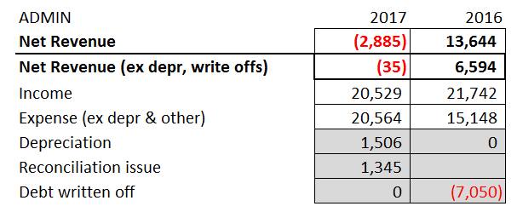
Administration

Slide 9
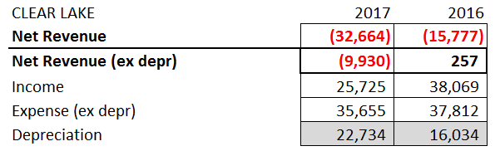
Clear Lake

Slide 10
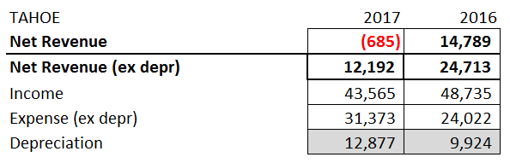
Tahoe

Slide 11
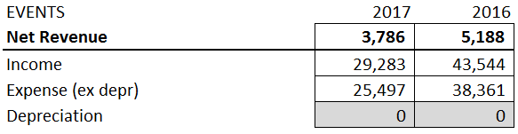
Events

Slide 12
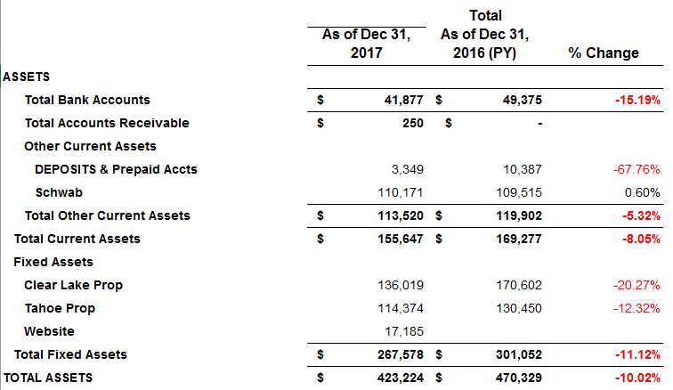
Balance Sheet (Assets)

Slide 13
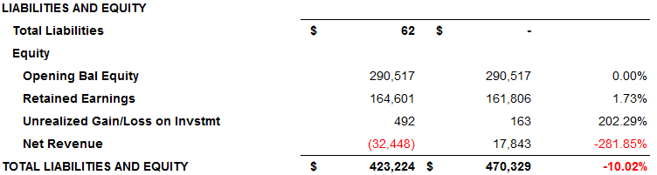
Balance Sheet (Liabilities, Equity)

Slide 14

Clear Lake (ski boat)

Slide 15
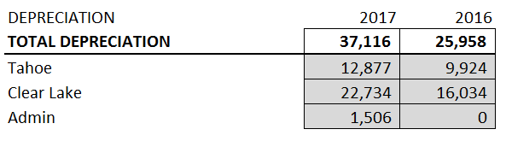
Depreciation

Slide 16
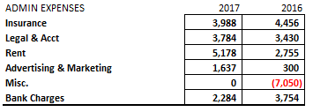
Administration, misc expenses

