Slide 1
Inside Flash: Flash Exploit Detection Uncovered
Ga1ois & Bo Qu

Slide 2
About us
Security Researchers in PANW
Work
IPS
APT Detection
After work
Bug hunting
Exploit technique researching

Slide 3
Agenda
Possible Exploit
Stop Exploit
Detect Exploit
Notes:
1. extract the possible exploits: static detect the loop in AS3
2. stop the exploits: corrupt the heap feng shui in flash using flash page heap
3. distinguish the real exploits: write primitive detect, especially JIT-ed write primitive

Slide 4
Part 1 : Possible Exploit
Find vector in loop using static detection
Notes:
Why need static
Why detect loop: to find possible exploit and filter non-exploit swf

Slide 5
Find opcode pattern of loop
Compile tools
As3compile.exe
Asc.jar– two embeded abc file needed
Mxmlc in flexsdk – most exploit used
Flash Builder
Flash CS*
Command line decompile tools
Swfdump.exe in swftools
Swfdump.py in mecheye-fusion
Swfdump.jar/swfdump.exe in flex – we use it
3 types of loop
For
While
Do/while
Notes:
Asc.jar is the same with the mxmlc

Slide 6
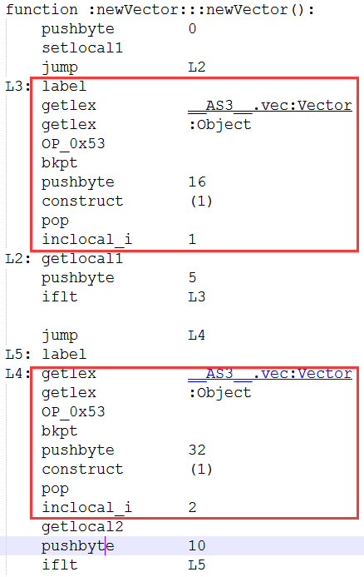
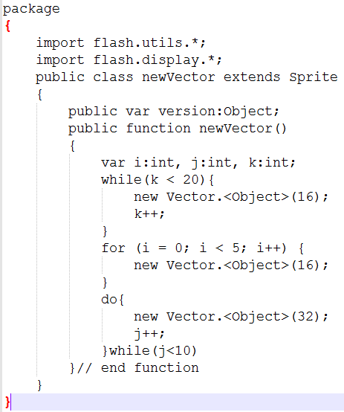

Simplest situation
AS3
While/for
SWF
MXMLC
Swfdump
Do/while
Notes:
The pattern of for and while is the same, so we only need to distinguish the for and do/while

Slide 7
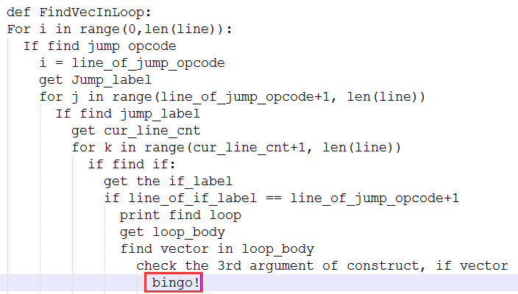
Algorithm
def FindVecInLoop:
For i in range(0,len(line)):
If find jump opcode
i = line_of_jump_opcode
get Jump_label
for j in range(line_of_jump_opcode+1, len(line))
If find jump_label
get cur_line_cnt
for k in range(cur_line_cnt+1, len(line))
if find if:
get the if_label
if line_of_if_label == line_of_jump_opcode+1
print find loop
get loop_body
find vector in loop_body
check the 3rd argument of construct, if vector
bingo!
Notes:
Asc.jar is the same with the mxmlc
def FindVecInLoop:
For i in range(0,len(line)):
If find jump opcode
i = line_of_jump_opcode
get Jump_label
for j in range(line_of_jump_opcode+1, len(line))
If find jump_label
get cur_line_cnt
for k in range(cur_line_cnt+1, len(line))
if find if:
get the if_label
if line_of_if_label == line_of_jump_opcode+1
print find loop
get loop_body
find vector in loop_body
check the 3rd argument of construct, if vector
bingo!

Slide 8
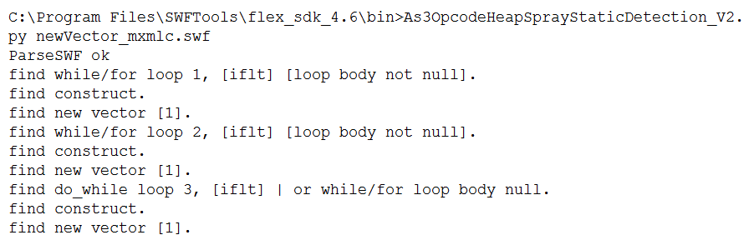
Find opcode pattern of loop
demo

Slide 9
Possible Exploit
Bad news
Loadbytes for obfuscation
Not use loop[jmp label or goto or repeat one statement for many times]
Good news
Hook and generate inner real exploit SWF
The pattern itself can be detected

Slide 10
Part 2 : Stop Exploit
A Light PageHeap for FixedMalloc in Flash

Slide 11
Custom Heap in Flash MMgc
GCHeap
FixedMalloc
Same size in one bucket
m_allocs[]
GC
Different sizes
Used buffer
Free buffer
Ptr to next free block

Slide 12
Custom Heap in Flash MMgc
GCHeap
FixedMalloc All of the internal buffer ByteArrayBuffer – UAF Bugs VectorBuffer – Used to Arbitrary Read/Write in the exploit BitmapDataBuffer – OBA Bugs
GC Toplevel: ArrayObject ByteArrayObject VectorObject … Native: BitmapDataObject SoundObject …
Vulnerable buffer and exploited buffer are all allocated here.
All interesting things happened here.

Slide 13
From AS3 To Memory
Take ByteArray As An Example
var ba:ByteArray = new ByteArray(); ba.length = 0x80;
/*static*/ avmplus::ScriptObject* FASTCALL avmplus::ByteArrayClass::createInstanceProc(avmplus::ClassClosure* cls) { return new (cls->gc(), MMgc::kExact, cls->getExtraSize()) avmplus::ByteArrayObject(cls->ivtable(), cls->prototypePtr()); }
static void *operator new(size_t size, GC *gc, GCExactFlag, size_t extra) { return gc->AllocExtraRCObjectExact(size, extra); }
ByteArrayObject::ByteArrayObject(VTable* ivtable, ScriptObject* delegate) : ScriptObject(ivtable, delegate) , m_byteArray(toplevel()) { c.set(&m_byteArray, sizeof(ByteArray)); ByteArrayClass* cls = toplevel()->byteArrayClass(); m_byteArray.SetObjectEncoding((ObjectEncoding)cls->get_defaultObjectEncoding()); toplevel()->byteArrayCreated(this); }
ByteArrayObject are managed by GC

Slide 14
From AS3 To Memory
Take ByteArray As An Example
var ba:ByteArray = new ByteArray(); ba.length = 0x80;
ByteArrayObject::set_length(unsigned int value)
ByteArray::SetLengthFromAS3(unsigned int newLength)
ByteArray::SetLengthCommon(unsigned int newLength, bool calledFromLengthSetter)
ByteArray::UnprotectedSetLengthCommon(unsigned int newLength, bool calledFromLengthSetter)
ByteArray::Grower::SetLengthCommon(unsigned int newLength, bool calledFromLengthSetter)
ByteArray::Grower::EnsureWritableCapacity()
ByteArray::Grower::ReallocBackingStore

Slide 15
From AS3 To Memory
void FASTCALL ByteArray::Grower::ReallocBackingStore(uint32_t newCapacity) { ... m_oldArray = m_owner->m_buffer->array; m_oldLength = m_owner->m_buffer->length; m_oldCapacity = m_owner->m_buffer->capacity; uint8_t* newArray = mmfx_new_array_opt(uint8_t, newCapacity, MMgc::kCanFail); … m_owner->TellGcNewBufferMemory(newArray, newCapacity); if (m_oldArray){ VMPI_memcpy(newArray, m_oldArray, min(newCapacity, m_oldLength)); if (newCapacity > m_oldLength) VMPI_memset(newArray+m_oldLength, 0, newCapacity-m_oldLength); }else{ VMPI_memset(newArray, 0, newCapacity); } m_owner->m_buffer->array = newArray; m_owner->m_buffer->capacity = newCapacity; … }
Take ByteArray As An Example
Mmfx_ is a series Macro in FixedMalloc
ByteArrayDataBuffer is managed by FixedMalloc

Slide 16
From AS3 To Memory
ByteArrayObject [managed by GC] 02A944A8 cc 4b 18 01 01 df 07 80 d8 bd f2 04 e8 52 9f 05 02A944B8 c0 44 a9 02 40 00 00 00 20 4a 18 01 34 4a 18 01 02A944C8 28 4a 18 01 3c 4a 18 01 18 6c a3 02 10 00 5b 00 02A944D8 88 c3 9f 05 00 00 00 00 00 00 00 00 00 da 14 01 02A944E8 a0 8b 5a 00 01 00 00 00 00 00 00 00 2c 4a 18 01 02A944F8 03 00 00 00 00 00 00 00
Take ByteArray As An Example
var ba:ByteArray = new ByteArray(); ba.length = 0x80;
ByteArrayBuffer [managed by FixedMalloc] 059FD010 41 41 41 41 41 41 41 41 41 41 41 41 41 41 41 41 059FD020 41 41 41 41 41 41 41 41 41 41 41 41 41 41 41 41 059FD030 41 41 41 41 41 41 41 41 41 41 41 41 41 41 41 41 059FD040 41 41 41 41 41 41 41 41 41 41 41 41 41 41 41 41 059FD050 41 41 41 41 41 41 41 41 41 41 41 41 41 41 41 41 059FD060 41 41 41 41 41 41 41 41 41 41 41 41 41 41 41 41 059FD070 41 41 41 41 41 41 41 41 41 41 41 41 41 41 41 41 059FD080 41 41 41 41 41 41 41 41 41 41 41 41 41 41 41 41
ByteArrayBufferObject [managed by FixedMalloc] 005A8BA0 f8 d9 14 01 01 00 00 00 10 d0 9f 05 00 10 00 00 005A8BB0 80 00 00 00

Slide 17
A Light Page Heap For FixedMalloc
Change all of Heap Allocators in FixedMalloc to HeapAlloc in ProcessHeap
Turn On Page Heap on Windows Process Heap

Slide 18
Heap Allocators in FixedMalloc/FixedAlloc
AllocationMaros.h in Avmplus/MMgc // Used for allocating/deallocating memory with MMgc's fixed allocator. // The memory allocated using these macros will be released when the MMgc aborts due to // an unrecoverable out of memory situation. #define mmfx_new(new_data) new (MMgc::kUseFixedMalloc) new_data #define mmfx_new0(new_data) new (MMgc::kUseFixedMalloc, MMgc::kZero) new_data #define mmfx_new_array(type, n) ::MMgcConstructTaggedArray((type*)NULL, n, MMgc::kNone) #define mmfx_new_opt(new_data, opts) new (MMgc::kUseFixedMalloc, opts) new_data #define mmfx_new_array_opt(type, n, opts) ::MMgcConstructTaggedArray((type*)NULL, n, opts) #define mmfx_delete(p) ::MMgcDestructTaggedScalarChecked(p) #define mmfx_delete_array(p) ::MMgcDestructTaggedArrayChecked(p) #define mmfx_alloc(_siz) MMgc::AllocCall(_siz) #define mmfx_alloc_opt(_siz, opts) MMgc::AllocCall(_siz, opts) #define mmfx_free(_ptr) MMgc::DeleteCall(_ptr)

Slide 19
Heap Allocators in FixedMalloc
Take mmfx_new_array_opt as an example
mmfx_new_array_opt(type, n, opts)
REALLY_INLINE void* FixedMalloc::Alloc(size_t size, FixedMallocOpts flags) { if (size <= (size_t)kLargestAlloc) return FindAllocatorForSize(size)->Alloc(size, flags); else return LargeAlloc(size, flags); }
MMgcConstructTaggedArray
MMgc::NewTaggedArray
MMgc::TaggedAlloc
MMgc::AllocCallInline
REALLY_INLINE FixedAllocSafe* FixedMalloc::FindAllocatorForSize(size_t size) { unsigned const index = (size <= 4) ? 0 : kSizeClassIndex[((size+7)>>3)]; GCAssert(size <= m_allocs[index].GetItemSize()); GCAssert(index == 0 || size > m_allocs[index-1].GetItemSize()); return &m_allocs[index]; }
MMgc::FixedMalloc::OutOfLineAlloc
FixedMalloc::Alloc()

Slide 20
Heap Allocators in FixedMalloc
Take mmfx_new_array_opt as an example
REALLY_INLINE void* FixedMalloc::Alloc(size_t size, FixedMallocOpts flags) { if (size <= (size_t)kLargestAlloc) return FindAllocatorForSize(size)->Alloc(size, flags); else return LargeAlloc(size, flags); }
Hook and change Fixed Heap Allocators to HeapAlloc in ProcessHeap
REALLY_INLINE void* FixedMalloc::Alloc(size_t size, FixedMallocOpts flags) { … return HeapAlloc(GetProcessHeap(), 0, size); }

Slide 21
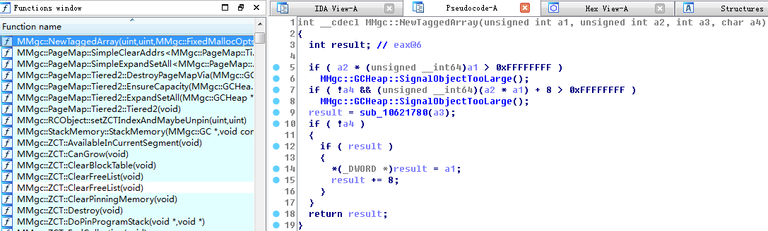
A Light Page Heap For FixedMalloc
Find Heap Allocators in FixedMalloc(Simplest Way – AVM.sig)

Slide 22
Page heap on windows process heap
A diagnostic option that can detect OBA(Out of Bounds Access) and UAF(Use After Free) bugs
OBA
UAF
Heap block
OBA
4096
4096
4096
CRASH !
1 page
NO_Access
1 page
NO_Access
free
NO_Access
use
4096
4096
4096
CRASH !

Slide 23
Stop Exploits with Page Heap For Flash Custom Heap
demo

Slide 24
Part 3 : Detect Exploit
Find *bad* vector

Slide 25
3 Layer Exploit Detection
Check the length of vector when doing finding *bad* vector, reading and writing using this *bad* vector
Monitor the length of vectors in Args of JIT-ed Code when length/read/write operation are JIT-ed
God Mode: Monitor all of vector length when DoABC2 Tag is parsed.

Slide 26
*Bad* Vector Detection
Exploit Process - exploit.as 1. Heap Spray and Feng Shui 2. Trigger the bug and corrupt the length of vector 3. Find this *bad* vector and use it to do arbitrary Read/Write to build ROP and overwrite v-table 4. Trigger controlled EIP 5. Restore and clean
Hook vector.length – vectorObject::get_length to check the length
Hook vector[] – vectorObject::Operator [] to check the length

Slide 27
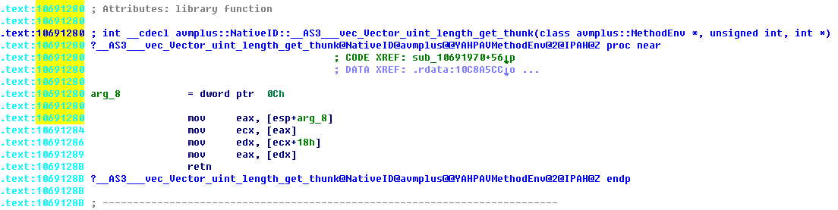
Not JIT-ed Length/Write/Read
Take vector.length as an example: Exploit.as for(_loc1_=0; _loc1_<cnt; _locl_++) { if(vectors[_locl_].length > orig_length) break; }
We can set a hookpoint at Vector::get_length

Slide 28
JIT-ed Length/Write/Read
Take vector.length as an example: Exploit.as for(_loc1_=0; _loc1_<cnt; _locl_++) { if(vectors[_locl_].length > orig_length) break; } 03d6042c mov edx,dword ptr [ebp-90h] ; edx is address of arg3 03d60432 mov eax,dword ptr [ebp-94h] ; eax is VectorObject address 03d60438 and eax,0FFFFFFF8h ; atom type address 03d6043b mov dword ptr [ebp-94h],eax 03d60441 je <Unloaded_oy.dll>+0x3d60671 (03d60672) 03d60447 mov ecx,dword ptr [eax+18h] ; [eax+0x18] is VectorBuffer 03d6044a mov eax,dword ptr [ecx] ; ecx is VectorBuffer and [ecx] is the length of vector 03d6044c mov dword ptr [ebp-98h],eax 03d60452 lea esp,[esp] 03d60455 mov ecx,dword ptr <Unloaded_oy.dll>+0xa7 (000000a8)[edx] ds:0023:03d44158=00000072 ; <- here 03d6045b mov dword ptr [ebp-9Ch],ecx ; ecx is orig_length now 03d60461 cmp eax,ecx ; compare vector.length and orig_length 03d60463 sete dl
We can’t set a hookpoint at dynamic JIT-ed code
Arg3[base+0xa8] = orig_length

Slide 29
Where is “VectorObject” in JIT-ed code from ?
JIT-ed ASM Code Fragment:
03d602be mov edi,dword ptr [ebp+10h] <- edi is from the arg3
03d602f7 mov ebx,dword ptr [edi]
03d602f9 mov dword ptr [ebp-50h],ebx
03d60342 mov eax,dword ptr [ebp-50h]
03d60345 mov dword ptr [ebp-90h],eax
03d6034b mov esi,dword ptr <Unloaded_oy.dll>+0x1d3 (000001d4)[eax] <- here
03d60351 mov dword ptr [ebp-94h],esi
03d60370 mov eax,dword ptr [ebp-94h]
03d60376 test eax,eax
03d6037e lea eax,[eax+1]
03d60387 push eax <- from arg3
03d60399 mov dword ptr [ebp-98h],eax <-eax is address of VectorObject
03d603f7 mov eax,dword ptr [ebp-98h]
03d6040d mov dword ptr [ebp-94h],eax
03d6042c mov edx,dword ptr [ebp-90h]
03d60432 mov eax,dword ptr [ebp-94h] <- eax is address of VectorObject
03d60438 and eax,0FFFFFFF8h
03d6043b mov dword ptr [ebp-94h],eax
03d60447 mov ecx,dword ptr [eax+18h]
Arg3 is the 3rd argument of endCoerce and _implGPR.
Atom BaseExecMgr::endCoerce(MethodEnv* env, int32_t argc, uint32_t *ap, MethodSignaturep ms)
(*env->method->_implGPR)(env, argc, ap);

Slide 30
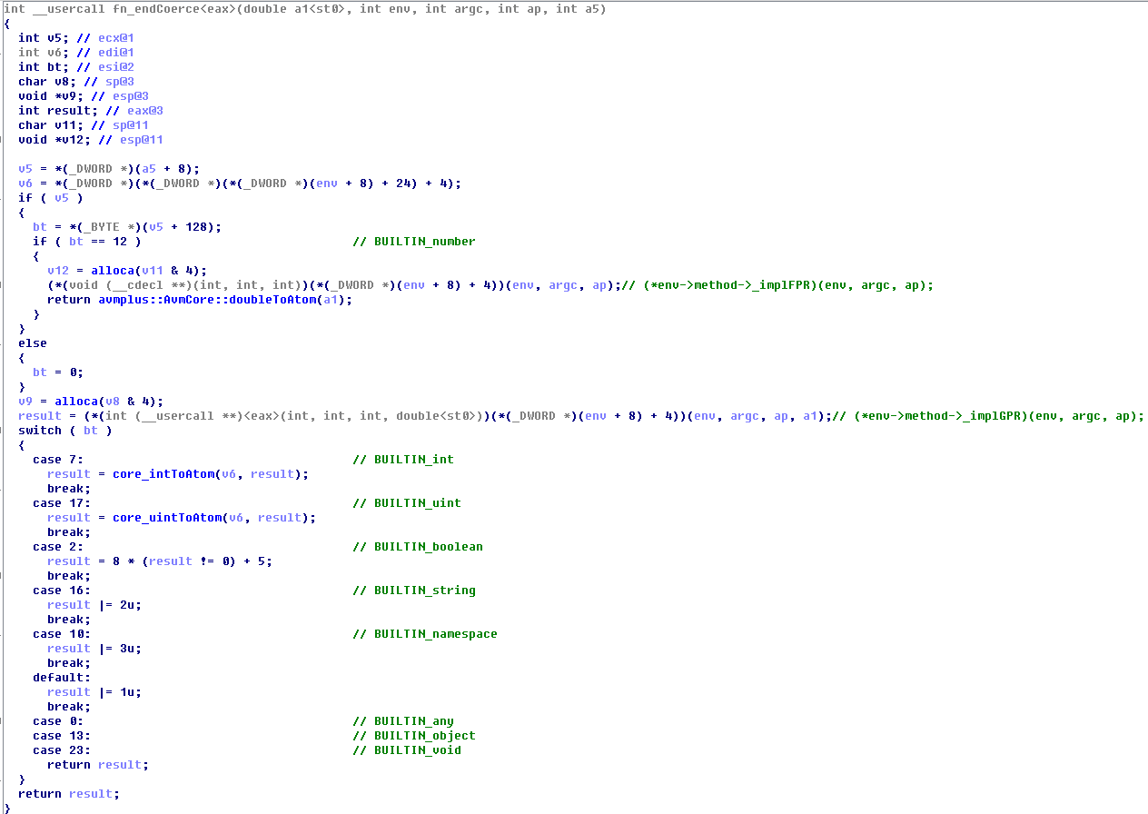
Real JIT-ed Code Entrance
Structure of ap
VT
array |  | vector | length
All of data used in JIT-ed code: object, variable, etc
Notes:
How to find this series function ? Leave it to you as a homework

Slide 31
A Typical JIT Procedure in Flash
[ClassClosure::constructObject()]
->[1064a7ed][ClassClosure::construct or ClassClosure::construct_Native]
->ScriptObject* obj = newInstance()
->jmp 102afa16 <- hook here
->[102afa5a] 105f3950 new Script_Env and set args buffer and length attribute
->[102AFA7D] 1027CA36 init ap/args structure ...
->ivtable->init->coerceEnter(argc, argv)
->verifyInvoke
->[106ae2ee](*env->method->_invoker)(env, argc, args) -- jitInvokeNext
->[106d7292]invokeGeneric
->[106ae805]endCoerce
->[106adb21](*env->method->_implGPR)(env, argc, ap)
Focus on it! Get Args address and buffer length from Script_Env, and Create a Thread to monitor possible vector.<*>, vectorBuffer, array, etc in Args buffer.
Use vtable to distinguish them.
Notes:
We spent much time in this procedure, RE 20-30 functions about JIT

Slide 32
Memory Dump of Script_Env and Args
Script_Env 0543e0f8 10c7d3c8 03a51000 03a51000 00000000 0543e108 00000000 03a510b0 00000000 00000007 0543e118 00000230 00000007 00000230 00000009 0543e128 00000008 00000022 1d420001 01010016 0543e138 00000001 04796000 10c7d3c8 00000000 0543e148 00000000 00000000 00000000 00000000 0543e158 00000007 00000007 00000230 00000007 0543e168 00000000 00000009 00000008 00000022
Args [length = 0x230] 03a510b0 10bb7240 20000003 03bb6478 03a37a78 03a510c0 00000000 00000000 03a4b480 00000000 03a510d0 00000000 06158060 0000003b 061702b8 03a510e0 00000000 03e70040 00000000 00000000 03a510f0 00000000 00000000 00000000 00000000 03a51100 00000000 00000000 ffffffff 00000000 03a51110 00000000 00000000 00000001 feedface 03a51120 00002000 bbbbbbbb 00002000 00000000 ... 03a51270 00000000 00000000 03d63f50 03a374c0 03a51280 056f0880 056f0df8 03a1db28 00000000 03a51290 056e4fe8 03a20160 03a201c0 00000000 03a512a0 00000000 40440000 00000000 00000000
vectorObject 03a1db28 10c99918 00000002 03e8b1f0 03d46d78 03a1db38 056e2150 00000000 062ca020 00000000 03a1db48 00000000 00000000
VectorBuffer 062ca020 40000000 06144000 feedbabe 00001680 062ca030 babeface 00000000 00000000 00000000 062ca040 00000000 00000000 00000000 00000000
Create a thread to monitor this buffer of Args and find *bad* vector
Notes:
To be mentioned here, static variable may be in the Scritp_Env structure, we should also monitor this buffer if needed

Slide 33
Whole process of detecting *bad* vector operation in JIT-ed Code
Find and hook “new Script_Env”
Get Args buffer and length, Create a thread to monitor this buffer
Use vtable to distinguish possible exploit object[vector.<*>, array, etc]

Slide 34
Turn on God Mode of Detection
Exploit Process - exploit.as 1. Heap Spray and Feng Shui 2. Trigger the bug and corrupt the length of vector 3. Find this *bad* vector and use it to do arbitrary Read/Write to build ROP and overwrite v-table 4. Trigger controlled EIP 5. Restore and clean
Hook VectorBaseObject::VectorBaseObject to Record all of allocated Vectors.<int>/<uint>/<double>
Create a Thread to Monitor every length change of vectors at the beginning of ActionScript was parsed

Slide 35
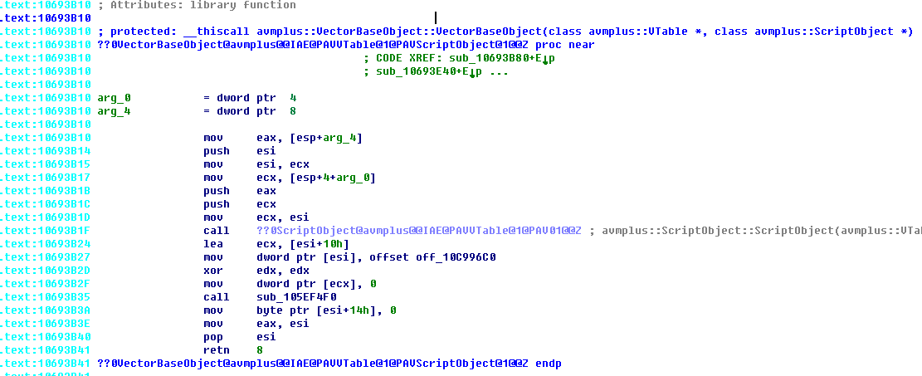
Turn on God Mode of Detection
Find VectorBaseObject::VectorBaseObject(Simplest Way – AVM.sig)

Slide 36
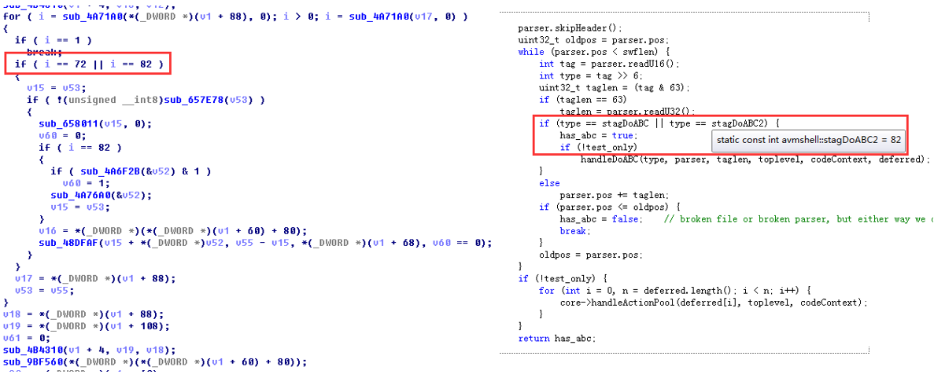
Turn on God Mode of Detection
Find DoABCTag Function which is responsible for parse DoABC Tag.
Notes:
The simplest way to find this pattern is IDA search, we can RE more functions here if needed.

Slide 37
Life cycle of *bad* vector
Why do we have to monitor the every length change, not check all of vectors once at the end of swf finish ?
Exploit Process - exploit.as 1. Heap Spray and Feng Shui 2. Trigger the bug and corrupt the length of vector 3. Find this *bad* vector and use it to do arbitrary Read/Write to build ROP and overwrite c_cleaner of bad vector itself 4. Trigger controlled EIP with “bad_vector.length = new_length” 5. Restore 0and clean
Exploiters can make the life cycle of *bad* vector very short !
Bad_vector will be free and reallocate. The length of this bad vector will be set to new_length, if we check after all this happened, everything will be normal.

Slide 38
Life cycle of *bad* vector
Why do we have to monitor the every length change, not check all of vectors once at the end of swf finish ?
VectorBuffer structure
Length | C_Cleaner | Data[0] | Data[1] | Data[2] | Data[3] | Data[4] | Data[5] | …
*bad* VectorBuffer with normal c_cleaner
40000000 | ABCDEFGH | data | data | data | data | data | data | data
*bad* VectorBuffer with *bad* c_cleaner
bad_vector[3fffffff] = bad_vector[base+3fffffff*4+8] = bad_vector[base+4] = DEADBEEF
40000000 | DEADBEEF | data | data | data | data | data | data | data
Bad_vector.length = 0x72, bad c_cleaner[DEADBEEF] will trigger controlled EIP, and bad vector change to normal vector
00000072 | DEADBEEF | data | data | data | data | data | data | data
Details about how c_cleaner[DEADBEEF] trigger controlled EIP -- http://researchcenter.paloaltonetworks.com/2015/05/the-latest-flash-uaf-vulnerabilities-in-exploit-kits/

Slide 39
Detect Exploit
Demo

Slide 40
Exploit Mitigation in flash_18_0_0_209
Kill the vector-like object with length validation and isolated heap
Raise the *bar* of exploit

Slide 41
Summary
Dissect and unclose some undocumented and uncovered internals inside flash for detecting flash exploits.
Multiple Dimensional Exploit Detection Based on the Deep Understanding of Exploit Essence
Find Other Possible/Potential Exploit Object in Flash In the future

Slide 42
Thanks
Thanks to Yamata Li and others in IPS Team
Special thanks to guhe120, promised_lu

Slide 43
Questions ?

