Slide 1

LDA Exploration
Yang Dai

Slide 2
LDA (As classifier)
Notations:
The prior probability of class k is , and , K is class number
The conditional dense of X in class G is
Baesd on Bayes rule, we can write posterior probability of x being in class k,
Then we use MAP to infer parameter k, that is
Here we ignore denominator because given one x sample, the denominator is constant, it doesn't do anything for k inference, that means it is a constant

Slide 3
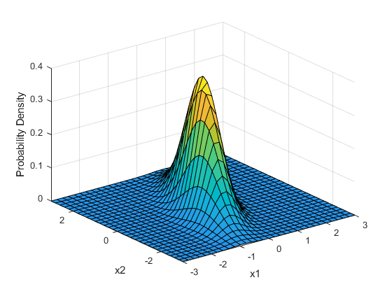
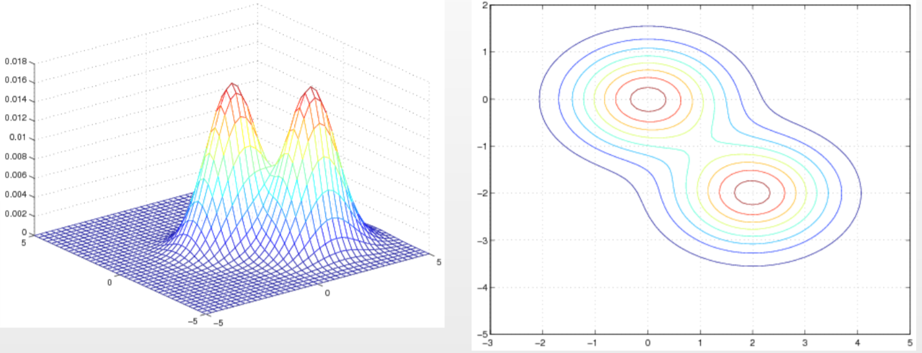
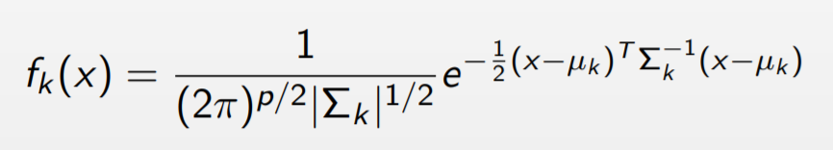



LDA (As classifier)
Assumption of LDA
x is Multivariate Gaussian:
the class covariances are identical:
2D Gaussian Distribution
2D mixture of 2 Gaussians

Slide 4
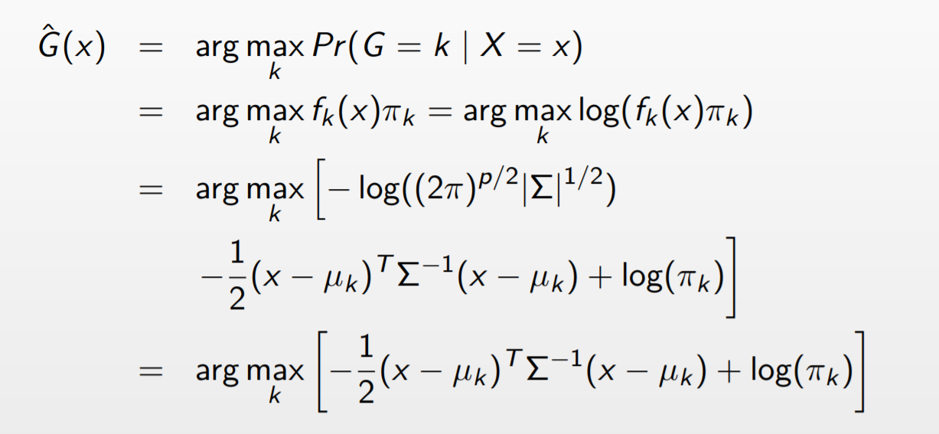
LDA (As classifier)
Optimal deducing process:
Then, based on our assumptions, we can replace terms into our optimal functions, then we get:

Slide 5
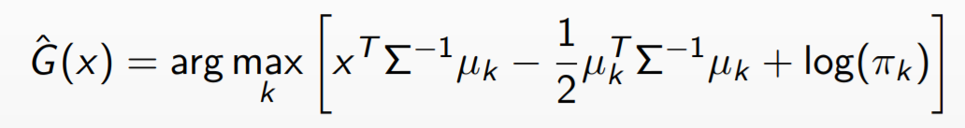
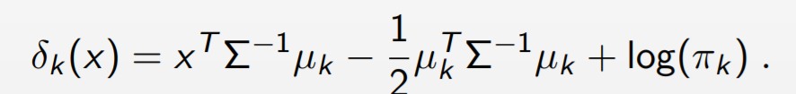
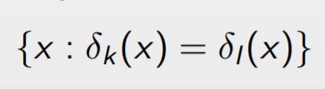
LDA (As classifier)
Optimal deducing process:
Then we extend the first term:
Then we get
We define:
And our decision boundary is
Constant(can be removed)
Here we get our FINAL MODEL

Slide 6
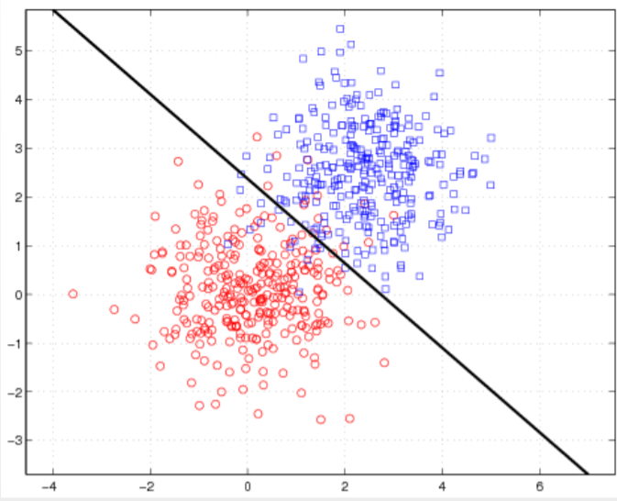
LDA (As classifier)
Practice
Analysis:
This data set is 2D data with Gaussian distribution with identical covariance
This data set obeys the assumption of LDA, thus we can see the result is pretty good.
For each class, they have their own multivariate Gaussian distributions, we can get the distribution of it from our data set, the more data we have, the more accurate we to estimate the parameters of these Gaussian distributions. And after we estimate these parameter, we can input our new data points into each class Gaussian model, and we pick up the one which has the highest value (that means the probability of falling into these distribution is biggest) as the final class we are trying to estimate. This is how LDA works.

Slide 7
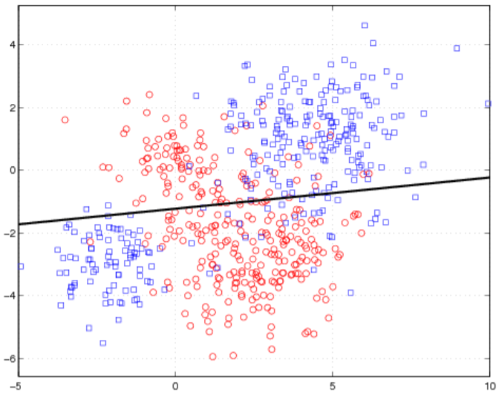
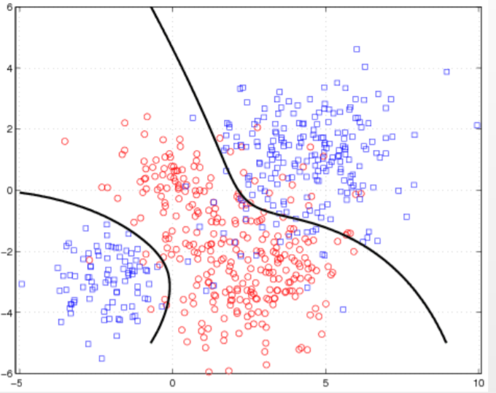
LDA (As classifier)
Practice
Analysis:
This data set is 2D data with mixture of Gaussian distribution
This data set breaks the assumption of LDA, thus we can see the result is bad. This is because our model still uses normal Gaussian distribution to estimate it. Thus when we apply LDA, we should carefully think about whether our sample(x) is Gaussian distribution or other distributions.
In the right picture, if we input our fk(x) as mixture of Gaussian distribution, and then we can also classify it well, so be careful about the fk(x) distribution form.

Slide 8
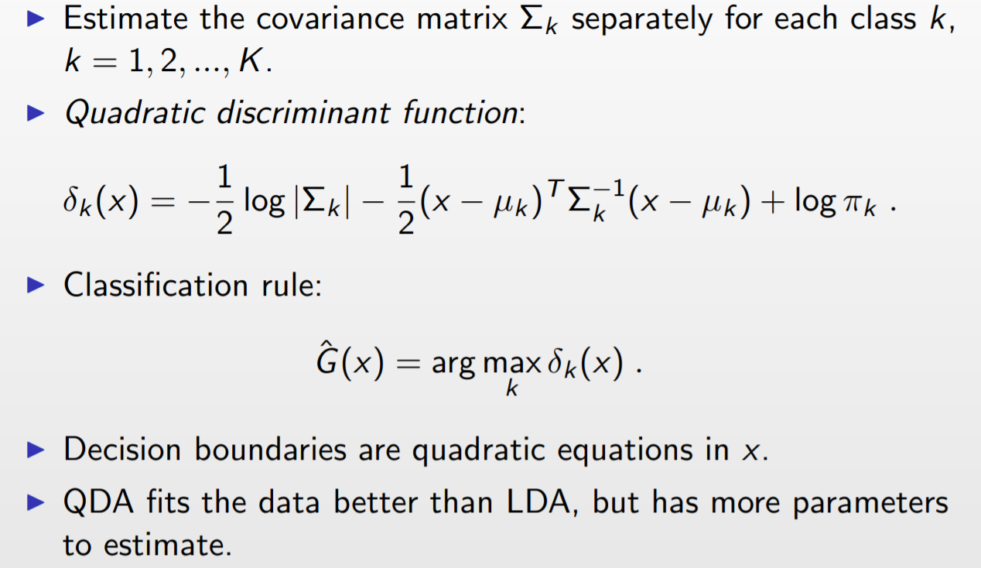
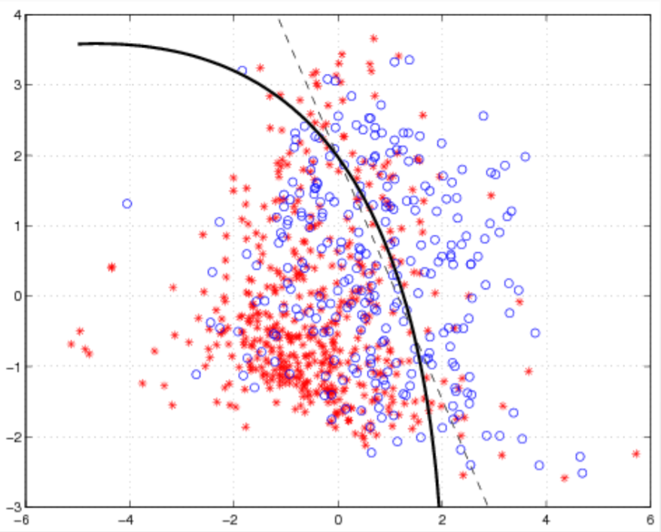
QDA VS LDA
QDA, short for quadratic discriminant analysis, it is an extension of LDA, in LDA, we assume the covariance matrix is the same for each class, whereas in most time, they don't, so we just modify LDA alittle bit, to assume the CM is different from different classes.
QDA practice:
Curve boundary

Slide 9
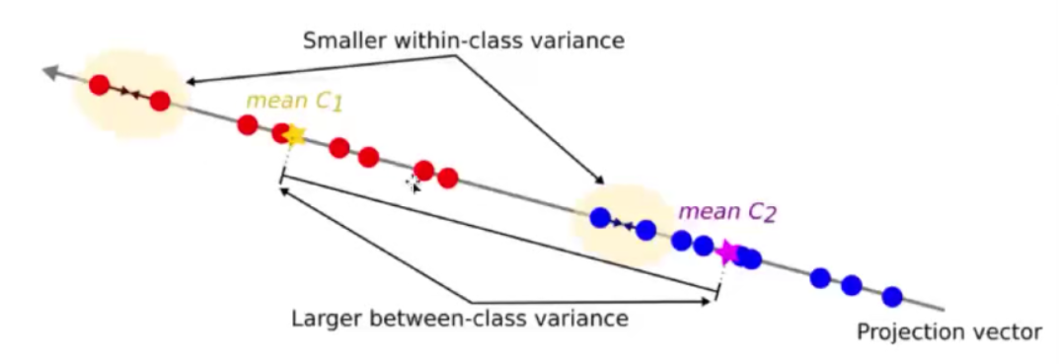
LDA (As Reduction of Dimension)
Fisher's linear discriminant:
The rationale is simple: We project our labeled sample into a space with lower dimension with the aime to maximize the distances between different classes and at the same time minimize the distainces within classes.
Our goal is to find such vectors to porject.

Slide 10
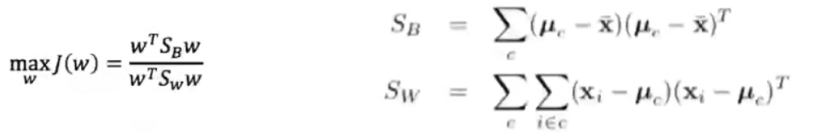
LDA (As Reduction of Dimension)
Deduction:
We define the distance between two classes with mean u1 and u2 after projecting to w direction as
We define the sample variance within class is
We try to maximize D whiling minimizing var, so we define our loss function (two classes)

Slide 11
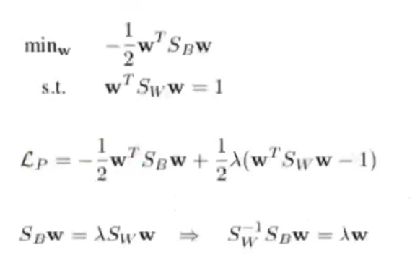
LDA (As Reduction of Dimension)
Deduction:
Then we could convert it to optimization problem with constriants
Here we put the denominator to 1 by adjusting w value, then we use lagarangian method and KKT condition, we can solve w by eigenvalue decomposition. Then we can select first k w as our new feature space's projection direction.

Slide 12
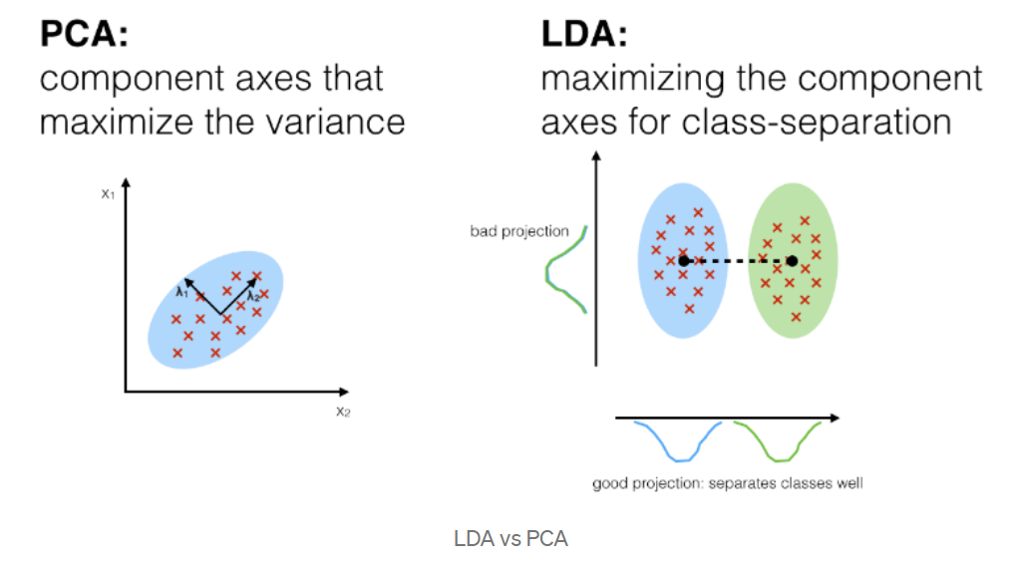
LDA VS PCA
Similarity:
All try to project samples into a new feature space to reduce the dimensions and discard less important features
Difference:
The key difference for PCA and LDA is whether they consider the labels or not. PCA is just try to projet samples inot a new space where we can lowest the information loss after projection. But LDA does the same while considering the labels.

Slide 13
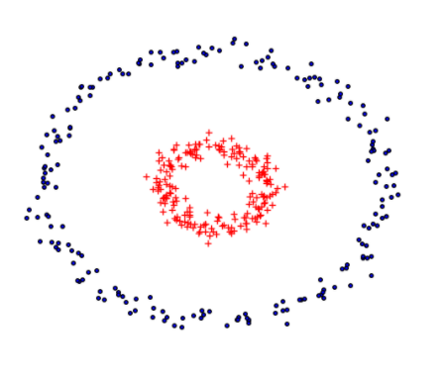

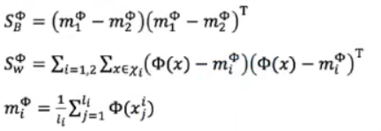


Kernel Fisher LDA
For some certain data set, we can't directly to use LDA to get good separation of data after LDA. For example circle data, thus we ca refer to the same ideas of kernel SVM, and apply it here.
Assuming is a non linear relfection to feature space F, the new feature space is
Then our objective function is
w belongs to F space, and we define new space Sb, Sw, mi is the mean of class i in new space
But we actually don't want to calcluate the function , we want to use Mercer Kernel methods to aviod calculating . Then we need to do some changes.
According to Representer Theorem, w cound be expressed as the linear combination of all training data, that is

Slide 14










Kernel Fisher LDA
According to mi notation, we can rewrite it , here a is our new-introduced parameter, li is the number of sample is mi, l is total number of sample
for every sample (j), the ith m (class) of it
then, we notate we can get
For below part, we notate N as so. Kj is l*li matrix, is the jth class kernel matrix
I is identity matrix, 1lj is the matrix with all elements equal to 1/lj, lj is number of jth class sample, so we get
Finally we have
and we can use the similar LDA methods to solve a.
And for the project part, kernel projection is
Here when l (number of sample) is larger than features, N perhaps can't be transposed, we can use as replacement, if lamda is large enough and N(lamda) could be transposed

Slide 15
Copyright
This ppt is refered from another ppt and greedyai company, just to learn the basic idea of LDA as the note of my ML learning voyage. This ppt will be updated after reading more materials, I am glad to share knowledge and disscuss stuffs about machine learning, thanks for the help of authors.
Most of the materials in this ppt is from Jia Li,http://www.stat.psu.edu/∼jiali.
This original material could be found here: http://personal.psu.edu/jol2/course/stat597e/notes2/lda.pdf

