Slide 1

IVM Model Illastration
Yang Dai

Slide 2





IVM Algorithm
Theorem:
According to Representation Theorem, for every L2-regularized linear model (objective functions has w square term), the optimal solution could always be represented as the linear combinations of x
That is:
For every model like this:
The optimal solution could be
The decision function could be
Replce error term
LR Loss Function (label {0,1})
Thus, we can replace error term here to logistic regression loss function, then we get:
H_{k} is the RKHS generated by Kernel K

Slide 3

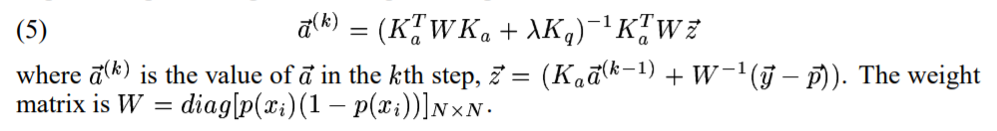
IVM Algorithm
H_{k} is the RKHS generated by Kernel K
Then with the finite dimensional form, we can rewrite it as:
We ignore b cause it doesn't influence result
Here, y is (N*1), Ka is (N*N), a is (N*1), Kq is equal to Ka
Then ,we can solve this problem by Netwon- Raphson iterative method to get optimal a
Iterative a for each step

Slide 4
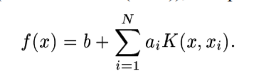
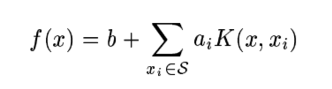
IVM Algorithm
We have model already and know how to get optimal solution of it, but one question is for each step (iteration), we have to use all the training data set to update a, which is too time consuming for computation, thus to solve this problem, we want to find a sub-model to approximate full model. In this paper, author illustrates a new way to select the sub-model which can save time for training
Original Model Alternative Model
Where S is the subset of the training data {x1,x2,,,xN}

Slide 5
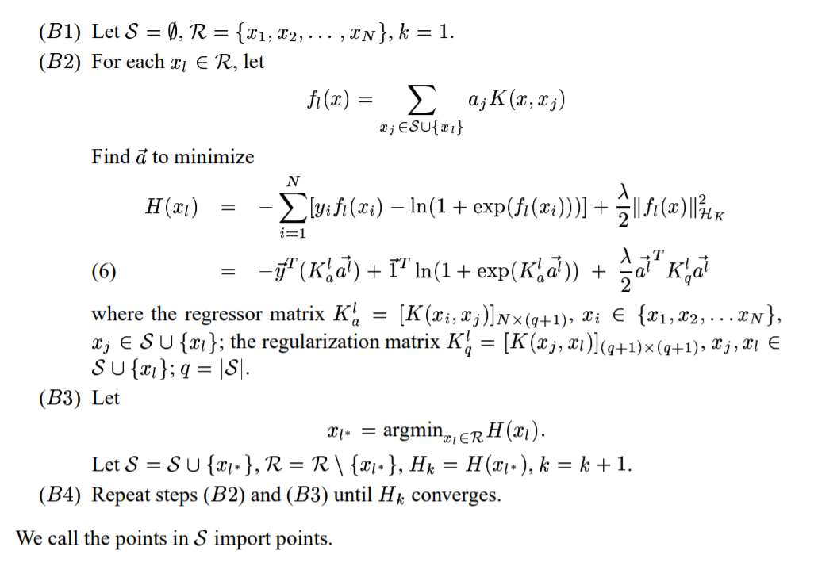
IVM Algorithm
It is impossible to find all the possible subset of training data set, thus we use greedy forward method to achieve it
In each epoch, we just select one sample and one possible subset element, and calculate Kernel of it and every subset elements and one possible subset element, then we get fx, then we calculate the loss function to find the optimal a under this epoch, then we get optimal a (and f), then we find the one sample which could minimize H most to put it to sub set, we repeat this step for a while until H converges. At last we get optimal a and subset S.

Slide 6
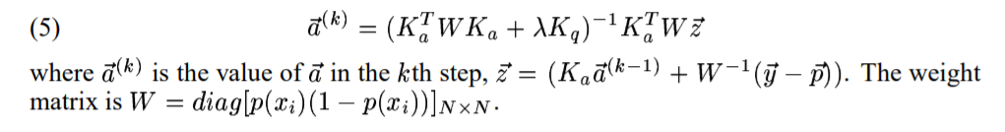
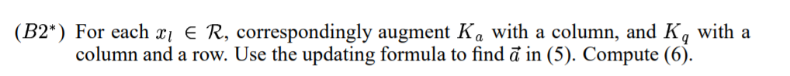
IVM Algorithm
Then author mentions that because for each epoch, we have to optimize a by using Newton method which also can be time consuming, so we do a further approximation:
This means for each epoch, we just update a for once to approximize full a value

Slide 7
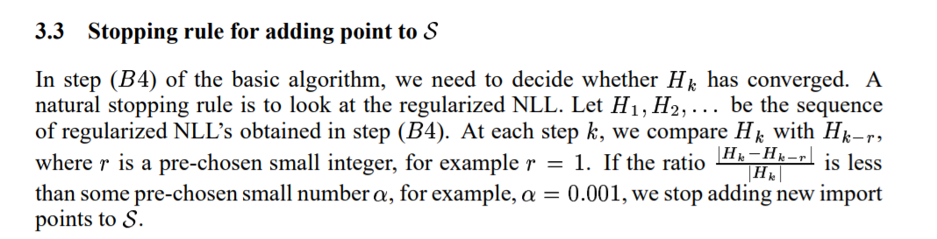
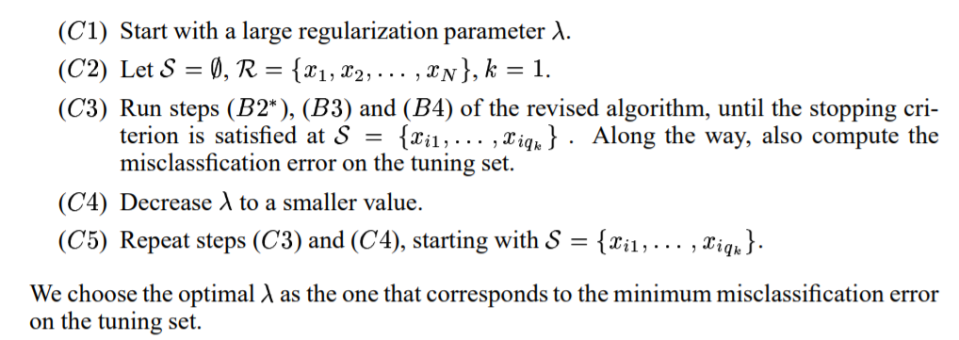
IVM Algorithm
Stoping rule
Hyper-parameter tuning
If we train many models and test their perfomances on validation data set to select lamda, it's too time consuming, to reduce the computation time, author illustrates to select optimal lamda while selecting sub set S
The process is like this, firstly we run the model normally, just compute the error on validataion data set and decrease lamda, then draw the plots: (1) Regularized NLL(negative log likelyhood) verse number of import vectors, (2) error on validation dataset verse import vectors number. Then we pick lamda the one which can minimize the error rate as the optimal lamda, then put it in the model, train it again to get optimal a and subset S

Slide 8
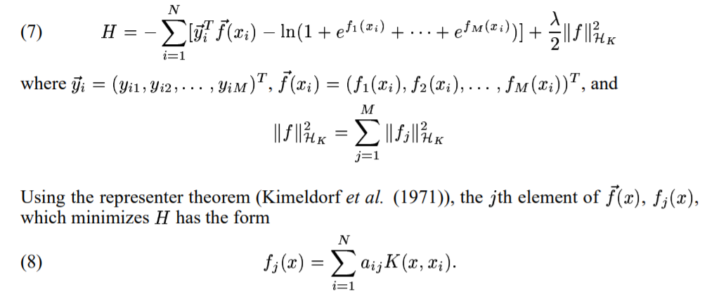
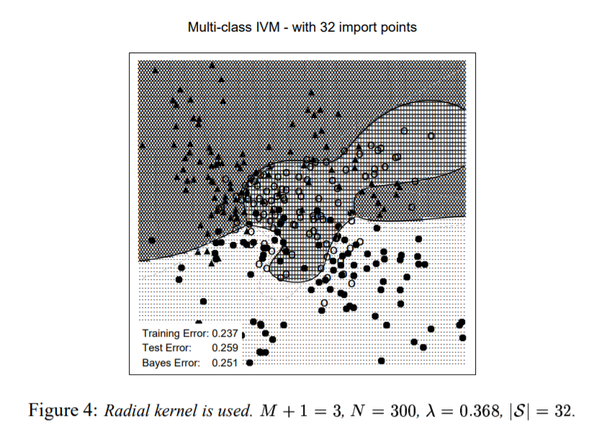
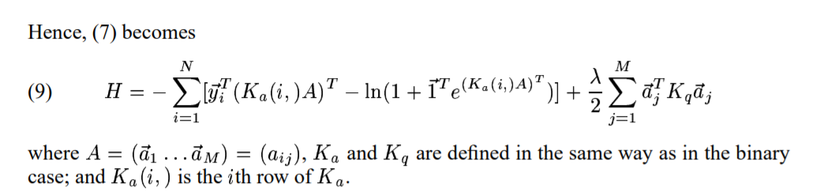
IVM Algorithm
As we said before, this algorithm is easy to be extended to multiple classification task
Exapmle of Multiple classes

Slide 9
IVM Algorithm
Conclusion:
This algorithms could be regarded as an improved algortihms compared with SVM.
It proposes the import vector (compared with support vector), which number of vectors (samples) is fewer than support vectors.
Secondly, it can output probability directly just like LR
Thirdly, it can easily be extended to multi-class classification tasks
Forthly, it imports import vector to reduce the computation time and proposes a new way to select hyper parameters lamda
After all, it's a good alternative fro SVM
This file is finished by myself, if there is any question, please let me know, thanks a lot.
Reference:
1. Original paper
2. 吃货改变世界's essay: https://zhuanlan.zhihu.com/p/108832010

