Slide 1

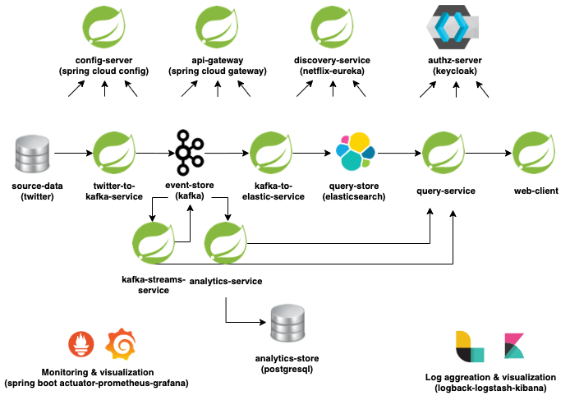






Big picture:
Keycloak authz server docker
Oauth2, open id connect
Jwt
Spring oauth2 resource server
Spring oauth2 client
Single sign-on
Externalized config pattern
Define config git repository
Connect to github
Security configuration
Enable encryption for sensitive data
Spring cloud gateway
Client side load balancing
Circuit breaker & fallbacks with resilience4j
Rate limiting with redis
Docker redis
Service discovery and registration with netflix eureka
High availability
Spring web
Hateoas
Controller advice
Api versioning
Elastic query
Open api docs
Reactive query with elastic
Spring Webclient
Spring thymeleaf
Bootstrap
Reactive webclient and thymeleaf
Client side Load balancing
Spring boot
Kafka basics
Spring-kafka (producer)
Kafka avro
Kafka admin
Docker kafka
Maven basics
Logback
Twitter4j
Elasticsearch basics
Elastic index
Docker elastic
Spring-elastic
Spring-kafka (consumer)
Microservices
Modular architecture
Reusable modules
Independent develop
Independent deploy
Messaging
Event-driven
Event sourcing
CQRS
Externalized config
Api Gateway
Circuit Breaker
Service Discovery
Log aggreation
Distributed tracing
Monitoring
Authentication/Authorization
Database per service
Java 11
Intellij
Maven
Git
Docker
Kafka streams
Kafka key/value stores
Spring data (postgresql)
CRUD
Batch inserts with spring data jpa
Spring boot actuator
Prometheus metrics
Grafana visualization
Log aggregation
Distributed tracing
Logback & Logstash
Kibana visualization

Slide 2
Big picture:

